Slide 1
CMPE226 – Data Structures
Introduction

Slide 2
Contents
Information about the course
Data Structures
Algorithms

Slide 3
Course Information

Slide 4
About the course
Lecturer: | Zuhal Kurt
Office Phone: | 8792
E-mail Address: | zuhal.kurt@atilim.edu.tr
Course Web Page: | https://moodle.atilim.edu.tr/course/view.php?id=1386
Class Hours and Location: | 09:30-11:30, Tuesday on 1017 11:30-12:30 Thursday on 1023
Office Hours: | Will be anounced
Prerequisites: | - CMPE113 & 114 – Computer Programming I & II - CMPE225 – Object Oriented Programming
Textbooks: | Data Structures Using C++, D.S. Malik, Thomson Course Technology, 2nd Edition

Slide 5
Course Outline
Iterative algorithms and their analysis
  Case Study: Iterative Sorting Algorithms
Recursive algorithm design & analysis
Lists – ArrayList & LinkedList
Stacks, Queues
Trees
Search Trees
  Binary Search Trees
  AVL Trees
  Splay Trees
Tries & Hash Tables

Slide 6
Course Contents
Week 1 | Introduction, Algorithm Analysis and Asymptotic (Big-O, Omega, Theta) Notations
Week 2 | Iterative Sorting Algorithms: Bubble Sort, Selection Sort, Insertion Sort
Week 3 | Introduction to Divide-and-Conquer (Recursive) Algorithms
Week 4 | Lists and Array Implementation: ArrayList
Week 5 | Linked Lists
Week 6 | Stacks and Queues
Week 7 | First Midterm

Slide 7
Course Contents (continued)
Week 8 | Stacks and Queues
Week 9 | Hash Tables
Week 10 | Trees
Week 11 | First Midterm
Week 12 | Binary Search Trees
Week 13 | AVL Trees
Week 14-15 | Final Exam

Slide 8
Grading Plan
1st MT: 25%, 2nd MT: 30%, Homework: 10%, Final: 35%.
Curve may be applied to the grades
If your grade is below 85%, you cannot get the grade AA, but it is not certain that if you pass 85% then you get AA.
If your grade is below 45%, you certainly fail, but this does not mean that you’ll get at least DD if you pass 45%.

Slide 9
Attendances
You have to attend the classes since recent experiences show that the students who attend the classes are more successful
All students are responsible for visiting the website of the course at least two times in each week
Announcements, assignments, grades, and project subjects will be published on the Moodle Page.

Slide 10
IntroductionC++ Review
CMPE226-Data Structures
Week 1 (Lecture-1)
Adapted from Textbook (D. S. MALIK ), Lecture notes (C. TURHAN) and Lecture Notes (H. QU), 2020

Slide 11
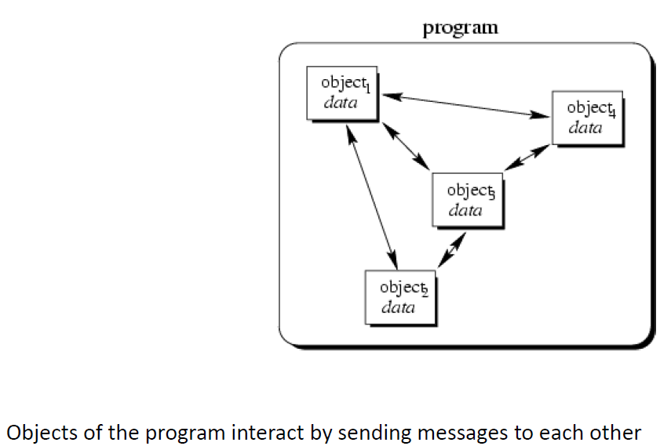

Object-Oriented Concept (C++)

Slide 12
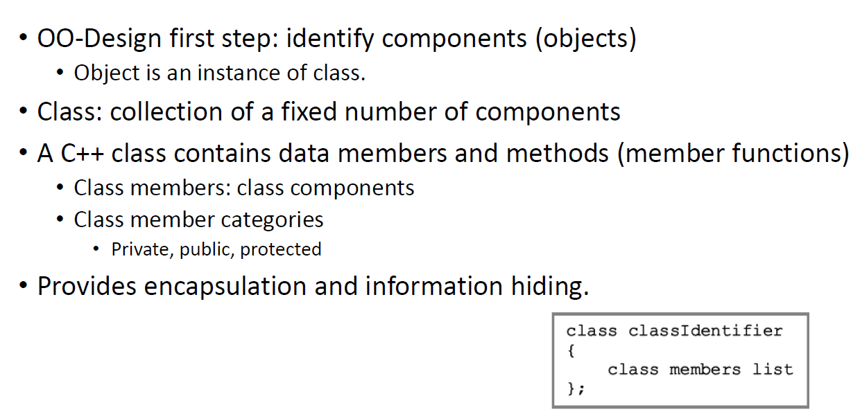
Classes

Slide 13
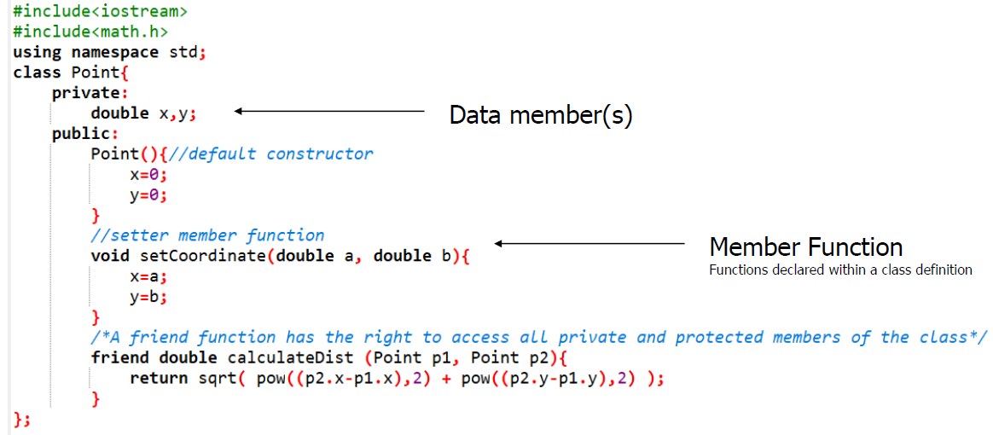
Example: Class Definition

Slide 14
Information Hiding in C++
Two labels: public and private
  Determine visibility of class members
  A member that is public may be accessed by any method in any class
  A member that is private may only be accessed by methods in its class
Information hiding
  Data members are declared private, thus restricting access to internal details of the class
  Methods intended for general use are made public
  Protected acts just like Private, except that it allow the inherited class to gain access.

Slide 15
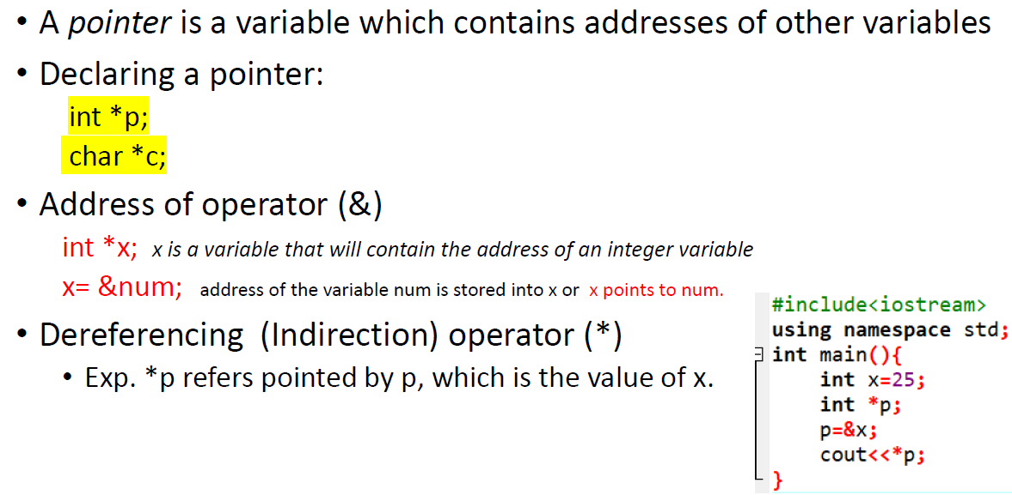
Pointers

Slide 16
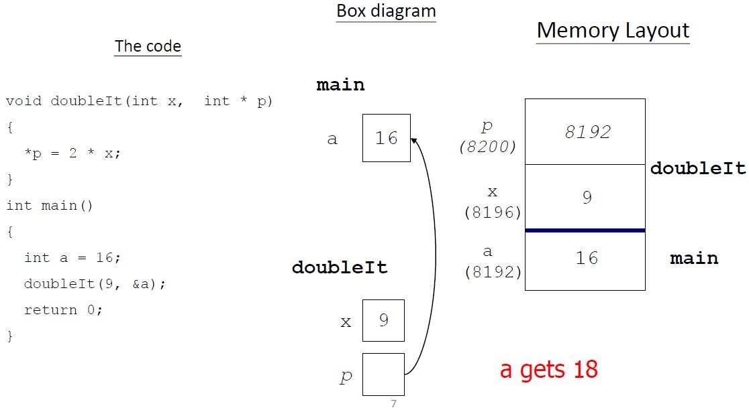
A Pointer Example

Slide 17
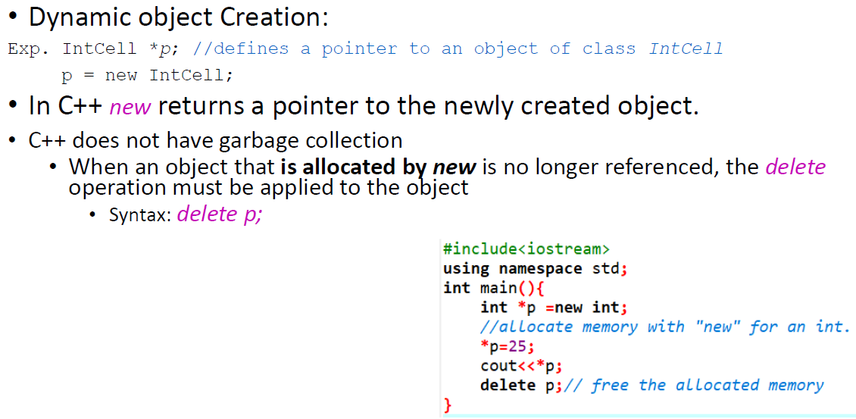
Delete a Pointer

Slide 18
Templates in C++
Problem: We wrote a function for adding two integer values. However, if we want other functions for adding two values of other types, do we need to write a function for each of them?
Use a template:
  the parameter is substituted by the compiler

Slide 19
Templates in C++
Template is simple and yet very powerful tool in C++. The simple idea is to pass data type as a parameter so that we don’t need to write same code for different data types.
Function Template
  template<class Type>
  function declaration
Class Template
  template<class Type>
  class declaration

Slide 20
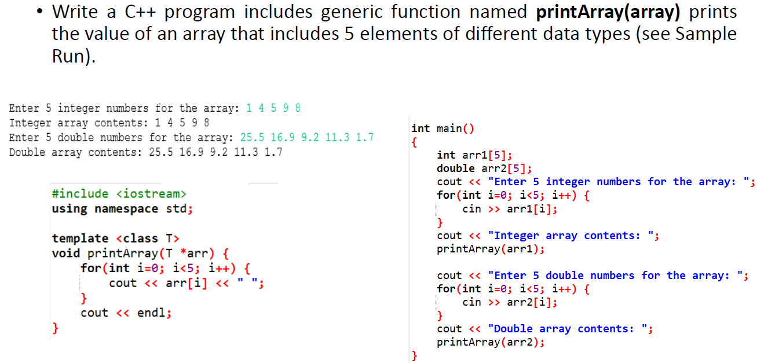
Example: Function Template

Slide 21
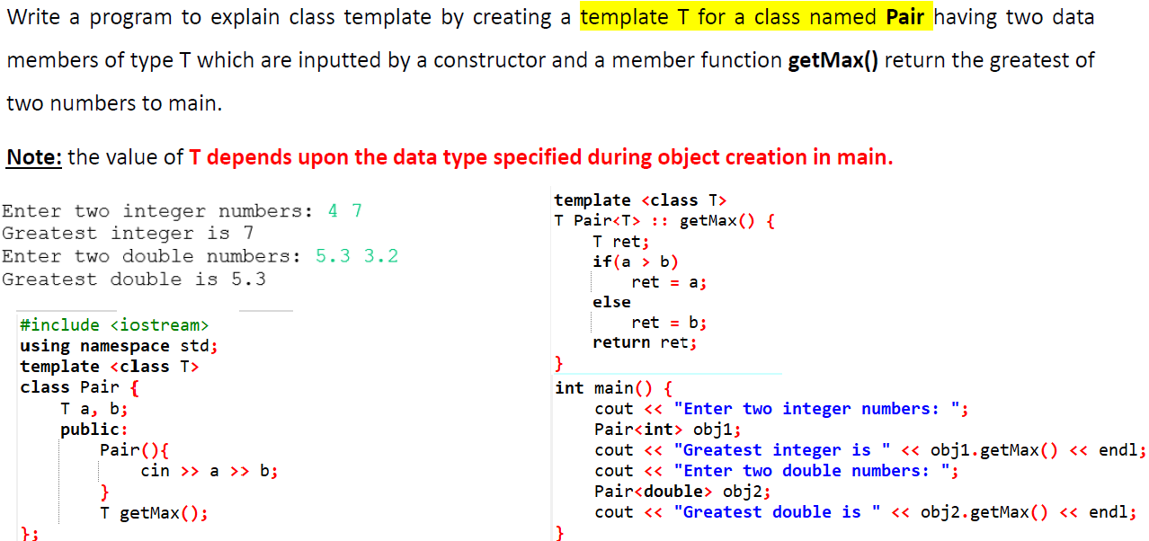
Example: Class Template

Slide 22
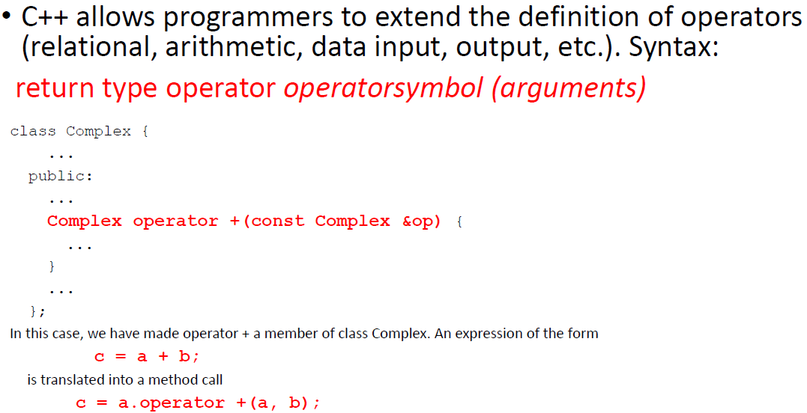
C++ Operator Overloading

Slide 23
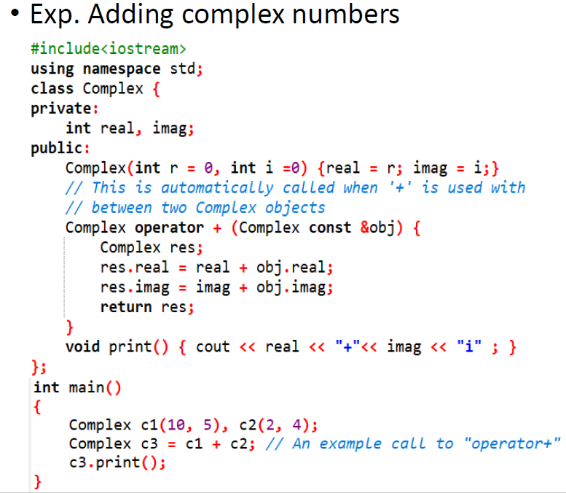
C++ Operator Overloading

Slide 24
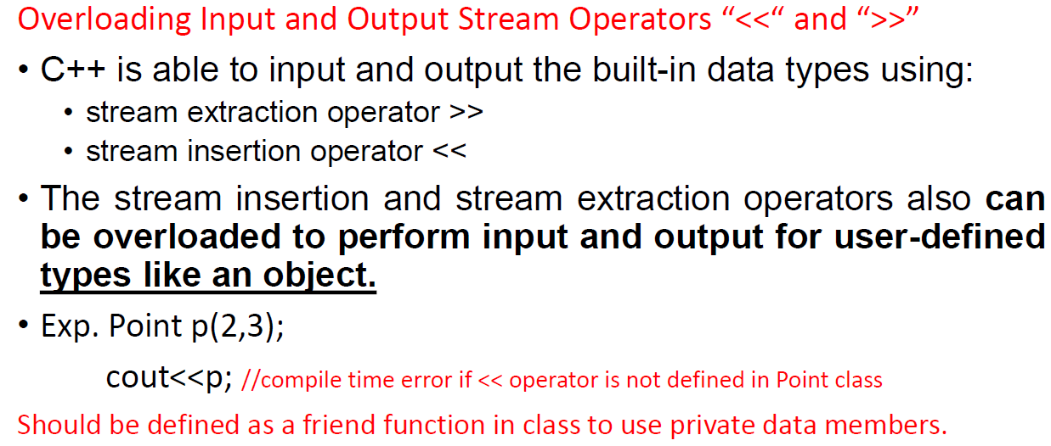
C++ Operator Overloading

Slide 25
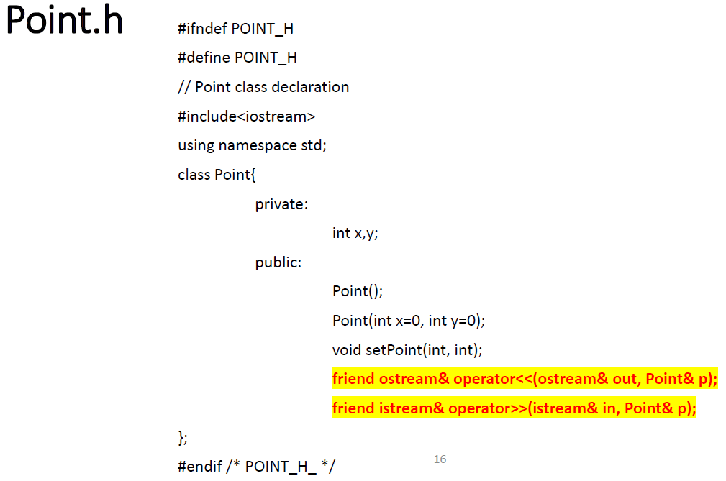
Example: C++ Operator Overloading

Slide 26
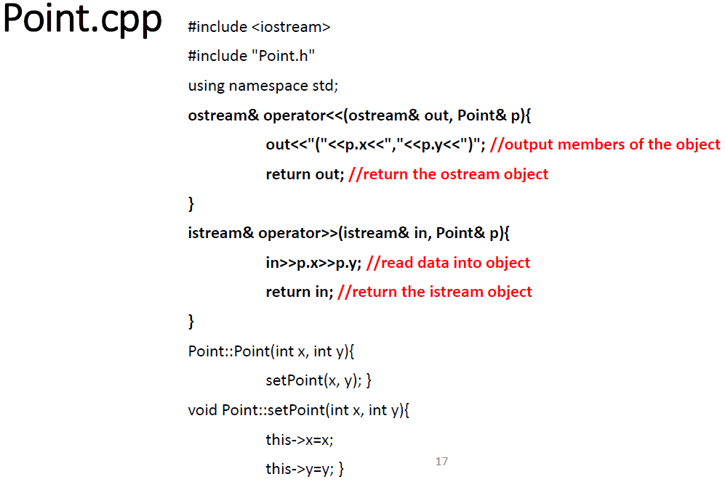
Example: C++ Operator Overloading

Slide 27
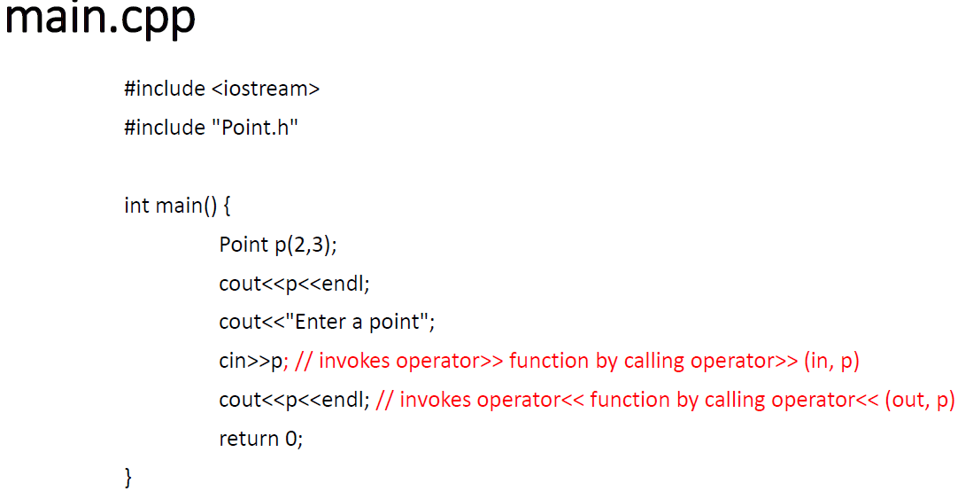
Example: C++ Operator Overloading

Slide 28
Data Structures
&
Algorithms

Slide 29
What’s this course about?
ALGORITHM
Input (DATA)
Output (Results)
An algorithm (program) is a well-defined computational procedure that
  takes some values (data) as “input”
  produces some result as “output”
Programs receive, manipulate, and output data
  Need to organize data according to problem being solved
  Data structures are methods for organizing data

Slide 30
Introduction
Programs are comprised of data and algorithms.
Data structures: Organized collection of data
Why to study Data Structures?
  The more sophisticated the data structure, the simpler the algorithm.
  Simple algorithms are less expensive to develop.
  There is less code to read and comprehend, less likely to introduce errors.
  It's usually much easier to repair defects, make modifications, or add enhancements.

Slide 31
Introduction
C++ Data Structures: Arrays, Linked Lists, Stacks, Queues, Trees
A certain data structure might be better suited for a problem in terms of efficiency.
Examples:
Queue: An example of FIFO data structure (Data inserted first, will leave the queue first.)
Exp: printer –first come first served
Stack: An example of LIFO data structure (Data inserted last will leave the stack first)
Exp: Web History

Slide 32
Abstract Data Type (ADT)
Data type
  a collection of values + a set of operations
Example: integer
  set of whole numbers: ……, -2, -1, 0, 1, 2, ……
  operations: +, -, x, /
Can this be generalized?
  (e.g. procedures generalize the notion of an operator)
  Yes!
Abstract data type
  A datatype that specifies the logical properties without the implementation details

Slide 33
Abstract Data Type (ADT)
An ADT defines a data type and a set of operations on that type.
  Details of implementation is hidden (encapsulation).
  Only know what operations are allowed on that datatype (abstraction).
ADT has three things associated with it:
The name of ADT: type name
The set of values belonging to ADT: domain
The set of operations on the data.

Slide 34
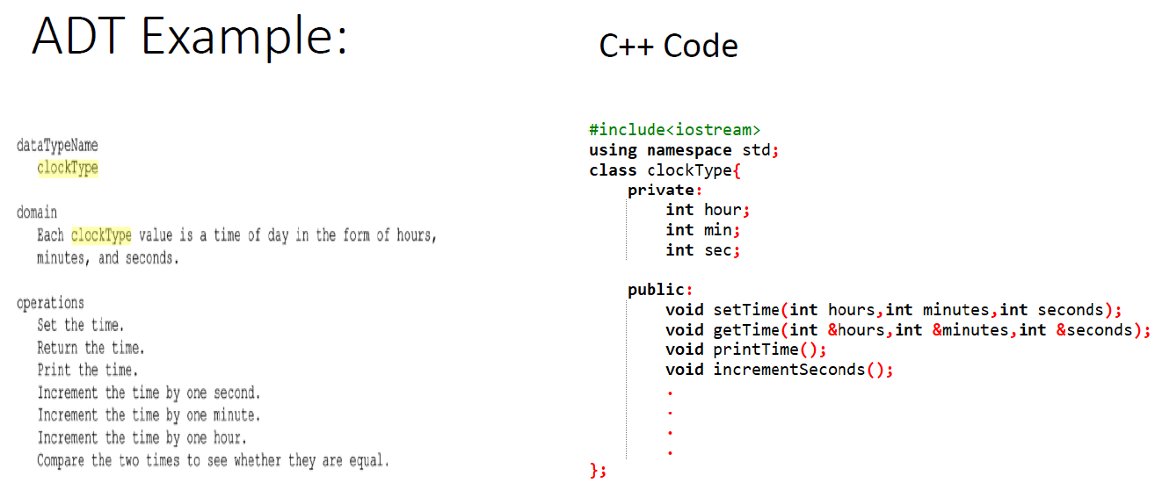

Slide 35
Data Structures (DS):
What, How, and Why?
Data structures are methods for organizing data
Formal definition of DS: Abstract Data Type (ADT)
  A “toolkit” of operations for manipulating data
  E.g. A list with operations insert and delete
  E.g. A stack with operations push and pop
  E.g. A queue with operations enqueue and dequeue

Slide 36
Data Structures (DS):
What, How, and Why?
Program design depends crucially on data organization, i.e., how data is structured for use by the program
  Implementation of some operations becomes easier or harder
  Speed of program may dramatically decrease or increase
  Memory used may increase or decrease
We will see examples of these throughout the course

Slide 37
Course Goals for Data Structures
Study different implementation techniques for some fundamental ADTs
Learn how to choose the “best” one
Learn how to modify standard ADTs for specific problems, and create new ADTs

Slide 38
Data Structures are used…
Everywhere
  Systems (Operating Systems, Computer Networks)
  Graphics
  Databases
  Theory
  Artificial Intelligence
  Information Retrieval
  …
Maybe the most important class in your curriculum ☺
  Guaranteed good and important stuff

Slide 39
E.g. 1: Tree of Files and Folders
/
docs
Program Files
games
classes
hw1.txt
hw2.txt
CMPE226
CMPE225
Project1
PPT
Nodes: Files/folders
Edges: contains
main.cpp
project.sln

Slide 40
E.g. 2: Queue of People
Queue of people waiting to pay bills
Rear of the queue
Next person will join the queue
from the rear
Front of the queue:
Next person to be served

Slide 41
E.g. 3: Representing Expressions
a
a = x*y + w-z;
+
*
-
x
y
w
z
Nodes: Symbols/Operators
Edges: Relationships

Slide 42
E.g. 4: Balanced Search Trees
20
10
30
Index
5
15
25
35
Veli
ID: 5
GPA: 2.0
Ali
ID: 10
GPA: 3.0
Cem
ID: 15
GPA: 2.5
Hasan
ID: 20
GPA: 2.8
Mehmet
ID: 25
GPA: 3.4
Taner
ID: 30
GPA: 3.2
Ayse
ID: 35
GPA: 2.9
Nodes: (Key/Value) pairs, Edges: Relationships

Slide 43
E.g. 5: Transportation Networks
Sakarya
70
Bilecik
Polatli
Inegol
30
60
50
60
Sivrihisar
Bozuyuk
Bursa
40
90
Eskisehir
50
90
130
80
Afyon
Nodes: Cities
Edges: Roads
100
Kutahya

Slide 44
Algorithms and their Analysis
What is an algorithm?
  A sequence of steps (a “program”) that accomplishes a task
  Independent of Programming Language
Many different algorithms may correctly solve a given task
  But choice of a particular algorithm may have enormous impact on time and memory used
  Time versus space tradeoffs are very common

Slide 45
Types of Algorithms
Iterative Algorithms
Recursive (Divide & Conquer) Algorithms
Randomized Algorithms
Dynamic Programming
Greedy Algorithms
Approximation Algorithms
Genetic Algorithms

Slide 46
Course Goals for Algorithms
Understand the mathematical fundamentals needed to analyze algorithms
Learn how to compare the efficiency of different algorithms in terms of running time and memory usage
Study a number of standard algorithms for data manipulation and learn to use them for solving new problems

Slide 47
References
Data Structures Using C++, D.S. Malik, Thomson Course Technology, 2nd Edition

