Slide 1
Data Structures
&
Algorithms

Slide 2
What’s an Algorithm about?
ALGORITHM
Input (DATA)
Output (Results)
An algorithm (program) is a well-defined computational procedure that
  takes some values (data) as “input”
  produces some result as “output”
Programs receive, manipulate, and output data
  Need to organize data according to problem being solved
  Data structures are methods for organizing data

Slide 3
Algorithms and their Analysis
What is an algorithm?
  A sequence of steps (a “program”) that accomplishes a task
  Independent of Programming Language
Many different algorithms may correctly solve a given task
  But choice of a particular algorithm may have enormous impact on time and memory used
  Time versus space tradeoffs are very common

Slide 4
Types of Algorithms
Iterative Algorithms
Recursive (Divide & Conquer) Algorithms
Randomized Algorithms
Dynamic Programming
Greedy Algorithms
Approximation Algorithms
Genetic Algorithms

Slide 5
Course Goals for Algorithms
Understand the mathematical fundamentals needed to analyze algorithms
Learn how to compare the efficiency of different algorithms in terms of running time and memory usage
Study a number of standard algorithms for data manipulation and learn to use them for solving new problems

Slide 6
Iterative Algorithm Analysis & Asymptotic Notations
Iterative Algorithms and their analysis
Asymptotic Notations
  Big O, Θ, Ω Notations
Review of Discrete Math
  Summations
  Logarithms

Slide 7
Example I:
Finding the sum of an array of numbers
How many steps does this algorithm take to finish?
  We define a step to be a unit of work that can be executed in constant amount of time in a machine.
int Sum(int A[], int N) {
int sum = 0;
for (i=0; i < N; i++){
sum += A[i];
} //end-for
return sum;
} //end-Sum

Slide 8
Example I:
Finding the sum of an array of numbers
Times Executed
1
N
N
1
--------
int Sum(int A[], int N) {
int sum = 0;
for (i=0; i < N; i++){
sum += A[i];
} //end-for
return sum;
} //end-Sum
Total: 1 + N + N + 1 = 2N + 2
Running Time: T(N) = 2N+2
  N is the input size (number of ints) to add

Slide 9
Example II:
Searching a key in an array of numbers
Times Executed
1
1<=L<=N
1<=L<=N
0<=L<=N
1
1
---------
int LinearSearch(int A[], int N,
int key) {
int i = 0;
while (i < N){
if (A[i] == key) break;
i++;
} //end-while
if (i < N) return i;
else return -1;
} //end-LinearSearch
Total: 1+3*L+1 = 3L+2

Slide 10
Example II:
Searching a key in an array of numbers
What’s the best case?
  Loop iterates just once =>T(n) = 5
What’s the average (expected) case?
  Loop iterates N/2 times =>T(n)=3*n/2+2 = 1.5n+2
What’s the worst case?
  Loop iterates N times =>T(n) = 3n+2

Slide 11
Worst Case Analysis of Algorithms
We will only look at WORST CASE running time of an algorithm. Why?
  Worst case is an upper bound on the running time. It gives us a guarantee that the algorithm will never take any longer
  For some algorithms, the worst case happens fairly often. As in this search example, the searched item is typically not in the array, so the loop will iterate N times
  The “average case” is often roughly as bad as the “worst case”. In our search algorithm, both the average case and the worst case are linear functions of the input size “n”

Slide 12
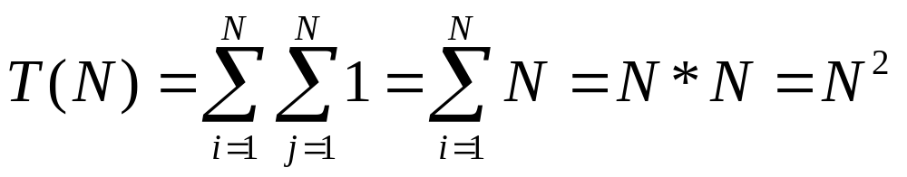
Example III: Nested for loops
for (i=1; i<=N; i++){
for (j=1; j<=N; j++){
println(“Foo\n”);
} //end-for-inner
} //end-for-outer
How many times is the printf statement executed?
  Or how many Foo will you see on the screen?

Slide 13
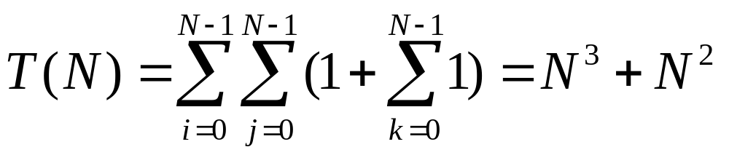
Example IV: Matrix Multiplication
/* Two dimensional arrays A, B, C. Compute C = A*B */
for (i=0; i<N; i++) {
for (j=0; j<N; j++) {
C[i][j] = 0;
for (int k=0; k<N; k++){
C[i][j] += A[i][k]*B[k][j];
} //end-for-innermost
} //end-for-inner
} //end-for-outer

Slide 14
Example V: Binary Search
Problem: You are given a sorted array of integers, and you are searching for a key
  Linear Search – T(n) = 3n+2 (Worst case)
  Can we do better?
  E.g. Search for 55 in the sorted array below
0
1
2
3
4
5
6
7
8
9
10
11
12
13
14
15
3
8
10
11
20
50
55
60
65
70
72
90
91
94
96
99

Slide 15
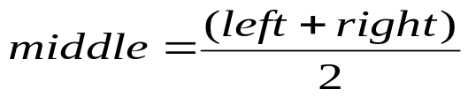
Example V: Binary Search
Since the array is sorted, we can reduce our search space in half by comparing the target key with the key contained in the middle of the array and continue this way
Example: Let’s search for 55
0
1
2
3
4
7
8
11
15
3
8
10
11
20
50
55
60
91
94
96
99
60
65
70
72
90
left
right
0
1
2
3
4
6
7
8
11
15
3
8
10
11
91
94
96
99
11
20
50
55
60
65
70
72
90
left
middle
right
Eliminated

Slide 16
Binary Search (continued)
0
1
2
3
4
5
6
7
8
11
15
3
8
10
11
20
50
91
94
96
99
50
55
60
65
70
72
90
Eliminated
left
middle
right
0
1
2
3
4
5
6
7
8
11
15
3
8
10
11
20
50
55
60
91
94
96
99
55
65
70
72
90
left
right
Eliminated
middle
Now we found 55→ Successful search
Had we searched for 57, we would have terminated at the next step unsuccessfully

Slide 17
Binary Search (continued)
< target
?
> target
left
right
At any step during a search for “target”, we have restricted our search space to those keys between “left” and “right”.
Any key to the left of “left” is smaller than “target” and is thus eliminated from the search space
Any key to the right of “right” is greater than “target” and is thus eliminated from the search space

Slide 18
Binary Search - Algorithm
// Return the index of the array containing the key or –1 if key not found
int BinarySearch(int A[], int N, int key){
left = 0;
right = N-1;
while (left <= right){
int middle = (left+right)/2; // Index of the key to test against
if (A[middle] == key) return middle; // Key found. Return the index
else if (key < A[middle]) right = middle – 1; // Eliminate the right side
else left = middle+1; // Eliminate the left side
} //end-while
return –1; // Key not found
} //end-BinarySearch
Worst case running time: T(n) = 3 + 5*log2N. Why?

Slide 19
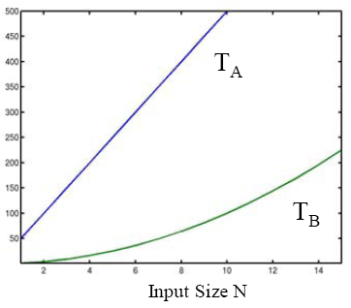
Motivation for Asymptotic Notation
Suppose you are given two algorithms A and B for solving a problem
Here is the running time TA(N) and TB(N) of A and B as a function of input size N:
Which algorithm would you choose?
Running Time

Slide 20
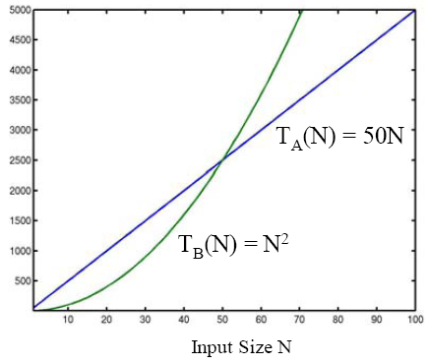
Motivation for Asymptotic Notation
For large N, the running time of A and B is:
Which algorithm would you choose now?
Running Time

Slide 21
Motivation for Asymptotic Notation
In general, what really matters is the “asymptotic” performance as N → ∞, regardless of what happens for small input sizes N.
Performance for small input sizes may matter in practice, if you are sure that small N will be common
  This is usually not the case for most applications
Given functions T1(N) and T2(N) that define the running times of two algorithms, we need a way to decide which one is better (i.e. asymptotically smaller)
  Asymptotic notations
  Big-Oh, Ω, Θ notations

Slide 22
Big-Oh Notation: Asymptotic Upper Bound
T(n) = O(f(n)) [T(n) is big-Oh of f(n) or order of f(n)]
  If there are positive constants c & n0 such that
  T(n) <= c*f(n) for all n >= n0
c*f(n)
Running Time
T(n)
n0
Input size N
Example: T(n) = 50n is O(n). Why?
  Choose c=50, n0=1. Then 50n <= 50n for all n>=1
  many other choices work too!

Slide 23
Big-Oh Notation: Asymptotic Upper Bound
T(n) = O(f(n))
  If there are positive constants c & n0 such that
  T(n) <= c*f(n) for all n >= n0
Example: T(n) = 2n+5 is O(n) why?
  We want T(n) = 2n+5 <= c*n for all n>=n0
  2n+5 <= 2n+5n <= 7n for all n>=1
    c = 7, no = 1
  2n+5 <= 3n for all n>=5
    c = 3, no=5
  Many other c & no values would work too

Slide 24
Big-Oh Notation: Asymptotic Upper Bound
T(n) = O(f(n))
  If there are positive constants c & n0 such that
  T(n) <= c*f(n) for all n >= n0
Example: T(n) = 2n+5 is O(n²) why?
  We want T(n) = 2n+5 <= c*n² for all n>=n0
  2n+5 <= 1*n² for all n>=4
    c = 1, no = 4
  2n+5 <= 2*n² for all n>=3
    c = 2, no = 3
  Many other c & no values would work too

Slide 25
Big-Oh Notation: Asymptotic Upper Bound
T(n) = O(f(n))
  If there are positive constants c & n0 such that
  T(n) <= c*f(n) for all n >= n0
Example: T(n) = n(n+1)/2 is O(?)
  T(n) = n²/2 + n/2 is O(N²). Why?
  n²/2 + n/2 <= n²/2 + n²/2 <= n² for all n >=1
  So, T(n)=n*(n+1)/2 <= 1* n² for all n >=1
    c=1, no=1
  Note: T(n) is also O(n³). Why?

Slide 26
Common Functions we will encounter
Name | Big-Oh | Comment
Constant | O(1) | Can’t beat it!
Log log | O(loglogN) | Extrapolation search
Logarithmic | O(logN) | Typical time for good searching algorithms
Linear | O(N) | This is about the fastest that an algorithm can run given that we need O(n) just to read the input
N logN | O(NlogN) | Most sorting algorithms
Quadratic | O(N²) | Acceptable when the data size is small (N<1000)
Cubic | O(N³) | Acceptable when the data size is small (N<1000)
Exponential | O(2^{N}) | Only good for really small input sizes (n<=20)
Increasing cost
Polynomial time

Slide 27
Ω Notation: Asymptotic Lower Bound
T(n) = Ω(f(n))
  If there are positive constants c & n0 such that
  T(n) >= c*f(n) for all n >= n0
T(n)
c*f(n)
Running Time
n0
Input size N
Example: T(n) = 2n + 5 is Ω(n). Why?
  2n+5 >= 2n, for all n >= 1
T(n) = 5*n² - 3*n is Ω(n²). Why?
  5*n² - 3*n >= 4*n², for all n >= 4

Slide 28
Θ Notation: Asymptotic Tight Bound
T(n) = Θ(f(n))
  If there are positive constants c1, c2 & n0 such that
  c1*f(n) <= T(n) <= c2*f(n) for all n >= n0
c2*f(n)
T(n)
Running Time
c1*f(n)
n0
Input size N
Example: T(n) = 2n + 5 is Θ(n). Why?
  2n <= 2n+5 <= 3n, for all n >= 5
T(n) = 5*n² - 3*n is Θ(n²). Why?
  4*n² <= 5*n² - 3*n <= 5*n², for all n >= 4

Slide 29
Big-Oh, Theta, Omega
Tips to guide your intuition:
Think of O(f(N)) as “less than or equal to” f(N)
  Upper bound: “grows slower than or same rate as” f(N)
Think of Ω(f(N)) as “greater than or equal to” f(N)
  Lower bound: “grows faster than or same rate as” f(N)
Think of Θ(f(N)) as “equal to” f(N)
  “Tight” bound: same growth rate
(True for large N and ignoring constant factors)

Slide 30
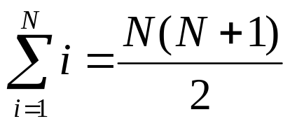
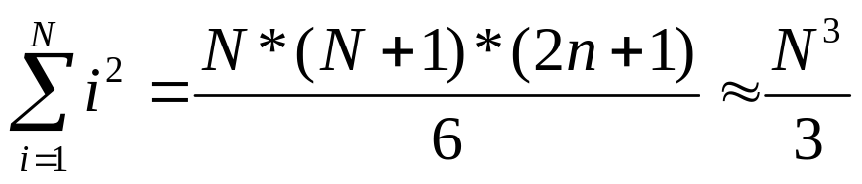
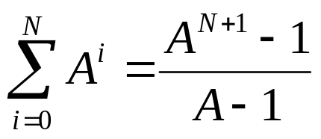
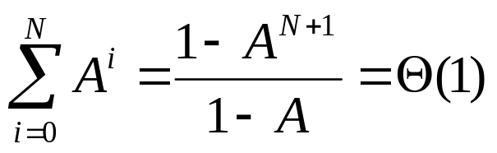
Some Math
S(N) = 1 + 2 + 3 + 4 + … N =
Sum of Squares:
Geometric Series: A > 1
A < 1

Slide 31
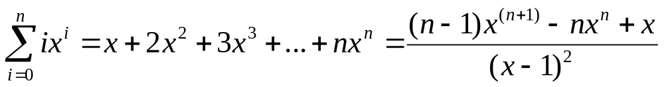
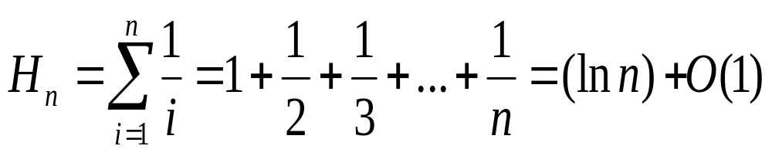
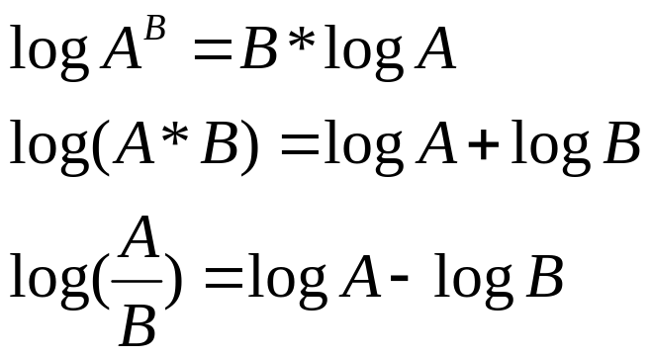
Some More Math
Linear Geometric
Series:
Harmonic Series:
Logs:

Slide 32
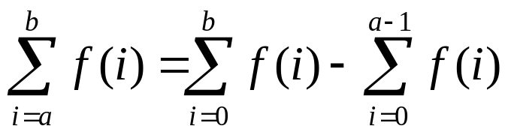
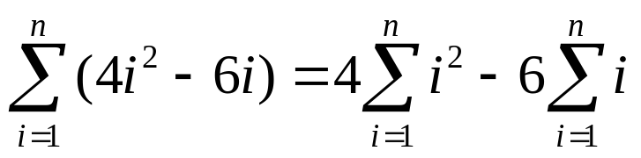
More on Summations
Summations with general bounds:
Linearity of Summations:

Slide 33

Take Care Everyone!
Thank you.

