Slide 1
Today’s Material
Recursive (Divide & Conquer) Algorithms
  Design
  Analysis

Slide 2



Divide & Conquer Strategy
https://deepmind.com/research/case-studies/alphago-the-story-so-far

Slide 3
Divide & Conquer Strategy
Very important strategy in computer science:
  Divide problem into smaller parts
  Independently solve the parts
  Combine these solutions to get overall solution
P
P1
P2
Pn
.........................
P11
P12
...
P1n
P21
P22
P2n
Pn1
Pn2
Pnn
...
...
................................................................................................................................................
Base
Cases
P
P
P
P
P
P
P
P
P
...................
P
P
P

Slide 4
Divide & Conquer Strategy (cont)
/* Solve a problem P */
Solve(P){
/* Base case(s) */
if P is a base case problem
return the solution immediately
/* Divide P into P1, P2, ..Pn each of smaller scale (n>=2) */
/* Solve subproblems recursively */
S1 = Solve(P1); /* Solve P1 recursively to obtain S1 */
S2 = Solve(P2); /* Solve P2 recursively to obtain S2 */
…
Sn = Solve(Pn); /* Solve Pn recursively to obtain Sn */
/* Merge the solutions to subproblems */
/* to get the solution to the original big problem */
S = Merge(S1, S2, …, Sn);
/* Return the solution */
return S;
} //end-Solve

Slide 5
Computing 1+2+..+N Recursively
Consider the problem of computing the sum of the number from 1 to n: 1+2+3+..+n
Here is how we can think recursively:
  In order to compute Sum(n) = 1+2+..+n
    compute Sum(n-1) = 1+2+..+n-1 (a smaller problem of the same type)
    Add n to Sum(n-1) to compute Sum(n)
    i.e., Sum(n) = Sum(n-1) + n;
  We also need to identify base case(s)
    A base case is a subproblem that can easily be solved without further dividing the problem
    If n = 1, then Sum(1) = 1;

Slide 6
Computing 1+2+..+N Recursively
/* Computes 1+2+3+…+n */
int Sum(int n){
int partialSum = 0;
/* Base case */
if (n == 1) return 1;
/* Divide and conquer */
partialSum = Sum(n-1);
/* Merge */
return partialSum + n;
} /* end-Sum */
main(String args[]){
int x = 0;
x = Sum(4);
println(“x: ” + x);
return 0;
} /* end-main */

Slide 7
Recursion Tree for Sum(4)
/* Computes 1+2+3+…+n */
int Sum(int n){
int partialSum = 0;
/* Base case */
if (n == 1) return 1;
/* Divide and conquer */
partialSum = Sum(n-1);
/* Merge */
return partialSum + n;
} /* end-Sum */
main(String args[]){
int x = Sum(4);
println(“Sum: ” + Sum(4));
} /* end-main */
main
x=Sum(4)
=10
Sum(4)
return 6+4
partialSum=Sum(3)
=6
Sum(3)
return 3+3
partialSum=Sum(2)
=3
return 1+2
Sum(2)
partialSum=Sum(1)
=1
Sum(1)
return 1

Slide 8
Running Time for Sum(n)
/* Computes 1+2+3+…+n */
int Sum(int n){
int partialSum = 0;
/* Base case */
if (n == 1) return 1;
/* Divide and conquer */
partialSum = Sum(n-1);
/* Merge */
return partialSum + n;
} /* end-Sum */
1 if n =1 (Base case)
T(n) =
T(n-1) + 1 if n>1

Slide 9
Computing a^{n} Recursively
/* Computes a^n */
double Power(double a, int n){
double partialResult;
/* Base cases */
if (n == 0) return 1;
else if (n == 1) return a;
/* partialResult = a^(n-1) */
partialResult = Power(a, n-1);
/* Merge */
return partialResult*a;
} /* end-Power */
We can combine divide, conquer & merge into a single statement
/* Computes a^n */
double Power(double a, int n){
/* Base cases */
if (n == 0) return 1;
else if (n == 1) return a;
return Power(a, n-1)*a;
} /* end-Power */

Slide 10
Recursion Tree for Power(3, 4)
main
/* Computes a^n */
double Power(double a, int n){
/* Base cases */
if (n == 0) return 1;
else if (n == 1) return a;
return a * Power(a, n-1);
} /* end-Power */
main(String args[]){
double x;
x = Power(3, 4);
} /* end-main */
x=Power(3,4)
=81
Power(3,4)
return 81
return 3*Power(3,3)
=81
Power(3,3)
return 27
return 3*Power(3,2)
=27
return 9
Power(3,2)
return 3*Power(3,1)
=9
Power(3,1)
return 3

Slide 11
Running Time for Power(a, n)
/* Computes a^n */
double Power(double a, int n){
/* Base cases */
if (n == 0) return 1;
else if (n == 1) return a;
return a * Power(a, n-1);
} /* end-Power */
1 if n <=1 (Base case)
T(n) =
T(n-1) + 1 if n>1

Slide 12
Fibonacci Numbers
Fibonacci numbers are defined as follows
  F(0) = 0
  F(1) = 1
  F(n) = F(n-1) + F(n-2)
/* Computes nth Fibonacci number */
int Fibonacci(int n){
/* Base cases */
if (n == 0) return 0;
if (n == 1) return 1;
return Fibonacci(n-1) + Fibonacci(n-2);
} /* end-Fibonacci */

Slide 13
Recursion Tree for F(5)
5
F(5)
F(4)+F(3)
2
3
F(4)
F(3)
F(3)+F(2)
F(2)+F(1)
1
1
2
1
F(3)
F(2)
F(2)
F(1)
F(2)+F(1)
F(1)+F(0)
F(1)+F(0)
1
1
1
0
1
0
F(2)
F(1)
F(1)
F(0)
F(1)
F(0)
F(1)+F(0)
1
0
F(1)
F(0)

Slide 14
Summation I
Compute the sum of N numbers A[1..N]
Stopping rule (Base Case):
    If N == 1 then sum = A[1]
Key Step
  Divide:
    Consider the smaller A[1] and A[2..N]
  Conquer:
    Compute Sum(A[2..N])
  Merge:
    Sum(A[1..N]) = A[1] + Sum(A[2..N])

Slide 15
Recursive Calls of Summation I
A[1..N]
A[1]
A[2..N]
A[2]
A[3..N]
A[3]
A[4..N]
A[N-1..N]
A[N-1]
A[N]

Slide 16
Summation I – Code
/* Computes the sum of an array of numbers A[0..N-1] */
int Sum(int A[], int index, int N){
/* Base case */
if (N == 1) return A[index];
/* Divide & Conquer */
int localSum = Sum(A, index+1, N-1);
/* Merge */
return A[0] + localSum;
} //end-Sum
1 if N =1 (Base case)
T(n) =
T(n-1) + 1 if N>1
Time to find the sum
of n-1 numbers
Time to combine
the results

Slide 17
Summation II
Compute the sum of N numbers A[1..N]
Stopping rule:
    If N == 1 then sum = A[1]
Key Step
  Divide:
    Consider the smaller A[1..N/2] and A[N/2+1..N]
  Conquer:
    Compute Sum(A[1..N/2]) and Sum(A[N/2+1..N])
  Merge:
    Sum(A[1..N]) = Sum(A[1..N/2]) + Sum(A[N/2+1..N])

Slide 18
Recursive Calls of Summation II
N
A[1..N]
N/2
A[1..N/2]
A[N/2+1..N]
N/4
A[1..N/4]
A[N/4+1..N/2]
N/8

Slide 19
Summation II – Code
/* Computes the sum of an array of numbers A[0..N-1] */
int Sum(int A[], int index1, int index2){
/* Base case */
if (index2-index1 == 1) return A[index1];
/* Divide & Conquer */
int middle = (index1+index2)/2;
int localSum1 = Sum(A, index1, middle);
int localSum2 = Sum(A, middle, index2);
/* Merge */
return localSum1 + localSum2;
} //end-Sum
1 if N =1 (Base case)
T(n) =
T(n/2) + T(n/2) + 1 if N>1

Slide 20
Linear Search
Link: https://www.youtube.com/watch?v=-PuqKbu9K3U
Find a key in an array of numbers A[0..N-1]
Stopping rules (Base Cases):
    if (N == 0) return false;
    if (key == A[0]) return true;
Key Step
  Divide & Conquer
    Search key in A[1..N-1]

Slide 21
Linear Search – Code
/* Searches a key in A[0..N-1] */
bool LinearSearch(int A[], int index, int N, int key){
/* Base cases */
if (N == 0) return false; /* Unsuccessful search */
if (key == A[0]) return true; /* Success */
/* Divide & Conquer & Merge */
return LinearSearch(A, index+1, N-1, key);
} //end-LinearSearch
1 if N <=1 (Base cases)
T(n) =
T(n-1) + 1 if N>1

Slide 22
Binary Search
Link: https://www.youtube.com/watch?v=iP897Z5Nerk
Find a key in a sorted array of numbers A[0..N-1]
Stopping rules (Base Cases):
    if (N == 0) return false;
    if (key == A[N/2]) return true;
Key Step
    if (key < A[N/2]) Search A[0..N/2-1]
    else Search A[N/2+1..N-1]

Slide 23
Binary Search – Code
/* Searches a key in sorted array A[0..N-1] */
bool BinarySearch(int A[], int index1, int index2, int key){
int middle = (index1+index2)/2;
int N = index2-index1;
/* Base cases */
if (key == A[middle]) return true; /* Success */
if (N == 1) return false; /* Unsuccessful search */
/* Conquer & Merge */
else if (key < A[middle])
return BinarySearch(A, index1, middle, key);
else
return BinarySearch(A, middle, index2, key);
} //end-BinarySearch
1 if N <=1 (Base cases)
T(n) =
T(n/2) + 1 if N>1

Slide 24
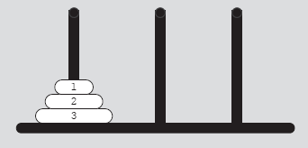
Tower of Hanoi
Object
  Move 64 disks from first needle to third needle
Rules
  Only one disk can be moved at a time
  Removed disk must be placed on one of the needles
  A larger disk cannot be placed on top of a smaller disk
FIGURE 6-8 Tower of Hanoi problem with three disks

Slide 25
Tower of Hanoi (cont’d.)
Case: first needle contains only one disk
  Move disk directly from needle 1 to needle 3
Case: first needle contains only two disks
  Move first disk from needle 1 to needle 2
  Move second disk from needle 1 to needle 3
  Move first disk from needle 2 to needle 3
Case: first needle contains three disks

Slide 26
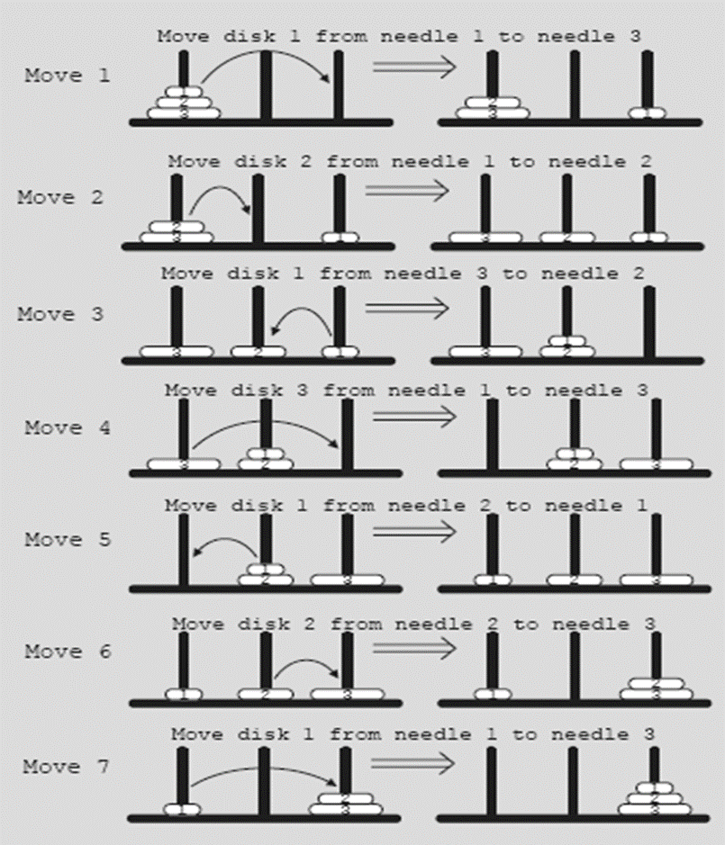
Tower of Hanoi (cont’d.)
FIGURE 6-9 Solution to Tower of Hanoi problem with three disks

Slide 27
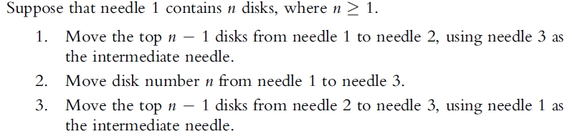
Tower of Hanoi (cont’d.)
Generalize problem to the case of 64 disks
  Recursive algorithm in pseudocode
Data Structures Using C++ 2E

Slide 28
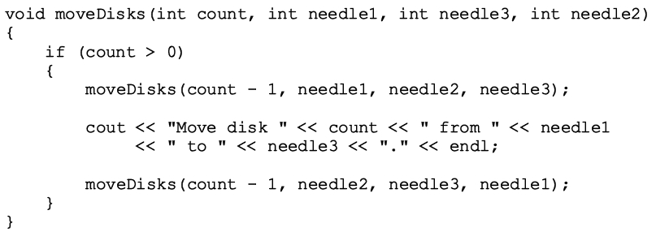
Tower of Hanoi (cont’d.)
Generalize problem to the case of 64 disks
  Recursive algorithm in C++
Data Structures Using C++ 2E

Slide 29
Tower of Hanoi (cont’d.)
Analysis of Tower of Hanoi
  Time necessary to move all 64 disks from needle 1 to needle 3
  Manually: roughly 5 x 10¹¹ years
    Universe is about 15 billion years old (1.5 x 10¹⁰)
  Computer: 500 years
    To generate 2⁶⁴ moves at the rate of 1 billion moves per second

Slide 30
Summary
Recursion
  Solve problem by reducing it to smaller versions of itself
Recursive algorithms implemented using recursive functions
  Direct, indirect, and infinite recursion
Many problems solved using recursive algorithms
Choosing between recursion and iteration
  Nature of solution; efficiency requirements
Backtracking
  Problem solving; iterative design technique

Slide 31

Take Care Everyone!
Thank you.

Slide 32
References
CMPE226-Lecture Notes by CigdemTurhan
•Data Structures Using C++, D.S. Malik, Thomson Course Technology, 2nd Edition.
•Lecture Slides by HuaminQu, The Hong Kong University of Science and Technology (2005)

