Slide 1
Today’s Material
List
  Definition & Operations
List Abstract Data Type (ADT)
  Definition & Operations
List Implementation: ArrayList

Slide 2
List - Definition
What is a list?
  An ordered sequence of elements A1, A2, …, AN
  Elements may be of arbitrary, but the same type (i.e., all ints, all doubles etc.)
Example list with 4 elements indexed 0..4
  2, 6, 1, 2, 3
    Index of 2 is 0
    Index of 6 is 1
    Index of 1 is 2
    Index of 2 is 3
    Index of 3 is 4

Slide 3
List Operations: add
Add a new element to the end of the list
  4, 6, 1, 4, 5 → add(8)→ 4, 6, 1, 4, 5, 8
Add a new element at an arbitrary position
  4, 6, 1, 4, 5 → add(2, 9) → 4, 6, 9, 1, 4, 5

Slide 4
List Operations: remove
Remove an existing element from the list
  4, 6, 1, 4, 5 → remove(2)→ 4, 6, 4, 5
  4, 6, 1, 4, 5 → remove(0)→ 6, 1, 4, 5
  4, 6, 1, 4, 5 → remove(1)→ 4, 1, 4, 5
  4, 6, 1, 4, 5 → remove(4)→ 4, 6, 1, 4

Slide 5
List Operations: indexOf & lastIndexOf
indexOf returns the index of the first matching element
  4, 6, 1, 4, 5 → indexOf(6)→ 1
  4, 6, 1, 4, 5 → indexOf(5)→ 4
  4, 6, 1, 4, 5 → indexOf(4)→ 0
lastIndexOf returns the index of the last matching element
  4, 6, 1, 4, 5 → lastIndexOf(1) → 2
  4, 6, 1, 4, 5 → lastIndexOf(4) → 3

Slide 6
List Operations: get & set
get returns the element at a particular index
  4, 6, 1, 4, 5 → get(1)→ 6
  4, 6, 1, 4, 5 → get(3)→ 4
  4, 6, 1, 4, 5 → get(0)→ 4
set changes the value of the element at a particular index
  4, 6, 1, 4, 5 → set(1, 9) → 4, 9, 1, 4, 5
  4, 6, 1, 4, 5 → set(3, 5) → 4, 9, 1, 5, 5
  4, 6, 1, 4, 5 → set(4, 7) → 4, 9, 1, 4, 7

Slide 7
Abstract Data Type (ADT)
So far we have defined an Abstract Data Type (ADT) with a set of operations
  Operations specify how the ADT behaves, but does not reveal how they are implemented
  In many cases, there are more than one way to implement an ADT
In this course we will cover lots of ADTs
  Lists
  Stacks
  Queues
  Trees & Search Trees
  Hash Tables & Tries

Slide 8
Abstract Data Type (ADT) - more
An Abstract Data Type (ADT) is a data structure with a set of operations
Attributes (ADT State)
…
…
Operations (ADT Methods)
Operation1(…)
Operation2(…)
Operation3(…)
…
…
…

Slide 9
List ADT
public class List {
…
public:
void add(int e); // Add to the end (append)
void add(int pos, int e); // Add at a specific position
void remove(int pos); // Remove
int indexOf(int e); // Forward Search
int lastIndexOf(int e); // Backward Search
bool clear(); // Remove all elements
bool isEmpty(); // Is the list empty?
int first(); // First element
int last(); // Last element
int get(int pos); // Get at a specific position
int size(); // # of elements in the list
};

Slide 10
Using List ADT
public static void main(String args[]){
// Create an empty list object
List list = new List();
list.add(10); // 10
list.add(5); // 10, 5
list.add(1, 7); // 10, 7, 5
list.add(2, 9); // 10, 7, 9, 5
list.indexOf(7); // Returns 1
list.get(3); // Return 5
list.remove(1); // 10, 9, 5
list.size(); // Returns 3
list.isEmpty(); // Returns false
list.remove(0); // 9, 5
list.clear(); // empty list
}/* end-main */

Slide 11
Lists: Implementation
Two types of implementation:
  Array-Based - Today
  Linked List – Next Week
We will compare worst case running time of ADT operations with different implementations

Slide 12
Lists: Array-Based Implementation
Basic Idea:
  Pre-allocate a big array of size MAX_SIZE
  Keep track of first free slot using a variable N
  Empty list has N = 0
  Shift elements when you have to insert or delete
0
1
2
3
………
N-1
MAX_SIZE
A_1
A_2
A_3
A_4
………
A_N-1

Slide 13
Array List ADT – Declarations
ArrayList ADT
public class ArrayList {
private:
int capacity;
int noOfItems;
int items[];
// Constructor:
// Make empty list
ArrayList(){
items = new int[4];
capacity = 4;
noOfItems = 0;
} // end-ArrayList
public:
ArrayList (); // Constructor
void add(int pos, int e);
void remove(int pos);
int indexOf(int e);
bool isEmpty();
int first();
int last();
int get(int pos);
int size();
};

Slide 14
Lists Operations: add
add(Position P, ElementType E)
  Example: add(2, X): Insert X at position 2
Basic Idea: Shift existing elements to the right by one slot and insert new element
Here is the final list. Running time: O(N)
0
1
2
3
………
N-1
MAX_SIZE
A_1
A_2
A_3
A_4
………
A_N
0
1
2
3
………
N-1
N
MAX_SIZE
A_1
A_2
X
A_3
………
A_N-1
A_N

Slide 15
Lists Insert – Full Array
What if the array is already full?
  Can return an error
    Not preferred
  Typically though, you would do the following:
    Allocate a bigger array (usually double the capacity)
    Copy all elements from the old array to the new one
    Free up the space used by the old array
    Start using the new array
  With this dynamic array implementation, you would also need to keep track of the capacity of the array

Slide 16
Lists Operations: remove
remove(Position P)
  Example: remove(1): Delete element at position 1
Basic Idea: Remove element and shift existing elements to the left by one
Here is the final list. Running time: O(N)
0
1
2
3
………
N-1
MAX_SIZE
A_1
A_2
A_3
A_4
………
A_N
0
1
2
3
………
N-2
N-1
MAX_SIZE
A_1
A_3
A_4
A_5
………
A_N

Slide 17
Lists Operations: indexOf
indexOf(ElementType E)
  Example: indexOf(X): Search X in the list
Must do a linear search
  Running time: O(N)
0
1
2
3
………
N-1
MAX_SIZE
A_1
A_2
A_3
A_4
………
A_N

Slide 18
Lists Operations: isEmpty
isEmpty()
  Returns true if the list is empty
Trivial – Return true if N == 0
  Running time: O(1)
0
1
2
3
………
N-1
MAX_SIZE
A_1
A_2
A_3
A_4
………
A_N

Slide 19
Lists Operations: first, last, get
first(): Return A[0]
last(): Return A[N-1]
get(Position K): Return A[K]
first – Running time: O(1)
last – Running time: O(1)
get – Running time: O(1)
0
1
2
3
………
N-1
MAX_SIZE
A_1
A_2
A_3
A_4
………
A_N

Slide 20
Application of Lists
Polynomial ADT: store and manipulate single variable polynomials with non-negative exponents
  10X^3 + 4X^2 + 7 = 10X^3 + 4X^2 + 0X^1 + 7X^0
  Data structure: stores coefficients Ci and exponents i
Array Implementation: C[i] = Ci
  E.g. C[3] = 10, C[2] = 4, C[1] = 0, C[0] = 7
ADT operations: Input polynomials in arrays A and B, result in C
  Addition: C[i] = ?
  Multiplication: ?

Slide 21
Application of Lists: Polynomials
Add(Poly A, Poly B, Poly C):
  C[i] = A[i] + B[i] for 0<=i<=N
Multiply(Poly A, Poly B, Poly C):
  Set C[i] = 0 for 0<=i<=N
  For each pair (i, j)
    C[i+j] = C[i+j] + A[i]*B[j]
Divide(Poly A, Poly B, Poly C):
  You do it…

Slide 22
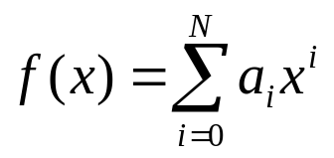
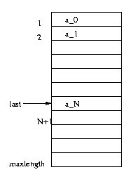
Example: The Polynomial ADT
An ADT for single-variable polynomials
Array implementation

Slide 23
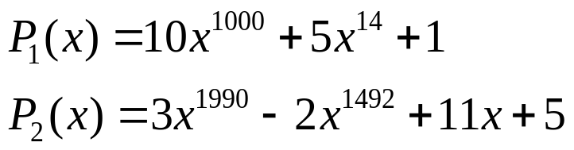
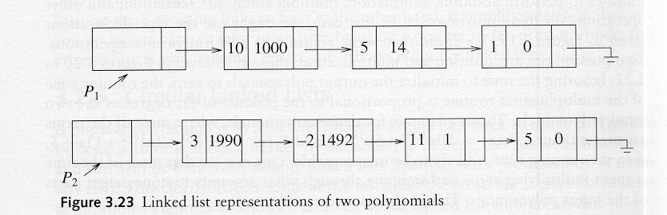
The Polynomial ADT…
  Acceptable if most of the coefficients A_{j} are nonzero, undesirable if this is not the case
  E.g. multiply
    most of the time is spent multiplying zeros and stepping through nonexistent parts of the input polynomials
Implementation using a singly linked list
  Each term is contained in one cell, and the cells are sorted in decreasing order of exponents

Slide 24
Application of Lists: Polynomials
Problem with Array Implementation: Sparse Polynomials
  E.g. 10X^3000+ 4X^2+ 7
  Waste of space and time (Ci are mostly 0s)
Solution?
  Use singly linked list, sorted in decreasing order of exponents
head
(10, 3000)
(4, 2)
(7, 0)

Slide 25

Take Care Everyone!
Thank you.

