Slide 1

Data Structures Using C++ 2E
Heapsort

Slide 2
Heapsort: Array-Based Lists
Overcomes quicksort worst case
Heap: list in which each element contains a key
  Key in the element at position k in the list
    At least as large as the key in the element at position 2k + 1 (if it exists) and 2k + 2 (if it exists)
C++ array index starts at zero
  Element at position k
    k + 1th element of the list
FIGURE 10-41 A heap
Data Structures Using C++ 2E

Slide 3
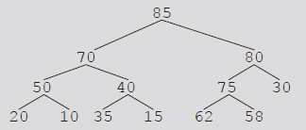
Heapsort: Array-Based Lists (cont’d.)
Data given in Figure 10-41
  Can be viewed in a complete binary tree
Heapsort
  First step: convert list into a heap
    Called buildHeap
  After converting the array into a heap
    Sorting phase begins
FIGURE 10-42 Complete binary tree
corresponding to the list in Figure 10-41
Data Structures Using C++ 2E

Slide 4
Heapsort Algorithm
Build Heap from list
Exchange root and the last element, and remove old root
Repeat the above proves for the rest of the list
Data Structures Using C++ 2E

Slide 5
Heapsort Example
y | r | p | d | f
y
r
p
d
f
heap
Data Structures Using C++ 2E

Slide 6
Heapsort Example
Not ordered
In order
f | r | p | d | y
f
r
p
d
y
Not a heap
Data Structures Using C++ 2E

Slide 7
Heapsort Example
r | f | p | d | y
r
f
p
d
heap
Data Structures Using C++ 2E

Slide 8
Heapsort Example
d | f | p | r | y
d
f
p
r
Not a heap
Data Structures Using C++ 2E

Slide 9
Heapsort Example
p | f | d | r | y
p
f
d
heap
Data Structures Using C++ 2E

Slide 10
Heapsort Example
d | f | p | r | y
d
f
p
Not a heap
Data Structures Using C++ 2E

Slide 11
Heapsort Example
f | d | p | r | y
f
d
heap
Data Structures Using C++ 2E

Slide 12
Heapsort Example
d | f | p | r | y
d
f
The array is sorted.
Efficiency is O(nlogn)
Data Structures Using C++ 2E

Slide 13
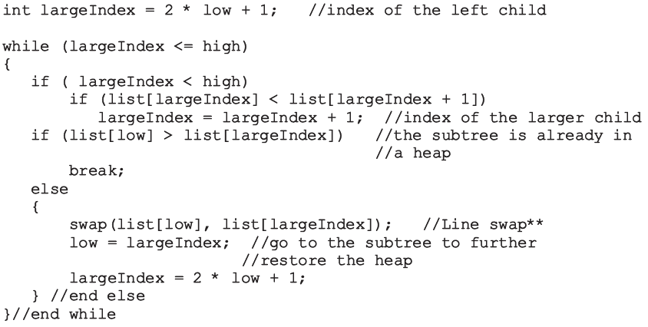
Build Heap
Data Structures Using C++ 2E

Slide 14
Build Heap (cont’d.)
Function heapify
  Restores the heap in a subtree
  Implements the buildHeap function
    Converts list into a heap
Data Structures Using C++ 2E

Slide 15
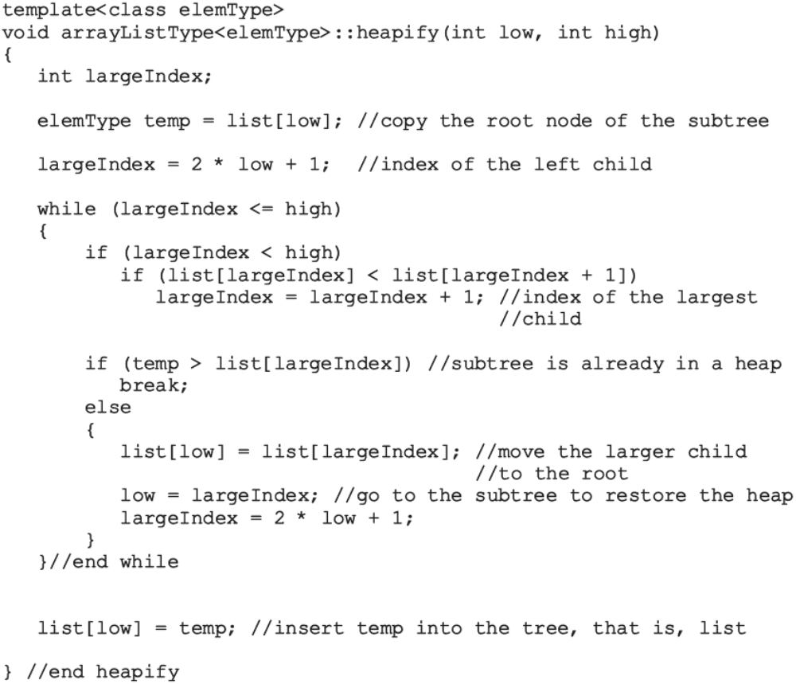
Data Structures Using C++ 2E

Slide 16
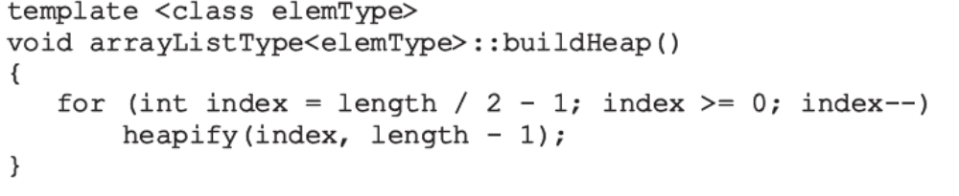
Build Heap (cont’d.)
Data Structures Using C++ 2E

Slide 17
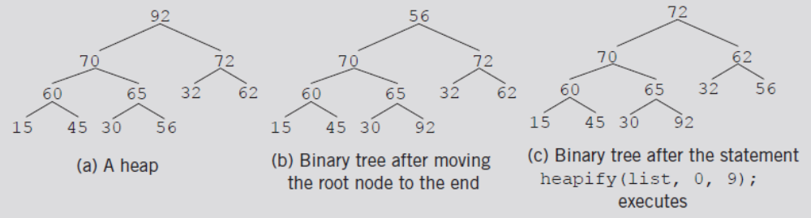
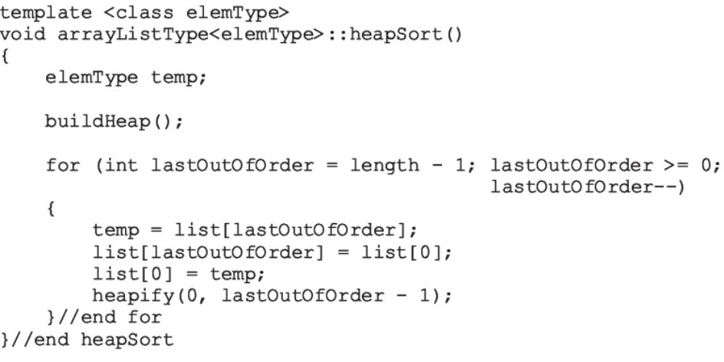
Build Heap (cont’d.)
The heapsort algorithm
FIGURE 10-48 Heapsort
Data Structures Using C++ 2E

Slide 18
Analysis: Heapsort
Given L a list of n elements where n > 0
Worst case
  Number of key comparisons to sort L
    2nlog₂n + O(n)
  Number of item assignments to sort L
    nlog₂n + O(n)
Average number of comparisons to sort L
  O(nlog₂n)
Heapsort takes twice as long as quicksort
  Avoids the slight possibility of poor performance
Data Structures Using C++ 2E

