Slide 1
Today’s Material
List ADT
  Definition
List ADT Implementation: LinkedList

Slide 2
List ADT
What is a list?
  An ordered sequence of elements A1, A2, …, AN
public class List {
…
public:
void add(int e); // Add to the end (append)
void add(int pos, int e); // Add at a specific position
void remove(int pos); // Remove
int indexOf(int e); // Forward Search
int lastIndexOf(int e); // Backward Search
bool clear(); // Remove all elements
bool isEmpty(); // Is the list empty?
int first(); // First element
int last(); // Last element
int get(int pos); // Get at a specific position
int size(); // # of elements in the list
};

Slide 3
Using List ADT
public static void main(String args[]){
// Create an empty list object
List list = new List();
list.add(10); // 10
list.add(5); // 10, 5
list.add(1, 7); // 10, 7, 5
list.add(2, 9); // 10, 7, 9, 5
list.indexOf(7); // Returns 1
list.get(3); // Return 5
list.remove(1); // 10, 9, 5
list.size(); // Returns 3
list.isEmpty(); // Returns false
list.remove(0); // 9, 5
list.clear(); // empty list
}/* end-main */

Slide 4
Lists: Implementation
Two types of implementation:
  Array-Based - ArrayList
  Linked - LinkedList
We will compare worst case running time of ADT operations with different implementations

Slide 5
Lists: Array-Based Implementation
Basic Idea:
  Pre-allocate a big array of size MAX_SIZE
  Keep track of first free slot using a variable N
  Empty list has N = 0
  Shift elements when you have to add or remove
  What happens if the array is full?
    Allocate a bigger array
    Copy elements from the old array to the new one
    Free up the space used by the old array
    This requires a lot of memory copy operations!
0
1
2
3
………
N-1
MAX_SIZE
A_1
A_2
A_3
A_4
………
A_N-1

Slide 6
Lists: Linked Implementation
Basic Idea:
  Allocate one node per element
  Nodes are NOT contiguous but are scattered in the memory
  Each element keeps track of the location (address) of the next node that follows it
  Need to know the location of the first node
List Head
List Tail
0
1
2
3
A_1
next
A_2
next
A_3
next
A_4
next
node
A list with 4 elements (nodes)

Slide 7
Lists: Contiguous vs Linked Implementation
Memory
Address
Memory
0
0
1
1
2
2
List Head = T
T
A_1
Y
Address
L0
A_1
c bytes
L0 + c
A_2
W
A_5
NULL
L0 + 2c
A_3
L0 + 3c
A_4
X
A_3
Z
L0 + 4c
A_5
Y
A_2
X
Z
A_4
W
Contiguous
Non-contiguous (Linked)

Slide 8
Linked Lists: Pictorial View
node
class LinkedListNode {
public ElementType value;
public LinkedListNode next;
};
value
next
Pictorial view of a list node
LinkedListNode head;
LinkedListNode tail;
head = T
tail = W
0
1
2
3
4
A_1
Y
A_2
X
A_3
Z
A_4
W
A_5
null
Pictorial view of the list shown on the previous page
Notice that T, W, X, Y and Z are arbitrary locations in memory

Slide 9
Linked List ADT – C++ Declarations
LinkedList ADT
class LinkedList {
private:
LinkedListNode head;
LinkedListNode tail;
int noOfNodes;
0
1
2
3
A_1
A_2
A_3
A_4
null
public:
LinkedList(){head=tail=null;}
void add(int pos, int e);
void remove(int pos);
int indexOf(int e);
bool isEmpty();
int first();
int last();
int get(int pos);
int size();
};

Slide 10
Lists Operations: add
add(Position P, ElementType E)
  Example: add(2, X): Insert X at position 2
  Algorithm:
    (1) Find where X needs to be inserted (after p)
    (2) Create a new node containing X
    (3) Update next pointers
0
1
2
List
Head
A_1
next
next
A_2
A_3
null
p
Running Time?
O(N) – to find the location
O(1) to insert
new node
X
next
node

Slide 11
Lists Operations: remove
remove(Position P)
  Example: remove(2): Delete element at position 2
  First we need to find the node to delete
  Can we delete the node pointed to by p?
  Need a pointer to the previous node
    While finding the node to delete, keep track of the previous node (q trails p as we go over the list)
  Now adjust the next pointers – How?
    q->next = p->next
0
1
2
3
List
Head
A_1
next
A_2
next
next
A_3
A_4
null
q
p

Slide 12
Lists Operations: remove
remove(Position P)
  Example: remove(2): Delete element at position 2
0
1
2
3
List
Head
A_1
next
A_2
next
next
A_3
A_4
null
q
p
0
1
2
List
Head
A_1
next
A_2
next
next
A_3
A_4
null
q
p
Running Time?
O(N) – to find the node, O(1) to delete

Slide 13
Lists Operations: indexOf
indexOf(ElementType E)
  Example: indexOf(X): Search X in the list
Must do a linear search
  Running time: O(N)
0
1
2
3
List
Head
A_1
next
A_2
next
next
A_3
A_4
null

Slide 14
Lists Operations: isEmpty
isEmpty()
  Returns true if the list is empty
Trivial – Return true if head == NULL
  Running time: O(1)
0
1
2
3
List
Head
A_1
next
A_2
next
next
A_3
A_4
null

Slide 15
Lists Operations: first, last, get
first()
last()
get(Position K)
first – Running time: O(1)
last – Running time: O(1) – If we keep a tail ptr
get – Running time: O(N)
List
tail
0
1
2
3
List
Head
A_1
next
A_2
next
next
A_3
A_4
null

Slide 16
Caveats with Linked Lists
Whenever you break a list, your code should fix the list up as soon as possible
  Draw pictures of the list to visualize what needs to be done
Pay special attention to boundary conditions:
  Empty list
  Single node– same node is both first and last
  Two nodes– first, last, but no middle nodes
  Three or more nodes– first, last, and middle nodes

Slide 17
Lists: Running time comparison
Operation | Array-based List | Linked List
add | O(N) | O(N) or O(1)
remove | O(N) | O(N)
indexOf | O(N) | O(N)
isEmpty | O(1) | O(1)
first | O(1) | O(1)
last | O(1) | O(1)
get | O(1) | O(N)
size | O(1) | O(1)

Slide 18
More on remove
What if you already have a pointer to the node to delete?
  remove(LinkedListNode *p);
Still need a pointer to the previous node
  Makes the running time O(N)
  Can we make this operation faster?
  Yep: Also keep a pointer to the previous node!
    Called a doubly linked list
0
1
2
3
List
Head
A_1
next
A_2
next
next
A_3
A_4
null
p

Slide 19
Doubly Linked Lists
List
Head
List
Tail
A_1
prev
next
A_2
prev
next
A_3
prev
next
null
null
C++ Declarations
class DoublyLinkedListNode {
public ElementType value;
public DoublyLinkedListNode next;
public DoublyLinkedListNode prev;
};
DoublyLinkedListNode head;
DoublyLinkedListNode tail;

Slide 20
Doubly Linked Lists
List
Head
List
Tail
A_1
prev
next
A_2
prev
next
A_3
prev
next
null
null
Advantages:
  remove(LinkedListNode p) becomes O(1)
  previous(LinkedListNode p) becomes O(1)
  Allows going over the list forward & backwards
Disadvantages:
  More space (double the number of pointers at each node)
  More book-keeping for updating two pointers at each node

Slide 21
Application of Lists: Polynomials
Problem with Array Lists: Sparse Polynomials
  E.g. 10X^3000+ 4X^2+ 7
  Waste of space and time (Ci are mostly 0s)
Solution?
  Use singly linked list, sorted in decreasing order of exponents
head
(10, 3000)
(4, 2)
(7, 0)

Slide 22
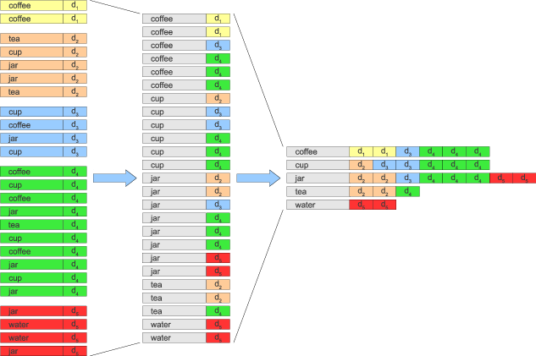
Application: Inverted Index Construction
coffee, coffee
cup, jar, jar, tea, tea
coffee, cup, cup, jar
coffee, coffee, coffee, cup, cup, cup, jar, jar, jar, tea
jar, jar, water, water
Sort terms with document references

Slide 23
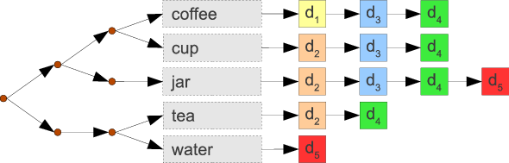
Inverted Index
Build search tree over vocabulary
Compile posting list for each term

Slide 24

Implementing Boolean Retrieval
Search for single term q=t
  Look up posting list for t ... and done!
Example : query „tea“
Result of a query is a posting list

Slide 25
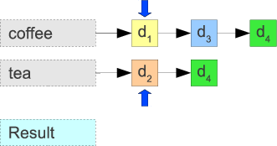
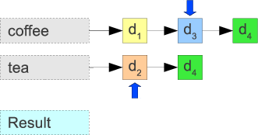
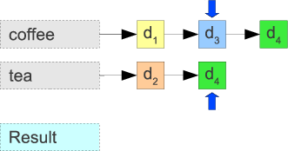
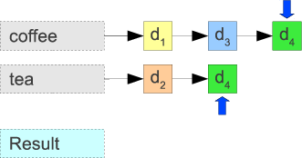
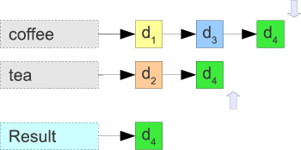
Implementing Boolean Retrieval
Search for q = q₁ AND q₂
  Intersect the result lists (posting lists)
Example : query „coffee AND tea“

Slide 26
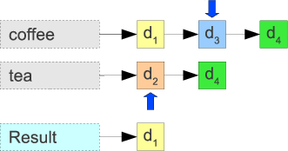
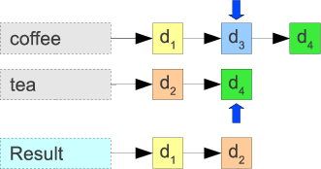
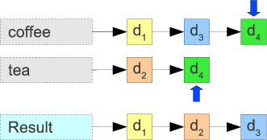
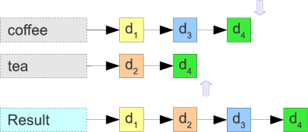
Implementing Boolean Retrieval
Search for q = q₁ OR q₂
  Merge the result lists (posting lists)
Example : query „coffee OR tea“

Slide 27

Take Care Everyone!
Thank you.

