Slide 1
Stacks – Chapter 3
A stack is a data structure in which all insertions and deletions of entries are made at one end, called the top of the stack.
Alternatively, in a stack the element deleted is the most recently inserted. This is also called last-in-first-out (LIFO)
Classical example for stacks is a stack of trays in a cafeteria

Slide 2
Stack Concept and Push Operation Example
Top of the stack
Top of the stack
Top of the stack
Initial Stack of trays
After green plate
is inserted
After black plate
is inserted
A stack has a top where insertions and deletions are made
Insert operation in a stack is often called Push
Notice that the element pushed to a stack is always placed at the top of the stack

Slide 3
Stack concept and Pop operation example
Pop the top element
off the stack
Pop the top element
off the stack
Top of the stack
Top of the stack
Top of the stack
Initial Stack of trays
After green plate
is popped off
After gray plate
is popped off
Delete operation in a stack is often called Pop
Notice that the element popped off the stack is always the one residing on top of the stack (LIFO)

Slide 4
Stack ADT
A stack is a data structure in which all insertions and deletions of entries are made at one end, called the top of the stack.
Common stack operations:
  Push(item) – push item to the top of the stack
  Pop() – Remove & return the top item
  Top() – Return the top item w/o removing it
  isEmpty() – Return true if the stack is empty

Slide 5
How do we implement stack ADT?
2 ways to implement a stack
  Using an array
  Using a linked list

Slide 6
Array Implementation of Stacks
We can implement a stack of at most “N” elements with an array “S” as follows
0
1
2
3
4
5
6
S
15
6
2
9
top = 3
top = 4
3
top = 3
9
9
top = 3
9
top = 2
2
2
2
2
6
6
6
6
15
15
15
15
After 3 is
popped
off
After 9 is
popped
off
Initial Stack
After 3 is inserted

Slide 7
Stack Declaration & Operations
public class Stack {
private:
static int N = 100; // size of the stack
int S[]; //Stack elements are positive integers
int top; // Current top of the stack
public:
Stack();
int Push(int item);
int Pop();
int Top();
bool isEmpty();
bool isFull();
};

Slide 8
Stack Operations: isEmpty, isFull
// Constructor
Stack(){
S = new int[N];
top = -1;
} // end-Stack
// Returns true if the stack is empty
bool isEmpty(){
if (top < 0) return true;
else return false;
} //end-isEmpty
// Returns true if the stack is full
bool isFull(){
if (top == N-1) return true;
else return false;
} // end-isFull

Slide 9
Stack Operations: Push
// Pushes an element to the top of the stack
// Returns 0 on success, -1 on failure
int Push(int newItem){
if (isFull()){
// Stack is full. Can’t insert the new element
System.out.println(“Stack overflow”);
return -1;
} //end-if
top++;
S[top] = newItem;
return 0;
} //end-Push

Slide 10
Stack Operations: Top
// Returns the element at the top of the stack
// If the stack is empty, returns -1
int Top(){
if (isEmpty()){
// Stack is empty! Return error
System.out.println(“Stack underflow”);
return -1;
} //end-if
return S[top];
} //end-Top

Slide 11
Stack Operations: Pop
// Pops the top element of the stack and returns it.
// If the stack is empty, returns -1
int Pop(){
if (isEmpty()){
// Stack is empty! Return error
System.out.println(“Stack underflow”);
return -1;
} //end-if
int idx = top; // Save current top
top--; // Remove the item
return S[idx];
} //end-Pop

Slide 12
Stack Usage Example
main(){
Stack s = new Stack();
if (s.isEmpty()) println(“Stack is empty”); // Empty stack
s.Push(49);
s.Push(23);
println(“Top of the stack is: ” + s.Pop()); // prints 23
s.Push(44);
s.Push(22);
println(“Top of the stack is: ” + s.Pop()); // prints 22
println(“Top of the stack is: ” + s.Pop()); // prints 44
println(“Top of the stack is: ” + s.Top()); // prints 49.
println(“Top of the stack is: ” + s.Pop()); // prints 49.
if (s.isEmpty()) println(“Stack is empty”); // Empty stack
} //end-main

Slide 13

Linked-List implementation of Stacks
Top
9
2
6
15
Initial Stack
Push(3)
Top
9
2
6
15
After 3 is pushed
Pop()
Top
9
2
6
15
After 3 is popped
Pop()
Top
2
6
15
After 9 is popped

Slide 14
Stack using Linked List: Declarations
public struct StackNode {
public int item;
public StackNode next;
StackNode(int e){item=e; next=null;}
};
/* Stack ADT */
public class Stack {
private:
StackNode top; // Stack only has a top
public:
Stack(){top=null;}
void Push(int item);
int Pop();
int Top();
bool isEmpty();
};

Slide 15
Stack Operations: Push, isEmpty
// Pushes an item to the stack
void Push(int item){
StackNode x = new StackNode(item);
x.next = top;
top = x;
} //end-Push
// Returns true if the stack is empty
bool isEmpty(){
if (top == null) return true;
else return false;
} //end-isEmpty

Slide 16
Stack Operations: Top
// Returns the top of the stack
int Top(){
if (isEmpty()){
println(“Stack underflow”); // Empty stack.
return -1; // error
} //end-if
return top.item;
} //end-Top

Slide 17
Stack Operations: Pop
// Pops and returns the top of the stack
int Pop(){
if (isEmpty()){
println(“Stack underflow”); // Empty stack.
return -1; // error
} //end-if
// Keep a pointer to the current top of the stack
StackNode tmp = top;
// Move the top of the stack to the next node
top = top.next;
// Return the item
return tmp.key;
} //end-Pop

Slide 18
Stack Usage Example
main(){
Stack s = new Stack();
if (s.isEmpty()) println(“Stack is empty”); // Empty stack
s.Push(49);
s.Push(23);
println(“Top of the stack is: ” + s.Pop()); // prints 23
s.Push(44);
s.Push(22);
println(“Top of the stack is: ” + s.Pop()); // prints 22
println(“Top of the stack is: ” + s.Pop()); // prints 44
println(“Top of the stack is: ” + s.Top()); // prints 49.
println(“Top of the stack is: ” + s.Pop()); // prints 49.
if (s.isEmpty()) println(“Stack is empty”); // Empty stack
} //end-main

Slide 19
EXAMPLE
Push 5, 3, 1, Pop, Pop, Push 7
1
3
3
5
5
5
Push 3
Push 1
Push 5
Get 1
Get 3
7
3
5
5
5
Pop
Pop
Push 7

Slide 20
Stacks: Linked List Implementation
Linked List Implementation.
Need not know the maximum size
Need not have a special header.
Add/Access/Delete in the beginning, O(1)
Need several memory access, deletions.

Slide 21
Push 5, 3, 1, Pop, Pop, Push 7
5
NULL
3
5
NULL
1
3
5
NULL

Slide 22
3
5
NULL
5
NULL
7
5
NULL

Slide 23

Application of Stacks I: Compilers/Word Processors
Compilers and Word Processors: Balancing Symbols
  E.g., 2*(i + 5*(17 – j/(6*k)) is not balanced – “)” is missing
  Write a Balance-Checker using Stacks and analyze its running time.

Slide 24
Application of Stacks I: Compilers/Word Processors
Balance-Checker using Stacks:
  Make an empty stack and start reading symbols
  If input is an opening symbol, Push onto stack
  If input is a closing symbol:
    If stack is empty, report error
    Else
    Pop the stack
    Report error if popped symbol is not a matching open symbol
  If End-of-File and stack is not empty, report error
Example: 2*(i + 5*(17 – j/(6*k))
Run time for N symbols in the input text: O(N)

Slide 25
App. Of Stacks II: Expression Evaluation
How do we evaluate an expression?
  20+2*3+(2*8+5)*4
Specify the sequence of operations (called a postfix or reverse polish notation)
  Store 20 in accumulator A1
  Compute 2*3 and store the result 6 in accumulator A2
  Compute A1+A2 and store the result 26 in A1
  Compute 2*8 and store the result in A2
  Compute 5+A2 and store the result 21 in A2
  Compute 4*A2 and store the result 84 in A2
  Compute A1+A2 and store the result 110 in A1
  Return the result, 110, stored in A1
20 2 3 * + 2 8 * 5 + 4 * + (postfix notation)

Slide 26
App. Of Stacks II: Expression Evaluation
The advantage of the postfix notation is that the postfix notation clearly specifies the sequence of operations without the need for paranthesis
  Therefore it is much easier to evaluate a postfix expression than an infix expression

Slide 27
App. Of Stacks II: Expression Evaluation
It turns out we can easily convert an infix expression to postfix notation using a stack
  When an operand is encountered, output it
  (2) When ‘(‘ is encountered, push it
  (3) When ‘)’ is encountered, pop all symbols off the stack until ‘(‘ is encountered
  (4) When an operator is encountered (+, -, *, /), pop symbols off the stack until you encounter a symbol that has lower priority
  (5) Push the encountered operator to the stack

Slide 28
Steps in converting the infix expression
20 + 2*3 + (2*8+5) *4 to postfix notation
(1)
(2)
(3)
20 2
*
20 2 3
20 2 3 * +
+
+
+
Output
Output
Output
Stack
Stack
Stack
(4)
(5)
(6)
*
+
(
20 2 3 * +
(
20 2 3 * + 2 8
(
20 2 3 * + 2 8 * 5
+
Output
+
Output
+
Output
Stack
Stack
Stack
(7)
(8)
(9)
20 2 3 * + 2 8 * 5 +
*
20 2 3 * + 2 8 * 5 + 4
20 2 3 * + 2 8 * 5 + 4 * +
+
+
Output
Output
Output
Stack
Stack
Stack

Slide 29
Evaluating a postfix expression
We can also use a stack to evaluate an expression specified in postfix notation
  When an operand is encountered, push it to the stack
  (2) When an operator is encountered, pop 2 operands off the stack, compute the result and push the result back to the stack
  (3) When all symbols are exhausted, the result will be the last symbol in the stack

Slide 30
Steps in evaluating the postfix expression: 20 2 3 * + 2 8 * 5 + 4 * +
(1)
(2)
(3)
(4)
(5)
Tos
3
Tos
8
2
Tos
6
2
Tos
16
20
20
Tos
26
26
26
Stack
Stack
Stack
Stack
Stack
Push: 20, 2, 3
Pop 3, 2
Compute 3 * 2
Push 6
Pop 6, 20
Compute 6 + 20
Push 26
Push 8, 2
Pop 8, 2
Compute 8 * 2
Push 16
(6)
(7)
(8)
(9)
(10)
Tos
5
Tos
4
16
Tos
21
21
Tos
84
20
20
26
26
Tos
110
Stack
Stack
Stack
Stack
Stack
Push: 5
Pop 5, 16
Compute 5 + 16
Push 21
Push 4
Pop 4, 21
Compute 4 * 21
Push 84
Pop 84, 26
Compute 84 * 26
Push 110

Slide 31
Postfix Expressions
Calculate 4.99 * 1.06 + 5.99 + 6.99 * 1.06
  Need to know the precedence rules
Postfix (reverse Polish) expression
  4.99 1.06 * 5.99 + 6.99 1.06 * +
Use stack to evaluate postfix expressions
  When a number is seen, it is pushed onto the stack
  When an operator is seen, the operator is applied to the 2 numbers that are popped from the stack. The result is pushed onto the stack
Example
  evaluate 6 5 2 3 + 8 * + 3 + *
The time to evaluate a postfix expression is O(N)
  processing each element in the input consists of stack operations and thus takes constant time

Slide 32
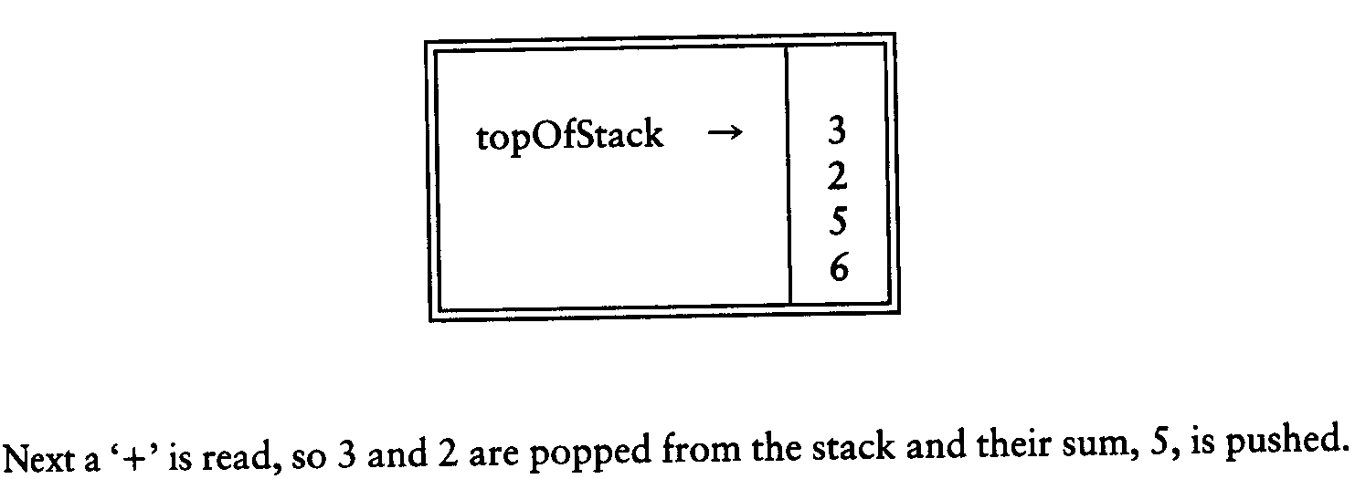
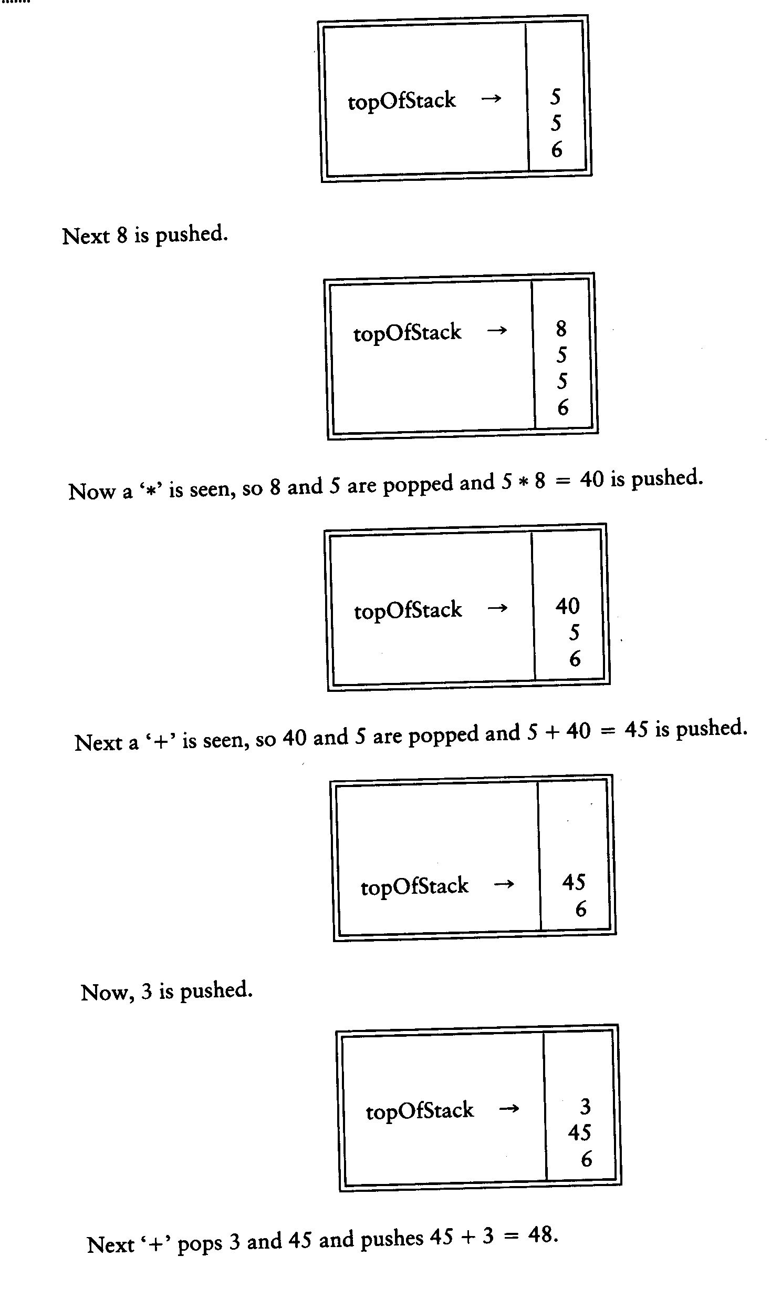
Postfix Expressions: Evaluate 6 5 2 3 + 8 * + 3 + *

Slide 33
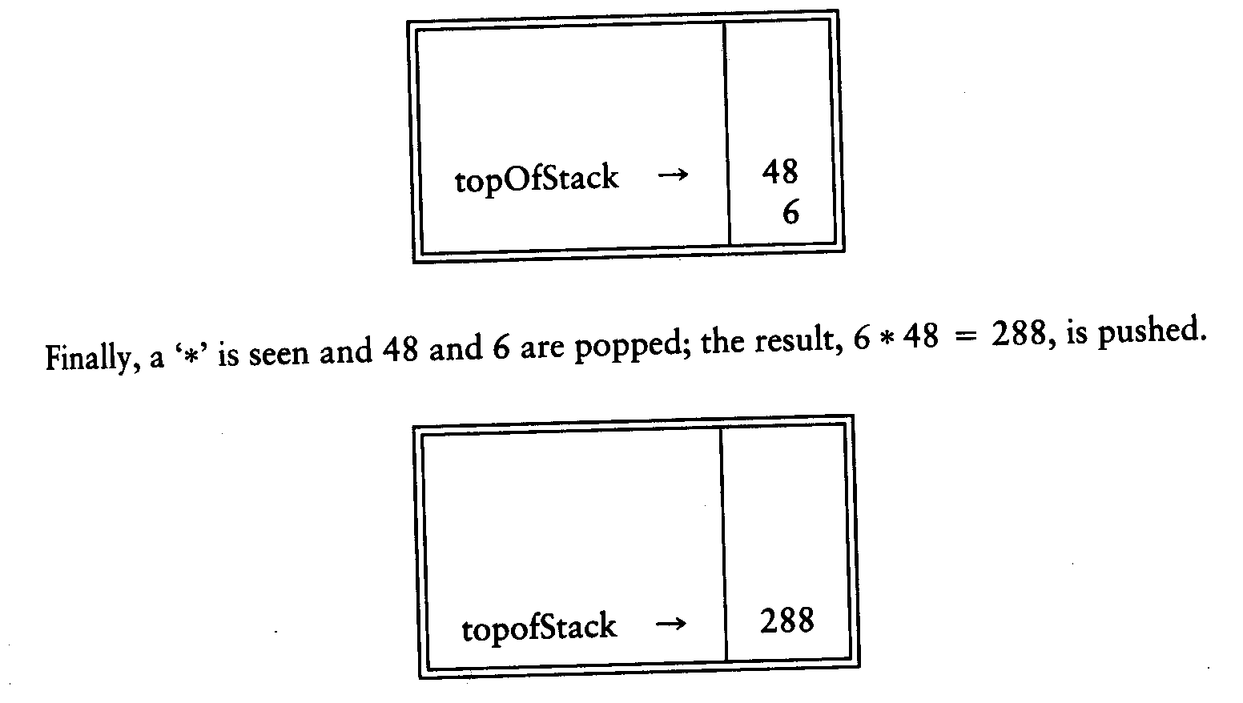
  Postfix Expressions: Evaluate 6 5 2 3 + 8 * + 3 + *

Slide 34
Symbol Matching
Braces, paranthenses, brackets, begin, ends must match each other
[ { [ ( )] } ]
[{]}()
Easy check using stacks

Slide 35
Symbol Matching
Start from beginning of the file.
Push the beginning symbols you wish to match, ignore the rest.
  Push brace, parantheses, brackets, ignore the alphabets
Whenever you encounter a right symbol, pop an element from the stack. If stack is empty, then error.
Otherwise, if the popped element is the corresponding left symbol, then fine, else there is an error.
O(n)
What is the complexity of the operation?

Slide 36
EXAMPLE
Check brace, bracket parentheses matching [a+b{1*2]9*1}+(2-1)
Push [, Push {, Pop, Pop, Push (, Pop
{
[
[
Push {
Push [
Oops! Something wrong, was expecting [
Get {
[
Pop Expect?

Slide 37
EXAMPLE
Check brace, bracket parentheses matching [a+b{1*2}9*1]+(2-1)
Push [, Push {, Pop , Pop, Push (, Pop
Get {
{
[
[
[
Push {
Pop
Expect {
Push [
Perfect!
Get (
Get [
(
Pop Expect [
Push (
Pop Expect (

Slide 38
Symbol Priority
A*B + C
A*(B + C)
A+B+C*D
A*D+B+C*E
To do the correct operation, calculator needs to know the priority of operands
We don’t need any priority nor parantheses if the operation is expressed in postfix or reverse polish notion.

Slide 39
Postfix
A*B + C = AB*C+
A*(B + C)
= (B + C)*A
= BC+A*
A+B+C*D
= AB+CD*+
A*D+B+C*E
= AD*B+CE*+
Suppose the expression is in postfix, how do we compute the value?

Slide 40
Computatation of a Postfix Expression
Whenever you see a number push it in the stack.
Whenever you see an operator,
  pop 2 numbers,
  apply the operator,
  Push the result
At end Pop to get answer
Time Complexity?
O(n)

Slide 41
EXAMPLE
Compute 5*4+6+7*2 Result: 40
Postfix: 5 4*6+7 2*+
Get 4
4
5
5
5
Push 4
Pop
Push 5
Get 5
6
20
20
Pop
Push 20
Push 6

Slide 42
Get 6
Get 20
20
26
Pop
Pop
Push 26
Get 2
2
7
7
7
26
26
26
Push 7
Push 2
Pop
Get 7
Get 14
14
26
26
26
Pop
Push 14
Pop

Slide 43
Get 26
40
Pop
Push 40
Pop to get answer as 40

Slide 44

Take Care Everyone!
Thank you.

