Slide 1


Data Structures Using C++ 2E
Chapter 8
Queues

Slide 2
Objectives
Learn about queues
Examine various queue operations
Learn how to implement a queue as an array
Learn how to implement a queue as a linked list
Discover queue applications
Become aware of the STL class queue
Data Structures Using C++ 2E

Slide 3
Introduction
Queue data structure
  Elements added at one end (rear), deleted from other end (front)
  First In First Out (FIFO)
  Middle elements inaccessible
Data Structures Using C++ 2E

Slide 4
Queue Operations
Two key operations
  add OR enQuque
  remove OR deQueue
Additional operations
  initialize, isEmpty, isFull, front, back
Two pointers queueFront, queueRear pointers
  Keep track of front and rear
Data Structures Using C++ 2E

Slide 5
Implementation of Queues as Arrays
Four member variables
  Array to store queue elements
  Variables queueFront, queueRear
  Variable maxQueueSize
Using queueFront, queueRear to access queue elements
  queueFront: first queue element index
  queueRear: last queue element index
    queueFront changes after each remove operation
    queueRear changes after each add operation
Data Structures Using C++ 2E

Slide 6
Implementation of Queues as Arrays
(cont’d.)
Execute operation
  q.add('A');
Execute
  q.add('B');
  q.add('C');
Execute
  q.remove();
Data Structures Using C++ 2E

Slide 7
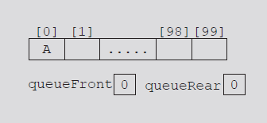
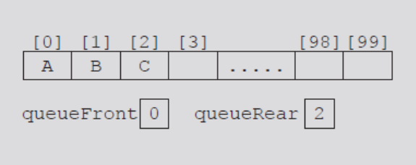
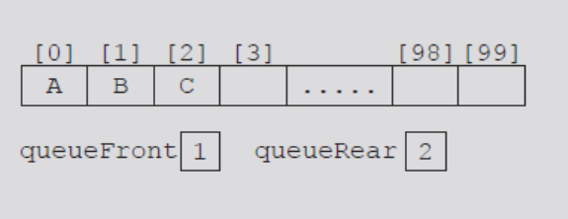
FIGURE 8-1 Queue after the first add operation
FIGURE 8-2 Queue after two more add operations
FIGURE 8-3 Queue after the remove operation
Data Structures Using C++ 2E

Slide 8
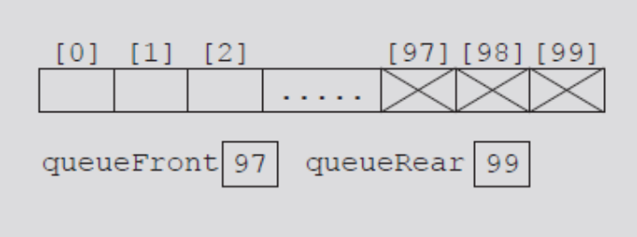
Implementation of Queues as Arrays
(cont’d.)
Consider the sequence of operations: AAADADADADADADADA...
  Eventually index queueRear points to last array position
    Looks like a full queue
    Reality: queue has two or three elements, array empty in the front
FIGURE 8-4 Queue after the sequence
of operations AAADADADADADA...
Data Structures Using C++ 2E

Slide 9
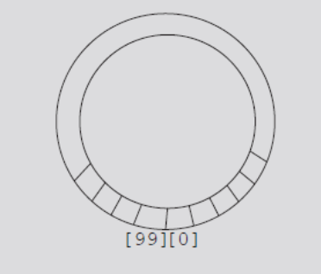
Implementation of Queues as Arrays
(cont’d.)
First solution
  Upon queue overflow to the rear
    Check value of queueFront
    If room available in front: slide all queue elements toward first array position
  Works if queue size very small
Second solution: assume circular array
FIGURE 8-5 Circular queue
Data Structures Using C++ 2E

Slide 10
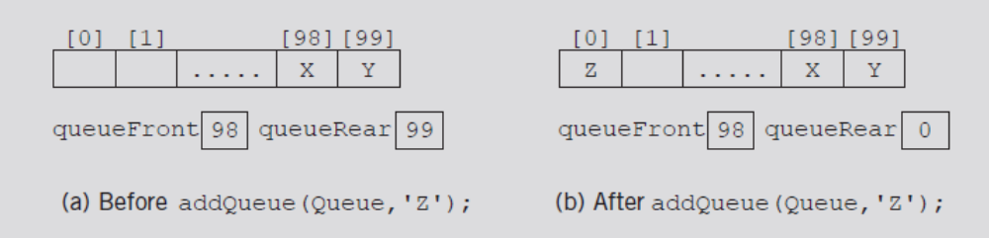
Implementation of Queues as Arrays
(cont’d.)
queueRear = (queueRear + 1) % maxQueueSize;
  Advances queueRear (queueFront) to next array position
FIGURE 8-6 Queue before and after the add operation
Data Structures Using C++ 2E

Slide 11
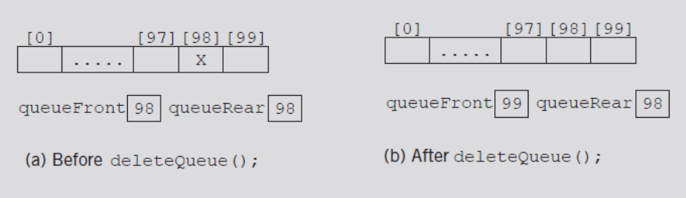
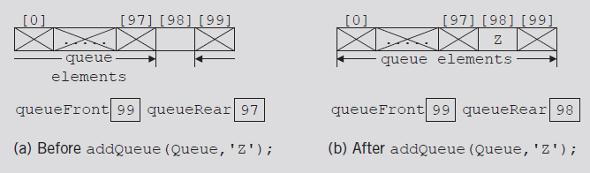
Implementation of Queues as Arrays
(cont’d.)
Two cases with identical queueFront, queueRear values
  Figure 8-7(b) represents an empty queue
  Figure 8-8(b) represents a full queue
FIGURE 8-7 Queue before and after the delete operation
FIGURE 8-8 Queue before and after the add operation
Data Structures Using C++ 2E

Slide 12
Implementation of Queues as Arrays
(cont’d.)
First solution: use variable count
  Incremented when new element added
  Decremented when element removed
  Functions initialize, clearQueue initialize count to zero
Data Structures Using C++ 2E

Slide 13
Implementation of Queues as Arrays
(cont’d.)
Second solution
  queueFront indicates index of array position preceding first element of the queue
  Assume queueRear indicates index of last element
    Empty queue if queueFront == queueRear
  Slot indicated by index queueFront is reserved
  Queue is full
    If next available space represents special reserved slot
Data Structures Using C++ 2E

Slide 14
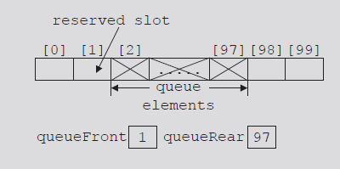
Implementation of Queues as Arrays
(cont’d.)
FIGURE 8-9 Array to store the queue
elements with a reserved slot
See code on pages 459-460
  Uses first solution
Data Structures Using C++ 2E

Slide 15
Empty Queue and Full Queue
Empty queue
  If count == 0
Full queue
  If count == maxQueueSize
//Checks whether the queue is empty or not
template <class T>
bool Queue<T>::isEmpty()
{
return count==0;
}
//Checks whether the queue is full or not
template <class T>
bool Queue<T>::isFull()
{
return count==maxQueueSize;
}
Data Structures Using C++ 2E

Slide 16
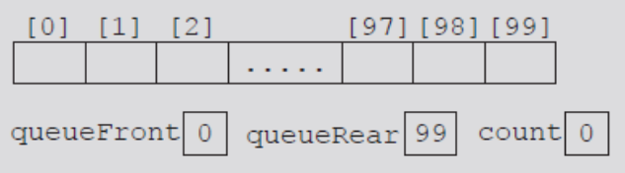
Initialize Queue
Initializes queue to empty state
  First element added at the first array position
  Initialize queueFront to zero, queueRear to maxQueueSize - 1, count to zero
  We use constructor for initialization purpose
FIGURE 8-10 Empty queue
template <class T>
Queue<T>::Queue(int size)
{
maxQueueSize = size; //set max to be the size entered by the user, or 100 by default
data = new T[maxQueueSize]; //Create an array of T values of size max
count = 0;
queueFront = 0;
queueRear = maxQueueSize-1;
}
Data Structures Using C++ 2E

Slide 17
Front
Returns first queue element
  If the queue nonempty
    Element indicated by index queueFront returned
  Otherwise
    Program terminates
template <class T>
T Queue<T>::front() const
{
assert(!isEmpty());
return data[queueFront];
}
Data Structures Using C++ 2E

Slide 18
Back
Returns last queue element
  If queue nonempty
    Returns element indicated by index queueRear
  Otherwise
    Program terminates
template <class T>
T Queue<T>::rear()
{
assert(!isEmpty());
return data[queueRear];
}
Data Structures Using C++ 2E

Slide 19
Add Queue
template <class T>
void Queue<T>::add(T& item)
{
if(!isFull())
{
queueRear = ( queueRear + 1 ) % maxQueueSize;
data[queueRear] = item;
count++;
}
else
cerr<<"No space left in queue!"<<endl;
}
New element is added at the rear.
Data Structures Using C++ 2E

Slide 20
Delete Queue
template <class T>
T Queue<T>::remove()
{
assert(!isEmpty());
T temp;
temp = data[queueFront];
queueFront = ( queueFront + 1 ) % maxQueueSize;
count--;
return temp;
}
Front element is removed from the queue and its data value is returned to calling statement.
Data Structures Using C++ 2E

Slide 21
Constructors and Destructors
template <class T>
Queue<T>::Queue(int size)
{
maxQueueSize = size; //set max to be the size entered by the user
// or 100 by default
data = new T[maxQueueSize]; //Create an array of T values of size max
count = 0;
queueFront = 0;
queueRear = maxQueueSize-1;
}
Data Structures Using C++ 2E

Slide 22
Constructors and Destructors (cont’d.)
Array storing queue elements
  Created dynamically
  When queue object goes out of scope
    Destructor deallocates memory occupied by the array storing queue elements
template <typename T>
Queue<T>::~Queue()
{
delete [] data;
}
Data Structures Using C++ 2E

Slide 23
Linked Implementation of Queues
Array implementation issues
  Fixed array size
    Finite number of queue elements
  Requires special array treatment with the values of the indices queueFront, queueRear
Linked implementation of a queue
  Simplifies special cases of the array implementation
  Queue never become full as far as the computer has memory space
Data Structures Using C++ 2E

Slide 24
Empty and Full Queue
Empty queue if queueFront is NULL
Memory allocated dynamically
  Queue never full
  Function implementing isFull operation returns the value false
template <typename T>
bool Queue<T>::isEmpty() const{
return queueFront == NULL;
}
template <typename T>
bool Queue<T>::isFull() const{
return false;
}
Data Structures Using C++ 2E

Slide 25
Initialize Queue
Initializes queue to an empty state
  We do it by constructor
template <typename T>
Queue<T>::Queue() {
queueFront = queueRear = NULL;
count = 0;
}
Data Structures Using C++ 2E

Slide 26
add, front, rear, and remove Operations
add operation adds a new element at end of the queue
  Access the pointer queueRear
template <typename T>
void Queue<T>::add(const T &val){
Node<T> *newNode = new Node<T>;
newNode->data = val;
newNode->next = NULL;
if (queueFront == NULL){ // queue is empty
queueFront = queueRear = newNode;
}
else{ // queue is not empty, add to rear
queueRear->next = newNode;
queueRear = queueRear->next;
}
count++;
}
Data Structures Using C++ 2E

Slide 27
add, front, rear, and remove Operations (cont’d.)
If queue nonempty
  Operation front returns first element
  Element indicated queueFront returned
If queue empty: front terminates the program
template <typename T>
T Queue<T>::front() const{
assert(!isEmpty());
return queueFront->data;
}
Data Structures Using C++ 2E

Slide 28
add, front, rear, and remove Operations (cont’d.)
If queue nonempty
  Operation rear returns last element
  Element indicated by queueRear returned
If queue empty: rear terminates the program
template <typename T>
T Queue<T>::rear() const{
assert(!isEmpty());
return queueRear->data;
}
Data Structures Using C++ 2E

Slide 29
add, front, rear, and remove Operations (cont’d.)
If queue nonempty
  Operation remove removes first element
    Access pointer queueFront
template <typename T>
T Queue<T>::remove(){
assert(!isEmpty());
T temp = queueFront->data;
Node<T> *p = queueFront;
queueFront = queueFront->next;
delete p;
count--;
return temp;
}
Data Structures Using C++ 2E

Slide 30
add, front, rear, and remove Operations (cont’d.)
Default constructor
  When queue object goes out of scope
    Destructor destroys the queue
    Deallocates memory occupied by the queue elements
  Function definition similar to function initializeQueue
Data Structures Using C++ 2E

Slide 31
Queue Derived from the class unorderedLinkedListType
Linked queue implementation
  Similar to forward manner linked list implementation
  Similar operations
    add Queue, insertFirst
    initializeQueue , initializeList
    isEmptyQueue, isEmptyList
  deleteQueue operation implemented as before
  Same pointers
    queueFront and first, queueRear and last
Data Structures Using C++ 2E

Slide 32
Queue Derived from the class unorderedLinkedListType (cont’d.)
Linked queue implementation (cont’d.)
  Can derive the class to implement the queue from the class linkedListType
  class linkedListType
    An abstract
    Does not implement all operations
  class unorderedLinkedListType
    Derived from class linkedListType
    Provides definitions of the abstract functions of the class linkedListType
Data Structures Using C++ 2E

Slide 33
STL class queue (Queue Container Adapter)
Standard Template Library (STL)
  Provides a class to implement queues in a program
  Queue
    Name of class defining the queue
    Name of header defining class queue
Data Structures Using C++ 2E

Slide 34
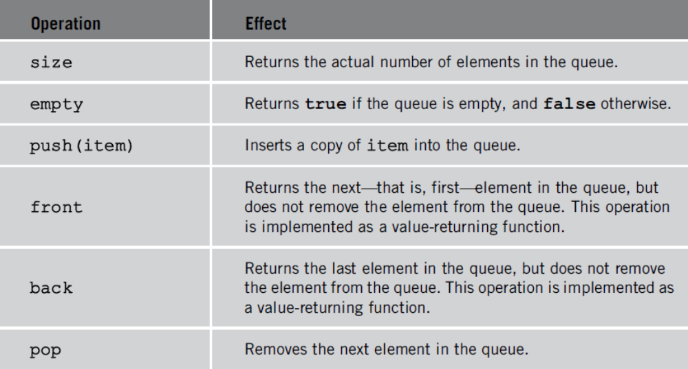
STL class queue (cont’d.)
Queue container class
  Provides relational operators comparing two queues
See Example 8-2
TABLE 8-1 Operations on a queue object
Data Structures Using C++ 2E

Slide 35
Priority Queues
Queue structure ensures items processed in the order received
Priority queues
  Customers (jobs) with higher priority pushed to the front of the queue
Implementation
  Ordinary linked list
    Keeps items in order from the highest to lowest priority
  Treelike structure
    Very effective
    Chapter 10
Data Structures Using C++ 2E

Slide 36
STL class priority_queue
class template priority_queue<elemType>
  Queue element data type specified by elemType
  Contained in the STL header file queue
Specifying element priority
  Default priority criteria for the queue elements
    Less-than operator (<)
  Overloading the less-than operator (<)
    Compare the elements
  Defining a comparison function to specify the priority
Data Structures Using C++ 2E

Slide 37
Application of Queues: Simulation
Simulation
  Technique in which one system models the behavior of another system
Computer simulation
  Represents objects being studied as data
  Actions implemented with algorithms
    Programming language implements algorithms with functions
    Functions implement object actions
Data Structures Using C++ 2E

Slide 38
Application of Queues: Simulation (cont’d.)
Computer simulation (cont’d.)
  C++ combines data, data operations into a single unit using classes
    Objects represented as classes
    Class member variables describe object properties
    Function members describe actions on data
  Change in simulation results occurs if change in data value or modification of function definitions occurs
  Main goal
    Generate results showing the performance of an existing system
    Predict performance of a proposed system
Data Structures Using C++ 2E

Slide 39
Application of Queues: Simulation (cont’d.)
Queuing systems
  Computer simulations
    Queues represent the basic data structure
  Queues of objects
    Waiting to be served by various servers
  Consist of servers and queues of objects waiting to be served
Data Structures Using C++ 2E

Slide 40
Designing a Queuing System
Server
  Object that provides the service
Customer
  Object receiving the service
Transaction time (service time)
  Time required to serve a customer
Queuing system consists of servers, queue of waiting objects
  Model system consisting of a list of servers; waiting queue holding the customers to be served
Data Structures Using C++ 2E

Slide 41
Designing a Queuing System (cont’d.)
Modeling a queuing system: requirements
  Number of servers, expected customer arrival time, time between customer arrivals, number of events affecting system
Time-driven simulation
  Clock implemented as a counter
  Passage of time
    Implemented by incrementing counter by one
Run simulation for fixed amount of time
  Example: run for 100 minutes
    Counter starts at one and goes up to 100 using a loop
Data Structures Using C++ 2E

Slide 42
Customer
Has a customer number, arrival time, waiting time, transaction time, departure time
  With known arrival time, waiting time, transaction time
    Can determine departure time (add these three times)
See class customerType code on pages 475-476
  Implements customer as an ADT
Member function definitions
  Functions setWaitingTime, getArrivalTime, getTransactionTime, getCustomerNumber
    Left as exercises
Data Structures Using C++ 2E

Slide 43
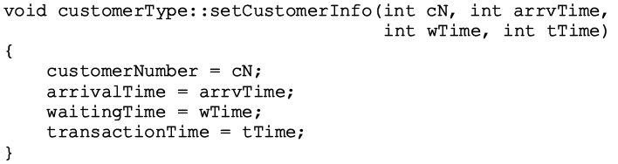
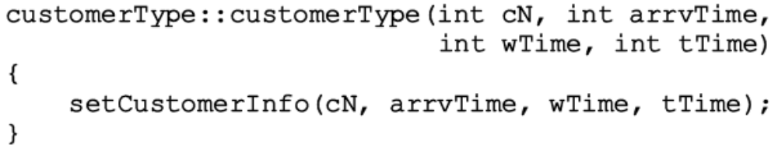
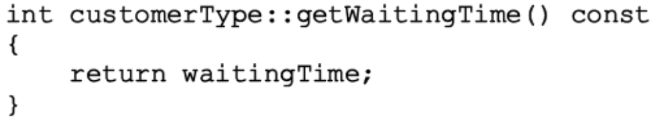
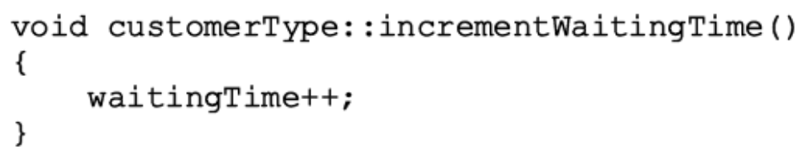
Data Structures Using C++ 2E

Slide 44
Server
At any given time unit
  Server either busy serving a customer or free
String variable sets server status
Every server has a timer
Program might need to know which customer served by which server
  Server stores information of the customer being served
Three member variables associated with a server
  status, transactionTime, currentCustomer
Data Structures Using C++ 2E

Slide 45
Server (cont’d.)
Basic operations performed on a server
  Check if server free
  Set server as free
  Set server as busy
  Set transaction time
  Return remaining transaction time
  If server busy after each time unit
    Decrement transaction time by one time unit
See class serverType code on page 477
  Implements server as an ADT
Member function definitions
Data Structures Using C++ 2E

Slide 46
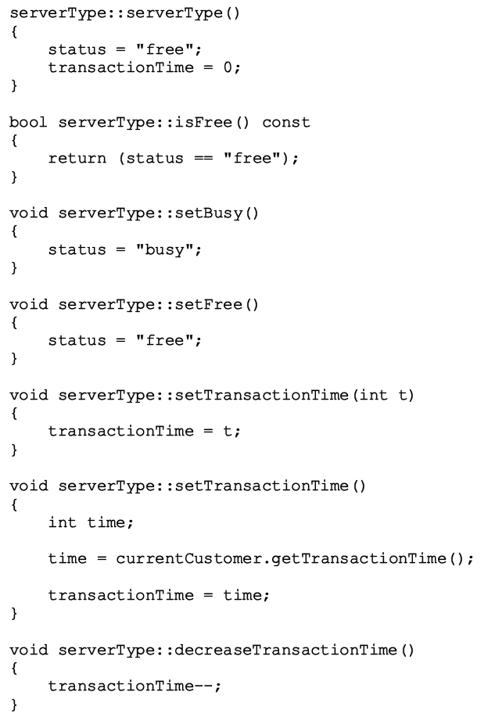
Data Structures Using C++ 2E

Slide 47
Server List
Set of servers
class serverListType
  Two member variables
    Store number of servers
    Maintain a list of servers
  List of servers created during program execution
  Several operations must be performed on a server list
  See class serverListType code on page 481
    Implements the list of servers as an ADT
  Definitions of member functions
Data Structures Using C++ 2E

Slide 48
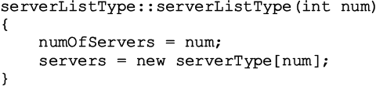
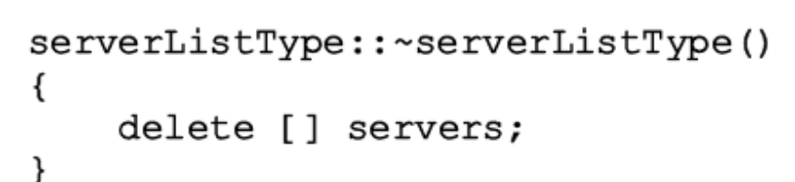
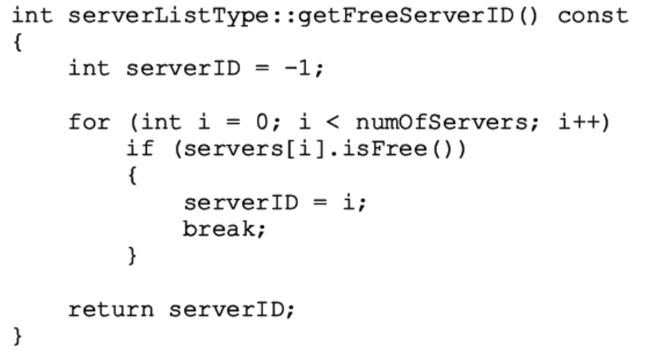
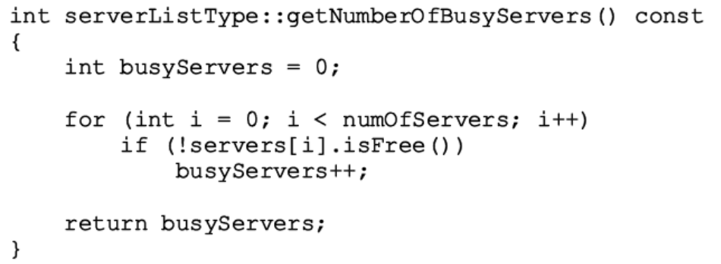
Data Structures Using C++ 2E

Slide 49
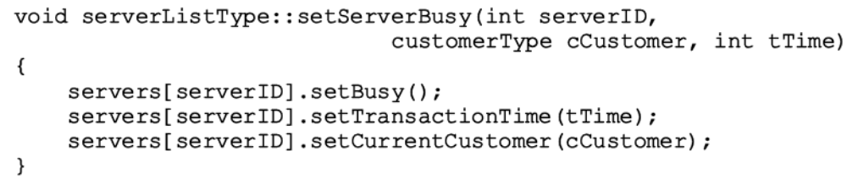
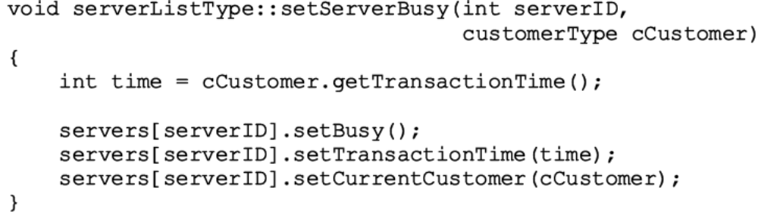
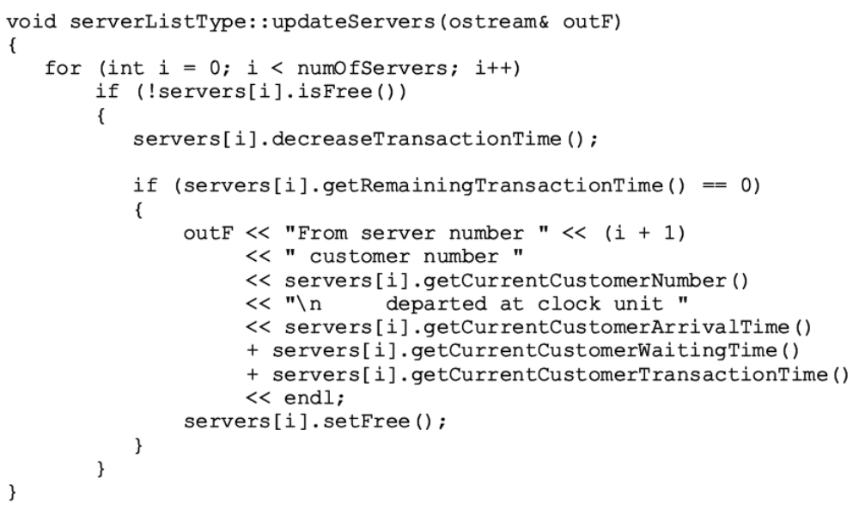
Data Structures Using C++ 2E

Slide 50
Waiting Customers Queue
Upon arrival, customer goes to end of queue
  When server available
    Customer at front of queue leaves to conduct transaction
  After each time unit, waiting time incremented by one
Derive class waitingCustomerQueueType from class queueType
  Add additional operations to implement the customer queue
  See code on page 485
Data Structures Using C++ 2E

Slide 51
Main Program
Run the simulation
  Need information (simulation parameters)
    Number of time units the simulation should run
    The number of servers
    Transaction time
    Approximate time between customer arrivals
  Function setSimulationParameters
    Prompts user for these values
    See code on page 487
Data Structures Using C++ 2E

Slide 52
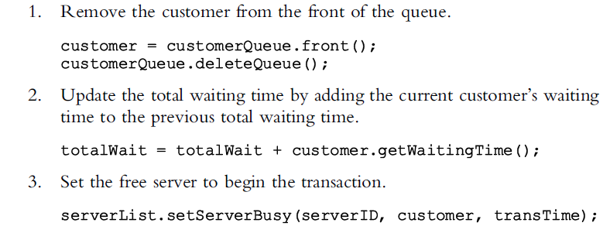
Main Program (cont’d.)
General algorithm to start the transaction
Data Structures Using C++ 2E

Slide 53
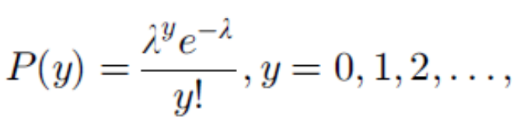
Main Program (cont’d.)
Use the Poisson distribution from statistics
  Probability of y events occurring at a given time
    Where λ is the expected value that y events occur at that time
Function runSimulation implements the simulation
  Function main is simple and straightforward
    Calls only the function runSimulation
Data Structures Using C++ 2E

Slide 54
Summary
Queue
  First In First Out (FIFO) data structure
  Implemented as array or linked list
  Linked lists: queue never full
Standard Template Library (STL)
  Provides a class to implement a queue in a program
Priority Queue
  Customers with higher priority pushed to the front
Simulation
  Common application for queues
Data Structures Using C++ 2E

