Slide 1


Bank Loan Classification Predictor

Slide 2
Data Cleansing
-The overall .csv file has 5000 rows, but no outlier problems (NaN-s, etc…)
-Removed the ID column, as a pandas DataFrame has one built in.

Slide 3
Models
-3 Random Forests, one default, one with 200 estimators and „log2” max features, and another with 100 estimators and „sqrt” max features, both with 10 max depth.
-3 Logistic Regressions, 1 default w/ 400 iterations, another with a penalty of L1, C of 0.3 and 200 iterations, and another with a penalty of L2, C of 0.1, 200 iterations.

Slide 4
GridSearch CV
-I am also using GridSearchCV for both models, to find a fourth optimal type of them, based on accuracy.

Slide 5


Confusion Matrixes

Slide 6
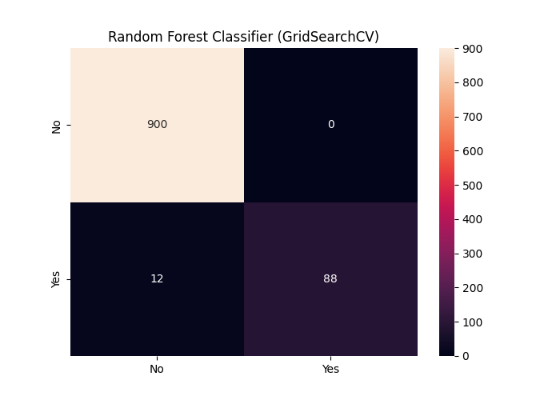

Slide 7
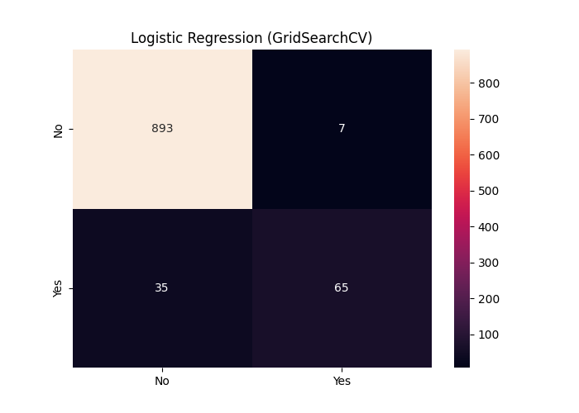

Slide 8
