Slide 1
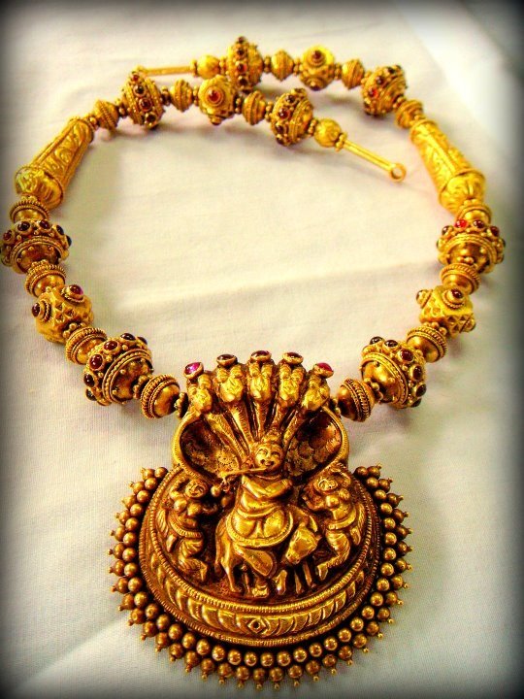
Kalyan Jewellers
TEAM05
Babita
Inderpreet Kaur

Slide 2
Project First Stage: Planning
Project title
Kalyan Jewellers
The team
Team05Nov16(Babita & Inderpreet Kaur)
Goals or Objectives
To develop a responsive website for The Jewellery Store to make it more attractive for the users.
Notes:
• State the project title and objectives of the project
A description of the proposed system in terms of a set of integrated ideas and concepts about what it should do, behave and look like, that will understandable by the users in the manner intended.
• Explain why this project idea is selected
• State what the importance/novelty of this project is

Slide 3
Project First Stage: Planning (cont)
Target Users
Primary users
Females
Youngsters who are planning to get married
Secondary users
Website visitors
User characteristics
Age and gender: 18+ females
Computer and web experience: Novice to expert
Notes:
Discuss the characteristics of the target users
Age: Users are likely to be under 25 …
Education
Gender
Computer experience, online shopping experience
…

Slide 4
Project First Stage: Planning (cont)
Features
Kalyan jewellers offers a wide range of jewellery to the users.
In collections, we have exquisite as well as contemporary jewellery designs that suit with women from all walks of life.
Our website exclusively provides visitors to book an appointment that is just a click away.
We also have search options for convenient browsing.
Store locator makes easier to the users to locate the nearest store.
We allow our users to sign up for the free membership and enjoy the discounted jewellery.

Slide 5
Project First Stage: Planning (cont)
Features
Features to enhance user experience
Home, menu, Jewellery icon, jewellery logo
Jewellery, Collection, latest designs, Festive offers, Store locator, Book an appointment.
We are using different jewellery designs

Slide 6
Project First Stage: Planning (cont)
Technologies
Front end : Dreamweaver, HTML, CSS, Javascript
Back end : PHP, MySQL
Main functions of website.
The home page will include the logo, contacts ,collections and other features.
A site diagram (or blueprint)
http://webstyleguide.com/wsg3/index.html).

Slide 7
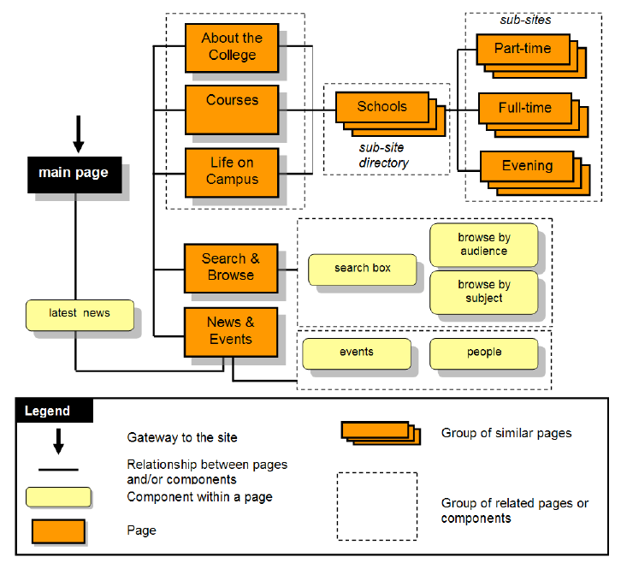
Project First Stage: Planning (cont)
Site diagram (Blueprint)

Slide 8
Project First Stage: Planning (cont)
Technologies
A series of sketched pages (home page and a few subsequent pages). They can even be an abstract visual representation of your site. To be sure that:
Users can easily find what they need (well-structured, meaningful and consistent links)
Users can move around the system easily
Provide feedback that tell users where they are
There is a consistent look throughout the system
Data requirements
For example, user info, product info, order info etc.
ER or class diagram

Slide 9

Project First Stage: Planning (cont)
Abstract visual representation of your site
https://helpx.adobe.com/dreamweaver/how-to/stages-web-design.html?set=dreamweaver--get-started--essential-beginners

Slide 10
Project First Stage: Planning (cont)
Responsibilities
Identify the strengths and weaknesses of each member
State and justify who in charge of what
Schedule
Identify the major milestones of the project
Indicate when each milestone should be achieved

