Slide 1
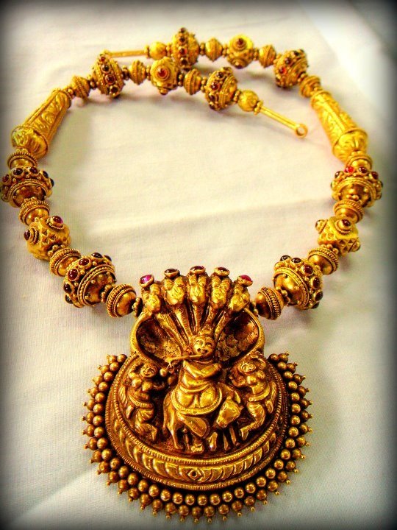
Kalyan Jewellers
TEAM05
Babita
Inderpreet Kaur

Slide 2
Project First Stage: Planning
Project title
Kalyan Jewellers
The team
Team05Nov16(Babita & Inderpreet Kaur)
Goals or Objectives
The mission
To develop a responsive website for The Jewellery Store to make it more attractive for the users.
Notes:
• State the project title and objectives of the project
A description of the proposed system in terms of a set of integrated ideas and concepts about what it should do, behave and look like, that will understandable by the users in the manner intended.
• Explain why this project idea is selected
• State what the importance/novelty of this project is

Slide 3
Project First Stage: Planning (cont)
Target Users
Primary users
Females
Secondary users
Youngsters who are planning to get married
Website visitors
Notes:
Discuss the characteristics of the target users
Age: Users are likely to be under 25 …
Education
Gender
Computer experience, online shopping experience
…

Slide 4
Project First Stage: Planning (cont)
Features
Kalyan jewellers offers a wide range of jewellery to the users.
In collections, we have exquisite as well as contemporary jewellery designs that suit with women from all walks of life.
Our website exclusively provides visitors to book an appointment that is just a click away.
We also have search options for convenient browsing.

Slide 5
Project First Stage: Planning (cont)
Features
Features to enhance user experience
Home, menu, Jewellery icon, jewellery logo
Jewellery, Collection, latest designs, Festive offers, Store locator, We are using different jewellery designs
We allow our users to sign up for the free membership and enjoy the discounted jewellery.
Store locator makes easier to the users to locate the nearest store.
It will introduce various brands under kalyan jewellers like antara, tejasvi etc.

Slide 6
Project First Stage: Planning (cont)
Technologies
Front end : Dreamweaver, HTML, CSS, Javascript
Back end : PHP
The home page will include the logo, contacts ,collections and other features.
A site diagram (or blueprint)

Slide 7
Gold
Collection
Silver
News & Events
Diamond
Offers
Home
About Us
Careers
Gifts

Slide 8
Project First Stage: Planning (cont)
Responsibilities
Home page & About us page with Data collection and Designing, Offers: Inderpreet
Menu page, contact us , Deals and Documentation :Babita
Schedule
Week 6: Blue print & Website Visual Design layout.
Week 7:Designing of all the following pages and assembling their database .
Week 8:Linking the Home, Menu and Offers page to the following subset web pages.
Week 10: Final Website.

