Slide 1
IBM University Engagement Project Submission

Slide 2

Project Title – [Power System Fault Detection and Classification]
Domain of the project- Electrical Engineering
Student Name | Recent Passport Photo | Email ID | Mobile number [WhatsApp]
Babita Patel |  | babita1234qwer@gmail.com | Other mobile no-7307882459 Watsappnumber-9044176557

Slide 3
Problem Statement -
Problem Statement : Power System Fault Detection and Classification
The Challenge
Design a machine learning model to detect and classify different types of faults in a power distribution system. Using electrical measurement data (e.g., voltage and current phasors), the model should be able to distinguish between normal operating conditions and various fault conditions (such as line-to-ground, line-to-line, or three-phase faults).
The Objective
. Detect faults in power distribution systems using machine learning techniques.
Classify fault types based on voltage and current measurements.
Distinguish normal and faulty operating conditions accurately.
Reduce fault detection time and improve grid reliability.
Assist in maintaining power system stability through automated fault identification.

Slide 4
Technology Used
1.IBM watsonx.ai Lite
2. Algorithms-Random forest,Logistic regression
3. IBM Cloud
4.Power Distribution Fault Dataset

Slide 5
Proposed Solution -
The proposed solution is an AI-based fault detection and classification system developed using IBM watsonx.ai. The system analyzes electrical measurement data such as voltage and current values from a power distribution network to identify abnormal operating conditions.
The AI model is trained to distinguish between normal operating conditions and different types of faults.
When measurement data is provided to the model, it predicts the fault category and helps operators quickly identify the nature of the disturbance. This enables faster fault diagnosis, reduces system downtime, and improves the reliability of the power distribution network.
IBM watsonx.ai is used for model development, training, and prediction. The system can be integrated with a monitoring dashboard to display fault classifications and system status in real time.
Overall, the solution provides an intelligent and automated approach for fault detection and classification in power distribution systems.

Slide 6
Component used
Input Dataset – Contains electrical measurement data such as voltage, current, temperature, power load, and fault location information.
IBM watsonx.ai AutoAI – Automatically analyzes the dataset, performs data preprocessing, selects suitable algorithms, and builds the prediction model.
Machine Learning Model – Trained using the uploaded historical data to identify patterns associated with different fault conditions.
Prediction System – Classifies system conditions and predicts the type of fault based on new input data.
Output Results – Displays the predicted fault category and model confidence scores.
Model Evaluation Component – Measures model performance using metrics such as accuracy.

Slide 7
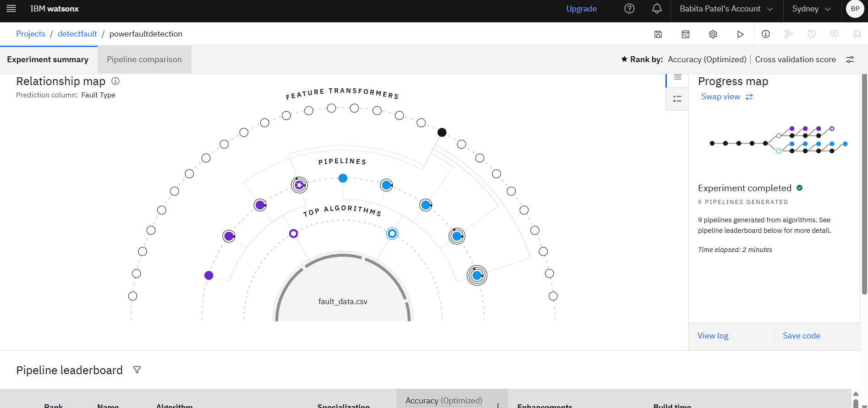
Screenshot

Slide 8
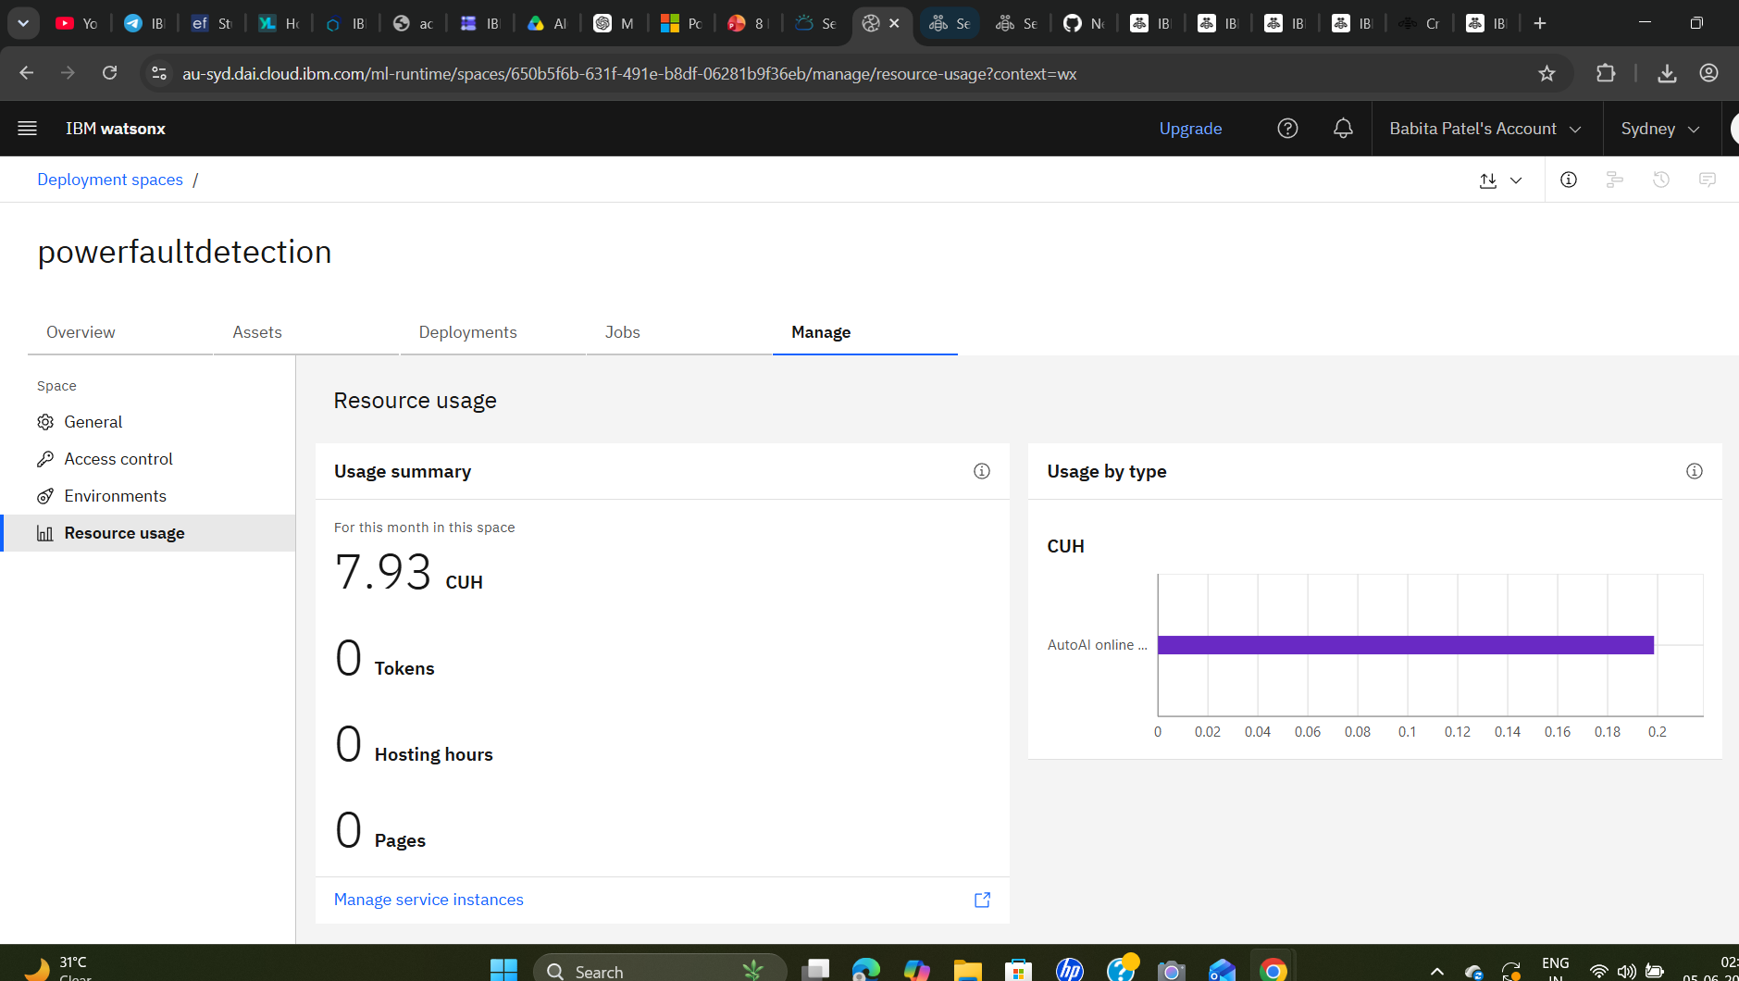
Screenshot

Slide 9
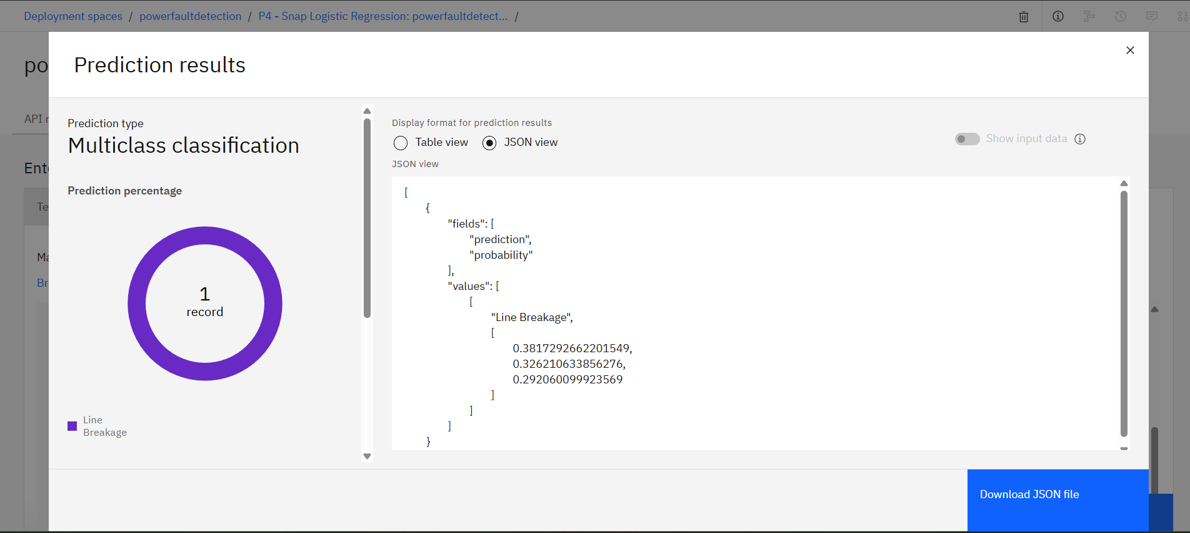
Screenshot

Slide 10
Watsonx.ai workflow
│ Data Sources │
│ CSV, DB, API │
└──────┬───────┘
│
▼
┌──────────────────┐
│ Data Preparation │-
│ Clean & Transform│
└──────┬───────────┘
┌──────────────────┐ │ Model Building │ │ AutoML/Notebook │ └──────┬───────────┘ │ ▼ ┌──────────────────┐ │ Model Evaluation │ │ Accuracy & XAI │ └──────┬───────────┘
┌──────────────────┐ │ Deployment │ │ API Endpoint │ └──────┬───────────┘ │ ▼ ┌──────────────────┐ │ Monitoring │ │ Drift & Metrics │ └──────────────────┘

Slide 11
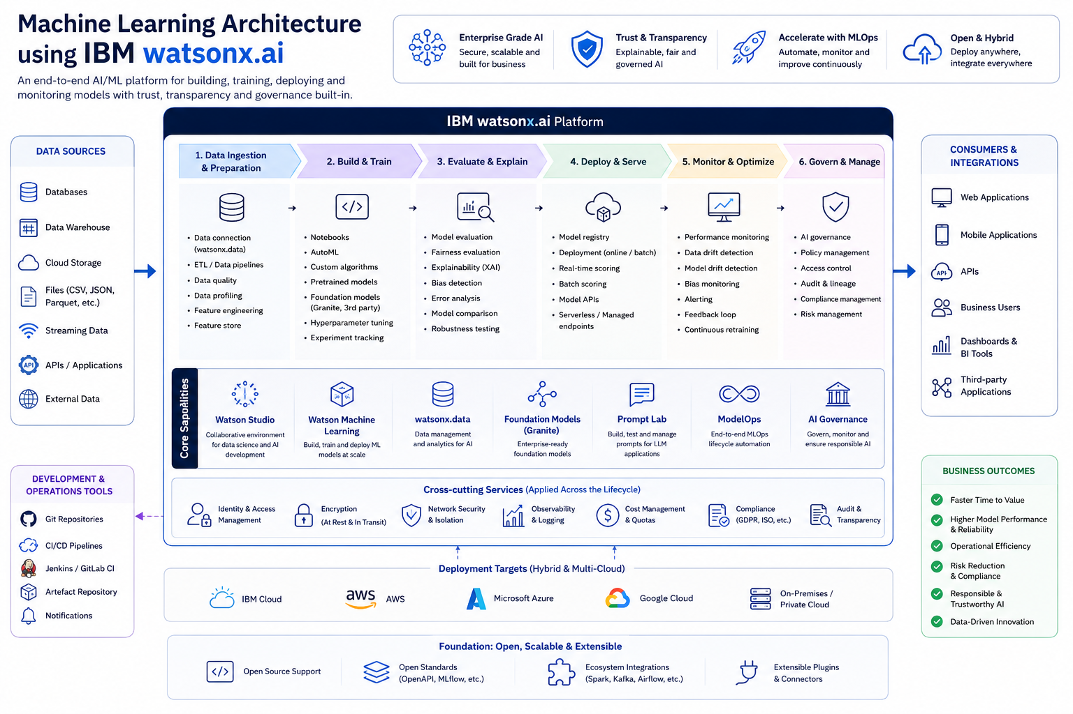
Architecture blueprint

Slide 12
Novelty and Uniqueness
• Uses AI-driven fault classification instead of traditional rule-based fault detection methods.
• Automatically distinguishes between multiple fault types using electrical measurement data.
• Reduces fault identification time, enabling faster response and minimizing power outages.
• Built using IBM watsonx.ai AutoAI, allowing automated model selection, training, and optimization.
• Provides a scalable solution that can be adapted to different power distribution networks.
• Supports data-driven decision-making for improving grid reliability and operational efficiency.
• Can be extended for real-time smart grid monitoring and predictive maintenance applications.

Slide 13
Git Hub Link
Please test and Paste the working Github URL –https://github.com/babita1234qwer/power-fault-detection.git
·
·
·

Slide 14
Future Scope
• Integrate the model with real-time smart grid monitoring systems for instant fault detection.
• Improve prediction accuracy by training the model on larger and more diverse power system datasets.
• Extend the system to identify fault locations in addition to fault types.
• Develop a real-time dashboard for visualization, monitoring, and alert generation.
• Integrate IoT sensors and PMUs (Phasor Measurement Units) for continuous data collection.
• Deploy the model on cloud platforms to enable scalable and remote monitoring.
• Incorporate predictive maintenance capabilities to detect potential failures before faults occur.
·
·
·

Slide 15


