Slide 1




BITCOIN PRICE PREDICTION USING MACHINE LEARNING
Group No: 29
Guide – Prof. Nilkamal More
Co-Guide – Prof. Ruchira Jadhav
Babita Ratudi - 1813090
Mohammed Mudassir Khatri -1814032
Onkar Sanap – 1814035
Yashvi Vora – 1814121

Slide 2

PROBLEM DEFINITION
Cryptocurrencies such as Bitcoin, Ethereum, etc. generated significant attention in 2017. Cryptocurrencies have significant volatility as there is rampant speculation. Given the high variance in prices, can data science methods be used to model the market dynamics? There are many directions this project could take.
Trading Strategy Can an effective trading strategy be found? We are looking for a demonstration of sound data science principles here.
Market Analysis Given there is now option trading on certain cryptocurrencies, is it possible to create a volatility index for cryptocurrencies such as VIX? Is variance of this market infinite and therefore not predictable? Are there any rational reasons for investing that you can justify using data science?
Arbitrage Given the number of different currencies and different markets, how efficient is the market? Are there arbitrage opportunities? Can evidence be found of arbitrage?

Slide 3


Functional and Non- Functional Requirements
Functional Requirements
Getting Bitcoin price data (model building phase)
preparing data for training and testing (model building phase)
the price of Bitcoin using LSTM neural network. (model building phase)
Every input a user enters during signup/login should be validated using javascript/backend.
Email will be used to get the details of the user, so it should be unique.
Password should be encrypted and stored.
User will be able to visualize the predicted result.

Slide 4
Functional and Non- Functional Requirements
Non Functional Requirements
Reliability
Security
Traceability
Portability
Performance
Availability

Slide 5
LITERATURE REVIEW
[1] Focuses on the Bitcoin closing price and sentiments of the current market for the development of the predictive model. It does also calculate the market sentiments to predict the price more accurately. The prediction is limited to previous data.The model developed using LSTM (Long Short-Term Memory) which turns out to be an effective learner on training data than ARIMA.
[2]Uses the LSTM version of Recurrent Neural Networks, pricing for Bitcoin. To develop a better understanding of its price influence and a common view of this good invention, we first give a brief overview of Bitcoin again economics. After that, we define the database, including data from stock market indices, sentiment, blockchain and Coin market cap. Further in this investigation, we demonstrate the use of LSTM structures with the series of time mentioned above. In conclusion, we draw the Bitcoin pricing forecast results 30 and 60 days in advance. Using deep neural networks provided a better understanding of Bitcoin, and LSTM architecture. The work in progress includes implementing hyperparameter tuning, in order to get a more accurate network architecture.
[3] This paper proposes an LSTM-based model to analyze company sentiments towards cryptocurrencies. It achieved 99% accuracy on the training set and 83.59% accuracy on the testing set.

Slide 6
TECHNOLOGIES USED
Python
Flask
HTML
CSS
Javascript
Machine Learning Algorithms: LSTM, ARIMA

Slide 7
IMPLEMENTATION DETAILS
Download Bitcoin Price data using Kaggle open source
Data Study using different technique
Data Cleaning
Dickey fuller test
Data splitting into Training dataset and testing dataset
Used Arima Model for training ML Model
Used LSTM Model for training ML Model
Comparision of RMSE of both algorithms
Visualization of Result

Slide 8
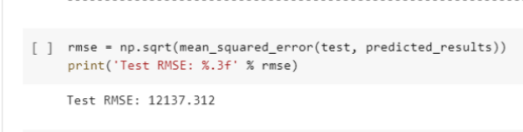
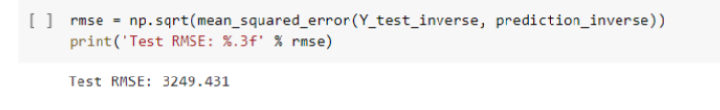
RESULT AND DISCUSSION
RMSE value of ARIMA
RMSE value of LSTM

Slide 9
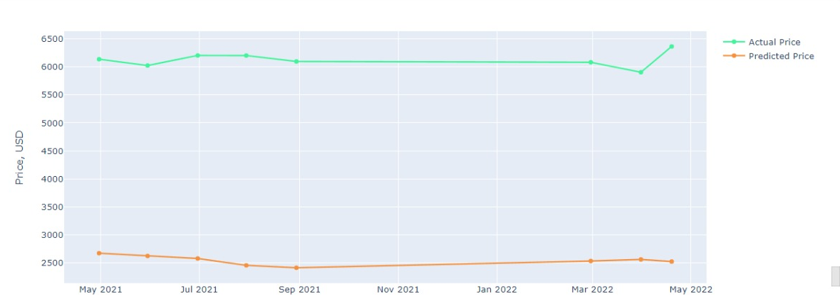
RESULTS AND DISCUSSION
Actual vs Predicted price of ARIMA model

Slide 10
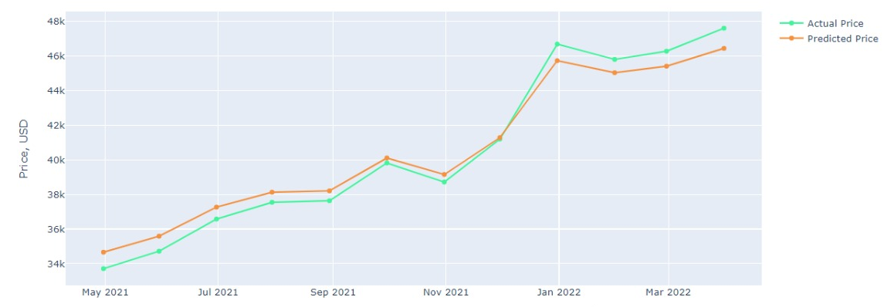
RESULTS AND DISCUSSION
Actual vs Predicted price of LSTM model

Slide 11
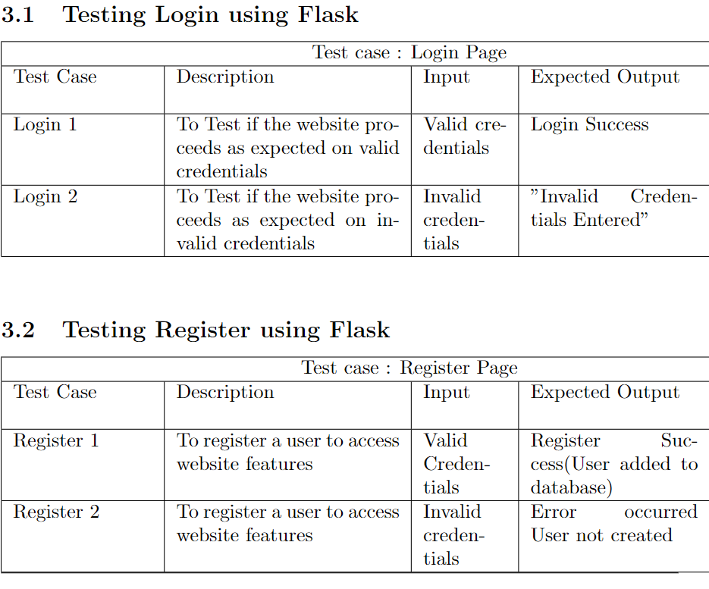
SOFTWARE TEST DOCUMENT

Slide 12
CONCLUSION
In this work, we have implemented a model to predict real time bitcoin prices using various parameters such as High, low, open , volume etc. We have pridcted bitcoin price on daily basis.Thus drawing a comparison between RMSE values of LSTM and ARIMA by taking into consideration various time series data to ultimately reduce the difference between the predicted and actual prices, aiming to get the low RMSE value out of it using appropriate machine learning algorithms.

Slide 13
REFERENCES
[1] S M Raju , Ali Mohammad Tarif, “Real-Time Prediction of BITCOIN Price using Machine Learning Techniques and Public Sentiment Analysis
[2] Mrs Vaidehi M, Alivia Pandit, Bhaskar Jindal, Minu Kumari and Rupali Singh, “Bitcoin price predcition using machine learning"
[3] Z.Mustafaoglu, N.Bogumill ,A..Jumah, University of Illinois Springfield, “LSTM-based analysis of company sentiments regarding cryptocurrencies”
[4] Jacquart P, Danny D, Weinhardt C , “Short-term bitcoin market prediction via machine learning” \bibitem{b5}
[5] Royal Society open science “The impact of news media on Bitcoin prices: modeling data driven discourses in the crypto-economy with natural language processing”
[6] Kamini,“Currency Price Prediction using Machine Learning Algorithms”
[7] Gowtham Saini , Dr. M. Shobana in “CRYPTOCURRENCY PRICE PREDICTION USING ARIMA TIME SERIES
[8] T.Awoke, M.Rout , Bitcoin Price Prediction and Analysis Using Deep Learning Models, 4th October 2020.
[9] Mr.A Chavan , Miss.D Paraskar2 ,Mr. S Pandey ,Bitcoin Price Prediction using Machine Learning,2021
[10] M.Agashahi,S.Bamdad,Analysis of different artificial nerual networks for Bitcoin price prediction ,2022.

Slide 14
HYPERLINKS
https://github.com/babitaratudi/Bitcoin-Price-Prediction-web-app
https://www.youtube.com/watch?v=B97qWOUvlnU&t=1113s
https://www.geeksforgeeks.org/login-and-registration-project-using-flask-and-mysql/
https://towardsdatascience.com/using-machine-learning-to-predict-future-bitcoin-prices-6637e7bfa58f

