Slide 1




BITCOIN PRICE PREDICTION USING MACHINE LEARNING
Group No: 29
Guide – Prof. Nilkamal More
Co-Guide – Prof. Ruchira Jadhav
Mohammed Mudassir Khatri -1814032
Onkar Sanap – 1814035
Yashvi Vora – 1814121
Babita Ratudi - 1813090

Slide 2

PROBLEM DEFINITION
Cryptocurrencies such as Bitcoin, Ethereum, etc. generated significant attention in 2017. Cryptocurrencies have significant volatility as there is rampant speculation. Given the high variance in prices, can data science methods be used to model the market dynamics? There are many directions this project could take.
Trading Strategy Can an effective trading strategy be found? We are looking for a demonstration of sound data science principles here.
Market Analysis Given there is now option trading on certain cryptocurrencies, is it possible to create a volatility index for cryptocurrencies such as VIX? Is variance of this market infinite and therefore not predictable? Are there any rational reasons for investing that you can justify using data science?
Arbitrage Given the number of different currencies and different markets, how efficient is the market? Are there arbitrage opportunities? Can evidence be found of arbitrage?

Slide 3


LITERATURE REVIEW
In the first paper, we attempt to predict the Bitcoin price accurately taking into consideration various parameters that affect the Bitcoin value. For the first phase of our survey, we aim to understand and identify daily trends in the Bitcoin market while gaining insight into optimal features surrounding Bitcoin price. For the second phase of our survey, using the available information, we will predict the sign of the daily price change with highest possible accuracy.
The second research paper study is more focused on leveraging the accurate forecast of bitcoin prices via the normalization of a particular dataset. With the use of LSTM machine learning, this dataset has been trained to deploy a more accurate forecast of the bitcoin price. Furthermore, this research work has evaluated different machine learning methods and found that the suggested work delivers better results. Based on the resultant findings, the accuracy, recall, precision, and sensitivity of the test has been calculated.
In third paper, we discuss the method of Bayesian regression and its efficacy for predicting price variation of Bitcoin, a recently popularized virtual, cryptographic currency. Bayesian regression refers to utilizing empirical data as proxy to perform Bayesian inference. In this paper, instead they utilize model for predicting real-valued quantity, the price of Bitcoin. Based on this price prediction method, they devise a simple strategy for trading Bitcoin. The strategy is able to nearly double the investment in less than 60 day period when run against real data trace.

Slide 4
SRS(Functional and Non- Functional Requirements)
Functional Requirements
Bitcoin Price Prediction:
Getting Realtime Bitcoin price data (model building phase) preparing data for training and testing (model building phase)
Predicting the price of Bitcoin(model building phase)
Visualize the prediction result.
Non-Functional Requirements
Security Management

Slide 5
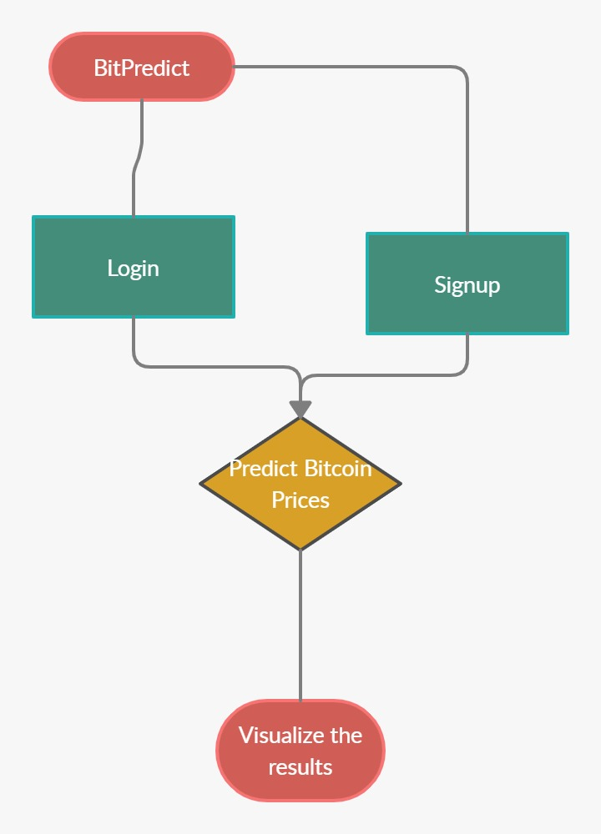
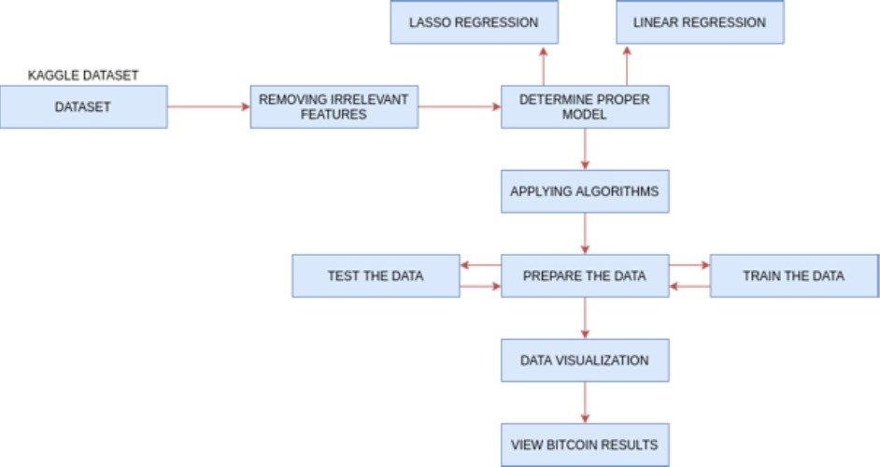
SOFTWARE DESIGN DOCUMENT
Flow Chart Diagram
Block Diagram

Slide 6
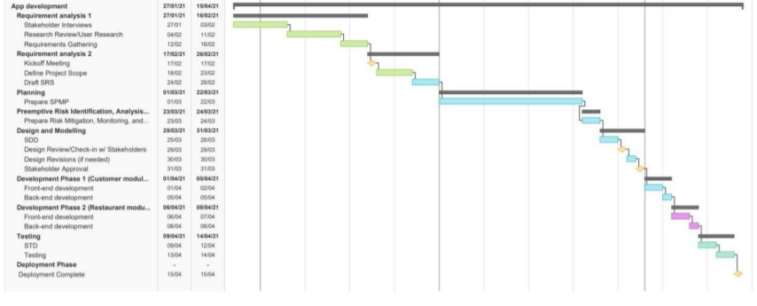
Software Project Management Plan(Timeline chart with responsibilities)
Timeline Chart

Slide 7
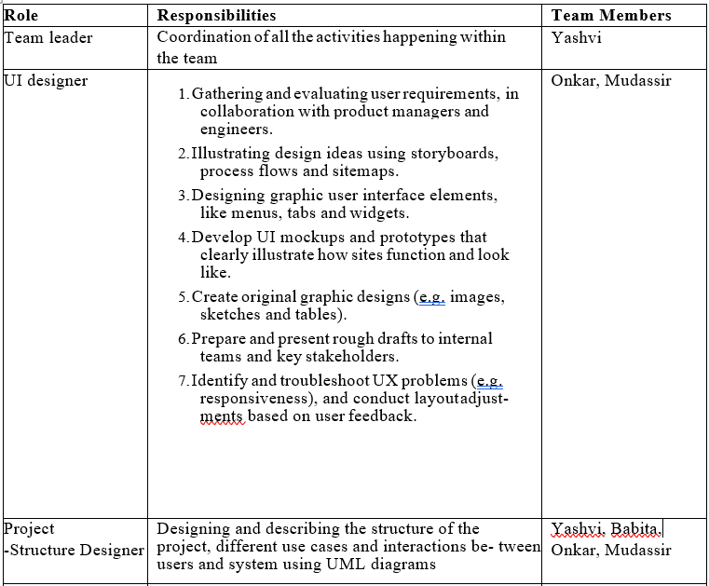
Software Project Management Plan
Responsibilities

Slide 8
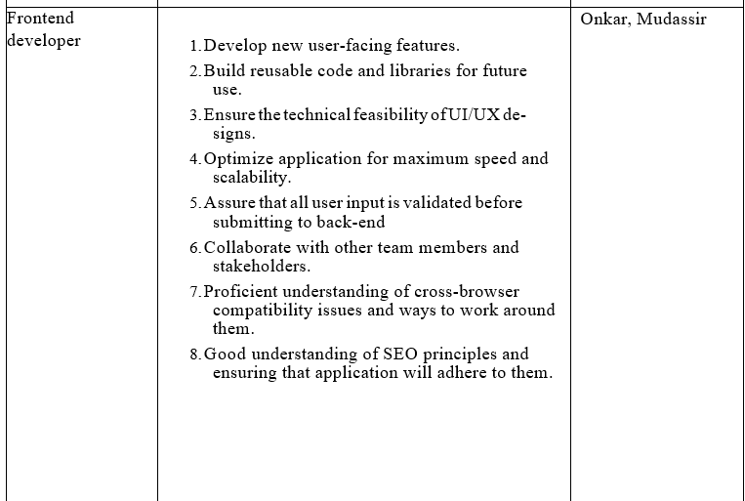
Software Project Management Plan
Responsibilities

Slide 9

Software Project Management Plan
Responsibilities

Slide 10
TECHNOLOGIES USED
Python
Flask
HTML
CSS
Bootstrap
Javascript, Jquery
Machine Learning Algorithms: LSTM, Mean Absolute Error

Slide 11
IMPLEMENTATION DETAILS
Retrieve the historical data of Bitcoin downloaded as a convenient CSV file from Kaggle.
Plot the Autocorrelation Function(ACF) and Partial Autocorrelation Function (PACF).
By knowing the PACF and ACF, we now better understand our dataset and the parameters to potentially choose.
In order to get the best performance out of the model,we must find the optimum parameters.
Now that we have our parameters, let’s go ahead andtrain and fit the model to Bitcoin’s prices.

Slide 12
IMPLEMENTATION DETAILS
Now that we have our parameters, let’s go ahead and train and fit the model to Bitcoin’s prices.
Now we can get to the part that we really want to know about — Predicting Bitcoin’s future prices!
We created Registration portal in Flask
The user can register through the portal and can also update the credentials if required.

Slide 13
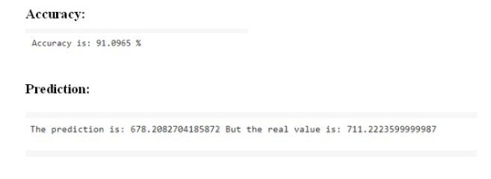
RESULTS AND DISCUSSION

Slide 14
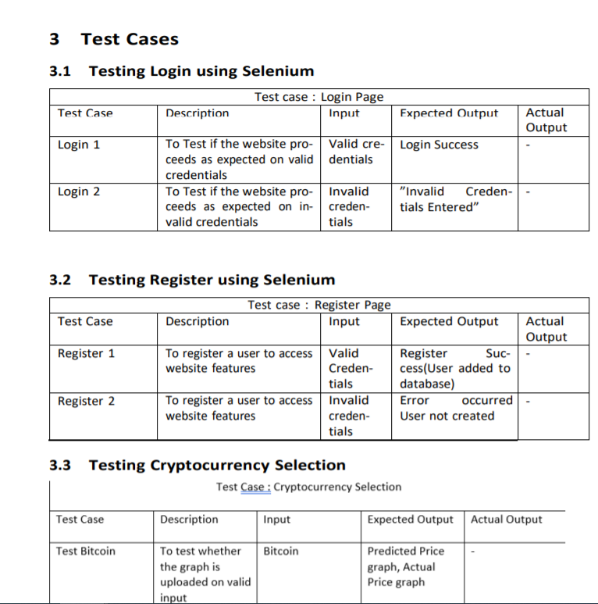
SOFTWARE TEST DOCUMENT(Test Cases)

Slide 15
REFERENCES
[1] Issac Madan, Shaurya Saluja, Aojia Zhao, “Automated Bitcoin Trading via Machine Learning Algorithms”,Department of Computer Science , Stanford University, Stanford , 2015.
[2] Brian Vockathaler, “ The Bitcoin Boom: An In Depth Analysis of The Price Of Bitcoins”, Thesis, University Of Ottawa, Ontario, Canada, June 2017.
[3] D. Shah and K. Zhang, “Bayesian regression and Bitcoin,” in 52nd Annual Allerton Conference on Communication, Control, and Computing (Allerton), 2015, pp. 409-415.
[4] Huisu Jang and Jaewook Lee, “An Empirical Study on Modelling and Prediction of Bitcoin Prices with Bayesian Neural Networks based on Blockchain Information,” in IEEE Early Access Articles, 2017.
[5] Siddhi Velankar, Sakshi Valecha , Shreya Maji, “Bitcoin Price Prediction using Machine Learning”, International Conference onAdvanced Communications Technology(ICACT) ,Dept of Electronics and Telecommunication, Pune Institute of Computer Technology, Pune Maharashtra, India,February 2018.
Hyperlinks
https://drive.google.com/file/d/1oX55fLpy0Tp8UXeonZ4EMJYavWykAU8t/view?usp=sharing

