Slide 1
Wanderlust A Personalized Travel Planning And Tracking App
R.BABITHA-711222104007
P.Hemapriya-711222104018
S.Amisha chris-711222104006
R.Abithra-711222104003

Slide 2
DESCRIPTION
Personalized Itinerary Creation :Allow users to create tailored travel itineraries based on their preferences, including interests, travel style, budget, and destination-specific recommendations.
Smart Destination Recommendations:Provide recommendations on destinations, activities, accommodations, and dining options using AI algorithms that learn from user interests, past trips.
Real-Time Travel Assistance:Offer in-app assistance such as maps, local emergency contacts, weather updates, currency conversion, and transportation guidance to help users during their trips.
Budget Planning and Tracking:Enable users to set budgets for their trips and track spending in real time, with cost breakdowns for flights, accommodation, meals, and activities.
Travel Tracking and Memories:Allow users to track their journeys by logging visited locations, activities, and experiences. They can document trips with photos, notes, and shareable timelines.

Slide 3
Main Activity.java:
package com.example.travelapp
import android.content.Context
import android.content.Intent
import android.os.Bundle
import androidx.activity.ComponentActivity
import androidx.activity.compose.setContent
import androidx.compose.foundation.Image
import androidx.compose.foundation.clickable
import androidx.compose.foundation.layout.*
import androidx.compose.foundation.rememberScrollState
import androidx.compose.foundation.verticalScroll
import androidx.compose.material.Card
import androidx.compose.material.Text
import androidx.compose.runtime.Composable
import androidx.compose.ui.Alignment

Slide 4
import androidx.compose.ui.Modifier
import androidx.compose.ui.draw.scale
import androidx.compose.ui.graphics.Color
import androidx.compose.ui.res.painterResource
import androidx.compose.ui.res.stringResource
import androidx.compose.ui.text.font.FontFamily
import androidx.compose.ui.text.font.FontWeight
import androidx.compose.ui.text.style.TextAlign
import androidx.compose.ui.unit.dp
import androidx.compose.ui.unit.sp
class MainActivity : ComponentActivity() {
override fun onCreate(savedInstanceState: Bundle?) {
super.onCreate(savedInstanceState)
setContent {
TravelApp(this)
}
}

Slide 5
@Composable
fun TravelApp(context: Context) {
Column(
modifier = Modifier
.padding(20.dp)
.verticalScroll(rememberScrollState())
) {
Text(
fontSize = 40.sp,
color = Color(android.graphics.Color.rgb(120, 40, 251)),
fontFamily = FontFamily.Cursive,
text = "Wanderlust Travel"
)

Slide 6
Spacer(modifier = Modifier.height(20.dp))
// 01
Card(
modifier = Modifier
.fillMaxWidth()
.height(250.dp)
.clickable {
context.startActivity(
Intent(context, BaliActivity::class.java)
)
},
elevation = 8.dp
)
{

Slide 7
Column(
horizontalAlignment = Alignment.CenterHorizontally
) {
Image(
painterResource(id = R.drawable.bali), contentDescription = "",
modifier = Modifier
.height(150.dp)
.scale(scaleX = 1.2F, scaleY = 1F)
)
Text(
text = stringResource(id = R.string.place_1),
fontSize = 18.sp
Text(
text = stringResource(id = R.string.description),

Slide 8
fontWeight = FontWeight.Light,
fontSize = 16.sp,
textAlign = TextAlign.Center,
)
Text(
text = stringResource(id = R.string.plan), color = Color.Gray,
fontSize = 16.sp
)
}
}
Spacer(modifier = Modifier.height(20.dp))

Slide 9
//02
Card(
modifier = Modifier
.fillMaxWidth()
.height(250.dp)
.clickable {
context.startActivity(
Intent(context, ParisActivity::class.java)
)
},
elevation = 8.dp
)
{
Column(
horizontalAlignment = Alignment.CenterHorizontally

Slide 10
) {
Image(
painterResource(id = R.drawable.paris), contentDescription = "",
modifier = Modifier
.height(150.dp)
.scale(scaleX = 1.2F, scaleY = 1F)
)
Text(
text = stringResource(id = R.string.place_2),
fontSize = 18.sp
)
Text(
text = stringResource(id = R.string.description),
fontWeight = FontWeight.Light,

Slide 11
fontSize = 16.sp,
textAlign = TextAlign.Center,
)
Text(
text = stringResource(id = R.string.plan), color = Color.Gray,
fontSize = 16.sp
)
}
}
Spacer(modifier = Modifier.height(20.dp))
//03
Card(
modifier = Modifier

Slide 12
.fillMaxWidth()
.height(250.dp)
.clickable {
context.startActivity(
Intent(context, SingaporeActivity::class.java)
)
},
elevation = 8.dp
)
{
Column(
horizontalAlignment = Alignment.CenterHorizontally
) {

Slide 13
Image(
painterResource(id = R.drawable.singapore), contentDescription = "",
modifier = Modifier
.height(150.dp)
.scale(scaleX = 1.2F, scaleY = 1F)
fontSize = 16.sp,
textAlign = TextAlign.Center,
)
Text(
text = stringResource(id = R.string.plan), color = Color.Gray,
fontSize = 16.sp
)
}
}

Slide 14
Spacer(modifier = Modifier.height(20.dp))
//03
Card(
) modifier = Modifier
.fillMaxWidth()
.height(250.dp)
.clickable {
context.startActivity(
Intent(context, SingaporeActivity::class.java)
)
},
elevation = 8.dp
)

Slide 15
{
Column(
horizontalAlignment = Alignment.CenterHorizontally
) {
Image(
painterResource(id = R.drawable.singapore), contentDescription = "",
modifier = Modifier
.height(150.dp)
.scale(scaleX = 1.2F, scaleY = 1F)
)
Text(
text = stringResource(id = R.string.place_3),
fontSize = 18.sp

Slide 16
)
Text(
text = stringResource(id = R.string.description),
fontWeight = FontWeight.Light,
fontSize = 16.sp,
textAlign = TextAlign.Center,
)
Text(
text = stringResource(id = R.string.plan), color = Color.Gray,
fontSize = 16.sp
)
}
}

Slide 17
Spacer(modifier = Modifier.height(20.dp))
}
}
}

Slide 18
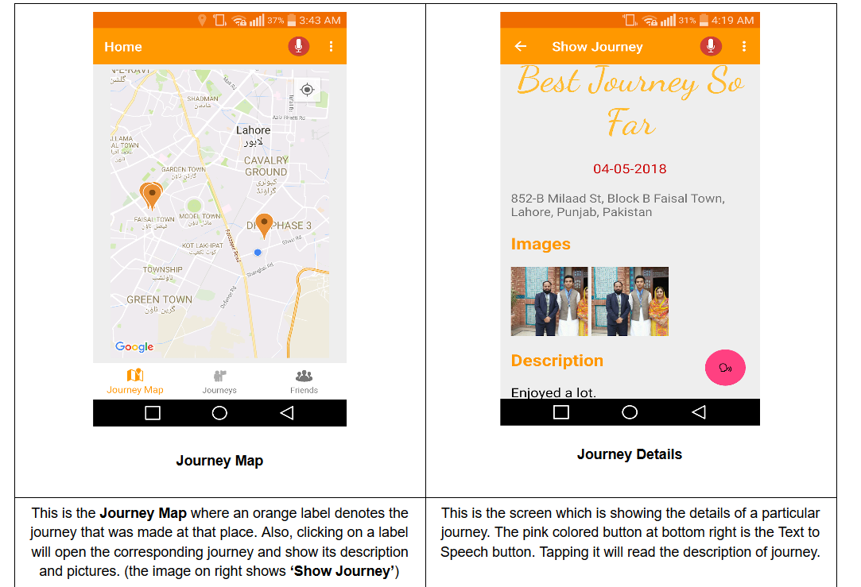
OUTPUT:

Slide 19
