Slide 1
DevOps

Slide 2
DevOps
What is a DevOps?
Definition:
DevOps = Development + Operations
A culture and methodology that integrates software development (Dev) and IT operations (Ops).
Purpose:
Deliver applications faster, more reliably, and with higher quality.
Automate and streamline processes across the SDLC.
Why DevOps? (Background)
Traditional SDLC → slow, manual, error-prone.
Market demand: frequent releases & faster innovation.
Cloud adoption → scalable infrastructure needed.
Need for better collaboration and automation.
Notes:
define its structure, format, and the relationships between different parts of a document using symbols called tags

Slide 3
DevOps
Problems with Traditional Approach
Slow Release Cycles – software delivered once in months/years.
Siloed Teams – Dev, QA, Ops work separately.
Manual Deployments – prone to errors.
Environment Mismatches – “works on my machine” issue.
Late Testing – bugs found late = costly fixes.
Scalability Challenges – servers provisioned manually.
Low Customer Satisfaction – delayed features & unresolved bugs.
Notes:
define its structure, format, and the relationships between different parts of a document using symbols called tags

Slide 4
DevOps
Key Principles of DevOps
Collaboration & Communication – shared responsibility.
Automation – builds, testing, deployment.
Continuous Integration (CI) – frequent code integration with automated testing.
Continuous Delivery/Deployment (CD) – automated release pipeline.
Infrastructure as Code (IaC) – automated provisioning with tools like Terraform.
Monitoring & Feedback – real-time performance checks.
Notes:
define its structure, format, and the relationships between different parts of a document using symbols called tags

Slide 5
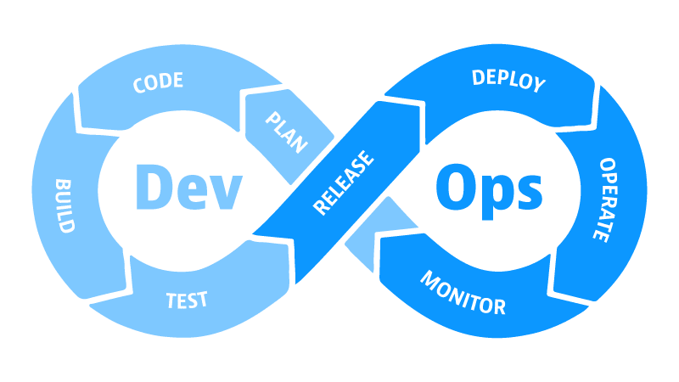
DevOps
DevOps Lifecycle
Stages:
Plan – requirements, backlog.
Code – development using version control (Git).
Build – compile, package software.
Test – automated testing.
Release – CI/CD pipeline deployment.
Deploy – deliver to production.
Operate – system management & scaling.
Monitor – performance monitoring, logs.
Notes:
define its structure, format, and the relationships between different parts of a document using symbols called tags

Slide 6
DevOps
DevOps Practices
CI/CD pipelines → faster delivery.
Automated Testing → unit, integration, performance tests.
Containerization → Docker for consistent environments.
Orchestration → Kubernetes for scaling apps.
Configuration Management → Ansible, Chef, Puppet.
Monitoring & Logging → Prometheus, Grafana, ELK.
Notes:
define its structure, format, and the relationships between different parts of a document using symbols called tags

Slide 7
DevOps
DevOps Tools Ecosystem
Version Control: Git, GitHub, GitLab
CI/CD: Jenkins, GitHub Actions, CircleCI
Containers: Docker, Kubernetes
IaC: Terraform, Ansible, Chef, Puppet
Monitoring: Prometheus, Grafana, ELK Stack, Splunk
Collaboration: Jira, Slack, Microsoft Teams
Notes:
define its structure, format, and the relationships between different parts of a document using symbols called tags

Slide 8
DevOps
Treditional Vs DevOps
Feature | Traditional Approach | DevOps Approach
Team Structure | Separate (Dev, QA, Ops) | Collaborative & cross-functional
Release Frequency | Months/Years | Daily/Weekly (Continuous)
Deployment | Manual, error-prone | Automated, reliable
Testing | After development | Continuous testing
Scalability | Hard, manual servers | Easy with containers & cloud
Customer Experience | Delays, bugs | Faster features, fewer failures
Notes:
define its structure, format, and the relationships between different parts of a document using symbols called tags

Slide 9
DevOps
Benefits of DevOps
Faster time-to-market
Higher software quality
Reduced downtime & failures
Increased automation & efficiency
Continuous feedback & improvement
Happier customers & better business outcomes
Notes:
define its structure, format, and the relationships between different parts of a document using symbols called tags

