Slide 1
wEBsERVICES

Slide 2
What is Web Service
Web Services Overview
A software system enabling applications to communicate and exchange data over a network using standard protocols (e.g., HTTP) and data formats (e.g., XML).
Key Features:
Interoperability – Works across different systems and programming languages.
Networked Communication – Relies on internet protocols like HTTP.
Standardized Messaging – Uses XML-based protocols like SOAP or simpler REST/HTTP methods.
Modular Design – Self-contained and self-describing.
Machine-to-Machine Interaction – Designed for applications, not direct human interaction.
Notes:
define its structure, format, and the relationships between different parts of a document using symbols called tags

Slide 3
Examples of Web Service Use Cases
Weather APIs – Mobile apps fetch weather forecasts.
Payment Gateways – E-commerce sites process payments securely.
Social Logins – Apps use Google/Facebook services for authentication.
Mapping & Location – Services like Google Maps provide routes and geodata.
Travel Aggregators – Websites fetch real-time flight/hotel data from multiple providers.
Notes:
define its structure, format, and the relationships between different parts of a document using symbols called tags

Slide 4
Web Service Roles
Service Provider
Creates and hosts the web service.
Defines the service contract (methods, input/output).
Publishes it for others to consume.
Service Requestor (Client/Consumer)
Uses the web service by sending requests.
Invokes operations through XML (SOAP) or JSON (REST).
Example: A mobile app calling a weather API.
Service Registry
A directory (like UDDI – Universal Description, Discovery, and Integration).
Stores details about available services.
Allows service requestors to discover services dynamically.
Notes:
define its structure, format, and the relationships between different parts of a document using symbols called tags

Slide 5
Web Service Architecture Layers
1. Service Transport Layer
Purpose: Transports messages between applications.
Function: Ensures communication between the service requestor and provider.
Protocols:
HTTP/HTTPS → most common for web communication.
SMTP → for email-based communication.
FTP → for file transfers.
JMS → Java Messaging Service.
2. XML Messaging Layer
Purpose: Encodes data in a common message format.
Function: Provides platform-independent data exchange using XML.
Examples:
SOAP (Simple Object Access Protocol) → XML-based messaging.
REST also uses XML/JSON in this layer.
Notes:
define its structure, format, and the relationships between different parts of a document using symbols called tags

Slide 6
Web Service Architecture Layers
3. Service Description Layer
Purpose: Defines the interface of the web service (what methods are available, what data types they accept/return).
Function: Allows requestors to understand how to interact with the service.
Standard:
WSDL (Web Services Description Language) → XML-based contract describing operations, inputs, outputs, and endpoints.
4. Service Discovery Layer
Purpose: Provides a central directory where services can be published and found.
Function: Helps service requestors discover available services dynamically.
Standard:
UDDI (Universal Description, Discovery, and Integration) → registry for web services.
Notes:
define its structure, format, and the relationships between different parts of a document using symbols called tags

Slide 7
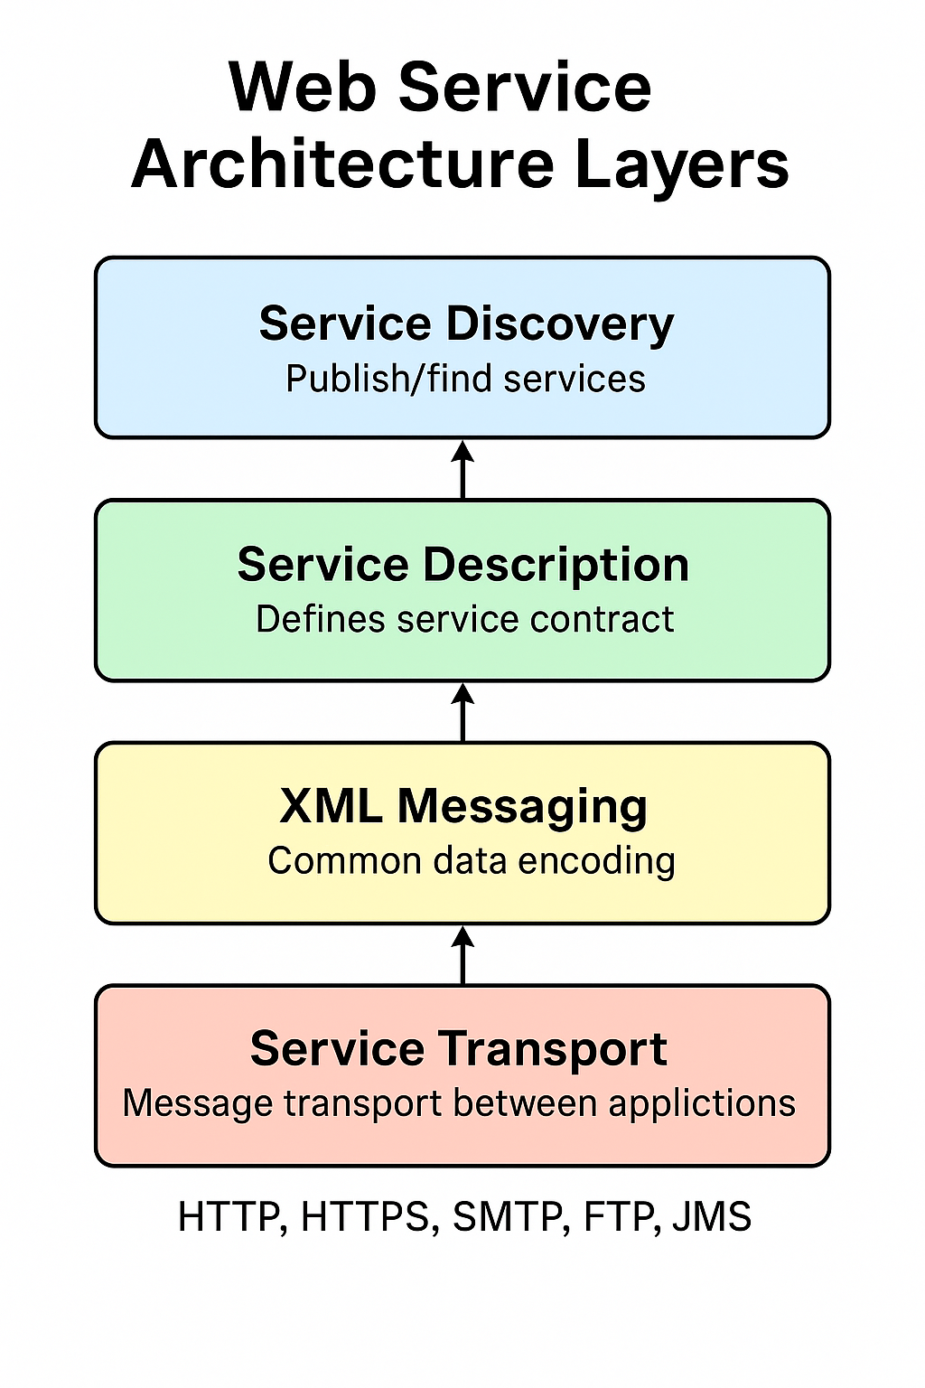
Web Service Architecture Layers
Notes:
define its structure, format, and the relationships between different parts of a document using symbols called tags

Slide 8
Web Service Architecture Layers
Service Discovery Layer
You (Requestor) search a Service Registry (UDDI) for “Weather Service”.
Registry returns a WSDL file link → http://weatherapi.com/weather?wsdl.
Service Description Layer (WSDL)
The WSDL describes:
Service name → WeatherService
Operation → getTemperature(cityName)
Input → cityName (string)
Output → temperature (int)
XML Messaging Layer (SOAP Request)
You create a SOAP request in XML as per WSDL
Service Transport Layer (HTTP)
This SOAP XML message is wrapped inside an HTTP POST and sent to: http://weatherapi.com/weather
Response Back
Provider processes the request and sends a SOAP response
HTTP transports this back to you.
Notes:
Universal description , discovery and integration
It is a dictionary service like phone book

Slide 9
SOAP Web Services (Simple Object Access Protocol)
Protocol-based web service.
Uses XML for request and response messages.
Highly standardized (WSDL for description, UDDI for discovery).
Transport usually HTTP/HTTPS, but can also use SMTP, JMS, etc.
Supports security (WS-Security), transactions, reliability.
Suitable for enterprise-level applications (e.g., banking, telecom).
Notes:
define its structure, format, and the relationships between different parts of a document using symbols called tags

Slide 10
RESTful Web Services (Representational State Transfer)
Architecture style, not a protocol.
Uses HTTP methods (GET, POST, PUT, DELETE) for operations.
Supports multiple data formats: JSON, XML, plain text (JSON is most common).
Lightweight, simple, fast, and scalable.
Widely used for mobile apps, social media APIs, cloud services.
Notes:
define its structure, format, and the relationships between different parts of a document using symbols called tags

Slide 11
WSDL stands for Web Services Description Language.
It is an XML-based language used to describe the functionality of a SOAP web service.
Purpose:
WSDL defines what a web service does, where it is located, and how to invoke it. It acts like a contract between the service provider and the consumer.
Format:
Written in XML.
Describes web service operations, input/output messages, data types, and endpoint URLs.
Protocol Used:
WSDL is mainly used with SOAP web services, which are highly structured and standardized.
Notes:
define its structure, format, and the relationships between different parts of a document using symbols called tags

Slide 12
WSDL stands for Web Services Description Language.
It is an XML-based language used to describe the functionality of a SOAP web service.
Purpose:
WSDL defines what a web service does, where it is located, and how to invoke it. It acts like a contract between the service provider and the consumer.
Format:
Written in XML.
Describes web service operations, input/output messages, data types, and endpoint URLs.
Protocol Used:
WSDL is mainly used with SOAP web services, which are highly structured and standardized.
Notes:
define its structure, format, and the relationships between different parts of a document using symbols called tags

Slide 13
Swagger
Swagger is a popular set of tools built around the OpenAPI Specification (OAS), which is a standard, language-agnostic way to describe RESTful APIs.
In essence, Swagger/OpenAPI provides a "blueprint" or contract for your API.
Key benefits include:
Interactive Documentation (Swagger UI): Generates live, clickable API documentation that allows developers to test endpoints directly.
Design-First Approach: Encourages defining your API's structure before coding, improving clarity and reducing errors.
Collaboration: Acts as a single source of truth for all teams (backend, frontend, QA).
Automation: Can auto-generate client SDKs (for various programming languages) and server stubs from the API definition.
Notes:
define its structure, format, and the relationships between different parts of a document using symbols called tags

