Slide 1

Fabric
Confidential

Slide 2
What is Microsoft Fabric
Microsoft Fabric is an end-to-end cloud analytics platform from Microsoft that brings data integration, data engineering, data warehousing, data science, real-time analytics, and Power BI into a single platform.
Simple definition for students
  Microsoft Fabric is a unified analytics platform where we can ingest, store, transform, analyze, and visualize data in one environment.

Slide 3
Traditional approach Fabric approch
Microsoft Fabric
│
┌────────────────────────────┐
↓ ↓
Data Factory Data Engineering Warehouse
↓ ↓ ↓
OneLake
↓
Power BI
Data Sources
↓
Azure Data Factory
↓
Data Lake
↓
Databricks / Spark
↓
SQL Data Warehouse
↓
Power BI

Slide 4
Why Microsoft Fabric?
The main reason for Fabric is unification.
Without Fabric You may have:
  Azure Data Factory
  Azure Data Lake Storage
  Azure Databricks
  Synapse
  Power BI
  Separate security
  Separate monitoring
  Multiple tools
With Fabric
Many of these capabilities are available through a single SaaS analytics platform.

Slide 5
Key benefits
  One platform
  OneLake centralized storage
  Integrated workloads
  Less data movement
  Easy integration with Power BI
  Centralized governance
  Shared security
  Data engineering with Spark
  Data warehousing with SQL
  Data pipelines and Dataflows
  Real-time analytics
  AI and data science capabilities

Slide 6
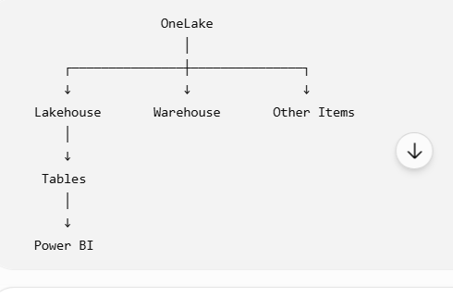
What is OneLake?
OneLake is Microsoft Fabric's unified, tenant-wide data lake that provides a single storage layer for Fabric workloads..

Slide 7
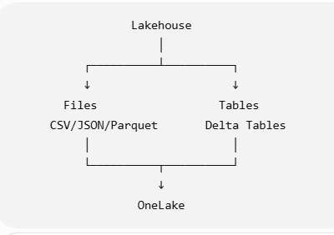
What is a Lakehouse?
A Lakehouse combines concepts of:
  Data Lake
  Data Warehouse
It allows us to store large amounts of data in a lake while also providing structured tables and SQL capabilities.

Slide 8
Lakehouse contains
A Lakehouse combines concepts of:
  Data Lake
  Data Warehouse
It allows us to store large amounts of data in a lake while also providing structured tables and SQL capabilities.

Slide 9
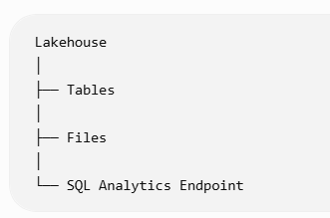
Lakehouse contains
When to use Lakehouse?
Use a Lakehouse when you need:
          Spark
          PySpark
          Data engineering
          Large-scale data processing
          Data science
          Semi-structured data
          Structured data

Slide 10
What is a Workspace?
A Workspace is a logical container where Fabric items are created, stored, and managed.
Workspace: SalesAnalytics
│
├── Lakehouse
├── Warehouse
├── Data Pipeline
├── Dataflow Gen2
├── Notebook
├── Semantic Model
└── Power BI Report

Slide 11
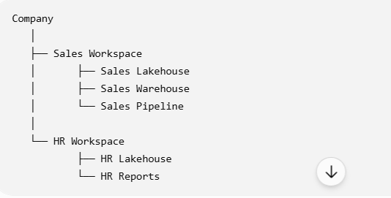
For example:
Workspace is also important for
  Collaboration
  Security
  Permissions
  Development
  Deployment
  Organizing Fabric items

Slide 12
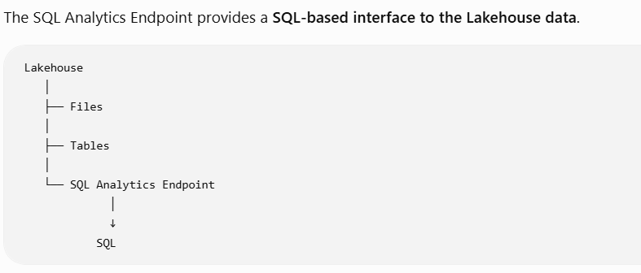
What is SQL Analytics Endpoint?
When you create a Lakehouse, Fabric provides a SQL Analytics Endpoint that allows you to query the Lakehouse tables using SQL.
For example:
SELECT *
FROM Customers;

Slide 13
What is a Warehouse?
A Fabric Warehouse is a relational data warehouse designed primarily for SQL-based analytical workloads.
Example:
        Sales
        Customer
        Product
        Date
        Warehouse is suitable for
            Structured data
            SQL developers
            Dimensional modeling
            Star schemas
            BI reporting
            Analytical SQL

Slide 14
Lakehouse vs Warehouse
Lakehouse | Warehouse
Data lake + tables | Data warehouse
Spark + SQL | Primarily SQL
Structured + semi-structured | Primarily structured
Data engineering friendly | SQL/BI friendly
Files + Tables | Tables
Great for engineering/data science | Great for analytical SQL
Lakehouse → Data Engineers + Spark + SQL
Warehouse → SQL Developers + BI + Analytics

Slide 15
What is a Workload?
A workload represents a specific type of analytics activity performed within Fabric.
Data Engineer
↓
Data Engineering
Data Analyst
↓
Power BI
SQL Developer
↓
Data Warehouse
Data Scientist
↓
Data Science

Slide 16
Types of Fabric Workloads
A workload represents a specific type of analytics activity performed within Fabric.
1. Data Factory
  Used for:
    Data ingestion
    Data integration
    Pipelines
    Dataflows
2. Data Engineering
Used for:
    Spark
    PySpark
    Notebooks
    Lakehouse
    Big data processing

Slide 17
Types of Fabric Workloads
Data Science
  Used for:
    Machine learning
    Data exploration
    Experiments
    ML models
4. Data Warehouse
Used for:
        SQL
        Relational data
        Analytical queries
        Data warehousing

Slide 18
Types of Fabric Workloads
  6. Power BI
  Used for:
    Semantic models
    Reports
    Dashboards
    Visualization

Slide 19
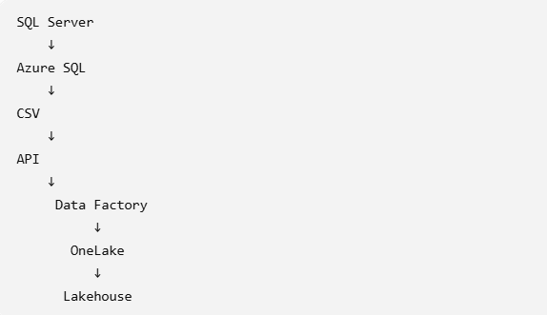
What is Data Factory in Fabric?
  Data Factory is the Fabric workload used for data integration and data ingestion.
  It helps us move and transform data from different sources into Fabric.
  Example

Slide 20
What is Data Factory in Fabric?
  Data Factory provides
    Pipelines
    Copy Data
    Dataflow Gen2
    Data integration
    Scheduling
    Orchestration

Slide 21
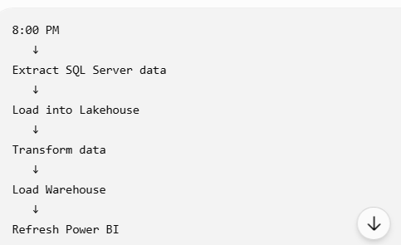
What is a Pipeline?
  A Pipeline is an orchestration mechanism used to execute a series of data activities in a specific order.
  For example:

Slide 22
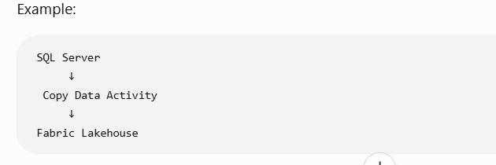
What is Copy Data Activity?
  Copy Data is an activity inside a pipeline used to move data from a source to a destination

Slide 23
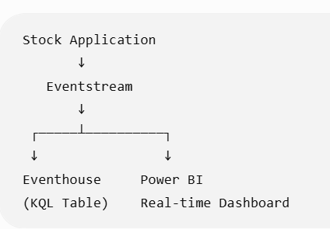
Eventstream
Eventstream in Microsoft Fabric is a real-time data ingestion and processing service. It continuously receives streaming data from sources such as applications, IoT devices, stock feeds, logs, and Event Hubs, and routes that data to one or more destinations.
Suppose you receive stock data every second:

Slide 24
Eventstream
Eventstream in Microsoft Fabric is a real-time data ingestion and processing service. It continuously receives streaming data from sources such as applications, IoT devices, stock feeds, logs, and Event Hubs, and routes that data to one or more destinations.
Suppose you receive stock data every second:

Slide 25
Eventstream
What does Eventstream do?
Receive real-time events
  Azure Event Hubs
  Custom applications
  IoT data
  Real-time feeds
Process/filter events
  Filter records
  Transform data
  Manage event fields
  Route different events to different destinations
Send data to destinations
  Eventhouse
  Lakehouse
  Custom endpoints
  Other supported Fabric destinations
Enable real-time analytics
  KQL queries
  Real-time dashboards
  Power BI real-time reporting

Slide 26
What is Dataflow Gen2?
  Dataflow Gen2 is a low-code/no-code data transformation and integration capability in Fabric.
  It is based on the Power Query experience.
  You can perform transformations such as:
    Filter rows
    Remove columns
    Rename columns
    Change data types
    Merge
    Append
    Group By
    Replace values
    Derived columns

Slide 27
Dataflow Gen2 vs Copy Data
Copy Data | Dataflow Gen2
Mainly moves data | Moves + transforms data
Simple ingestion | Transformation-focused
Pipeline activity | Power Query experience
Low transformation capability | Rich transformations
A → B | Source → Transform → Destination

Slide 28
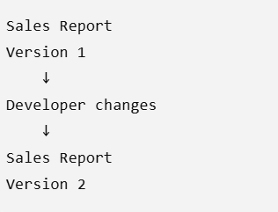
A Deployment Pipeline
A Deployment Pipeline in Power BI Service is a feature used to move Power BI content through different development stages in a controlled and organized way.
Suppose you are developing a Power BI sales report.
You don't want to directly modify the report that business users are currently using.
Development
This is where developers create and modify:
  Reports
  Semantic models
  Dashboards
  Dataflows
  Other supported Power BI/Fabric content
You can make changes without affecting production users.

Slide 29
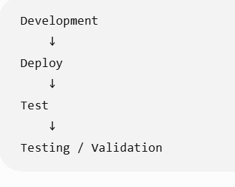
A Deployment Pipeline
Test
The content is deployed from Development to Test.
Testers/business analysts can verify:
Data is correct
DAX calculations are correct
Filters work
RLS works
Visuals are correct
Performance is acceptable
For example:

Slide 30
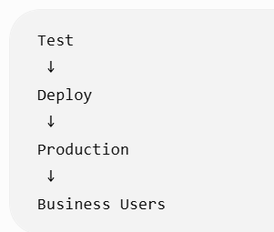
A Deployment Pipeline
Production
After testing is completed, deploy the approved content to Production.

Slide 31
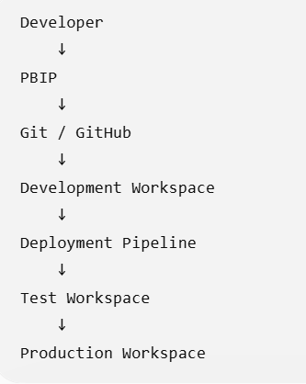
A Deployment Pipeline
In a modern Power BI project, you can use both:

Slide 32
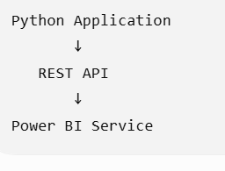
Power BI REST API
REST API (Representational State Transfer Application Programming Interface) allows applications to communicate with each other over HTTP.
For example:
Instead of manually performing an operation in Power BI Service, an application can perform it programmatically using an API.

Slide 33
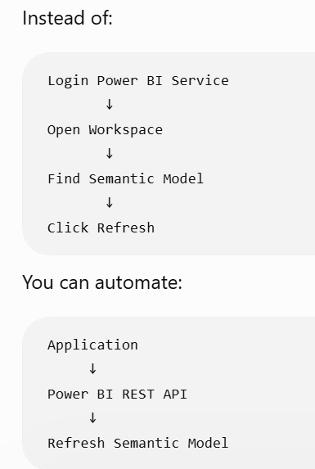
Power BI REST API
Why do we use REST API in Power BI?
Power BI Service provides many operations that can be automated.
For example:
Create workspaces
Get workspace information
Get reports
Get dashboards
Get semantic models
Refresh semantic models
Deploy content
Manage users and permissions
Export reports
Run queries
Monitor Power BI resources

Slide 34
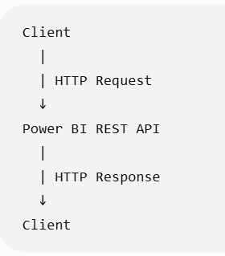
How REST API works
The basic communication is:

Slide 35
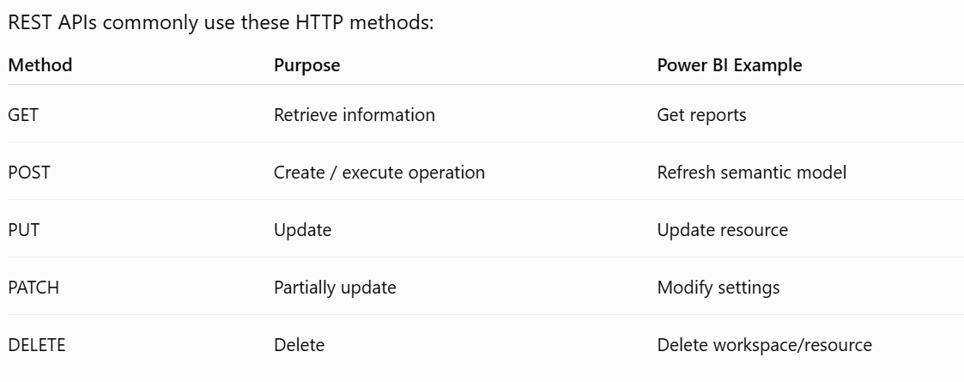
REST API methods

Slide 36
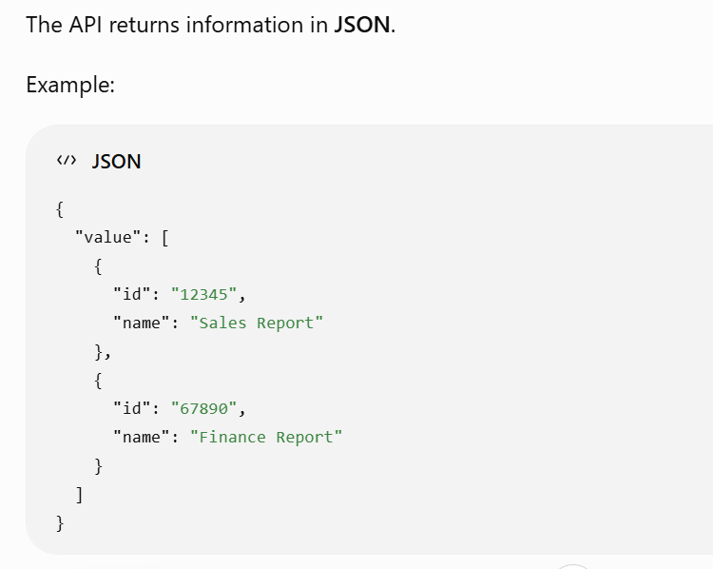
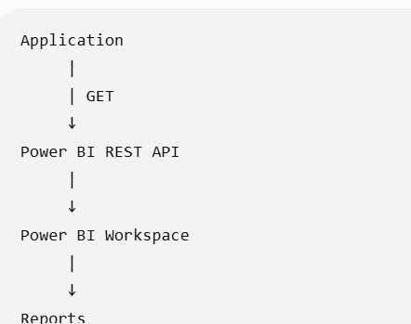
Example: Get Reports
Suppose you want to retrieve reports from a workspace.
Your application sends a:
GET Request
to the Power BI REST API.

Slide 37
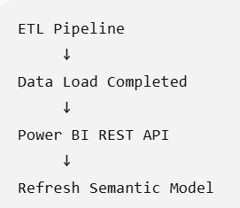
Power BI REST API Use Cases
Use Case 1 — Refresh Semantic Model
Instead of manually clicking Refresh, an application can trigger a refresh.

Slide 38
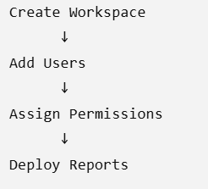
Power BI REST API Use Cases
Workspace Management
Organizations can automate workspace-related operations.
Report Management
Applications can retrieve information about:
Reports
Semantic models
Dashboards
Pages

Slide 39
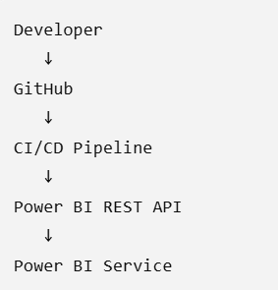
Power BI REST API Use Cases
Deployment Automation
REST APIs can be used as part of CI/CD processes.

Slide 40
Thank You!

