Slide 1

PowerBI

Slide 2
BUSINESS INTELLIGENCE (BI)
What is BI?
Business Intelligence (BI) is a process and technology used to:
  Collect data from multiple sources
  Clean and transform it
  Present it in a meaningful way (reports/dashboards)
  Help businesses make data-driven decisions
Simple Example (Classroom):
Students marks → Calculate average → Find topper → Decision (extra coaching)
👉 Decision: Increase marketing in Delhi
Notes:
BigQuery is Google Cloud’s serverless enterprise data warehouse.
You do not manage servers, indexes, or infrastructure.
It separates compute from storage and scales automatically.

Slide 3
BI vs Traditional Reporting
Feature | Traditional Reporting | BI
Data | Static | Dynamic
Updates | Manual | Automatic
Analysis | Limited | Deep insights
Output | Tables | Interactive dashboards
Notes:
BigQuery stores data in columnar format → faster analytics.
Separation of compute & storage means:
Storage billed separately
Query compute billed separately

Slide 4
BI Lifecycle
Data Collection
  Sources: Excel, DB, APIs
Data Cleaning
  Remove duplicates, nulls
Data Transformation
  Convert formats, merge tables
Data Modeling
  Create relationships
Visualization
  Charts, dashboards
Decision Making
  Business action

Slide 5
WHAT IS POWER BI – DETAILED
Power BI is a Microsoft Business Intelligence tool used to:
  Analyze data
  Create reports
  Build dashboards
Why Power BI is Popular
  Beginner-friendly
  Strong integration with Excel
  Low cost
  Cloud-based sharing
  High demand in jobs

Slide 6
Power BI Components
1. Power BI Desktop
  Used to create reports
  Installed on laptop
Example:
Import Excel → Build dashboar
2. Power BI Service
  Cloud platform
  Used to share reports
Example:
  Manager opens report in browser

Slide 7
Power BI Components
3. Power BI Mobile
  View reports on phone
4. Power BI Report Server
  Used when data must stay inside company

Slide 8
FEATURES OF POWER BI – DETAILED
Drag & Drop Interface
  No coding needed
  User-friendly
Example:
  Drag “Sales” → Chart created
Interactive Dashboards
  Clicking one chart filters others
Example:
  Click "India" → All visuals update
Real-Time Data Refresh
  Data updates automatically
Example:
  Stock price dashboard

Slide 9
FEATURES OF POWER BI
Power Query (Data Transformation)
Used for cleaning data
Operations:
  Remove nulls
  Split columns
  Merge tables
Data Modeling
  Create relationships between tables
Example:
Sales table ↔ Customer table

Slide 10
FEATURES OF POWER BI
DAX (Data Analysis Expressions)
  Formula language
Example:
  Total Sales = SUM(Sales[Amount])
Profit = Sales - Cost
AI Features
  Ask questions in English
Example:
“Top 5 products by sales”

Slide 11
FEATURES OF POWER BI
Security (RLS)
Restrict access
Example:
Manager sees only his region
Collaboration
Share dashboards
Workspaces

Slide 12
POWER BI TOOLS
Power Query
ETL tool (Extract, Transform, Load)
Example:
  Messy Excel → Clean dataset
Power Pivot
  Data modeling engine
  Handles relationships
DAX
  Used for calculations
Advanced:
  CALCULATE()
  FILTER()

Slide 13
POWER BI TOOLS
Power BI Gateway
  Connects local data to cloud
Example:
  SQL Server → Power BI Service
Power BI Mobile
  Access dashboards anywhere

Slide 14
ADVANTAGES OF POWER BI
Technical Advantages
  Fast (in-memory engine)
  Handles large data
  Real-time analytics
Business Advantages
  Better decisions
  Easy sharing
  Centralized data
Cost Advantages
  Cheaper than Tableau/Qlik
  Free version available

Slide 15
DATA SOURCES – DETAILED
File Sources
  Excel
  CSV
  JSON
Database Sources
  SQL Server
  MySQL
  Oracle

Slide 16
DATA SOURCES – DETAILED
Cloud Sources
  Azure
  Google Analytics
  Salesforce
Big Data
  Hadoop
  Spark
APIs & Streaming
  Web APIs
  IoT real-time data

Slide 17
Chat Types
Column Chart in Power BI
  A Column Chart in Power BI is a type of visualization used to compare values across different categories using vertical bars (columns).
Example (Sales by Region)
When to Use Column Chart
1. Compare Categories
  Sales by region
  Profit by product
2. Show Ranking
  Top 5 products
  Employee performance
3. Display Discrete Data
  Data separated by categories (not continuous

Slide 18
Chat Types
Types of Column Charts in Power BI
1. Clustered Column Chart
  Compares multiple categories side by side
Example: Sales of Product A vs B in each region
2. Stacked Column Chart
  Shows total + breakdown inside same column
Example: Sales = Online + Offline
3.100% Stacked Column Chart
  Shows percentage distribution
Example: Market share %

Slide 19
Chat Types
Bar Chart in Power BI
  A Bar Chart in Power BI is used to compare values across different categories using horizontal bars.
  It is the horizontal version of a column chart.
  Example (Sales by Region)
When to Use Bar Chart
1. Compare Categories
  Sales by region
  Profit by product
2. Handle Long Category Names
  Customer names
  Product descriptions
3. Show Ranking
  Top / Bottom performers

Slide 20
Chat Types
Types of Bar Charts in Power BI
1. Clustered Bar Chart
  Side-by-side comparison
Example: Product A vs Product B
2. Stacked Bar Chart
Shows total + breakdown
Example: Online vs Offline sales
3. 100% Stacked Bar Chart
  Shows percentage distribution

Slide 21
Chat Types
Bar Chart | Column Chart
Horizontal bars | Vertical bars
Good for long labels | Good for short labels
Categories on Y-axis | Categories on X-axis

Slide 22
Chat Types
Pie Chart in Power BI
  A Pie Chart in Power BI is used to show how a whole value is divided into different parts (percentages or proportions).
  It answers the question: “How much each category contributes to the total?”
  Example (Sales Distribution)
When to Use Pie Chart
1. Show Percentage Contribution
    Market share
    Sales distribution
2. Compare Parts of a Whole
    Category-wise revenue
    Department-wise expenses
3. Limited Categories (Important!)
    Best when categories are less than 5–6

Slide 23
Chat Types
When to Use Pie Chart
1. Show Percentage Contribution
    Market share
    Sales distribution
2. Compare Parts of a Whole
    Category-wise revenue
      Department-wise expenses
3. Limited Categories (Important!)
    Best when categories are less than 5–6
When NOT to Use Pie Chart
  Too many categories → becomes confusing
  Exact value comparison → use Bar/Column chart
  Trend over time → use Line chart

Slide 24
Chat Types
What is a Funnel Chart?
  A Funnel Chart in Power BI is used to represent stages in a process and how data flows through those stages. It visually shows progressive reduction (or drop-off) from one stage to another.
  It is called a funnel because the shape looks like a funnel — wide at the top and narrow at the bottom.
When to Use Funnel Chart
  You have sequential stages
  Data reduces step by step
  You want to analyze conversion or loss
Common Use Cases:
  Recruitment process
  Website conversion (Visitors → Signups → Purchases)
  Marketing campaign tracking

Slide 25
Chat Types
Advantages
  Easy to understand
  Highlights weak stages
  Helps improve decision-making
  Good for storytelling in dashboards
Limitations
  Only works for linear processes
  Not suitable for complex or non-sequential data
  Cannot show detailed comparisons like bar charts

Slide 26
Chat Types
What is a Ribbon Chart?
A Ribbon Chart in Power BI is used to show ranking changes over time or across categories.
It highlights:
  How categories (like products, regions, brands) move up or down in rank
  Changes in top performers over time
“Ribbon chart shows which category is leading and how rankings change over time.”
Example:
  In January → Product A is No.1
  In February → Product B becomes No.1
Ribbon chart shows this shift visually using ribbons.

Slide 27
Chat Types
When to Use Ribbon Chart
  You want to show rank changes
  Data has a time dimension (Month, Year)
  You are comparing multiple categories
Common Use Cases:
  Product sales ranking
  Regional performance comparison
  Market share changes
  Brand performance over time

Slide 28
Chat Types
Advantages
  Combines trend + ranking
  Visually engaging
  Easy to track leaders
  Helps in business decisions
Limitations
  Can be confusing with too many categories
  Not ideal for exact value comparison
  Works best with top N categories only

Slide 29
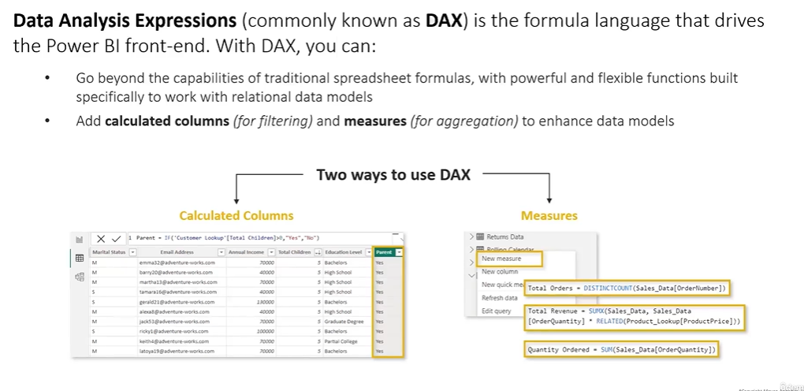

Slide 30
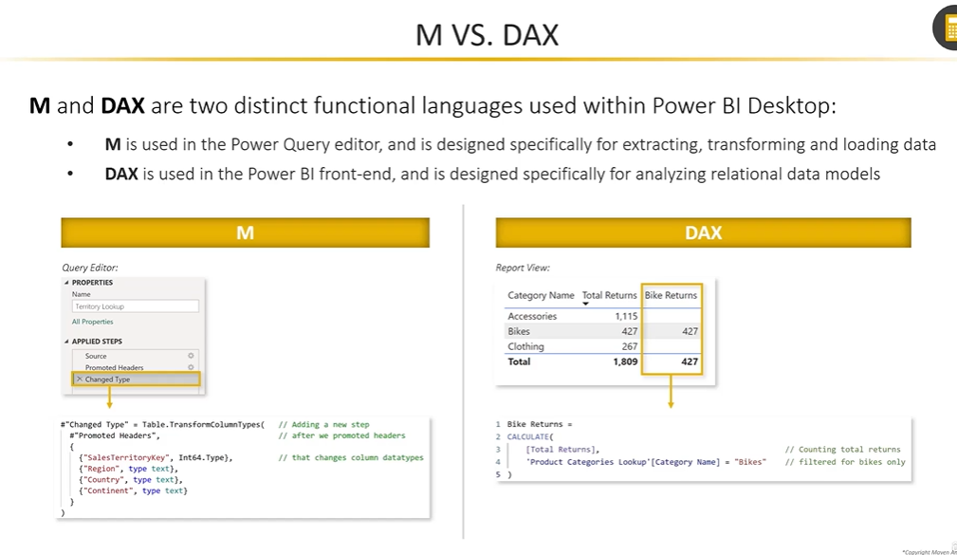

Slide 31
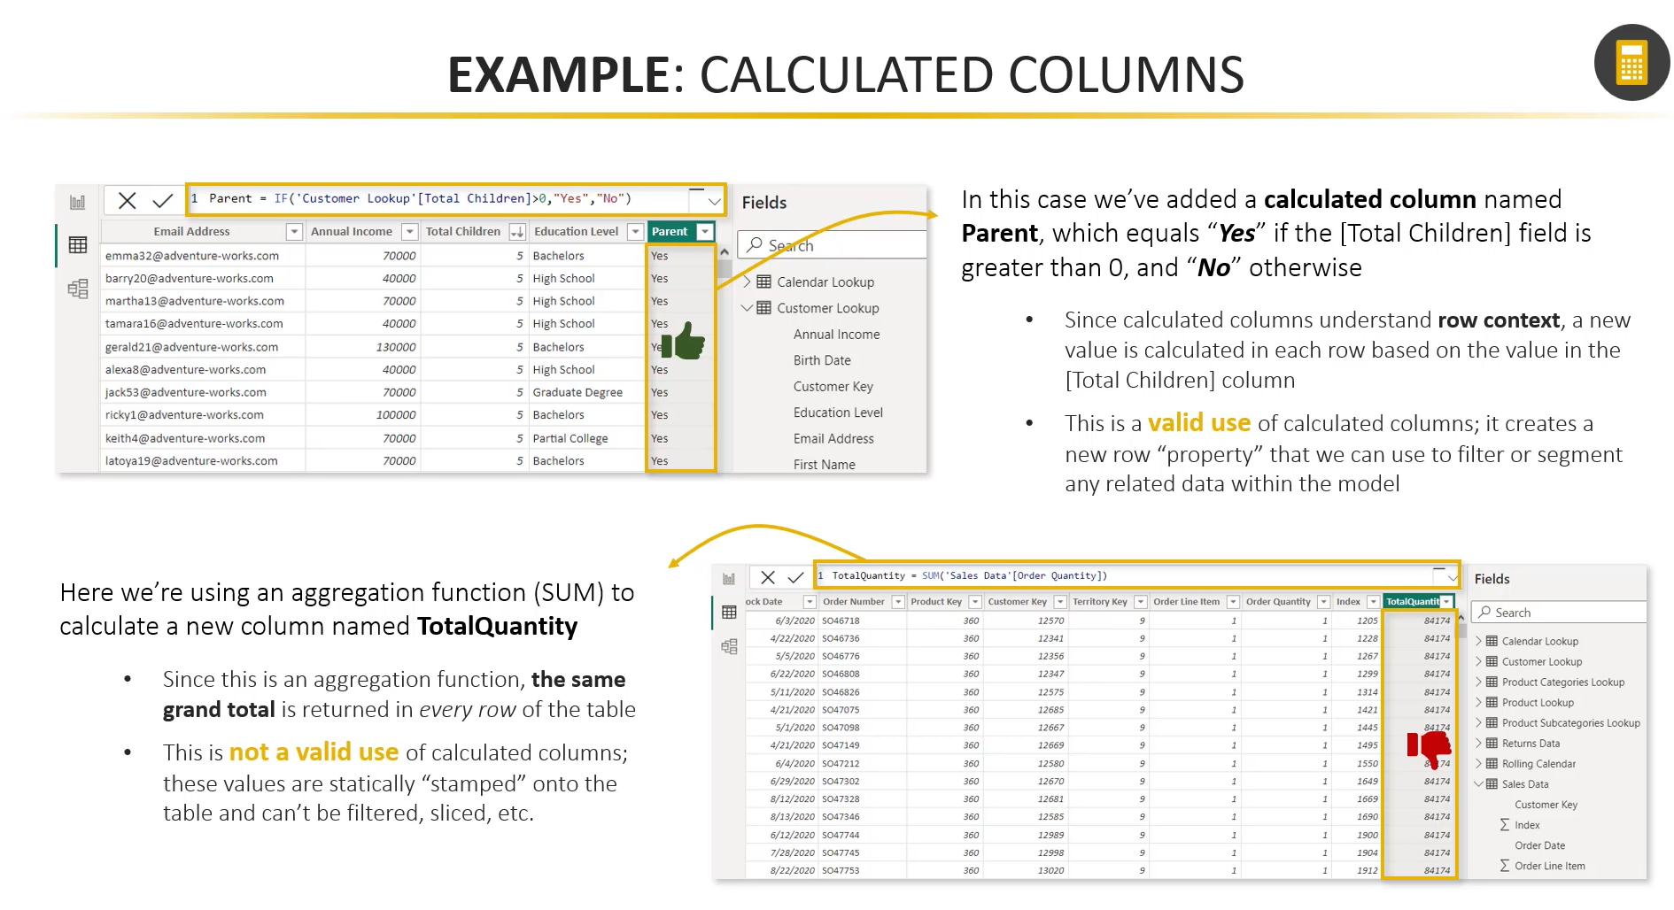

Slide 32
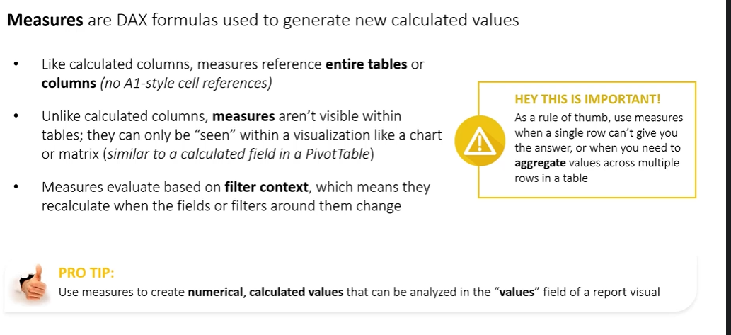

Slide 33
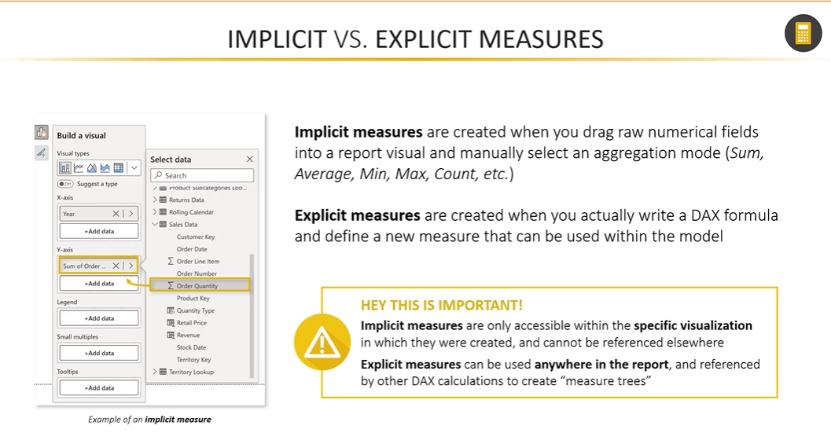

Slide 34
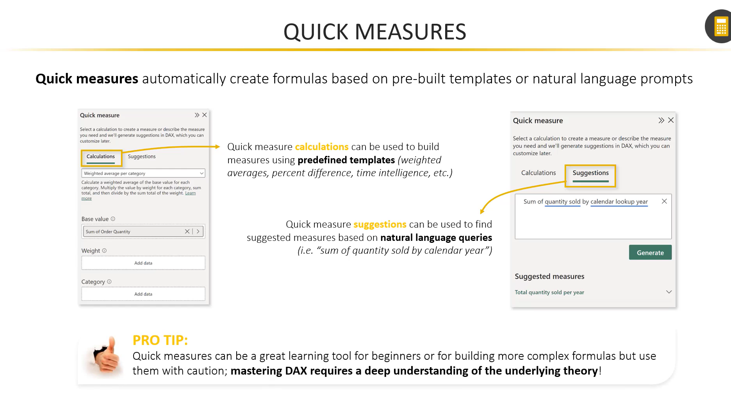

Slide 35
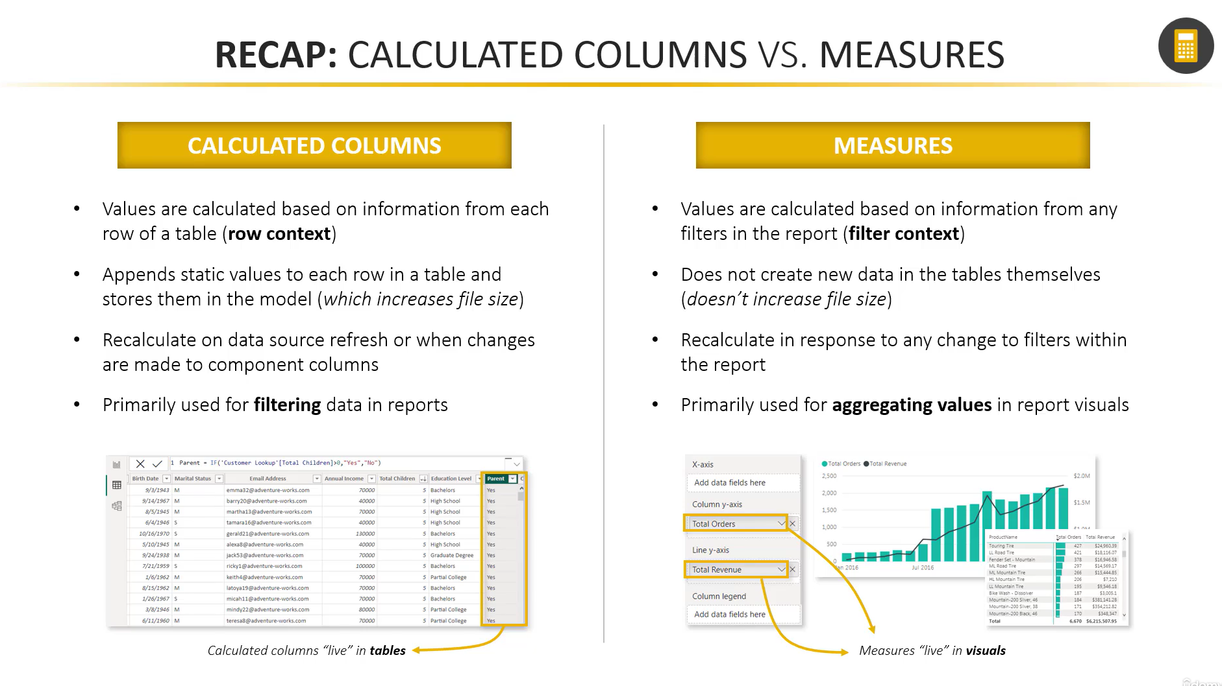

Slide 36
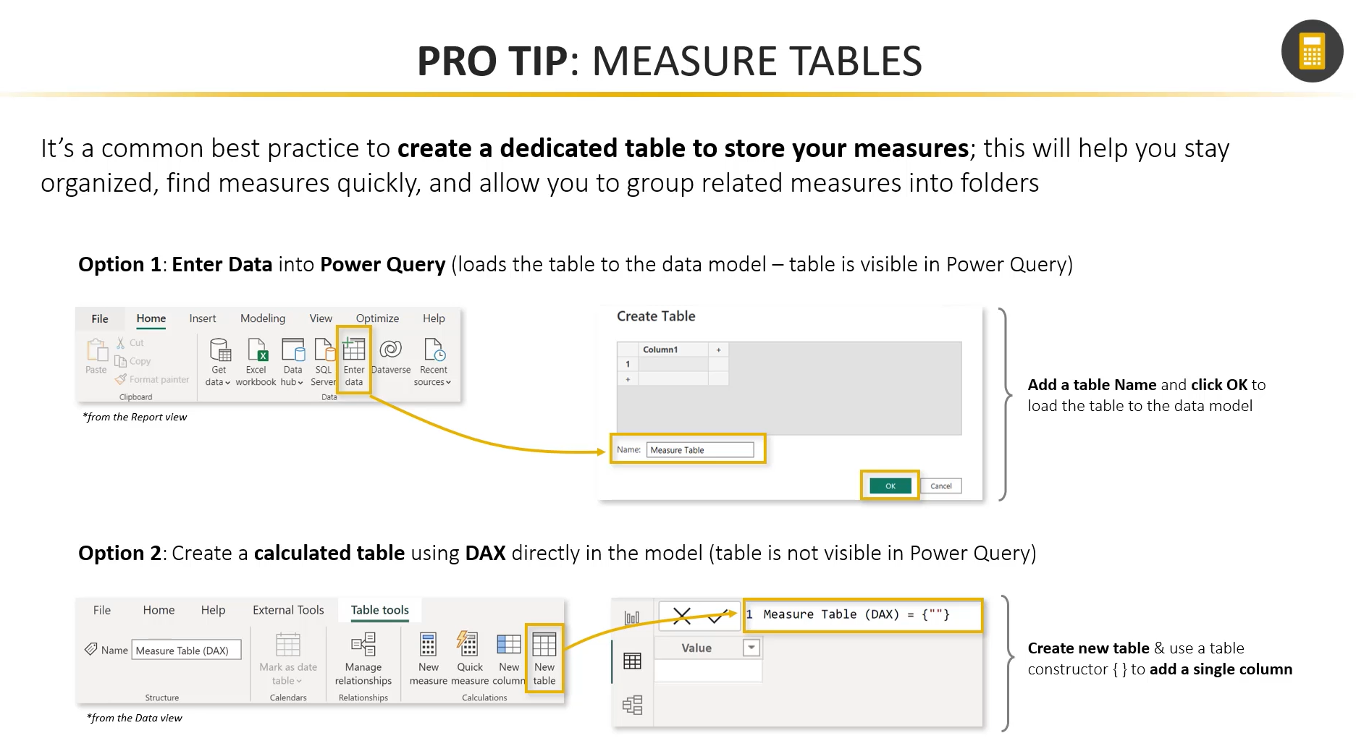

Slide 37
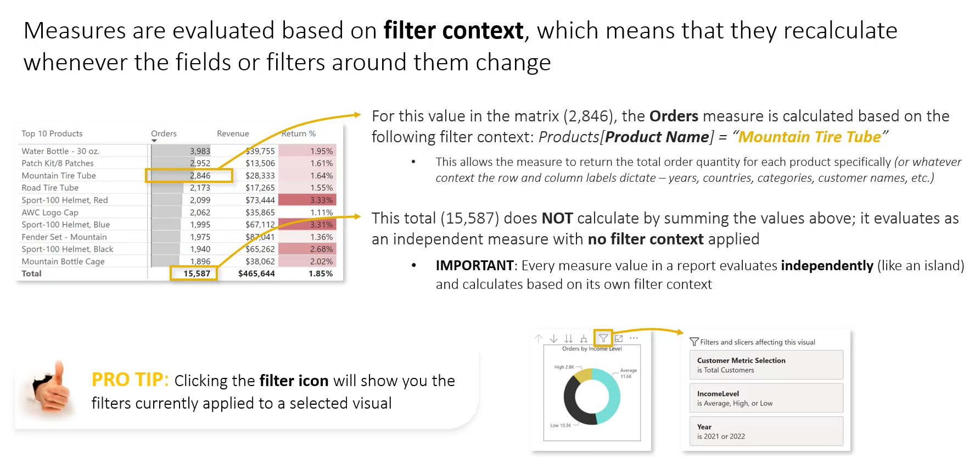

Slide 38
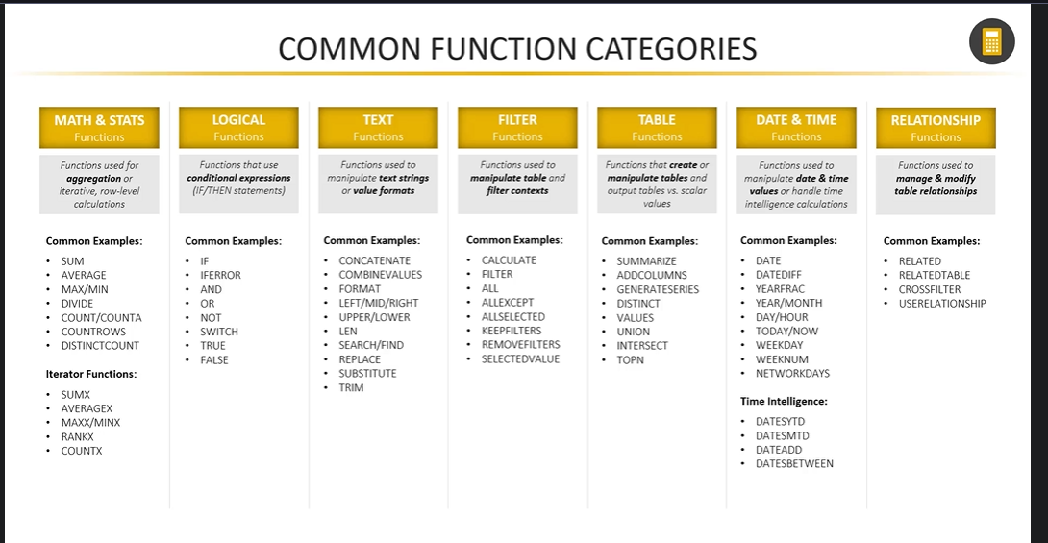

Slide 39
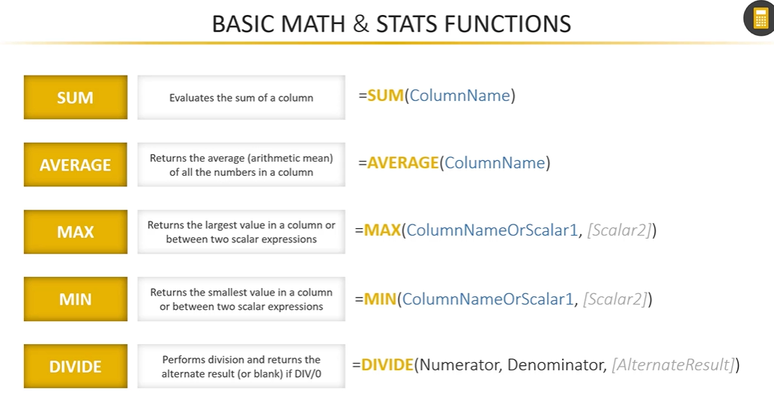

Slide 40
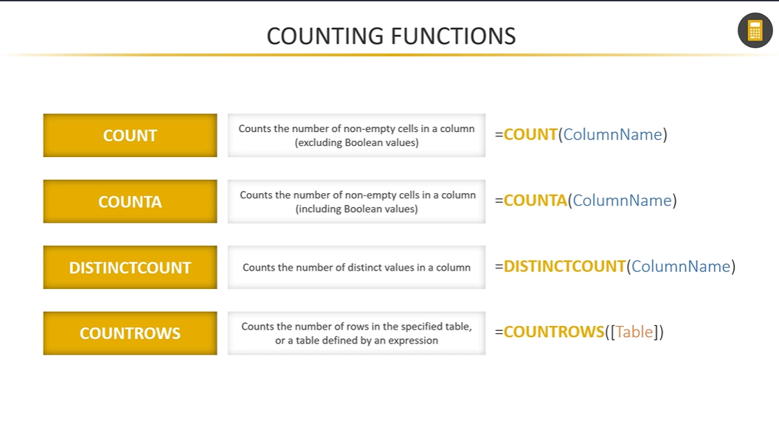

Slide 41
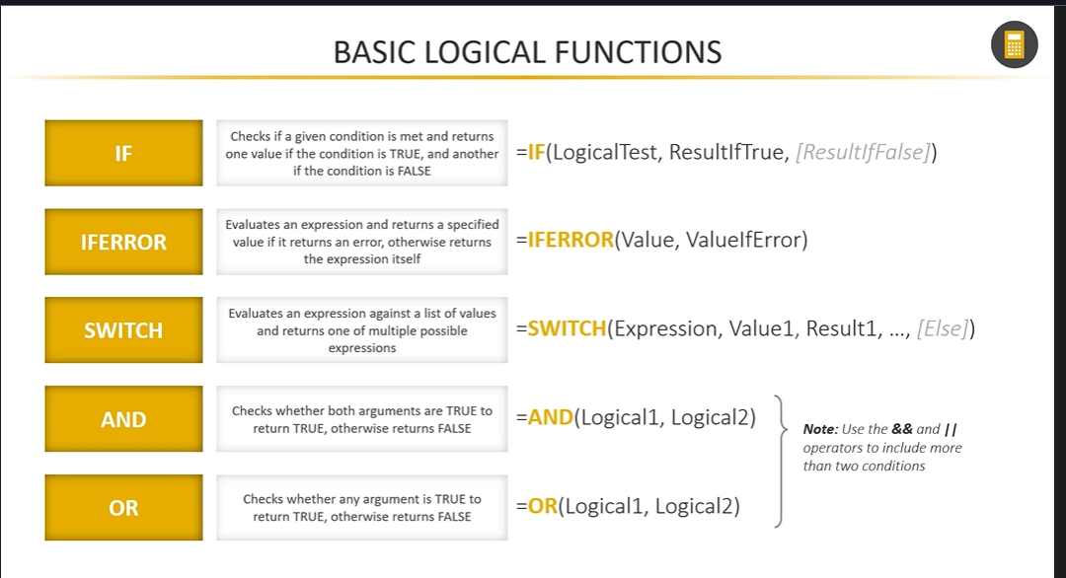

Slide 42
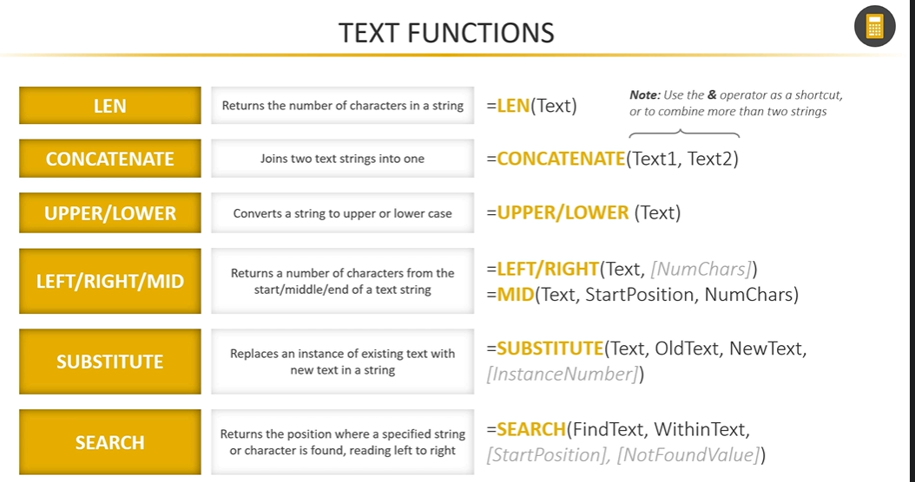

Slide 43
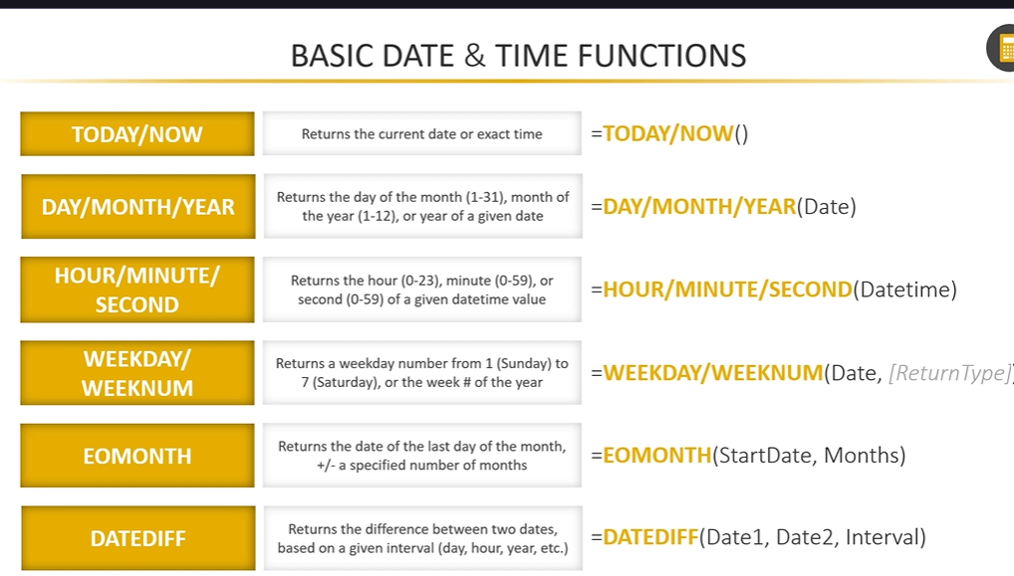

Slide 44
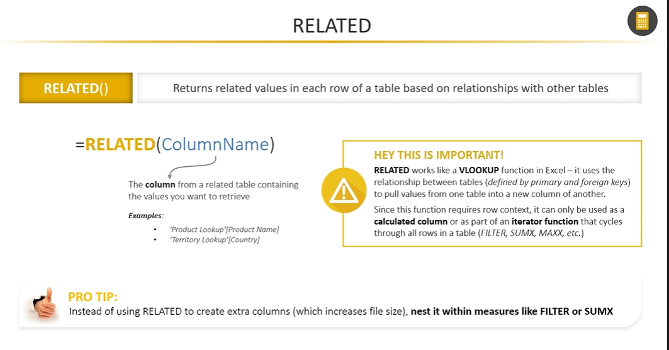

Slide 45
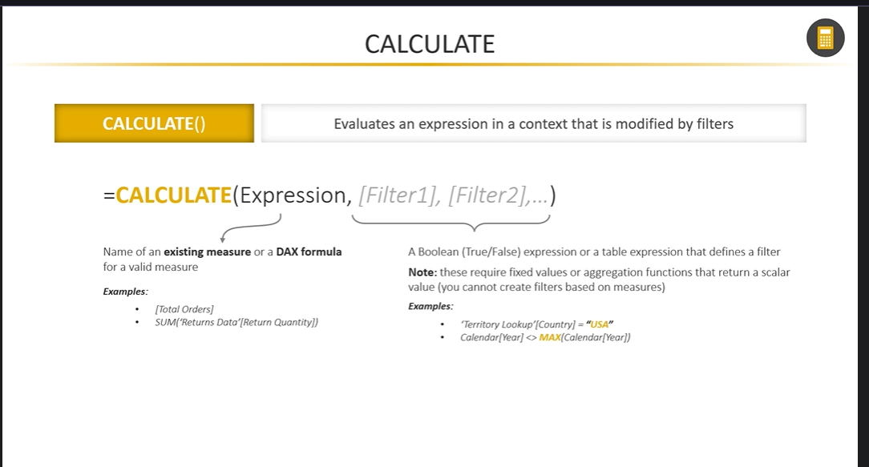

Slide 46
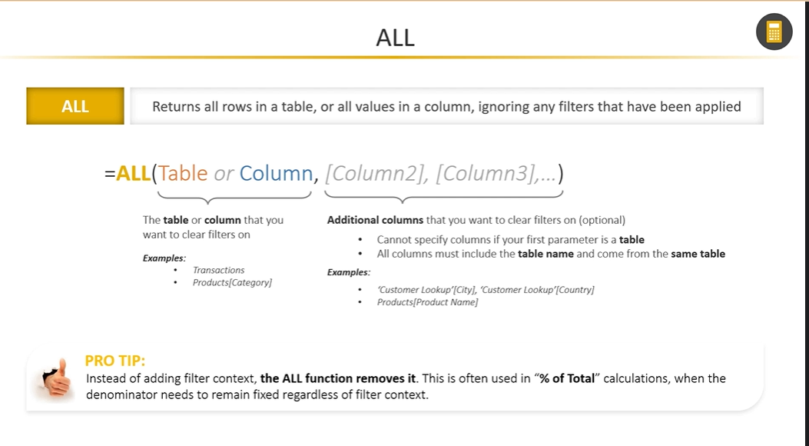

Slide 47
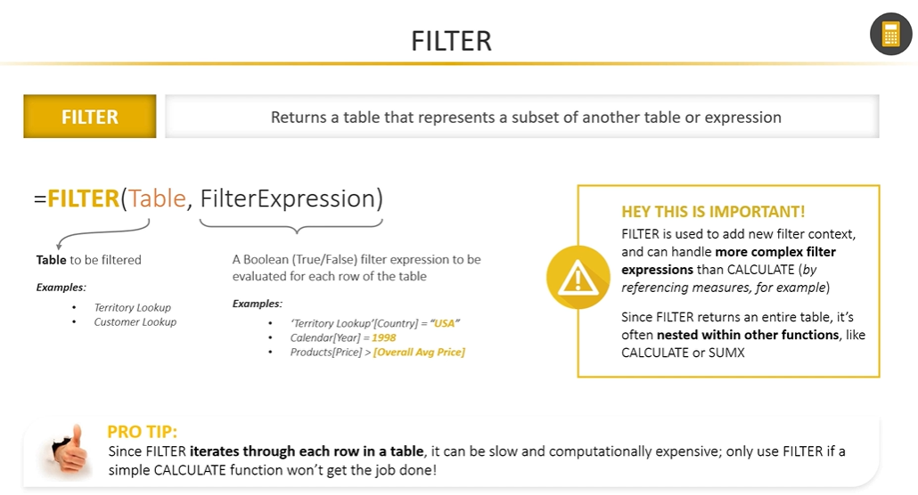

Slide 48
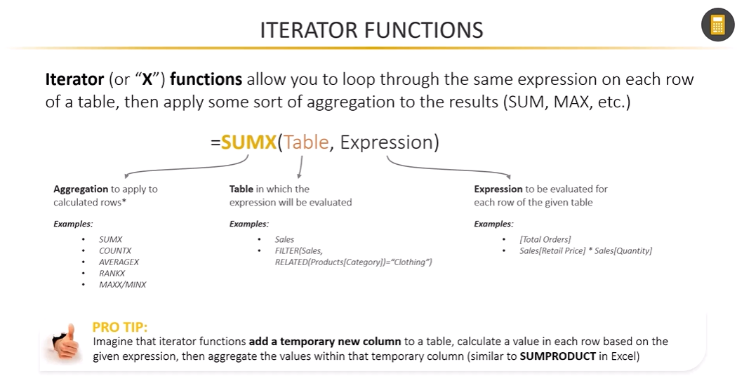

Slide 49
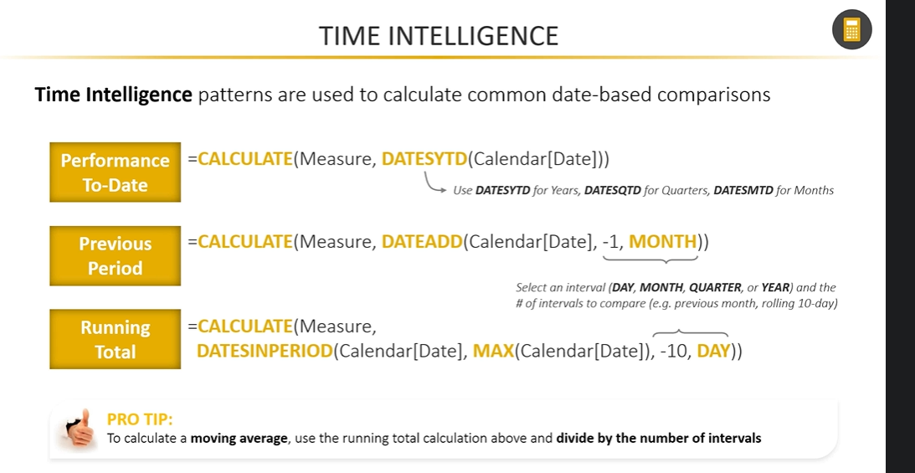

Slide 50
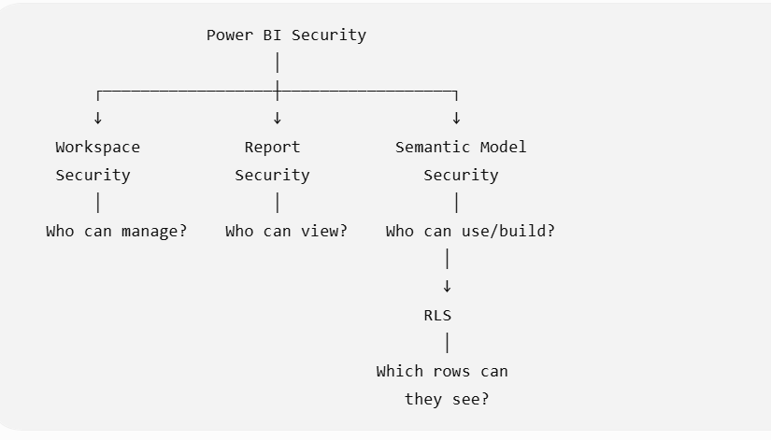
What is Power BI Security
Power BI security controls:
Who can access Power BI content and what they are allowed to do with it.
Power BI security operates at multiple levels:
Notes:
An Azure Tenant is a dedicated instance of Microsoft Azure's cloud services that represents a single organization within the Azure Active Directory

Slide 51
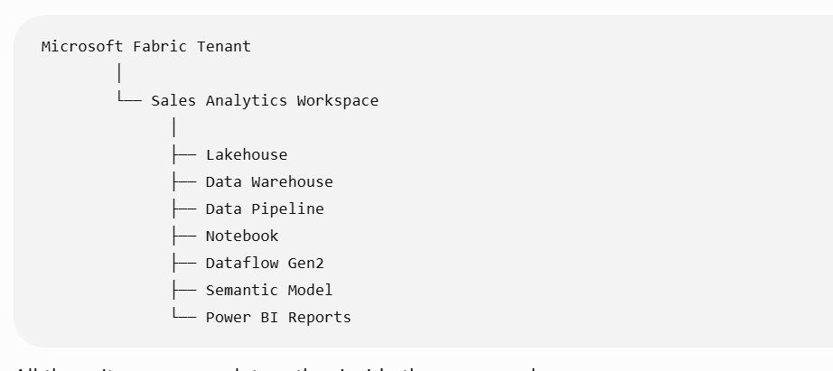
Workspace
A Workspace in Microsoft Fabric is a container used to organize, develop, manage, and share data and analytics items for a project, team, or business department.
Notes:
An Azure Tenant is a dedicated instance of Microsoft Azure's cloud services that represents a single organization within the Azure Active Directory

Slide 52
Why do we need a Workspace?
Purpose | Description
1. Organize | Keep related Fabric items together
2. Develop | Developers create notebooks, pipelines, lakehouses, reports, etc.
3. Collaborate | Multiple developers can work on the same project
4. Secure | Control who can view, edit, or manage content
5. Deploy/Share | Publish solutions to users and move content between environments
Notes:
An Azure Tenant is a dedicated instance of Microsoft Azure's cloud services that represents a single organization within the Azure Active Directory

Slide 53
Workspace Security
Workspace Security in Power BI, it controls who can access, view, edit, publish, and manage content inside a workspace.
Role | Main Permission
Admin | Full control over workspace, users, settings, and content
Member | Create, edit, publish, and manage content
Contributor | Create and edit content, but limited workspace management
Viewer | View reports and dashboards only
Workspace Security
→ Controls what users can do.
Example: John can edit the report.
Row-Level Security (RLS)
→ Controls what data users can see.
Example:John can see only South Region sales.
Notes:
An Azure Tenant is a dedicated instance of Microsoft Azure's cloud services that represents a single organization within the Azure Active Directory

Slide 54
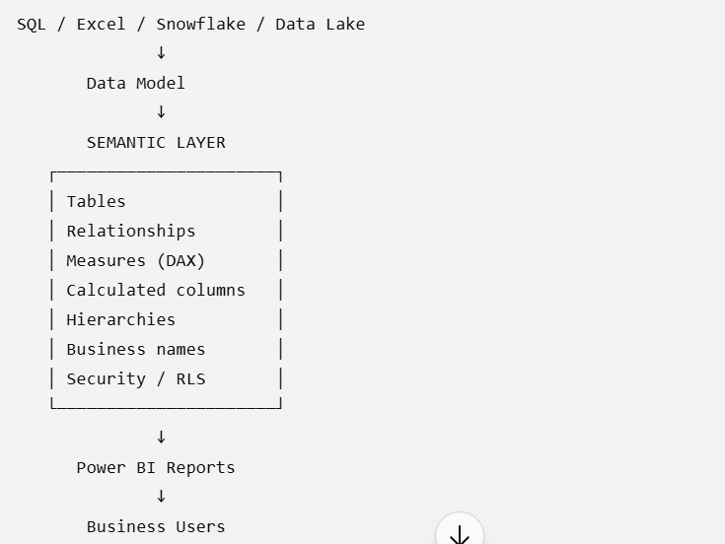
Semantic layer
A semantic model is a reusable, business-friendly data model that contains the relationships, calculations, business rules, and security needed to provide a consistent view of data to reports and users.
Notes:
An Azure Tenant is a dedicated instance of Microsoft Azure's cloud services that represents a single organization within the Azure Active Directory

Slide 55
Semantic Model Permission
It controls what another person can do with that data model.
Modify this semantic model
→ The person can change/edit the semantic model itself, such as its structure, relationships, measures, etc.
2.Share this semantic model ✅
→ The person can give other people access to this semantic model.
3.Build content with the data associated with this semantic model ✅
→ The person can create their own reports or other content using this dataset.
Notes:
An Azure Tenant is a dedicated instance of Microsoft Azure's cloud services that represents a single organization within the Azure Active Directory

Slide 56
Semantic Model Permission
It controls what another person can do with that data model.
Modify this semantic model
→ The person can change/edit the semantic model itself, such as its structure, relationships, measures, etc.
2.Share this semantic model ✅
→ The person can give other people access to this semantic model.
3.Build content with the data associated with this semantic model ✅
→ The person can create their own reports or other content using this dataset.
Notes:
An Azure Tenant is a dedicated instance of Microsoft Azure's cloud services that represents a single organization within the Azure Active Directory

Slide 57
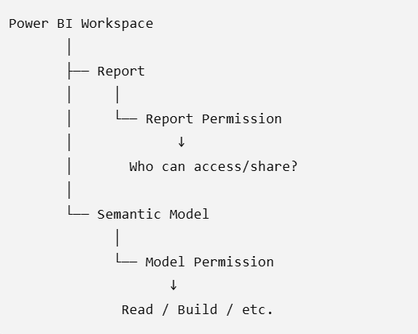
Power BI Report Permissions
Report permission controls who can access and share a particular Power BI report.
It is different from workspace permission and semantic model permission.
Notes:
An Azure Tenant is a dedicated instance of Microsoft Azure's cloud services that represents a single organization within the Azure Active Directory

Slide 58
Power BI Report Permissions
Permission / capability | Meaning
View | Open and interact with the report
Share / Reshare | Share access with other users, when permitted
Build | Create content from the underlying semantic model
Edit | Modify the report, normally associated with appropriate workspace/content permissions
Notes:
An Azure Tenant is a dedicated instance of Microsoft Azure's cloud services that represents a single organization within the Azure Active Directory

Slide 59
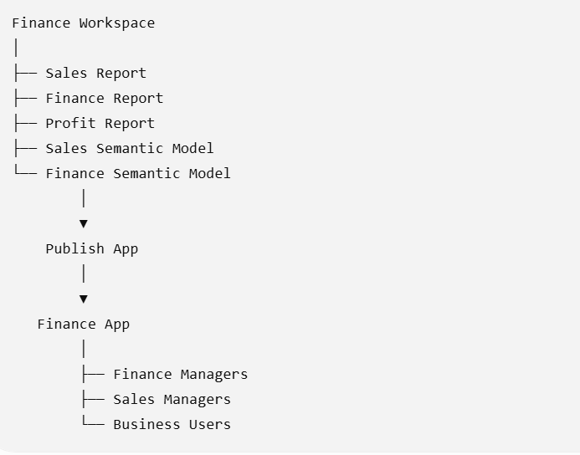
Microsoft Fabric app
What is an App in Microsoft Fabric?
A Fabric App is a way to package and distribute selected content from a Fabric workspace to business users.
The workspace is where developers/BI developers build content. The App is the controlled, user-friendly way to deliver that content to end users.
Notes:
An Azure Tenant is a dedicated instance of Microsoft Azure's cloud services that represents a single organization within the Azure Active Directory

Slide 60
Why do we use a Fabric App?
Purpose | Explanation
Easy sharing | Share reports and dashboards with many users from one place
Controlled access | Users see only the content you choose to publish
User-friendly | Users don't need to work directly inside the development workspace
Centralized distribution | Publish multiple reports/semantic models as one application
Separate development and consumption | Developers work in the workspace; users consume the published App
Audience-based access | Different groups can receive different content
Navigation | Organize reports/pages into a clean navigation structure
Notes:
An Azure Tenant is a dedicated instance of Microsoft Azure's cloud services that represents a single organization within the Azure Active Directory

Slide 61
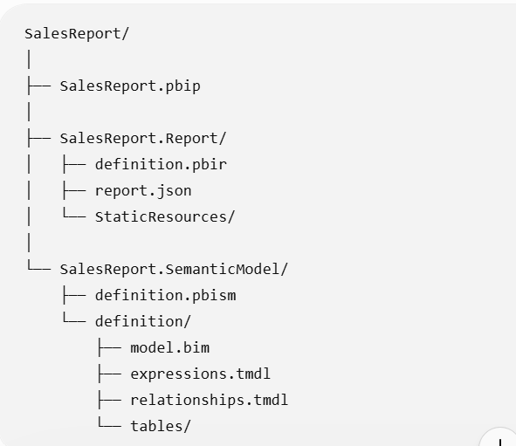
Power BI Project (PBIP)
What is PBIP?
PBIP = Power BI Project
A PBIP is a folder-based representation of a Power BI report/project.
Traditionally, Power BI Desktop saves a report as:
SalesReport.pbix
Notes:
An Azure Tenant is a dedicated instance of Microsoft Azure's cloud services that represents a single organization within the Azure Active Directory

Slide 62
Why was PBIP introduced?
Traditional .pbix files work very well for individual Power BI development.
But consider a development team:
With a .pbix file, collaboration and source-code management are difficult.
SalesReport.pbix
Git cannot meaningfully show:
    What DAX measure changed?
    What relationship changed?
    What visual changed?
    What table definition changed?
With PBIP, Power BI project components are stored as text-based files.
Therefore Git can track changes much more effectively.
Notes:
An Azure Tenant is a dedicated instance of Microsoft Azure's cloud services that represents a single organization within the Azure Active Directory

Slide 63
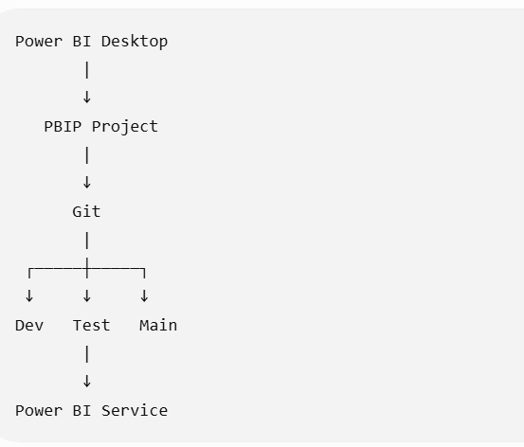
PBIP Development Model
Notes:
An Azure Tenant is a dedicated instance of Microsoft Azure's cloud services that represents a single organization within the Azure Active Directory

Slide 64
What does a PBIP project contain?
A PBIP project generally contains three important concepts:
1. Project file
SalesReport.pbip
This identifies the Power BI project.
2. Report definition
SalesReport.Report
Contains information related to the report.
For example:
      pages
      visuals
      visual configurations
      filters
      report structure
      report metadata
Notes:
An Azure Tenant is a dedicated instance of Microsoft Azure's cloud services that represents a single organization within the Azure Active Directory

Slide 65
What does a PBIP project contain?
3. Semantic model
SalesReport.SemanticModel
Contains the semantic model definition.
For example:
tables
columns
measures
relationships
calculated columns
calculation groups
model properties
Notes:
An Azure Tenant is a dedicated instance of Microsoft Azure's cloud services that represents a single organization within the Azure Active Directory

Slide 66
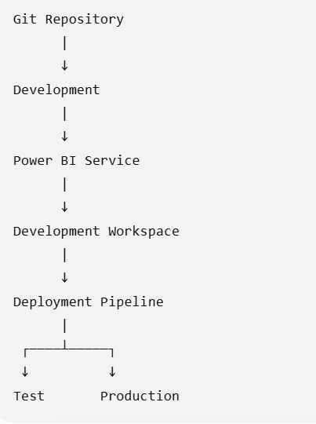
PBIP + Power BI Deployment Pipelines
Notes:
An Azure Tenant is a dedicated instance of Microsoft Azure's cloud services that represents a single organization within the Azure Active Directory

Slide 67
Thank You!

