Slide 1
databriics

Slide 2
What Is a Data Lake?
A Data Lake is a centralized storage system where you can store all types of data — raw, unstructured, semi-structured, and structured — at any scale and at low cost
Key Characteristics of a Data Lake
1. Stores All Types of Data
Structured: tables, CSV, RDBMS data
Semi-structured: JSON, XML, logs
Unstructured: images, videos, documents, audio
Binary files
2.Schema-on-Read
Data is stored first → structure is applied only when reading.
Very flexible for analytics, ML, data exploration.
3. Scalable and Low-Cost Storage
AWS S3
Azure Data Lake Storage
Google Cloud Storage
Hadoop HDFS
Notes:
define its structure, format, and the relationships between different parts of a document using symbols called tags

Slide 3
Supports Big Data Processing
Data Lakes work seamlessly with:
Apache Spark
Delta Lake
Hadoop
Presto
Databricks
Ideal for AI/ML
Because data is stored in raw form, data scientists can explore and prepare data for:
Machine learning models
Predictive analytics
Streaming analytics
Notes:
define its structure, format, and the relationships between different parts of a document using symbols called tags

Slide 4
Data Lake vs Data Warehouse
Feature | Data Lake | Data Warehouse
Data type | All (raw/structured/semi) | Mostly structured
Schema | Schema-on-read | Schema-on-write
Cost | Low | High
Processing | Batch + Streaming | Mostly batch
Use cases | AI/ML, big data, logs | BI reports, dashboards
Flexibility | Very high | Limited
Notes:
define its structure, format, and the relationships between different parts of a document using symbols called tags

Slide 5
Disadvantages of a Data Lake:
Data Becomes a “Data Swamp”
If data is dumped without proper governance, metadata, or cataloging:
Users cannot find the right data.
Duplicate and inconsistent files appear.
Data quality becomes poor.
Example:
Multiple copies of sales.json stored in different folders with different schemas → confusion.
Lack of Data Quality & Validation
Data Lakes store raw data, so:
No validation on ingestion
Incorrect or inconsistent data can enter
Harder to ensure accuracy for reporting
Example:
Missing values, wrong date formats, corrupted logs, etc.
Notes:
define its structure, format, and the relationships between different parts of a document using symbols called tags

Slide 6
Disadvantages of a Data Lake:
Complex to Manage & Govern
Since it stores all types of data:
Requires strong governance policies
Needs metadata management
Requires proper access control
If not handled:
Unauthorized users may access sensitive data.
Slow Query Performance
Because data is unstructured and schema is applied at read time:
Queries may be slow
Large scans required
Not optimized like data warehouses
Example:
SQL queries on raw CSV files → slow performance.
Notes:
define its structure, format, and the relationships between different parts of a document using symbols called tags

Slide 7
Disadvantages of a Data Lake:
Security Challenges
Raw zones may contain:
Personal information
Financial data
Confidential logs
If security policies are not tight, large data leaks can happen.
High Storage Consumption
Since data is stored as-is:
Multiple file versions
Duplicate logs
Backup copies
This increases storage cost over time.
Notes:
define its structure, format, and the relationships between different parts of a document using symbols called tags

Slide 8
What Is a Lakehouse?
A Lakehouse is a modern data architecture that combines the best features of a Data Lake + Data Warehouse.
What it solves:
Data Lakes store raw data but lack governance & performance.
Data Warehouses provide structured, reliable analytics but re expensive and rigid.
Lakehouse =
Open Data Lake Storage
+
Data Warehouse Reliability
+
Delta/Parquet Format for ACID & Transactions
Notes:
define its structure, format, and the relationships between different parts of a document using symbols called tags

Slide 9
Why Lakehouse? (Business Need)
Issue in Traditional Systems | Lakehouse Solution
Data duplication in DW & DL | Single source of storage
High ETL costs | Direct analytics on lake
No ACID in Data Lake | Delta/Hudi/Iceberg provide ACID
Poor governance | Unified governance & catalogs
ML needs raw data | Raw + curated layers exist together
Expensive DW scaling | Low-cost storage + scalable compute
Notes:
define its structure, format, and the relationships between different parts of a document using symbols called tags

Slide 10
Core Features of a Lakehouse
ACID Transactions
reliability
correct updates/deletes/merges
no partial writes
(Enabled by Delta Lake / Hudi / Iceberg)
Schema Enforcement + Evolution
Rejects bad data
Allows schema changes (add column, modify fields)
Unified Storage for All Data
structured
semi-structured
unstructured
Time Travel
Query older versions of the table.
Separation of Compute & Storage
Storage: cheap (S3, ADLS, GCS, local object storage)
Compute: Spark, Databricks, Presto, Trino, etc.
Notes:
define its structure, format, and the relationships between different parts of a document using symbols called tags

Slide 11
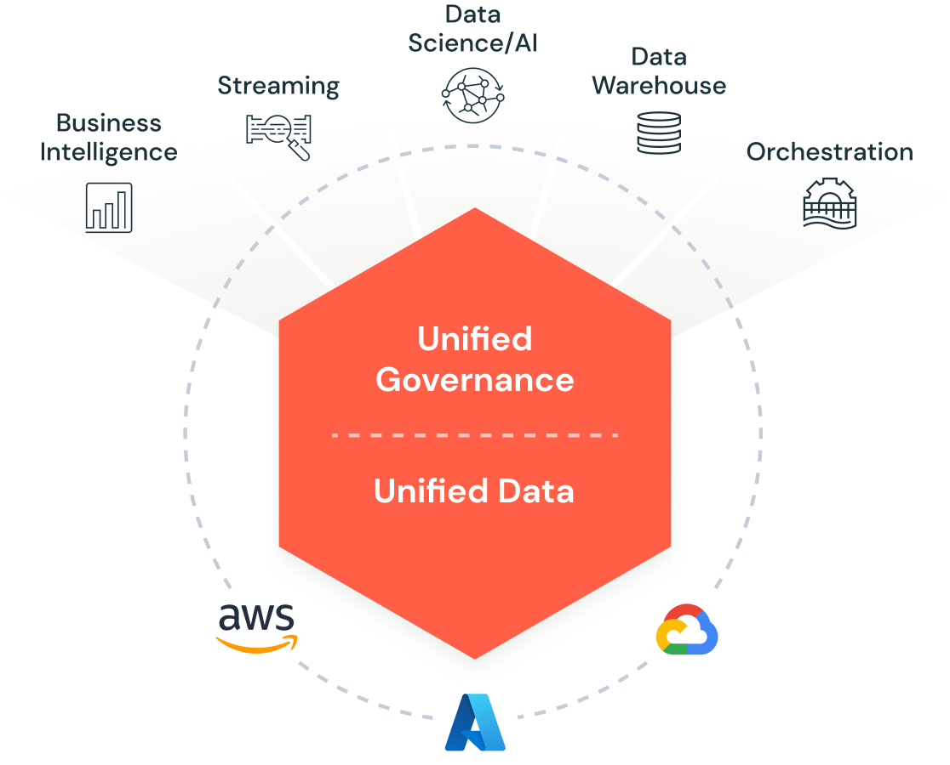
Notes:
define its structure, format, and the relationships between different parts of a document using symbols called tags

Slide 12
Components of a Lakehouse Architecture
Storage Layer (Open Format)
Parquet
Delta
Iceberg
ORC
Examples:AWS S3,Azure ADLS,GCS,On-prem object store
Metadata & Governance Layer
Hive Metastore
Unity Catalog
AWS Glue Catalog
Handles:
Table definitions
Permissions
Lineage
Auditing
Notes:
define its structure, format, and the relationships between different parts of a document using symbols called tags

Slide 13
Compute Engines
Apache Spark
Databricks
Presto / Trino
Snowflake
BigQuery
Synapse
Ingestion Tools
Apache Kafka
Apache Spark Streaming
Flink
AWS Kinesis
Azure Event Hub
Batch ingestion tools (ADF, Glue, NiFi)
ML & Analytics
Spark MLlib
TensorFlow
MLflow
Notes:
define its structure, format, and the relationships between different parts of a document using symbols called tags

Slide 14
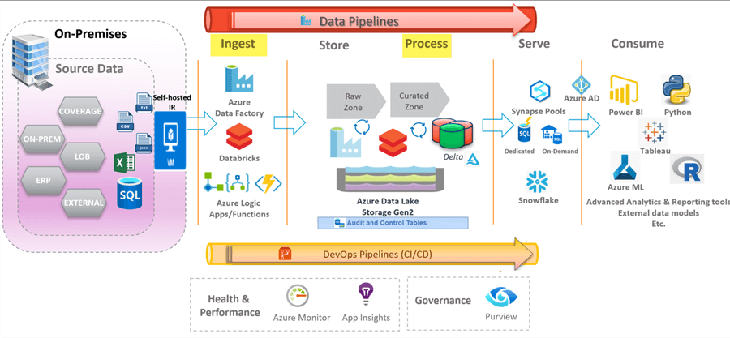
Notes:
define its structure, format, and the relationships between different parts of a document using symbols called tags

Slide 15
Compute Engines
Apache Spark
Databricks
Presto / Trino
Snowflake
BigQuery
Synapse
Ingestion Tools
Apache Kafka
Apache Spark Streaming
Flink
AWS Kinesis
Azure Event Hub
Batch ingestion tools (ADF, Glue, NiFi)
ML & Analytics
Spark MLlib
TensorFlow
MLflow
Notes:
define its structure, format, and the relationships between different parts of a document using symbols called tags

Slide 16
Step 1:
Data Ingestion
Data flows from:
operational DBs (Oracle, MySQL)
IoT devices
ERP / CRM
streaming sources (Kafka)
→ to Bronze layer
Step 2: Data Processing
Using Spark:
clean
transform
deduplicate
validate schema
→ move to Silver layer
Notes:
define its structure, format, and the relationships between different parts of a document using symbols called tags

Slide 17
Step 3: Data Aggregation
Business logic:
fact tables (sales, revenue, cost)
dimension tables (customers, products)
→ move to Gold layer
Step 4: Serving Data
BI dashboards
ML training
Real-time apps
Data APIs
Notes:
define its structure, format, and the relationships between different parts of a document using symbols called tags

Slide 18
Lakehouse vs Data Lake vs Data Warehouse
Feature | Data Lake | Data Warehouse | Lakehouse
Data Type | All types | Structured | All types
ACID | ❌ No | ✔ Yes | ✔ Yes
Governance | Weak | Strong | Strong
Performance | Low | High | High
Cost | Low | High | Medium
ML Support | High | Low | High
Time Travel | ❌ | ✔ | ✔
Schema | On-read | On-write | Both
Notes:
define its structure, format, and the relationships between different parts of a document using symbols called tags

Slide 19
LAKEHOUSE PRINCIPLES
1 ACID Transactions
Lakehouse systems must support Atomicity, Consistency, Isolation, Durability.
Why?
Ensures reliable writes/updates/deletes
Prevents partial writes or corrupted tables
Supports concurrent operations
Important for:
Upserts, merges, streaming writes, time travel
2 Schema Enforcement & Governance
A Lakehouse maintains data quality using:
Schema enforcement (reject bad data)
Schema evolution (allow adding new fields)
Centralized governance (catalogs & permissions)
Why?
Data Lakes become “data swamps” without structure. Lakehouses prevent this.
Notes:
define its structure, format, and the relationships between different parts of a document using symbols called tags

Slide 20
3 Storage & Compute Separation
Lakehouse uses:
Cheap object storage → S3 / ADLS / GCS
Independent compute engines → Spark, Presto, Trino, DB SQL
Benefit:
Scale storage and compute separately → lower cost, more flexibility.
4 Open Storage Formats
Data is stored in open, columnar formats:
Delta Lake
Apache Iceberg
Apache Hudi
Parquet
Why?
Avoid vendor lock-in
Any engine can read/write
Enables long-term durability
Notes:
define its structure, format, and the relationships between different parts of a document using symbols called tags

Slide 21
5 Support for BI + AI/ML Workloads (Unified System)
Traditional systems separate:
Data Warehouse → BI
Data Lake → AI/ML
Lakehouse combines both.
Advantages:
Single data copy
Simpler pipeline
Same data accessible by Power BI, MLflow, Python, Spark, Tableau, etc.
6 End-to-End Streaming + Batch Support
Lakehouse supports:
Real-time ingestion (Kafka, Event Hub)
Stream processing
Batch analytics
Using a unified table format (like Delta), streaming writes become first-class citizen.
Notes:
define its structure, format, and the relationships between different parts of a document using symbols called tags

Slide 22
7 Time Travel & Data Versioning
Lakehouse maintains snapshots/versions of the table.
You can:
Query old versions
Reproduce past dashboards
Recover from accidental deletes
Enabled by:
Delta Lake transaction logs
Iceberg metadata snapshots
Notes:
define its structure, format, and the relationships between different parts of a document using symbols called tags

Slide 23
8 Indexing & Performance Optimization
To achieve Data Warehouse–level performance,
Lakehouses provide:
Data skipping
Z-ordering
Bloom filters
Caching
Column pruning
File compaction
Why?
Raw data in lakes is slow → Lakehouse solves performance issues.
Notes:
define its structure, format, and the relationships between different parts of a document using symbols called tags

Slide 24
9 Unified Governance & Security
Lakehouse centralizes governance:
Access control
Lineage
Auditing
Metadata management
Fine-grained permissions
Powered by tools like:
Unity Catalog (Databricks)
Apache Ranger
AWS Lake Formation
10 Standard SQL Support
BI teams require SQL.
Lakehouse engines support:
ANSI SQL
DDL/DML
MERGE, UPDATE, DELETE directly on tables
Notes:
define its structure, format, and the relationships between different parts of a document using symbols called tags

Slide 25
Introduction to Databricks
Databricks is a unified data analytics and AI platform built on top of Apache Spark.
Provides a collaborative environment for data engineering, data science, machine learning, and analytics.
Founded by the creators of Apache Spark.
Supports multiple languages: Python, SQL, R, Scala, Java.
Available on major clouds: Azure, AWS, Google Cloud.
Why Databricks?
Traditional data architectures are complex, slow, and expensive.
Data exists in multiple systems (data warehouse, data lake, ETL pipelines, ML environments).
Difficulty in:
Handling unstructured data
Scaling big data
Operationalizing machine learning
Databricks solves these problems with a Lakehouse Architecture.
Notes:
define its structure, format, and the relationships between different parts of a document using symbols called tags

Slide 26
Key Components of Databricks
Databricks Workspace: Interface for notebooks, repos, workflows.
Databricks Runtime: Optimized Spark cluster engine.
Delta Lake: Storage layer enabling ACID transactions on data lakes.
Unity Catalog: Centralized governance for data, models, and AI.
MLflow: Machine learning lifecycle platform.
Databricks SQL: BI engine for SQL analytics.
Databricks Lakehouse Platform
The Lakehouse combines the best of:
Data Lakes → Scalability, low cost
Data Warehouses → ACID transactions, governance, BI performance
Core principles:
Open Storage Format → Delta Lake
Governance + Security → Unity Catalog
High Performance → Photon Engine, optimized Spark
Support for All Workloads → Batch, streaming, ML, BI
Notes:
define its structure, format, and the relationships between different parts of a document using symbols called tags

Slide 27
What is Delta Lake?
Open-source storage layer from Databricks.
Enables ACID transactions on data lakes.
Solves problems such as:
Dirty reads
Schema inconsistencies
Slow query performance
Data corruption
Features
Time Travel
Schema Enforcement
Schema Evolution
MERGE, UPDATE, DELETE
Auto Optimize & Z-Ordering
Notes:
define its structure, format, and the relationships between different parts of a document using symbols called tags

Slide 28
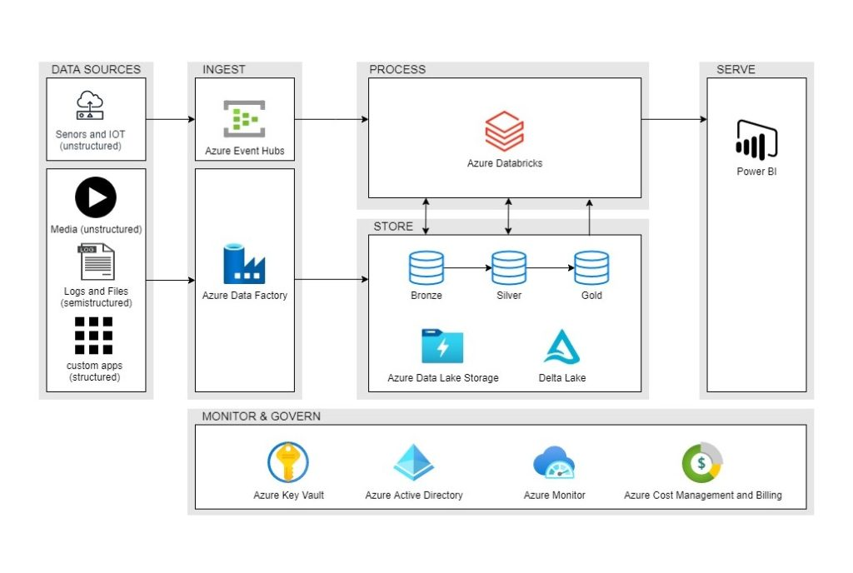
Databricks Architecture
Notes:
define its structure, format, and the relationships between different parts of a document using symbols called tags

Slide 29
Databricks Architecture
Layers:
Storage Layer → Cloud Object Storage (S3, ADLS, GCS) with Delta Lake
Compute Layer → Clusters (Spark, Photon)
Governance Layer → Unity Catalog
Consumption Layer → Notebooks, Databricks SQL, BI tools (PowerBI, Tableau)
Databricks Notebooks
Interactive environment for:
Data exploration
ETL pipelines
Machine learning models
Visualizations
Supports multiple languages in a single notebook.
Version control using Repos + GitHub/Azure DevOps.
Notes:
define its structure, format, and the relationships between different parts of a document using symbols called tags

Slide 30
Databricks Architecture
Databricks Clusters
Clusters are the compute engines.
Types of clusters:
Interactive → For development
Job clusters → Auto-spin for ETL jobs
All-Purpose Clusters → Multi-user
Autoscaling supported.
Databricks Runtime accelerates Spark performance.
Notes:
define its structure, format, and the relationships between different parts of a document using symbols called tags

Slide 31
Unity Catalog – Governance
Platform for:
Data discovery
Access control
Lineage
Security
Auditing
Provides fine-grained access down to column-level.
Governs:
Tables
Files
ML Models
Dashboards
Functions
Notes:
define its structure, format, and the relationships between different parts of a document using symbols called tags

Slide 32
Databricks for Machine Learning
MLflow built-in for lifecycle:
Experiment Tracking
Model Registry
Deployment
AutoML for quick model development.
Supports distributed training frameworks:
TensorFlow
PyTorch
Scikit-learn
Feature Store for feature versioning and reuse.
Notes:
define its structure, format, and the relationships between different parts of a document using symbols called tags

Slide 33
Databricks SQL
High-performance SQL warehousing layer.
Photon query engine → extremely fast.
Enables dashboards and BI workloads.
Integrates with:
Power BI
Tableau
Looker
Notes:
define its structure, format, and the relationships between different parts of a document using symbols called tags

Slide 34
Use Cases
ETL / ELT Pipelines
Ingesting raw data (batch or streaming)
Transformation using Spark
Storing in Delta Lake
Real-Time Analytics
Structured Streaming
IoT data pipelines
Data Science & ML
Feature engineering
Training models at scale
BI and Reporting
Dashboards
SQL data warehouse workloads
Notes:
define its structure, format, and the relationships between different parts of a document using symbols called tags

Slide 35
Industry Examples
Retail: Recommendation engines
Banking: Fraud detection
Healthcare: Predictive analytics
Manufacturing: IoT device monitoring
Government: Compliance reporting
Notes:
define its structure, format, and the relationships between different parts of a document using symbols called tags

Slide 36
Databricks Advantages
Unified platform → No siloed systems
Faster performance with Photon Engine
Open and enterprise-ready (Delta Lake, MLflow)
Best-in-class governance (Unity Catalog)
Cost-efficient & elastic
Databricks vs Traditional Systems
Feature | Data Warehouse | Data Lake | Databricks Lakehouse
Handles structured data | Yes | Limited | Yes
Handles unstructured data | No | Yes | Yes
Supports BI | Yes | No | Yes
Supports ML | Limited | Yes | Yes
ACID Transactions | Yes | No | Yes
Cost Efficiency | Low | High | High + ACID
Notes:
define its structure, format, and the relationships between different parts of a document using symbols called tags

Slide 37
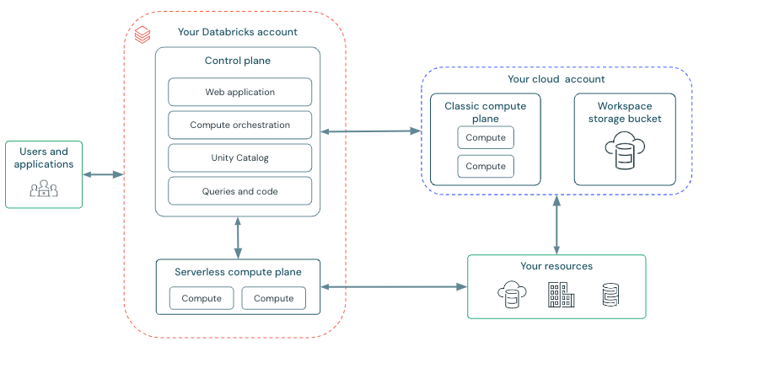
Databricks architecture is split into two logical layers:
Control Plane
Managed completely by Databricks
Stores meta-information, notebooks, job configurations, etc.
Data Plane
Runs in your cloud account (AWS / Azure / GCP)
Your actual data stays here
All compute happens here (clusters, SQL warehouses)
This separation ensures security, privacy, and enterprise control.
Notes:
define its structure, format, and the relationships between different parts of a document using symbols called tags

Slide 38
Why Split Architecture?
Benefits:
Security: Databricks never stores or accesses your business data.
Scalability: Compute autoscaling happens independently.
Governance: Central identity & access control through Control Plane.
Flexibility: You choose storage, networking, encryption in Data Plane.
What is the Control Plane?
The Databricks Control Plane is the fully managed SaaS layer responsible for:
User authentication
Workspace UI & notebooks
Cluster configuration
Job scheduling
SQL endpoints & dashboard metadata
Model registry (MLflow metadata)
Notebooks storage (encrypted)
It does not process your data.
Notes:
define its structure, format, and the relationships between different parts of a document using symbols called tags

Slide 39
Control Plane Responsibilities
Cluster Manager: Creates, starts, stops compute clusters
Notebook Management: Stores notebook code and revisions
Job Orchestration: Workflow scheduler for ETL/ML jobs
REST APIs & UI: All UI interactions go through the control plane
Unity Catalog Governance: Central location for permissions & lineage
Secrets Management: Secure storage of tokens, passwords
What the Control Plane Contains
Component | Stored in Control Plane
Notebooks | ✔️ Yes
Job definitions | ✔️ Yes
Metadata | ✔️ Yes
SQL dashboards | ✔️ Yes
Data | ❌ No
Cluster execution | ❌ No
Notes:
define its structure, format, and the relationships between different parts of a document using symbols called tags

Slide 40
What is the Data Plane?
The Data Plane refers to the environment inside your own cloud account where:
Compute clusters run
SQL warehouses run
Your actual data lives (ADLS / S3 / GCS)
Delta Lake tables are stored
ETL processing happens
This ensures your data never leaves your cloud boundary.
Data Plane Responsibilities
Running Spark compute clusters
Processing ETL / batch / streaming workloads
Storing and reading data from:
Data Lakes (Delta Lake)
Parquet / CSV / JSON
External Databases
ML training using distributed compute
Execution of Databricks SQL queries
Notes:
define its structure, format, and the relationships between different parts of a document using symbols called tags

Slide 41
What the Data Plane Contains
Component | Stored/Executed in Data Plane
Business data | ✔️ Yes
Delta Lake tables | ✔️ Yes
Clusters (Spark/Photon) | ✔️ Yes
SQL Warehouse compute | ✔️ Yes
Unity Catalog–governed tables | ✔️ Yes
Notebooks | ❌ No
Metadata | ❌ No
COMMUNICATION BETWEEN PLANES
Control Plane sends → “Run this notebook code”
Data Plane executes → Spark/SQL engine
Results (not the full data) return to the Control Plane for display
Notes:
define its structure, format, and the relationships between different parts of a document using symbols called tags

Slide 42
What is DBFS?
DBFS = Databricks File System
A virtual, distributed filesystem built on top of cloud storage:
Azure → ADLS Gen2
AWS → S3
GCP → GCS
Provides a POSIX-like interface to cloud data:
dbfs:/mnt/data/file.csv
/dbfs/mnt/data/file.csv
Why DBFS Is Important
Simplifies reading and writing files from Databricks notebooks
Works seamlessly with Spark APIs (CSV, Parquet, Delta)
Allows mounting external cloud storage to easier paths
Enables:
ETL processing
Machine Learning workflows
Storage for temp files & artifacts
Notebook datasets and shared files
Notes:
define its structure, format, and the relationships between different parts of a document using symbols called tags

Slide 43
Components:
DBFS Root → Managed by Databricks (temporary storage)
FileStore → UI uploads, images, dataset sharing
Mount Points → Mapped cloud storage (S3/ADLS/GCS)
Local driver path → /dbfs/... for local file access
DBFS Mount Points
Mount external storage for easy access:
Example
dbfs:/mnt/raw-data
dbfs:/mnt/delta/sales
Benefits:
Simplifies file operations
Centralized data access
Works with Spark & ML workflows seamlessly
Notes:
define its structure, format, and the relationships between different parts of a document using symbols called tags

Slide 44
What is a Workspace (WorkSpark) in Databricks?
In Databricks, the Workspace is the main user interface where you develop, manage, and collaborate on data engineering, data science, machine learning, and analytics tasks.
Think of it like a virtual office where all tools, notebooks, datasets, clusters, jobs, dashboards, and users come together.
What Does the Databricks Workspace Contain?
The workspace consists of the following major components:
Notebooks
Interactive environment to write Python, SQL, Scala, R, or Markdown.
Used for ETL pipelines, data analysis, ML modeling.
Supports visualizations, widgets, commands, charts.
Repos (Git Integration)
Connects workspace with GitHub, GitLab, Azure DevOps, Bitbucket.
Helps version control your notebooks and code.
Notes:
define its structure, format, and the relationships between different parts of a document using symbols called tags

Slide 45
Clusters
Compute engines where Spark code runs.
Types:
Interactive clusters (for notebooks)
Job clusters (for scheduled workflows)
High-concurrency clusters
Jobs
Workflows to schedule notebooks, JARs, Python scripts.
Supports:
Multi-task workflows
Notifications
Retry policies
DBFS (Databricks File System)
Distributed file storage built on top of cloud storage.
Used to store:
Data files
Delta tables
Libraries
Model files
Notes:
define its structure, format, and the relationships between different parts of a document using symbols called tags

Slide 46
Unity Catalog (If enabled)
Central governance layer.
Manages:
Users
Permissions
Data lineage
Tables, schemas, volumes
External storage locations
MLflow
Used for:
Experiment tracking
Model versioning
Model registry
Deploying ML models
Libraries
External packages for clusters:
Python wheels
JAR files
Maven libraries
Notes:
define its structure, format, and the relationships between different parts of a document using symbols called tags

Slide 47
Dashboards (Databricks SQL)
Visual analytics layer.
Create dashboards using SQL queries.
Connects to:
Lakehouse tables
Delta tables
External data sources
Data Explorer
Browser for:
Catalogs
Schemas
Tables
Views
Table details (schema, history, permissions)
SQL Warehouses
Dedicated SQL compute for BI workloads.
Used in Databricks SQL workspace.
Notes:
define its structure, format, and the relationships between different parts of a document using symbols called tags

Slide 48
What is a Catalog in Databricks?
A Catalog in Databricks is the top-level container for organizing data in the Databricks Lakehouse.
Think of a Catalog like a drive in a computer (e.g., C:, D:)
Inside a catalog, you have Schemas, and inside schemas you have Tables / Views / Volumes.
So the hierarchy is:
Catalog
└── Schema (Database)
└── Tables / Views / Functions / Volumes
Why does Databricks use catalogs?
To provide:
Central management of all data
Governance (permissions, data access control)
Data lineage (tracking)
A single place to manage tables across teams and projects
Notes:
define its structure, format, and the relationships between different parts of a document using symbols called tags

Slide 49
Types of Catalogs
Databricks provides two types of catalogs:
Unity Catalog (UC) catalogs
These are catalogs created and governed by Unity Catalog.
Examples:
main
sandbox
finance_catalog
Marketing_catalog
These catalogs support:
Row/column-level access control
Audit logs
Lineage tracking
External locations
Volumes
Managed & external tables
This is the recommended modern catalog type.
Notes:
define its structure, format, and the relationships between different parts of a document using symbols called tags

Slide 50
Hive Metastore catalog (hive_metastore)
This is the old (legacy) storage metastore.
hive_metastore
Limitations:
No fine-grained access control
No lineage
No external volumes
Weaker governance
Not allowed in many enterprises
Unity Catalog replaces this in modern setups.
Catalog Structure Example
main ← catalog
└── default ← schema
└── customers ← table
└── orders ← table
└── sales ← table
└── bronze ← schema
└── silver ← schema
└── gold ← schema
Notes:
define its structure, format, and the relationships between different parts of a document using symbols called tags

Slide 51
CATALOG vs WORKSPACE in DATABRICKS
Feature | Catalog | Workspace
Definition | A data container that stores and organizes tables, schemas, views, and files | The user interface environment where you develop notebooks, run jobs, manage clusters, and collaborate
Purpose | Manage data governance (tables, schemas, permissions) | Manage development, compute, users, notebooks
What it contains | Catalog → Schemas → Tables/Views/Volumes | Notebooks, clusters, jobs, dashboards, repos, Delta tables, MLflow
Security | Fine-grained access control (Unity Catalog) | User/workspace-level permissions (folders, notebooks)
Scope | Controls data access | Controls compute and development
Example | main, hive_metastore, catalog1, sales_data | Workspace folders, notebooks, clusters
Managed by | Unity Catalog (data governance layer) | Databricks workspace UI and admin settings
Notes:
define its structure, format, and the relationships between different parts of a document using symbols called tags

Slide 52
Schema Enforcement (Also called Schema Validation)
Schema Enforcement ensures that incoming data must follow the table schema. If new data has:
Missing columns Extra columns Wrong data types
Delta Lake rejects the write operation to prevent corrupt or inconsistent data.
Example
If your Delta table has:
id INT, name STRING, salary DOUBLE
and you try to append:
{id: "abc", name: "Ravi", salary: 50000}
The write fails because id must be INT.
Purpose
Prevents bad data from entering the table
Maintains schema consistency
Ensures reliable analytics
Notes:
define its structure, format, and the relationships between different parts of a document using symbols called tags

Slide 53
Schema Evolution
Schema Evolution allows changing the table schema automatically when new data arrives — typically during:
MERGE operations
AutoLoader (cloud ingestion)
Streaming ingestion
Overwrite operations
Append with mergeSchema or autoMerge settings
What Evolutions Are Allowed
You can add new columns automatically:
Example: Adding a new column
Incoming data:{id: 1, name: "Ravi", salary: 50000, dept: "IT"}
Your table does not have dept column.
With auto-merge enabled, Delta will add the dept column Automatically
Notes:
define its structure, format, and the relationships between different parts of a document using symbols called tags

Slide 54
What is Partitioning in Delta Lake?
Partitioning is the technique of organizing data into subfolders based on the value of one or more columns.
Why?
Faster queries
Faster reads
Reduced data scanning
Lower compute cost
When to Use Partitioning?
Partition only when:
✔ Queries frequently filter by this column ✔ Column has low or medium cardinality ✔ Column is in WHERE clause, GROUP BY, or JOIN
Types of partitions
Type | Description | Example
Single Column | Partition by one field | PARTITIONED BY (country)
Multi Column | Hierarchical partitions | PARTITIONED BY (year, month)
Time-based | Partition by year/month/day | year(order_date)
Notes:
define its structure, format, and the relationships between different parts of a document using symbols called tags

Slide 55
What is Z-Ordering in Databricks?
Z-Ordering (also written as ZORDER BY) is an optimization technique used in Delta Lake to improve data skipping for tables that are frequently filtered on certain columns.
It works by co-locating related data in the same data files using a multi-dimensional clustering algorithm (Z-Curve).
Why it is needed?
When you run a query like:
SELECT * FROM sales WHERE customer_id = 1005;
Without Z-Ordering:
Data may be randomly distributed across many files.
Spark needs to scan many files ➝ slow.
With Z-Ordering:
Rows with similar customer_id are stored together in fewer files.
Spark skips unnecessary files ➝ much faster.
Notes:
define its structure, format, and the relationships between different parts of a document using symbols called tags

Slide 56
When to use Z-Ordering
Use Z-ORDER on:
High-cardinality columns (customer_id, order_id, invoice_no)
Frequently filtered columns
Join keys
Avoid Z-ORDER on:
Low-cardinality columns (gender, status)
Constantly changing columns
Basic Syntax of Z-Ordering
OPTIMIZE table_name
ZORDER BY (column1, column2);
Notes:
define its structure, format, and the relationships between different parts of a document using symbols called tags

Slide 57
Difference Between Partitioning and Z-Ordering
Feature | Partitioning | Z-Ordering
Type | Heavy physical re-organization | Light clustering
Best for | Low-cardinality columns (year, month) | High-cardinality columns (customer_id, product_id)
Removes data? | Yes (prunes partitions) | Yes (skips files)
When to avoid | High-cardinality columns | Rarely used columns
Notes:
define its structure, format, and the relationships between different parts of a document using symbols called tags

Slide 58
What is Auto Loader in Databricks?
Auto Loader is a Databricks feature used to automatically ingest new files from cloud storage (ADLS, S3, GCS) incrementally and efficiently into Delta tables using Structured Streaming.
Feature | Explanation
Incremental Processing | Reads only new files arriving in a folder.
Schema Evolution | Automatically detects new columns.
High Performance | Uses file notification or directory listing for efficiency.
Exactly-Once Processing | Uses checkpoints & metadata to avoid duplicate processing.
Supports CSV, JSON, Parquet, Avro | Multiple file formats.
Notes:
define its structure, format, and the relationships between different parts of a document using symbols called tags

Slide 59
What is Auto Loader in Databricks?
Auto Loader is a Databricks feature used to automatically ingest new files from cloud storage (ADLS, S3, GCS) incrementally and efficiently into Delta tables using Structured Streaming.
Feature | Explanation
Incremental Processing | Reads only new files arriving in a folder.
Schema Evolution | Automatically detects new columns.
High Performance | Uses file notification or directory listing for efficiency.
Exactly-Once Processing | Uses checkpoints & metadata to avoid duplicate processing.
Supports CSV, JSON, Parquet, Avro | Multiple file formats.
Notes:
define its structure, format, and the relationships between different parts of a document using symbols called tags

Slide 60
Use Case | Recommended?
Lots of new files arriving daily | ✔ Yes
Continuous ingestion | ✔ Yes
Schema changing over time | ✔ Yes
Large CSV/JSON data | ✔ Yes
Only one-time ingestion | ❌ Not needed
Notes:
define its structure, format, and the relationships between different parts of a document using symbols called tags

Slide 61
What is the Delta Table Transaction Log?
Every Delta table has a special folder called:
<table_path>/_delta_log/
This folder stores transaction metadata so that Delta Lake can guarantee:
✔ ACID transactions ✔ Time travel ✔ Schema enforcement ✔ Concurrency control ✔ File-based versioning
_delta_log/
00000000000000000000.json
00000000000000000001.json
00000000000000000002.json
...
00000000000000000100.checkpoint.parquet
00000000000000000100.json
00000000000000000101.json
...
Notes:
define its structure, format, and the relationships between different parts of a document using symbols called tags

Slide 62
How Delta Reads the Log
When a query runs:
Delta looks at _last_checkpoint
Loads the latest checkpoint parquet
Applies JSON commits after that checkpoint
Gets the final table state → used for reading
File Type | Purpose | Contents
*.json | Incremental commit logs | add, remove, schema, protocol
*.checkpoint.parquet | Full table snapshot | Active files, schema, metadata
_last_checkpoint | Pointer to latest checkpoint | Checkpoint version
add | Add new data files | statistics + metadata
remove | Remove files | marks deletion
metaData | Table schema & properties | schemaString, partition, properties
protocol | Writer/reader compatibility | min versions
txn | Prevent duplicates | streaming idempotency
Notes:
define its structure, format, and the relationships between different parts of a document using symbols called tags

Slide 63
Delta Log Components
JSON Commit Files
Each transaction creates one atomic JSON file.
Each file contains actions describing table changes:
Action | Purpose
add | New data files added to the table
remove | Data files removed (due to update/delete/merge/compaction)
metaData | Table schema, partitioning, properties
protocol | Delta protocol version
txn | Transaction info (used for idempotency)
checksum | Integrity verification (in latest versions)
add → new data files added
remove → old files removed
metaData → updated schema or partition
protocol → updated delta version
Notes:
define its structure, format, and the relationships between different parts of a document using symbols called tags

Slide 64
JSON Commit Files
{
"add": {
"path": "part-0000.snappy.parquet",
"size": 2048,
"modificationTime": 1733792800,
"dataChange": true
}
}
{
"metaData": {
"id": "1234-abcd-5678",
"format": {"provider": "parquet"},
"schemaString": "{\"type\":\"struct\",\"fields\":[{\"name\":\"id\",\"type\":\"integer\"}]}",
"partitionColumns": [],
"configuration": {"delta.appendOnly": "true"}
}
}
{
"protocol": {
"minReaderVersion": 1,
"minWriterVersion": 2
}
}
Notes:
define its structure, format, and the relationships between different parts of a document using symbols called tags

Slide 65
Checkpoints file
✔ Purpose:
A snapshot of the table state at a point in time.
Created every 10 commits by default.
Speeds up reading (instead of applying all JSON files one by one).
✔ Contains:
Full list of active data files
Current schema
Table version
Partition info
Table properties
✔ Why Needed?
Without checkpoints, Delta would need to process thousands of JSON logs → slow.
Checkpoint = complete state → fast time travel, fast queries.
actions up to that version.
Notes:
define its structure, format, and the relationships between different parts of a document using symbols called tags

Slide 66
_last_checkpoint File
✔ Purpose:
Points to the latest checkpoint file.
_last_checkpoint
Contains:
{
"version": 20,
"size": 3,
"parts": 1
}
Notes:
define its structure, format, and the relationships between different parts of a document using symbols called tags

Slide 67
What is Medallion (Bronze–Silver–Gold) Architecture?
In Databricks / Delta Lake, Medallion architecture is a way to structure your data in layers:
Bronze (Raw)
What: Raw ingested data, almost as-is from source
Goal: Ingest everything reliably & cheaply (append-only)
Typical format: Delta, “one row = one event/record”
Silver (Refined / Conformed)
What: Cleaned, de-duplicated, standardized data
Goal: Business-ready, joinable tables (e.g., orders, customers, products)
Ops: Data quality checks, type casting, deduplication, CDC merges, etc.
Gold (Business / Analytics)
What: Aggregated, curated datasets for reports, dashboards, ML
Goal: Directly usable by BI tools / business teams
Ops: Aggregations by date, region, category, customer 360, etc.
Think of it as:
Source Systems → Bronze (raw) → Silver (clean) → Gold (aggregated)
Notes:
define its structure, format, and the relationships between different parts of a document using symbols called tags

Slide 68
VACUUM is a Delta Lake command used to remove old data files that are no longer needed by the Delta table.
Delta tables keep version history for:
Time Travel
Rollbacks
Streaming reads
MERGE operations
When data is updated or deleted, Delta Lake does NOT remove old files immediately. VACUUM cleans unnecessary files and frees storage.
Why VACUUM is Required?
✔ Reduces storage cost
✔ Improves read performance
✔ Avoids old snapshot accumulation
✔ Keeps table storage clean
Notes:
define its structure, format, and the relationships between different parts of a document using symbols called tags

Slide 69
Delta Lake stores:
1. Data files (Parquet) Actual table data.
2. Transaction logs Located in _delta_log/
VACUUM only affects unused data files, NOT the transaction logs.
Default Retention Period
Delta Lake keeps 7 days of history by default.
VACUUM only deletes files older than 7 days unless explicitly overridden.
How Delta Lake Stores Files (Important)
Basic VACUUM Command
VACUUM delta.`/mnt/silver/sales` ;
or using a Delta table name:
VACUUM silver.sales;
Notes:
define its structure, format, and the relationships between different parts of a document using symbols called tags

Slide 70
VACUUM With Retention Period
Delete files older than 30 days
VACUUM silver.sales RETAIN 720 HOURS; --(30 days × 24 = 720)
Delete files older than 1 hour (very risky)
VACUUM silver.sales RETAIN 1 HOURS;
⚠ VERY IMPORTANT
Delta Lake will NOT allow retention < 168 hours (7 days) unless you disable retention check.
Force VACUUM with <7 days retention (Advanced)
Step 1 — Disable retention check:
SET spark.databricks.delta.retentionDurationCheck.enabled = false;
Step 2 — Run VACUUM:
VACUUM silver.sales RETAIN 1 HOURS;
Notes:
define its structure, format, and the relationships between different parts of a document using symbols called tags

Slide 71
Check How Many Files Can Be Vacuumed
VACUUM silver.sales DRY RUN;
This shows which files would be deleted, but does NOT delete them.
When to Run VACUUM?
After large delete or update
After MERGE operations
When storage cost increases
After archiving old partitions
Regular cleanup (nightly or weekly)
Notes:
define its structure, format, and the relationships between different parts of a document using symbols called tags

Slide 72
VACUUM Limitations
Feature | Supported?
Deletes unused Parquet files | Yes
Deletes delta logs | No
Works with streaming | Yes
Force vacuum smaller than 7 days | Yes (unsafe mode)
Needed for Auto Loader | No
Notes:
define its structure, format, and the relationships between different parts of a document using symbols called tags

Slide 73
Liquid Clustering
Liquid Clustering is an advanced data layout feature in Delta Lake on Databricks that automatically organizes your table data to improve query performance — without requiring fixed partitions.
Automatic, flexible, smart partitioning.”
But better than traditional partitioning because:
No need to choose partitions
No need to manage too many small partitions
Automatically adapts when data distribution changes
Great for large tables (billions of rows)
Why Liquid Clustering Was Introduced?
Problem | Example
Choosing wrong partition key | Partition on country → imbalanced data
Too many partitions | High metadata overhead
Partition skew | 90% of data in 1 partition
Poor performance when querying multiple partitions | Long scans
Liquid clustering fixes all of these.
Notes:
define its structure, format, and the relationships between different parts of a document using symbols called tags

Slide 74
How Liquid Clustering Works
Instead of large fixed partitions, Databricks:
Breaks data into liquid clusters
Uses clustering keys (e.g., date, customer_id)
Moves data around to group similar values
Continuously maintains cluster quality
Uses OPTIMIZE to reorganize data
A cluster is NOT a partition; it's an internal optimization unit.
When to Use Liquid Clustering?
Use Liquid Clustering when:
Frequent updates/merges
Very large Delta tables
Skewed data
Multi-column filter queries
You want ZORDER-like optimization but automated
Notes:
define its structure, format, and the relationships between different parts of a document using symbols called tags

Slide 75
Liquid Clustering vs Partitioning
Feature | Partitioning | Liquid Clustering
Fixed structure | Yes | No
Auto adapts | ❌ | ✔
Skew resistant | ❌ | ✔
Multi-column clustering | Limited | ✔
Write performance | Medium | High
Query performance | Good | Excellent (especially for selective queries)
Notes:
define its structure, format, and the relationships between different parts of a document using symbols called tags

Slide 76
Liquid Clustering vs Zorder
Feature | ZORDER | Liquid Clustering
One-time optimization | ✔ | ❌ (continuous)
Automatic maintenance | ❌ | ✔
Multi-column clustering | Limited | Strong
Best for | Read-heavy workloads | Read + write workloads
Rebuild required | Manual | Automatic
Notes:
define its structure, format, and the relationships between different parts of a document using symbols called tags

Slide 77
Medallion Architecture (Bronze–Silver–Gold Model)
The Medallion Model is a layered data architecture used in modern data platforms (especially Databricks Lakehouse) to systematically organize data as it moves from raw ingestion to business-ready analytics.
It improves data quality, governance, performance, and scalability.
Architecture Layers
Bronze Layer – Raw Data
Stores raw, ingested data exactly as received
Source formats: CSV, JSON, Parquet, logs, IoT streams, etc.
Minimal transformations (only ingestion metadata like load time)
Purpose:
Data traceability & audit
Reprocessing capability
Example:
Raw sales transactions
Source system dumps
🥈
Notes:
define its structure, format, and the relationships between different parts of a document using symbols called tags

Slide 78
Silver Layer – Cleaned & Enriched Data
Data is cleaned, validated, and standardized
Business rules applied:
Remove duplicates
Handle nulls
Type casting
Referential integrity
Data from multiple Bronze sources may be joined
Purpose:
Trusted, analytics-ready data
Reusable for multiple use cases
Example:
Validated customer orders
Enriched sales with product & customer master data
Notes:
define its structure, format, and the relationships between different parts of a document using symbols called tags

Slide 79
Gold Layer – Business Aggregates
Data is aggregated and optimized for reporting & BI
Designed for:
Dashboards
KPIs
Highly curated and performance-tuned
Purpose:
Business decision-making
Example:
Daily sales summary
Revenue by region / product
Customer lifetime value
Notes:
define its structure, format, and the relationships between different parts of a document using symbols called tags

Slide 80
Databricks Workflows automate data engineering pipelines, ETL jobs, ML workflows, and production tasks using:
Jobs
Tasks
Scheduling
Triggers
Alerts
Cluster configuration
Git integration
Notebooks / Python Scripts / SQL
A workflow = a group of tasks executed in sequence or in parallel.
Notes:
define its structure, format, and the relationships between different parts of a document using symbols called tags

Slide 81
Use Cases
Automatic ingestion pipelines (Bronze → Silver → Gold)
Delta Live Tables processing
Daily refresh of dimension & fact tables
ML model training & prediction scoring pipeline
Incremental batch jobs
Streaming jobs with recovery
A typical architecture:
Task 1 — Ingest (Bronze) Auto Loader / COPY INTO
Task 2 — Clean & Transform (Silver) Delta table upserts, schema enforcement
Task 3 — Aggregate (Gold) Business metrics based tables
Task 4 — ML / Alerts / Sync
Model scoring
Send notifications
Task 5 — Export / Reports Push to SQL Warehouse, Power BI, ADLS
Notes:
define its structure, format, and the relationships between different parts of a document using symbols called tags

Slide 82
Volumes in Databricks?
Volumes are managed, secure directories in Databricks used to store non-table files (CSV, JSON, images, PDFs, ML artifacts, checkpoints, etc.) under Unity Catalog governance.
Why Volumes are needed
Before Volumes:
Files lived in DBFS or cloud paths (ADLS/S3)
Weak governance & access control
Mixing tables and raw files was messy
With Volumes:
Centralized file storage
Fine-grained access control (GRANT/REVOKE)
Clean separation between tables and files
Notes:
define its structure, format, and the relationships between different parts of a document using symbols called tags

Slide 83
Volume Types
Managed Volume
Databricks manages storage
No need to specify cloud path
Data deleted when volume is dropped
CREATE VOLUME main.sales.raw_files;
External Volume
Uses your own ADLS / S3 / GCS
Data persists even if volume is dropped
External Volume
Uses your own ADLS / S3 / GCS
Data persists even if volume is dropped
CREATE EXTERNAL VOLUME main.sales.ext_files
LOCATIVolume Path Structure
/Volumes/<catalog>/<schema>/<volume_name>/ON 'abfss://raw@storageaccount.dfs.core.windows.net/sales';
Notes:
define its structure, format, and the relationships between different parts of a document using symbols called tags

Slide 84
Feature | Volume | Table
Stores files | Yes | No
Stores structured data | No | Yes
Supports SQL queries | NO | Yes
Governed by Unity Catalog | Yes | Yes
Used for ML / raw data | Yes | NO
Common Use Cases
Raw ingestion files ML models & artifacts Checkpoints Config files
Notes:
define its structure, format, and the relationships between different parts of a document using symbols called tags

Slide 85
What is Delta Live Tables (DLT)?
Delta Live Tables (DLT) is a declarative data pipeline framework in Databricks used to build, manage, monitor, and govern reliable data pipelines using Delta Lake.
A declarative framework allows developers to specify the desired outcome of a system without defining the step-by-step execution logic, leaving execution, optimization, and error handling to the framework.
Instead of writing complex Spark jobs and orchestration logic, you declare what the data should look like, and DLT manages how to build and maintain it.
Notes:
define its structure, format, and the relationships between different parts of a document using symbols called tags

Slide 86
Why Delta Live Tables Exists
Traditional Spark pipelines require:
Manual job orchestration
Custom error handling
Schema enforcement logic
Data quality checks
Incremental logic
Monitoring & retries
DLT automates all of this.
DLT = Delta Lake + Streaming + Data Quality + Orchestration + Monitoring
Notes:
define its structure, format, and the relationships between different parts of a document using symbols called tags

Slide 87
Key Problems DLT Solves
Problem | How DLT Solves
Pipeline failures | Automatic retries & recovery
Bad data | Built-in data quality rules
Schema drift | Schema enforcement & evolution
Complex orchestration | Declarative DAG
Operational overhead | Managed pipelines
Incremental loads | Streaming by default
Observability | Built-in event logs & UI
Notes:
define its structure, format, and the relationships between different parts of a document using symbols called tags

Slide 88
Core Concepts of Delta Live Tables
1.Declarative Programming Model
You define transformations, not execution steps.
Example (Python):
@dlt.table
def bronze_orders():
return spark.read.format("csv").load("/raw/orders")
You do NOT:
Manage clusters
Write checkpoints
Schedule jobs
Handle retries
DLT does it automatically.
Notes:
define its structure, format, and the relationships between different parts of a document using symbols called tags

Slide 89
Core Concepts of Delta Live Tables
2. Pipeline-Managed Tables
DLT creates managed Delta tables:
Stored in pipeline storage
Automatically versioned
Automatically optimized
Types:
Streaming tables
Materialized views
Notes:
define its structure, format, and the relationships between different parts of a document using symbols called tags

Slide 90
Core Concepts of Delta Live Tables
3. Built-in Data Quality (Expectations)
DLT allows data quality rules called Expectations.
@dlt.expect("valid_order_id", "order_id IS NOT NULL")
@dlt.expect_or_drop("positive_amount", "amount > 0")
@dlt.table
def silver_orders():
return dlt.read("bronze_orders")
Types of expectations:
expect → log failures
expect_or_drop → drop bad records
expect_or_fail → fail pipeline
Notes:
define its structure, format, and the relationships between different parts of a document using symbols called tags

Slide 91
Core Concepts of Delta Live Tables
4. Streaming by Default
DLT pipelines are incremental by design.
Even batch sources:
Are processed incrementally
Use checkpoints internally
Avoid reprocessing old data
This gives:
Near-real-time pipelines
Exactly-once processing
High scalability
Notes:
define its structure, format, and the relationships between different parts of a document using symbols called tags

Slide 92
Core Concepts of Delta Live Tables
Medallion Architecture in DLT
DLT is best suited for the Bronze–Silver–Gold pattern.
Layer | Purpose
Bronze | Raw, ingested data
Silver | Cleaned, validated data
Gold | Aggregated, business data
Notes:
define its structure, format, and the relationships between different parts of a document using symbols called tags

Slide 93
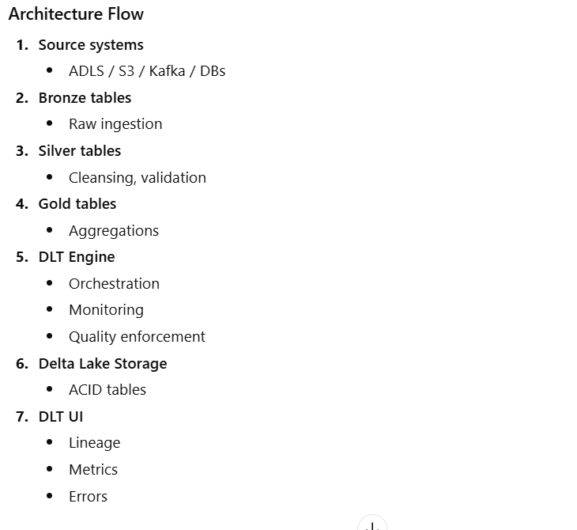
Notes:
define its structure, format, and the relationships between different parts of a document using symbols called tags

Slide 94
DLT Pipeline Types
1. Triggered Pipeline
Runs once
Batch-like
Used for historical loads
2. Continuous Pipeline
Always running
Streaming
Near real-time processing
Notes:
define its structure, format, and the relationships between different parts of a document using symbols called tags

Slide 95
DLT Programming Interfaces
Python (Most common)
import dlt
@dlt.table(
comment="Cleaned orders"
)
def silver_orders():
return dlt.read("bronze_orders")
2. SQL DLT
CREATE LIVE TABLE silver_orders
AS
SELECT *
FROM LIVE.bronze_orders
WHERE order_id IS NOT NULL;
Notes:
define its structure, format, and the relationships between different parts of a document using symbols called tags

Slide 96
Reading data in DLT
Function | Purpose
dlt.read() | Read batch table
dlt.read_stream() | Read streaming table
LIVE.table_name | SQL reference
Table Types in DLT
Table Type | Description
Streaming Table | Continuously updated
Materialized View | Batch-like
Managed Table | DLT managed storage
External Table | User-managed storage
Notes:
define its structure, format, and the relationships between different parts of a document using symbols called tags

Slide 97
Data Lineage & Dependency Graph
DLT automatically:
Builds DAG
Tracks dependencies
Shows lineage graph
You get:
End-to-end visibility
Impact analysis
Easy debugging
Notes:
define its structure, format, and the relationships between different parts of a document using symbols called tags

Slide 98
Monitoring & Observability
DLT provides:
Pipeline UI
Event logs
Record counts
Expectation metrics
Error details
Processing latency
No custom logging needed.
Error Handling in DLT
DLT automatically:
Retries failed tasks
Resumes from checkpoints
Captures errors in event logs
You can query
SELECT * FROM event_log
WHERE level = 'ERROR';
Notes:
define its structure, format, and the relationships between different parts of a document using symbols called tags

Slide 99
DLT vs Traditional Delta Tables
Feature | Delta Tables | DLT
Data storage | Yes | Yes
ACID | Yes | Yes
Streaming | Manual | Built-in
Quality checks | Manual | Built-in
Orchestration | External | Automatic
Lineage | Partial | Full
Monitoring | Custom | UI
Notes:
define its structure, format, and the relationships between different parts of a document using symbols called tags

Slide 100
When to Use Delta Live Tables
Use DLT when:
Building ETL / ELT pipelines Using Bronze-Silver-Gold Need data quality guarantees Want low operational overhead Streaming + batch together
Avoid DLT when:
Ad-hoc analysis Complex ML training jobs One-time transformations
Notes:
define its structure, format, and the relationships between different parts of a document using symbols called tags

Slide 101
What is Delta Sharing?
Delta Sharing is an open protocol for secure data sharing that allows organizations to share live data across:
Different companies
Different clouds (Azure / AWS / GCP)
Different platforms (Databricks, Spark, Pandas, BI tools)
No data copy
Read-only access
Always up-to-date
Data stays with the owner. Consumers query it securely.
Notes:
define its structure, format, and the relationships between different parts of a document using symbols called tags

Slide 102
Why Delta Sharing Was Needed
Traditional Data Sharing Problems
CSV / Excel exports
SFTP file transfers
Periodic snapshots
Data duplication
Security & version issues
Result:
Stale data
High storage cost
Manual governance
Compliance risk
Notes:
define its structure, format, and the relationships between different parts of a document using symbols called tags

Slide 103
What Delta Sharing Solves
Challenge | Delta Sharing Solution
Data duplication | ❌ Eliminated
Data freshness | ✅ Real-time
Security | ✅ Read-only
Governance | ✅ Central control
Scalability | ✅ Massive scale
Key Concepts
Provider
The data owner
Owns the Delta tables
Controls access
Share
Logical collection of:
Tables
Views
Recipient
The data consumer
External company
Partner
Notes:
define its structure, format, and the relationships between different parts of a document using symbols called tags

Slide 104
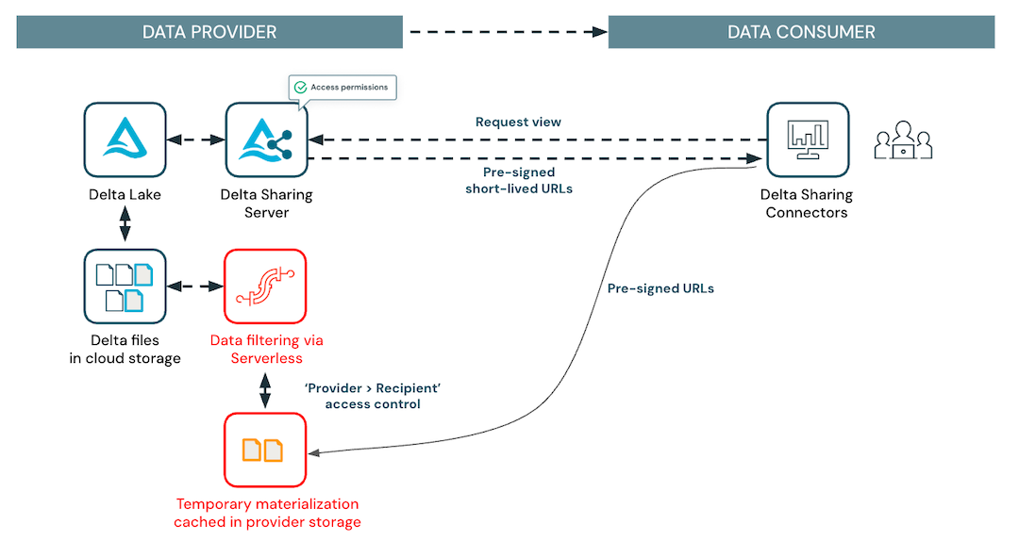
Notes:
define its structure, format, and the relationships between different parts of a document using symbols called tags

Slide 105
Flow:
Provider defines Share
Provider adds Tables / Views
Provider grants access to Recipient
Recipient queries data live
Data never leaves provider storage
What Can Be Shared
Object | Supported
Delta Tables | Yes
Views | Yes
Parquet Files | Yes
Time Travel Versions | Yes
Write Access | Not allowed
Notes:
define its structure, format, and the relationships between different parts of a document using symbols called tags

Slide 106
Security & Governance
Read-only access
No UPDATE / DELETE / INSERT
Table-level & view-level access
Row & column masking via views
Central audit logging
Notes:
define its structure, format, and the relationships between different parts of a document using symbols called tags

Slide 107
What is CLONE in Databricks?
CLONE is a Delta Lake feature that allows you to create a copy of an existing Delta table.
It copies:
Table schema
Table metadata
Optionally the data files
Used for testing, backup, sandboxing, and migrations
Why CLONE is Needed
Problems Without CLONE
Copying data manually using INSERT INTO
Slow and expensive
Risk of data inconsistency
Duplicate ETL pipelines
CLONE Solves:
Fast table duplication
Minimal storage (shallow clone)
Safe experimentation
Notes:
define its structure, format, and the relationships between different parts of a document using symbols called tags

Slide 108
Types of CLONE
Databricks supports two types:
Type | Description
Shallow Clone | Copies metadata only
Deep Clone | Copies metadata + data
SHALLOW CLONE
What is Shallow Clone?
Creates a new table
References the same data files
Only metadata is copied
No data duplication Extremely fast Very low storage cost
CREATE TABLE sales_clone_shallow
SHALLOW CLONE sales;
Notes:
define its structure, format, and the relationships between different parts of a document using symbols called tags

Slide 109
SHALLOW CLONE behavior
Action | Impact
Insert into clone | New files created
Insert into source | Not reflected in clone
Delete source table | Clone breaks
Time travel | Independent
DEEP CLONE (Concept)
What is Deep Clone?
Creates a full physical copy
Copies:
Schema
Metadata
Data files
Independent table
Safe for long-term use
More storage & time
Notes:
define its structure, format, and the relationships between different parts of a document using symbols called tags

Slide 110
CREATE TABLE sales_clone_deep
DEEP CLONE sales;
Data copied
Independent storage Safe even if source deleted
Action | Impact
Insert into source | Not reflected
Delete source | Clone unaffected
Storage | Full copy
Performance | Slower than shallow
Notes:
define its structure, format, and the relationships between different parts of a document using symbols called tags

Slide 111
Slide 14 – CLONE vs CREATE TABLE AS SELECT
Feature | CLONE | CTAS
Speed | Very fast | Slow
Schema | Preserved | Rebuilt
History | Preserved | Lost
ACID | Yes | Partial
Use case | Backup / Test | Transformation
CLONE with Time Travel
You can clone older versions of a table.
CREATE TABLE sales_clone_v5
DEEP CLONE sales VERSION AS OF 5;
OR
CREATE TABLE sales_clone_time
SHALLOW CLONE sales TIMESTAMP AS OF '2025-03-01';
Notes:
define its structure, format, and the relationships between different parts of a document using symbols called tags

Slide 112
CLONE vs CREATE TABLE AS SELECT
Feature | CLONE | CTAS
Speed | Very fast | Slow
Schema | Preserved | Rebuilt
History | Preserved | Lost
ACID | Yes | Partial
Use case | Backup / Test | Transformation
CLONE with Time Travel
You can clone older versions of a table.
CREATE TABLE sales_clone_v5
DEEP CLONE sales VERSION AS OF 5;
OR
CREATE TABLE sales_clone_time
SHALLOW CLONE sales TIMESTAMP AS OF '2025-03-01';
Notes:
define its structure, format, and the relationships between different parts of a document using symbols called tags

Slide 113
What are Deletion Vectors?
Deletion Vectors (DV) are a Delta Lake feature that allows row-level DELETE, UPDATE, and MERGE operations without rewriting the underlying Parquet data files.
Instead of rewriting files, Delta Lake records which rows are deleted.
Why Deletion Vectors Were Introduced
Traditional Delta DELETE behavior
DELETE rewrites entire Parquet files
High I/O cost
Slow on large tables
Expensive for frequent deletes
Deletion Vectors solve:
Faster DELETE
Less storage churn
Better performance
Efficient row-level operations
Notes:
define its structure, format, and the relationships between different parts of a document using symbols called tags

Slide 114
Simple Concept
Think of a Parquet file as a page in a ledger.
Old method: Tear the page and rewrite it
Deletion Vectors:
Keep the page
Put a checklist marking rows as deleted
Page remains
Deleted rows are skipped when you query
What Exactly Is a Deletion Vector?
A Deletion Vector is:
A bitmap / index structure
Stored separately from data files
Tracks row positions that are deleted
DV + Data File = Logical table state
Notes:
define its structure, format, and the relationships between different parts of a document using symbols called tags

Slide 115
Components:
Original Parquet data file
Deletion Vector file (DV)
_delta_log entry referencing DV
Delta Reader:
Reads data file
Applies DV
Skips deleted rows
When Are Deletion Vectors Used?
Row-level DELETE
UPDATE
MERGE
Change Data Capture (CDC)
Notes:
define its structure, format, and the relationships between different parts of a document using symbols called tags

Slide 116
Feature availability
Item | Status
Delta table only | ✅
Databricks Runtime | DBR 12+
Default behavior | Enabled in newer runtimes
Open-source Delta | Supported
Enable Deletion Vectors (Explicit)
ALTER TABLE sales
SET TBLPROPERTIES (
'delta.enableDeletionVectors' = true
);
Check status:
DESCRIBE DETAIL sales;
Notes:
define its structure, format, and the relationships between different parts of a document using symbols called tags

Slide 117
What Physically Happens?
Step | Action
Data file | Remains unchanged
DV file | Records deleted row IDs
Delta log | Points to DV
Query | Skips deleted rows
DELETE Without Deletion Vectors (Old Way)
DELETE FROM sales WHERE region = 'EU’;
Rewrites entire Parquet files
Slow on large tables
DELETE With Deletion Vectors (New Way)
DELETE FROM sales WHERE region = 'EU’;
No file rewrite
Only DV updated
Much faster
Notes:
define its structure, format, and the relationships between different parts of a document using symbols called tags

Slide 118
UPDATE Example Using Deletion Vectors
UPDATE sales
SET amount = amount * 1.1
WHERE region = 'US';
Under the hood:
Old rows → marked deleted via DV
New rows → appended
Efficient
Minimal rewrite
Query Performance Impact
Slight overhead to apply DV at read time
Negligible compared to rewrite cost
Optimized by Databricks engine
Best for frequent deletes
Notes:
define its structure, format, and the relationships between different parts of a document using symbols called tags

Slide 119
In Databricks Unity Catalog (UC), functions are governed, reusable logic objects—very similar to tables and views—that live inside a catalog.schema and are controlled with fine-grained permissions.
What are Functions in Unity Catalog?
A function in Unity Catalog is:
A named, reusable computation
Stored centrally in catalog.schema
Callable from SQL, notebooks, and dashboards
Fully governed with GRANT / REVOKE
Shareable across workspaces in the same metastore
Types of Functions in Unity Catalog
Unity Catalog supports two main types of functions:
A. SQL Functions (Scalar / Table Functions)
B. Python Functions (User-Defined Functions – UDFs)
Notes:
define its structure, format, and the relationships between different parts of a document using symbols called tags

Slide 120
Scalar SQL Functions
Return a single value per row
Example: GST calculation
CREATE FUNCTION calculate_gst(amount DOUBLE)
RETURNS DOUBLE
RETURN amount * 0.18;
Table-Valued Functions (TVF)
Return a result set (table)
Example: Filter high-value invoices
CREATE FUNCTION main.finance.high_value_invoices(min_amount DOUBLE)
RETURNS TABLE (invoice_id STRING, amount DOUBLE)
RETURN
SELECT invoice_id, amount
FROM main.finance.invoices
WHERE amount >= min_amount;
Notes:
define its structure, format, and the relationships between different parts of a document using symbols called tags

Slide 121
Python Functions (UC Python UDFs)
Unity Catalog allows governed Python UDFs, stored centrally and reusable.
Example: Mask PAN number
CREATE FUNCTION main.security.mask_pan(pan STRING)
RETURNS STRING
LANGUAGE PYTHON
AS $$
return pan[:2] + "XXXX" + pan[-2:]
$$;
Notes:
define its structure, format, and the relationships between different parts of a document using symbols called tags

Slide 122
What Lakehouse Federation Means
Lakehouse Federation is a query federation platform that lets you run queries across multiple external data sources from within a Lakehouse platform (such as Databricks), without moving or copying the underlying data to a central repository.
Most implementations—like Databricks Lakehouse Federation with Unity Catalog—work by connecting external systems (databases, warehouses, other databricks) into a unified view so you can:
Query disparate data sources (e.g., MySQL, PostgreSQL, Snowflake, Redshift, BigQuery) together using a single interface.
Avoid data movement or replication, which saves storage costs and keeps data fresh.
Use unified metadata, governance, and access controls through a central catalog (like Unity Catalog).
Create foreign catalogs, which are virtual representations of external databases inside the lakehouse catalog so SQL queries can treat them like local tables.
In essence, Lakehouse Federation makes it possible to access and analyze distributed data as if it were in a single system, combining the flexibility of data virtualization with centralized governance.
How It Works (Simplified)
Create a connection to each external data source (using drivers like JDBC). Register a foreign catalog in the lakehouse catalog that mirrors the structure of the external source. Run federated queries across all connected sources using standard SQL.
Notes:
define its structure, format, and the relationships between different parts of a document using symbols called tags

Slide 123
Why Unity Catalog? (Business Context)
Challenges Before Unity Catalog
Data scattered across multiple workspaces
No single view of who can access what
Inconsistent permissions
Manual security management
Difficult audits & compliance (SOX, GDPR, DPDP Act)
Need of the Hour
✔ Centralized governance ✔ Fine-grained access control ✔ Auditability ✔ Secure data sharing
➡ Unity Catalog solves these problems
Notes:
define its structure, format, and the relationships between different parts of a document using symbols called tags

Slide 124
What is Unity Catalog?
Definition
Unity Catalog is a centralized governance layer in Databricks that provides:
Unified access control
Data discovery
Auditing
Secure sharing
📌 It governs:
Tables
Views
Files
Functions
ML models
Across all Databricks workspaces
Notes:
define its structure, format, and the relationships between different parts of a document using symbols called tags

Slide 125
What is Unity Catalog?
Definition
Unity Catalog is a centralized governance layer in Databricks that provides:
Unified access control
Data discovery
Auditing
Secure sharing
📌 It governs:
Tables
Views
Files
Functions
ML models
Across all Databricks workspaces
Notes:
define its structure, format, and the relationships between different parts of a document using symbols called tags

Slide 126
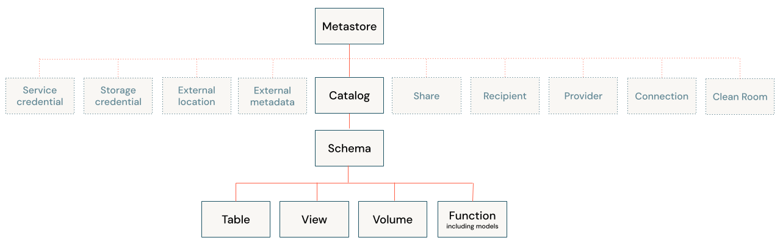
Notes:
define its structure, format, and the relationships between different parts of a document using symbols called tags

Slide 127
Key Components of Unity Catalog
Component | Purpose
Metastore | Central metadata repository
Catalog | Top-level container
Schema | Logical grouping
Table / View | Data objects
Function | Logic & security
Storage Credential | Secure cloud access
External Location | Governed storage
Volume | Governed file system
Notes:
define its structure, format, and the relationships between different parts of a document using symbols called tags

Slide 128
What is a Metastore?
Metastore
Created at Databricks Account level
Stores metadata & permissions
Attached to one or more workspaces
One Metastore Can:
✔ Serve multiple workspaces ✔ Enforce uniform governance
Catalog
What is a Catalog?
Highest logical container
Used for data domain segregation
Examples
finance
sales
hr
audit
Notes:
define its structure, format, and the relationships between different parts of a document using symbols called tags

Slide 129
Schema
What is a Schema?
Logical grouping within a catalog
Similar to Oracle schema
Tables & Views
Managed Tables
Data stored in Databricks-managed location
Full lifecycle control
External Tables
Data stored in cloud storage (ADLS/S3/GCS)
Governed via Unity Catalog
Views
Logical layer
Often used with Row-Level Security
Volumes (Governed File Storage)
Secure alternative to DBFS
Governed file storage under Unity Catalog
Notes:
define its structure, format, and the relationships between different parts of a document using symbols called tags

Slide 130
Schema
What is a Schema?
Logical grouping within a catalog
Similar to Oracle schema
Tables & Views
Managed Tables
Data stored in Databricks-managed location
Full lifecycle control
External Tables
Data stored in cloud storage (ADLS/S3/GCS)
Governed via Unity Catalog
Views
Logical layer
Often used with Row-Level Security
Volumes (Governed File Storage)
Secure alternative to DBFS
Governed file storage under Unity Catalog
Notes:
define its structure, format, and the relationships between different parts of a document using symbols called tags

Slide 131
Storage Credentials
Why Needed?
Unity Catalog never uses account keys
Uses cloud-native identities
Examples
Azure Managed Identity
AWS IAM Role
GCP Service Account
External Locations
What is an External Location?
Mapping between storage path and credential
Enables governed access to cloud storage
Notes:
define its structure, format, and the relationships between different parts of a document using symbols called tags

Slide 132
Fine-Grained Access Control
Unity Catalog supports permissions on:
Catalog
Schema
Table
Column
Row (RLS)
Files & Volumes
Functions
Functions in Unity Catalog
Types
Scalar functions
Used for:
RLS
Masking
Business rules
Benefits
✔ Reusable ✔ Auditable ✔ Secure
Notes:
define its structure, format, and the relationships between different parts of a document using symbols called tags

Slide 133
Auditing & Compliance
Unity Catalog automatically logs:
Who accessed data
What was accessed
When it was accessed
From which workspace
📌 Critical for:
ICAI audits
SOX
GDPR
DPDP Act (India)
Delta Sharing (Powered by Unity Catalog)
What is Delta Sharing?
Secure data sharing without copying
Works across organizations
Supports
Databricks → Databricks
Databricks → Power BI / Excel / Pandas
✔ Read-only ✔ Fully governed
Notes:
define its structure, format, and the relationships between different parts of a document using symbols called tags

Slide 134
What is Row-Level Security (RLS)?
Row-Level Security restricts which rows of data a user can see, based on:
User identity
User group / role
Business rules (region, department, cost center, etc.)
Even though users query the same table, each user sees different rows.
Why Row-Level Security is Important
Business Reasons
Confidentiality (salary, profit, margins)
Regulatory compliance
Least-privilege access
Multi-tenant data sharing
Notes:
define its structure, format, and the relationships between different parts of a document using symbols called tags

Slide 135
Flow:
User logs into Databricks
User queries a table
Unity Catalog evaluates:
User identity
Group membership
Row filter logic
Only permitted rows are returned
Key Requirements for RLS in Databricks
Unity Catalog must be enabled
Use SQL Warehouse or Cluster with UC
Table must be managed by Unity Catalog
Not supported on legacy Hive Metastore
Notes:
define its structure, format, and the relationships between different parts of a document using symbols called tags

Slide 136
Column-Level Security (CLS)
What is Column-Level Security?
Column-Level Security (CLS) is a data-governance mechanism that restricts access to specific columns in a table based on user roles or groups, even when users have access to the table itself.
In simple terms: “Users can see the table, but not all columns.”
Why Column-Level Security is Important
In real-world business data, some columns are highly sensitive, such as:
Salary
PAN / Aadhaar
Bank Account Numbers
Email / Mobile Numbers
Credit Card or Financial Details
Not all users need to see this information, even if they work on the same dataset.
Notes:
define its structure, format, and the relationships between different parts of a document using symbols called tags

Slide 137
CLS helps:
Protect sensitive data
Meet compliance requirements (GDPR, DPDP Act, SOX, HIPAA)
Implement least-privilege access
Avoid data duplication or masking outside the platform
How Column-Level Security Works (Concept)
Table access is granted to users or groups
Specific columns are restricted using:
Column privileges, or
Dynamic masking functions
Users see:
Full data for allowed columns
Masked or hidden data for restricted columns
Notes:
define its structure, format, and the relationships between different parts of a document using symbols called tags

