Slide 1
Agenda
Discuss the component of Hadoop
Describe different Nodes in Hadoop Cluster
Explain the Hadoop replication Factor
Discuss how Hadoop use rack awareness

Slide 2
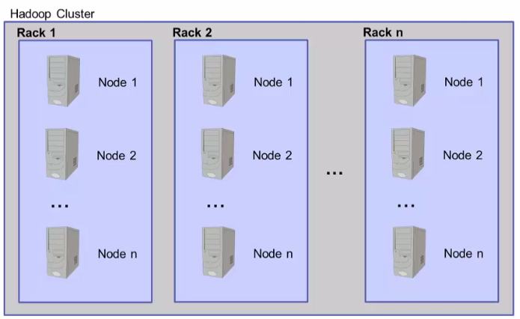
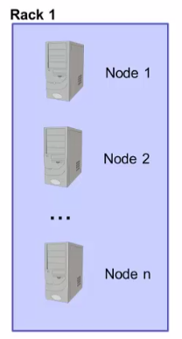
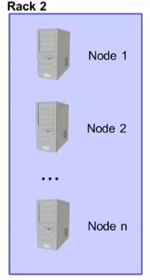
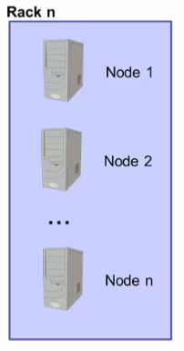
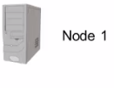
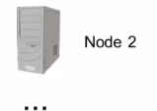
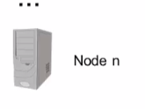
Terminology review

Slide 3
Pre-Hadoop 2.2 architecture
Two Main Components
  -Hadoop Distributed File System(HDFS)
  -MapReduce Engine
  Framework for performing Calculations on the data in the file system
  Has built in resource management and schedule

Slide 4
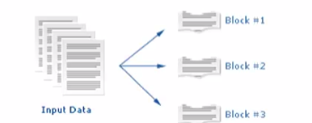
Hadoop Distributed File System(HDFC)
HDFC runs on top of the existing file system
-Not POSIX compliant
-Designed to tolerate high component failure rate
Reliability is through replication
Designed to handle very large files
-Large Streaming data across patters
No random access
Use blocks to store a file or part of file

Slide 5

Hadoop Blocks
Not same as operating system’s file blocks
-HDFS blocks ade up of multiple operating system blocks
Default for Hadoop is 64 Mb
- Recommended is 128 mb
Size of the file can be larger than single disk in the cluster
- Blocks for the single file are spread across multiple node in the cluster
If Chunk of the file is smaller than the HDFS block size
- only needed space is use
Blocks work well with replication

Slide 6
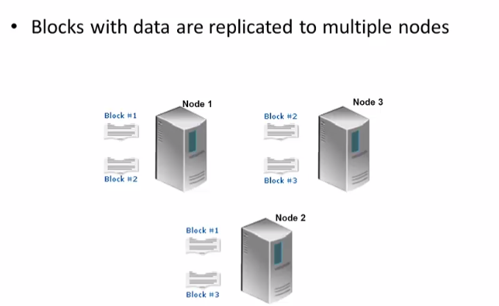
HDFC Replication

Slide 7
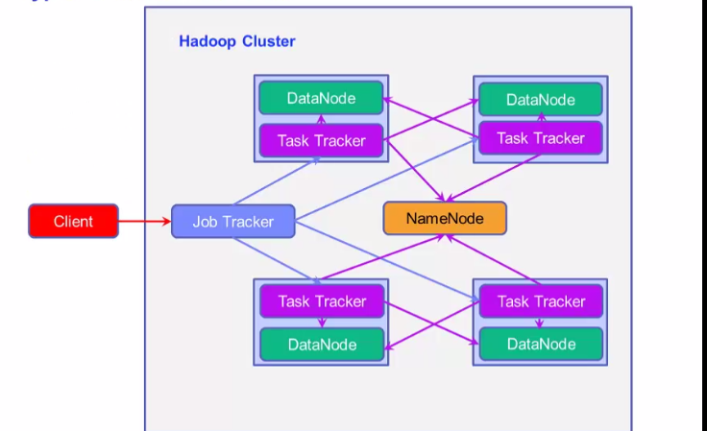
Type of Nodes in Hadoop

Slide 8
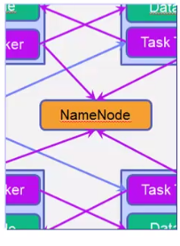
Type of node Name node
Only one Name Node for Cluster
Manages file system namespace and metadata
  -Data does not go through name node
  Data Does not Store in the name node
Single point of failure
  -Good idea mirror name node
-Do not use in expensive commodity hardware
Has large memory requirement
  -File system metadata is maintained in RAM

Slide 9
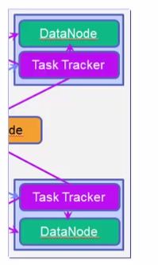
Type of node : Data node
Many for Hadoop cluster
Manages blocks with data and server the to clients
Blocks from different files can be stored on the same data node
Periodically notify to name node list of block is stored
Suitable for inexpensive ,commodity hardware

Slide 10
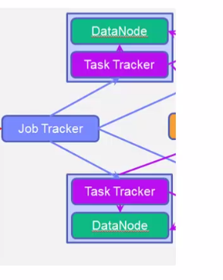
Type of nodes: JobTracker
One per Hadoop cluster
Manages MapReduce job in the cluster
Receives job request submitted by the client
Schedules and Monitors MapReduce jobs on Task Traker
  Attempts to detect a task to the TakTracker Where the
  Data is resides

Slide 11
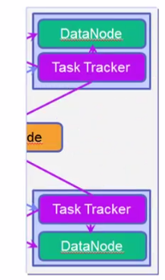
Types of nodes TaskTracker
Many per Cluster
Execute MapReduce Operations
-Runs the MapReduce task in JVM
-Have set number of slots used to run task
-Communicate JobTraker via heart beat message
-Read blocks form DataNode

Slide 12
Hadoop 2.2 architecture
YARN provide
-Referred to as MapReduce V2
- Resource Manager and scheduler external to an framwork
- DataNodes Still exist
- Job Tracker and Task Trackers no longer exist

Slide 13
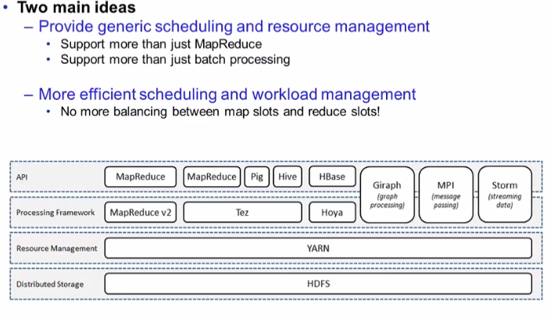
YARN

Slide 14
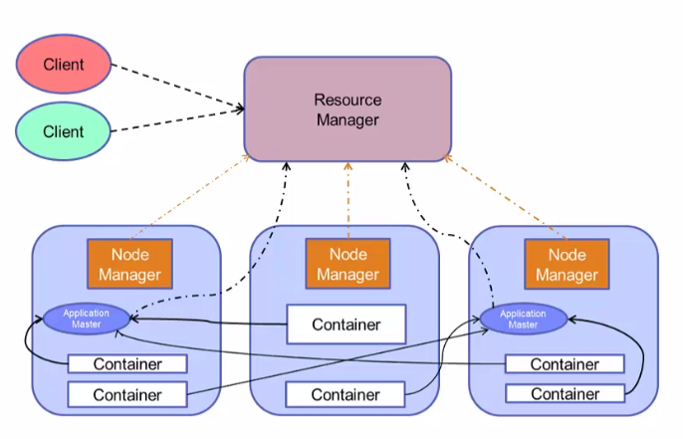
YERN

Slide 15
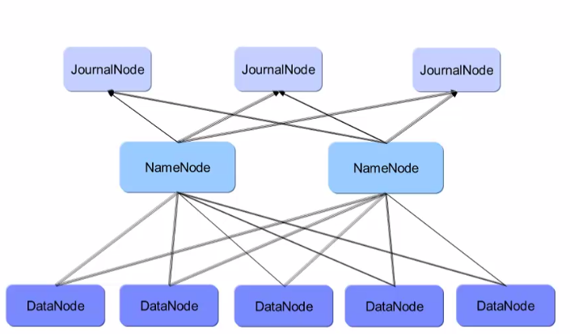
Hadoop high availability

Slide 16
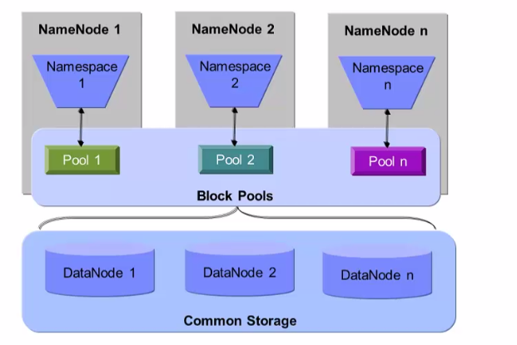
Hadoop Federation

Slide 17
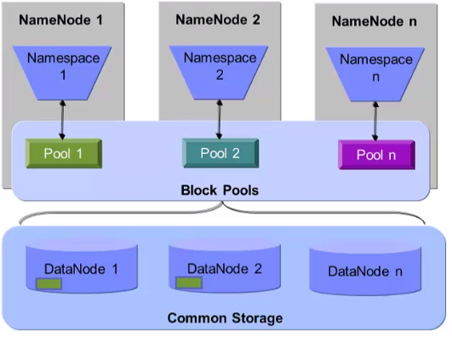
Hadoop Federation

Slide 18
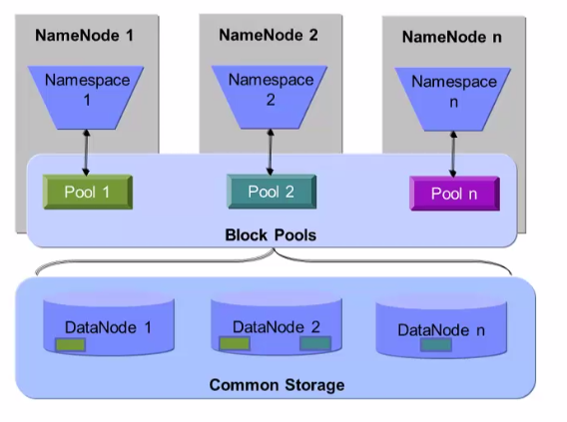
Hadoop Federation

Slide 19
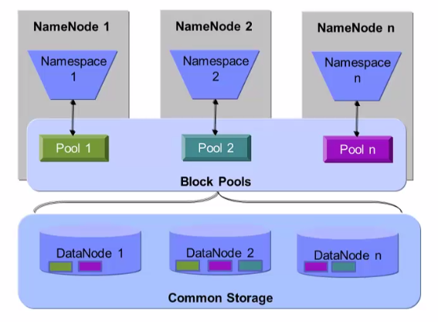
Hadoop Federation

Slide 20
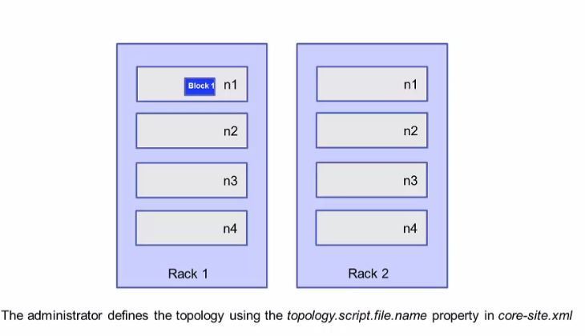
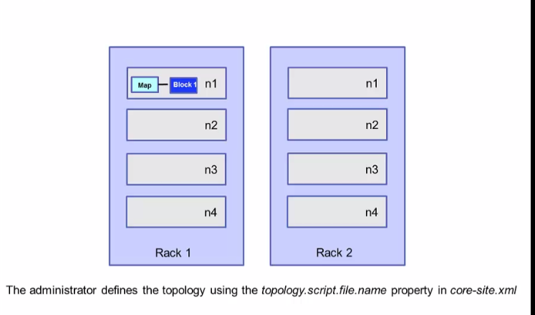
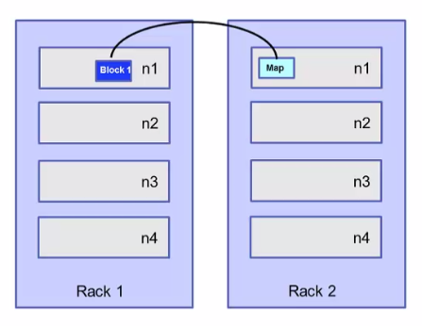
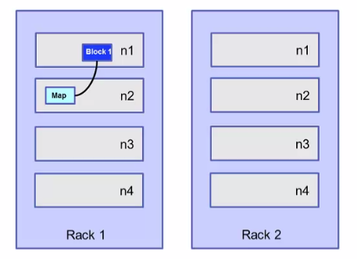
Topology awareness

Slide 21
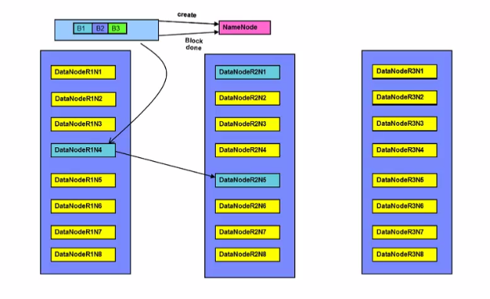
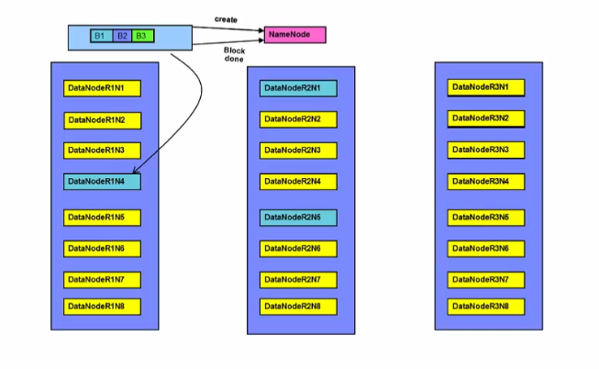
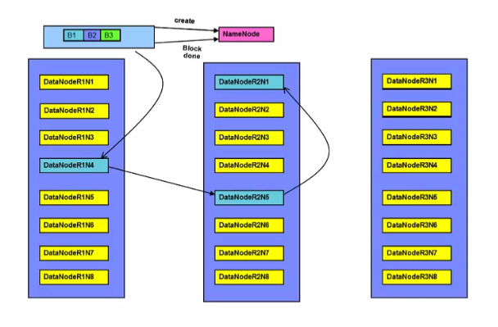
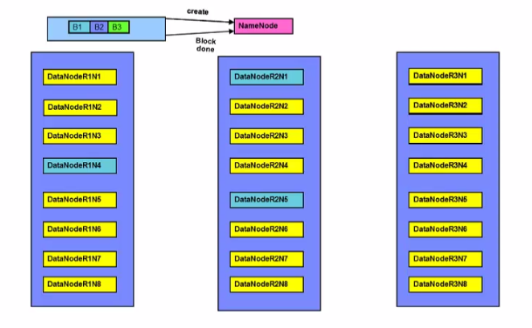
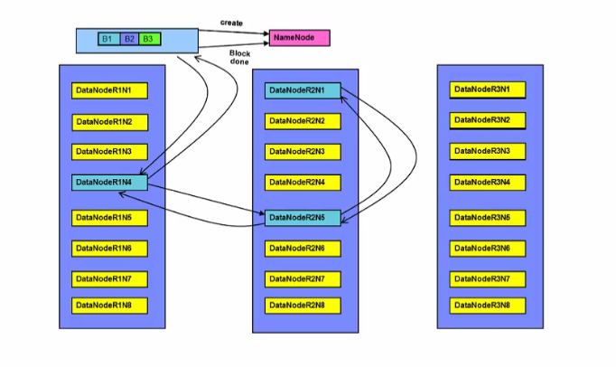
Hdfc Replication

Slide 22
Hdfs Command
The File Sytem (fs) Shell can be invoked
hadoop fs <args>
Example to list the current directory in HDFS
hadoop fs –ls
Example to create a directory in HDFS
hadoop fs –mkdir <dir>
Example to copy file to hdfs
haoop fs copyFromLocal localfile to hdfs location
Example to copy file from hdfs
hadoop fs copyToLocal hdfsfile to locatl location
Example to copy file to hdfs
hadoop fs –put localfile to hdfsfile
Example to copy form hdfs
hadoop fs -get hdfs to local

Slide 23
Hdfc commands
Show the content of the file
hdoop fs -cat filename.txt
Other commands
chmod cp , du , rm ,tail
Hdfc command to set replcation
setrep

Slide 24
MapReduce
MapReduce is a programming paradigm that runs in the background of Hadoop to provide scalability and easy data-processing solutions
MapReduce divides a task into small parts and assigns them to many computers.
Later, the results are collected at one place and integrated to form the result dataset
The Map task takes a set of data and converts it into another set of data, where individual elements are broken down into tuples (key-value pairs).
The Reduce task takes the output from the Map as an input and combines those data tuples (key-value pairs) into a smaller set of tuples.

Slide 25
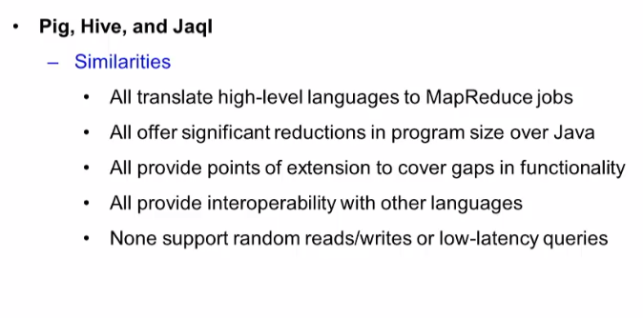

Slide 26
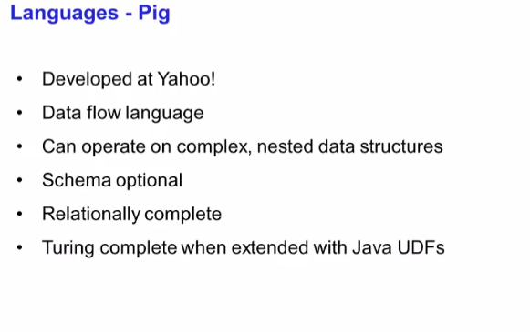

Slide 27
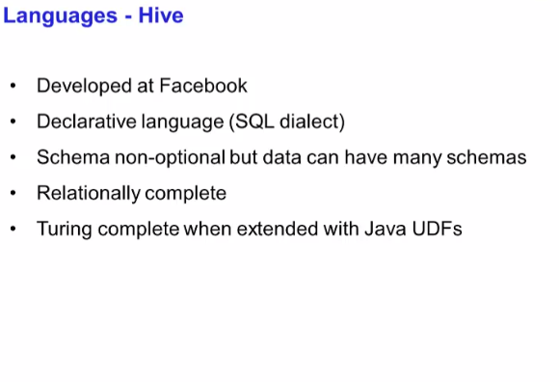

Slide 28
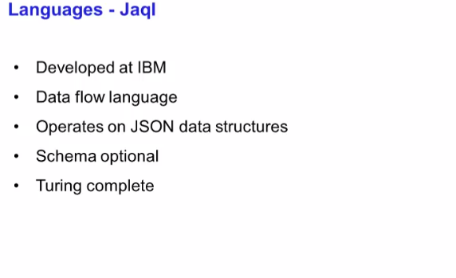

Slide 29
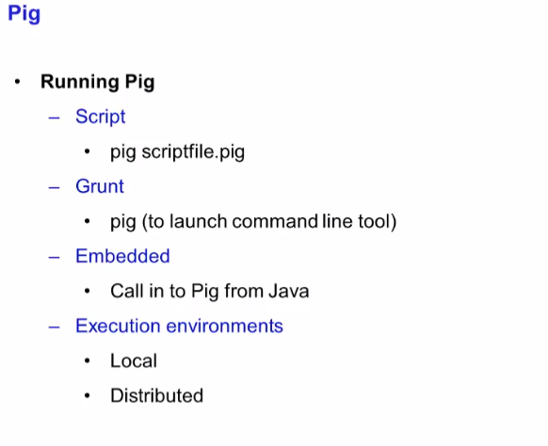

Slide 30
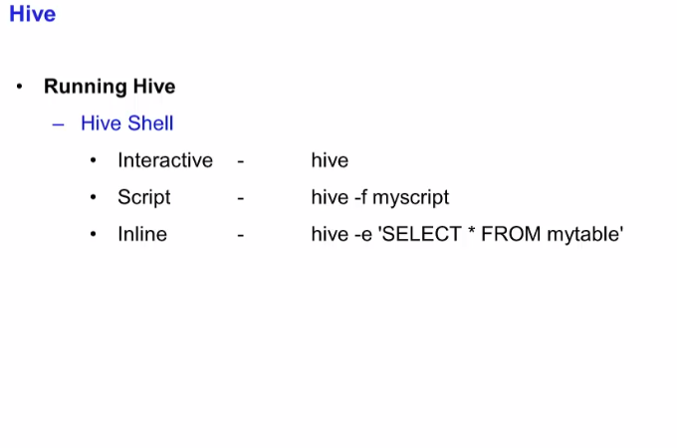

Slide 31
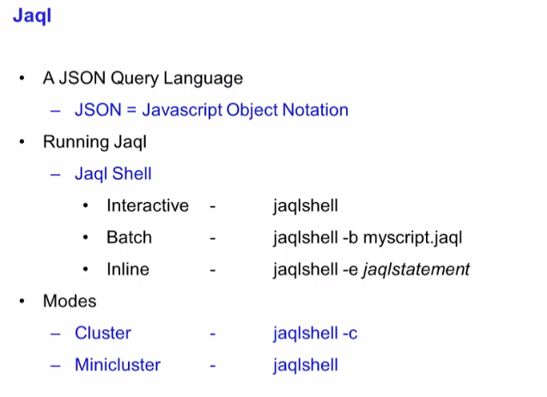

Slide 32
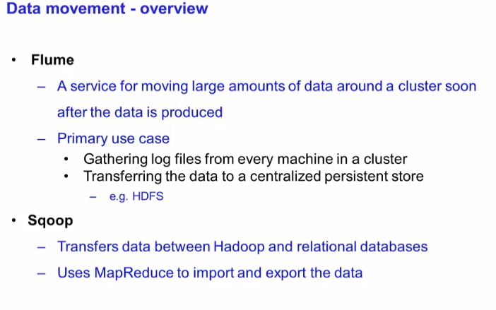

Slide 33
