Slide 1
Batch Processing
Batch processing means processing data in chunks (batches) at scheduled times.
Characteristics:
Processes a large volume of data at once
Runs on a schedule (e.g., hourly, daily)
Used for historical or non-time-critical data
High throughput, but higher latency
You run a job every night at 2 AM to analyze yesterday’s website traffic logs.

Slide 2
What is Structured Streaming?
Structured Streaming is a scalable and fault-tolerant stream processing engine built on the Spark SQL engine. You can express your streaming computation the same way you would express a batch computation on static data.
Why do we need Streaming?
In the modern world, data isn't just static.
  Fraud Detection: Identifying a stolen credit card must happen in seconds, not hours.
  Stock Markets: Prices change every millisecond.
  IoT Sensors: Temperature alerts in a factory need immediate action.
Batch vs. Streaming
Feature | Batch Processing | Streaming Processing
Data Scope | Fixed set of data (e.g., yesterday's logs) | Continuous, never-ending data
Latency | High (Minutes to Hours) | Low (Seconds to Milliseconds)
Processing | All data at once | Incremental (bits at a time)

Slide 3
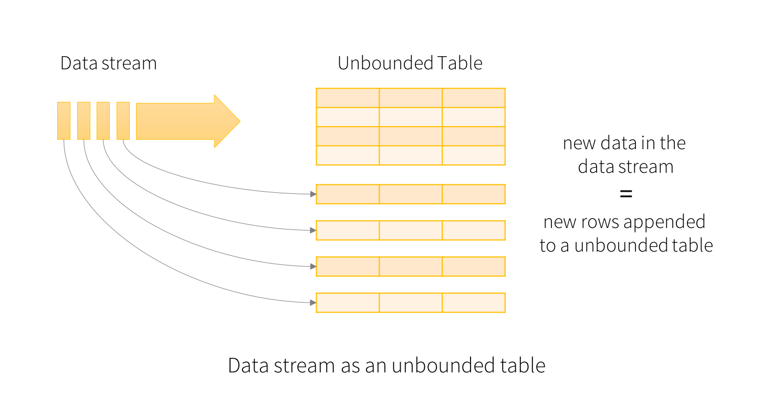
The key idea in Structured Streaming is to treat a live data stream as a table(unbounded) that is being continuously appended and you can write queries on it just like you would with a batch DataFrame.
Every data item that is arriving on the stream is like a new row being appended to the Input Table.

Slide 4
Micro-batch Concept
Instead of processing records one-by-one ,Spark groups data into tiny "batches" (e.g., every 1 second).
  Collect data for X seconds.
  Run a Spark job on that small batch.
  Update the results.
  Repeat.
Key Components:
  Input Source: Where data comes from (Kafka, Files, Sockets).
  Micro-batch Engine: The brain that triggers the job.
  State Management: Remembers previous data (e.g., current count of "Apple" stocks).
  Checkpointing: Saves progress to disk (S3/HDFS) so if the server crashes, it can restart from where it left off.

Slide 5
Streaming Input Sources
1. File Source
Reads files written in a directory. Spark monitors the folder for new files.
Formats: CSV, JSON, Parquet, Text.
2. Socket Source (For Testing)
Reads text data from a network connection. Used mostly for learning/debugging.
3. Kafka Source (Production Standard)
The most popular source. Spark acts as a consumer to Kafka topics.
Diagram: Data Monitoring
Folder/Source Spark Monitoring Result Table [File A] ------> [Trigger] --------> [ Row 1-10 ] [File B] ------> [Trigger] --------> [ Row 11-20]

Slide 6
Streaming Trigger Modes
Triggers define when Spark should look for new data.
Trigger Type | Description | Code Example
Default | Runs the next batch as soon as the previous one finishes. | .trigger(processingTime='0 seconds')
Fixed Interval | Runs every X seconds/minutes. | .trigger(processingTime='10 seconds')
Available Now (Once) | Processes all available data, then stops. Great for daily jobs. | .trigger(availableNow=True)
Continuous | Ultra-low latency (~1ms). (Experimental/Advanced). | .trigger(continuous='1 second')

Slide 7
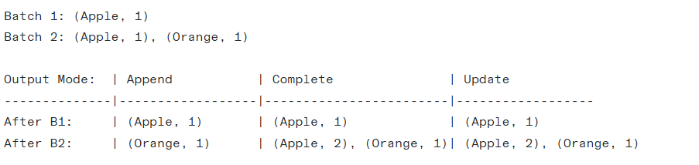
Output Modes
1. Append Mode (Default)
Only new rows added to the Result Table since the last trigger will be written.
Use case: Logging, moving files.
2. Complete Mode
The entire updated Result Table will be written to the sink every time.
Use case: Aggregations (e.g., Total Word Count).
3. Update Mode
Only the rows that were updated in the Result Table since the last trigger will be written.
Use case: Real-time dashboards showing changing counts.

Slide 8
Watermarking (Handling Late Data)
The Problem: Late Data
Imagine a sensor sends data at 10:00 AM, but due to bad network, Spark receives it at 10:15 AM.
  Event Time: When the data was generated (10:00).
  Processing Time: When Spark saw the data (10:15).
If we don't handle this, Spark will wait forever for late data, and the RAM (State) will explode!
The Solution: Watermark
A watermark is a threshold. It tells Spark: "I will wait for data up to 10 minutes late. Anything older, ignore it."
df.withWatermark("event_time", "10 minutes") \ .groupBy(window("event_time", "5 minutes")) \ .count()
Current Time: 10:30 Watermark: 10 minutes (10:20) [10:25 Data] -> ACCEPTED (After 10:20) [10:15 Data] -> REJECTED (Too old, state cleared)

Slide 9
Streaming Sinks (The Destinations)
If the Source is where data starts, the Sink is where the data ends up after being processed. In Spark, you define a sink using the .writeStream method.
Sink Type | Use Case | Production Ready?
Console | Debugging and testing logic. | No (it prints to the screen).
File | Saving data to HDFS, S3, or local disk. | Yes (very common).
Kafka | Sending data to another streaming service. | Yes (standard for pipelines).
Memory | Interactive testing (view data with SQL). | No (stored in RAM).
ForeachBatch | Writing to Databases (Postgres, MongoDB, etc.) | Yes (very flexible).

Slide 10
1. Console Sink (For Learning)
This is what students will use 90% of the time during your class. It prints the micro-batch results directly to the terminal.
2. File Sink (The Data Lake)
Stores the stream as physical files (Parquet, CSV, JSON).
Requirement: You must provide a checkpointLocation. If the stream stops, Spark uses this folder to remember which files it already wrote.
3. Kafka Sink
Used when Spark is just one step in a larger pipeline. It pushes the result back into a Kafka Topic.
4. Memory Sink (Interactive Debugging)
The data is stored in a temporary table in Spark's memory. You can then run standard SQL queries against it while the stream is running.
5. ForeachBatch Sink
Standard sinks only support specific formats (CSV, Kafka, etc.). If you want to write to a Database (JDBC) or a NoSQL store, you use foreachBatch. It gives you the micro-batch as a standard Batch DataFrame.

Slide 11
What is Checkpointing?
Imagine you are playing a video game. If you play for 5 hours and the power goes out, you don't want to start from Level 1 again. You want to start from your last Save Point.
Checkpointing is the "Save Point" for Spark. It saves the current progress of the stream to a reliable storage (like HDFS, S3, or Azure Blob Storage).
Why do we need it?
Fault Tolerance: If a server crashes or the Spark driver fails, Spark looks at the checkpoint to see where it left off.
State Persistence: If you are counting words (Aggregation), Spark needs to remember the counts. The checkpoint stores these intermediate numbers.
Preventing Duplicates: By knowing exactly which data was already processed, Spark avoids processing the same data twice upon restart.
When you provide a checkpointLocation, Spark creates a folder with these sub-folders:
/offsets: Records "How much data have I read from the source?" (e.g., I read up to line 500 in the CSV).
/commits: Records "I have successfully written this batch to the sink."
/state: Stores the actual data for aggregations (e.g., "Apple" count is 52).
/metadata: Stores the unique ID of the streaming query.

