Slide 1
What is Snowpipe?
Snowpipe is Snowflake's continuous data ingestion service.
Allows real-time or near-real-time loading of data into Snowflake.
Automatically detects new files in a staging location (e.g., AWS S3, Azure Blob, GCS).
Eliminates the need for manual batch loads or cron jobs.
Why Use Snowpipe?
⏱️ Low-latency ingestion – data is available within seconds.
⚙️ Fully managed and serverless – no infrastructure to manage.
📥 Event-driven architecture – file arrival triggers ingestion.
💰 Cost-effective – pay only for ingestion, not compute.

Slide 2
Snowpipe + Azure Architecture
Azure Components:
Azure Blob Storage: Landing zone for raw files.
Event Grid: Detects new file uploads.
Azure Queue Storage: Sends events to Snowflake.
Snowflake Components:
External Stage: Reference to the Azure Blob container.
Pipe: Contains logic to load files using COPY INTO.
Step-by-Step Setup Overview
Upload file to Azure Blob Storage.
Event Grid detects new blob.
Event triggers Azure Queue message.
Snowflake listens for the queue using a notification integration.
Snowpipe loads the file into the target table.

Slide 3
Monitoring Loads
Views for monitoring:
INFORMATION_SCHEMA.LOAD_HISTORY
COPY_HISTORY
PIPE_USAGE_HISTORY
Cost Model
Pay only for files ingested (per 1000 files).
No need to keep virtual warehouses running.
Cost efficiency increases with automation.

Slide 4
What is Snowflake Time Travel?
A feature that allows users to access historical data.
Enables querying, restoring, and cloning data as it existed at a previous point in time.
Useful for:
Accidentally deleted or modified data recovery
Auditing
Data pipeline debugging
Key Capabilities
Query Historical Data: Query data "as it was" using a specific timestamp or offset.
Restore Tables/Drops: Recover dropped tables, schemas, or databases.
Undrop: Use UNDROP to recover dropped objects.
Clone Historical Data: Create zero-copy clones from historical points.

Slide 5
What Are Streams in Snowflake?
A Stream in Snowflake is a change data capture (CDC) object that tracks inserts, updates, and deletes to a table.
Think of a Stream like a bookmark for changes in a table.
It doesn’t store the data, only the change metadata.
You query it like a table to process only new or changed rows.
Why Use Streams?
ETL / ELT workflows: Only process changed data.
Auditing: Track who changed what and when.
Real-time dashboards: Reflect recent changes.
Micro-batching: Combine with tasks for automation.

Slide 6
How Streams Work
You create a Stream on a table or view.
Snowflake starts tracking DML operations (INSERT, UPDATE, DELETE).
When you query the stream, you get only the changes.
After querying, Snowflake advances the stream offset — so next query gives only newer changes.
Stream Types
Standard StreamsT rack DML changes (insert/update/delete).
Append-OnlyTrack only inserts — more efficient.

Slide 7
Introduction to Snowflake Caching
Definition: Caching in Snowflake refers to the storage of data, metadata, or query results to speed up future query execution and reduce costs.
Purpose: Enhances performance, lowers query latency, and decreases compute costs.
Core Idea: Instead of re-processing the same query or reading data from storage repeatedly, Snowflake leverages cached layers.

Slide 8
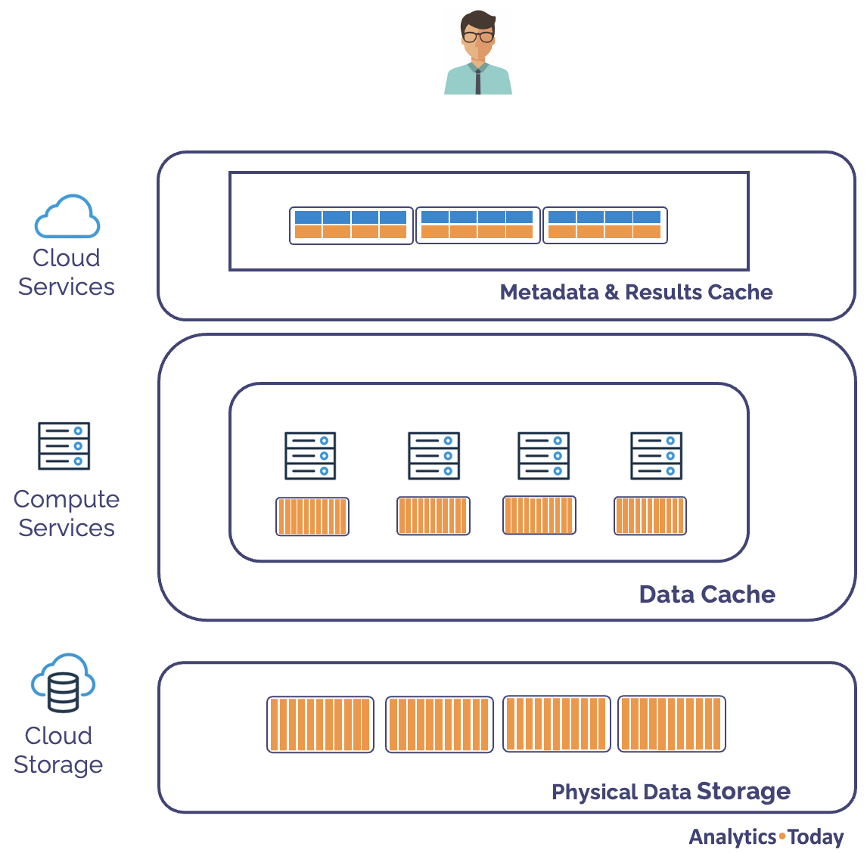
Types of Caches in Snowflake
1. Result Cache: Stores query results for reuse (global) .
2. Metadata Cache: Keeps table/file metadata for faster planning.
3. Data Cache (Warehouse Cache): Stores recently accessed data in virtual warehouse memory.
.

Slide 9
Result Cache
Scope: Global across all users and virtual warehouses.
Duration: Cached for 24 hours.
Requirements:
Query must be textually identical.
No underlying data changes.
Benefit: Zero cost, no warehouse involvement.
Use Case: BI dashboards with repetitive queries.
Example:
SELECT * FROM SALES WHERE REGION = 'EAST';-- Rerunning the same query within 24h (with no data change) uses the result cache.

Slide 10
Metadata Cache
What it Stores: Table structure, micro-partition metadata, file stats.
Where: Cloud Services layer.
Function: Used during query compilation and optimization.
Benefit: Faster query planning.
Example: Faster access to new partitions in a table.

Slide 11
Data Cache (Warehouse Cache)
What it Stores: Recently accessed data blocks.
Where: Local memory of the virtual warehouse.
When Used: When a query accesses the same or similar data shortly after.
Cleared When: Warehouse is suspended or restarted.
Not Shared: Between different warehouses.
Benefit: Improves performance (but not cost).
Example: Running similar queries back-to-back

Slide 12
When Caching Doesn't Work
Result Cache Miss:
Query changed (even slightly).
Data has been modified (INSERT/UPDATE/DELETE).
Warehouse Restart: Clears data cache.
Different Warehouse: No access to another's data cache.
Live Pipelines: Don't benefit from caching due to constant updates.

Slide 13
Slide 7: Real-World Example
-- Initial query (cache miss)
SELECT * FROM CUSTOMER WHERE REGION = 'WEST';
-- Identical re-run (result cache hit)
SELECT * FROM CUSTOMER WHERE REGION = 'WEST';
-- Modified query (cache miss)
SELECT * FROM CUSTOMER WHERE REGION = 'EAST';
Use Query Profile to view cache usage.
Cached queries show little or no warehouse usage.

Slide 14
Best Practices
Reuse identical SQL where possible.
Keep frequently accessed warehouses warm.
Schedule warehouse suspend/resume strategically.
Monitor query history for cache usage insights.
Use clustering to make data access patterns more cache-friendly.

Slide 15
Snowflake clustering
Snowflake clustering is a technique employed in Snowflake tables to group related rows together within the same micro-partition, thereby enhancing query performance for accessing these rows. By organizing the data in a clustered manner, Snowflake can avoid scanning unnecessary micro-partitions during query execution.
Considerations for Choosing Clustering for a Table
The table contains a large number of micro-partitions. Typically, this means that the table contains multiple terabytes (TB) of data.
The queries are selective. In other words, the queries need to read only a small percentage of rows (and thus usually a small percentage of micro-partitions) in the table.
The queries sort the data. (For example, the query contains an ORDER BY clause on the table.)

Slide 16
Strategies for Selecting Clustering Keys
1 Cluster columns that are most actively used in selective filters
2 If there is room for additional cluster keys, then consider columns frequently used in join predicates, for example “FROM table1 JOIN table2 ON table2.column_A = table1.column_B”.

Slide 17
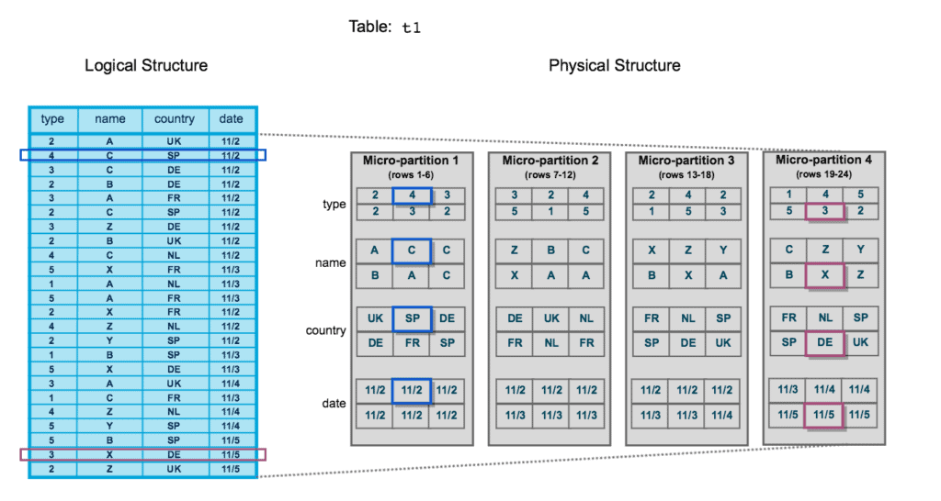

Slide 18
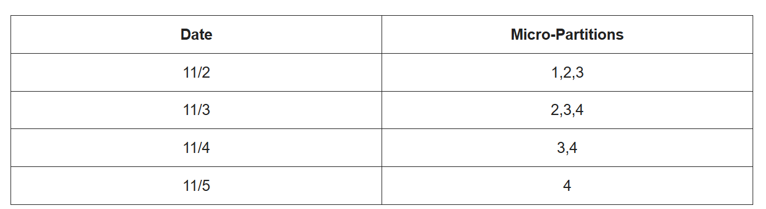
SELECT type, country FROM MY_TABLE WHERE Date = '11/2' ;
The data of the records that belong to date ‘11/2’ is present in micro-partitions 1, 2 and 3. Similarly for other dates, the data is spread across micro-partitions is as depicted below.

Slide 19
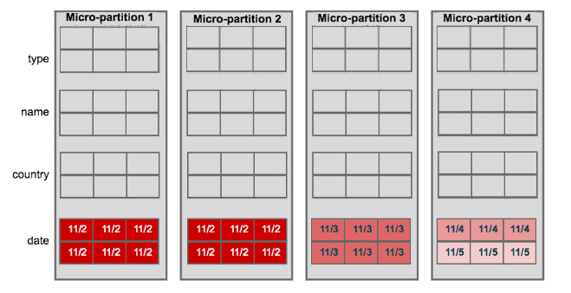
The below table shows distribution of rows with distinct date values in various micro-partitions. This clearly shows clustering the table on date columns reduced the number of micro-partitions to be scanned than earlier scenario.

Slide 20
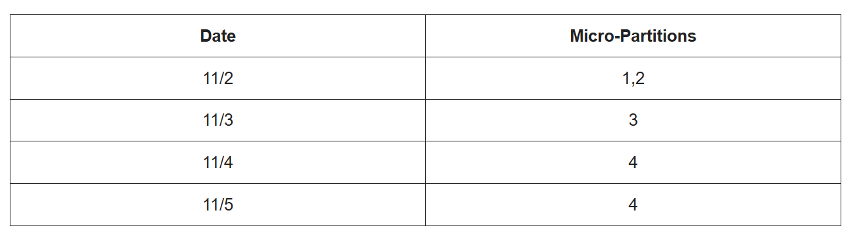
CREATE TABLE MY_TABLE ( type NUMBER , name VARCHAR(50) , country VARCHAR(50) , date DATE ) CLUSTER BY (date) ;
ALTER TABLE MY_TABLE CLUSTER BY (date, type) ;
Reclustering
A clustered table’s data may become less clustered as DML operations (INSERT, UPDATE, DELETE, MERGE, COPY) are carried out on it. The table must be periodically or regularly reclustered in order to maintain optimal clustering.

Slide 21
During reclustering, Snowflake uses the clustering key for a clustered table to reorganize the column data, so that related records are relocated to the same micro-partition. Each time data is reclustered, the rows are physically grouped based on the clustering key for the table, which results in Snowflake generating new micro-partitions for the table.
This reclustering results in storage costs because the original micro-partitions are marked as deleted, but retained in the system to enable Time Travel and Fail-safe.

Slide 22
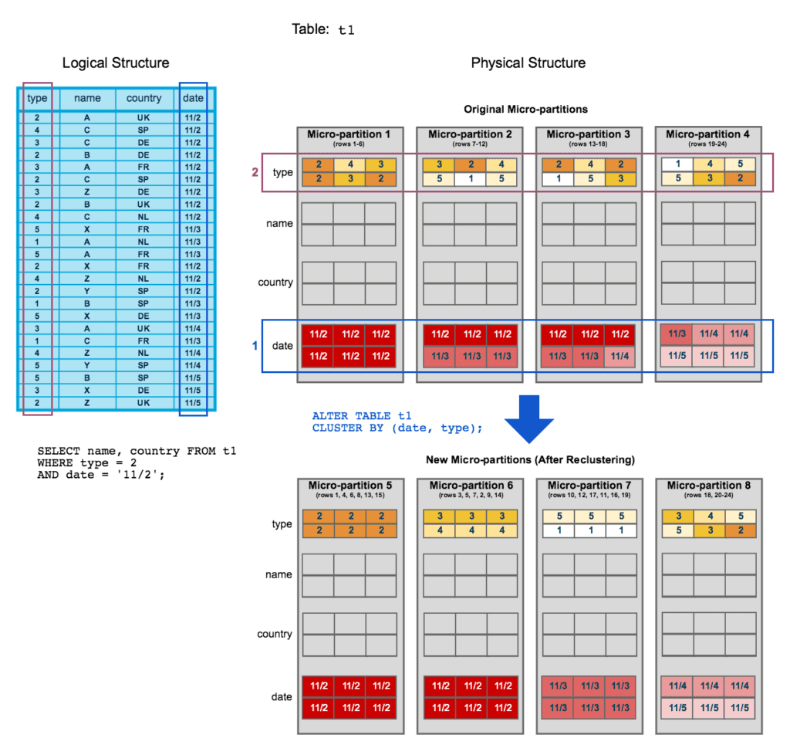

Slide 23
Storage Optimization
To optimize storage in Snowflake, focus on efficient data organization, compression, and reducing unnecessary storage consumption.
1. Understanding and Analyzing Storage Costs:
Monitor storage usage:
Utilize Snowflake's ACCOUNT_USAGE schema to track storage consumption and identify areas for optimization.
Identify unused tables:
Regularly review and delete tables that are no longer needed, as they consume storage space and contribute to costs.
Analyze data retention policies:
Determine the optimal retention periods for your data based on business needs and delete older, unnecessary data.

Slide 24
2. Optimizing Data Storage:
Choose appropriate table types:
Temporary tables: Use for short-lived data, which are automatically dropped after the session ends.
Transient tables: Use for long-lived data that can be deleted more easily and are not backed up.
Standard tables: For persistent data that requires backup and recovery.
Data compression:
Snowflake automatically compresses data, reducing storage space. Ensure optimal compression options are selected based on data characteristics.
Table clustering and partitioning:
Clustering: Organizes data physically on disk based on frequently used query patterns, improving query performance and reducing the amount of data scanned.
Partitioning: Divides tables into smaller, manageable chunks, allowing for faster data access and filtering, especially for large tables.

Slide 25
3 Efficient Data Loading and Handling:
Optimized data loading:
Avoid frequent DML operations: Minimize the number of Data Manipulation Language (DML) operations (INSERT, UPDATE, DELETE) to reduce the impact on performance and storage.
Large data files: Consider the optimal size of data files before loading into Snowflake to avoid performance issues.
Data Updates:
When updating data, use WHERE clauses to limit the number of rows being updated, and consider breaking large updates into smaller batches.
Leverage Snowflake features:
Utilize features like STREAMS and TASKS for complex data transformation and loading scenarios.

Slide 26
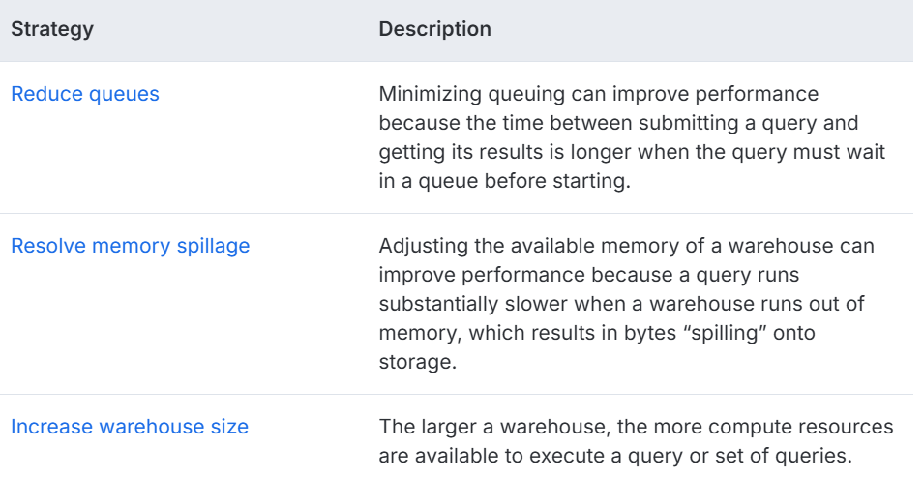
Optimizing warehouses for performance
In the Snowflake architecture, virtual warehouses provide the computing power that is required to execute queries. Fine-tuning the compute resources provided by a warehouse can improve the performance of a query or set of queries.

Slide 27
