Slide 1
Batch Processing
Batch processing means processing data in chunks (batches) at scheduled times.
Characteristics:
Processes a large volume of data at once
Runs on a schedule (e.g., hourly, daily)
Used for historical or non-time-critical data
High throughput, but higher latency
You run a job every night at 2 AM to analyze yesterday’s website traffic logs.

Slide 2
Streaming Processing
Streaming processing (also called real-time or event processing) handles data as it arrives, continuously.
Characteristics:
Processes data in real time
Ideal for time-sensitive tasks
Lower latency, often just seconds or milliseconds
Typically processes smaller chunks (records, micro-batches)
Example:
A fraud detection system that processes credit card transactions as they happen and raises alerts immediately.

Slide 3
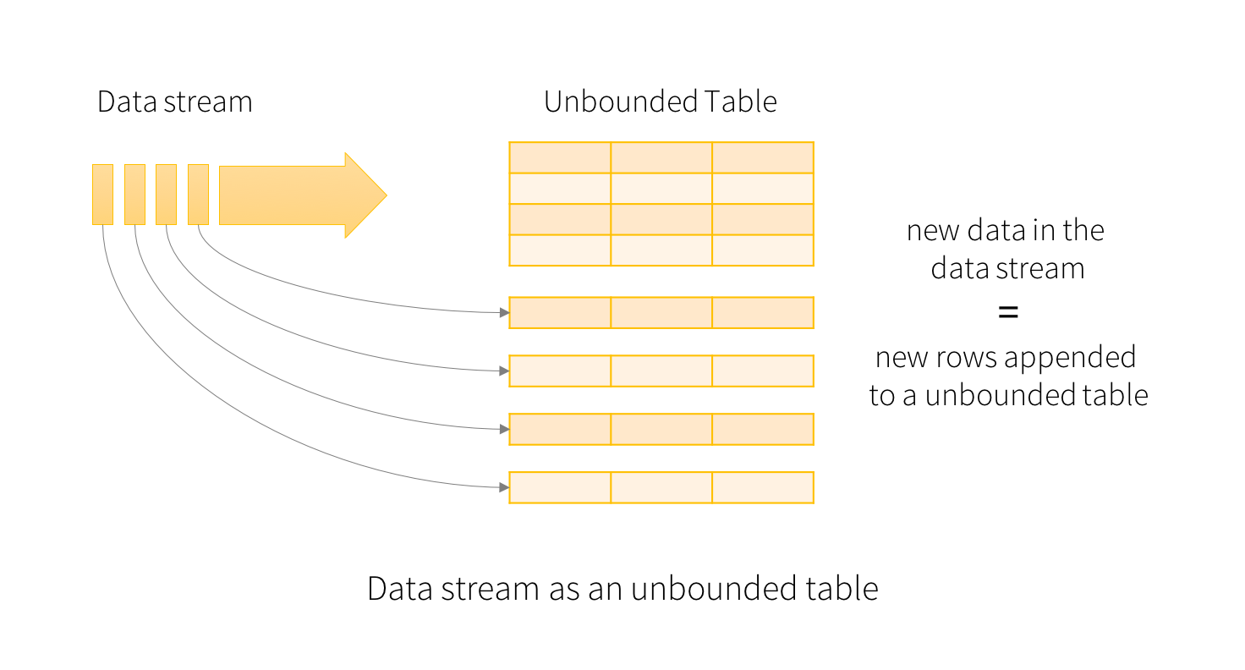
What is Structured Streaming?
Structured Streaming is a streaming engine built on top of Spark SQL that lets you process real-time data streams using the same DataFrame and SQL API as batch jobs.
The key idea in Structured Streaming is to treat a live data stream as a table(unbounded) that is being continuously appended and you can write queries on it just like you would with a batch DataFrame.
very data item that is arriving on the stream is like a new row being appended to the Input Table.

Slide 4
Input Sources
Structured Streaming supports sources like:
File system (e.g., CSV, JSON, Parquet)
Kafka
Socket
Custom sources
Triggers
Controls how frequently Spark processes data:
default: processes as fast as it can
Trigger.ProcessingTime("10 seconds"): processes every 10 seconds
Trigger.Once(): runs only once (used for micro-batch-style queries)
Output Modes
Defines how results are written:
append: only new rows are written to the sink
complete: all rows are written every time (used with aggregations)
update: only changed rows are written

Slide 5
Sinks (Outputs)
Where the results go:
Console
File
Kafka
Memory (for debugging)
Foreach (custom logic)

