Slide 1
What are the Software Development Models?
The software development models are the various processes or methodologies that are being selected for the development of the project depending on the project’s aims and goals
There are various Software development models or methodologies.
    Waterfall model
    V model
    Incremental model
    RAD model
    Agile model
    Iterative model
    Spiral model
    Prototype model

Slide 2
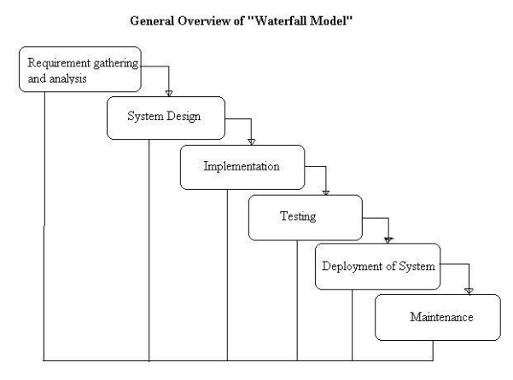
What is Waterfall model- advantages, disadvantages and when to use it
In a waterfall model, each phase must be completed fully before the next phase can begin. This type of model is basically used for the for the project which is small and there are no uncertain requirements

Slide 3
Advantages of waterfall model:
This model is simple and easy to understand and use.
It is easy to manage due to the rigidity of the model – each phase has specific deliverables and a review process.
In this model phases are processed and completed one at a time. Phases do not overlap.
Waterfall model works well for smaller projects where requirements are very well understood.

Slide 4
Disadvantages of waterfall model:
Once an application is in the testing stage, it is very difficult to go back and change something that was not well-thought out in the concept stage.
No working software is produced until late during the life cycle.
High amounts of risk and uncertainty.
Not a good model for complex and object-oriented projects.
Poor model for long and ongoing projects.
Not suitable for the projects where requirements are at a moderate to high risk of changing.

Slide 5
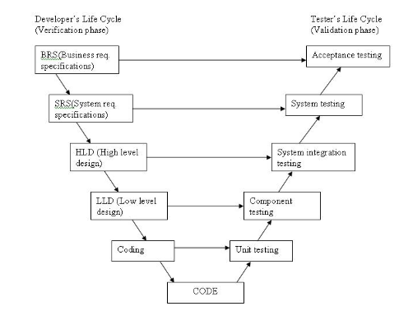
V-model
V- model means Verification and Validation model. Just like the waterfall model ,Each phase
must be completed before the next phase begins. Testing of the product is planned in parallel
with a corresponding phase of development in V-model.

Slide 6
Advantages of V-model:
Simple and easy to use.
Testing activities like planning, test designing happens well before coding. This saves a lot of time. Hence higher chance of success over the waterfall model.
Proactive defect tracking – that is defects are found at early stage.
Avoids the downward flow of the defects.
Works well for small projects where requirements are easily understood.

Slide 7
Disadvantages of V-model:
Rigid Process
Once a phase is completed, it is difficult to go back and make changes.
Not Suitable for Changing Requirements
  Frequent requirement changes are difficult and expensive to accommodate.
Late Working Software
A working product is available only after most development is completed.
High Documentation
Requires extensive documentation at every phase, which increases effort and time.
Time-Consuming
Each phase must be completed before moving to the next, making the process slower.
Costly for Requirement Changes
Changes made during development or testing can significantly increase cost.
Limited Customer Involvement
Customers are mainly involved during the requirements phase and final acceptance
testing, with limited interaction in between.

Slide 8
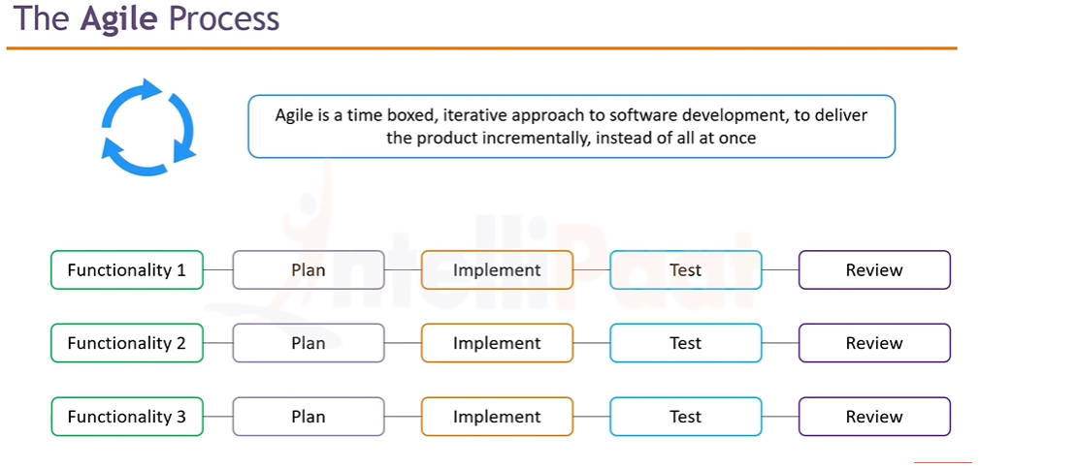
Notes:
Time-boxed
Time-boxed means every development cycle has a fixed duration.
Example:
Sprint 1 → 2 weeks Sprint 2 → 2 weeks Sprint 3 → 2 weeks
Iterative means repeating the same cycle again and again. The team continuously goes through:
Incremental Delivery
Software
↓
Functionality 1
Functionality 2
Functionality 3
Instead of waiting until everything is completed, Agile delivers the software feature by feature.

Slide 9
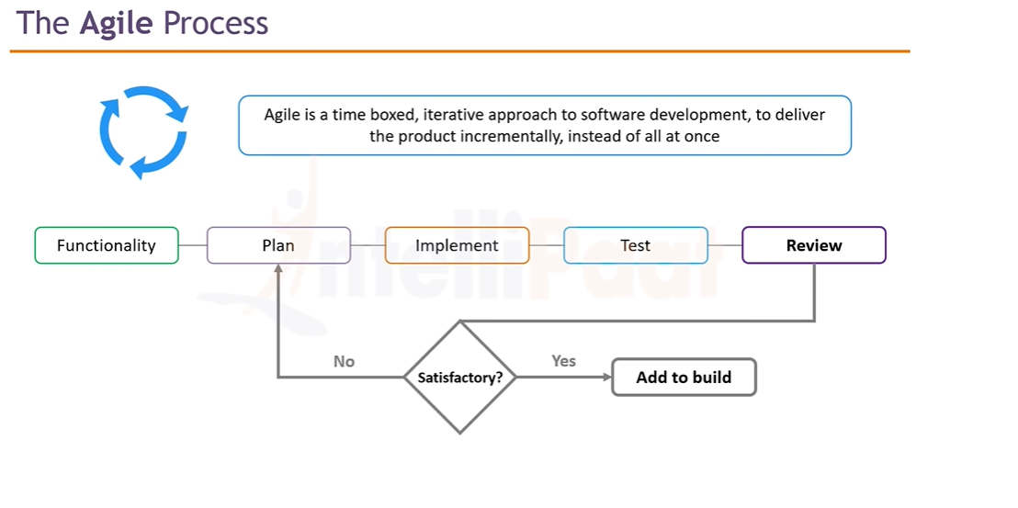

Slide 10
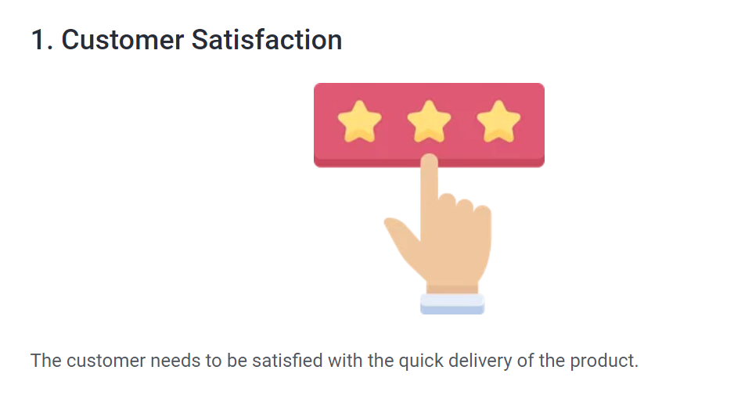
Agile Principles

Slide 11
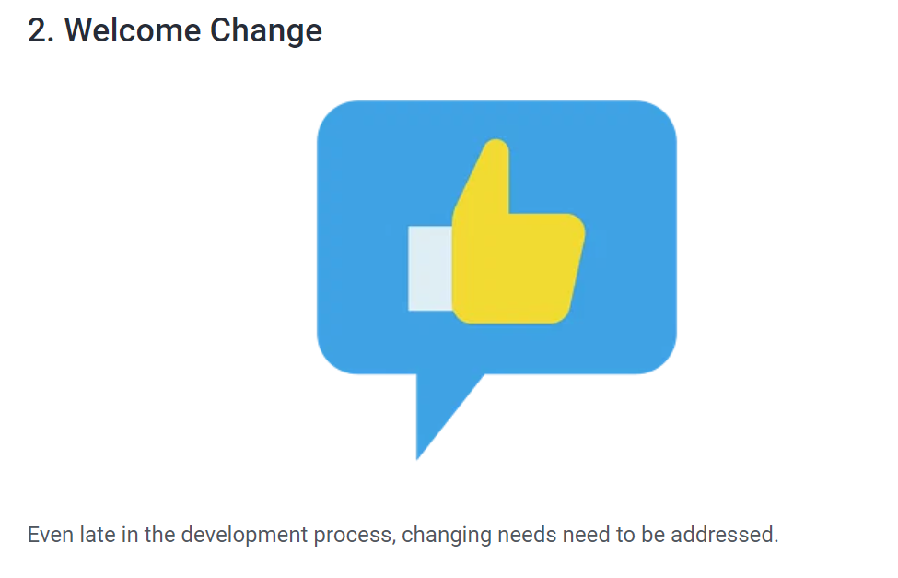
Agile Principles

Slide 12
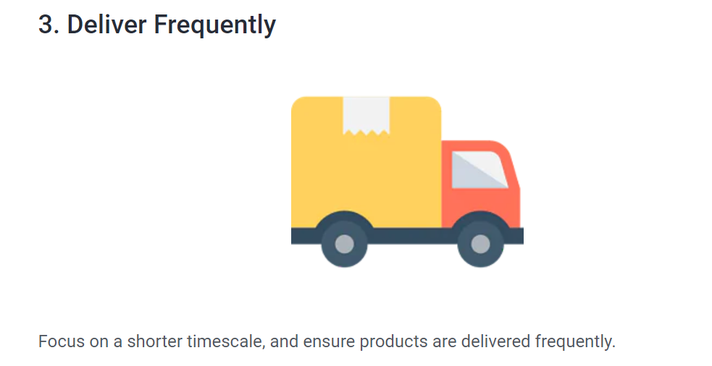
Agile Principles

Slide 13
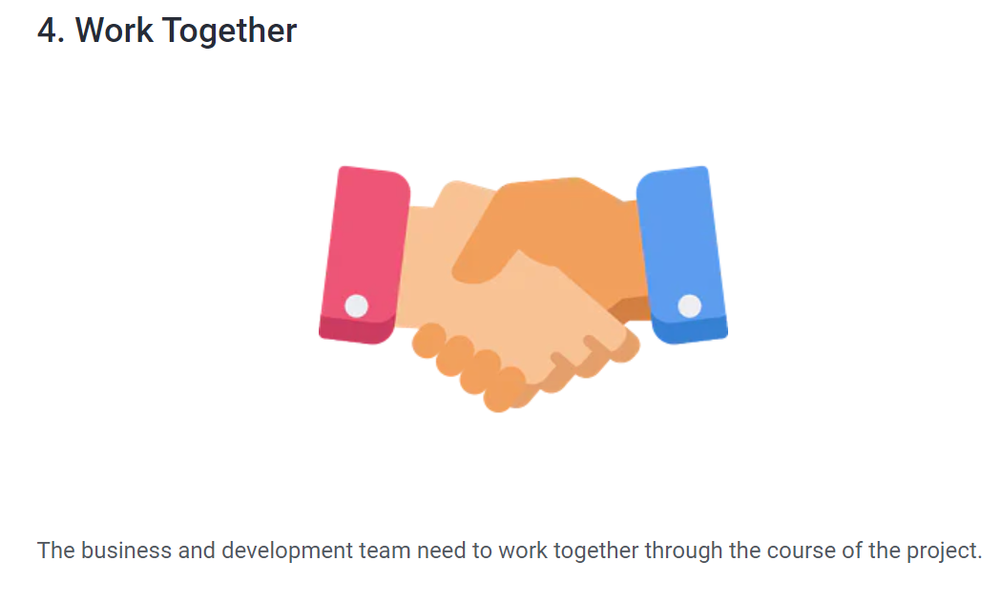
Agile Principles

Slide 14
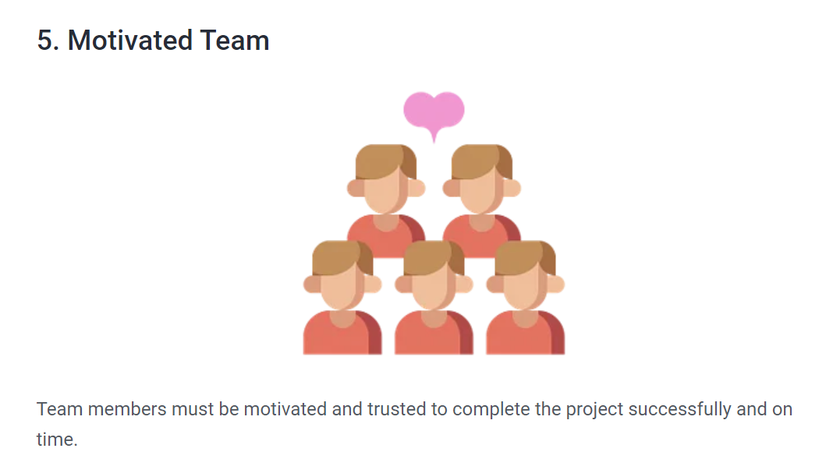
Agile Principles

Slide 15
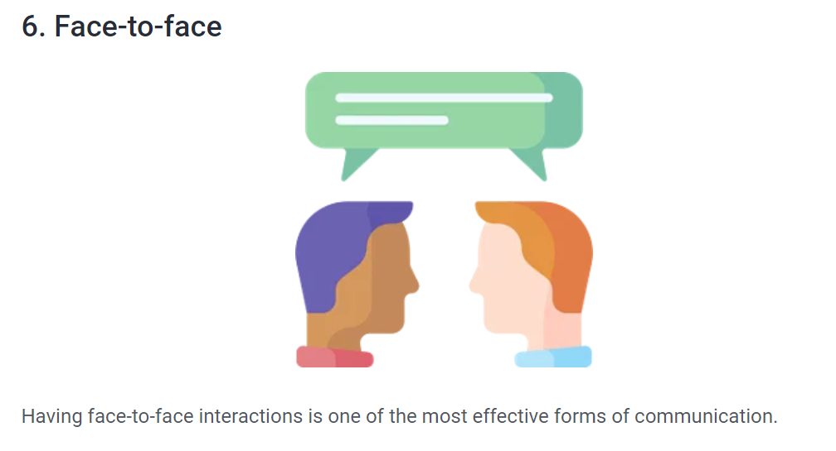
Agile Principles

Slide 16
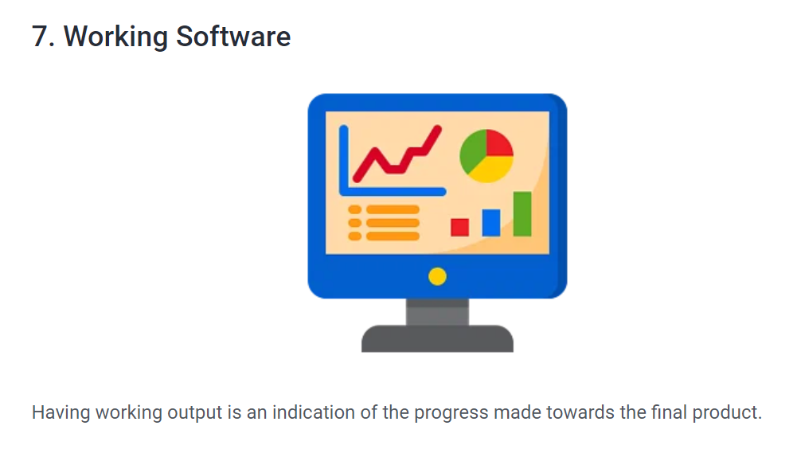
Agile Principles

Slide 17
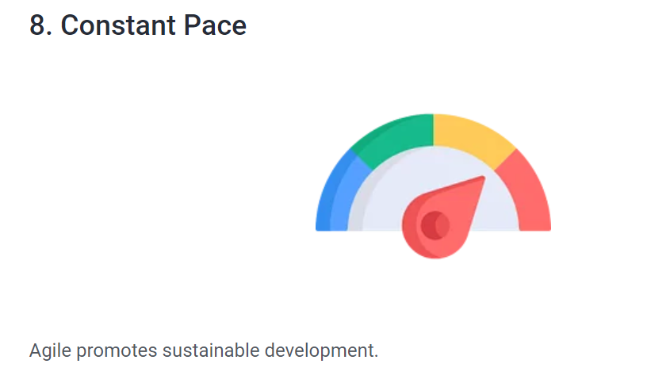
Agile Principles

Slide 18
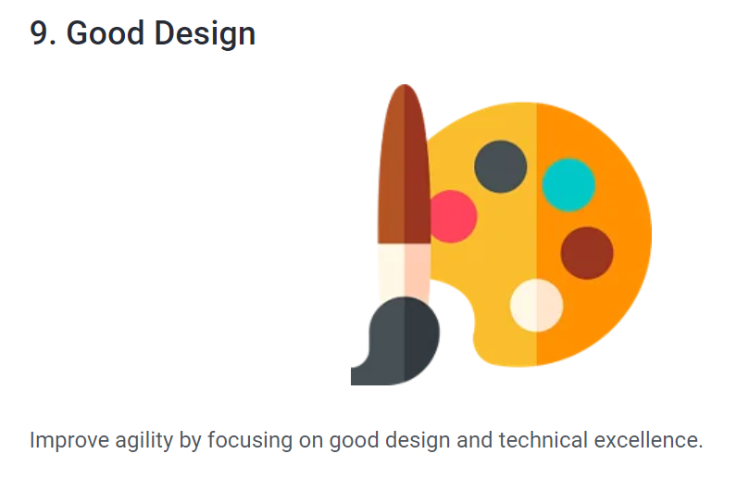
Agile Principles

Slide 19
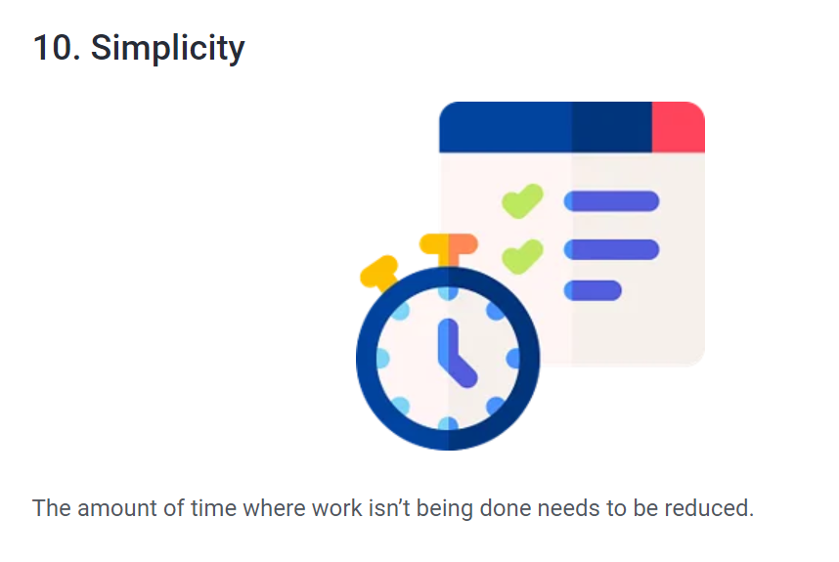
Agile Principles

Slide 20
Key Agile Concepts
1. User Stories
A user story is a short description of a feature or requirement from the user's point of view. It explains what the user wants and why they need it. The team creates user stories with the client or product owner before starting development.
Example:
"As a customer, I want to reset my password so that I can access my account if I forget it."

Slide 21
Key Agile Concepts
Daily Meeting (Daily Scrum)
A daily meeting is a short meeting held every day at the same time. Team members share what they completed yesterday, what they will work on today, and any obstacles they are facing. This helps the team stay coordinated and resolve issues quickly.

Slide 22
Key Agile Concepts
Team
A team is a small group of people working together on the same project. In Agile, team members usually work full-time, collaborate closely, and are responsible for delivering the project successfully.

Slide 23
Key Agile Concepts
Incremental Development
Incremental development is an approach where the product is built step by step. Each increment adds new, working features that provide value to the user. At the end of every iteration, the product becomes more complete than before.
Example:
  Increment 1: User Login
  Increment 2: User Registration
  Increment 3: Password Reset
  Increment 4: User Profile

Slide 24
Key Agile Concepts
Iterative Development
Iterative development is an approach where the team revisits and improves existing features in every iteration. Instead of building a feature only once, the team continuously refines and enhances it based on feedback.
Example:
  Iteration 1: Basic Login Page
  Iteration 2: Add Remember Me option
  Iteration 3: Improve Security with OTP
  Iteration 4: Enhance User Interface

Slide 25
Use case
A Use Case is a description of how a user interacts with a system to achieve a specific goal.
It answers questions like:
  Who is using the system?
  What does the user want to do?
  How does the system respond?
  What is the final outcome?

Slide 26
Use case
Example 1 – Grilled Cheese Sandwich
Scenario:
Imagine you are a cook.
Goal: Prepare a grilled cheese sandwich.
Use Case Steps
  Gather bread, butter, and cheese.
  Heat the pan.
  Butter the bread.
  Place cheese between bread slices.
  Grill both sides.
  Serve the sandwich.
The Use Case describes how the cook reaches the goal.

Slide 27
Components of a Use Case
1. Actor
The Actor is the person or external system interacting with the application.
The actor starts the Use Case.
Examples:
  Customer
  Student
  Employee
  Admin
  Bank
  Payment Gateway
Example:
Online Shopping App
Actor = Customer

Slide 28
Components of a Use Case
System
The System is the software or application that helps the actor achieve the goal.
Examples:
  Amazon Website
  ATM Machine
  Mobile Banking App
  Library Management System

Slide 29
Components of a Use Case
Goal
The Goal is what the actor wants to achieve successfully.
Examples:
  Place an order
  Transfer money
  Login
  Search products
  Borrow a book

Slide 30
Components of a Use Case
Online Shopping Example
Actor
Customer
  ↓
System
Amazon Website
↓
Goal
Purchase a Laptop
Use Case Flow
  Customer opens website.
  Customer searches for laptop.
  System displays products.
  Customer selects laptop.
  Customer adds laptop to cart.
  Customer makes payment.
  System confirms the order.
Goal achieved.

Slide 31
Components of a Use Case
Online Shopping Example
Actor
Customer
  ↓
System
Amazon Website
↓
Goal
Purchase a Laptop
Use Case Flow
  Customer opens website.
  Customer searches for laptop.
  System displays products.
  Customer selects laptop.
  Customer adds laptop to cart.
  Customer makes payment.
  System confirms the order.
Goal achieved.

Slide 32
What Is Scrum?
Scrum is a popular framework that enables teams to work together. Based on Agile principles, Scrum enables the development, delivery, and sustenance of complex projects.
With Scrum:
  Project deliverables are completed quickly and efficiently
  Time and money are used properly
  Projects are manageable since they’re divided into smaller units called sprints
  Teams have greater visibility, thanks to scrum meetings and stand-up sessions
  There’s constant feedback from customers and clients
  Individual efforts of the team members can be focused on

Slide 33
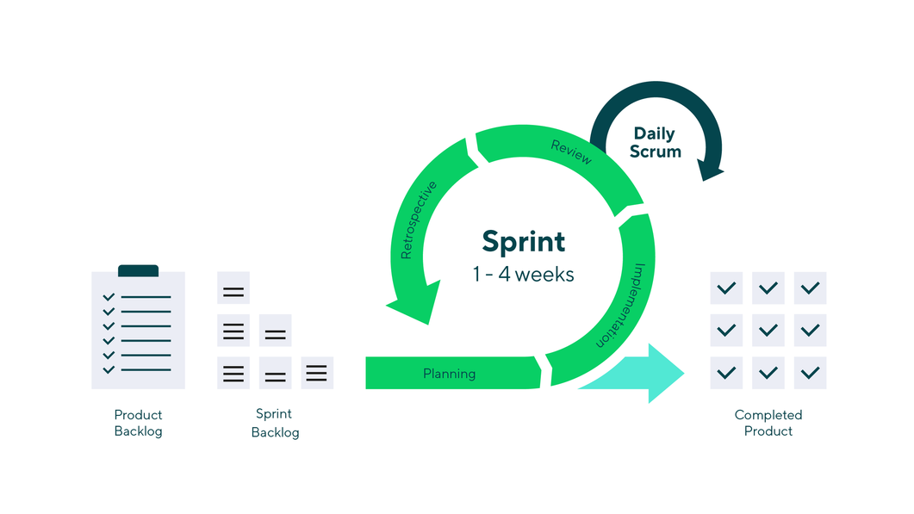
What are sprints?
A sprint is a short, time-boxed period when a scrum team works to complete a set amount of work

Slide 34
Epic
An Epic is a large feature or business requirement that cannot be completed in a single sprint. It is divided into multiple user stories.
Example:
Epic: Online Shopping System

Slide 35
User Story
A User Story is a small functional requirement that describes what a user
wants to achieve and why. It is small enough to be completed within a sprint.
Format:
As a <user>, I want <feature> so that <benefit>.
Example:
As a customer, I want to add products to my cart so that I can purchase multiple items together.

Slide 36
Task
A Task is a specific technical activity required to complete a user story. Tasks are assigned to team members.
Example (for the above User Story):
  Design the shopping cart page.
  Create the Cart database table.
  Develop the Add to Cart API.
  Write unit test cases.
  Perform testing.

Slide 37
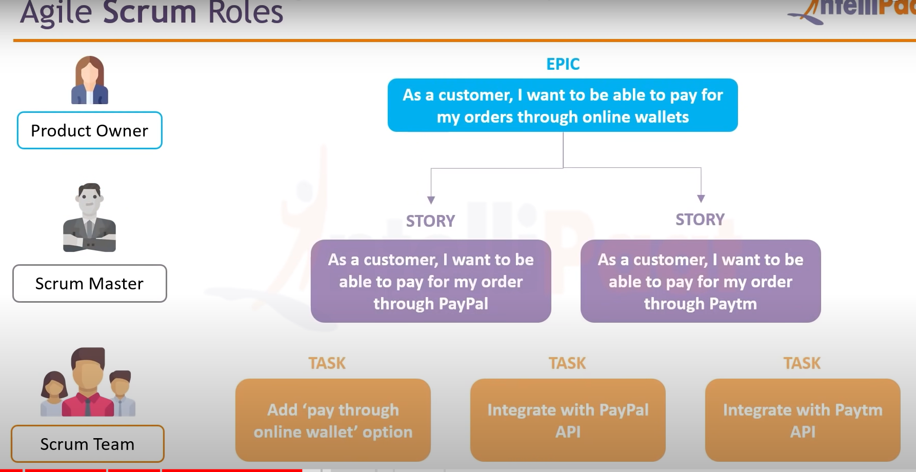

Slide 38
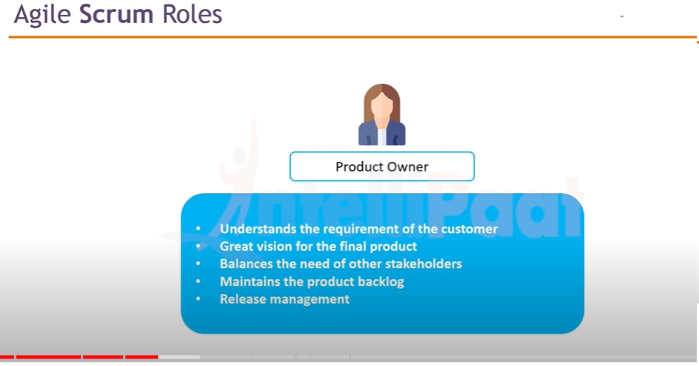

Slide 39
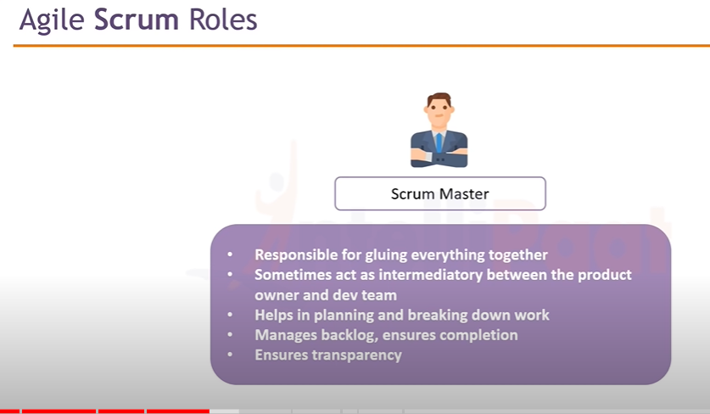

Slide 40
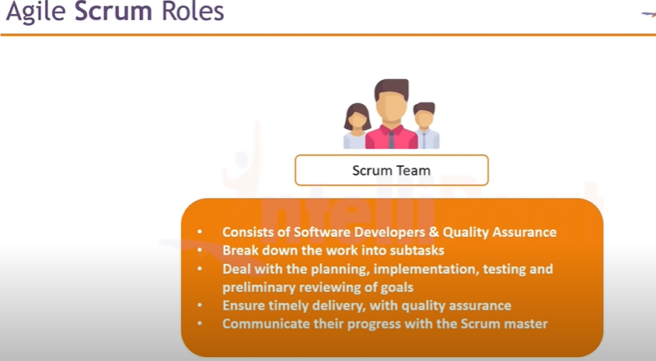

Slide 41
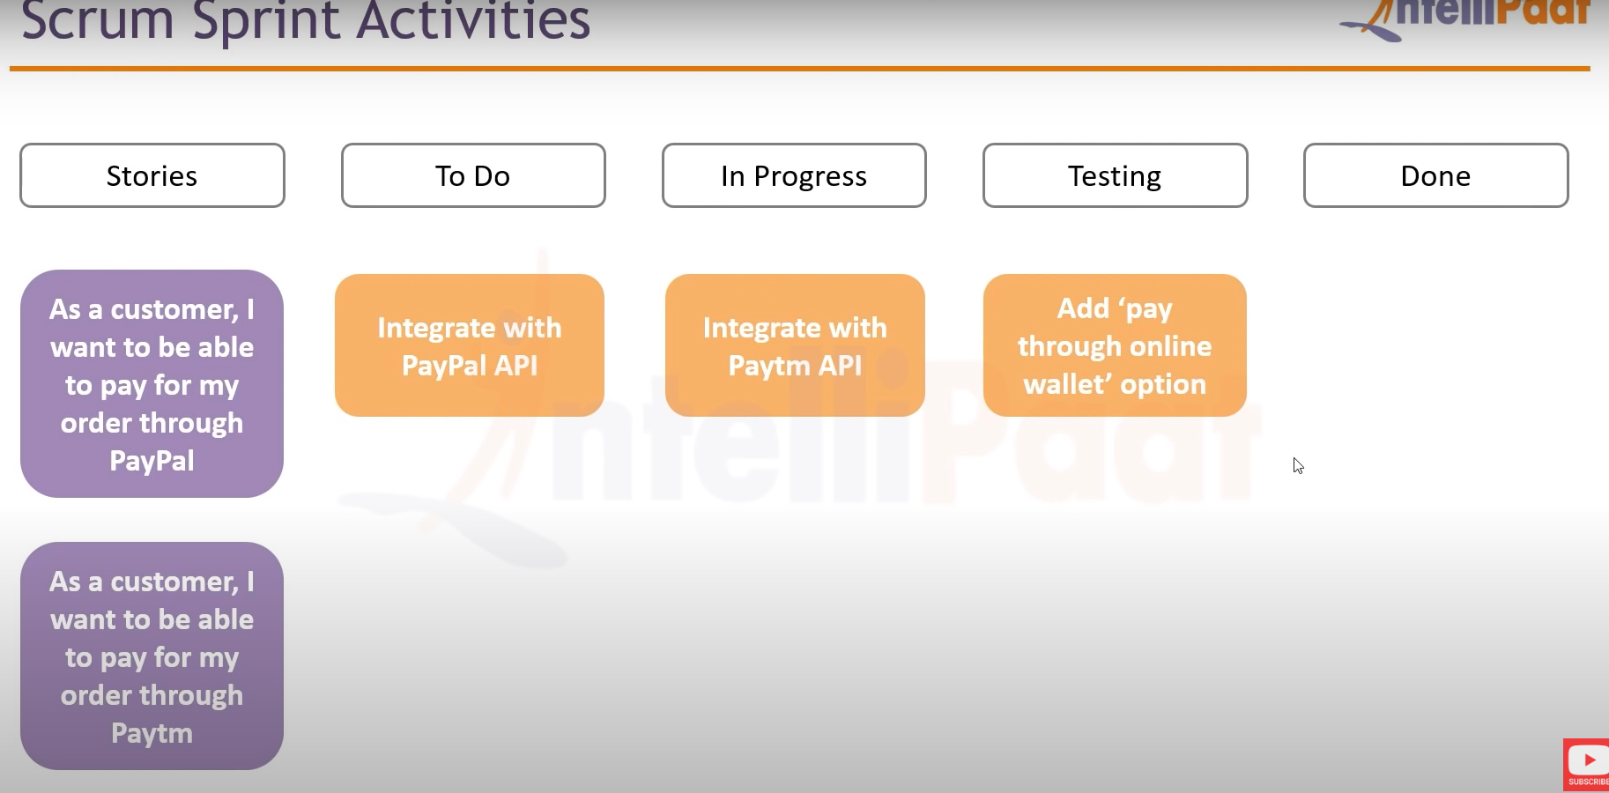

Slide 42
