Slide 1
Database Overview
S511 Session 2, IU-SLIS

Slide 2
Outline
Database
  What, Why, How
Evolution of Database
  File System
  Data Models
    Hierarchical
    Network
    Relational
    Entity-Relationship
    Object-Oriented
  Web Database

Slide 3
Database: What
Database
  is collection of related data and its metadata organized in a structured format
  for optimized information management
Database Management System (DBMS)
  is a software that enables easy creation, access, and modification of databases
  for efficient and effective database management
Database System
  is an integrated system of hardware, software, people, procedures, and data
  that define and regulate the collection, storage, management, and use of data within a database environment
Notes:
End user data – raw facts of interests to the end user
Metadata – description of data characteristics and relationships
Organization of data helps:
improve data accuracy
improve timely access
correlation and comparison
DBMS: a collection of programs that manages the database structure, control access to data
- Makes data management more efficient and effective
- Query language allows quick answers to ad hoc queries
- Provides better access to more and better-managed data
- Promotes integrated view of organization’s operations
- Reduces the probability of inconsistent data

Slide 4
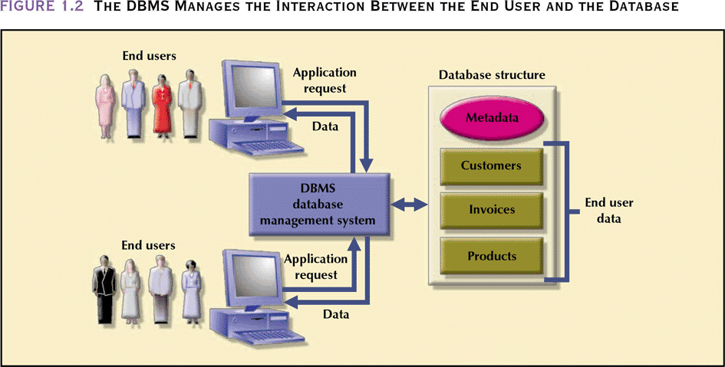
Database Management System
- manages interaction between end users and database
Database Systems: Design, Implementation, & Management: Rob & Coronel

Slide 5
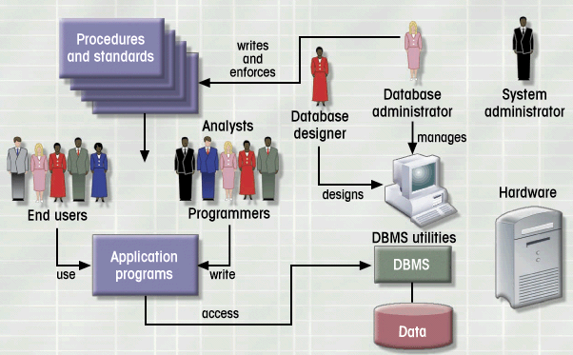
Database System Environment
Hardware
Software
- OS
- DBMS
- Applications
People
Procedures
Data
Database Systems: Design, Implementation, & Management: Rob & Coronel

Slide 6
Database: Why
Purpose of Database
  Optimizes data management
  Transforms data into information
Functions of DBMS/Database System
  Stores data and related data entry forms, report definitions, etc.
  Hides the complexities of relational database model from the user
    facilitates the construction/definition of data elements and their relationships
    enables data transformation and presentation
  Enforces data integrity
  Implements data security management
    access, privacy, backup & restoration
Notes:
Importance of Good Design
Poor design results in unwanted data redundancy
Poor design generates errors leading to bad decisions
Practical Approach
Focus on principles and concepts of database design
Importance of logical design

Slide 7
Database: Data Models
Importance
  Abstraction of complex real-word data structures in relative simple (graphical) representations
  Facilitate interaction among the designer, the applications programmer, and the end user
Basic Building Blocks
  Entity
    thing about which data are to be collected and stored
  Attribute
    a characteristic of an entity
  Relationship
    describes an association among entities
  Constraint
    restrictions placed on the data

Slide 8
Evolution of Data Models
Timeline
1960s
1970s
1980s
1990s
2000+
File-based
Hierarchical
Object-oriented
Network
Relational
Web-based
Entity-Relationship

Slide 9
Database: Historical Roots
Manual File System
  to keep track of data
  used tagged file folders in a filing cabinet
  organized according to expected use
    e.g. file per customer
  easy to create, but hard to
    locate data
    aggregate/summarize data
Computerized File System
  to accommodate the data growth and information need
  manual file system structures were duplicated in the computer
  Data Processing (DP) specialists wrote customized programs to
    write, delete, update data (i.e. management)
    extract and present data in various formats (i.e. report)

Slide 10
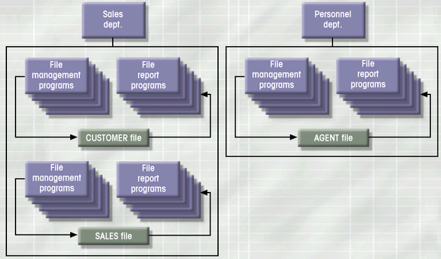
File System: Example
Database Systems: Design, Implementation, & Management: Rob & Coronel

Slide 11
File System: Weakness
Weakness
  “Islands of data” in scattered file systems.
Problems
  Duplication
    same data may be stored in multiple files
  Inconsistency
    same data may be stored by different names in different format
  Rigidity
    requires customized programming to implement any changes
    cannot do ad-hoc queries
Implications
  Waste of space
  Data inaccuracies
  High overhead of data manipulation and maintenance

Slide 12
File System: Problem Case
CUSTOMER file
AGENT file
SALES file
A_Name (15 char)
A_Name (20 char)
AGENT (20 char)
Carol Johnson
Carol T. Johnson
Carol J. Smith
- inconsistent field name, field size
- inconsistent data values
- data duplication

Slide 13
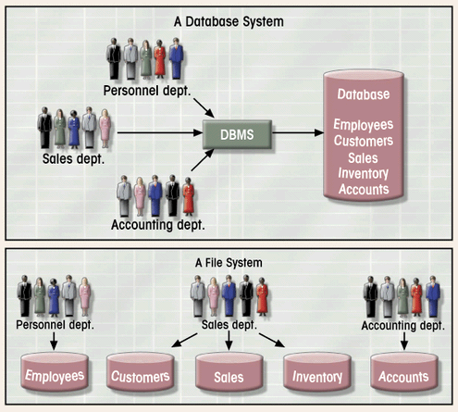
Database System vs. File System
Database Systems: Design, Implementation, & Management: Rob & Coronel

Slide 14
Hierarchical Database
Background
  Developed to manage large amount of data for complex manufacturing projects
  e.g., Information Management System (IMS)
    IBM-Rockwell joint venture
    clustered related data together
    hierarchically associated data clusters using pointers
Hierarchical Database Model
  Assumes data relationships are hierarchical
    One-to-Many (1:M) relationships
      Each parent can have many children
      Each child has only one parent
  Logically represented by an upside down tree

Slide 15
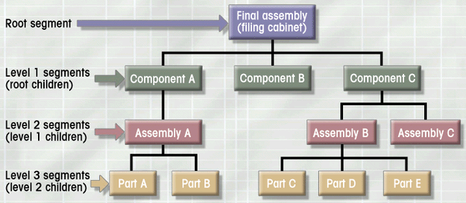
Hierarchical Database: Example
Database Systems: Design, Implementation, & Management: Rob & Coronel

Slide 16
Hierarchical Database: Pros & Cons
Advantages
  Conceptual simplicity
    groups of data could be related to each other
    related data could be viewed together
  Centralization of data
    reduced redundancy and promoted consistency
Disadvantages
  Limited representation of data relationships
    did not allow Many-to-Many (M:N) relations
  Complex implementation
    required in-depth knowledge of physical data storage
  Structural Dependence
    data access requires physical storage path
  Lack of Standards
    limited portability

Slide 17
Network Database
Objectives
  Represent more complex data relationships
  Improve database performance
  Impose a database standard
Network Database Model
  Similar to Hierarchical Model
    Records linked by pointers
  Composed of sets
    Each set consists of owner (parent) and member (child)
  Many-to-Many (M:N) relationships representation
    Each owner can have multiple members (1:M)
    A member may have several owners

Slide 18
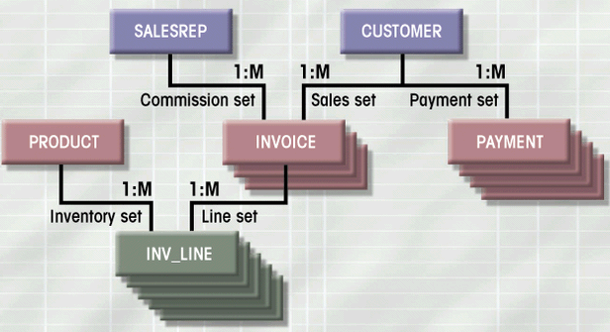
Network Database: Example
Database Systems: Design, Implementation, & Management: Rob & Coronel

Slide 19
Network Database: Pros & Cons
Advantages
  More data relationship types
  More efficient and flexible data access
    “network” vs. “tree” path traversal
  Conformance to standards
    enhanced database administration and portability
Disadvantages
  System complexity
    require familiarity with the internal structure for data access
  Lack of structural independence
    small structural changes require significant program changes
Notes:
disadvantages left over from hierarchical model

Slide 20
Relational Database
Problems with legacy database systems
  Required excessive effort to maintain
    Data manipulation (programs) too dependent on physical file structure
  Hard to manipulate by end-users
    No capacity for ad-hoc query (must rely on DB programmers).
Evolution in Data Organization
  E. F. Codd’s Relational Model proposal
    Separated the notion of physical representation (machine-view)
    from logical representation (human-view)
    Considered ingenious but computationally impractical in 1970
  Relational Database Model
    Dominant database model of today
    Eliminated pointers and used tables to represent data
    Tables
      flexible logical structure for data representation
      a series of row/column intersections
      related by sharing common entity characteristic(s)

Slide 21
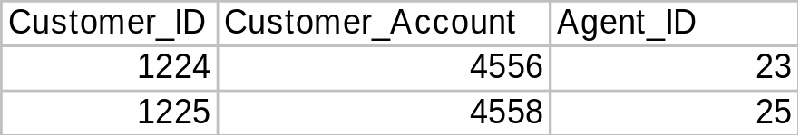
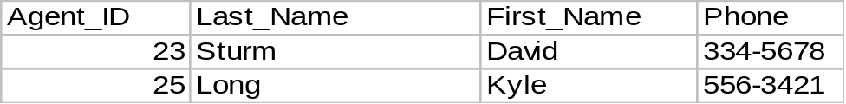
Relational Database: Example
Provides a logical “human-level” view of the data and associations among groups of data (i.e., tables)

Slide 22
Relational Database: Pros & Cons
Advantages
  Structural independence
    Separation of database design and physical data storage/access
    Easier database design, implementation, management, and use
  Ad hoc query capability with Structured Query Language (SQL)
    SQL translates user queries to codes
Disadvantages
  Substantial hardware and system software overhead
    more complex system
  Poor design and implementation is made easy
    ease-of-use allows careless use of RDBMS

Slide 23
Normalization:
Normalization is a technique which is used to organize the data in the database. It is a systematic approach to remove the data redundancy.
There are following Four Normal Forms used in Database Normalization:
  1.First Normal Form
  2.Second Normal Form
  3.Third Normal Form
  4. Boyce-code Normal Form(BCNF)
First Normal Form/1st Normal Form:
The first normal form is the normal form of database where data must not contain repeating groups.
  1.It contains only automic values.

Slide 24
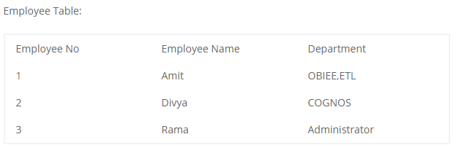
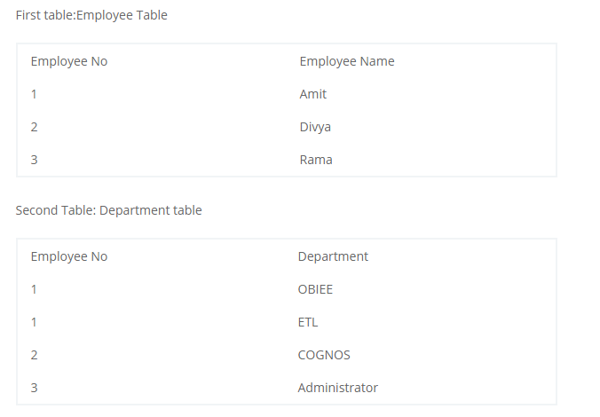
Example

Slide 25
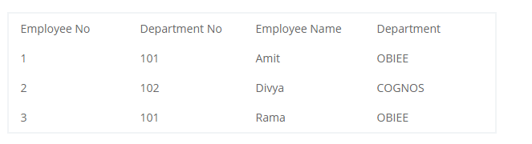
Second Normal Form/2nd Normal Form:
1.It is in First normal form
2.There should not be any partial dependency of any column on primary key.
3.All Non-key attributes are fully functionally dependent on primary.
Here We will see that there is composite key as{ Employee No,Department No}.Employee No is dependent on Employee Name and Department is dependent on Department No.We can split the above table into 2 different tables:

Slide 26
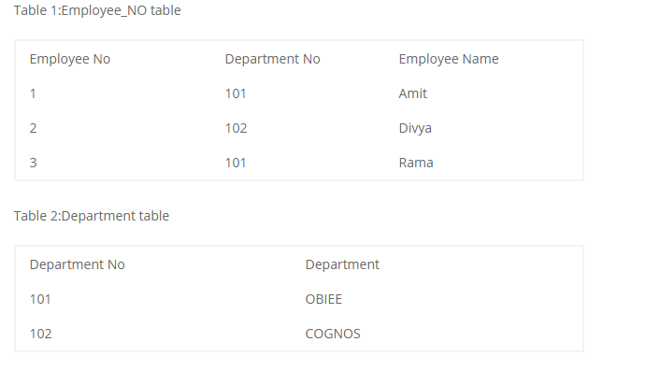

Slide 27
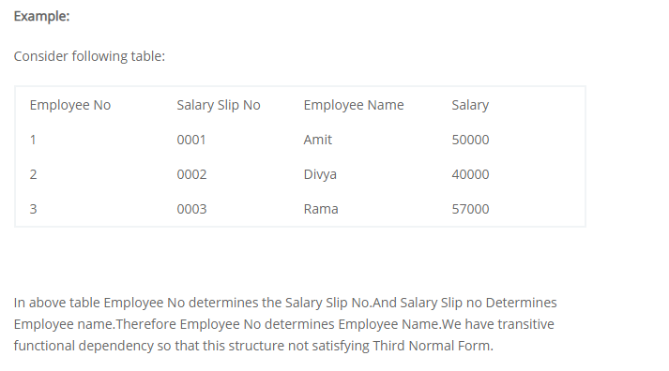
Third Normal Form/3rd Normal Form:
The database is in Third normal form if it satisfies following conditions:
1.It is in Second normal form
2.There is no transitive functional dependency
Transitive Dependency:
When table 1 is Functionally dependent on table 2. and table 2 is functionally dependent on table 3 then table 3 is transitively dependent on table 1 via table 2.

Slide 28
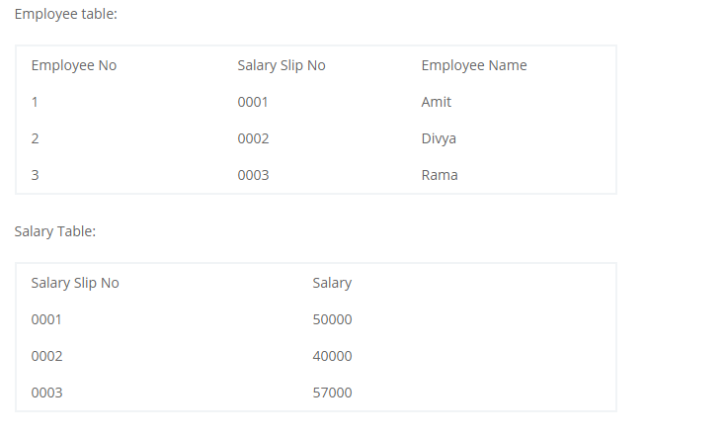

Slide 29
What is SQL?
SQL stands for Structured Query Language
SQL lets you access and manipulate databases
SQL became a standard of the American National Standards Institute (ANSI) in 1986,
and of the International Organization for Standardization (ISO) in 1987
What Can SQL do?
SQL can execute queries against a database
SQL can retrieve data from a database
SQL can insert records in a database
SQL can update records in a database
SQL can delete records from a database
SQL can create new databases
SQL can create new tables in a database
SQL can create stored procedures in a database
SQL can create views in a database
SQL can set permissions on tables, procedures, and views

Slide 30
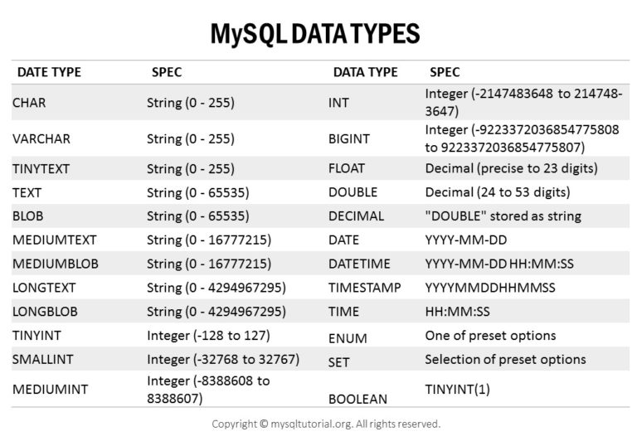
S511 Session 2, IU-SLIS

Slide 31
Types of SQL Commands
categories of commands used in SQL to perform various functions
The main categories are
  DDL (Data Definition Language)
  DML (Data Manipulation Language)
  DQL (Data Query Language)
  DCL (Data Control Language)
  Transactional control commands
DDL
DDL is short name of Data Definition Language, which deals with database schemas and descriptions, of how the data should reside in the database.
  Create - to create a database and its objects like (table, index, views, store procedure)
  ALTER - alters the structure of the existing database
  DROP - delete objects from the database
  TRUNCATE - remove all records from a table
  COMMENT - add comments to the data dictionary
  RENAME - rename an object

Slide 32
Create Database Command
create database if not exists test
SQL CREATE TABLE Example
create table Employees(
Employee_id int,
Last_name varchar(40),
First_name varchar(40),
Address varchar(40),
City varchar(40))
Insert into Employees values(1,'Babjee','Reddy','Tambaram','Chennai');
Insert into Employees values(2,'Naveen','Reddy','Tambaram','Chennai');
Insert into Employees(Employee_id,Last_name,City) values(3,'Ram','Bangalure');

Slide 33
Creating Table With Existing Table
Create Table Employees_Back as select * from Employees;
Create Table Employees_Back1 As Select Employee_id,First_name,Last_name From Employees;
Create Table Employees_Back2 As Select Employee_id,First_name,Last_name From Employees where Employee_id >100;
Creating Table With Auto Increment
CREATE TABLE EMPLOYEES1( EMPLOYEE_ID INT NOT NULL auto_increment PRIMARY KEY, LAST_NAME VARCHAR(40),
FIRST_NAME varchar(40),
SALARY decimal(10,2),
DOB DATE)
Insert Into Employees1(first_name,last_name,salary,dob) values('Babjee','Reddy',3000,'2004-10-20')

Slide 34
Create Table with Default value
CREATE TABLE Employees_default (
ID int NOT NULL,
LastName varchar(255) NOT NULL,
FirstName varchar(255), Age int,
City varchar(255) DEFAULT 'Chennai‘
);
Insert Into Employees_Default(Id,LastName,FirstName,Age) values(1,'Babjee','Reddy',35);
Insert Into Employees_Default values(1,'Babjee','Reddy',35,'Hyderabad');
CREATE TABLE Employees_default1 (
ID int NOT NULL,
LastName varchar(255) NOT NULL,
FirstName varchar(255),
Age int,
City varchar(255),
Dob datetime default CURRENT_TIMESTAMP()
);
Insert Into Employees_default1(Id,FirstName,LastName,city) values (1,'Babjee','Reddy','Hyderabad');

Slide 35
Temporary Tables
A TEMPORARY table is visible only within the current session, and is dropped automatically
when the session is closed.
CREATE temporary TABLE DUMMY(ID INT,NAME varchar(40));
INSERT INTO DUMMY VALUES(1,'BABJEE');
Constraints
SQL constraints are used to specify rules for the data in a table.
Constraints can be column level or table level. Column level constraints apply to a column,
and table level constraints apply to the whole table
The following constraints are commonly used in SQL:
NOT NULL - Ensures that a column cannot have a NULL value
UNIQUE - Ensures that all values in a column are different
PRIMARY KEY - A combination of a NOT NULL and UNIQUE.
FOREIGN KEY - Uniquely identifies a row/record in another table
CHECK - Ensures that all values in a column satisfies a specific condition
ENUM is a string object with a value chosen from a list of permitted values.
SET can have zero or more values. Each of the values must be chosen from a list of permitted values.

Slide 36
Not Null Constraint
Create Table Employees_NotNull
(Id int Not null,
Employee_Name varchar(40) Not Null,
Salary decimal(10,2)
)
Insert Into Employees_NotNull Values(null,'Babjee',3000);Insert
Into Employees_NotNull Values(1,null,3000);
Insert Into Employees_NotNull Values(1,'Babjee',3000);

Slide 37
Primary Key
Create Table Employees_PK(
Id int Primary Key,
Employee_Name varchar(40),
Salary decimal
);
Insert into Employees_PK Values(1,'Babjee',30000);
Insert into Employees_PK Values(1,'Babjee',30000);
Insert into Employees_PK Values(null,'Babjee',30000);
Create Table Employees_PK1(
Id int,
Employee_Name varchar(40),
Salary decimal ,
constraint emp_k primary key(id)
);

Slide 38
Create Table Employees_PK2(
Id int,
Employee_Name varchar(40),
Salary decimal ,
constraint emp_k primary key(id,Employee_name)
);
Insert into Employees_PK2 Values(1,'Babjee',30000);Insert
into Employees_PK2 Values(1,'Babjee',30000);
Insert into Employees_PK2 Values(1,'Naveen',30000);
select *from information_schema.table_constraints
where table_name ='Employees_pk2'

Slide 39
Unique Constraint
Create Table Employees_Unique(
id int unique ,
Employee_Name Varchar(40),
Salary decimal(10,2)
)
Insert into Employees_Unique values(1,'Naveen',50000); Insert into Employees_Unique values(1,'Naveen',50000); Insert into Employees_Unique values(NUll,'Ram',50000);
Create Table Employees_Unique1(
id int unique ,
Employee_Name Varchar(40) Unique,
Salary decimal(10,2)
)
Create Table Employees_Unique2(
id int ,
Employee_Name Varchar(40) ,
Salary decimal(10,2),
constraint emp_uqniq Unique(id,Employee_name)
)

Slide 40
Check Constraint
Create Table Employees_Check(
id int ,
Employee_Name Varchar(40) ,
Salary decimal(10,2),
constraint emp_cheq check(salay >50000)
);
insert into employees_check values(1,'Sham',3000
select * from employees_check

Slide 41
Foreign Key
Create table Supplier(
Supplier_id int Primary key,
Supplier_name varchar(40)
);
Insert Into Supplier value(1,'Abc Company');
Insert Into Supplier value(2,'Bca Company');
Create Table Products(
Product_id int,
Product_name varchar(40),
Supplier_id int ,
foreign key(supplier_id) references supplier(supplier_id)
);
Insert Into Products values(1,'Pen',1);
Insert Into Products values(2,'Pencil',3);
Create Table Products(
Product_id int,
Product_name varchar(40),
Supplier_id int ,
foreign key(supplier_id) references supplier(supplier_id) on delete cascade
);

Slide 42
ENMU
ENUM is a string object with a value chosen from a list of permitted values that are enumerated explicitly in the column specification at table creation time
CREATE TABLE shirts (
name VARCHAR(40),
size ENUM('x-small', 'small', 'medium', 'large', 'x-large')
);
INSERT INTO shirts (name, size) VALUES ('dress shirt','large'), ('t-shirt','medium'), ('polo shirt','small');
SET
A SET is a string object that can have zero or more values, each of which must be chosen from a list of permitted values specified when the table is created
CREATE TABLE myset (col SET('a', 'b', 'c', 'd'));
INSERT INTO myset (col) VALUES -> ('a,d'), ('d,a'), ('a,d,a'), ('a,d,d'), ('d,a,d');
INSERT INTO myset (col) VALUES ('a,d,d,s');
Show wanrnings

Slide 43
Alter Command
Changing data type
Alter table Employees modify employee_id float;
Channing form Null to Not Null /Not Null to Null
Alter table Employees modify employee_id float Not null;
Increasing Column Length
Alter table Employees modify Last_name varchar(300);
Adding Column
Alter table Employees add pincode int;
Adding Column multiple columns
Alter table Employees add (address1 varchar(40),address2 varchar(40))in;
Dropping column
Alter table Employees drop column address2
Rename Table
alter table employees1 rename to employee_new1

Slide 44
Rename Column
Alter table employees CHANGE city new_city varchar(40);
Adding Constraints
alter table employees add constraint emp_pk primary key(employee_id);
alter table employees drop primary key
alter table employees add constraint emp_uk UNIQUE(last_name);
ALTER TABLE EMPLOYEES DROP index emp_uk
ALTER TABLE products drop foreign key products_ibfk_1

Slide 45
Drop Command
Drop table test;
Truncate table Command
Truncate Myset1

Slide 46
DML Commands
INSERT – insert data into a table.
UPDATE – updates existing data within a table.
SELECT – retrieve data from the a database.
DELETE – deletes all records from a table, the space for the records remain.
MERGE – UPSERT operation (insert or update)
Create Table Students(
Student_id int,
Student_name varchar(40),
Age int,
Gender varchar(6)
);
Insert into students values (1,’Susil’,22,’Male’);
Insert into students values(2,’Ram’,21’,’Male’),(3,’Sheetal’,21,’Femaile’);
Insert into students1 select * from students;

Slide 47
Update command
update students set age =35 where student_id=2
update students set student_name='Ram Kumar', age=35 where student_id=3
update students set age =25 ;
update students set age=age+5 where student_id >1;
Update students set age =null where student_id=1;

Slide 48
SELECT STATE MENT
select * from emp;
select count(*) from emp;
Comarision Operator
select empno,ename,job from emp;
select * from emp where job='CLERK';
select * from emp where deptno=20;
select * from emp where deptno !=20;
select * from emp where deptno <>20;
select * from emp where deptno >20;
select * from emp where deptno >=20;
select * from emp where deptno <20;
select * from emp where deptno <=20;

Slide 49
select * from emp where deptno between 20 and 30;
select * from emp where deptno not between 20 and 30;
select * from emp where deptno in(10,20);
select * from emp where deptno not in(10,20);
select * from emp where comm is null;
select * from emp where comm is not null;
select * from emp where ename like 'S%';
select * from emp where ename like '%S‘
select * from emp where ename not like '%S‘
select * from emp where ename like '_mith';

Slide 50
Logical Operators
select * from emp where deptno=10 and sal >4000;
select * from emp where deptno=10 or sal >4000;
select * from emp where (deptno=10 and sal >4000) or (deptno=20 and sal <4000)
Order By class
select * from emp order by ename ;
select * from emp order by ename desc;
select * from emp order by deptno,sal desc

Slide 51
Functions
MySQL has many built-in functions.
Mysql contains string, numeric, date, and some advanced functions in MySQL.
Single row function: function execute for each row
Group function: function execute group of rows
String functions
ASCII Returns the ASCII value for the specific character
select ascii('A')
CHAR_LENGTH Returns the length of a string (in characters)
select ename,char_length(ename) from emp
BIN(N) Returns a string representation of the binary value of N
SELECT BIN(12);
CHARACTER_LENGTH Returns the length of a string (in characters)
select ename,CHARACTER_LENGTH(ename) from emp

Slide 52
CONCAT Adds two or more expressions together
SELECT CONCAT("SQL ", "Tutorial ", "is ", "fun!") AS ConcatenatedString;
FIELD Returns the index position of a value in a list of values
SELECT FIELD("q", "s", "q", "l") as position;
FORMAT Formats a number to a format like "#,###,###.##", rounded to a specified number of decimal places
SELECT FORMAT(250500.5634, 2);
INSERT Inserts a string within a string at the specified position and for a certain number of characters
SELECT INSERT("Bigems.com", 1, 6, "Example");
INSTR Returns the position of the first occurrence of a string in another string
select instr('Babjee Reddy ponnam',' ')
LCASE Converts a string to lower-case
select lcase(ename),ename from emp
UPPER Converts a string to upper-case
select upper(ename),ename from emp
select ucase(ename),ename from emp

Slide 53
Initial captical
select CONCAT(UCASE(LEFT(ename, 1)),SUBSTRING(lower(ename), 2)) from emp;
LEFT Extracts a number of characters from a string (starting from left)
SELECT LEFT("SQL Tutorial", 3) AS ExtractString;
RIGHT Extracts a number of characters from a string (starting from left)
select right("SQL Tutorial", 8) AS ExtractString;
LENGTH Returns the length of a string (in bytes)
select length('babjee');
LPAD Left-pads a string with another string, to a certain length
select lpad('babjee',15,'*')
RPAD Right-pads a string with another string, to a certain length
select rpad('babjee',15,'*');
LTRIM Removes leading spaces from a string
SELECT LTRIM(" SQL Tutorial") AS LeftTrimmedString;
RTRIM Removes trailing spaces from a string
SELECT RTRIM("SQL Tutorial ") AS LeftTrimmedString;

Slide 54
REPEAT Repeats a string as many times as specified
select repeat("babjee ",3)
REPLACE Replaces all occurrences of a substring within a string, with a new substring
SELECT REPLACE("SQL Tutorial", "SQL", "HTML");
STRCMP Compares two strings
SELECT STRCMP("SQL Tutorial", "SQL Tutorial");
SUBSTRING Extracts a substring from a string (starting at any position)
SELECT SUBSTRING("SQL Tutorial", 5, 3) AS ExtractString;

Slide 55
Number functions
ABS Returns the absolute value of a number
select abs(-2)
CEIL Returns the smallest integer value that is >= to a number
SELECT CEIL(25.15);
COS Returns the cosine of a number
Select cos(2)
DIV Used for integer division
SELECT 10 DIV 5;
EXP Returns e raised to the power of a specified number
select exp(4)
FLOOR Returns the largest integer value that is <= to a number
SELECT FLOOR(25.75);
GREATEST Returns the greatest value of the list of arguments
select greatest(1,50,30,60)

Slide 56
LEAST Returns the smallest value of the list of arguments
select least(1,50,30,60)
LN Returns the natural logarithm of a number
select ln(2)
MOD Returns the remainder of a number divided by another number
select mod(10,2)
PI Returns the value of PI
select pi();
POW Returns the value of a number raised to the power of another number
select pow(10,2)
ROUND Rounds a number to a specified number of decimal places
select round(10.51,0)
SQRT Returns the square of a number
SELECT SQRT(64);

Slide 57
Date Function
CURDATE Returns the current date
select curdate()
CURRENT_DATE Returns the current date
select CURRENT_DATE
CURRENT_TIME Returns the current time
select current_time()
CURTIME Returns the current time
select curtime()
CURRENT_TIMESTAMP Returns the current date and time
select current_timestamp()
ADDDATE Adds a time/date interval to a date and then returns the date
select ADDDATE("2015-10-01",interval 10 DAY)
SELECT ADDDATE(curdate(),interval 10 DAY)
DATEDIFF Returns the number of days between two date values
SELECT DATEDIFF("2017-06-25", "2017-06-15");

Slide 58
DATE_FORMAT Formats a date
SELECT DATE_FORMAT("2017-06-15", "%Y");
%a Three-characters abbreviated weekday name e.g., Mon, Tue, Wed, etc.
%b Three-characters abbreviated month name e.g., Jan, Feb, Mar, etc.
%c Month in numeric e.g., 1, 2, 3…12
%D Day of the month with English suffix e.g., 0th, 1st, 2nd, etc.
%d Day of the month with leading zero if it is 1 number e.g., 00, 01,02, …31
%e Day of the month without leading zero e.g., 1,2,…31
%f Microseconds in the range of 000000..999999
%H Hour in 24-hour format with leading zero e.g., 00..23
%h Hour in 12-hour format with leading zero e.g., 01, 02…12
%I Same as %h
%i Minutes with leading zero e.g., 00, 01,…59
%j Day of year with leading zero e.g., 001,002,…366
%k Hour in 24-hour format without leading zero e.g., 0,1,2…23
%l Hour in 12-hour format without leading zero e.g., 1,2…12
%M Full month name e.g., January, February,…December
%m Month name with leading zero e.g., 00,01,02,…12
%p AM or PM, depending on other time specifiers

Slide 59
%r Time in 12-hour format hh:mm:ss AM or PM
%S Seconds with leading zero 00,01,…59
%T Time in 24-hour format hh:mm:ss
%U Week number with leading zero when the first day of week is Sunday e.g., 00,01,02…53
%u Week number with leading zero when the first day of week is Monday e.g., 00,01,02…53
The following are some commonly used date format strings:
DATE_FORMAT string Formatted date
%Y-%m-%d 2018/4/25
%e/%c/%Y 4/7/2013
%c/%e/%Y 7/4/2013
%d/%m/%Y 4/7/2013
%m/%d/%Y 7/4/201

Slide 60
DATE_SUB Subtracts a time/date interval from a date and then returns the date
SELECT DATE_SUB("2017-06-15", INTERVAL 10 DAY);
DAY Returns the day of the month for a given date
SELECT DAY("2017-06-15");
DAYNAME Returns the weekday name for a given date
SELECT DAYname("2017-06-15");
DAYOFMONTH Returns the day of the month for a given date
SELECT dayofmonth("2017-06-15");
DAYOFWEEK Returns the weekday index for a given date
SELECT dayofweek("2017-06-15");
DAYOFYEAR Returns the day of the year for a given date
SELECT dayofyear(curdate());
EXTRACT Extracts a part from a given date
SELECT extract(year from curdate())
SELECT extract(month from curdate())

Slide 61
SELECT extract(day from curdate())
SELECT extract(week from curdate())
HOUR Returns the hour part for a given date
select hour(current_time())
LAST_DAY Extracts the last day of the month for a given date
select last_day(current_time())
LOCALTIME Returns the current date and time
select localtime()
LOCALTIMESTAMP Returns the current date and time
select localtimestamp()
MINUTE Returns the minute part of a time/datetime
select minute(localtime())
MONTH Returns the month part for a given date
select month(localtime())

Slide 62
MONTHNAME Returns the name of the month for a given date
select monthname(localtime())
NOW Returns the current date and time
select now()
QUARTER Returns the quarter of the year for a given date value
select quarter(now())
WEEK Returns the week number for a given date
SELECT WEEK("2017-06-15");
WEEKDAY Returns the weekday number for a given date
WEEKOFYEAR Returns the week number for a given date
SELECT WEEKOFYEAR("2017-06-15");
YEAR Returns the year part for a given date
select year(now())

Slide 63
MySQL Advanced Functions
BIN Returns a binary representation of a number
select bin(10)
CASE Goes through conditions and return a value when the first condition is met
select empno,ename,sal,deptno,
case when deptno =10 then "Accounts"
when deptno =20 then "IT"
else "Admin"
end
from emp
CAST Converts a value (of any type) into a specified datatype
SELECT CAST("2017-08-29" AS DATE);
SELECT CAST("14:06:10" AS TIME);
select cast(1234 as char(4));
select cast( "123" as signed);

Slide 64
COALESCE Returns the first non-null value in a list
SELECT COALESCE(NULL, NULL, NULL, 'Biges.com', NULL, 'Example.com');
CURRENT_USER Returns the user name and host name for the MySQL account that the server used to authenticate the current client
select current_user()
DATABASE Returns the name of the current database
select database()
IF Returns a value if a condition is TRUE, or another value if a condition is FALSE
SELECT IF(500<1000, "YES", "NO");
ISNULL Returns 1 or 0 depending on whether an expression is NULL
select isnull(comm) ,comm from emp
NULLIF Compares two expressions and returns NULL if they are equal. Otherwise, the first expression is returned
select nullif(ename,'smith') from emp

Slide 65
Ifnull
select ifnull(comm,0),comm from emp
SESSION_USER Returns the current MySQL user name and host name
select session_user()
SYSTEM_USER Returns the current MySQL user name and host name
select system_user()
USER Returns the current MySQL user name and host name
select user()
VERSION Returns the current version of the MySQL database
select version()

Slide 66
GROUP FUNCTIONS
SELECT DEPTNO,
MAX(SAL) AS MAX_SAL,
MIN(SAL) AS MIN_SAL,
AVG(SAL) AS AVG_SAL,
SUM(SAL) AS SUM_SAL,
COUNT(SAL) AS NO_OF_EMP
FROM EMP
GROUP BY DEPTNO
SELECT JOB,DEPTNO,
MAX(SAL) AS MAX_SAL,
MIN(SAL) AS MIN_SAL,
AVG(SAL) AS AVG_SAL,
SUM(SAL) AS SUM_SAL,
COUNT(SAL) AS NO_OF_EMP
FROM EMP
GROUP BY DEPTNO,JOB

Slide 67
WITH ROLLOUP
SELECT DEPTNO,
SUM(SAL) AS SUM_SAL
FROM EMP
GROUP BY DEPTNO WITH ROLLUP
SELECT
JOB,DEPTNO,
SUM(SAL) AS SUM_SAL
FROM EMP
GROUP BY DEPTNO,JOB
WITH ROLLUP
SELECT
if(grouping(deptno),"Alldeptno",deptno) as deptno,
if(grouping(job),"All jobs",job) as jobs ,
SUM(SAL) AS SUM_SAL
FROM EMP
GROUP BY DEPTNO,job WITH ROLLUP

Slide 68
HAVING CLASS
SELECT
DEPTNO,
MAX(SAL) AS MAX_SAL,
MIN(SAL) AS MIN_SAL,
AVG(SAL) AS AVG_SAL,
SUM(SAL) AS SUM_SAL,
COUNT(SAL) AS NO_OF_EMP
FROM EMP
GROUP BY DEPTNO
HAVING COUNT(SAL) >4

Slide 69
SQL JOIN
A JOIN clause is used to combine rows from two or more tables, based on a related column between them
(INNER) JOIN: Returns records that have matching values in both tables
LEFT (OUTER) JOIN: Return all records from the left table, and the matched records from the right table
RIGHT (OUTER) JOIN: Return all records from the right table, and the matched records from the left table
FULL (OUTER) JOIN: Return all records when there is a match in either left or right table
CROSS JOIN
NATURAL JOIN
SELF JOIN
NO EQUIE JOIN

Slide 70
SQL EQUI JOIN performs a JOIN against equality or matching column(s) values of the associated tables
SELECT
EMPNO,
ENAME,
JOB,
MGR,
HIREDATE,
SAL,
COMM,
EMP.DEPTNO,
DNAME
FROM EMP,DEPT
WHERE EMP.DEPTNO=DEPT.DEPTNO
INNER JOIN
EMP.DEPTNO=DEPT.DEPTNO

Slide 71
SELECT
EMPNO,
ENAME,
JOB,
MGR,
HIREDATE,
SAL,
COMM,
EMP.DEPTNO,
DNAME
FROM EMP
INNER JOIN DEPT
ON EMP.DEPTNO=DEPT.DEPTNO

Slide 72
INNER JOIN WITH ALIES
SELECT
EMPNO,
ENAME,
JOB,
MGR,
HIREDATE,
SAL,
COMM,
E.DEPTNO,
DNAME
FROM EMP E
INNER JOIN DEPT D
ON E.DEPTNO=D.DEPTNO
SELECT
EMPNO,
ENAME,
JOB,
MGR,
HIREDATE,
SAL,
COMM,
E.DEPTNO,
DNAME
FROM EMP E
JOIN DEPT D ON E.DEPTNO=D.DEPTNO

Slide 73
RIGHT OUTER JOIN
SELECT
EMPNO,
ENAME,
JOB,
MGR,
HIREDATE,
SAL,
COMM,
D.DEPTNO,
DNAME
FROM EMP E
RIGHT JOIN DEPT D
ON E.DEPTNO=D.DEPTNO

Slide 74
LEFT OUTER JOIN
SELECT
EMPNO,
ENAME,
JOB,
MGR,
HIREDATE,
SAL,
COMM,
E.DEPTNO,
DNAME
FROM EMP E
LEFT JOIN DEPT D
ON E.DEPTNO=D.DEPTNO

Slide 75
FULL OUTER JOIN
SELECT
EMPNO,
ENAME,
JOB,
MGR,
HIREDATE,
SAL,
COMM,
E.DEPTNO,
DNAME
FROM EMP E
FULL JOIN DEPT D
ON E.DEPTNO=D.DEPTNO
NATURAL JOIN
SELECT
EMPNO,
ENAME,
JOB,
MGR,
HIREDATE,
SAL,
COMM,
DEPTNO,
DNAME
FROM EMP NATURAL JOIN DEPT

Slide 76
SELF JOIN
SELECT
E.EMPNO,
E.ENAME,
E.JOB,
E.MGR,
M.ENAME AS MANAGER
FROM EMP E, EMP MWHERE E.MGR =M.EMPNO
NO EQUI JOIN
SELECT
EMPNO,
ENAME,
SAL,
GRADE
FROM
EMP E, SALGRADE S
WHERE E.SAL BETWEEN S.LOSAL AND S.HISAL
SELECT
DNAME,
MAX(SAL) AS MAX_SAL,
MIN(SAL) AS MIN_SAL,
AVG(SAL) AS AVG_SAL,
SUM(SAL) AS SUM_SAL,
COUNT(SAL) AS NO_OF_EMP
FROM EMP ,DEPT
WHERE EMP.DEPTNO =DEPT.DEPTNO
GROUP BY DNAME;

Slide 77
SET OPERATORS
SELECT * FROM FURITS
UNION
SELECT * FROM FRUITS1
SELECT * FROM FURITS
UNION ALL
SELECT * FROM FRUITS1
COMMON FRUITS FROM BOTH TABLE
SELECT * FROM FRUITS WHERE EXISTS(SELECT * FROM FRUITS1 WHERE FRUITS.FRUIT_NAME=FRUITS1.FRUIT_NAME);
FRUITS EXIST IN FRUIT TABLE NOT EXIST IN FRUITS1 TABLE
SELECT * FROM FRUITS WHERE NOT EXISTS(SELECT * FROM FRUITS1 WHERE FRUITS.FRUIT_NAME=FRUITS1.FRUIT_NAME);

Slide 78
SUB QUERY
A subquery is a SQL query nested inside a larger query.
SELECT * FROM EMP WHERE SAL > (SELECT SAL FROM EMP WHERE ENAME='SMITH')
SELECT * FROM DEPT WHERE DEPTNO IN (SELECT DEPTNO FROM EMP)
SELECT * FROM DEPT WHERE DEPTNO NOT IN (SELECT DEPTNO FROM EMP)
SELECT DEPTNO, AVG(SAL) AS AVG_SAL FROM EMP GROUP BY DEPTNO HAVING AVG(SAL) >= ALL(SELECT AVG(SAL) FROM EMP GROUP BY DEPTNO)
SELECT DEPTNO, AVG(SAL) AS AVG_SAL FROM EMP GROUP BY DEPTNO HAVING AVG(SAL) >= ANY(SELECT AVG(SAL) FROM EMP GROUP BY DEPTNO)
SELECT EMPNO,ENAME,SAL,DEPTNO FROM EMP E WHERE SAL >(SELECT AVG(SAL) FROM EMP I WHERE DEPTNO=E.DEPTNO) ORDER BY DEPTNO;
SELECT EMPNO,ENAME,SAL,DEPTNO FROM EMP E WHERE SAL >=(SELECT max(SAL) FROM EMP I WHERE DEPTNO=E.DEPTNO) ORDER BY DEPTNO;

Slide 79
SELECT * FROM EMP WHERE EXISTS (SELECT DEPTNO FROM DEPT WHERE DEPTNO =EMP.DEPTNO)
SELECT * FROM DEPT WHERE NOT EXISTS (SELECT DEPTNO FROM EMP WHERE DEPTNO =DEPT.DEPTNO)
SECOND HIGHYEST SALARY
SELECT EMPNO, Sal FROM Emp e WHERE 2=(SELECT COUNT(DISTINCT Sal) FROM Emp p WHERE e.SaL<=p.Sal)
VIEWS
create view emp_dept
as select
empno,
ename,
job,
mgr,
hiredate,
sal,
comm,
emp.deptno,
dname,
location
from emp , dept
where emp.deptno =dept.deptno

Slide 80
create view emp_view1
as select
empno,
ename,
job,
mgr,
hiredate,
sal
from emp;
create view emp_view2
as select
empno,
ename,
job,
mgr,
hiredate,
sal
from emp
where deptno in (10,20);

Slide 81
create view emp_view3
as select
empno as employee_no,
ename as employee_name,
job employee_job,
mgr as manager,
hiredate,
sal
from emp ;
create view emp_view4
as select dname,
max(sal) as max_sal,
min(sal) as min_sal,
avg(sal) as avg_sal,
sum(sal) as sum_sal,
count(sal) as employee_count
from emp,dept
where emp.deptno =dept.deptno;

Slide 82
Commit/rollback
SET autocommit=0;
START TRANSACTION;
insert into dept values (60,'prod','Chennai');
select * from dept;rollback ;
Savepoint
START TRANSACTION;
savepoint a;
insert into dept values (60,'prod','Chennai');
savepoint b;
update dept set dname ='abc' where deptno=10;
select * from dept;
rollback to savepoint b;
List user in mysql
select user from mysql.user

Slide 83
GRANT AND REVOKE
grant select,update,delete on emp to root@localhost
show grants for root@localhost
revoke select,update,delete on emp from root@localhost

Slide 84
Procedures
delimiter //
create PROCEDURE getemp()
BEGIN
select * from emp;
END//
delimiter ;
Procedure with input paratmeter
CREATE PROCEDURE getdept(pdeptno int)
BEGIN
select * from emp where deptno=pdeptno;
END

Slide 85
Stored procedure with input and output parameter
CREATE PROCEDURE empsp
( IN pdeptno int, OUT total INT)
BEGIN
SELECT count(empno) INTO total FROM emp WHERE deptno = pdeptno;
END
Procedure with local variable declaration
CREATE PROCEDURE test()
begin
DECLARE total_emp INT DEFAULT 0;
SELECT COUNT(*) INTO total_empFROM emp;
select total_emp;
end

Slide 86
Inout parameter
CREATE PROCEDURE set_counter
(INOUT count INT(4),IN inc INT(4))
BEGIN
SET count = count + inc;
END
calling inout parameter
SET @counter = 1;
CALL set_counter(@counter,1);
CALL set_counter(@counter,1);
CALL set_counter(@counter,5);
SELECT @counter;

Slide 87
Procedure with if condition
delimiter $$
CREATE PROCEDURE
updateempsal(in p_empno int(11), out p_saltype varchar(20))
BEGIN
DECLARE salary double;
SELECT sal INTO salary FROM emp WHERE empno = p_empno;
IF salary > 4000 THEN
SET p_saltype = 'Good';
ELSEIF salary > 3000 THEN
SET p_saltype = 'Fair';
else
SET p_saltype = 'Poor';
END IF;
END$$

Slide 88
Case statement
delimiter $$
CREATE PROCEDURE
empcase( in p_empno int(11), out p_saltype varchar(20))
BEGIN
DECLARE salary double;
SELECT sal INTO salary FROM emp WHERE empno = p_empno;
case when salary >4000 then
set p_saltype ='Good';
when salary >3000 then
set p_saltype ='Fair';
else set p_saltype ='Poor';
end case;
END$$
delimiter ;

Slide 89
While loop
DELIMITER $$
CREATE PROCEDURE test_loop()
BEGIN
DECLARE x INT;
DECLARE str VARCHAR(255);
SET x = 1;
SET str = '';
WHILE x <= 5 DO
SET str = CONCAT(str,x,',');
SET x = x + 1;
END WHILE;
SELECT str;
END$$
DELIMITER ;

Slide 90
FUNCTIONS
DELIMITER $$
CREATE FUNCTION
EMPFUN(p_creditLimit double) RETURNS VARCHAR(10) DETERMINISTIC
BEGIN
DECLARE lvl varchar(10);
IF p_creditLimit > 4000 THEN
SET lvl = 'Good';
ELSEIF p_creditLimit > 3000 THEN
SET lvl = 'FAIR';
else
SET lvl = 'POOR';
END IF;
RETURN (lvl);
END $$
delimiter ;

