Slide 1


Slide 2

At the end of this session, the participants will be able to:
  Understand the concept of Exceptions
  Comprehend the difference between system and user-defined exceptions
  Write PL/SQL blocks to handle system and user-defined exceptions
  Understand the rules for Exception Propagation
CONFIDENTIAL© Copyright 2008 Tech Mahindra Limited

Slide 3

What is an exception?
Why exception handling is needed
Handling Oracle predefined (named), non-predefined (unnamed) and user-defined exceptions
SQLERRM and SQL_CODE
Pragma EXCEPTION_INIT
Propagation of exceptions, raised in different parts of a PL/SQL block (nested blocks) with examples
CONFIDENTIAL© Copyright 2008 Tech Mahindra Limited

Slide 4

Compile time errors are reported by the PL/SQL compiler and you have to correct them before recompiling.
Run time errors are reported by the run time engine and they are handled programmatically by raising an exception and catching it in the Exception section.
CONFIDENTIAL© Copyright 2008 Tech Mahindra Limited

Slide 5

An exception is an error situation which may arise during program execution
PLSQL supports Oracle named (predefined) and unnamed (not predefined) exceptions as well as user-defined exceptions
In any type of Exception, when the exception takes place the exception is said to be “RAISED”
An Exception Handler is used to specify the response for a raised exception

Slide 6

When an exception is raised, either implicitly or explicitly, the normal execution of the program is abandoned
The control then shifts to the corresponding exception handler if it is present else control shifts to the calling environment
In any case, when an exception is fired then the control can not return to the executable section of the current block
If an exception is handled then the program unit is considered as successful i. e. the effect of the operations performed before the exception is raised, is saved else the earlier operations are rolled back
CONFIDENTIAL© Copyright 2008 Tech Mahindra Limited

Slide 7

Named (predefined) Oracle Exceptions -- implicitly raised
Unnamed (predefined) Oracle Exceptions -- implicitly raised
User-defined Exceptions – explicitly raised
Named Exceptions | Approximately 20 errors that occur most offen in PLSQL block | Do not declare and allow the Oracle server to raise them implicitly
Unnamed Exceptions | Set of Oracle standard exceptions that are not given name | Declare within the declarative section. Associate an exception name with an Oracle error number and allow Oracle to raise them implicitly. – Pragma exception
User-defined Exceptions | A condition that the developer determines is abnormal | Declare within the declarative section and raise explicitly Declare – Raise - handle
CONFIDENTIAL© Copyright 2008 Tech Mahindra Limited
Notes:
a) Named Exceptions:
The exceptions which are already given names by Oracle are declared in the STANDARD package in PL/SQL. You do not have to declare them in your own programs. You only need to handle them.
Oracle Exception Name - Oracle Error - Explanation
1.NO_DATA_FOUND ORA-01403 - You executed a SELECT INTO statement and no rows were returned.
2. TOO_MANY_ROWS ORA-01422 -You tried to execute a SELECT INTO statement and more than one row was returned.
3. ZERO_DIVIDE ORA-01476 -You tried to divide a number by zero.
4. INVALID_NUMBER ORA-01722 -You tried to execute an SQL statement that tried to convert a string to a number, but it was unsuccessful.
5.. VALUE_ERROR ORA-06502 -You tried to perform an operation and there was a error on a conversion, truncation, or invalid constraining of numeric or character data.
6. CURSOR_ALREADY_OPEN ORA-06511 -You tried to open a cursor that is already open
b) unnamed Exceptions:
It is used to trap an internal error raised by PL/SQL or the SQL engine, which is not been given a predefined name. Although this error is identified only by its internal error number, exception handlers need a name by which they can check for a match .The following are some of the unnamed exceptions which don’t have standard Oracle names but the names can be created and assigned with the error number by the user by using PRAGMA EXCEPTION_INIT
1. ORA-00001: unique constraint (SCOTT.SYS_C003701) violated - raised when trying to put a duplicate value in a column that has UNIQUE / PRIMARY KEY constraint
2. ORA-02292: integrity constraint (SCOTT.SYS_C003731) violated - child record Found – raised when trying to delete a parent record that has child records and while setting the referential integrity constraint in the referencing table no “ON DELETE” clause used

Slide 8

The exceptions which are already given names by Oracle are declared in the STANDARD package in PL/SQL. You do not have to declare them in your own programs. You only need to handle them.
Oracle Exception Name - Oracle Error - Explanation
1.NO_DATA_FOUND ORA-01403 - You executed a SELECT INTO statement and no rows were returned.
2. TOO_MANY_ROWS ORA-01422 -You tried to execute a SELECT INTO statement and more than one row was returned.
3. ZERO_DIVIDE ORA-01476 -You tried to divide a number by zero.
4. INVALID_NUMBER ORA-01722 -You tried to execute an SQL statement that tried to convert a string to a number, but it was unsuccessful.
5.. VALUE_ERROR ORA-06502 -You tried to perform an operation and there was a error on a conversion, truncation, or invalid constraining of numeric or character data.
6. CURSOR_ALREADY_OPEN ORA-06511 -You tried to open a cursor that is already open
CONFIDENTIAL© Copyright 2008 Tech Mahindra Limited

Slide 9
Named Exceptions
  Oracle has around 20 named predefined exceptions
  Trapped within the Exception handling block
Some commonly encountered oracle named exceptions:
  NO_DATA_FOUND – fired when SELECT INTO statement does not return any row
  TOO_MANY_ROWS - fired when SELECT INTO statement returns more than one row
  INVALID_CURSOR – fired when trying to FETCH from a cursor that is not open
  ZERO_DIVIDE – fired when an arithmetic, conversion, truncation or constraint error occurs in a procedural statement
  VALUE_ERROR – fired when trying to put an incompatible value in a variable or column
CONFIDENTIAL© Copyright 2008 Tech Mahindra Limited
Notes:
e.g. # 1
DECLARE
v_emp_rec emp%ROWTYPE;
BEGIN
SELECT * INTO v_emp_rec FROM emp WHERE empno=1001;
DBMS_OUTPUT.PUT_LINE(‘Employee Number :’ || v_emp_rec.empno);
DBMS_OUTPUT.PUT_LINE(‘Employee Name :’ || v_emp_rec.ename);
DBMS_OUTPUT.PUT_LINE(‘Employee Salary :’ || v_emp_rec.sal);
DBMS_OUTPUT.PUT_LINE(‘Employee Deptno :’ || v_emp_rec.deptno);
EXCEPTION
WHEN NO_DATA_FOUND THEN
DBMS_OUTPUT.PUT_LINE(‘Employee Does Not Exist’);
END;
e.g. # 2
DECLARE
v_emp_rec emp%ROWTYPE;
BEGIN
SELECT * INTO v_emp_rec FROM emp;
DBMS_OUTPUT.PUT_LINE(‘Employee Number :’ || v_emp_rec.empno);
DBMS_OUTPUT.PUT_LINE(‘Employee Name :’ || v_emp_rec.ename);
DBMS_OUTPUT.PUT_LINE(‘Employee Salary :’ || v_emp_rec.sal);
DBMS_OUTPUT.PUT_LINE(‘Employee Deptno :’ || v_emp_rec.deptno);
EXCEPTION
WHEN TOO_MANY_ROWS THEN
DBMS_OUTPUT.PUT_LINE(‘Too Many Employees’);
END;

Slide 10

DECLARE
v_emp_rec emp%ROWTYPE;
BEGIN
SELECT * INTO v_emp_rec FROM emp WHERE empno=1001;
DBMS_OUTPUT.PUT_LINE(‘Employee Number :’ || v_emp_rec.empno);
DBMS_OUTPUT.PUT_LINE(‘Employee Name :’ || v_emp_rec.ename);
DBMS_OUTPUT.PUT_LINE(‘Employee Salary :’ || v_emp_rec.sal);
DBMS_OUTPUT.PUT_LINE(‘Employee Deptno :’ || v_emp_rec.deptno);
EXCEPTION
WHEN NO_DATA_FOUND THEN
DBMS_OUTPUT.PUT_LINE(‘Employee Does Not Exist’);
END;
CONFIDENTIAL© Copyright 2008 Tech Mahindra Limited

Slide 11
e.g. # 2
DECLARE
v_emp_rec emp%ROWTYPE;
BEGIN
SELECT * INTO v_emp_rec FROM emp;
DBMS_OUTPUT.PUT_LINE(‘Employee Number :’ || v_emp_rec.empno);
DBMS_OUTPUT.PUT_LINE(‘Employee Name :’ || v_emp_rec.ename);
DBMS_OUTPUT.PUT_LINE(‘Employee Salary :’ || v_emp_rec.sal);
DBMS_OUTPUT.PUT_LINE(‘Employee Deptno :’ || v_emp_rec.deptno);
EXCEPTION
WHEN TOO_MANY_ROWS THEN
DBMS_OUTPUT.PUT_LINE(‘Too Many Employees’);
END;
CONFIDENTIAL© Copyright 2008 Tech Mahindra Limited

Slide 12

It is used to trap an internal error raised by PL/SQL or the SQL engine, which is not been given a predefined name. Although this error is identified only by its internal error number, exception handlers need a name by which they can check for a match .The following are some of the unnamed exceptions which don’t have standard Oracle names but the names can be created and assigned with the error number by the user by using PRAGMA EXCEPTION_INIT
1. ORA-00001: unique constraint (SCOTT.SYS_C003701) violated - raised when trying to put a duplicate value in a column that has UNIQUE / PRIMARY KEY constraint
2. ORA-02292: integrity constraint (SCOTT.SYS_C003731) violated - child record Found – raised when trying to delete a parent record that has child records and while setting the referential integrity constraint in the referencing table no “ON DELETE” clause used
CONFIDENTIAL© Copyright 2008 Tech Mahindra Limited

Slide 13
Unnamed Oracle Exceptions
  Unnamed exceptions can be trapped by using OTHERS handler
  Unnamed exceptions can be handled by PRAGMA EXCEPTION_INIT which tells the compiler to associate an exception name with an oracle error number
  PLSQL provides PRAGMA EXCEPTION_INIT keyword which can be used to named an exception.
  User defined exception may be named with error number between -2000 and -2999
    PRAGMA keyword signifies that the statement is a compiler directive, which is not processed when the PL/SQL block is executed
CONFIDENTIAL© Copyright 2008 Tech Mahindra Limited

Slide 14

DECLARE
e_emp_exist EXCEPTION;
  --Naming non-predefined oracle error
PRAGMA EXCEPTION_INIT(e_emp_exist , -2292);
v_deptno dept.deptno%TYPE := &dno;
BEGIN
DELETE FROM dept
WHERE deptno = v_deptno;
COMMIT;
EXCEPTION
WHEN e_emp_exist THEN
DBMS_OUTPUT.PUT_LINE(‘Can not delete dept Employees exist’);
END;
CONFIDENTIAL© Copyright 2008 Tech Mahindra Limited
Notes:
To demonstrate the working of the above program you have to verify that there is a primary key constraint on deptno column of dept table and referential integrity constraint on deptno column of the emp table with deptno column of dept table as its referenced column
For Oracle predefined exceptions the error numbers are negative except for NO_DATA_FOUND (+100). The error number for a specific oracle exception can be found from the oracle documentation
http://download.oracle.com/docs/cd/B19306_01/appdev.102/b14261/toc.htm
The error code -2292 given in above example, is for the exception that is fired by oracle when one is trying to delete a parent record that has child records. This exception does not have a name. So we can not write a separate handler for it as the handler syntax needs exception name. Hence in the above program we are associating a name with this Oracle exception using the PRAGMA EXCEPTION_INIT so that we can then write a separate handler for this exception using the name associated with it. However note that this name association is local and is limited only to the above code block.
we can also locally rename the predefined named exceptions to another name that may be more relevant for our program, using PRAGMA EXCEPTION_INIT

Slide 15

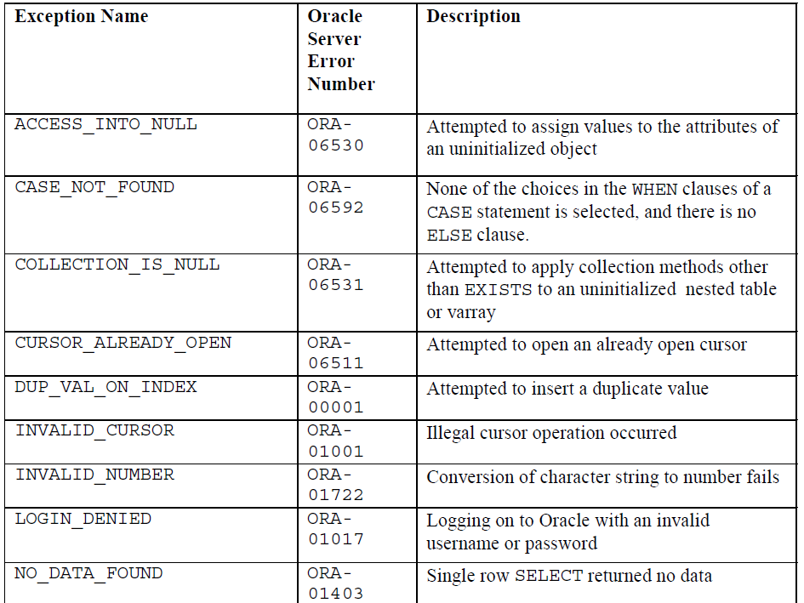
CONFIDENTIAL© Copyright 2008 Tech Mahindra Limited

Slide 16
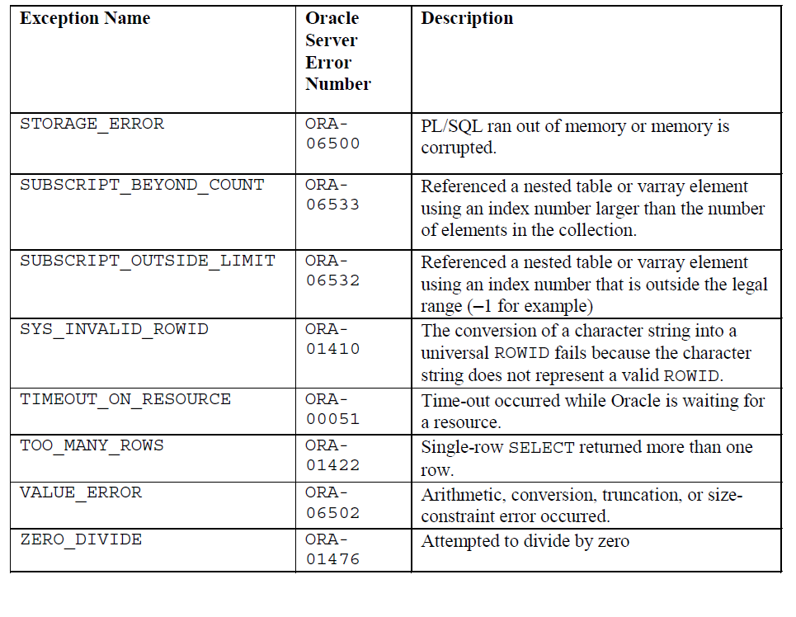
CONFIDENTIAL© Copyright 2008 Tech Mahindra Limited

Slide 17

An exception is raised implicitly if any Oracle error occurs e. g. when no rows are retrieved by SELECT statement, PL/SQL raises the exception NO_DATA_FOUND
We raise an exception explicitly by issuing the RAISE statement within the block
CONFIDENTIAL© Copyright 2008 Tech Mahindra Limited

Slide 18
If an exception is raised in the executable section and there is an associated handler, the exception is trapped (handled)
To catch the raised exception, write exception handler, which consist of WHEN clause
Handlers for various exceptions can be specified in the EXCEPTION section
A handler for an exception is of the form
WHEN exception_name THEN
a sequence of statements
Example
EXCEPTION
WHEN NO_DATA_FOUND THEN
DBMS_OUTPUT.PUT_LINE('WRONG INPUT');
END;
CONFIDENTIAL© Copyright 2008 Tech Mahindra Limited

Slide 19

DECLARE
myName VARCHAR2(8);
BEGIN
SELECT ename INTO myName FROM emp WHERE empno = &eno;
DBMS_OUTPUT.PUT_LINE('Name of the employee : '|| myName);
EXCEPTION
WHEN NO_DATA_FOUND THEN
DBMS_OUTPUT.PUT_LINE('WRONG EMPLOYEE NUMBER');
WHEN VALUE_ERROR THEN
DBMS_OUTPUT.PUT_LINE(‘ Employee Name size larger than 8’);
END;
/
CONFIDENTIAL© Copyright 2008 Tech Mahindra Limited
Notes:
SQL> /
Enter value for eno: 7839
old 4: SELECT ename INTO myName FROM emp WHERE empno = &eno;
new 4: SELECT ename INTO myName FROM emp WHERE empno = 7839;
Name of the employee : KING
PL/SQL procedure successfully completed.
SQL> /
Enter value for eno: 4545
old 4: SELECT ename INTO myName FROM emp WHERE empno = &eno;
new 4: SELECT ename INTO myName FROM emp WHERE empno = 4545;
WRONG EMPLOYEE NUMBER
PL/SQL procedure successfully completed.

Slide 20

Most of the times Exceptions occur because of inappropriate values passed for user inputs
In a good program the probable exceptions are visualized and handled
However for a program, one may not be able to visualize all the probable exceptions
Handling all possible exceptions may make the program very bulky
To overcome this problem a “General Exception Handler” named “OTHERS” is provided by PL/SQL
The handler OTHERS traps exceptions not handled in the other handlers in the exception handling section of the block
Thus in a program separate handlers are written for those named exceptions, that require some specific actions to be taken when the exception is fired while for all the remaining exceptions, the general OTHERS handler is used
CONFIDENTIAL© Copyright 2008 Tech Mahindra Limited

Slide 21

WHEN OTHERS should be put up as the last handler
Handlers for several exceptions can be included in a single block but for a single exception only one handler can be written
At a time there can be only one active exception
CONFIDENTIAL© Copyright 2008 Tech Mahindra Limited

Slide 22

There are two built-in functions which can be used to find out which exception occurred during an execution of a program unit
SQLCODE
Returns the error number of the corresponding Oracle error that was raised
Returns 1 for user-defined exception
SQLERRM
Returns the error message associated with the given error number
Returns “USER DEFINED EXCEPTION” for user-defined exceptions
CONFIDENTIAL© Copyright 2008 Tech Mahindra Limited

Slide 23

DECLARE
VJOB MYEMP.JOB%TYPE;
EMP_REC MYEMP%ROWTYPE;
BEGIN
VJOB :='&JOB';
SELECT * INTO EMP_REC FROM MYEMP WHERE UPPER(JOB)=UPPER(VJOB);
DBMS_OUTPUT.PUT_LINE(EMP_REC.ENAME|| ' '||EMP_REC.SAL);
EXCEPTION
WHEN NO_DATA_FOUND THEN
DBMS_OUTPUT.PUT_LINE(VJOB || ' DOES NOT EXIST');
WHEN TOO_MANY_ROWS THEN
DBMS_OUTPUT.PUT_LINE('MANY EMPLOYEES AS '||VJOB);
WHEN OTHERS THEN
DBMS_OUTPUT.PUT_LINE(SQLERRM);
DBMS_OUTPUT.PUT_LINE(SQLCODE);
END;
CONFIDENTIAL© Copyright 2008 Tech Mahindra Limited

Slide 24
User-defined Exceptions
  Declared in the Declare Section with data type as EXCEPTION
  Raised Explicitly by using the RAISE keyword
  Handled in the Exception Section
  Local to a PL/SQL block
  Name the Raise the exception Handle the RAISED exception using RAISED exception
  Keyword
DECLARE
RAISE
REFERENCE
Declarative Section
Executable Section
Exception Handling Section
CONFIDENTIAL© Copyright 2008 Tech Mahindra Limited
Notes:
At times the application needs to implement some validations as per business rules. Now these are user imposed validations so would not give rise to Oracle error when violated. Similarly we may want to indicate to the user when the criteria specified in the WHERE condition of a DML statement is satisfied by none of the rows in the table. To incorporate these kind of validations that are not actual Oracle errors, PL/SQL lets you define exceptions of your own, raise those and handle the error accordingly.
Unlike Oracle exceptions, user-defined exceptions must be declared and must be raised explicitly by using RAISE statement.
e. g.
DECLARE
-- Declaring user defined exception
e_invalid_dept EXCEPTION;
BEGIN
UPDATE dept
SET dname = '&dname'
WHERE deptno = &deptno;
IF SQL%NOTFOUND THEN
--Raising user defined exception
RAISE e_invalid_dept;
END IF;
COMMIT;
EXCEPTION
--Handling user defined exception
WHEN e_invalid_dept THEN
DBMS_OUTPUT.PUT_LINE('Invalid department Number');
END;

Slide 25

DECLARE
DUP_DEPT_NO EXCEPTION;
V_COUNTER BINARY_INTEGER;
V_DEPARTMENT NUMBER(2) :=50;
BEGIN
SELECT COUNT(*) INTO V_COUNTER FROM DEPT WHERE DEPTNO=50;
IF V_COUNTER >0 THEN
RAISE DUP_DEPT_NO;
END IF;
INSERT INTO DEPT VALUES (V_DEPARTMENT, ‘NEW NAME’,’NEW LOC’);
EXCEPTION
WHEN DUP_DEPT_NO THEN
INSERT INTO ERROR_LOG VALUES (‘DEPARTMENT ’ ||V_DEPARTMENT|| ‘ IS ALREADY PRESENT’);
END;
CONFIDENTIAL© Copyright 2008 Tech Mahindra Limited

Slide 26
DECLARE
-- Declaring user defined exception
e_check_sal EXCEPTION;
v_empno emp.empno%TYPE :=&empno;
emp_sal emp.sal%TYPE :=&empsal;
mgr_sal emp.sal%TYPE;
BEGIN
SELECT e1.sal INTO mgr_sal FROM emp e,emp e1
WHERE e.mgr=e1.empno and e.empno=v_empno;
IF(emp_sal > mgr_sal) THEN
RAISE e_check_sal; -- Raising user-defined exception
ELSE
UPDATE emp SET sal=emp_sal WHERE empno=v_empno;
END IF;
DBMS_OUTPUT.PUT_LINE('Salary updated');
COMMIT;
EXCEPTION
--Handling user defined exception
WHEN e_check_sal THEN
DBMS_OUTPUT.PUT_LINE('Employee salary can not be greater than Manager salary');
WHEN OTHERS THEN
DBMS_OUTPUT.PUT_LINE(‘ Wrong input’);
END;
CONFIDENTIAL© Copyright 2008 Tech Mahindra Limited
Notes:
Consider the following business rule
Revised Company policy imposed the rule that the salary of employee should not be greater than his manager’s salary. It was decided that for the existing values the rule will not be applicable but for any further salary updates the rule should be implemented.
So for every update the above checking is done using the user defined exception e_check_Sal.
If any violation, then error message is given else the salary is updated.
In the above program we are dealing with only those employees that have a manager.

Slide 27

Exceptions Raised in the Executable Section
PL/SQL uses the following rule to determine which exception handler to invoke:
  Current block has a handler for the exception, execute it and complete the block successfully. Control then passes to the enclosing block.
  No handler for current exception, propagate the exception by raising it in the enclosing block. Step 1 is executed for the enclosing block. If there is no enclosing block, the exception will be propagated out to the calling environment, such as SQL* Plus.
CONFIDENTIAL© Copyright 2008 Tech Mahindra Limited

Slide 28
DECLARE
A EXCEPTION;
BEGIN
BEGIN
RAISE A;
EXCEPTION
WHEN A THEN
. . .
END;
………..
END;
Exception A is raised in the inner block
A is handled in the inner block
Control resumes here

Slide 29
DECLARE
A EXCEPTION;
B EXCEPTION;
BEGIN
BEGIN
RAISE B;
EXCEPTION
WHEN A THEN
. . .
END;
EXCEPTION
WHEN B THEN
. . .
END;
Exception B is raised in the inner block
No handler for exception B in the inner block
Exception B is propagated
to the enclosing block and
handle there
Control then passes out of
enclosing block, which completes
successfully

Slide 30
Illegal assignment raises VALUE_ERROR
DECLARE
v_number NUMBER(3):=‘ABC’;
BEGIN
. . .
EXCEPTION
WHEN OTHERS THEN
. . .
END;
Even though there is a WHEN OTHERS handler, it is not executed
The block completes unsuccessfully with the VALUE_ERROR exception

Slide 31
Illegal assignment raises VALUE_ERROR
BEGIN
DECLARE
v_number NUMBER(3):=‘ABC’;
BEGIN
. . .
EXCEPTION
WHEN OTHERS THEN
. . .
END;
EXCEPTION
WHEN OTHERS THEN
. . .
END;
Even though there is an OTHERS handler for the inner block, it is not executed
The exception handler in the outer block handles the exception
Control then passes out of enclosing block which completes successfully

Slide 32
DECLARE
A EXCEPTION;
B EXCEPTION;
BEGIN
RAISE A;
EXCEPTION
WHEN A THEN
RAISE B;
WHEN B THEN
. . .
END;
Exception A is raised
Exception A is handled and B is raised in A’s handler
Even though there is a handler for B here, it is not executed. The exception is propagated out of the block
The block completes unsuccessfully with unhandled exception B
CONFIDENTIAL© Copyright 2008 Tech Mahindra Limited

Slide 33

BEGIN
UPDATE dept SET loc = ‘New1' WHERE deptno =10;
DECLARE
myJob emp.job%TYPE := '&myjob';
empRec emp%ROWTYPE;
BEGIN
UPDATE dept SET loc = ‘New2' WHERE deptno =20;
SELECT * INTO empRec FROM emp WHERE job= UPPER(myJob);
DBMS_OUTPUT.PUT_LINE(empRec.ename||' has salary '||empRec.sal);
EXCEPTION
WHEN NO_DATA_FOUND THEN
DBMS_OUTPUT.PUT_LINE('The job does not exist');
WHEN TOO_MANY_ROWS THEN
DBMS_OUTPUT.PUT_LINE('More than one employee with the job');
WHEN OTHERS THEN
DBMS_OUTPUT.PUT_LINE('Other error '||SQLERRM);
END;
UPDATE dept SET loc = ‘New3' WHERE deptno =30;
EXCEPTION
WHEN OTHERS THEN
DBMS_OUTPUT.PUT_LINE('The inner block error is trapped here as raised in
DECLARE section');
END;
CONFIDENTIAL© Copyright 2008 Tech Mahindra Limited
Notes:
The demonstration of error propagation rules –
Give large value for job (more than 9 charactors). Since this VALUE ERROR is raised in DECLARE section of the inner block it can not be handled by the inner block. So the inner block fails and control passes on to the exception handler of the outer block. Thus the location for department 20 is not changed as the statement is rolled back. Similarly the UPDATE statement in outer block after inner block, is not executed so the location of department 30 is also unchanged. The outer block handles this exception so it is considered successful hence the initial UPDATE statement is not rolled back. So location of department 10 is changed
SQL> /
Enter value for myjob: Assistant Manager
old 4: myJob emp.job%TYPE := '&myjob';
new 4: myJob emp.job%TYPE := ' Assistant Manager';
The inner block error is trapped here as raised in DECLARE section
PL/SQL procedure successfully completed.
SQL> SELECT * FROM dept;
DEPTNO DNAME LOC
---------- -------------- -------------
10 ACCOUNTING New1
20 RESEARCH DALLAS
30 SALES CHICAGO
40 OPERATIONS BOSTON
4 rows selected.

Slide 34

In this session, We have covered,
  Terms: Exceptions and Exception handling
  Predefined exceptions
  User-defined exceptions
  Rules for Exception Propagation
CONFIDENTIAL© Copyright 2008 Tech Mahindra Limited

Slide 35


