Slide 1


Slide 2

At the end of this session, you will be able to:
  Understand database triggers and their need
  Differentiate between stored procedures and triggers
  Identify the trigger types
  Create statement and row level DML triggers
  Use conditional predicates
  Overcome Mutating table error
CONFIDENTIAL© Copyright 2008 Tech Mahindra Limited

Slide 3

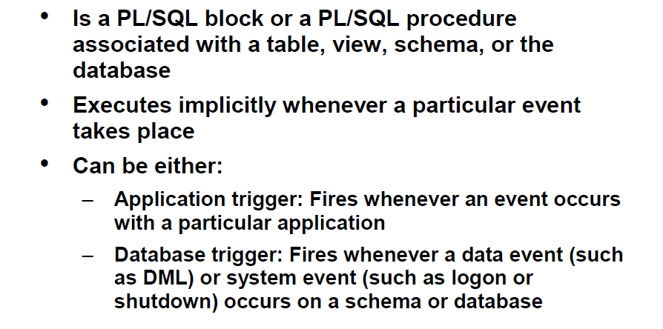
CONFIDENTIAL© Copyright 2008 Tech Mahindra Limited

Slide 4

Triggers are named PL/SQL blocks with declarative, executable, and exception handling sections
A trigger is executed implicitly whenever the triggering event takes place
Triggers do not accept arguments
Like packages, triggers are stored database objects and can not be local to a block
CONFIDENTIAL© Copyright 2008 Tech Mahindra Limited

Slide 5

Stored Procedures | Triggers
A procedure is called explicitly by a user, application or a trigger | A trigger executes implicitly in response to an event, such as an update operation on a table
Can not be inactive | We can enable and disable according to the need
Can have parameters | Can not have parameters
No restriction on the size of a procedure | There may be a restriction on the size of a trigger depending on the version of oracle used
CONFIDENTIAL© Copyright 2008 Tech Mahindra Limited

Slide 6

Application:
  To impose complex integrity constraints not possible through declarative constraints
  To audit information in a table. Auditing information in a table by recording the changes made and who made them is called as an audit trail
  Security reasons.
    A trigger that prohibits updates to salary data of the EMP table during weekends, holidays, and non-working hours.
CONFIDENTIAL© Copyright 2008 Tech Mahindra Limited
Notes:
Triggers can enforce complex integrity rules.
Example: A trigger can ensure that employee's new salary is within the job classification's limits. This cannot be done with constraints.
Triggers can be used to monitor and store the history of changes made to a table.
Example: A trigger can track the changes made to the EMP table, which row/s was inserted, updated, deleted, when the operation was performed and which user made this change. All this information can be stored in a table.
Triggers can be used to create a replica of tables synchronously, in real time.
Example: A trigger can maintain at location X, a replica of EMP table that is physically located on a server at location Y.
Triggers are commonly used to enforce complex security authorizations for table data that cannot be defined using the database security features provided by Oracle.
Example: A trigger that prohibits updates to salary data of the EMP table during weekends, holidays, and non-working hours.

Slide 7

DML Triggers
  DML Triggers are fired by the execution of DML statements
DDL Triggers
  DDL triggers execute every time a DDL statement is executed
Database Triggers
  Database triggers are fired during system events like startup/shutdown and user events like logon/logoff
CONFIDENTIAL© Copyright 2008 Tech Mahindra Limited

Slide 8
DML Trigger Components
Part
Description
Possible Values
Trigger Timing
Defines whether trigger is executed before statement is executed or after statement is executed
BEFORE
AFTER
Triggering Event
Which data manipulation operation on the table or view, causes the trigger to fire
INSERT
UPDATE
DELETE
Trigger Type
How many times the trigger body executes
Statement
Row
Trigger Body
What action the trigger performs
Complete PL/SQL Block
CONFIDENTIAL© Copyright 2008 Tech Mahindra Limited

Slide 9

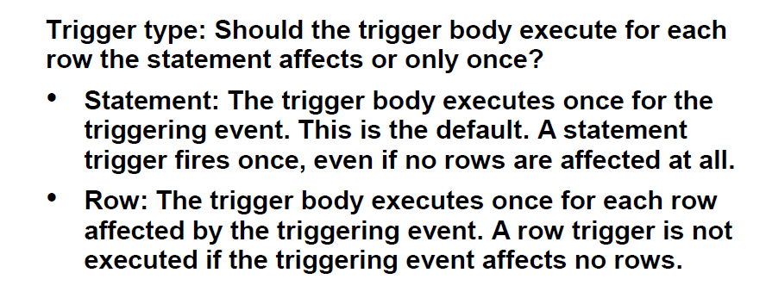
CONFIDENTIAL© Copyright 2008 Tech Mahindra Limited

Slide 10

The trigger body executes only once for the triggering event. This is the default.
Syntax:
    CREATE [ OR REPLACE ] TRIGGER trigger_name
    trigger_timing event1 [ OR event2 OR event3 ]
    ON table_name
    PL/SQL Block;
CONFIDENTIAL© Copyright 2008 Tech Mahindra Limited

Slide 11

CREATE OR REPLACE TRIGGER chk_time
BEFORE INSERT OR UPDATE OR DELETE
ON emp
BEGIN
IF (TO_CHAR(sysdate,’DY’) IN (‘SAT’,’SUN’)) OR (TO_CHAR(sysdate,’HH24’) NOT
BETWEEN ‘08’ AND ‘18’)
THEN
RAISE_APPLICATION_ERROR(-20400, ‘You can
not perform any DML Operation’);
END IF;
END;
CONFIDENTIAL© Copyright 2008 Tech Mahindra Limited
Notes:
Note : The Trigger will be fired if on Saturday or Sunday or after office hours( 8am to 6pm) a user tries to perform any DML operation on the EMP table.
When a database trigger fails, the triggering statement is automatically rolled back by the Oracle Server.

Slide 12

The trigger body executes once for each row affected by the triggering event.
Syntax for creating Row Triggers:
CREATE [ OR REPLACE ] TRIGGER trigger_name
trigger_timing event1 [ OR event2 OR event3 ]
ON table_name
FOR EACH ROW
[WHEN condition]
PL/SQL Block;
FOR EACH ROW: Designates the trigger to be a row trigger
WHEN condition: Specifies the trigger restriction
For the UPDATE event there is an optional clause
[OF column_name[,column_name…..]]
CONFIDENTIAL© Copyright 2008 Tech Mahindra Limited
Notes:
Before / for each row trigger
A before trigger is called before because it fires before the new values (:new.field_name) are stored in the table. That means that the new value can be changed in the trigger.
This type of trigger is frequently used in the following situations:
When the trigger action should determine whether that triggering statement should be allowed to complete. This allows you to eliminate unnecessary processing of the triggering statement and its eventual rollback in cases where an exception is raised in the triggering action
To derive column values before completing a triggering INSERT or UPDATE satement.
After / for each row trigger
In contrast to a before trigger, an after trigger does not allow to change (:new.field_name) because when the trigger fires, the value is already written to the table.
If one tries to assign a value to (:new.field_name), Oracle throws an ORA-04084: cannot change NEW values for this trigger type.
This type of trigger is frequently used in the following situations:
When you want the triggering statement to complete before executing the triggering action.
If a BEFORE trigger is already present, and an AFTER trigger can perform different actions on the same triggering statement.
Performance Impact
AFTER row triggers are slightly more efficient than BEFORE row triggers. With BEFORE row triggers, affected data blocks must be read (logical read, not physical read) once for the trigger and the again for the triggering statement.
Alternatively, with AFTER row triggers, the data blocks must be read only once for both the triggering statement and the trigger.
For UPDATE event we can have the optional clause [OF <column name>]
When this clause is mentioned the trigger body will be executed only when in the update operation the value of the column mentioned is updated thereby improving on the execution efficiency of the code.

Slide 13

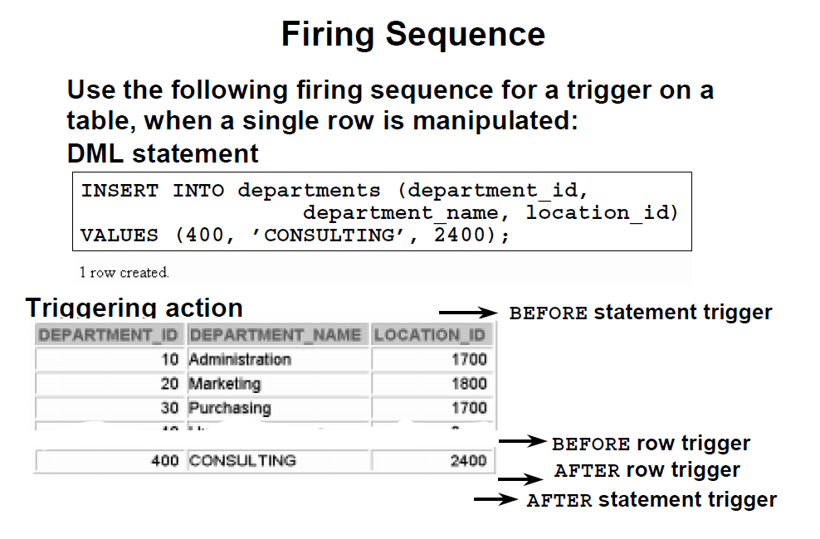
CONFIDENTIAL© Copyright 2008 Tech Mahindra Limited

Slide 14
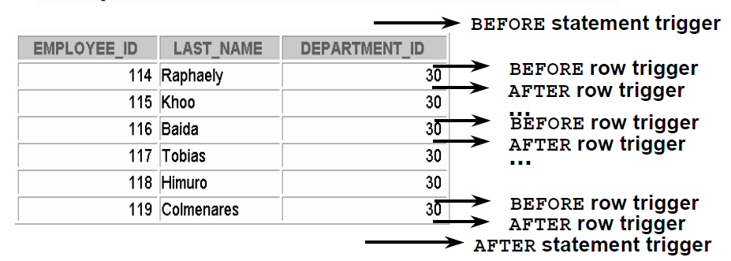
Use the following firing sequence for a trigger on a table, when many rows are manipulated:
  UPDATE employees
  SET salary = salary * 1.1
  WHERE department_id = 30;
CONFIDENTIAL© Copyright 2008 Tech Mahindra Limited

Slide 15

The following is an example of a simple before statement-level trigger that displays a message prior to an insert operation on the emp table.
CREATE OR REPLACE TRIGGER emp_alert_trig
BEFORE INSERT ON emp
BEGIN
  DBMS_OUTPUT.PUT_LINE('New employees are about to be added');
END;
The following INSERT is constructed so that several new rows are inserted upon a single execution of the command. For each row that has an employee id between 7900 and 7999, a new row is inserted with an employee id incremented by 1000. The following are the results of executing the command when three new rows are inserted.
INSERT INTO emp (empno, ename, deptno) SELECT empno + 1000, ename, 40 FROM emp WHERE empno BETWEEN 7900 AND 7999;
New employees are about to be added
CONFIDENTIAL© Copyright 2008 Tech Mahindra Limited

Slide 16

Whenever an insert, update, or delete operation occurs on the emp table, a row is added to the empauditlog table recording the date, user, and action.
CREATE TABLE empauditlog
( audit_date DATE, audit_user VARCHAR2(20), audit_desc VARCHAR2(20) );
CREATE OR REPLACE TRIGGER emp_audit_trig
AFTER INSERT OR UPDATE OR DELETE ON emp
DECLARE
v_action VARCHAR2(20);
BEGIN
IF INSERTING THEN
v_action := 'Added employee(s)';
ELSIF UPDATING THEN
v_action := 'Updated employee(s)';
ELSIF DELETING THEN
v_action := 'Deleted employee(s)';
END IF;
INSERT INTO empauditlog VALUES (SYSDATE, USER, v_action);
END;
CONFIDENTIAL© Copyright 2008 Tech Mahindra Limited

Slide 17
INSERT INTO emp VALUES (9001,'SMITH','ANALYST',7782,SYSDATE,NULL,NULL,10);
INSERT INTO emp VALUES (9002,'JONES','CLERK',7782,SYSDATE,NULL,NULL,10);
UPDATE emp SET sal = 4000.00, comm = 1200.00 WHERE empno IN (9001, 9002);
DELETE FROM emp WHERE empno IN (9001, 9002);
SELECT TO_CHAR(AUDIT_DATE,'DD-MON-YY HH24:MI:SS') AS "AUDIT DATE", audit_user, audit_desc FROM empauditlog ORDER BY 1 ASC;
AUDIT DATE AUDIT_USER AUDIT_DESC
------------------ -------------------- --------------------
31-MAR-05 14:59:48 SYSTEM Added employee(s)
31-MAR-05 15:00:07 SYSTEM Added employee(s)
31-MAR-05 15:00:19 SYSTEM Updated employee(s)
31-MAR-05 15:00:34 SYSTEM Deleted employee(s)
CONFIDENTIAL© Copyright 2008 Tech Mahindra Limited

Slide 18

CREATE OR REPLACE TRIGGER emp_comm_trig
BEFORE INSERT ON emp
FOR EACH ROW
BEGIN
IF :NEW.deptno = 30
THEN :NEW.comm := :NEW.sal * .4;
END IF;
END;
INSERT INTO emp VALUES (9005,'ROBERS','SALESMAN',7782,SYSDATE,3000.00,NULL,30);
INSERT INTO emp VALUES (9006,'ALLEN','SALESMAN',7782,SYSDATE,4500.00,NULL,30);
SELECT * FROM emp WHERE empno IN (9005, 9006);
EMPNO ENAME JOB MGR HIREDATE SAL COMM DEPTNO
---------- ---------- --------- ---------- --------- ---------- ---------- 9005 ROBERS SALESMAN 7782 01-APR-05 3000 1200 30
9006 ALLEN SALESMAN 7782 01-APR-05 4500 1800 30
CONFIDENTIAL© Copyright 2008 Tech Mahindra Limited

Slide 19

In a ROW LEVEL trigger all the column values of the current row, before modification and after modification, are available to the trigger block as local variables. To access these values, the OLD and NEW quantifiers are used
e.g. :OLD.empno, :NEW.deptno
Data Operation
Data Operation
Old Value
Old Value
New Value
New Value
INSERT
INSERT
NULL
NULL
Inserted Value
Inserted Value
UPDATE
UPDATE
Value before update
Value before update
Value after update
Value after update
DELETE
DELETE
Value before delete
Value before delete
NULL
NULL
CONFIDENTIAL© Copyright 2008 Tech Mahindra Limited
Notes:
CREATE OR REPLACE TRIGGER chk_emp_sal
AFTER UPDATE OF sal
ON emp
FOR EACH ROW
BEGIN
IF :NEW.sal < :OLD.sal
THEN
RAISE_APPLICATION_ERROR(-20101,’Salary cannot be decremented’);
END IF;
END;

Slide 20

Valid for row triggers only
Trigger body executes for those rows that meet the condition
Evaluates for each row
OLD and NEW variables can be referenced here
For OLD and NEW variables we should not use colon (:) in the WHEN condition
CONFIDENTIAL© Copyright 2008 Tech Mahindra Limited
Notes:
For Old and NEW variables we should not use : in the WHEN condition
OLD and NEW are like pseudo Bind variables. Inside the trigger body we refer to them using colon, like any other bind variables. This is to indicate to the compiler that, they are environment (outside the block) variables available to the block.
Whereas the WHEN condition is evaluated by the compiler before the trigger block execution starts. For the calling environment, the OLD and NEW are not bind variables. Hence : should not be used in the WHEN clause

Slide 21

CREATE OR REPLACE TRIGGER CHECK_SAL
BEFORE INSERT OR UPDATE OF SAL , JOB ON EMP
FOR EACH ROW
WHEN (NEW.JOB!='PRESIDENT')
DECLARE
V_MINSAL NUMBER;
V_MAXSAL NUMBER;
BEGIN
SELECT MINSAL,MAXSAL INTO V_MINSAL,V_MAXSAL
FROM SALES WHERE JOB=:NEW.JOB;
IF(:NEW.SALN <V_MINSAL) OR (:NEW.SAL > V.MAXSAL) THEN
RAISED_APPLICATION_ERROR(-20220,'NOT IN RANGE');
ELSIF (:NEW.SAL <:OLD.SAL) THEN
RAISED_APPLICATION_ERROR(-20221,'SAL CANNOT DECREASE');
ELSIF(:NEW.SAL > 1.1*OLD.SAL) THEN
RAISED_APPLICATION_ERROR(-20222,'INCREASE EXCEEDS 10%');
END IF;
END;
/
CONFIDENTIAL© Copyright 2008 Tech Mahindra Limited

Slide 22
CREATE OR REPLACE TRIGGER TRIG_WHEN
AFTER UPDATE OF sal ON emp
FOR EACH ROW
WHEN (old.sal > new.sal)
BEGIN
RAISE_APPLICATION_ERROR(-20009, ‘Cannot reduce salary’);
END;
CONFIDENTIAL© Copyright 2008 Tech Mahindra Limited
Notes:
If the expression in the WHEN clause evaluates to TRUE for a row, then the trigger body is fired on behalf of that row. However, if the expression evaluates to FALSE, then the trigger body is not fired for that row.
Triggers can be somewhat costly. Use the WHEN clause to prevent them from firing when unnecessary.
In the example shown, the trigger body gets fired for a row only if the new salary is found to be lesser than the old salary.
The above code can also be written as
CREATE OR REPLACE TRIGGER Sal_Check_TRIG
AFTER UPDATE OF sal ON emp
FOR EACH ROW
BEGIN
IF :OLD.sal > :NEW.sal THEN
RAISE_APPLICATION_ERROR(-20101,’Salary cannot be decremented’);
END IF;
END;
However it is less efficient than the example in the PPT as this trigger body gets fired for every row when salary is getting updated irrespective of the old and new values of salary

Slide 23

CREATE TABLE emp_hist
( empno NUMBER(5),
oldSal NUMBER(10),
newSal NUMBER(10));
CREATE OR REPLACE TRIGGER LOG_TRIG
AFTER UPDATE OF sal ON emp
FOR EACH ROW
BEGIN
IF :NEW.sal < :OLD.sal THEN
RAISE_APPLICATION_ERROR(-20101,’Salary cannot be decremented’);
ELSE
INSERT INTO emp_hist VALUES
(:OLD.empno, :OLD.sal, :NEW.sal);
END IF;
END;
CONFIDENTIAL© Copyright 2008 Tech Mahindra Limited
Notes:
Use of UPDATE OF <column name>
If a triggering statement includes a column list, the trigger is fired only when one of the specified columns is updated. If a triggering statement omits a column list, the trigger is fired when any column of the associated table is updated. A column list is applicable only for UPDATE triggering statement and cannot be specified for INSERT or DELETE triggering statements.

Slide 24

Multiple triggers can be created on the same table for the same event.
The order of execution is as follows
  Execute all BEFORE STATEMENT triggers
  For each row in the target table:
  (a) Execute all BEFORE ROW triggers
  (b) Execute the DML statement and perform integrity constraint checking
  (c) Execute all AFTER ROW triggers
  Execute all AFTER STATEMENT triggers
CONFIDENTIAL© Copyright 2008 Tech Mahindra Limited

Slide 25
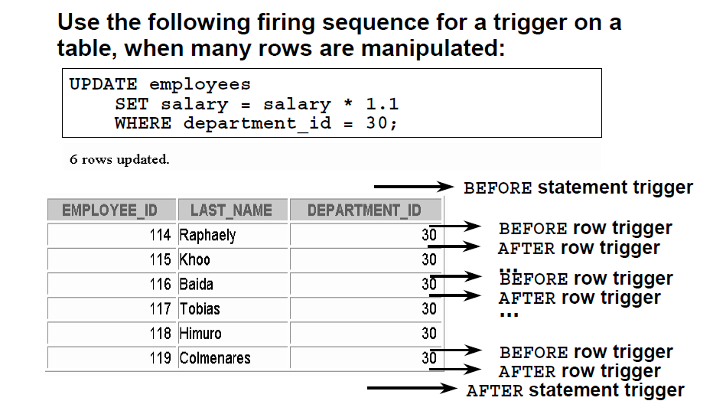
CONFIDENTIAL© Copyright 2008 Tech Mahindra Limited

Slide 26

You can combine several triggering events in one trigger
To identify which event has raised the trigger, use conditional predicates:
  INSERTING
  UPDATING
  DELETING
They return a TRUE value depending upon the DML statement executed
CONFIDENTIAL© Copyright 2008 Tech Mahindra Limited

Slide 27

  CREATE TABLE audit_table
  (user_name VARACHAR2(10),
  table_name VARCHAR2(10),
  ins NUMBER(4),
  del NUMBER(4),
  upd NUMBER(4));
  INSERT INTO audit_table VALUES(USER,’EMP’,0,0,0);
  CREATE OR REPLACE TRIGGER audit_emp
  AFTER INSERT OR UPDATE OR DELETE ON emp
  FOR EACH ROW
  BEGIN
  IF INSERTING THEN
  UPDATE audit_table SET ins = ins + 1
  WHERE user_name = USER AND table_name= ‘EMP’;
  ELSIF DELETING THEN
  UPDATE audit_table SET del = del + 1
  WHERE user_name = USER AND table_name= ‘EMP’;
  ELSIF UPDATING THEN
    UPDATE audit_table SET upd = upd + 1
    WHERE user_name = USER AND table_name= ‘EMP’;
    END IF;
  END;
CONFIDENTIAL© Copyright 2008 Tech Mahindra Limited

Slide 28

CREATE OR REPLACE TRIGGER secure_emp
BEFORE INSERT OR UPDATE OR DELETE ON employees
BEGIN
IF (TO_CHAR (SYSDATE,’DY’) IN (’SAT’,’SUN’)) OR
(TO_CHAR (SYSDATE, ’HH24’) NOT BETWEEN ’08’ AND ’18’)
THEN
IF DELETING THEN
RAISE_APPLICATION_ERROR (-20502,’You may delete from EMPLOYEES table only during business hours.’);
ELSIF INSERTING THEN
RAISE_APPLICATION_ERROR (-20500,’You may insert into EMPLOYEES table only during business hours.’);
ELSIF UPDATING (’SALARY’) THEN
RAISE_APPLICATION_ERROR (-20503,’You may update SALARY only during business hours.’);
ELSE
RAISE_APPLICATION_ERROR (-20504,’You may update EMPLOYEES table only during normal hours.’);
END IF;
END IF;
END;
CONFIDENTIAL© Copyright 2008 Tech Mahindra Limited

Slide 29

Trigger may not include any transaction control statements like COMMIT, ROLLBACK, SAVEPOINT. whenever trigger statement is committed or rollbacked the work done in trigger also gets committed or rollback
Any procedure or function that are called by trigger cannot have any transaction control statement
Trigger body cannot declare any long or long raw variable. Also :new and :old cannot refer to LONG data type
There are restriction on which table a trigger can access depending on type of trigger and constraints on the table
CONFIDENTIAL© Copyright 2008 Tech Mahindra Limited

Slide 30
CREATE TRIGGER trig
AFTER INSERT ON emp
BEGIN
INSERT INTO emp_log VALUES (SYSDATE, 'Insert on emp');
COMMIT;
END;
INSERT INTO emp(empno) VALUES (1);
INSERT INTO emp(empno) VALUES (1)
*
ERROR at line 1:
ORA-04092: cannot COMMIT in a trigger
ORA-06512: at "SCOTT.TAB1_TRIG", line 3
ORA-04088: error during execution of trigger 'SCOTT.TAB1_TRIG'
CONFIDENTIAL© Copyright 2008 Tech Mahindra Limited
Notes:
To demonstrate the program in this and the next slide first create table emp_log using the following command
CREATE TABLE emp_log(
myDate DATE,
myOperation VARCHAR2(35)
);
Note : COMMIT, ROLLBACK , SAVEPOINT statements are not allowed within the trigger body.
Triggers are fired implicitly by the triggering event. Thus by default, a trigger is part of the same transaction as the triggering event. Hence changes made within triggers should be committed or rolled back as part of the transaction in which they execute. By default a trigger is NOT allowed to execute COMMIT or ROLLBACK statements thereby to terminate its triggering transaction (with the exception of autonomous triggers).

Slide 31

CREATE OR REPLACE TRIGGER tab1_trig
AFTER insert ON tab1
DECLARE
-- declare the trigger as separate transaction from the triggering event
PRAGMA AUTONOMOUS_TRANSACTION;
BEGIN
INSERT INTO emp_log VALUES (SYSDATE, 'Insert on emp');
COMMIT; -- allowed only in autonomous triggers
END;
SQL> INSERT INTO emp(empno) VALUES (1);
1 row created.
CONFIDENTIAL© Copyright 2008 Tech Mahindra Limited
Notes:
Autonomous transactions:
Autonomous transactions execute separately from the current transaction.
Unlike regular triggers, autonomous triggers can contain COMMIT and ROLLBACK statements.

Slide 32

Disable / Enable trigger:
ALTER TRIGGER trigger_name ENABLE/DISABLE;
Disable / Enable all triggers for a table:
ALTER TABLE table_name DISABLE/ENABLE ALL TRIGGERS;
Dropping Triggers:
DROP TRIGGER trigger_name;
USER_TRIGGERS data dictionary view:
To query database trigger details stored in a database dictionary
CONFIDENTIAL© Copyright 2008 Tech Mahindra Limited

Slide 33
The following is an example of a simple before statement-level trigger that displays a message prior to an insert operation on the emp table.
  CREATE OR REPLACE TRIGGER emp_alert_trig
  BEFORE INSERT ON emp
  BEGIN
  DBMS_OUTPUT.PUT_LINE('New employees are about to be added');
  END;
The following INSERT is constructed so that several new rows are inserted upon a single execution of the command. For each row that has an employee id between 7900 and 7999, a new row is inserted with an employee id incremented by 1000. The following are the results of executing the command when three new rows are inserted.
INSERT INTO emp (empno, ename, deptno) SELECT empno + 1000, ename, 40 FROM emp WHERE empno BETWEEN 7900 AND 7999; New employees are about to be added SELECT empno, ename, deptno FROM emp WHERE empno BETWEEN 8900 AND 8999; EMPNO ENAME DEPTNO ---------- ---------- ---------- 8900 JAMES 40 8902 FORD 40 8934 MILLER 40
The message, New employees are about to be added, is displayed once by the firing of the trigger even though the result is the addition of three new rows.
CONFIDENTIAL© Copyright 2008 Tech Mahindra Limited

Slide 34

In this session, we have covered,
  Trigger creation
  Stored procedures vs Triggers
  Types of Triggers
  :old and :new variables
  WHEN clause
  Managing triggers
CONFIDENTIAL© Copyright 2008 Tech Mahindra Limited

Slide 35


