Slide 1

Welcome!
2022 SPESS Graduate Student Association

Slide 2
Collection of semester dues
Cash
Venmo : rpruth1@lsu.edu
Zelle : rpruth1@lsu.edu

Slide 3
Group Communication Platform
WhatsApp
GroupMe
Facebook Group
Suggestions?

Slide 4
GSA Positions Available
Secretary – Aids in communication among GSA by taking and distributing minutes in meetings, sending email announcements, and managing a master contact and information list of members. Drafts important documents for GSA. Keeps and discusses updated set of by-laws for the GSA and how they are applied.
Social Media Coordinator – Maintain all social media platforms regularly. Organize a campaign to increase following and engagement on these platforms. Publicize the ongoing research and projects taking place in the department.

Slide 5
Possible Classes for SPESS Graduate Students
AGRO
AGRO 7051 Advanced Soil Fertility
AGRO 4064 Principles of Plant Breeding
AGRO 4070 Weed Science
AGRO 4071 Weed Biology and Ecology
AGRO 7071 Advanced Plant Genetics
AGRO 4092 Precision Ag
AGRO 7041 Plant-Herbicide Physiology
AGRO 7075 Plant Abiotic Stress
AGRO 7080 Plant Genomics
AGRO 7001 Seminar
AGRO 7087 Digital Agriculture
AGRO 7040 Research Methods in Plant Science
AGRO 7041 Plant-Herbicide Physiology
AGRO 7055 Advanced Soil Chemistry
AGRO 7074 Quantitative Genetics in Plant Improvement
EXST
EXST 4025 SAS Programming
EXST 7003 Statistical Inference I
EXST 7004 Experimental Statistics I
EXST 7005 Statistical Techniques I
EXST 7013 Statistical Inference II
EXST 7014 Experimental Statistics II
EXST 7015 Statistical Techniques II
EXST 7031 Experimental Design
EXST 7034 Regression Analysis
EXST 7037 Multivariate Statistics
EXST 7011: Nonparametric Statistics
EXST 7087: Digital Agriculture
HORT
HORT 4061 Advanced Plant Propagation
HORT 4071 Nursery Management
HORT 4072 Sustainable Ornamental Production
HORT 4083 Principles and Practices in Olericulture
HORT 4085 Principles and Practices in Fruit and Nut Production
HORT 4091 Advanced Turfgrass Management
HORT 4096 Postharvest Physiology
HORT 4099 Horticulture Capstone
HORT 4545 Sustainable Agriculture
PLHL
PLHL 7083 Epidemiology and Crop Loss Assessment
PLHL 7051 Microbial Genomics
PLHL 7080 Host-Parasite Interaction and Disease Resistance
BIOL
BIOL 7260 Advanced Genetics
BIOL 7063 Plant Metabolism

Slide 6
Upcoming Conferences
ASA, CSSA, SSSA Conference
2023 Southern Cover Crops Conference
2023 Rice Technical Working Group Conference
Louisiana Division of ASSCT Meeting
Plant and Animal Genome Conference
2023 International Plant Propagator’s Society

Slide 7


Annual Crop and Soil Science Meeting
Tri-Society Meeting (Nov 6-9)
ASA :- American Society of America
CSSA:- Crop Science Society of America
SSSA :- Soil Science Society of America
https://www.agronomy.org/gradstudents/
Membership fees: $44
Important for building connections and for future career
Who can Participate?
Students pursuing their research in Plant Breeding and Genetics, Soil Science, Precision Agriculture and Agronomy
ASA CSSA SSSA 2022 (Baltimore)
Graduate Students: Poster and Oral Presentation
Abstract Submission: July 12
Registration Deadline: Oct. 4
https://www.acsmeetings.org/submit/oral/

Slide 8
2023 Southern Cover Crops Conference
Date: February 14-15
Location: Baton Rouge, LA
Registration close date:

Slide 9
2023 Rice Technical Working Group Conference
Date: February 19-23 (20-24)
Location: Hot Springs Convention Center, Hot Springs, AR
Registration close date:
Price (student): $300.00
Call for papers: December 1

Slide 10
Louisiana Division of ASSCT Meeting
Date: February
Location:
Registration close date:
Price (student):
Call for papers:

Slide 11
Plant and Animal Genome Conference/ PAG 30
Date: January 13-18
Location: San Diego, CA
Registration close date: January 18
Price (student): $475.00
Call for papers: November 4

Slide 12
2023 International Plant Propagator’s Society
Date:
Location: Durham, NC
Registration close date:
Price (student):
Call for papers:

Slide 13
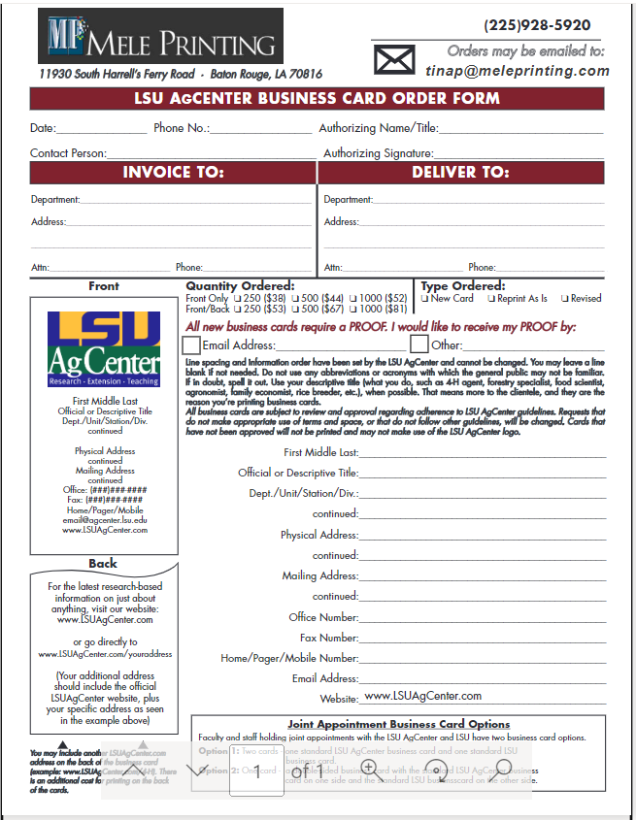
Business Cards
Department: SPESS
Invoice/Delivery Address: 104 Madison B. Sturgis Hall, Baton Rouge, LA 70803
Order with LaCarte Card and use Account Number PG005787

Slide 14
Dr. Roberto Neto

Slide 15
Dr. Ed Bush

Slide 16
Future Planning/Possible Social Events

Slide 17
Feedback and Discussion
Social Events (with students and faculty)
Professional Development including soft skill training
Networking with Industry Professionals/Recruiters
Writing workshops
Research seminars
Improved communication avenues
CV tips and best practices

Slide 18
Meet and Greet

