Slide 1
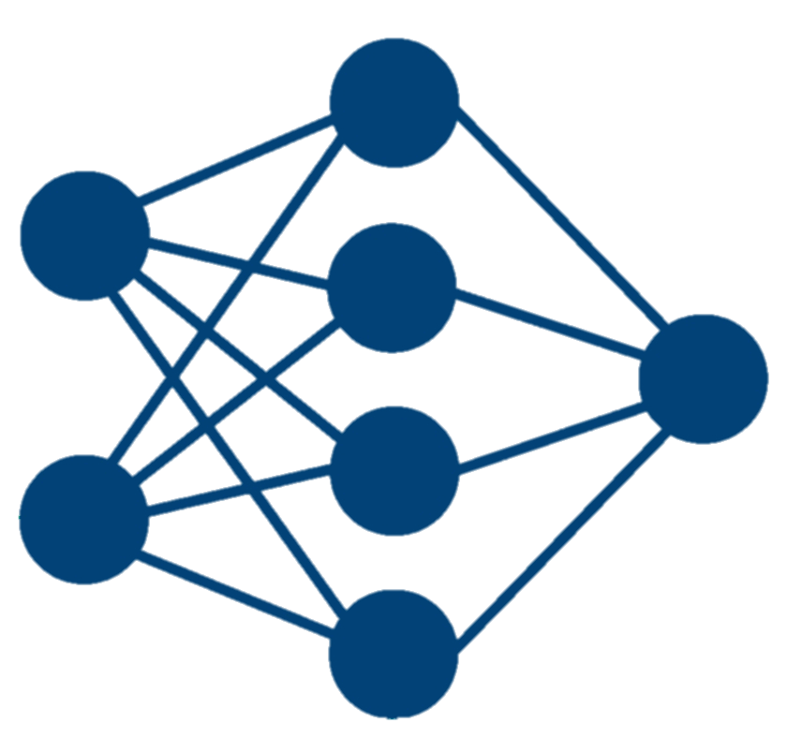

Introduction
Genome wide association studies and marker assisted selection techniques are becoming important tools for sugarcane breeding
Training, modifying, and testing prediction models is important for this technology to be effective
Objective: Using DNA markers to predict phenotypic performance of five traits of interest using a diverse panel of Louisiana hybrid sugarcane clones

Slide 2
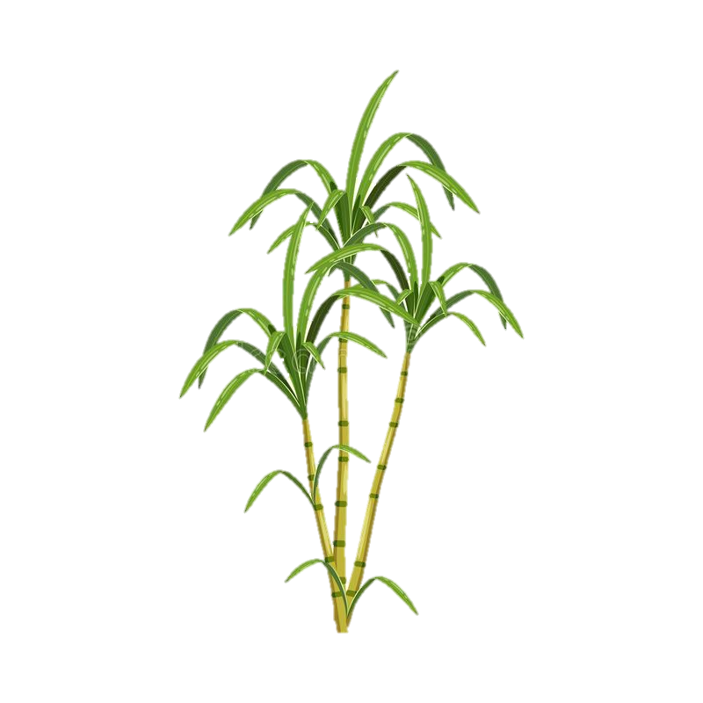

Dataset Description
Phenotypic data for 107 clones
5815 SNP and INDEL markers
TRS (theoretical recoverable sucrose)
Brix (% soluble solids)
Stalk Diameter (mm)
Fiber %
Stalk Bundle Weight (lbs)

Slide 3
Prediction Models
Models |  | Parameters
 |  | TRS | Brix | Fiber | Diameter | Bundle Weight
Neural Network | Layers | 6 | 6 | 6 | 3 | 6
 | Loss Function | MSE | MSE | MSE | MSE | MSE
 | Optimizer | Adam | Adam | Adam | Adam | Adam
 | Epochs | 1000 | 1000 | 1000 | 300 | 300
 | Batch Size | 60 | 60 | 60 | 130 | 50
Linear Regression | Iterations of Train/Test split | 50 | 50 | 50 | 50 | 50
Random Forest | Iterations of Train/Test split | 5 | 5 | 5 | 5 | 5
 | Decision Trees | 250 | 250 | 250 | 250 | 250
 | Random Seed | 42 | 42 | 42 | 42 | 42

Slide 4
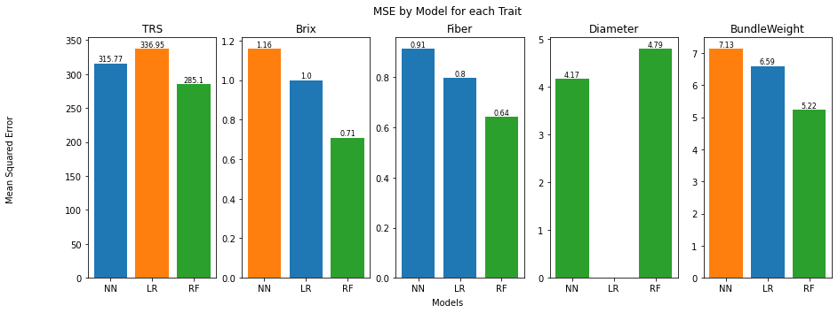
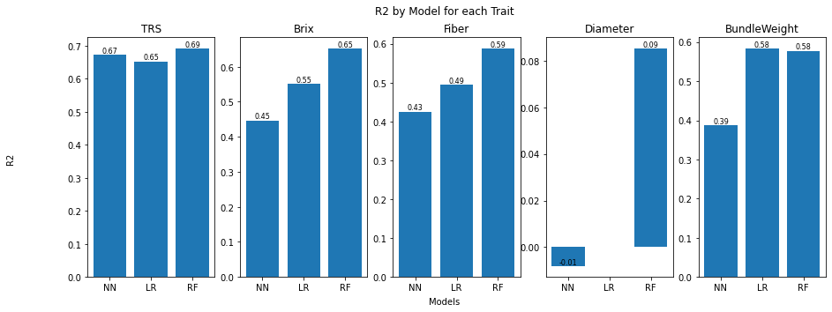
Analysis/Results
*
*
*
*
The random forest model performed statistically better than both other models for all traits of interest except diameter where it performed statistically similar to a neural network.

Slide 5
Conclusion
It is important to continually train, modify, and test prediction models so that new tools like genomic information can continually become useful to breeding programs.
For this study, three prediction models were tested using multiple iterations in order to validate their performance and statistically compare them to one another.
The random forest model seemed to provide the most accuracy of prediction and performed statistically better than the other models for all traits except Diameter.
Overall, the prediction capabilities is lower than ideal, but this type of continual testing and validation of prediction models is crucial for future applications of marker assisted selection.

