Slide 1
Times Series
Brayden Blanchard and Maria Montiel
EXST 7087
Digital Agriculture

Slide 2
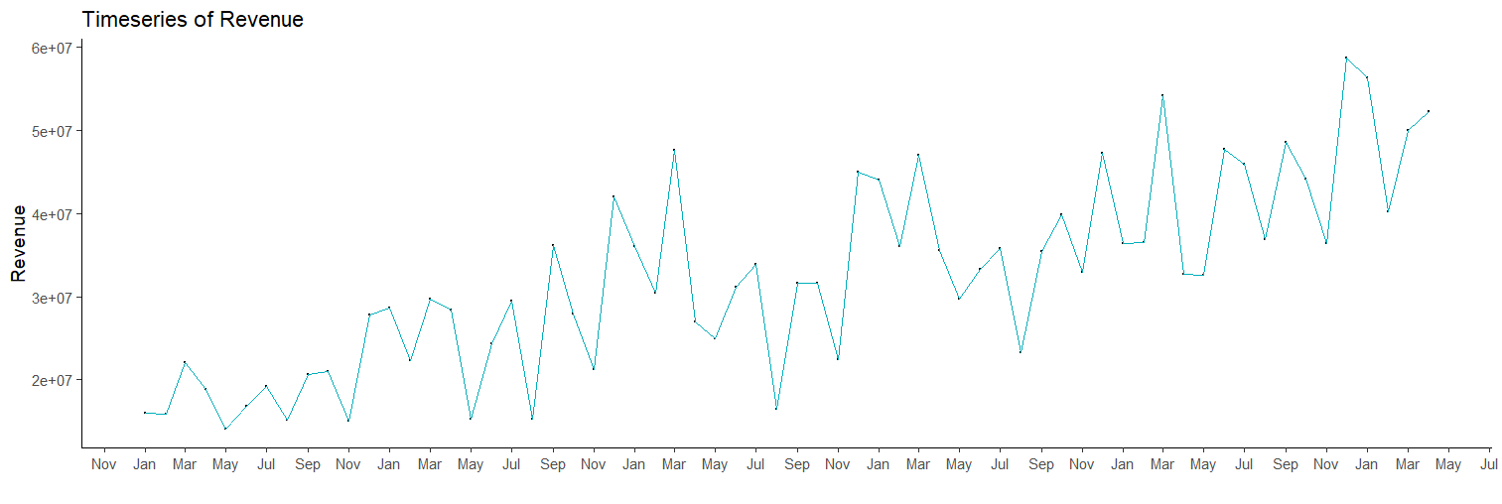
Time series: Monthly Revenue
Monthly revenue values from a company, from 2015 to 2020 ( n =64)
Variable: “Revenue”. Increasing tendence

Slide 3
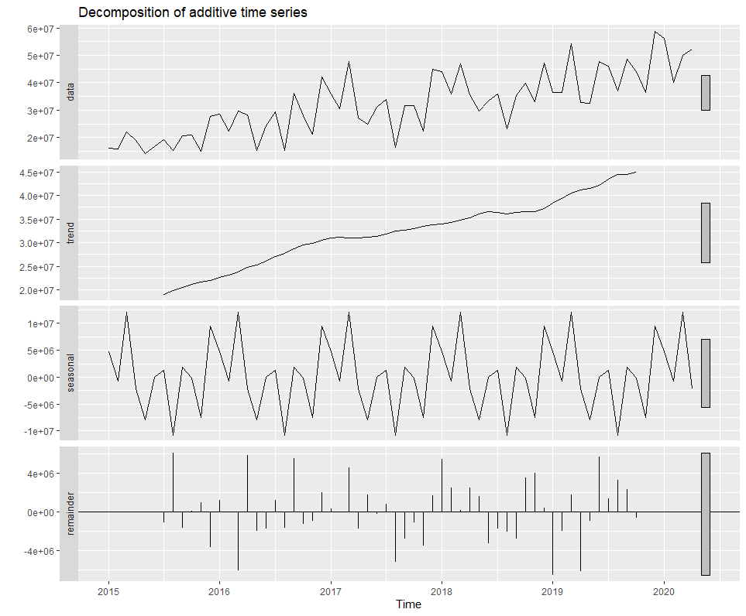
Decomposition
Data: real data plotting (trend + seasonal + remaining)
Trend: long term representation (increase over time)
Seasonal: recurrent pattern.
Remainder: random fluctuations (not explained by the trend or the seasonal component).
Notes:
This plot shows the decomposition of a time series into its three components: trend, seasonal, and remainder. The trend represents the long-term behavior of the time series, while the seasonal component represents the recurring patterns that occur over a fixed period of time. The remainder component contains the random fluctuations that are not explained by the trend or seasonal components.
The top panel of the plot shows the original time series, which is the sum of the trend, seasonal, and remainder components. The middle panel shows the estimated trend component, which shows the overall direction of the time series over time. The bottom panel shows the estimated seasonal component, which shows the repeating patterns that occur over a fixed period of time.
We can see from the plot that the trend component appears to be increasing over time, indicating that the overall revenue is growing over the period of the time series. The seasonal component shows a clear pattern of spikes and dips that occur on a weekly basis, indicating that revenue is higher on certain days of the week compared to others. The remainder component appears to be relatively small, indicating that most of the variation in the time series is explained by the trend and seasonal components.
The decomposition of the time series can help us better understand the underlying patterns and trends in the data, which can be useful for forecasting future values and identifying anomalies or changes in the data.

Slide 4
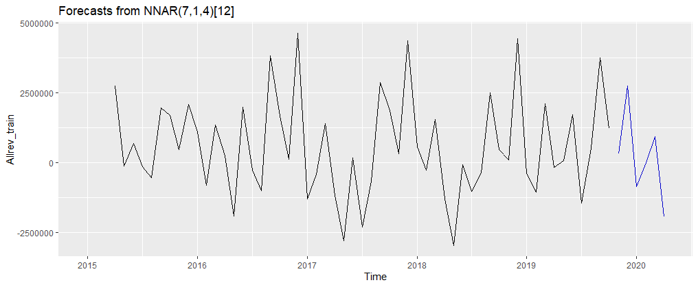
Neural Network Autoregressive - 1 (personalized)
Personalized values of the arguments:
p= 7 (lagged value)
Size= 10 neurons
Repeats: 50 ( a single NNAR model)
It is supposed to be more accurate
Notes:
This R script fits a neural network autoregressive (NNAR) model to a time series called Allrev_train and generates a forecast for a specified number of future time periods. Here's a breakdown of each part of the script:
nnetar(): This is the function used to fit a neural network autoregressive model in the forecast package in R. It takes in a time series object as its first argument and several other arguments that control the behavior of the neural network model. In this case, the nnetar() function is used to fit a NNAR model to the Allrev_train time series.
Allrev_train: This is the time series object that contains the training data for the NNAR model. This time series is used to estimate the model parameters, which are then used to generate forecasts for future time periods.
p=7: This argument specifies the number of lagged values of the time series to include as predictors in the neural network model. In this case, the NNAR model will include 7 lagged values of the time series as predictors.
Size=10: This argument specifies the number of neurons to include in the hidden layer of the neural network model. In this case, the NNAR model will have 10 neurons in the hidden layer.
repeats=50: This argument specifies the number of times to repeat the training process in order to generate an ensemble of models. This can help improve the accuracy of the forecasts by reducing the impact of random initialization of the model weights.
lambda = "auto": This argument specifies the regularization parameter to use in the neural network model. The value "auto" indicates that the function should automatically choose an appropriate value for lambda based on the data.
forecast(): This is the function used to generate forecasts for a time series using a fitted model object. In this case, the forecast() function is used to generate a forecast for a specified number of future time periods based on the fit1 NNAR model.
fit1: This is the fitted model object returned by the nnetar() function. This object contains information about the trained neural network model, such as the weights of the neural network and the chosen regularization parameter.
for1: This is the forecast object returned by the forecast() function. This object contains the point forecasts and prediction intervals for the specified number of future time periods.
To summarize, the script first fits a NNAR model to the Allrev_train time series using the nnetar() function with specified arguments. It then generates a forecast for a specified number of future time periods using the forecast() function and the fitted fit1 model object. The resulting forecast object, for1, contains the point forecasts and prediction intervals for the future time periods.

Slide 5
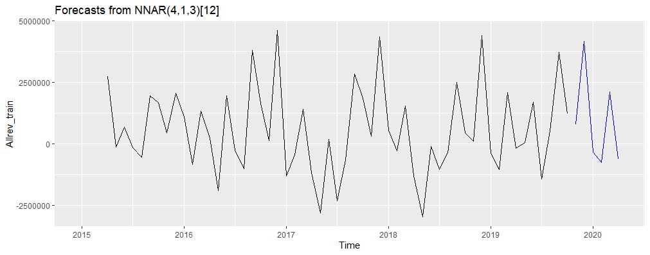
Neural Network Autoregressive - 2 (default)
Default values of the arguments:
p = 1 (lagged value)
size:= 5 neurons
Repeats: 1 ( a single NNAR model)
Notes:
When you call nnetar(Allrev_train) with no additional arguments, the function fits a NNAR model to the time series using default values for the following arguments:
p: The number of lagged values of the time series to include as predictors in the NNAR model. The default value is 1, meaning that the model will include only the most recent lagged value as a predictor.
Size: The number of neurons to include in the hidden layer of the NNAR model. The default value is 5.
repeats: The number of times to repeat the training process in order to generate an ensemble of models. The default value is 1, meaning that the function will fit a single NNAR model to the time series.
lambda: The regularization parameter to use in the NNAR model. The default value is 0, meaning that no regularization is applied.
On the other hand, when you call nnetar(Allrev_train, p = 7, Size = 10, repeats = 50, lambda = "auto"), you are specifying different values for these arguments. In this case, the NNAR model will include 7 lagged values of the time series as predictors, will have 10 neurons in the hidden layer, will be trained 50 times to generate an ensemble of models, and will use an automatically selected value for the regularization parameter.
Therefore, the main difference between fit1 and fit2 is that fit1 specifies additional arguments to control the behavior of the NNAR model, potentially leading to a more accurate forecast, while fit2 uses default values for these arguments.

Slide 6
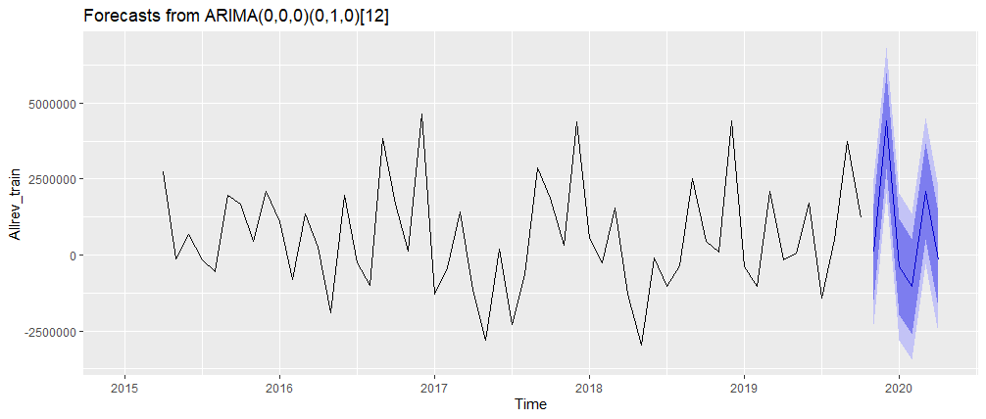
ARIMA and prediction -1 (default)
Autoregressive integrated moving average (ARIMA):
Automatically select the values of the model (d, p and q)
- Will search the best ARIMA model to fit the data
Notes:
The auto.arima() function fits an autoregressive integrated moving average (ARIMA) model to a given time series. The function uses an algorithm that automatically selects the order of differencing (d), the order of the autoregressive term (p), and the order of the moving average term (q) based on a grid search and information criteria such as the Akaike Information Criterion (AIC) and the Bayesian Information Criterion (BIC).
In the script fit3 = auto.arima(Allrev_train), Allrev_train is the time series that you want to model. The auto.arima() function will search for the best ARIMA model to fit the data, taking into account different combinations of d, p, and q, and will return the best-fitting model based on the AIC and BIC criteria.
The resulting fit3 object will contain the estimated parameters of the selected ARIMA model, as well as other information such as the residuals of the model and the estimated variance of the errors.
Overall, the auto.arima() function is a useful tool for time series forecasting because it automates the process of selecting the appropriate ARIMA model order, which can be time-consuming and difficult to do manually. However, it is important to note that the automatic selection process is not always perfect, and it is still necessary to carefully evaluate the model's assumptions and diagnostic tests to ensure that it is appropriate for the data.

Slide 7
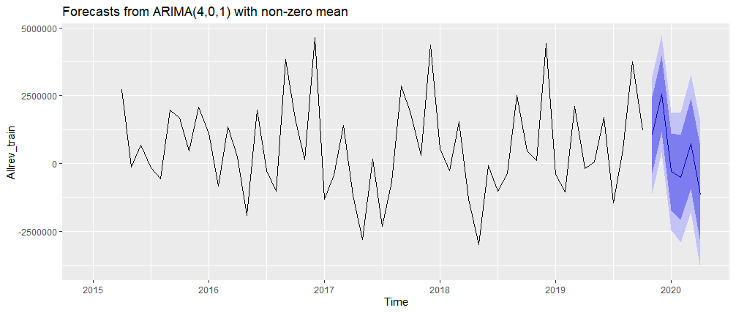
ARIMA and prediction -2 (personalized)
Autoregressive integrated moving average (ARIMA):
In this case we select the order of the parameters (d, p and q)
p = 4: order of the autoregressive term.
d = 0: no differencing.
q = 1: order of the moving average.

Slide 8
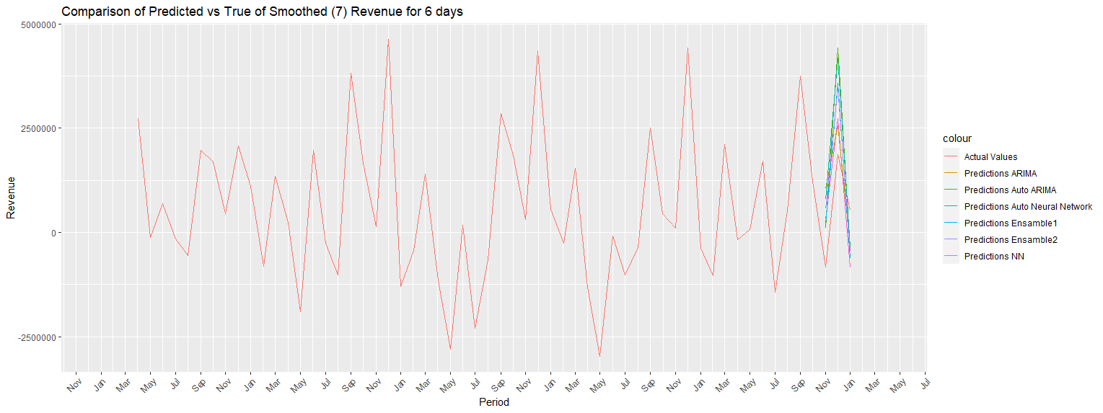
Comparing the predictions Versus the truth
Table: RMSE values from each model
PredNN | PredAutoNN | PredAutoARIMA | PredARIMA | Ensamble1 | Ensamble2
946,669.8 | 1,838,942 | 1,654,333 | 1,252,022 | 1,172,617 | 1,326,946
Notes:
The plot "Predictions_vs_Test_days_6_Revenue.jpg" appears to show a comparison between the predicted values and the actual values of a time series. The x-axis represents time, with each point representing a specific time interval (e.g., day, week, month) depending on the time granularity of the data. The y-axis represents the value of the revenue for each time interval.
The blue line in the plot represents the actual revenue values for the test set of the time series, while the orange line represents the predicted revenue values from the chosen forecasting model. The shaded area around the orange line represents the 95% prediction intervals, which indicate the range of values that the predicted revenue values are likely to fall within.
By comparing the actual and predicted revenue values, we can assess the accuracy of the forecasting model. Ideally, the predicted values will closely match the actual values, indicating that the model is performing well. However, if the predicted values differ significantly from the actual values, it may indicate that the forecasting model is not capturing all the underlying trends and patterns in the data.
Overall, the plot provides a visual representation of the accuracy of the forecasting model and can be used to evaluate its performance and identify areas for improvement.

Slide 9
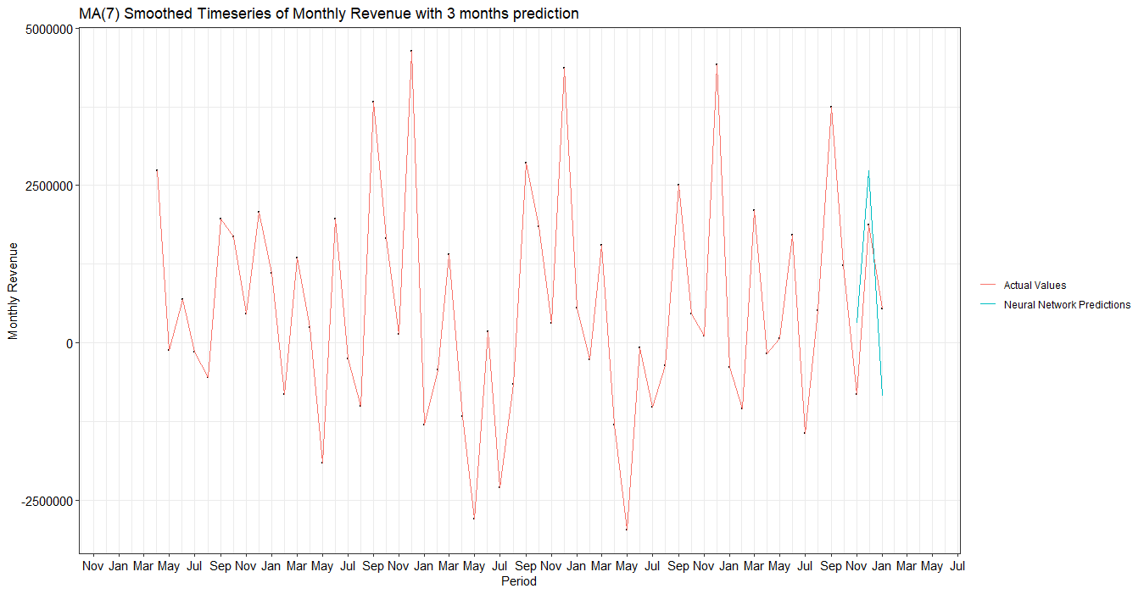
Conclusions
Overall, the best model is the one with the lowest RMSE: the Neural Network (PredNN) with:
7 lagged values,
10 neurons in the hidden layer,
50 repeats.
The worst model for prediction would be the Neural Network with the default values.

