Slide 1
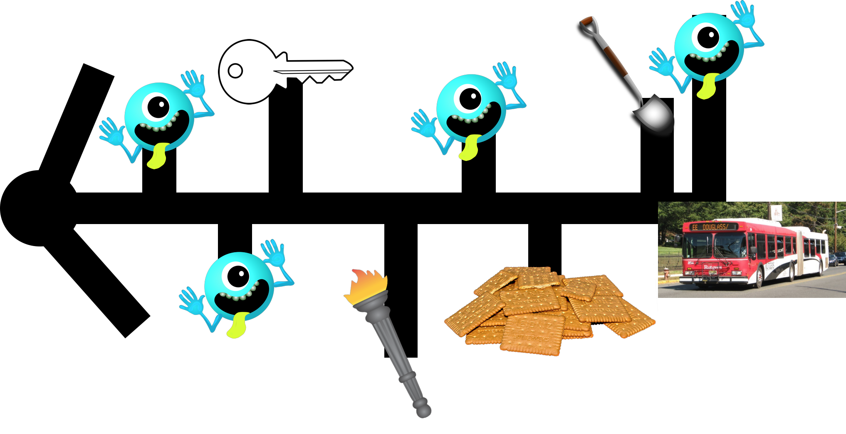
Map

Slide 2


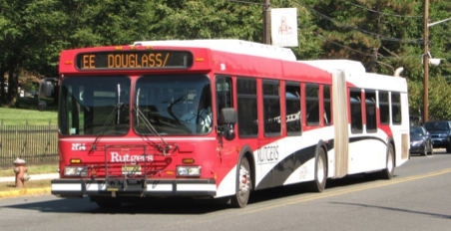
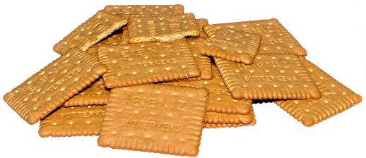


Legend
Treasures to pick up on the way
Key
Graham Crackers
Monsters with Questions
The ride to your success
Torch
Shovel

