Slide 1


Digital Freelancer:
Managing Freelancing Projects
Project: Working with a Mock Client

Slide 2
Part 1
Project Listing

Slide 3
Sample Project Listing #3: Data Analyst
Seeking experienced Data Analyst to build dashboard for local insurance company.
Posted 1 week ago
Hourly: $90.00 Based on experience.
Project Time: 1 year, 20 hours a week.
Project Description:
I have taken over a local car insurance company from my parents and have inherited hundreds of Excel spreadsheets with past and current customer information. I need help organizing this data and creating a dashboard to allow me to filter the data and create reports as needed. I would also need guidance on how to transfer the data to the tool of your choice. Looking forward to working together!

Slide 4
Part 2
Expression of Interest

Slide 5
Expression of Interest (Provided)
Which Sample Project Listing did you select to respond to?
Answer: Data Analyst
Expression of Interest:
Dear Project Manager, I’m glad to work with you to make professional job for your company.
I’m Eslam, a data analyst enthusiast who enjoys analyzing new data. I have 1 year of experience, and I have good knowledge about the insurance field that will make analyzing your data much easier.
After reviewing your project description, it’s clear that you need to acquire a data analyst with solid experience on how to create professional dashboards and reports, organize all of your customer data in Excel spreadsheets, and transfer the data to the right tool.
I would like to inform you that the sheets will be highly organized, and the dashboards and the reports will meet your specifications.
I may address your data using Python libraries because it makes filtering data much easier, and I will give you a full analysis with critical questions to guide you in solving problems and taking the right decisions, and I will transfer your data to the right tool.
I look forward to elaborating on how my specific skills and abilities will benefit your insurance company and how you’ll help me sharpen them as well.
I would like to tell you that the cost will be simple, and I will give you a competitive price compared to market prices. You may find my estimated cost in more detail in the invoice file. Also, my detailed work plan for your project with set deadlines will be in the Trello board file.
I will be happy to contact you.
Sincerely, Eslam Mohamed.
Email: eslam.mohammed98@yahoo.com

Slide 6
Part 3
Project Management Process

Slide 7
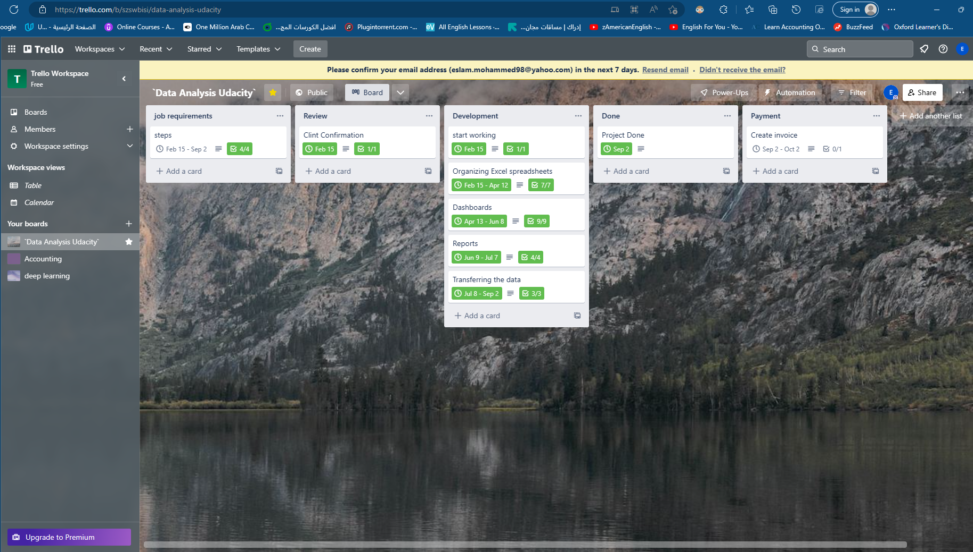
Trello Board
Please include the following information for your Trello board:
A link to your public Trello board should be provided here:
[Link to Trello board]
`Data Analysis Udacity` | Trello
Include a screenshot of the board below:
Paste screenshot here

Slide 8
Part 4
Invoice and Payment Options

Slide 9
Eslam Mohamed Mahmoud
Building 8,street 3,Ismailia,Egypt
Invoice
Recipient:
[Project Manager]
[USA]
Invoice #: [0100807]
Date issued: 15/02/2023
Date due: 2/09/2023
Services Rendered
Service | Description of Work Done | Hours Spent | Amount Per Hour | Total
Organizing Excel spreadsheets | Preparation of a good spreadsheet, organizing the information flow, removing duplication, sorting the data, and streamlining data by merging and redesigning, linking spreadsheets for ease of access, and ordering the sheets. | 160 | $35 | 160*35$ = 5,600$
Dashboards | Defining the dashboard audience and visualizing the data and objectives Selecting the right chart type for data, customizing solutions to fit company needs, and Building a Balanced Perspective. | 160 | $50 | 160*50$ =8,000$
Reports | project tracking and updating information, Improving performance | 80 | $35 | 80*35$ =2,800$
Transferring the data | Gathering and transferring the data | 160 | $50 | 160*50$ =8,000$
Total Payment Due: [24,400$]
Payment Options: By my PayPal, Paymob, Payoneer
Email: eslam.moahmmed98@yahoo.com

