Slide 1
UQ in Python - Intro
André R. Brodtkorb, Associate Professor, Oslo Metropolitan University Researcher SINTEF Digital
Notes:
Bildet illustrerer:
· bredden i SINTEFs ekspertise, fra havrom til verdensrom.
· hvilke områder og bransjer vi jobber innen for å realisere visjonen Teknologi for et bedre samfunn.
Bildestilen er basert på stikkordene fremtidsrettet, teknologi og norsk natur (naturressurser). SINTEFs visuelle univers er utviklet for SINTEF av Headspin Productions AS.

Slide 2
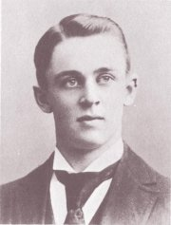
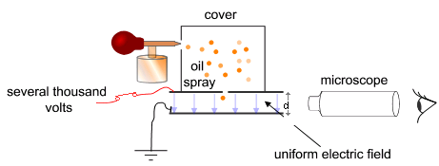
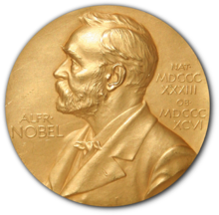
Measuring the charge of an electron
Robert Millikan held a famous experiment published in 1910.
Part of the reason for his 1923 Nobel prize in physics
By varying the charge of the electric field, the (charged) oil particles would rise or fall.
Millikan discovered that that charge was discrete, and had a value of 1.5924(17)×10⁻¹⁹ coulomb with a very small margin of error
The value is today believed to be 1.602176487(40)×10⁻¹⁹ coulomb
Oil-drop experiment image, CC-BY-SA 3.0, Theresa Knott

Slide 3
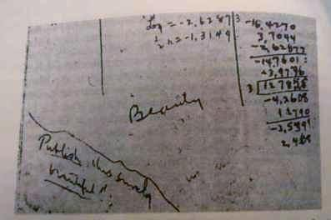
Measuring the charge of an electron
Beauty
Publish this surely Beautiful!!

Slide 4
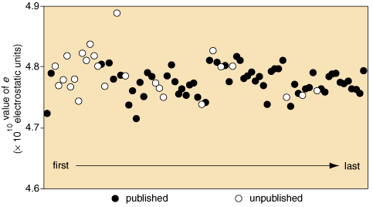
Measuring the charge of an electron
Millikan had almost exactly the correct value, but extremely small error margins in published result.
A lot of data excluded from publication
Figure by David Schneider

Slide 5
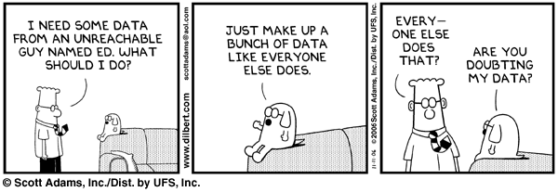
Making up data

Slide 6


Tenfold increase in scientific research papers retracted for fraud since 1975: Two thirds retracted for scientific misconduct, not error
Findings in six of 53 landmark studies in cancer research can be confirmed
Source:
Tenfold increase in scientific research papers retracted for fraud, Alok Jha, The Guardian, Monday 1 October 2012
Drug development: Raise standards for preclinical cancer research, C. Glenn Begley and Lee M. Ellis, Nature 483, 2012

Slide 7
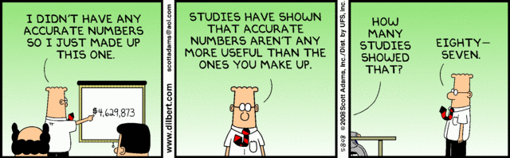
Making up data

Slide 8
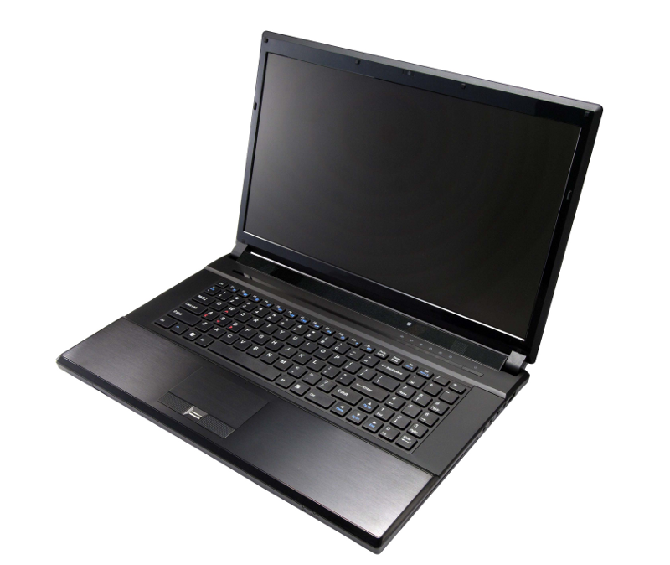
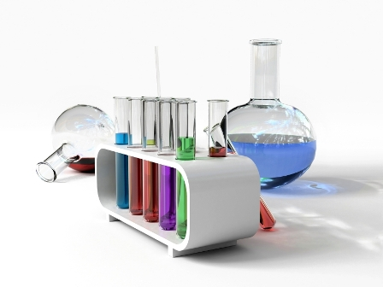
A chemist treats the laboratory with thorough respect, having strict security procedures, careful note taking during experiments, etc. So should we also treat our computers, as it is the laboratory of computational science.

Slide 9
"In academia, software quality, user interfaces,
documentation, testing and reproducibility, will all be
sacrificed at the altar of publications"
Working reproducibly should become a central part of your everyday work cycle: it is not enough to think of it as a post publication step (which never happens, anyway…)

Slide 10
Python and Jupyter Notebooks

Slide 11

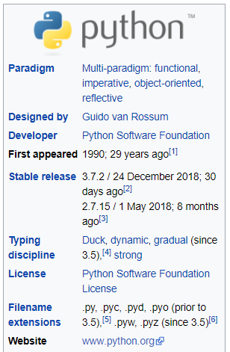
Python
Almost 30 years old!
Two "versions"
"Jurassic" version 2.7
Modern version 3.x
Mostly compatible with each other
Runs on everything from cellphones to supercomputers

Slide 12
Python ecosystem
Mature and fast libraries
Numpy – matrices and arrays in Python
Pandas – statistics and data analysis
Scikit-learn – Machine learning (see 2018 winter school!)
Matplotlib – interactive plotting similar to Matlab
Mayavi – 3D interactive visualization
…

Slide 13
Jupyter Notebook
Major part of 2013 Geilo Winter School on Reproducible Research
Makes Python interactive (what Julien is using)
REPL environment Read-Eval-Print-loop
Interactive prototyping workbench

Slide 14
Exercise 1: Plot unit circle
Unit circle: y = +/- sqrt(1 – x^2)
import numpy as np from matplotlib import pyplot as plt
Generate x as a linear space (linspace) in numpy
Use sqrt from numpy to generate y
Use plt.plot(x, y, 'r.-') to plot
Use question mark (?) to get help on commands!
Add legend, change plot color, line type, add marker

Slide 15
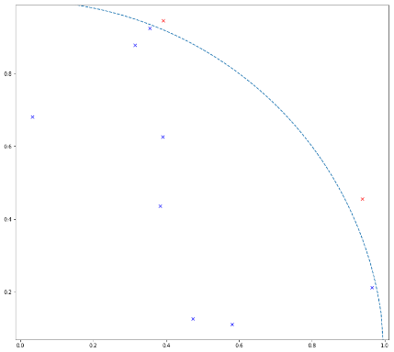
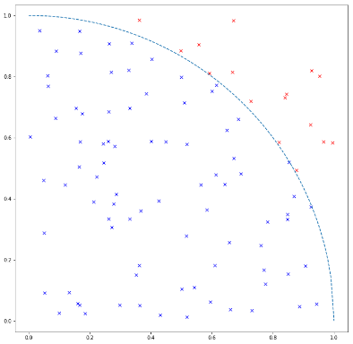
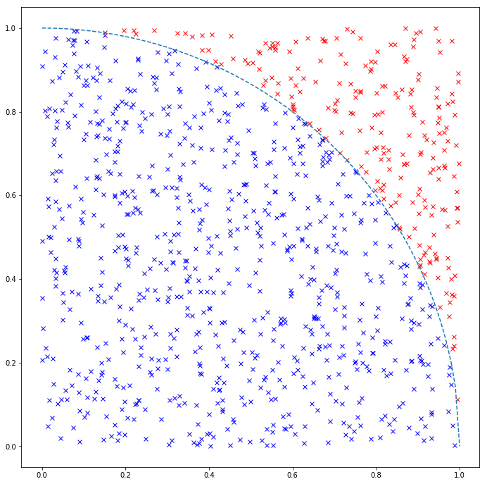
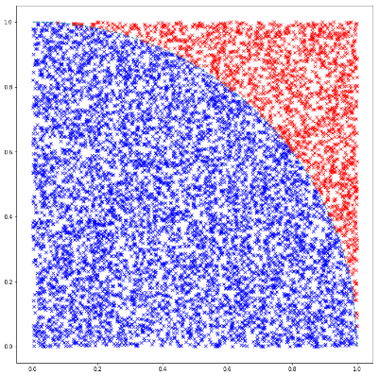
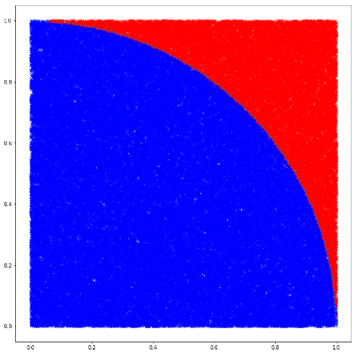
Exercise 2: Monte Carlo integration of Pi
Sample n random points in 2d (np.random.random)
Estimate area of circle, and use pi = A / r^2

