Slide 1

Soccer Agent - Planner Implementation
Group members: Babneet Singh, Chen Zhang, Tosin Agagu

Slide 2

Overview of our Approach
Environment Properties
Agent Actions
STRIPS
Examples of STRIPS Notation
Agent Architecture

Slide 3
Environment Properties
Environment properties that can be evaluated by the agent:
“ball_in_possession”
“is_ball_visible”
“is_being_blocked”
“ball_inside_goal”
“is_goal_visible”

Slide 4
Agent Actions
Actions that can be performed by the agent:
“pass”
“locate_ball”
“intercept_ball”
“locate_goal”
“score_goal”

Slide 5
Description of Agent’s Actions (STRIPS)
For each agent action, we give define the following three sets:
Preconditions
Deletions
Additions

Slide 6
STRIPS Notation for Agent’s Actions
Example 1 -
action: (pass)
preconditions: (ball_in_possession ^ is_being_blocked)
additions: ()
deletions: (ball_in_possession)
Example 2 -
action: (intercept_ball)
preconditions: (is_ball_visible)
additions: (ball_in_possession)
deletions: ()

Slide 7
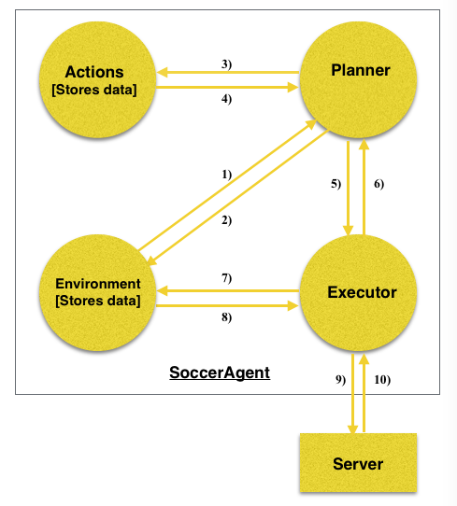
Agent Architecture

Slide 8
Thank You

