Slide 1
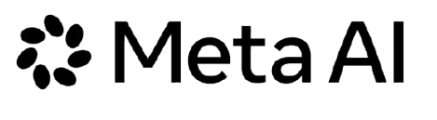
META AI HACKATHON 2026 - BUILD FOR YOUR WORLD
Introducing Babu Studio
The Next Generation Creator Studio From Recording Studio to AI-Powered Creator Studio
Babu Studio is a CPU/GPU-optimized creator studio that captures gameplay, webcam, and audio once, then exports both Landscape (16:9) and Vertical (9:16) formats automatically.
Unlike traditional tools such as OBS and Meld Studio, which primarily focus on recording and streaming rather than an integrated dual-layout workflow, Babu Studio is designed to simplify both formats in one recording process.
Powered by Meta AI, it also generates short clips, transcribes audio, and creates multilingual subtitles—eliminating repetitive editing and saving creators time and resources.
babu-studios.github.io/babu-studio-app/meta-hackathon
01 / 10

Slide 2
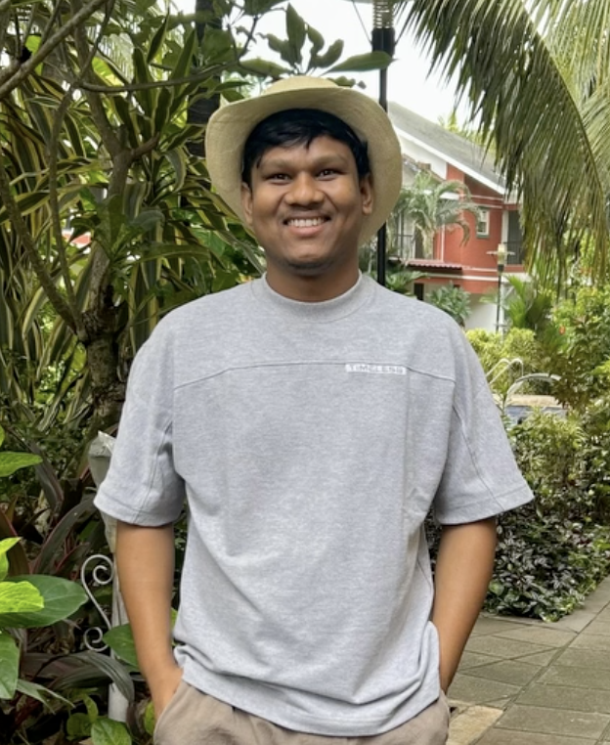
META AI HACKATHON 2026 - BUILD FOR YOUR WORLD
Meet the Developer
I'm Deep Bag, a Software Engineer passionate about building innovative software, solving real-world problems, and exploring AI-powered technologies.
I'm the developer of Babu Studio, a CPU/GPU-optimized creator studio designed to simplify video recording, multi-format content creation, and AI-assisted editing.
Connect With Me (Website URL)
LinkedIn: linkedin.com/in/deepbag
GitHub:github.com/deepbag
Project:github.com/babu-studios/babu-studio-app
(Branch - BetaMetaAIHackathon)
Instagram: instagram.com/b4babugaming instagram.com/deepbaaaaaag
babu-studios.github.io/babu-studio-app/meta-hackathon
02 / 10

Slide 3

META AI HACKATHON 2026 - BUILD FOR YOUR WORLD
Babu Studio
From Recording Studio to AI-Powered Creator Studio
A unified creator platform that transforms a single recording into ready-to-publish, multi-format and multilingual content.
Record Once, Capture Everything
Export to Landscape & Vertical Formats
(Meta AI) Generate Short Clips and Multiple Language Transcribes
Publish to Youtube, Shorts, Instagram, Facebook
Record once. Export in Landscape (16:9) and Vertical (9:16). Generate AI Shorts and Transcribe
babu-studios.github.io/babu-studio-app/meta-hackathon
03 / 10

Slide 4
META AI HACKATHON 2026 - BUILD FOR YOUR WORLD
The Problem We're Solving
Content creation is more complicated than it needs to be.
01
02
03
04
Separate Landscape & Vertical Workflows
Repetitive Editing
Performance Overhead
Disconnected Creator Tools
Creators must spend extra time creating and editing separate 16:9 and 9:16 videos from the same recording.
Creating Shorts, Reels, captions, and subtitles manually adds significant editing effort.
Managing multiple video layouts can increase CPU/GPU usage and reduce recording performance.
Traditional tools like OBS and Meld Studio lack an integrated dual-format and AI-powered creation workflow.
babu-studios.github.io/babu-studio-app/meta-hackathon
04 / 10

Slide 5
META AI HACKATHON 2026 - BUILD FOR YOUR WORLD
AI-Powered Gameplay Highlights
Turn long gameplay recordings into engaging short clips automatically. Website URL
01
02
03
04
AI Video Analysis
Smart Highlight Detection
Automatic Clip Generation
Shorts/Reel Upload
Analyzes gameplay footage to identify interesting moments.
Suggests potential highlights with start and end timestamps.
Extracts selected moments into separate video clips.
Uploads generated highlights to YouTube as Unlisted videos for preview and review.
babu-studios.github.io/babu-studio-app/meta-hackathon
05 / 10

Slide 6
META AI HACKATHON 2026 - BUILD FOR YOUR WORLD
AI-Powered Timestamped Subtitles
Convert microphone recordings into accurate, synchronized, multilingual subtitles using AI. Website URL
01
02
03
04
Microphone Recording
Audio Conversion
AI Transcription
Multilingual Subtitles
Capture microphone audio and save it as an M4A file.
Convert M4A into WAV format for AI processing.
Convert spoken words into text with timestamps.
Translate transcripts and generate synchronized subtitle files.
babu-studios.github.io/babu-studio-app/meta-hackathon
06 / 10

Slide 7
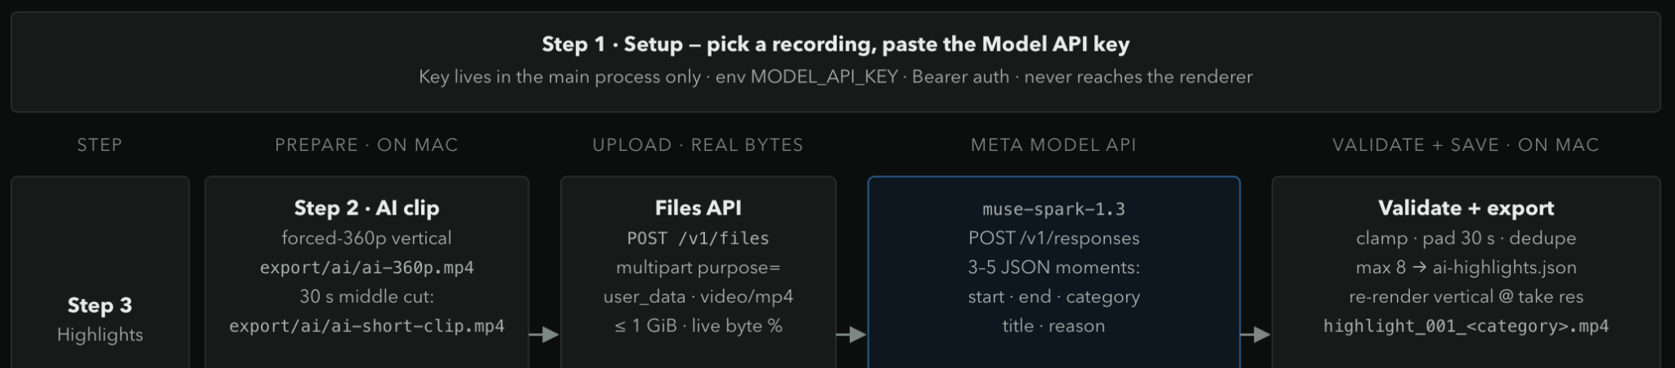
META AI HACKATHON 2026 - BUILD FOR YOUR WORLD
Technical Architecture: AI Highlights
Transform recorded gameplay into AI-detected highlights using Meta's models, with automated clip extraction and export. Website URL
babu-studios.github.io/babu-studio-app/meta-hackathon
07 / 10

Slide 8
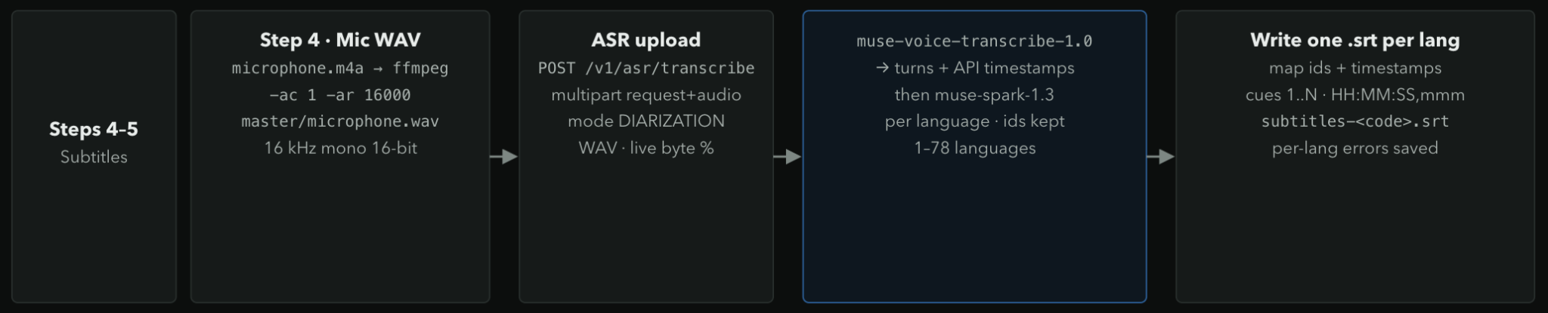
META AI HACKATHON 2026 - BUILD FOR YOUR WORLD
Technical Architecture: Subtitles
Microphone audio processing and multilingual subtitle generation using Meta AI Muse Voice Transcribe 1.0 and Muse Spark 1.3. Website URL
babu-studios.github.io/babu-studio-app/meta-hackathon
08 / 10

Slide 9
META AI HACKATHON 2026 - BUILD FOR YOUR WORLD
Future Roadmap
Expanding Babu Studio into a complete, intelligent creator platform.
Our vision is to unite recording, editing, AI-powered creation, live streaming, and multi-platform publishing in one optimized application—making content creation faster, smarter, and easier.
01
02
03
04
Performance Optimization
Advanced AI Editing
Live Streaming Integration
Multi-Platform Publishing
Further optimize CPU/GPU usage, recording efficiency, and export performance.
AI object removal, intelligent scene detection, and automated video editing.
Bring recording, streaming, and multi-format content creation together.
Expand automated publishing across YouTube, Instagram, Facebook, and more.
babu-studios.github.io/babu-studio-app/meta-hackathon
09 / 10

Slide 10
META AI HACKATHON 2026 - BUILD FOR YOUR WORLD
Thank You!!
Building a smarter creator experience with AI, performance, and innovation.
babu-studios.github.io/babu-studio-app/meta-hackathon
10 / 10

