Slide 1

UNDER THE
HOOD

Slide 2



Hello!
I am Ridhwana Khan
@Ridhwana_K

Slide 3



Kasi Maths
Ladies that UX
Women In Tech

Slide 4






Slide 5

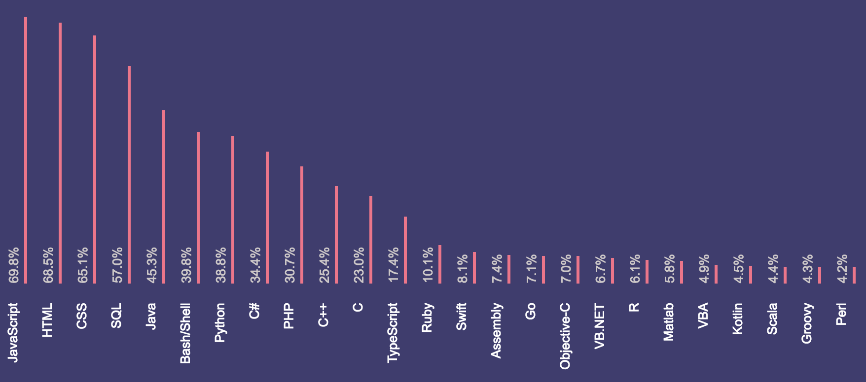
Stack Overflow
https://insights.stackoverflow.com/survey/2018/

Slide 6
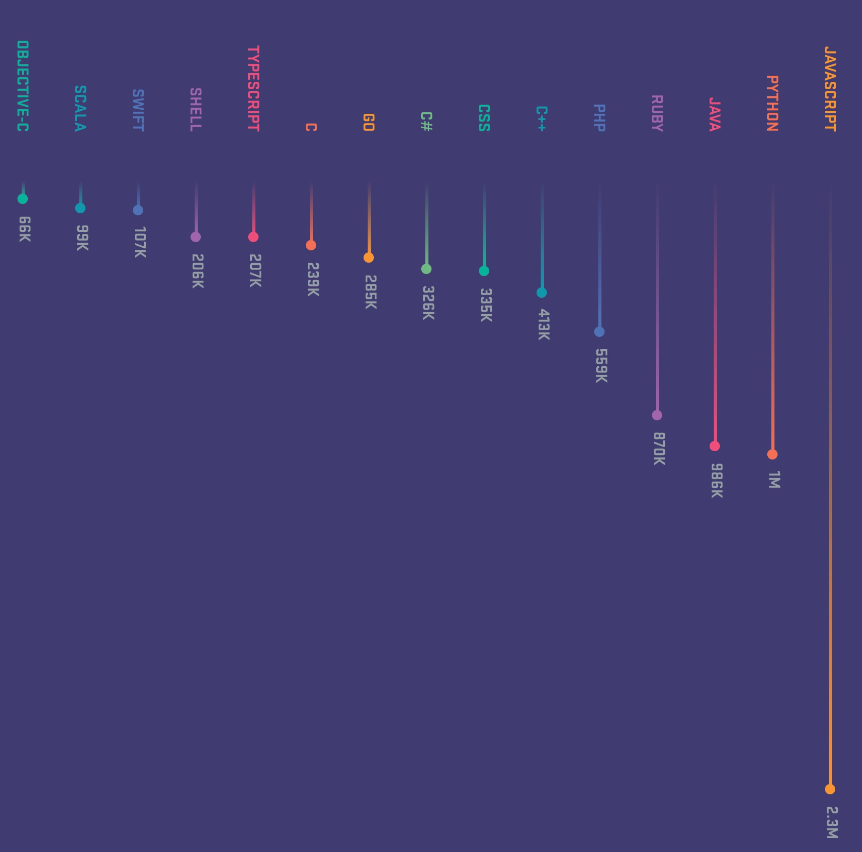

Github Pull Requests
https://octoverse.github.com/

Slide 7
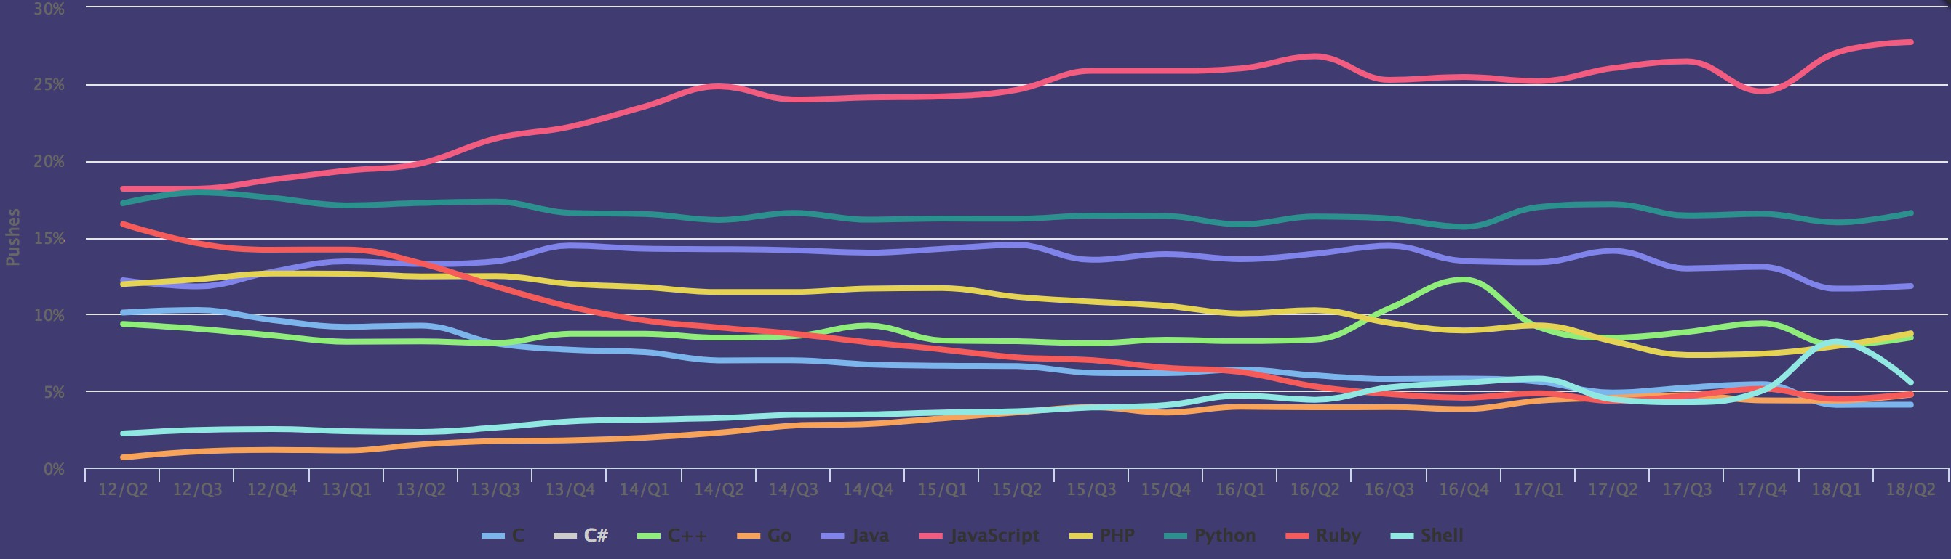
Github Pushes
https://madnight.github.io/githut/#/pushes/2018/2

Slide 8


Slide 9
Concurrent
Call Stack
Asynchronous
Single-Threaded
V8
Non-blocking
Event Loops

Slide 10


Javascript under the hood
Performance | Efficiency | Architecture

Slide 11
Javascript on the web
S T O R A G E
USER INTERFACE
BROWSER ENGINE
RENDERING ENGINE
JAVASCRIPT ENGINE

Slide 12
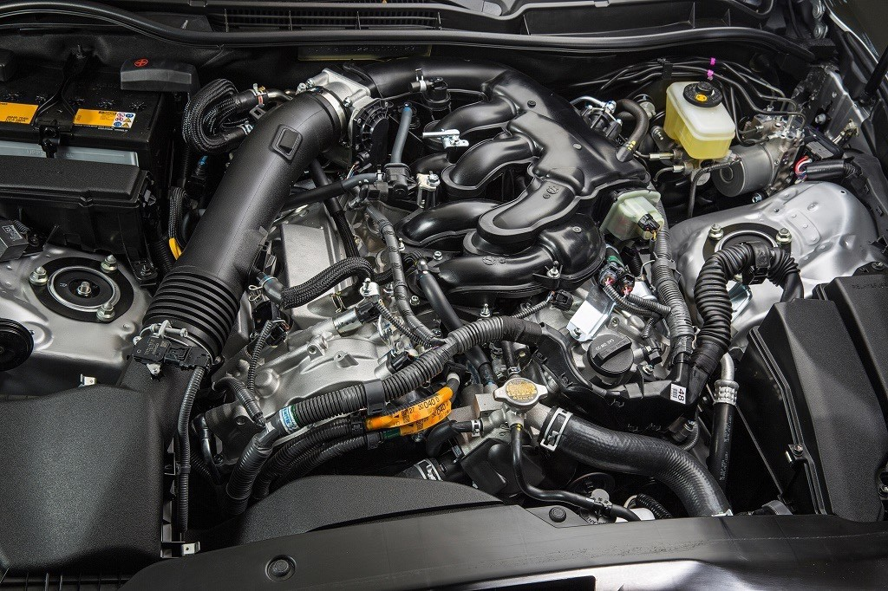
The Javascript Engine
The Javascript engine is specifically designed for speedy execution of applications.
It is a technology that executes the Javascript code.

Slide 13




Browsers & their
Javascript Engines
V 8
https://en.wikipedia.org/wiki/JavaScript_engine
Spider Monkey
Javascript Core

Slide 14


What is it?
Javascript Engine
Translates your script into runnable machine code instructions so it can be executed by the CPU of the host machine. The engine translates scripts at runtime on the fly. Your code won’t be compiled unless you run it.
Javascript Runtime
Provides your scripts with utility libraries which can be used during execution. It’s your script that references these libraries. The engine itself doesn’t depend on them.

Slide 15
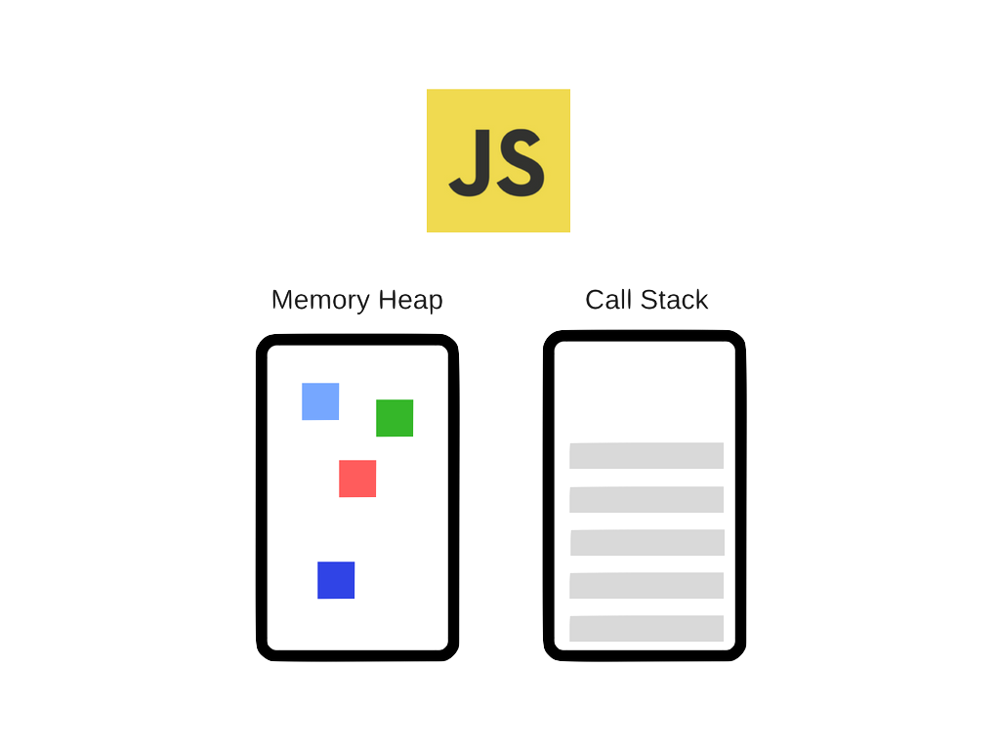

Javascript synchronous execution
Memory Heap
Call Stack
Used for memory allocation & memory management
Data structure that records any function calls that occur.

Slide 16


The heap
Mr Garbage collector
“A collector aims to reclaim memory occupied by objects that are no longer being used.
Objects that are still referenced by the app are not cleaned up.”

Slide 17

The Call Stack
“A data structure that records any function calls that occur.”

Slide 18
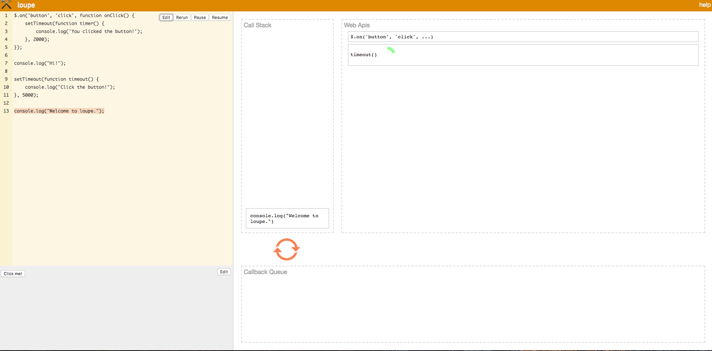
Loupe : A visualization of the runtime

Slide 19
Example
http://latentflip.com/loupe/
function saySomethingNice() { return 'You guys are awesome!';
}
function composeGreeting(name) { let greeting = saySomethingNice(); console.log(greeting);
}
composeGreeting('Jozi');

Slide 20
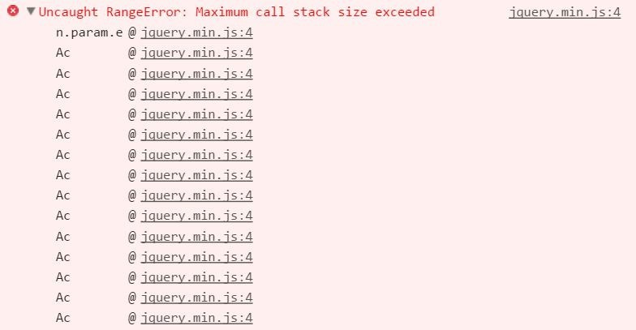
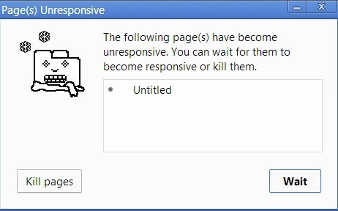
Maximum Call Stack Error
function bar() { bar();
}
bar();

Slide 21
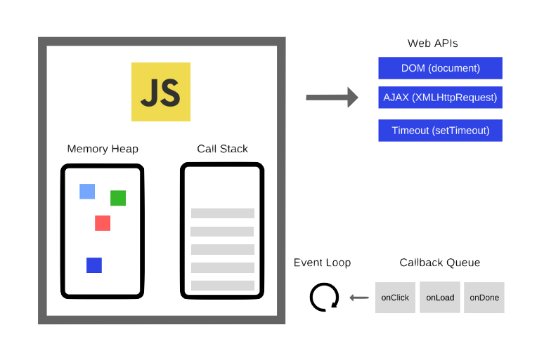
Asynchronous Javascript using callbacks
Web Api’s
Memory Heap
Call Stack
Event Loop
Callback Queue

Slide 22
Web Api’s
Web Api’s
Memory Heap
Call Stack
Event Loop
Callback Queue

Slide 23

Callback Queues
Web Api’s
Memory Heap
Call Stack
Event Loop
Callback Queue

Slide 24
Event Loops
Web Api’s
Memory Heap
Call Stack
Event Loop
Callback Queue

Slide 25
Example
http://latentflip.com/loupe/
http://latentflip.com/loupe/

Slide 26
Optimizing for the runtime
Scoping Variables Appropriately
Don’t hold onto objects for longer than necessary Unbind event listeners when no longer required Clean local caches or use aging mechanisms Referencing Closures Correctly
Timers and Callbacks
Chunking up work into smaller pieces

Slide 27
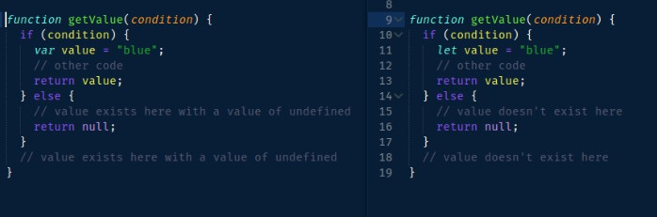


Scoping Variables Appropriately

Slide 28


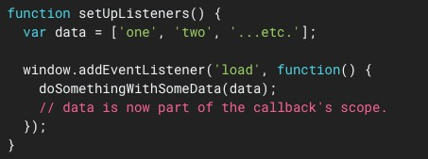
Unbind event listeners when no longer required

Slide 29
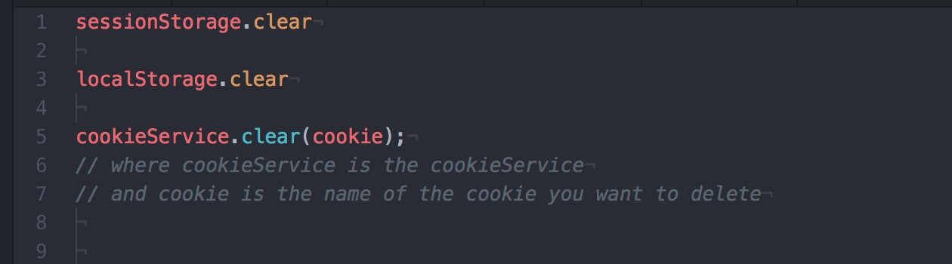

Clean local caches or use aging mechanisms

Slide 30
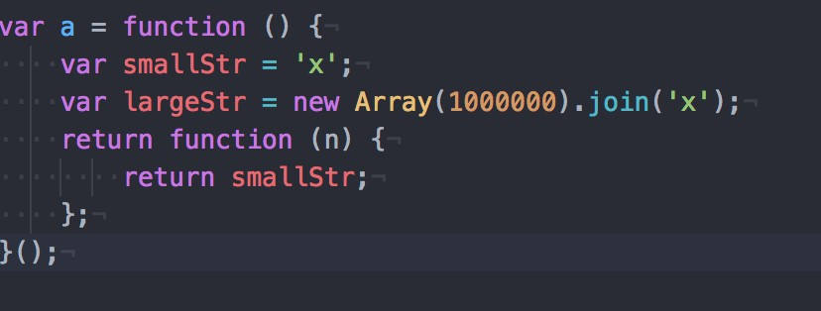

Referencing Closures Correctly

Slide 31
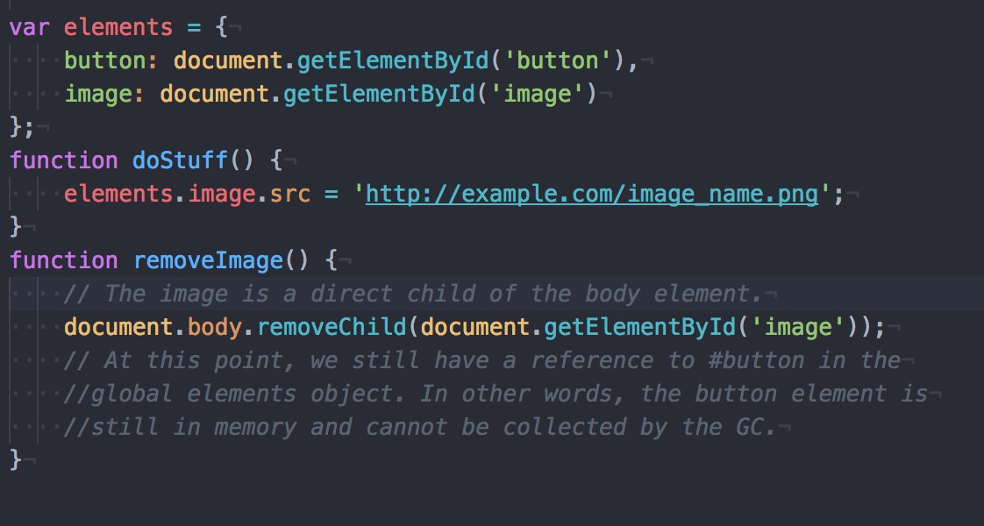
Out of DOM references

Slide 32

Chunking up work into
smaller pieces

Slide 33
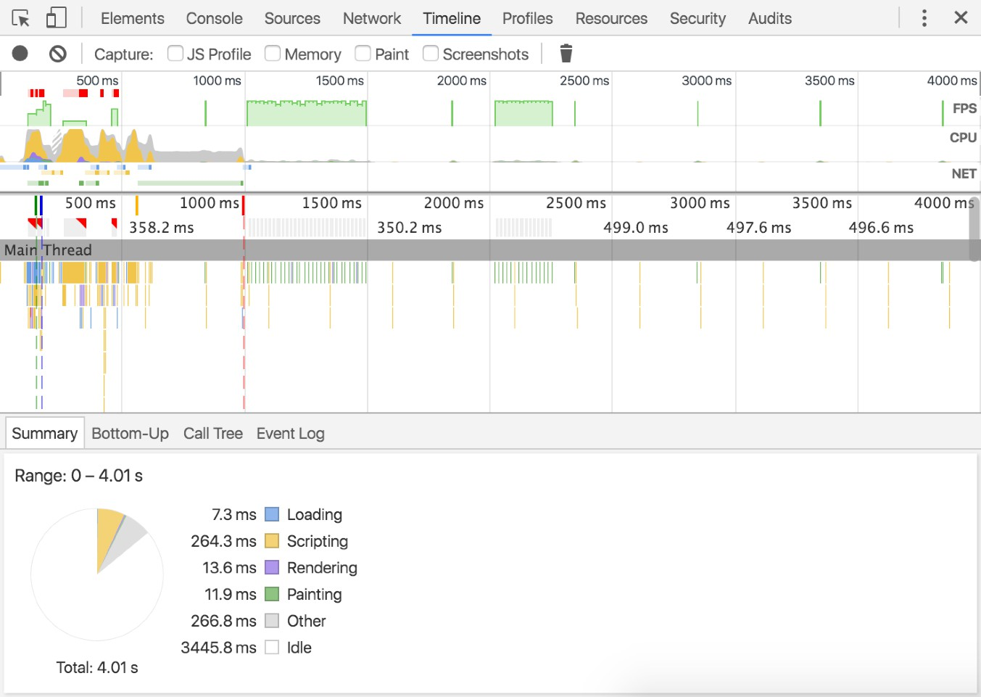
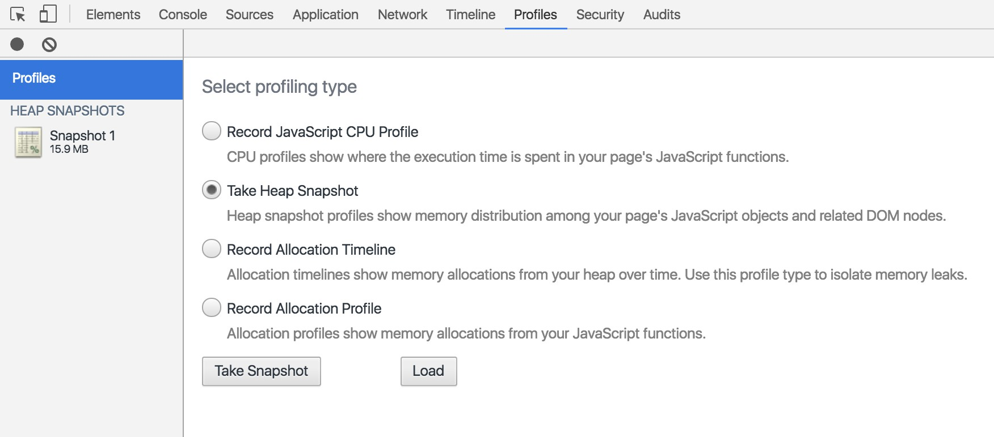
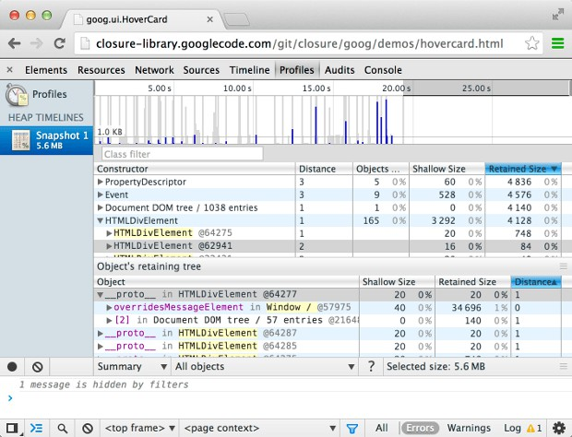
Some Tools to debug
Allocation Profiler
Timeline
Heap Snapshot

Slide 34


Some Stats
53% of visits are abandoned if a mobile site takes more than 3 seconds to load
1 out of 2 people
expect a page to load in less than 2 seconds

Slide 35

Javascript after this presentation

Slide 36

Thanks!
Any questions?
Ridhwana_K

Slide 37
References
These amazing articles, videos and tools made it possible for me to put this presentation together and learn so much more than I anticipated…
https://developers.google.com/web/updates/2016/10/addeventlistener-once
https://blog.sessionstack.com/how-does-javascript-actually-work-part-1-b0bacc073cf
https://www.youtube.com/watch?v=8aGhZQkoFbQ
http://latentflip.com/loupe/
https://www.google.com/url?q=https://developer.mozilla.org/en-US/docs/Web/ JavaScript/EventLoop
http://www.competa.com/blog/memory-leaks-in-javascript/
https://en.wikipedia.org/wiki/JavaScript_engine

