Slide 1


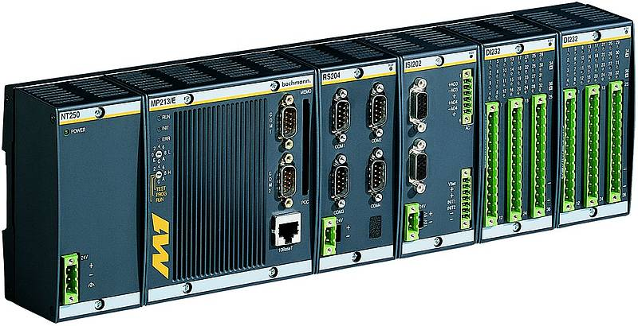
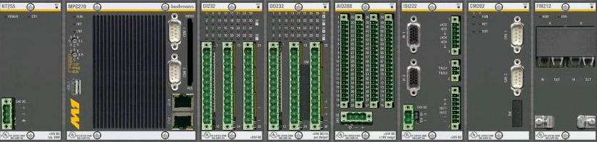
P L C
Programmable Logic Controller
Presented By Shankar Jothyraj

Slide 2



Contents
What is PLC?
Definition of PLC
What is Control?
History of PLC
Need for PLC
Hardwire System and PLC
Comparison
PLC Function
PLC Operating Cycle
How does a PLC work?
PLC Signal Flow
Ladder Diagram
Ladder Program
Basic Components of a PLC
Central Processing Unit
CPU Duties
Input Modules
Output Modules
Digital and Analog Modules
Chassis and Backplane
Power Supply
Programming Software
Types of Programme Software
PlC Control Panel
PLC Relay
PLC Advantages & Disadvantages
PLC Applications
PLC Size
Leading Brands of PLC

Slide 3


What is a PLC?
The Basic Block
CPU
Inputs
Outputs
A PROGRAMMABLE LOGIC CONTROLLER is a solid state control system that continuously monitors the status of devices connected as inputs. Based upon a user written program, stored in memory, it controls the status of devices connected as outputs.

Slide 4
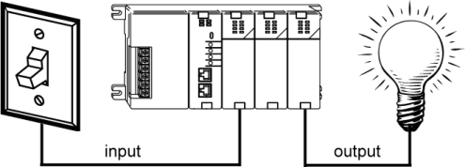
Definition of PLC
A digital electronic device that uses a programmable memory to store instructions and to implement specific functions such as logic, sequence, timing, counting and arithmetic to control machines and process.
It uses a programmable memory to store the instructions and specific functions that include On/Off control, timing counting, sequencing, arithmetic and data handling.
A PLC is a computer designed to work in an industrial environment.

Slide 5

What is Control?
“ CONTROL is the process in a system in which
one or several input variables influence other
variables. “
A Simple View of a Control System
INFORMATION
C
O
N
T
R
O
L
S
Y
S
T
E
M
SENSORS
P
L
A
N
T
COMMANDS
ACTUATORS

Slide 6

History of PLC
During the late 1960s, General Motors (USA) was interested in the computer application to replace the hardwire systems.
Bedford Associates (Modicon) and Allen Bradley responded to General Motors.
The name given was “Programmable Controllers” or PC.
Programmable Logic Controller or PLC was a registered trademark of the Allen Bradley.
Later, PC was used for “Personal Computer” and to avoid confusion PLC for “Programmable Controller” and PC for a personal computer.

Slide 7
Need for PLC
Hardwired panels were very time consuming to time, debug and change.
The following requirements for computer controllers to replace hardwired panels.
  1.Solid-state not mechanical.
  2.Easy to modify input and output devices.
  3.Easily programmed and maintained by plant electricians.
  4.Be able to function in an industrial environment.

Slide 8
Hardwire System and PLC
L
24 VDC
S1
S1
S2
S2
K1
PLC
K1
K1
N
0 V
Hardwire
PLC

Slide 9
Comparison
Hardwired control systems
The functions are determined by the physical wiring.
Changing the function means changing the wiring.
Can be contact-making type (relays, contactors) or electronic type (logic circuits)
PLC Systems
The functions are determined by a program stored in the memory.
The control functions can be changed simply by changing the program.
Consist of a control device, to which all the sensors and actuators are connected.

Slide 10
PLC Function
Communications
Port
Circuits
Central
Processor
Unit
(CPU)
Circuits
Input
Output
CR
High
Voltage
High
Voltage
MEMORY
Isolation
Barrier
Isolation
Barrier
program
data
Low Voltage
AC Power Supply
or

Slide 11
PLC Operating Cycle
Four Steps in the PLC Operations
  Input Scan
    Scan the state of the Inputs
  Program Scan
    Processes the program logic
  Output Scan
    Energize/de-energize the outputs
  Housekeeping
    This step includes communications, Internal Diagnostics, etc.
The steps are continually repeated - processed in a loop.
START
Housekeeping
Input
Scan
Output
Scan
Program
Scan

Slide 12
How Does a PLC Work?
The sensors are connected to the INPUT MODULES
The processor in the CPU MODULE executes the program and scans the individual input for presence or absence of voltage
Depending on the state of the inputs, the processor directs the OUTPUT MODULES to switch voltages
The ACTUATORS or ANNUNCIATORS are switched “ON” or “OFF” according to the voltage states
24 VDC
Sensors
Power
Supply
Program
Memory
Processor
Input modules
Output modules
Actuators / Annunciators
GND

Slide 13
PLC Signal Flow
Input Module
Processor Memory
Output Modules
Input
Image Table
Data
Output
Image Table
I:0/6
O:0/7
I:0/6
O:0/7
I:1/4
O:1/5
Input Devices
Output Devices
Ladder Program
I:0/6
O:0/7
I:1/4
O:1/5
I:1/4
O:1/5
Programming Terminal

Slide 14
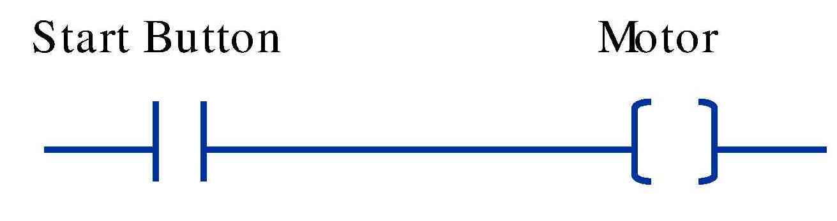

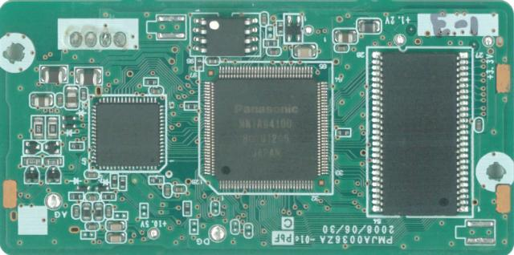
Ladder Diagram
Very similar to traditional circuit diagrams, but the
current paths are arranged horizontally instead of
vertically.
LAD - Ladder Diagram
I 0.0
I 0.1
Q 4.0
(
)

Slide 15

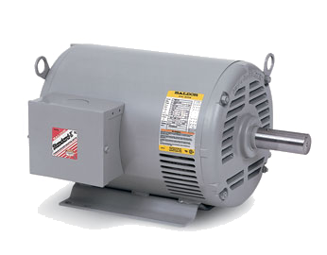
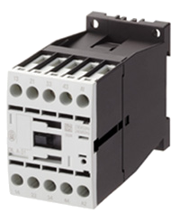
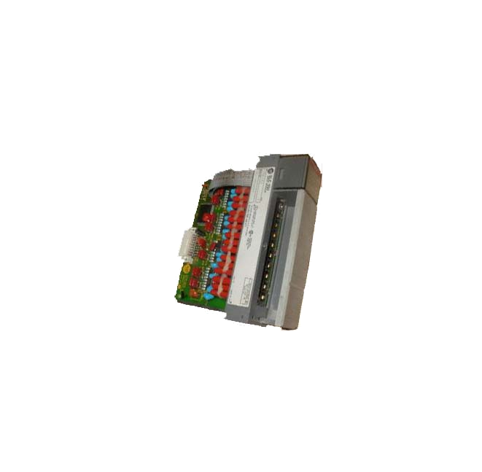
Ladder Program
L1
O:4
L2
CONTACTOR
0
CONTACTOR
L2
L1
N.O
MOTOR
L2
C
L1
SOLENOID
VALVES
LAMP
BUZZER
FIELD WIRING
OUTPUT MODULE
WIRING

Slide 16
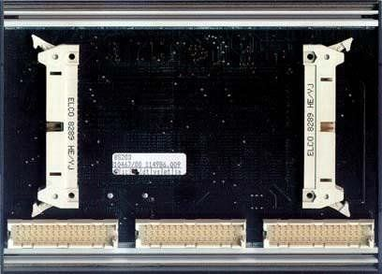
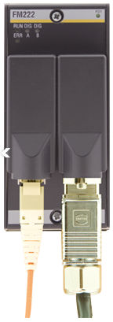
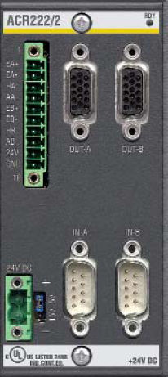
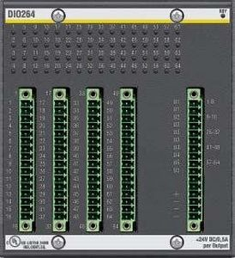
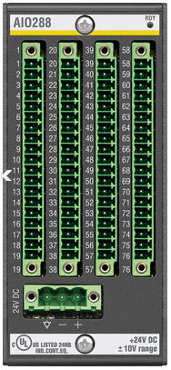
Basic Components of a PLC
There are five basic components in a PLC system:
1. The PLC processor, or CPU.
2. I/O (Input /Output) modules.
3. Chassis and backplane.
4. Programming software that runs in a PC.
5. Power supply.

Slide 17


Central Processing Unit
What is CPU?
The “Brain” of a PLC.
Controlled by a program called the executive or operating system (OS).
The executive is a collection of supervisory programs permanently stored in memory.
Four basic types of CPU operations:
Input and output operation
Arithmetic and logic
Reading or changing contents of memory locations
Jump operations

Slide 18
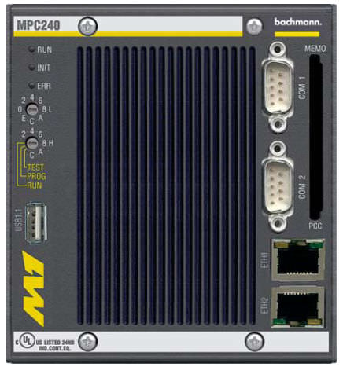
CPU Duties
The CPU reads in input signal states, processes the control program and controls the outputs.
The CPU provides internal Memory, timers and counters.
Stores the control program and data in its memory.
Executes the control program.
Commands connected outputs to change state based on program execution For example: Turn a light on, start a fan, adjust a speed, or temperature.

Slide 19
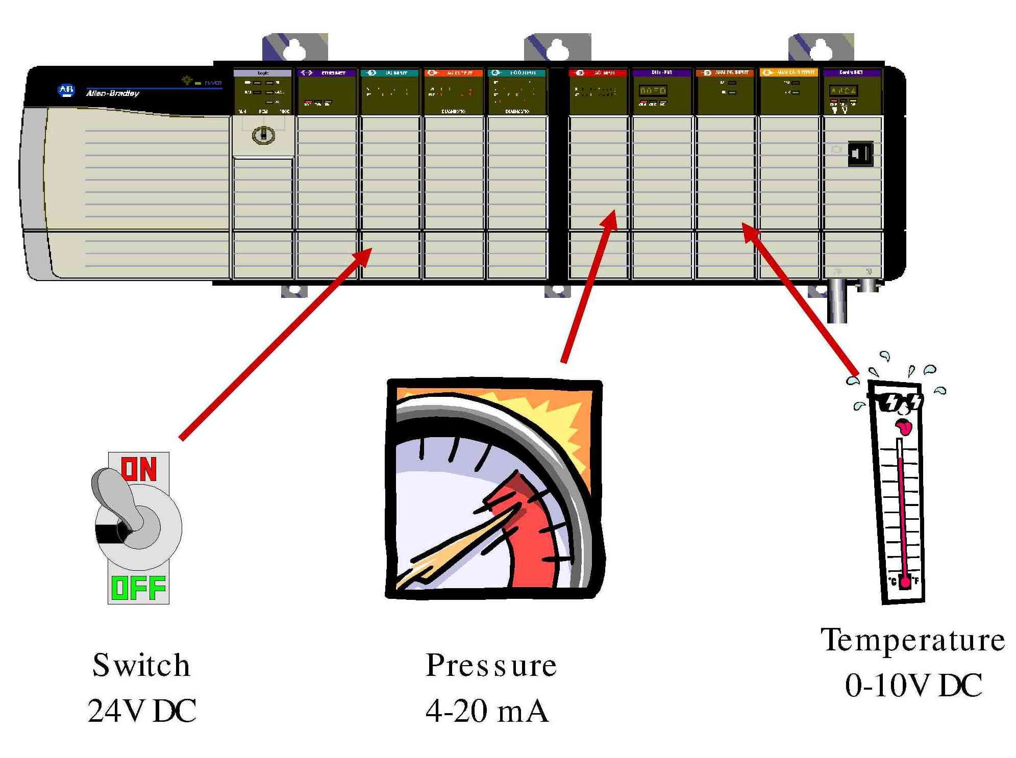
Input Modules
Input modules interface directly to devices such as switches and temperature sensors.
Input modules convert many different types of electrical signals such as 120VAC, 24VDC, or 4-20mA, to signals which the controller can understand.

Slide 20
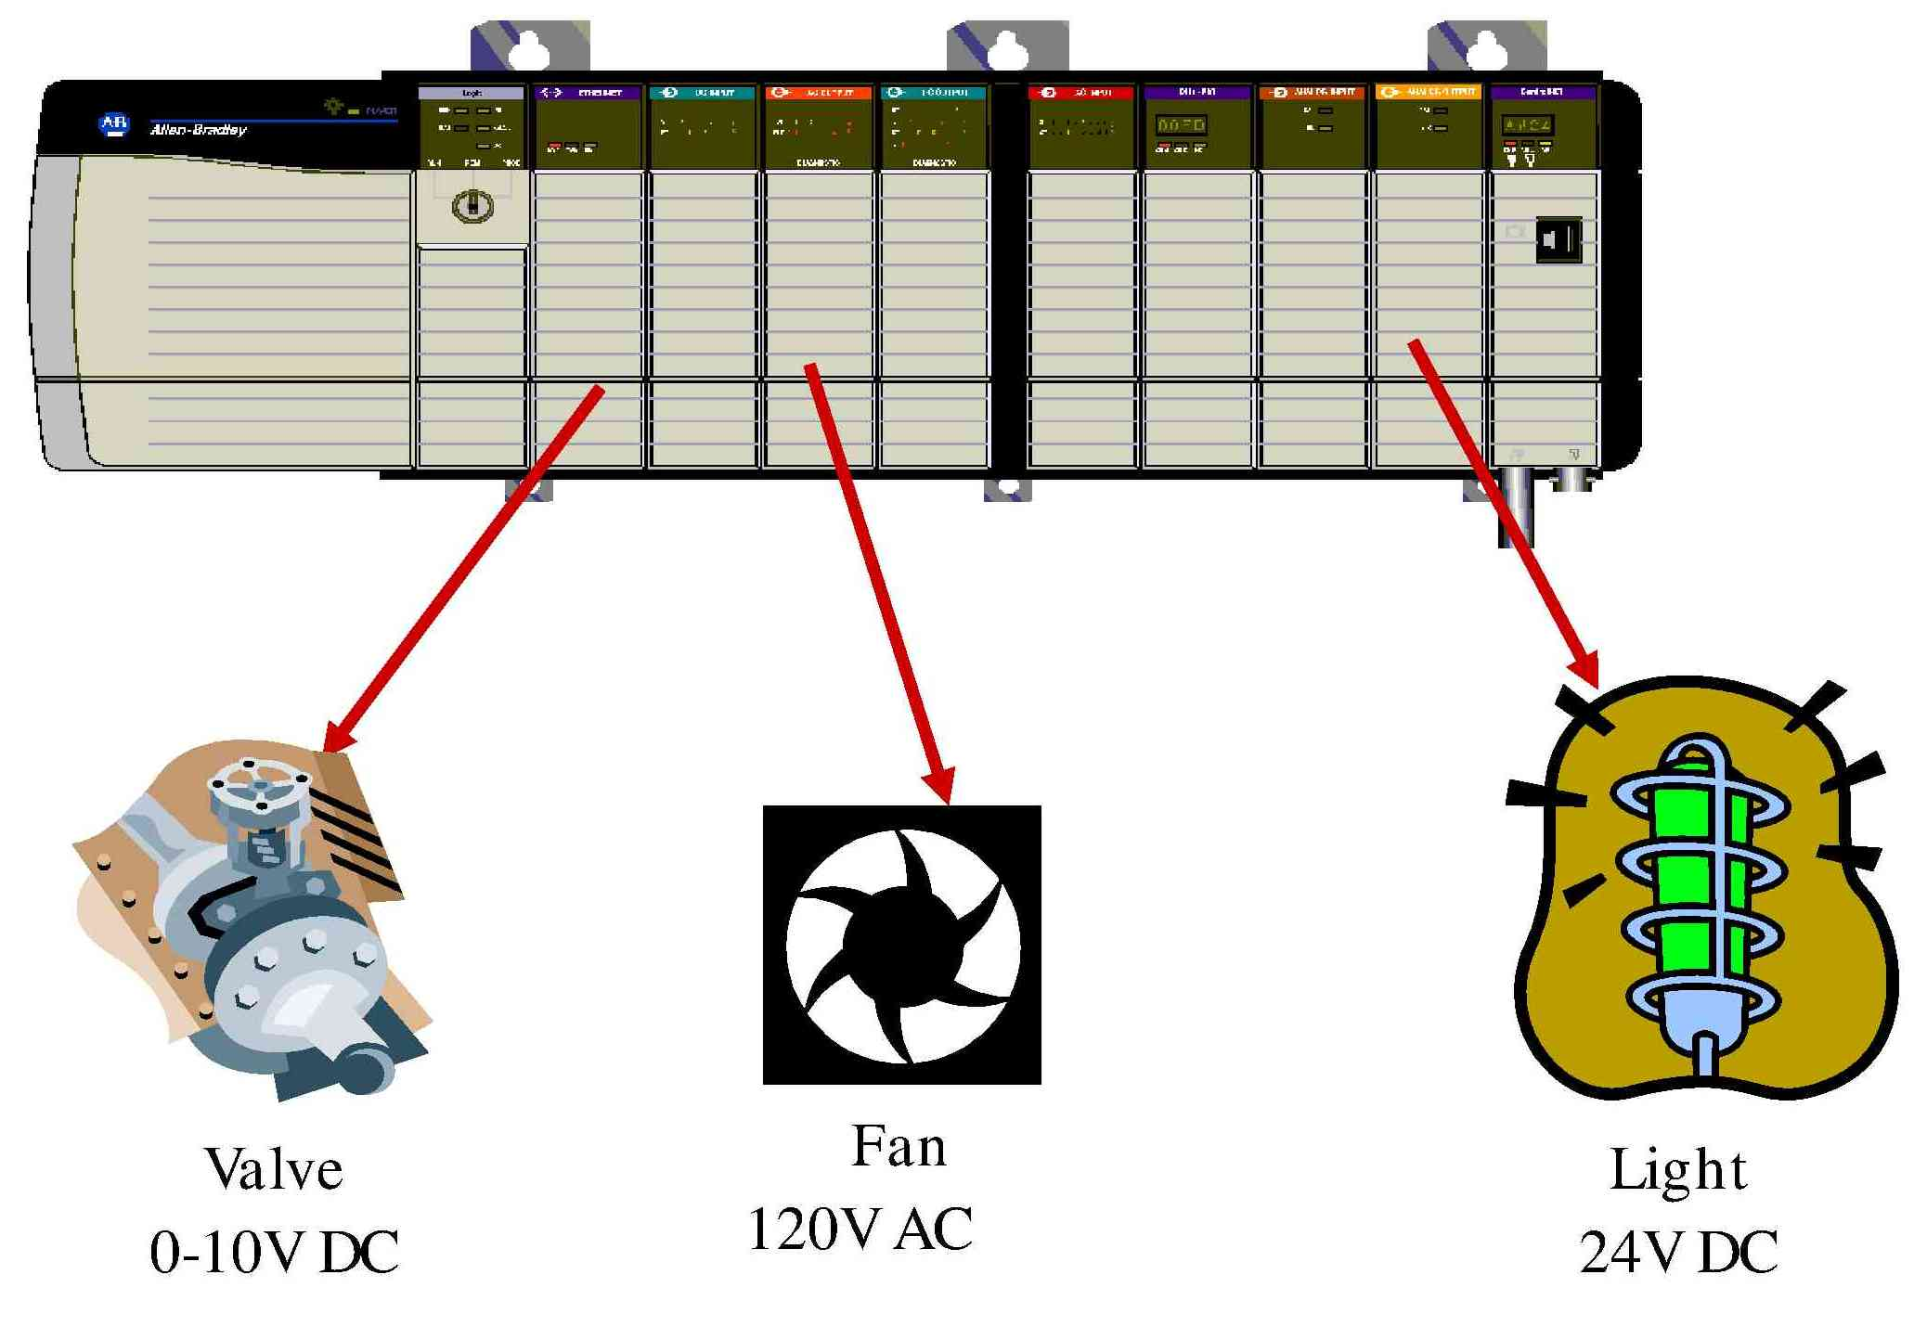
Output Modules
Output modules take a signal from a PLC and convert it to a signal that a field device needs to operate. Since there are different types of output devices, there is a wide variety of output cards available, including both digital and analog cards.

Slide 21
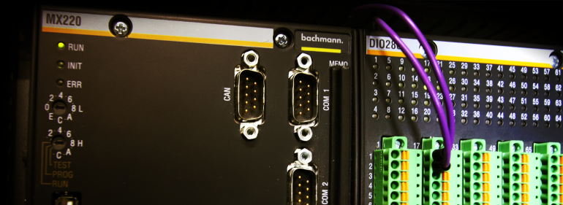
Digital/Analog Modules
Digital input modules adapt digital signals e.g. from proximity sensors.
Digital output modules convert the internal signal level of PLC into digital process signals e.g. relays.
Analog input modules adapt analog process signals e.g. from transducers.
Analog output modules convert internal digital values of the PLC to analog process signals e.g. temperature controller.

Slide 22
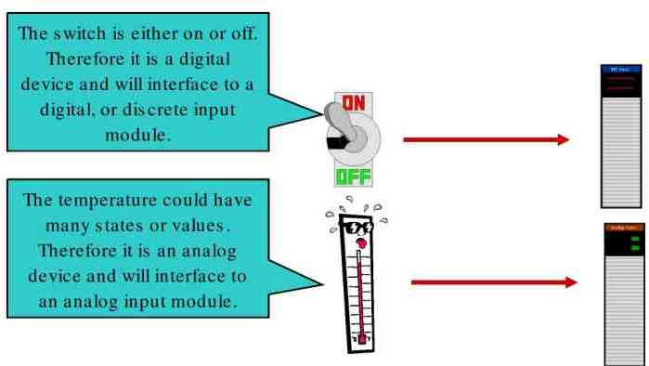
Digital and Analog
Digital modules use only a single bit to represent the state of the device. For example, a switch is either open or closed. Therefore, the bit is either a 0 (switch is open) or a 1 (switch is closed).
Analog modules use words to represent the state of a device. An analog signal represents a value.. For example, the temperature could be 5, 9, 20, 100, etc degrees. Analog modules use a value, such as 52, rather than a 0 or 1 to represent the state of the device.

Slide 23

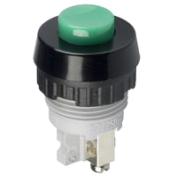


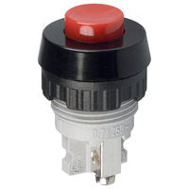
Inputs and Outputs
OUTPUTS
INPUTS
MOTOR
CONTACTOR
LAMP
PUSHBUTTONS
PLC

Slide 24
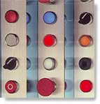
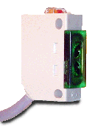

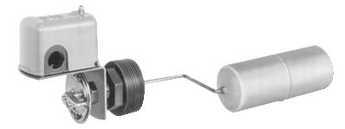
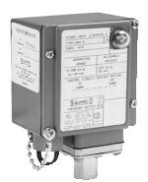

What are Inputs?
Switches and Pushbuttons
Sensing Devices
  Limit Switches
  Photoelectric Sensors
  Proximity Sensors
Condition Sensors
  Pressure Switches
  Level Switches
  Temperature Switches
  Vacuum Switches
  Float Switches
  Encoders

Slide 25
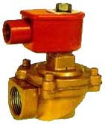
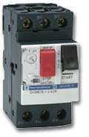
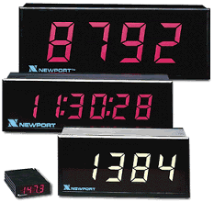
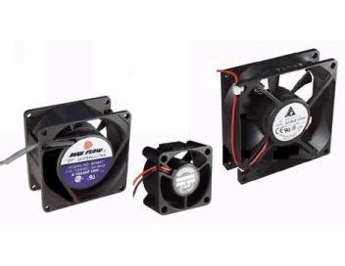
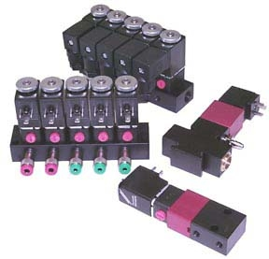
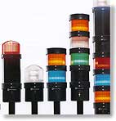
What are Outputs?
Valves
Motor Starters
Solenoids
Actuators
Control Relays
Horns & Alarms
Stack Lights
Fans
Counter
Pumps
Printers

Slide 26
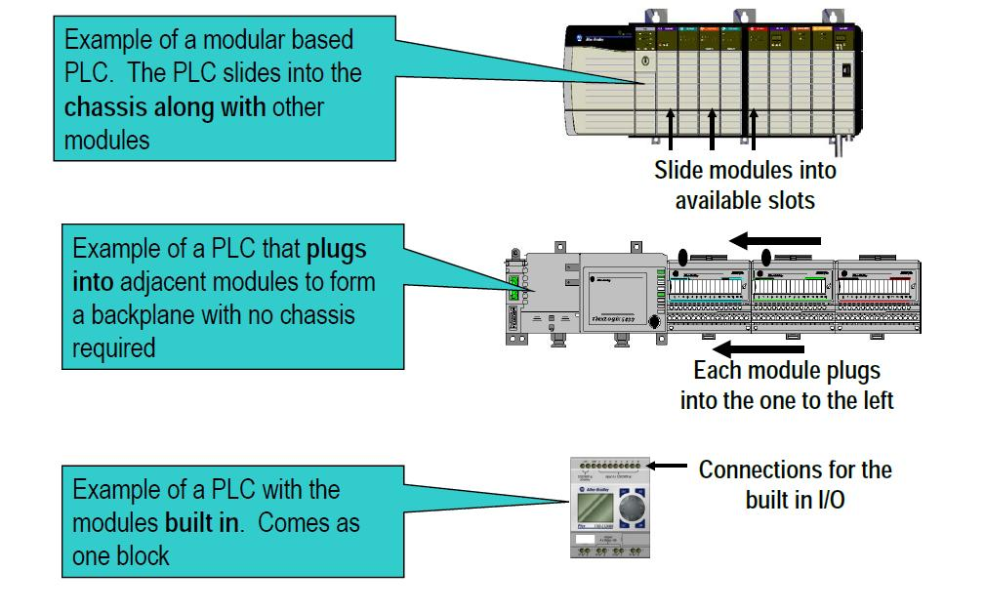
Chassis and Backplane
All PLCs need some method of communicating between the controller, I/O and communications modules. Here are three ways used to accomplish this communications between the various components that make up the PLC system.

Slide 27
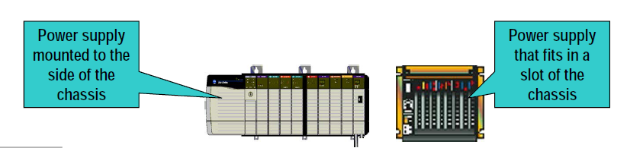
Power Supply
A power supply is needed to provide power to the PLC and any other modules. Power supplies come in various forms:
• Power supply modules that fit into one of the slots in a chassis
•External power supplies that mount to the outside of a chassis
•Stand alone power supplies that connect to the PLC or I/O
through a power cable
•Embedded power supplies that come as part of the PLC block.

Slide 28
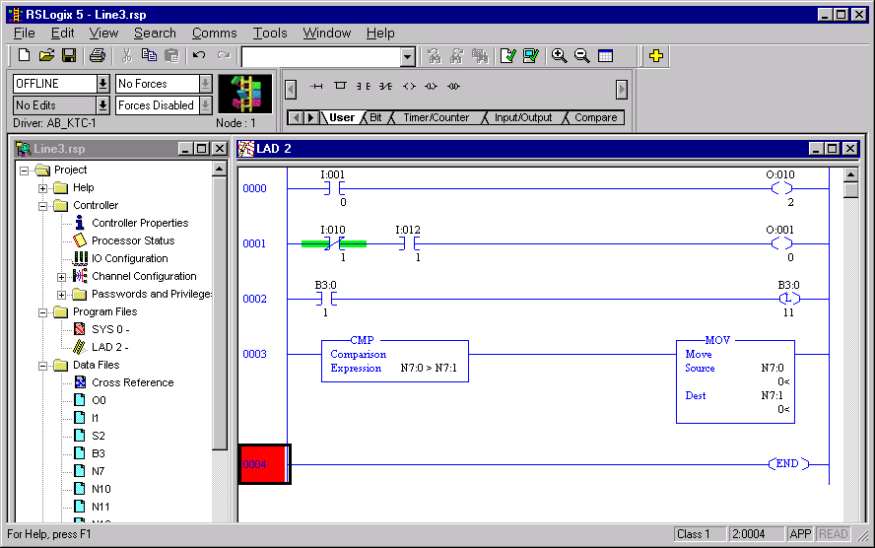
Programming Software
Software that runs on a PC is required to configure and program PLCs
Different products may require different programming software.
Software allows programs to be written in several different languages.

Slide 29

Types of Programme Memory
Program memory
Programmable
(Read-write memory)
Non-programmable
Non-alterable
ROM / PROM
Alterable
UV erasable
EPROM / REPROM
Electrically erasable
EEPROM / EAPROM
Semiconductor RAM
Semiconductor
EEPROM / EAPROM

Slide 30
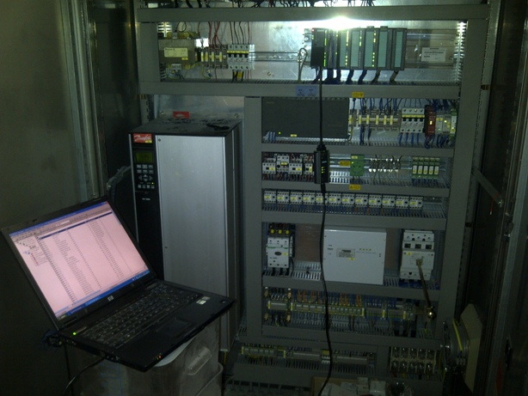
PLC Requirements
List of items required when working with PLCs:
Programming Terminal - laptop or desktop PC.
PLC Software. PLC manufacturers have their own specific software and license key.
Communication cable for connection from Laptop to PLC.
Backup copy of the ladder program (on diskette, CDROM, hard disk, flash memory). If none, upload it from the PLC.
Documentation- (PLC manual, Software manual, drawings, ladder program printout, and Seq. of Operations manual.)

Slide 31
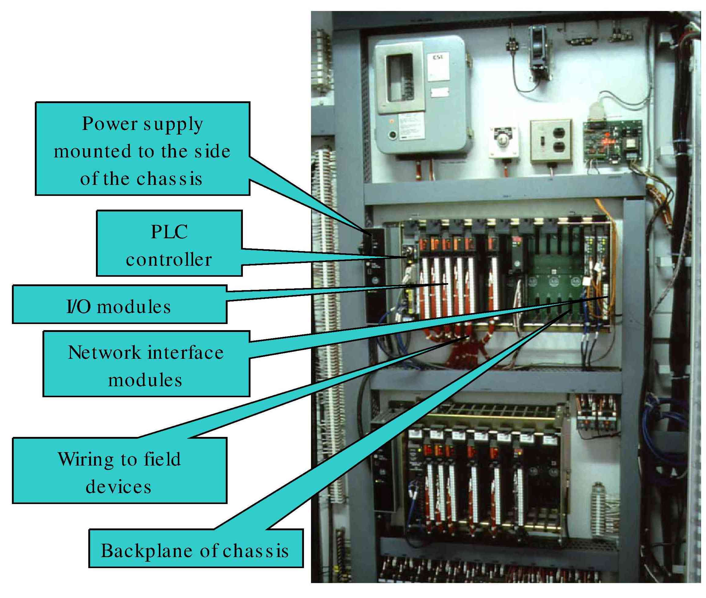
PLC Control Panel

Slide 32
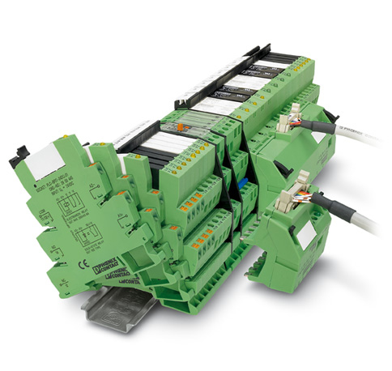
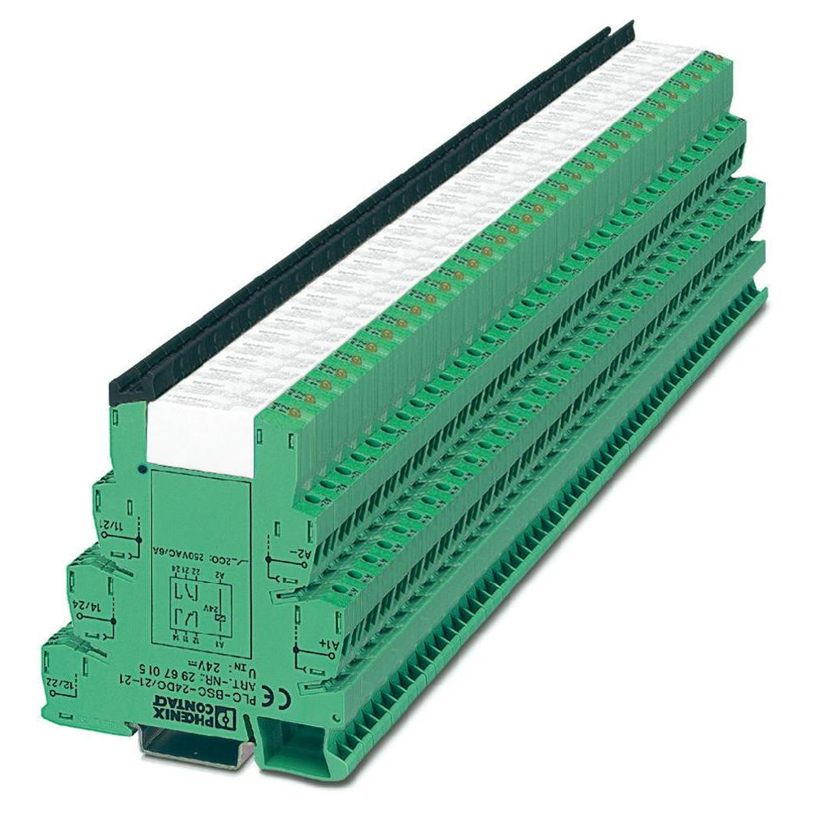
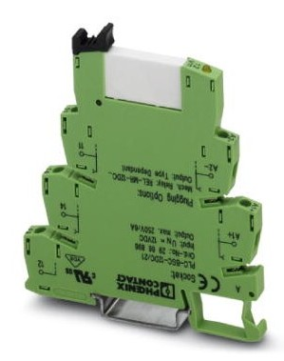
PLC Relay

Slide 33
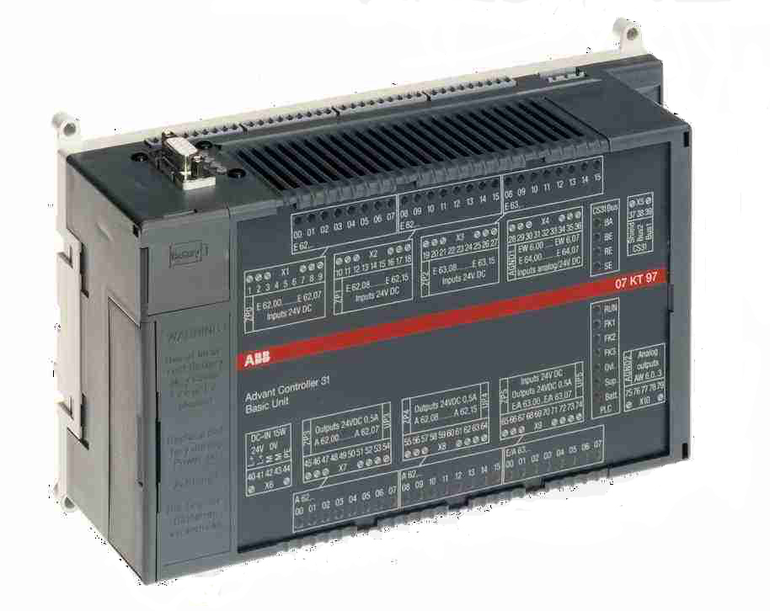
Simple PLC
network
digital inputs
analog inputs / outputs
digital outputs

Slide 34
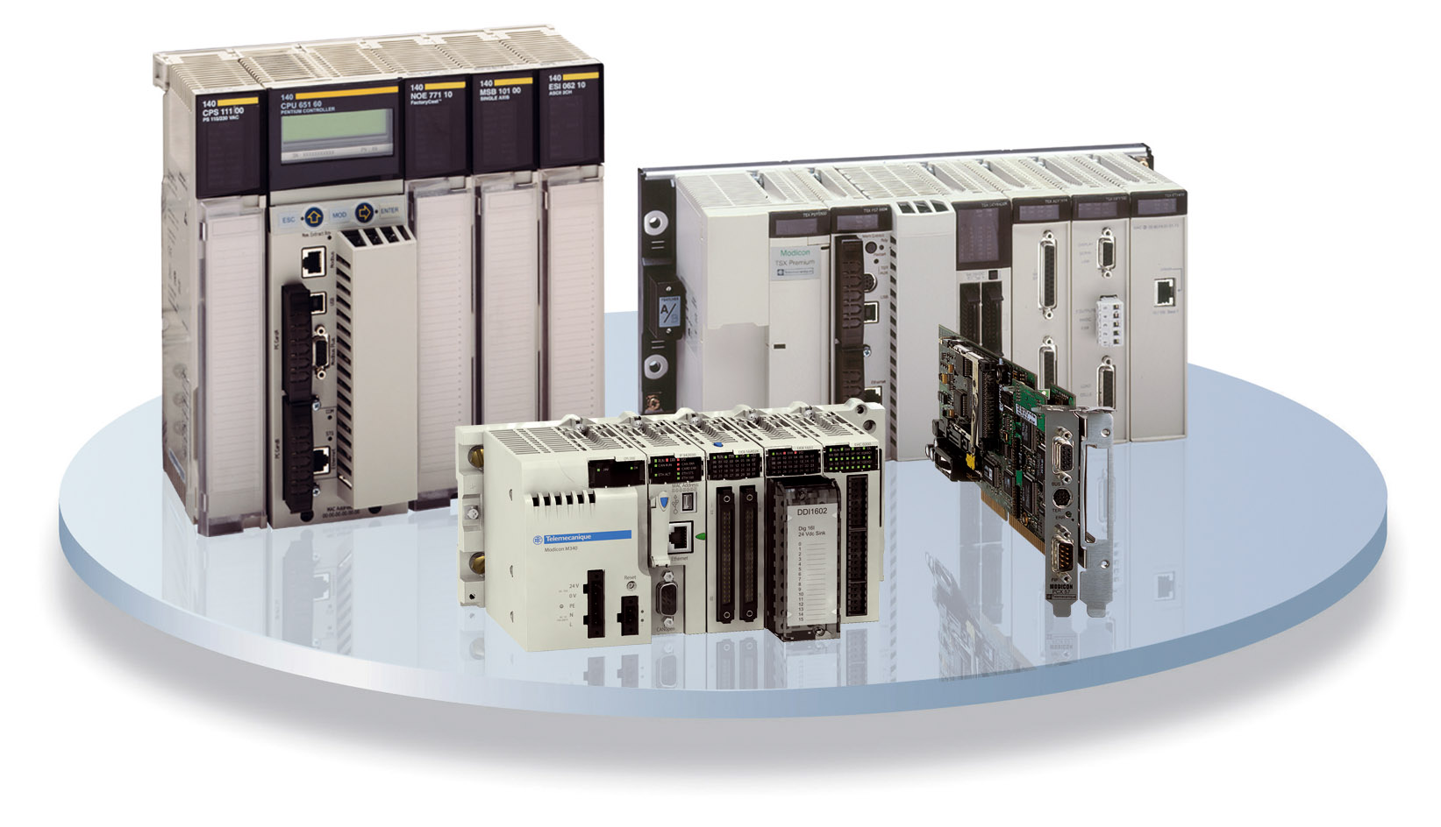
PLC Advantages
Handles much more complicated
systems.
Less and simple wiring.
Increased Reliability.
More Flexibility.
Lower Cost .
Faster Response.
Easier to troubleshoot.
Remote control capability.
Communication Capability.

Slide 35

PLC Disadvantages
In contrast to microcontroller systems that have what is called an open architecture, most PLCs manufacturers offer only closed architectures for their products .
PLC devices are proprietary, which means that parts and software from one manufacturer can ‘t easily be used in combination with parts of another manufacturer, which limits the design and cost options.
PLC were Designed for Relay Logic Ladder and have Difficulty with some Smart Devices.
To maximize PLC performance and Flexibility, a number of Optional Modules must be added

Slide 36
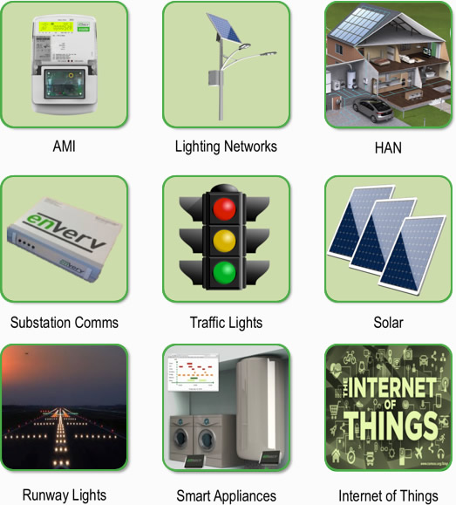
PLC Applications
Originally hardwired arrays of relays were used to control the operation of heavy machines that contain motors and other high power devices.
PLCs were originally used to substitute the switching relay networks used in industrial applications, but now they can also be used implement other tasks such as timing, delaying counting, calculating, comparing and processing of analog signals.

Slide 37
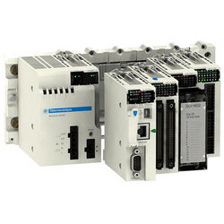
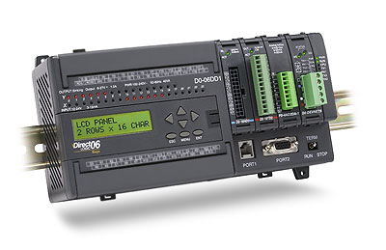
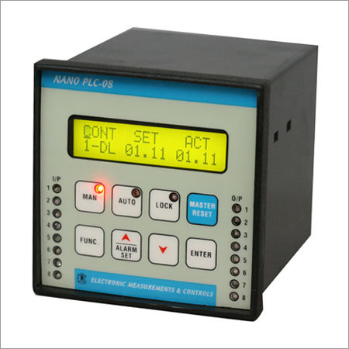
PLC Size
SMALL - It covers units with up to128 I/O’s and memories up to2 Kbytes.
- These PLC’s are capable of providing simple to advance levels or
machine controls.
MEDIUM- Have up to 2048 I/O’s and memories up to 32 Kbytes.
LARGE - The most sophisticated units of the PLC family. They have up to
8192 I/O’s and memories up to 750 Kbytes.
- Can control individual production processes or entire plant.

Slide 38
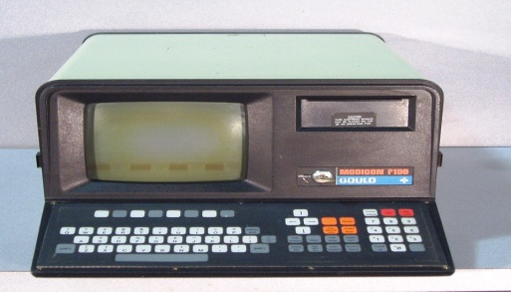
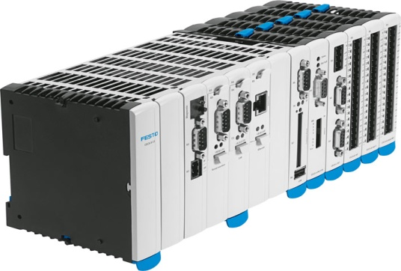
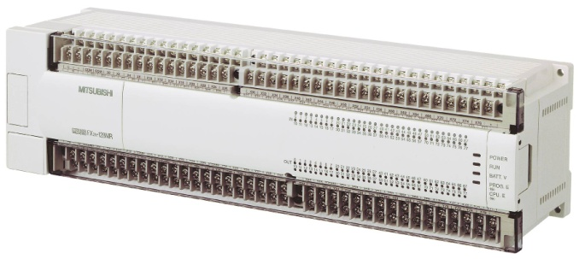
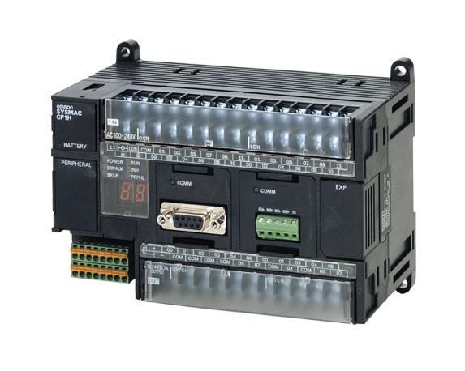
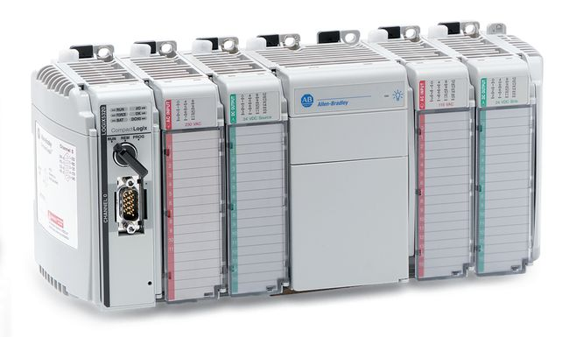
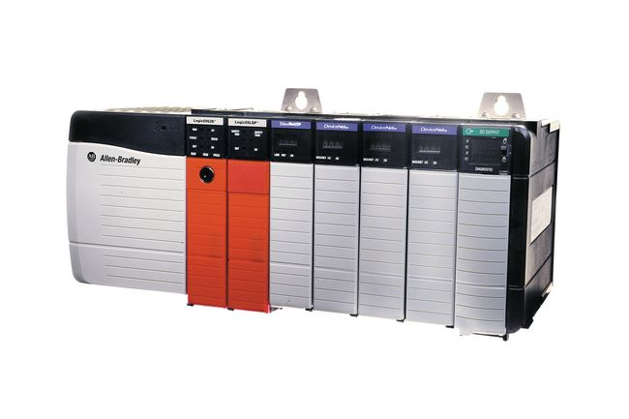

Leading Brands of PLC
AMERICAN:
Allen Bradley
Gould Modicon
Texas Instruments
General Electric
Westinghouse
Cutter Hammer
Square D
EUROPEAN:
Siemens
Klockner & Mouller
Festo
Telemechanique
JAPANESE:
Toshiba
Omron
Fanuc
Mitsubishi

Slide 39


Thank You!
Thank You!

