Slide 1
PLC & SCADA
RATNESH VERMA
1509720042
EE(3rd Year)

Slide 2

What is AUTOMATION
Making products under the control of computers and
programmable controllers is known as automation.
Manufacturing assembly lines as well as stand alone machine
tools and robotic devices fall into this category.
It is delegation of human control functions to technical equipment for increasing the productivity, quality, and increasing the safety in working conditions thereby reducing the manpower and cost.

Slide 3
INSUSTRIAL AUTOMATION
Now a days, every small and large industry employ automation.
In manual control, an operator periodically reads the process and adjusts the input accordingly. Quite hectic!
In automation control, measurements and adjustments are done automatically on a continuous basis. Quite convenient!

Slide 4
Types of Control Systems used in INDUSTRIAL AUTOMATION
PID controller based control system
PLC based control system
DCS based control system
PC based control system

Slide 5
PLC(Programmable Logic Controller)
It is microprocessor based solid state/industrial computer that perform discrete or sequential logic.
It was developed to replace mechanical relays, timers, counters.
The early PLC’s were used to reduce the changeover time, wiring/re-wiring.
PLC works on 24V DC and I/O devices that are directly connected to PLC also works on 24V DC.
To connect it with AC devices we use relay and transistor

Slide 6
Brands of PLC’s
Panasonic
Allen Bradley
Delta
Omron
Siemense
Keyence
Schnieder
Mitshubishi

Slide 7
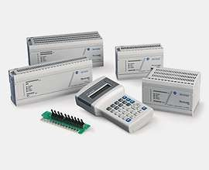
Different types of programmable controller

Slide 8
Types of PLC
Fixed/Compact type
Expansion is not possible
Fixed number of I/O ports
Memory up to 2kb
Maximum 248 I/O ports are possible
Modular type
Expansion is possible
Serial expansion
Memory up to 32kb
Maximum 2048 I/O ports are possible
Rack type
Expansion is possible
Parallel expansion
Maximum 16000 I/O ports are possible
Memory up to 2mb

Slide 9
Architecture of a PLC
BLOCK DIAGRAM
(24V DC, 120V AC)
POWER
SUPPY
(Toggle or Push buttons, proximity or pressure sensors)
INPUT DEVICES
PLC
OUTPUT DEVICES
(Displays & Monitors)
MEMORY
INTERFACE
(SCADA or HMI)
(External memory module)

Slide 10
PROGRAMMING the PLC
Programming language used:
LADDER language- The programming can be done with simple contacts that simulate the opening and closing of relays, counters, timers, shift registers and other math operations.

Slide 11
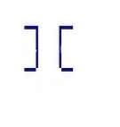
START- STOP LOGIC:
START:
hardware software
NO-
NC-
STOP: NO-
NC-

Slide 12
Software for the Programing of Allen Bradley PLC
RSLinx Classic( Driver Software)
RSLogix 500 English(Programing Software)
RS Logix Emulate 500(Simulation Software)

Slide 13
Advantages
Reliability in operation.
Flexibility in control and programming techniques.
Online offline modifications.
Small physical size, shorter project time.
In house simulation and testing of project.
Speed of operation.
Ease of maintenance and troubleshooting.
Ability to communicate and networking with computer system in plant.
Documentation and security.
Designed to work in all types of industrial conditions.

Slide 14

Applications
Material Handling
Packaging Applications
General Industrial Machinery
Printing
Food and Beverage
Pharmaceutical
Water Wastewater / SCADA
Clutch/Brake control
Position Control - Pick-and-place / Conveyor

Slide 15

SCADA
Supervisory Control And Data Acquisition
It is a software through which we can create visualization of any industrial process.
Earlier, PLC’s were programmed, download the program in it and it used to run for years
The problem- no one knew what’s happening inside the PLC.
Solution= PLC+SCADA

Slide 16
FEATURES OF SCADA
Alarm
Real time trend and historical trend view
Security
Device connectivity

Slide 17
SCADA Software
Wonderware- Intouch
Rockwell- RS view32
Siemens- winCC
GE- Intellation

Slide 18
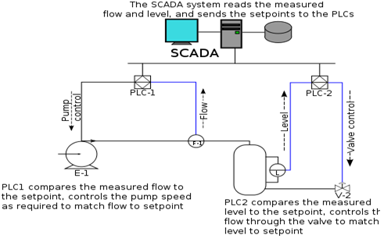
Application of SCADA

Slide 19
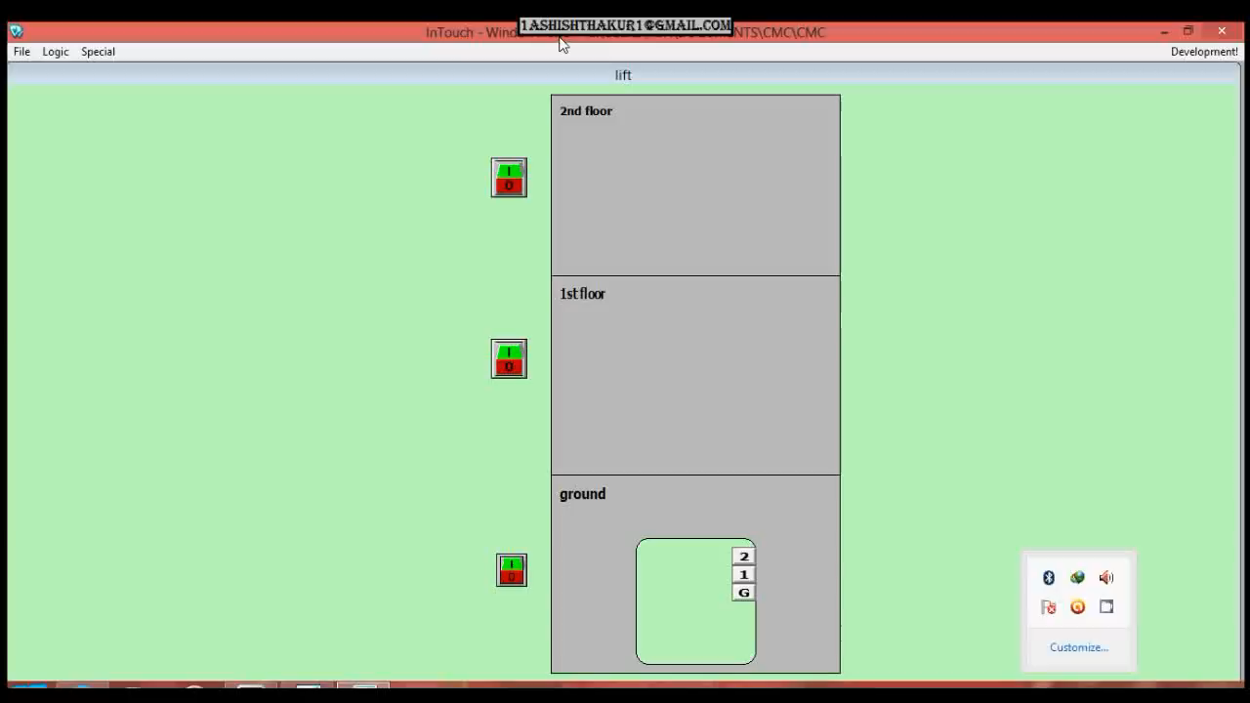
Application of SCADA

Slide 20
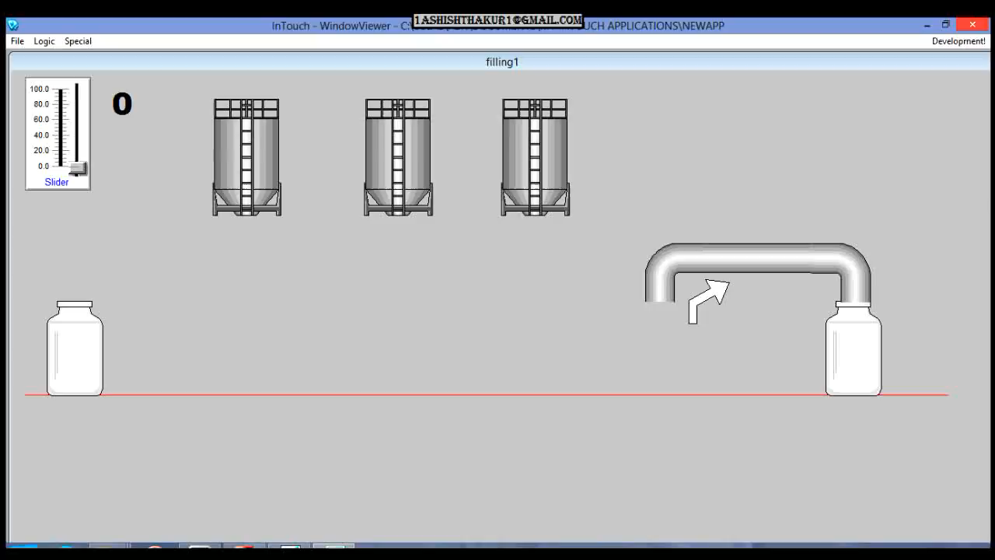
Bottle Filling

Slide 21
THANK YOU !!!

