Slide 1
PLC
Application Exercises

Slide 2

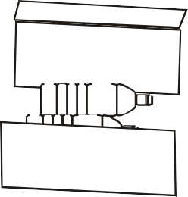
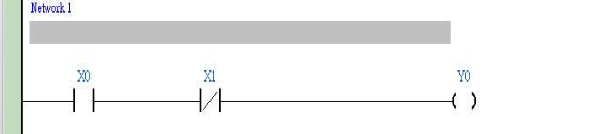
1. Basic Program Design Examples
1.1 Normally Closed Contact in Series Connection
Y0
X1 X0
Control Purpose:
Detecting the standing bottles on the conveyor and pushing the fallen bottles out
Devices:
Device | Function
X0 | X0 = ON when the detected input signal from the bottle-bottom is sheltered.
X1 | X1 = ON when the detected input signal from the bottle-neck is sheltered.
Y0 | Pneumatic pushing pole
Control Program:
Program Description:
If the bottle on the conveyor belt is upstanding, the input signal from monitoring photocell at both bottle-bottom and bottle-neck will be detected. In this case, X0 = ON, and X1 = ON. The normally open (NO) contact X0 will be activated as well as the normally closed (NC) contact X1. Y0 remains OFF and pneumatic pushing pole will not perform any action.
If the bottle from the conveyor belt is down, only the input signal from monitoring photocell at the bottle-bottom will be detected. In this case, X0 = ON, X1 = OFF. The state of output YO will be ON because the NO contact X0 activates and the NC contact X1 remains OFF. The pneumatic pushing pole will push the fallen bottle out of the conveyor belt.
DVP-PLC Application Examples
1-1

Slide 3
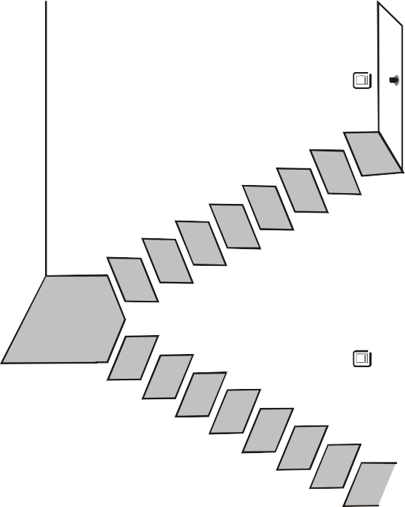
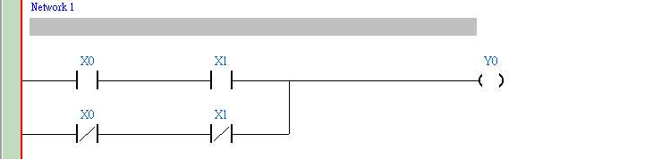
1. Basic Program Design Examples
1.2 Block in Parallel Connection
Y0
X1
X0
Control Purpose:
Setting up a lighting system for users to switch on/off the light whether they are at the bottom or the top of the stairs.
Devices:
Device | Function
X0 | X0 turns ON when the bottom switch is turned to the right
X1 | X1 turns ON when the top switch is turned to the right.
Y1 | Stair light
Control Program:
Program Description:
If the states of the bottom switch and the top switch are the same, both ON or OFF, the light will be ON. If different, one is ON and the other is OFF, the light will be OFF.
When the light is OFF, users can turn on the light by changing the state of either top switch at the bottom switch of the stairs. Likewise, when the light is ON, users can turn off the light by changing the state of one of the two switches..
1-2
DVP-PLC Application Examples

Slide 4
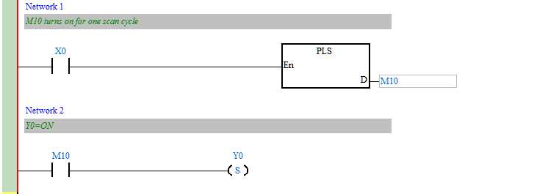
1. Basic Program Design Examples
1.3 Rising-edge Pulse Output for One Scan Cycle
Control Purpose:
Creating a pulse of one program scan cycle as the condition to trigger the indicator or other devices when the switch (X0) is turned on.
X0
M10
One scan cycle
Y0
Devices:
Device | Function
X0 | Switch )
M10 | Creating a trigger pulse for one program scan cycle
Y0 | Indicator
Control Program:
Program Description:
When X0 is turned on (Rising-edge triggered), PLS instruction will be executed, and M10 will send a pulse for one program scan cycle.
When M10 = ON, [SET Y0] instruction will be executed and Y0 will be ON. In this case, the indicator will be lighted, and other devices will be activated as well.
DVP-PLC Application Examples
1-3

Slide 5

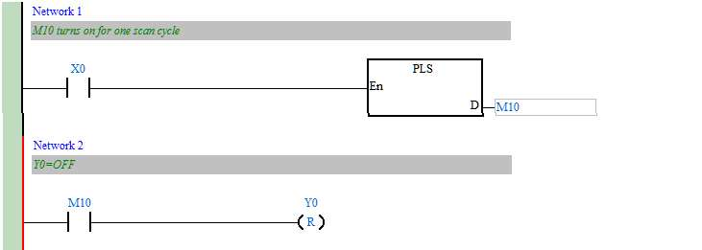
1. Basic Program Design Examples
1.4 Falling-edge Pulse Output for One Scan Cycle
X0
Y0(Electromagnetic valve)
Control Purpose:
Creating a pulse of one program scan cycle as the condition to trigger the electromagnetic valve or other devices when the switch is turned off.
X0
M10
Y0
Devices:
One scan cycle
Device | Function
X0
M10 | Creating a trigger pulse for one program scan cycle
Y0 | Electromagnetic valve
Control Program:
Program Description:
When X0 is turned on (Falling-edge triggered), PLF instruction will be executed, and M10 will send a pulse for one program scan cycle.
When M10 = ON, [RST Y0] instruction will be executed and Y0 will be OFF. In this case, the electromagnetic valve will be shut down.
1-4
DVP-PLC Application Examples

Slide 6

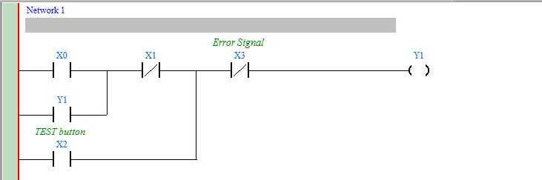
1. Basic Program Design Examples
1.5 Latching Control Circuit
Y0
X0
START
X1
STOP
X2
TEST
Control Purpose:
Controlling the running state of the ceiling-fan by pressing START and STOP. Checking if the ceiling-fan is running normally by pressing TEST.
Devices:
Device | Function
X0 | Press START, X0 = ON.
X1 | Press STO, X1 = ON.
X2 | Press TEST, X2 = ON.
X3 | Error signal
Y1 | Ceiling-fan motor control signal
Control Program:
Program Description:
Press START lightly and X0 = ON. The ceiling-fan will keep running if no error occurred (X3
= OFF). The action can be practiced by a latching circuit which takes output Y1 as one of the input condition to keep the fan running even if the START button is not pressed.
When STOP is pressed, X1 = ON and Y1 = OFF. The ceiling-fan will stop running. If error occur (X3 = ON), Y1 will be OFF and the ceiling-fan will stop running.
When TEST is pressed (X2 = ON), Y1 = ON. The ceiling-fan will start running if no error occurred (X3 = OFF). On the contrary, when TEST is released, the ceiling-fan will stop running. The testing function is performed by this process.
DVP-PLC Application Examples
1-5

Slide 7



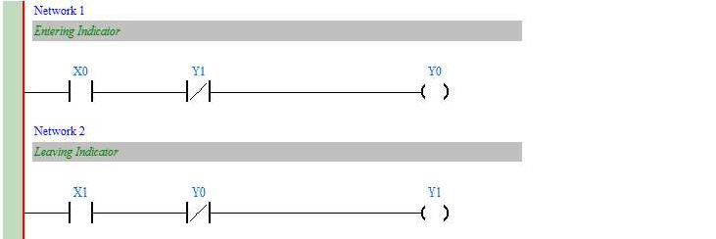
1. Basic Program Design Examples
1.6 Interlock Control Circuit
Y1
Y0
X0
X1
Control Purpose:
The Entry/Exit of the parking lot is a single lane passage. By controlling the indicators, the program ensures that only one car can pass through the Entry/Exit so as to prevent car accident between entering and leaving cars
Devices:
Device | Function
X0 | Car entering sensor. When a car passes through the sensor, X0 = ON.
X1 | Car leaving sensor. When a car passes through the sensor, X1 = ON.
Y0 | Entering car indicator ON means “GO”, OFF means “STOP”
Y1 | Leaving car indicator ON means “GO”, OFF means “STOP”
Control Program
Program Description:
In the parking lot, there are two indicators individually directing the entering and leaving cars. By the interlock control circuit, only one indicator will show “GO” signal and the car accident will thus be prevented.
When an entering car draws near the vehicle control barrier, X0 will be ON and so will Y0. The entering car indicator will show “GO”. At the same time, the leaving car indicator will show “STOP.” Car entering is allowed but leaving is prohibited in this case.
1-6
DVP-PLC Application Examples

Slide 8
1. Basic Program Design Examples
When a leaving car draws near the vehicle control barrier, X1 will be ON and so will Y1. The leaving car indicator will show “GO” and the entering car indicator will show “STOP.”
DVP-PLC Application Examples
1-7

Slide 9
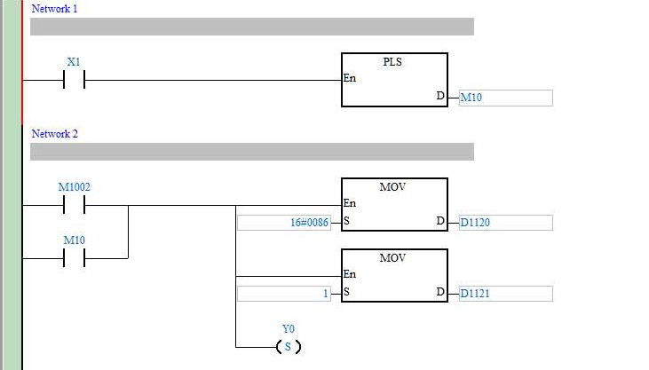
1. Basic Program Design Examples
1.7 Automatic Parameter Initialization When Powered Up
X1
Initialization button
Control Purpose:
When the machine is powered up, all the parameters will be initialized automatically and the machine will be ready. Users don’t need to set the parameters manually.
Users can initialize parameters by pressing Initialization button at any time when the machine is running.
Devices:
Device | Function
X1 | Initialization button. X1 will be ON when pressed
M1002 | Creating a pulse when PLC is powered on
M10 | Creating a trigger pulse for one scan cycle
D1120 | PLC COM2 communication protocol
D1121 | PLC communication address
Y0 | Parameter initialization completed signal
Control Program:
1-8
DVP-PLC Application Examples

Slide 10
1. Basic Program Design Examples
Program Description:
When PLC begins running, M1002 will be ON once and create a pulse with the width of one scan cycle. This action will be executed for just once during the PLC running process and is generally used to initialize devices such as D (data register), C (counter) and S (step point) By pressing X1, users can initialize parameters at any time during the program running process, that is, setting PLC Slave ID as No. 1, COM2 communication format as 9600, 7, E, 1 and Y0 to be ON.
DVP-PLC Application Examples
1-9

Slide 11
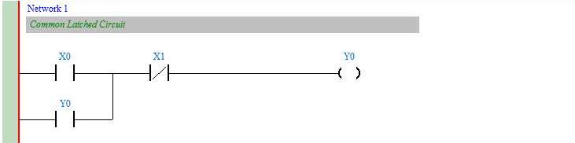
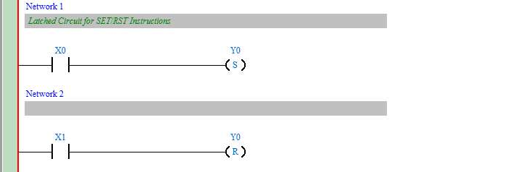
1. Basic Program Design Examples
1.8 Common Latched Circuit and SET/RST Instructions Application
Control Purpose:
Turn on the switch, the light will be ON; turn off the switch, the light will be OFF.
Devices:
Device | Function
X0 | Switch-on button. X0 will be ON when pressed
X1 | Switch-off button. X1 will be ON when pressed
Y0 | Indicator
Control Program:
Common Latched Circuit
Latched Circuit for SET/RST Instructions
Program Description:
In the above examples, when X0 goes from OFF to ON, Y0 will stay in ON state. When X1 goes from OFF to ON, Y1 will stay in OFF state
When X0 and X1 are enabled at the same time, it will be “Stop First”, that is, Y1 and the indicator will be OFF.
1-10
DVP-PLC Application Examples

Slide 12
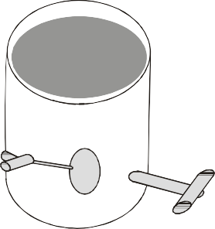

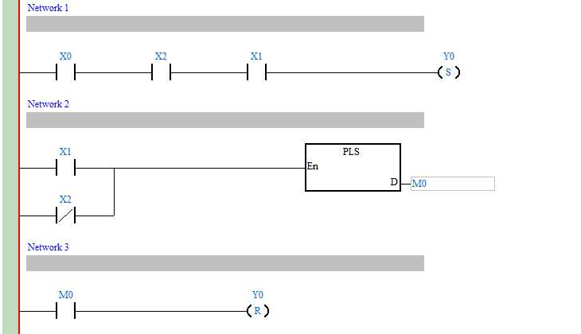
1. Basic Program Design Examples
1.9 SET/RST - Latched and Unlatched Circuit
X0
START
X1
STOP
X2
Y0
Control Purpose:
Press START, the pump begins to pump out the water; press STOP or when the water is empty, the pump stops working.
Devices:
Device | Function
X0 | START button. X0 will be ON when pressed
X1 | STOP button. X1 will be ON when pressed
X2 | Level detector. X2 will be ON if there is water in the container
M0 | Trigger pulse for one scan cycle
Y0 | Pump motor
Control Program:
Program Description:
X2 will be ON If there is water in the container. When START is pressed, X0 = ON, and SET instruction will be executed. Y0 will be set, and the pump motor begins pumping the water.
There are two situations for stopping the motor. First, when STOP is pressed, X1 = ON. PLS instruction will be executed and M0 will be ON for one scan cycle. RST instruction will thus
DVP-PLC Application Examples
1-11

Slide 13
1. Basic Program Design Examples
be executed, and Y0 will be reset to stop pumping. Second, when the water in the container is empty, X2 will be OFF and PLS instruction will be executed to trigger M0 for resetting Y0. In this case, the pump motor will stop pumping as well.
1-12
DVP-PLC Application Examples

Slide 14
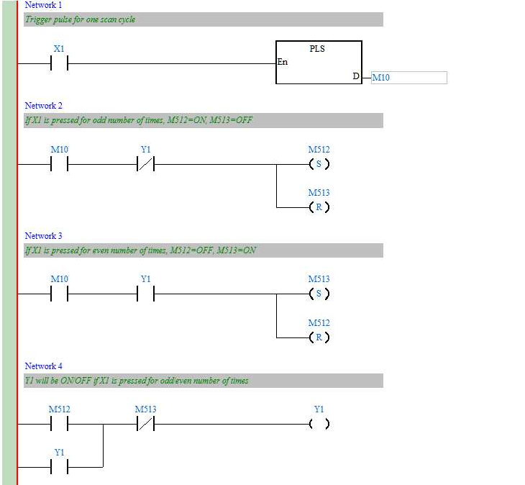
1. Basic Program Design Examples
1.10 Alternate Output Circuit (With Latched Function)
Control Purpose:
Setting the light ON by pressing the switch for the 1st time, the 3rd time, 5th time, etc.; setting the light OFF by pressing the switch for the 2nd time, 4th time, 6th time, etc.
Restoring the indicator to the state before power off when the device is powered up again.
Devices:
Device | Function
X1 | Light switch. X1 will be ON when the button is pressed
M10 | Trigger pulse for one scan cycle
M512 | If X1 is pressed for odd number of times, M512 ON, M513 = OFF.
M513 | If X1 is pressed for even number of times, M512 = OFF, M513 = ON.
Y1 | Indicator
Control Program:
Program Description:
Pressing X1 for the 1st time (or odd number of times):
DVP-PLC Application Examples
1-13

Slide 15
1. Basic Program Design Examples
When the switch X1 is pressed, X1 will be ON and the [PLS M10] instruction will be executed for triggering M10 to be ON for one scan cycle. In this case, M10 is ON and Y1 is OFF, SET and RST instructions at line 2 will thus be executed. On the contrary, SET and RST instructions at line 3 will not be executed due to the open loop of Y1. At line 4, coil Y1 is ON because of the results of Line 2: M512 is ON and M513 is OFF. When the 2nd scan cycle is started, SET/RST at both line 2 and line 3 will not be executed because M10 is OFF in this scan cycle. As a result, the light will be ON until the switch is pressed next time.
Pressing X1 for the 2nd time (or even number of times):
When the switch X1 is pressed again, X1 will be ON and M10 will be ON for one scan cycle. According to the result of pressing X1 for the first time, the state of Y1 has been ON.
SET/RST instructions at line 3 will thus be executed. In addition, SET/RST instructions at line 2 won’t be executed due to the open loop of Y1. In this case, M513 will be ON and M512 will be OFF. When the 2nd scan cycle is started, SET/RST at both line 2 and line 3 will not be executed because M10 is OFF in this scan cycle. As a result, the light will remain OFF until the switch is pressed next time.
Alternate output(ON/OFF) function can also be performed by using API 66 ALT instruction
1-14
DVP-PLC Application Examples

Slide 16
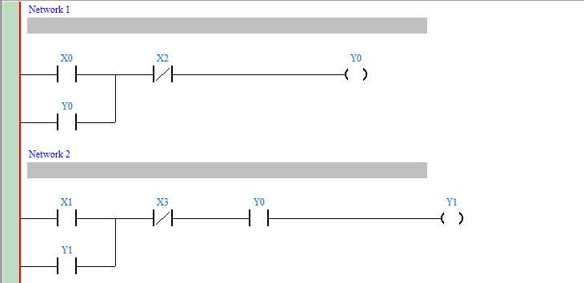
1. Basic Program Design Examples
1.11 Conditional Control Circuit
Y0
X0 X2
START STOP
Oil Pump Motor
Oil Pump Motor
X1 X3
START STOP
Y1
Main Motor
Main Motor
Control Purpose:
Providing lube for the gear box before the lathe spindle starts to run which aims to ensure that the oil pump motor starts first and the main motor starts subsequently.
Devices:
Device | Content
X0 | Oil pump START button. X0 will be ON when pressed.
X1 | Main motor START button. X0 will be ON when pressed.
X2 | Oil pump STOP button. X2 will be ON when pressed.
X3 | Main motor STOP button. X3 will be ON when pressed.
Y0 | Oil pump motor
Y1 | Main motor
Control Program:
Program Description:
This program is a typical application of the conditional control circuit. Y0 = ON when Oil Pump START button is pressed. Therefore, the oil pump will start to provide lube for the gear box of main motor(Y1)
DVP-PLC Application Examples
1-15

Slide 17
1. Basic Program Design Examples
Under the precondition of the operating state of the Oil pump, the main motor (Y1) will be ON when the Main motor START button is pressed.
During the operation of main motor (Y1), oil pump (Y0) needs to provide lube continuously. The oil pump will be stopped when Oil pump STOP button X2 is activated, and the main motor will be stopped when Main motor STOP button X3 is activated.
1-16
DVP-PLC Application Examples

Slide 18




1. Basic Program Design Examples
1.12 First-in Priority Circuit
X0 Y0 X1
X2 Y1
X3 Y2 X4
Pupil Group
High School Student Group
Professor Group
X5
Host
Control Purpose:
There are 3 groups participating in the quiz game: pupils, high school students and professors. If they want to get the chance of answering the question from the host, they
must press the answer button on their table first. Other groups’ pressing will be invalid if any group gets the chance successfully
There are 2 answer buttons for the pupil group and professor group and 1 answer button for the high school student group. In order to give preferential treatment to the pupil group, Y0 will be ON if any one of X0 or X1 is pressed. However, in order to limit the professor group, Y2 will be ON when X3 and X4 are pressed at the same time. For the high school student group, Y1 will be ON when X2 is pressed.
If the host presses X5 (Reset button), Y0, Y1 and Y2 will be OFF.
Devices:
Device | Function
X0 | Answer button for pupil group
X1 | Answer button for pupil group
X2 | Answer button for high school student group
X3 | Answer button for professor group
X4 | Answer button for professor group
X5 | Reset button for host
Y0 | Indicator for pupil group
Y1 | Indicator for high school student group
Y2 | Indicator for professor group
Control Program:
DVP-PLC Application Examples
1-17

Slide 19
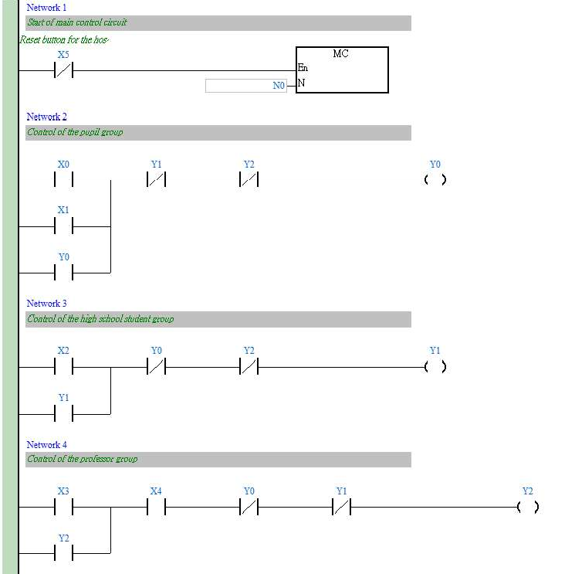
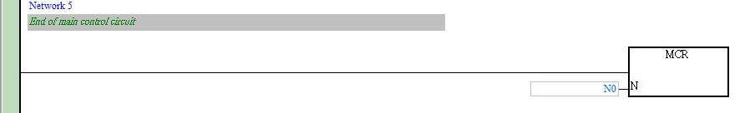
1. Basic Program Design Examples
Program Description:
If the host didn’t press the reset button X5, [MC N0] instruction will be executed and the program between MC and MCR will also be executed normally.
The answer buttons are connected in parallel connection for the pupil group, and in series connection for the professor group. For the high school student group, there is only one answer button. If one group presses the answer button successfully, its indicator will form a latching circuit, that is, the indicator will be ON even the button is released.
Through the interlock circuit, any other button pressings will be invalid as long as one indicator is ON
When the host presses the reset button, X5 = ON. [MC N0] instruction and the program between MC and MCR will not be executed. Y0, Y1 and Y2 will be out of power, and all the indicators for the 3 groups will be OFF. When the host releases the button, X5 = OFF. The
1-18
DVP-PLC Application Examples

Slide 20
1. Basic Program Design Examples
program between MC and MCR will be executed normally again, and the new round will begin as well.
DVP-PLC Application Examples
1-19

Slide 21
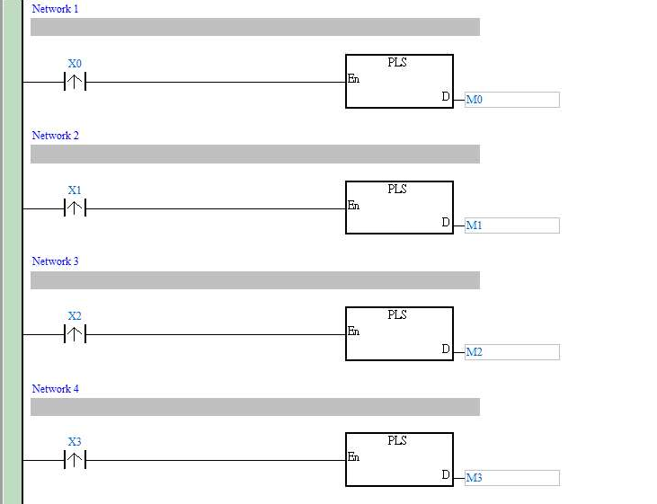
1. Basic Program Design Examples
1.13 Last-in Priority Circuit
Control Purpose:
There are 4 buttons corresponding to 4 indicators. The program is to turn on the indicators corresponding to pressed buttons and to turn off the previous ON indicators.
Devices:
Device | Function
X0 | Button 1. X0 will go from OFF to ON when pressed
X1 | Button 2. X1 will go from OFF to ON when pressed
X2 | Button 3. X2 will go from OFF to ON when pressed
X3 | Button 4. X3 will go from OFF to ON when pressed
Y0 | Indicator 1
Y1 | Indicator 2
Y2 | Indicator 3
Y3 | Indicator 4
Control Program:
1-20
DVP-PLC Application Examples

Slide 22
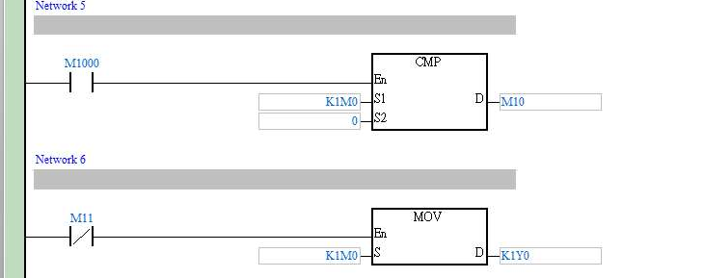
1. Basic Program Design Examples
Program Description:
When a button is pressed, the corresponding device X will go from OFF to ON. In this scan cycle, PLS instruction is executed, and the corresponding internal relay M is enabled as well. CMP instruction will be executed and the compared result is K1M0>0 which makes M10 ON but M11 OFF. [MOV K1M0 K1Y0] instruction will then be executed and sent out the state of M to its corresponding output Y. At the same time, the previous ON indicator(Y) will be turned off.
When it comes to the 2nd scan cycle, PLS instructions will not be executed and the value of M0~M3 will be 0. Therefore, the CMP instruction will be executed and set M11 to be ON (K1M0 = 0). [MOV K1M0 K1Y0] instruction will not be executed, and the 0 state of device M
will not be sent out, either. In this case, Output Y will remain its original state until any other button is pressed next time.
DVP-PLC Application Examples
1-21

Slide 23


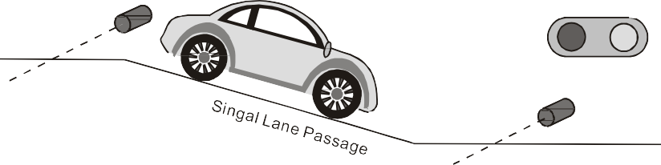
1. Basic Program Design Examples
1.14 Entry/Exit Control of the Underground Car Park
Red Light Green Light
Y1 Y2
X1
Red Light Green Light
Entry/Exit of the Ground Floor
Y1 Y2 X2
Entry/Exit of the Basement
Control Purpose:
The entry/exit of the underground car park is a single lane passage which needs the traffic lights to control the cars. Red lights prohibit cars entering or leaving while green lights allow cars to enter or leave.
When a car enters the passage from the entry of the ground floor, the red lights both on the ground floor and the basement will be ON, and the green lights will be OFF. Any car entering or leaving is prohibited during the process till the car passes through the passage completely. When the passage is clear, the green lights will be ON again and allow other cars entering from the ground floor or the basement.
Similarly, when a car leaves the basement and enters the passage, any other car entering or leaving is prohibited till the car passes from the passage to the ground completely.
When PLC runs, the initial setting of traffic lights will be green lights ON and red lights OFF.
Devices:
Device | Function
X1 | Photoelectric switch at the ground floor entry/exit. X1 will be ON when a car passes.
X2 | Photoelectric switch at the basement entry/exit. X2 will be ON when a car passes.
M1 | M1 will be ON for one scan cycle when a car from the ground floor passes X1.
M2 | M2 will be ON for one scan cycle when a car from the basement passes X1.
M3 | M3 will be ON for one scan cycle when a car from the basement passes X2.
M4 | M4 will be ON for one scan cycle when a car from the ground floor passes X2
M20 | M20 = ON during the process of a car entering the passage from the ground floor.
M30 | M30 = ON during the process of a car entering the passage from the basement.
Y1 | Red lights at the entry/exit of the ground floor and the basement
Y2 | Green lights at the entry/exit of the ground floor and the basement
1-22
DVP-PLC Application Examples

Slide 24
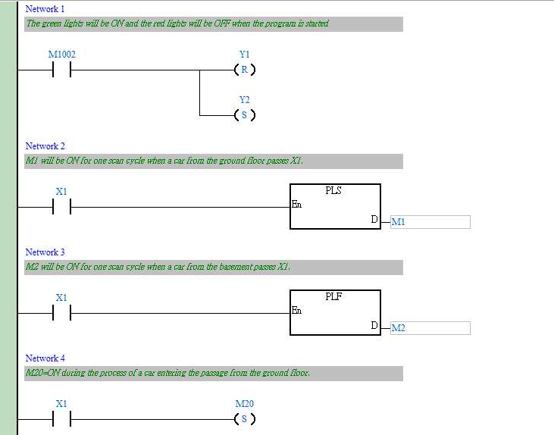
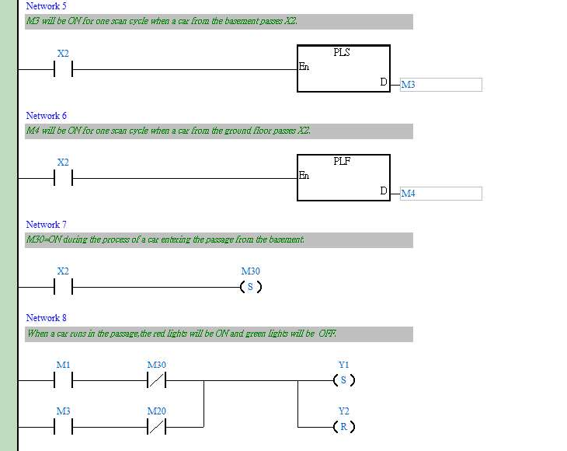
1. Basic Program Design Examples
Control Program:
DVP-PLC Application Examples
1-23

Slide 25
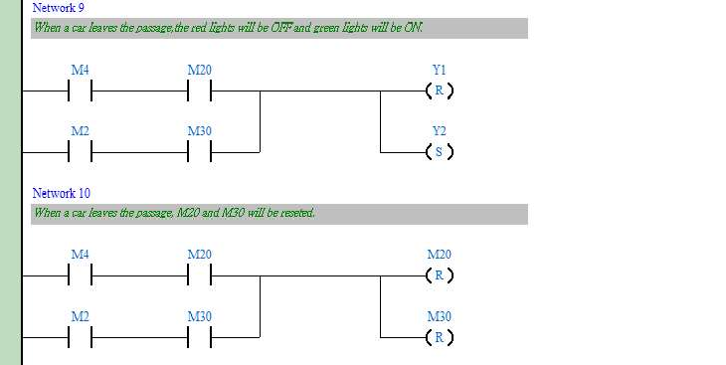
1. Basic Program Design Examples
Program Description:
The ground floor and the basement share the same red light signal Y1 and green light signal Y2.
The key of the program is to identify that the car is entering or leaving the passage at the ground floor entry/exit when M1 is ON to activate Y1 because [PLS M1] will be executed in both entering and leaving conditions. Therefore, the confirming signal M20 is required for confirming that the car is entering the passage from the ground floor.
Also, it needs to identify that the car is entering or leaving the passage at the basement entry/exit when M3 is ON because [PLS M3] will be executed in both entering and leaving conditions. Therefore, the confirming signal M30 is required for confirming that the car is entering the passage from the basement.
1-24
DVP-PLC Application Examples

Slide 26
1. Basic Program Design Examples
1.15 Forward/Reverse Control for the Three-Phase Asynchronous Motor
Forward
Forward
Reverse Stop
Reverse
Control Purpose:
Controlling the motor to run forward when Forward is pressed, run reverse when Reverse is pressed and stop when Stop is pressed.
Devices:
Device | Function
X0 | Forward button of the motor. X0 will be ON when pressed
X1 | Reverse button of the motor. X1 will be ON when pressed
X2 | Stop button. X2 will be ON when pressed.
T1 | 1 sec timer
T2 | 1 sec timer
Y0 | Forward contactor
Y1 | Reverse contactor
DVP-PLC Application Examples
1-25

Slide 27
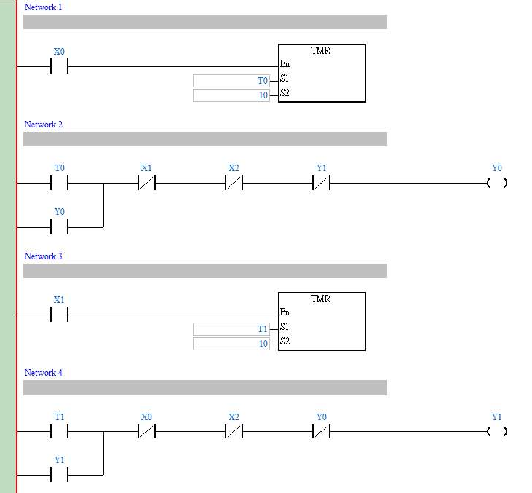
1. Basic Program Design Examples
Control Program:
Program Description:
X0 = ON when Forward is pressed. After 1 second, contactor Y0 will be enabled, and the motor begins to run forward. On the other hand, X1 = ON when Reverse is pressed. After 1 second, contactor Y1 will be enabled, and the motor begins to run reverse. Besides, Y0 and Y1 will be disabled and the motor will stop running when X2 is pressed.
The two timers in the program are used to avoid the interphase short-circuit when the motor changes its running mode. The short circuit may occur if another contactor is enabled instantly while the electric arc in the disabled contactor still exists.
1-26
DVP-PLC Application Examples

Slide 28







1. Basic Program Design Examples
1.16 Selective Execution of Programs
Green
X3
Yellow Blue
Y0 Y1
Yellow X1
X2 Blue
Color Selection
X0
Control Purpose:
There are pigments of 3 colors. By controlling different switches, operators can fill the cans with corresponding pigments.
Devices:
Device | Function
X0 | Filling Start switch. X0 will be ON when turned on.
X1 | Yellow control switch. X1 will be ON when turned on.
X2 | Blue control switch. Turn it on, X2 will be On
X3 | Green (mixing of yellow and blue) control switch. X3 will be ON when turned on
Y0 | Yellow control valve
Y1 | Blue control valve
DVP-PLC Application Examples
1-27

Slide 29
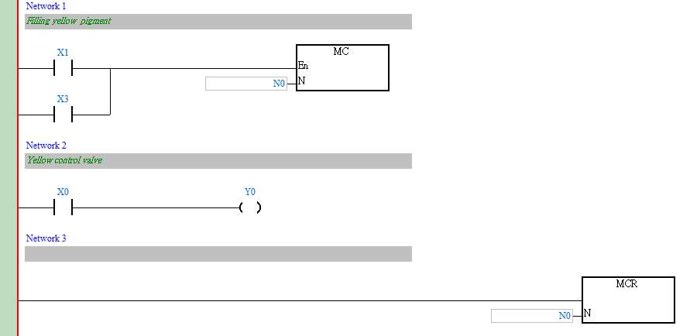
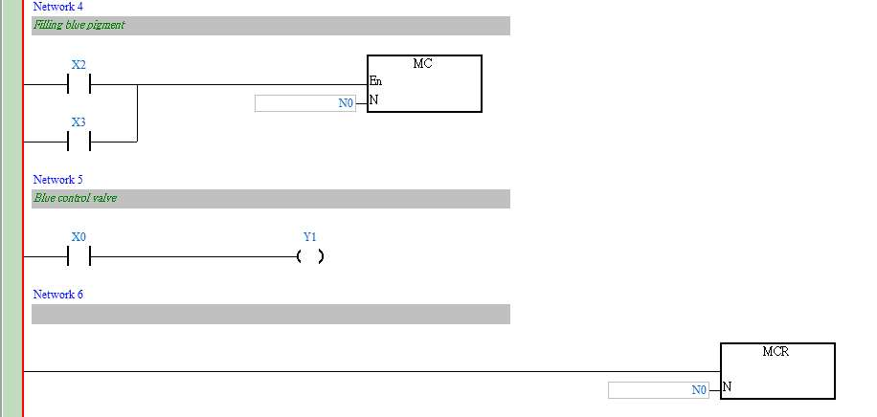
1. Basic Program Design Examples
Control Program
Program Description:
The master switch of filling control needs to be turned on (X0 = ON) before filling started. When both yellow and blue are filled at the same time, it will become green.
When the switch of filling yellow pigment is turned on, X1 = ON. The first MC ~ MCR instruction will be executed. Y0 = ON, and the system begins to fill the yellow color. When the switch of filling blue pigment is turned on, X2 = ON. The second MC ~ MCR
instruction will be executed. Y1 = ON, and the system begins to fill the blue color.
When the switch of filling green pigment is turned on, X3 = ON, both of the two MC ~ MCR instructions will be executed, and the system begins to fill the green color.
1-28
DVP-PLC Application Examples

Slide 30





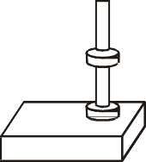

1. Basic Program Design Examples
1.17 MC/MCR - Manual/Auto Control
Auto
X0
Clip
Transfer Release
Manual
X1
Conveyor A
Conveyor B
Control Purpose:
When the button Manual is pressed, the robotic arm will begin to execute the manual control process: pressing Clip to clip the product from conveyor A, pressing Transfer to move the product to the conveyor B, and pressing Release to release the product and send it away by conveyor B.
When the button Auto is pressed, the robotic arm will begin to execute the auto control process once: clip product (keep holding this product before releasing) transfer product (the action takes 2 sec) release the product. Auto control process can be performed one more time if the button Auto is pressed again.
Manual control process and auto control process are interlocked.
Devices:
Device | Function
X0 | Auto button. X0 goes from OFF to ON when pressed.
X1 | Manual button. X1 goes from OFF to ON when pressed
X2 | Clip button. X2 will be ON when pressed.
X3 | Transfer button. X3 will be ON when pressed.
X4 | Release button. X4 will be ON when pressed.
M0~M2 | Auto control process
M3~M5 | Manual control process
M10 | Auto control selection
M11 | Manual control selection
T0 | 2 sec timer
Y0 | Product clipping/releasing. Y0 is ON/OFF when clipping/releasing the product.
Y1 | Product transferring
DVP-PLC Application Examples
1-29

Slide 31
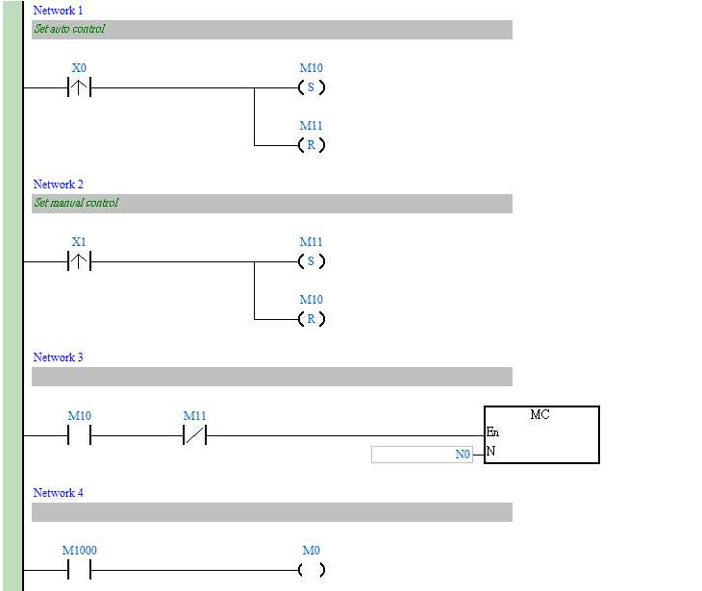
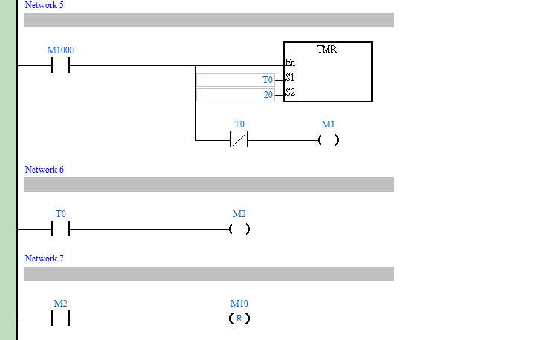
1. Basic Program Design Examples
Control Program:
1-30
DVP-PLC Application Examples

Slide 32
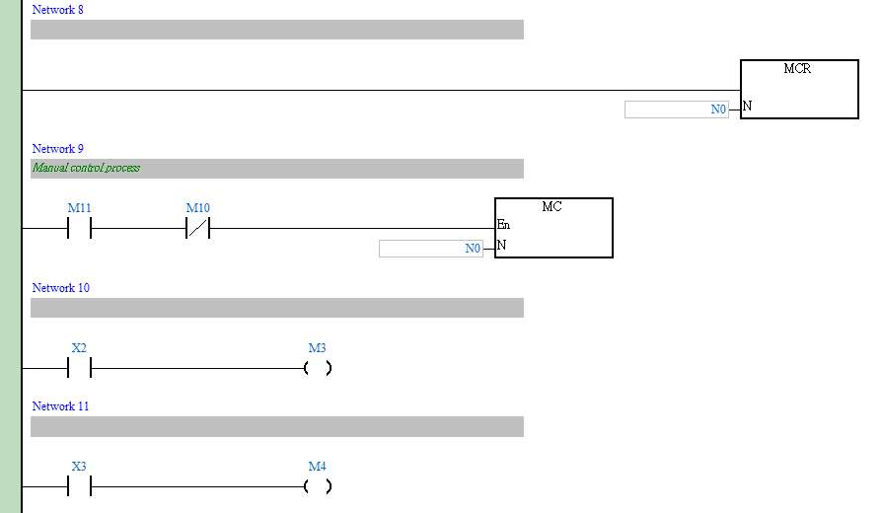
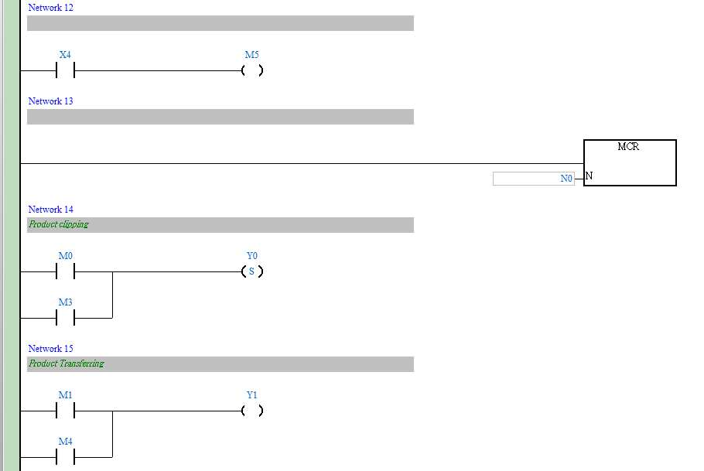
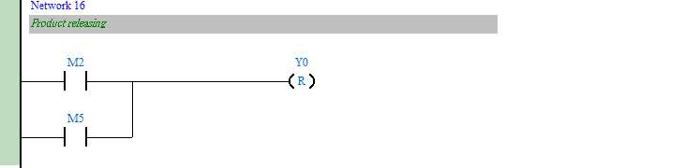
1. Basic Program Design Examples
DVP-PLC Application Examples
1-31

Slide 33
1. Basic Program Design Examples
Program Description:
When X0 goes from OFF to ON, the auto control process will be executed once, whereas when X1 goes from OFF to ON, the manual control process will be executed. In the manual control, the clipping and releasing actions require pressing the corresponding button for one time. However, the button Transfer should be pressed for 2 sec during the moving process till the product is moved to Conveyor B.
X0 and X1 are interlocked. When the auto control process is executed, the robotic arm will perform the following actions: first “clipping”, then “transferring” (for 2 sec.), and “releasing.” When the manual control process is executed, the controlling actions will be performed by 3 corresponding buttons: clipping product by turning on Y0, transferring product by pressing Y1 and releasing product by turning off Y0.
1-32
DVP-PLC Application Examples

Slide 34

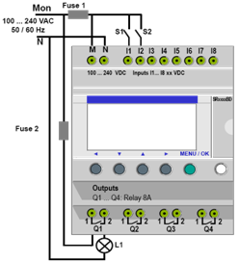

PLC Exercises
Ladder Diagram Programming
By
Dr. Mohammad Salah
Mechatronics Engineering Department Hashemite University

Slide 35

Steps for Building a Ladder Diagram
Dr. Mohammad Salah – Mechatronics
Determine the No. of digital I/O
Determine the No. of analog I/O (if needed)
Determine if there are special functions in the process
Estimate program capacity depending on the process
Choose a suitable PLC series
Prepare the wiring diagram
Draw flowchart or control diagram (Optional)
Program the PLC using the ladder diagram
٢

Slide 36
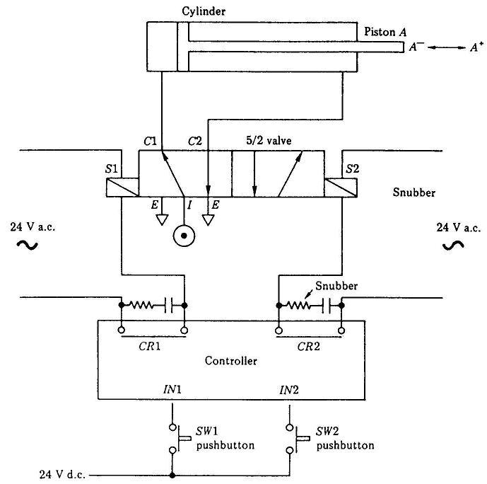
Exercise #1: Moving a Pneumatic Piston
Dr. Mohammad Salah – Mechatronics
Control Problem
The PLC task is to move the piston in and out. When switch SW1 is momentarily turned on, piston A is to move out of the cylinder in A+ direction. When switch SW2 is momentarily turned on, piston A is to move into the cylinder in A- direction.
٣

Slide 37
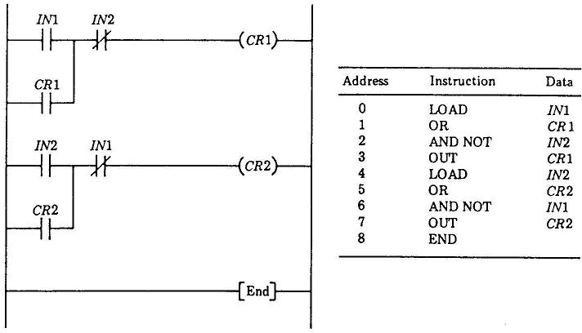
Exercise #1: Moving a Pneumatic Piston
Dr. Mohammad Salah – Mechatronics
٤

Slide 38
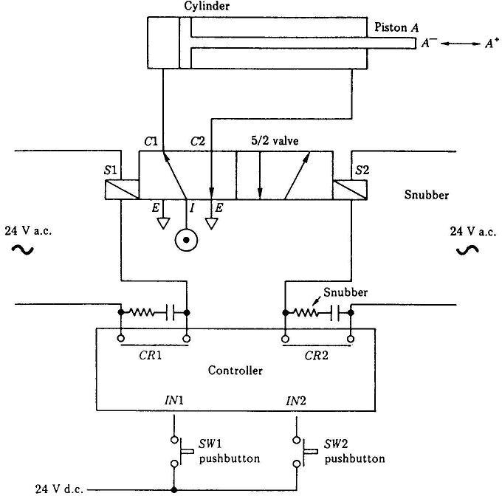
Exercise #1: Moving a Pneumatic Piston
Dr. Mohammad Salah – Mechatronics
If SW1 and SW2 are pressed together, what would happen?
The two solenoid valves will be tuned off
How can we make an electrical interlock?
٥
Use the contacts of the main relays instead of the input contacts

Slide 39
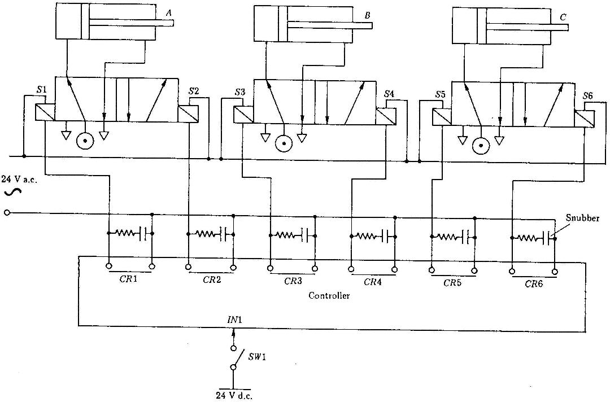
Exercise #2: Sequencing of Pneumatic Pistons
Dr. Mohammad Salah – Mechatronics
٦
Control Problem
The PLC task is to operate piston A followed by piston B followed by piston C. The sequence is A+, A-, B+, B-, C+, C- is to be repeated when switch SW1 is turned on

Slide 40
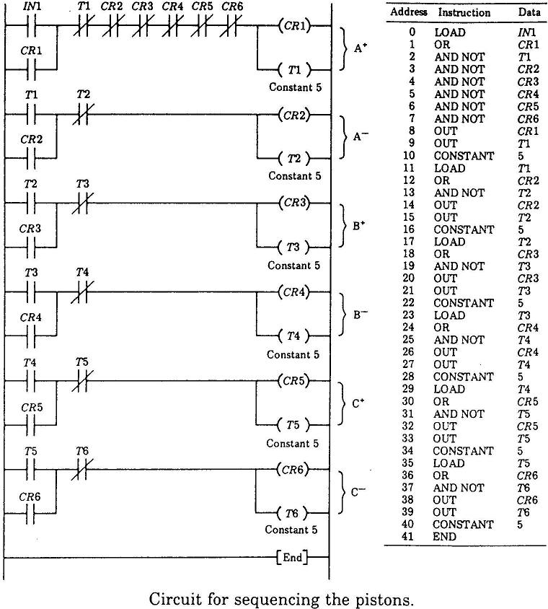
Exercise #2: Sequencing of Pneumatic Pistons
Dr. Mohammad Salah – Mechatronics
٧

Slide 41
Exercise #2: Sequencing of Pneumatic Pistons
Dr. Mohammad Salah – Mechatronics
٨
If the system does not work or sequence in not correct, what would be the possible reasons?
Solenoid valves do not work
The wiring of solenoid valves is not correct or not in the correct order (wiring problem)
The ladder diagram is not properly written (sequence in not correct)

Slide 42
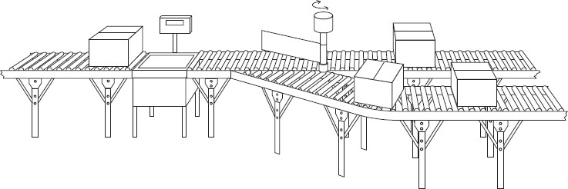
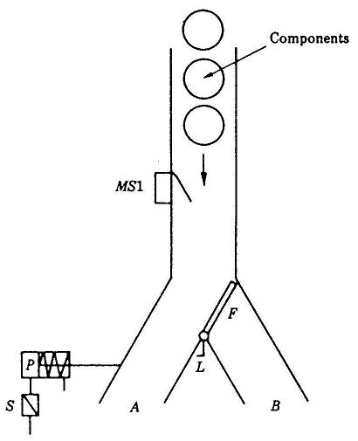
Exercise #3: Batching Machine
Dr. Mohammad Salah – Mechatronics
Control Problem
The PLC task is to control a simple machine which counts and batches
٩
components moving along a conveyor. It is required that ten components be channeled down route A and twenty components down route B. A reset facility is required

Slide 43
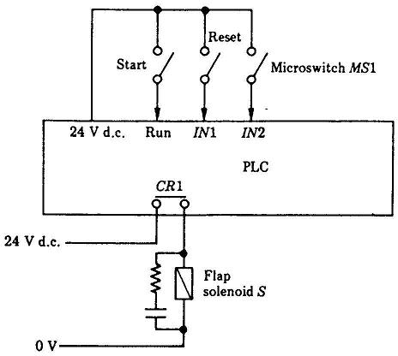
Exercise #3: Batching Machine
Dr. Mohammad Salah – Mechatronics
١٠

Slide 44
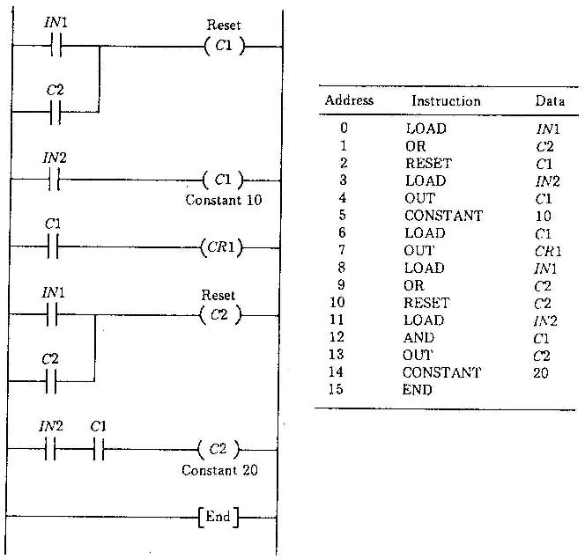
Exercise #3: Batching Machine
Dr. Mohammad Salah – Mechatronics
١١

Slide 45

Exercise #3: Batching Machine
Dr. Mohammad Salah – Mechatronics
If the system does not batch and/or count, what would be the possible reasons?
The reset switch is always on
The microswitch does not work
The flap solenoid does not work
The ladder diagram is not properly written
١٢

Slide 46
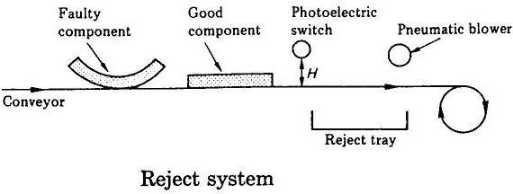
Exercise #4: Reject Machine
Dr. Mohammad Salah – Mechatronics
١٣
Control Problem
The PLC task is to detect and reject faulty components. Components are transported on a conveyor past a retro-reflective type photoelectric switch. The photoelectric switch is positioned at a height (H) above the conveyor where (H) represents a tolerance value for component height. Good components pass underneath the photoelectric switch and no signal is generated. Faulty components break the light beam twice as they pass the photoelectric switch.

Slide 47
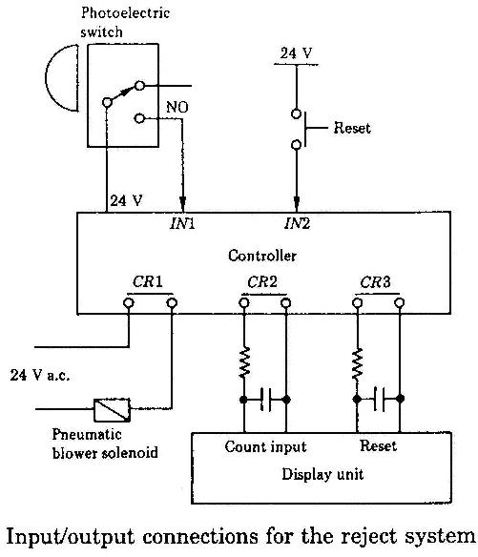
Exercise #4: Reject Machine
Dr. Mohammad Salah – Mechatronics
١٤

Slide 48
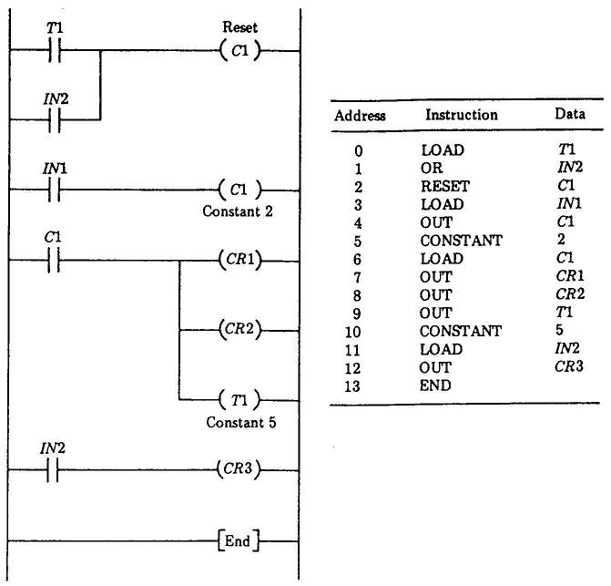
Exercise #4: Reject Machine
Dr. Mohammad Salah – Mechatronics
١٥

Slide 49
Exercise #4: Reject Machine
Dr. Mohammad Salah – Mechatronics
١٦
If the system does not reject faulty components, what would be the possible reasons?
The photoelectric switch is too high (H is too big)
The photoelectric switch does not work
The pneumatic blower does not work
The ladder diagram is not properly written
The faulty components is not as described in the drawing

Slide 50
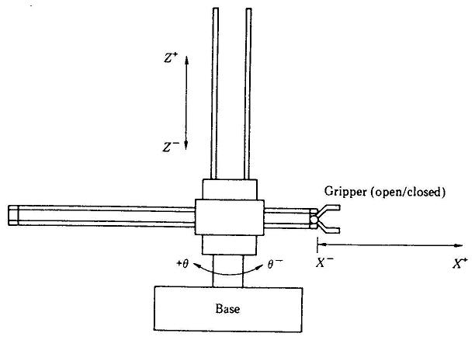
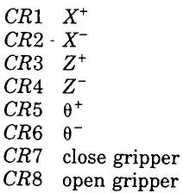
Exercise #5: Pick and Place Unit
Dr. Mohammad Salah – Mechatronics
١٧
Control Problem
The PLC task is to:
move the gripper to X+ position
close the gripper so that it takes hold of a component
rotate the gripper through 180º to the Θ+ position
Release the component
Rotate the gripper back to the Θ- position so that the pick and place operation may be repeated

Slide 51
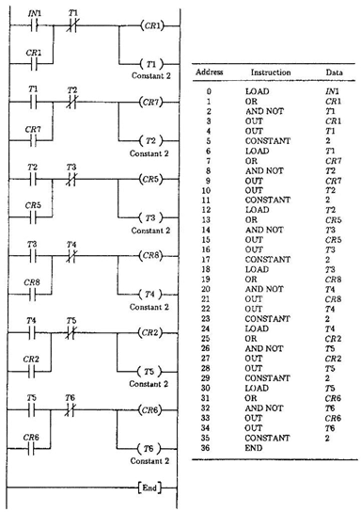
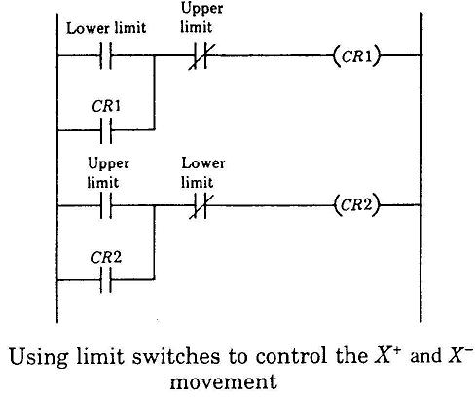
Exercise #5: Pick and Place Unit
Dr. Mohammad Salah – Mechatronics
١٨

Slide 52
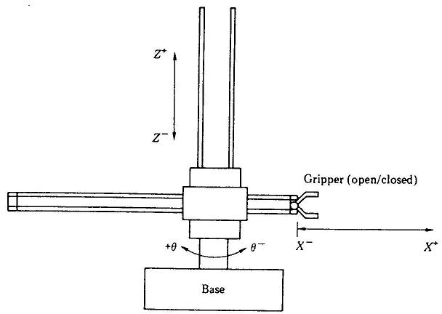
Exercise #5: Pick and Place Unit
Dr. Mohammad Salah – Mechatronics
If the system does not work or sequence is not correct, what would be the possible reasons?
Wiring problem
Some solenoid valves do not work
Timing is not correct
The ladder diagram is not properly written (sequence in not correct)
١٩
How can we get rid of the timers in the ladder diagram/program?
Use position sensors for feedback but that would be expensive compared to using timers but more accurate and reliable in case the mechanical system
starts to have some problems

Slide 53

Exercise #6: Production Line
Dr. Mohammad Salah – Mechatronics
٢٠
Control Problem
The PLC task is to organize the production process. Cans filled with fluid and capped before passing into a conveyor. The photoelectric switches P1 and P2 are used to check that each can has a cap. Photoelectric switch P3 provides a trigger for the ink jet printer which prints a batch number on each can. Photoelectric switch P4 is used to count three cans into the palletizing machine that transports three cans through a machine which heat shrinks a plastic wrapping over them. All photoelectric switches on the production line are of the retro reflective type.

Slide 54

Exercise #6: Production Line
Dr. Mohammad Salah – Mechatronics
٢١

Slide 55

Exercise #6: Production Line
Dr. Mohammad Salah – Mechatronics
٢٢

Slide 56
Exercise #6: Production Line
Dr. Mohammad Salah – Mechatronics
٢٣
If the system allows uncapped cans to pass, what would be the possible reasons?
The height of the photoelectric switch needs to be readjusted
The photoelectric switch does not work (transmitter or receiver)
The photoelectric transmitter is not aligned with the receiver
The ladder diagram is not properly written (or timer is not set properly)

Slide 57



Exercise #7: Star-Delta Connection
Dr. Mohammad Salah – Mechatronics
٢٤

Slide 58


Exercise #7: Star-Delta Connection
Dr. Mohammad Salah – Mechatronics
٢٥

Slide 59

Exercise #7: Star-Delta Connection
Dr. Mohammad Salah – Mechatronics
٢٦
PLC system layout – Wiring diagram

Slide 60

Exercise #7: Star-Delta Connection
Dr. Mohammad Salah – Mechatronics
٢٧

Slide 61

PLC Application Exercises
These exercises are extracted from DVP-PLC Manual

Slide 62

2. Counter Design Examples
2.1 Product Mass Packaging
X0
Y0
X1
Control Purpose:
Once the photoelectric sensor detects 10 products, the robotic arm will begin to pack up. When the action is completed, the robotic arm and the counter will be reset.
Devices:
Device | Function
X0 | Photoelectric sensor for counting products. X0 = ON when products are detected.
X1 | Robotic arm action completed sensor. X1 = ON when packing is completed.
C0 | Counter: 16-bit counting up (general purpose)
Y0 | Robotic arm for packing
Control Program:
DVP-PLC Application Examples
2-1

Slide 63
2. Counter Design Examples
Program Description:
Once the photoelectric sensor detects a product, X0 will go from OFF to ON once, and C0 will count for one time.
When the present value in C0 reaches 10, the Normally Open contact C0 will be closed. Y0
= ON, and the robotic arm will begin to pack.
When the packing is completed, the robotic arm action completed sensor will be enabled. X1 will go from OFF to ON and RST instruction will be executed. Y0 and C0 will be reset for the next packing task.
2-2
DVP-PLC Application Examples

Slide 64

2. Counter Design Examples
2.2 Daily Production Record (16-bit Counting Up Latched Counter)
X1
Clear
Daily Q
uantity Co 456
mpletion
X0
456
Control Purpose:
The production line may be powered off accidentally or turned off for noon break. The program is to control the counter to retain the counted number and resume counting after the power is ON again.
When the daily production reaches 500, the target completed indicator will be ON to remind the operator for keeping a record.
Press the Clear button to clear the history records. The counter will start counting from 0 again.
Devices:
Device | Function
X0 | Photoelectric sensor. Once detecting the products, X0 will be ON.
X1 | Clear button
C120 | Counter: 16-bit counting up (latched)
Y0 | Target completed indicator
DVP-PLC Application Examples
2-3

Slide 65

2. Counter Design Examples
Control Program:
Program Description:
The latching counter is demanded for the situation of retaining data when power-off.
When a product is completed, C120 will count for one time. When the number reaches 500, target completed indicator Y0 will be ON.
For different series of DVP-PLC, the setup range of 16-bit latching counter is different. C112
~ C127 for ES/EX/SS series, C96 ~ C199 for SA/SX/SC series and C100 ~ C199 for EH series.
2-4
DVP-PLC Application Examples

Slide 66

2. Counter Design Examples
2.3 Products Amount Calculation (32-bit Counting Up/Down Counter)
Entry
Exit
Control Purpose:
This program is used for monitoring the product amount in the warehouse by photoelectric sensors at both entry and exit. When the amount reaches 40,000, the alarm will be enabled.
Devices:
Device | Function
X0 | Photoelectric sensors for monitoring incoming goods. X0 = ON when incoming detected.
X1 | Photoelectric sensors for monitoring outgoing goods. X1 = ON when outgoing detected.
M1216 | Counting mode of C216(ON: counting down)
C216 | 32-bit counting up/down counter
Y0 | Alarm
DVP-PLC Application Examples
2-5

Slide 67

2. Counter Design Examples
Control Program:
Program Description:
The key of this example is using the 32-bit addition/subtraction flag M1216 to control the counting up/ down of C216. When X0 goes from OFF to ON, M1216 = OFF, and C216 will count up; when X1 goes from OFF to ON, M1216 = ON, C216 will count down.
When the present value of C216 reaches 40,000, C216 = ON, and the alarm Y0 will be enabled.
2-6
DVP-PLC Application Examples

Slide 68


2. Counter Design Examples
2.4 24-hour Clock Operated by 3 Counters
Hour
Minute
Second
Control Purpose:
Using 3 counters together with the flag of M1013 (1s clock pulse) to operate a 24-hour clock.
Devices:
Device | Function
C0 | count per second
C1 | count per minute
C2 | count per hour
M1013 | 1s clock pulse
Control Program:
DVP-PLC Application Examples
2-7

Slide 69

2. Counter Design Examples
Program Description:
The key of operating a 24-hour clock is to use M1013 (1s clock pulse). When the program is executed, C0 will count once per second. When the counted number reaches 60(1 minute), C0 = ON. C1 will count once, and C0 will be reset at the same time; similarly, when the counted number in C1 reaches 60(1 hour), C1 = ON. C2 will count once, and C1 will be reset at the same time. Furthermore, when the present value in C2 reaches 24, C2 will be reset, and the 24-hour counting process will start again.
The 24-hour clock operates by using C0 to count “second”, C1 to count “minute” and C2 to count “hour.” In this clock, the value of “second”, “minute” and “hour” can be read by C0, C1 and C2 correspondingly. When the set value of C2 is 12, the clock will be a 12-hour clock.
2-8
DVP-PLC Application Examples

Slide 70

APPLICATION EXAMPLES OF BASIC COMMANDS
Example : Packaging Line Control
6-28

Slide 71
APPLICATION EXAMPLES OF BASIC COMMANDS
Operation
When PBl (START Puzh Botton) iz prezzed, the box conveyor movez. Upon detection of box prezent, the box conveyor ztopz and the Apple conveyor ztartz. Part zenzor will count for l0 applez. Apple conveyor ztopz and box conveyor ztartz again. Counter will be rezet and operation repeatz until PB2 (STOP Puzh Button) iz prezzed.
Input | Devices
00000 | START Puzh Button (PBl)
0000l | STOP Puzh Button (PB2)
00002 | Part Prezent (SEl)
00003 | Box Prezent (SE2)
Output | Devices
0l000 | Apple Conveyor
0l00l | Box Conveyor
00000
00001
00002
00003
20000
CNT010
01000
01001
6-29

Slide 72



6. APPLICATION EXAMPLES OF BASIC COMMANDS
Ladder diagram : Main l Network l
Main l – Packaging
Packaging line control for Applez
Network l – Start condition
30
000.00
000.0l 200.00
PBl 200.00
PB2
RUN
RUN
Network 2 – Apple conveyor
200.00
0l0.0l
0l0.00
RUN BoxCon CONVYR
Network 3 – Counter Counter prezet at l0
000.02
CNT
SEl 000.03
0l0
#00l0
SE2
Network 4 – Box conveyor
CNT0l0 200.00 0l0.0l
000.03
RUN
Boxcon
SE2
Network 5 - END
END (0l)
Address | Instruction | Data
0000 | LD | 00000
000l | OR | 20000
0002 | AND NOT | 0000l
0003 | OUT | 20000
0004 | LD | 20000
0005 | AND NOT | 0l00l
0006 | OUT | 0l000
0007 | LD | 00002
Address | instruction | Data
0008 | LD NOT | 00003
0009 | CNT | 0l0
 |  | #00l0
00l0 | LD CNT | 0l0
00ll | OR NOT | 00003
00l2 | AND | 20000
00l3 | OUT | 0l00l
00l4 | END (0l)
6-30

Slide 73
APPLICATION EXAMPLES OF BASIC COMMANDS
Application #3 : Control Circuit For Packaging Machine
The control circuit iz uzed to detect and count the number of productz being carried on an azzembly line. When it countz five productz, the circuit energizez a zolenoid. The zolenoid iz energized for a period of two zecondz and iz then zhunt off, cauzing it to retract.
Senzor
Solenoid
Conveyor
Input | Device
00000 | Senzor
Output | Device
0l000 | Conveyor
0l00l | Solenoid
Others
CNT 047 | Product counter
TIM 000 | Solenoid energizer timer
6-3l

Slide 74
6. APPLICATION EXAMPLES OF BASIC COMMANDS
Question: Fill in the gapz below to make thiz circuit operate.
S
CNT 047 #
R
CNT 047
TIM 000
#0020
6-32

Slide 75


APPLICATION EXAMPLES OF BASIC COMMANDS
Application #4 : Drilling Control Operation
Control Panel
Indication Box
Auto
Manual Forward
Stop
Reverse Auto Start
Manual
Auto
Auto-start
LS1 (5)
(7) PBS
(1003) Motor Reverse
LS2 (6)
I/O Assignments
(1002) Motor Forward
Input | Device
00000 | Auto Switch
0000l | Manual
00002 | Forward Switch (SWl)
00003 | Stop Switch (SW2)
00004 | Reverze Switch (SW3)
00005 | Limit Switch (LSl)
00006 | Limit Switch (LS2)
00007 | Auto Start Button (PBS)
Output | Device
l000 | Auto Indicator
l00l | Manual Indicator
l002 | Motor Forward
l003 | Motor Reverze
l004 | Auto Start Indicator
Procedure
Manual Operation
l.l When SWl iz ON, Motor movez forward. It can be ztopped by SW2. When the drill touchez LS2, the Motor iz cut-off.
l.2 When SW3 iz ON, Motor movez in reverze. It can be ztopped by SW2. When he drill touchez LSl, the Motor iz cut-off.
2. Auto-cycle
2.l When PB and LSl iz ON, the Motor movez forward until LS2 iz activated. The Timer then ztartz timing down. The Motor reverzez when the timer reachez 2 zecondz. When it returnz to LSl pozition, the cycle iz repeated.

Slide 76





6. APPLICATION EXAMPLES OF BASIC COMMANDS
Answer
Ladder diagram : Main l Network l
Main l – Drilling Control Drilling control operation
Network l – Manual indication
000.0l 0l0.0l
Manual Manu
Network 2 – Auto indication
000.00 0l0.00
Auto Autom
Network 3 – Manual forward
0l0.0l 000.02 000.03 000.06 005.07 005.06
Manu 005.06
Forwzw
Stopzw
LS2
Rev
Manuforw
Manuforw
Network 4 – Manual reverze
0l0.0l 000.04 000.03 000.05 005.06 005.07
Manu 005.07
Reverze
Stopzw
LSl
Manuforw
Rev
Rev
Network 5 – Auto ztart
0l0.00 000.07 000.05 000.03 005.08
Autom 005.08
PB
LSl
Stopzw
Autoztart
Autoztart 005.l0
Confirmforw
Network 6 – Motor forward
005.08 000.05 005.l0
000.03
005.09
Autoztart LSl Confirmforw 005.09
Stopzw
Motorforw
Motorforw
Network 7 – Confirm forward
0l0.00 000.06 000.05 000.03 005.l0
Autom 005.l0
LS2
LSl
Stopzw
Confirmforw
TIM
Confirmforw
000
delay
#0020

Slide 77




6. APPLICATION EXAMPLES OF BASIC COMMANDS
Network 8 – Motor reverze
TIM000 005.ll
^{Delay} Motorreverz
Network 9 – Motor forward
005.09 0l0.02
Motorforw
Motorforw
005.06
Motorforw
Network l0 – Motor reverze
005.ll 0l0.03
Motorreverze
Motorreverze
005.07
Rev
Network ll – Autoztart Autoztart indicator
005.08 0l0.04
^{Autoztart} Autoztirtindi
Network l2 – End
END (0l)

Slide 78


APPLICATION EXAMPLES OF BASIC COMMANDS
KEEP(11) – Latching relay
HEEP iz uzed az a latch. It maintainz an ON or OFF ztate of a bit until one of itz two inputz zetz or rezetz it. If the HEEP function iz uzed together with a HR relay, the ztate of the latched output iz retained even during a power failure.
Ladder diagram Mnemonic codes
00000
HEEP(ll) l0000
0000l
Address | Instruction | Data
0000 | LD | 00000
000l | LD | 0000l
0002 | HEEP(ll) | l0000
0003 | END(0l)
END(0l)
DIFU(13) and DIFD(14) – Differentiation
DIFU and DIFD turnz an output ON for one zcan only.
DIFU turnz itz output ON when it detectz an OFF -> ON tranziztion in itz input zignal. DIFD turnz itz output ON when it detectz an ON -> OFF tranziztion in itz input zignal.
Input
DIFU
DIFD

Slide 79





APPLICATION EXAMPLES OF BASIC COMMANDS
Application #3: Filling/Draining Control Operation
MV l
Control Panel
START STOP RESET
END
BUZZER
PBl (0)
TLBl (5)
PB2
(l)
TLB2 (6)
PB3 (2)
PL (l004)
MV 2
M
BZ (l005)
I/O Assignments
Input | Device
00000 | Start Button (PBl)
0000l | Stop Button (PB2)
00002 | Rezet Button (PB3)
00005 | Upper Level Switch (TLBl)
00006 | Lower Level Switch (TLB2)
Output | Device
0l000 | Water Supply Valve (MVl)
0l00l | Drain Valve (MV2)
0l002 | Stirring Motor (M)
0l004 | End Indicator
0l005 | Buzzer
Procedure
l. Az the PBl iz prezzed, MVl openz and the water beginz to fill the tank. At the zame time, the ztirring motor M ztartz operationz.
When the water level pazzez TLB2 and reachez TLBl, the MVl clozez and the ztirring motor ztopz.
Next, MV2 openz and ztartz draining the water. When the water levelz dropz below TLB2, MV2 clozez.
When the cycle of operation haz repeated four timez, the operation END indicator illuminatez, and the filling and draining operation will not reztart even if PBl iz prezzed.

Slide 80




6. APPLICATION EXAMPLES OF BASIC COMMANDS
Ladder diagram : Main l Network l
Main l – Fill / Draining
Filling / Draining control operation
Network l – Start condition
000.00 0l0.05 0l0.04 200.02 000.0l 0l0.00
ztart 0l0.00
BZ
PL
Reach
Stop
MVl
MVl 200.04
MV2clozez
Network 2 – Stirring
0l0.00 0l0.02
MVl Stirrer
Network 3 – Reach TLB l
000.05
DIFU(l3)
TLBl
200.0l
Reach TLBl
Network 4 – Water reach TLB
000.06 200.0l 200.02
TLB2 ReachTLBl Reach
Network 5 – Drain
0l0.00 000.05 000.06 0l0.0l
MVl 0l0.0l
TLBl
TLB2
MV2
MV2
Network 6 – MV2 clozez
0l0.0l
DIFD(l4)
MV2
200.04
MV2clozez
Network 7 – Pazz TLB2
000.06
TL
 | DIFD(l4)
B2 | 200.03 PazzTLB2

Slide 81


6. APPLICATION EXAMPLES OF BASIC COMMANDS
Network 8 – Counter Counter prezet at 4
200.03
CNT
PazzTLB2
047
Counter
000.02
#0004
Rezet
Network 9 – End indication
CNT047 0l0.04
Counter
PL
Network l0 – Delay Delay for 2 zecondz
0l0.04
TIM
PL
000
#0020
Network ll – Buzzer
CNT047
TIM000 0l0.05
Counter
BZ
Network l2 – End
END (0l)

Slide 82
APPLICATION EXAMPLES OF BASIC COMMANDS
Shift Register – SFT(10)
Shift Regizter (SFT) zhiftz a l6-bit data in zpecified channel by l bit. Although thiz inztruction zhiftz data within channelz, both a ztart channel and an end channel muzt be zpecified az the data.
Ladder diagram
IN
Operand Data Areas
CP
SFT(l0)
S E
I/O, Internal auxiliary Relay
R
Holding Relay
Start CH
End CH
00 | 0l | 02 |  | l5 |  | 00 | 0l | 02 |  | l5 |  | 00 | 0l | 02 |  | l5
Example circuit
Ladder Diagram
00002 00003
Mnemonic code
Data Input
SFT(l0)
200
200
Address | Instruction | Data
0000 | LD | 00002
000l | AND NOT | 00003
0002 | LD | 00004
0003 | LD | 00005
0004 | SFT(l0)
 |  | 200
 |  | 200
0005 | LD | 20000
0006 | OUT | l000
0003 | END(0l)
00004
Clock Pulze
00005
Rezet
20000
l000
End(0l)
Note :
When a rezet input iz applied to the Shift Regizter, all l6 bitz are rezet together. If the Holding Relay area iz uzed, the data are retained during power failure.

Slide 83









APPLICATION EXAMPLES OF BASIC COMMANDS
Application #6: Overhead Crane Control of Degreasing Operation
In thiz application, the part needz to be degreazed in the degreazing tank before being pazzed to the next zection.
(S5)
6
Left (1001)
Right (1003)
(S4)
5
(S1)
2
Roller
Up (1000)
Up Sensor (S3) 4 Down Sensor (S2) 3
PB1 (Start) (0)
Down (1002)
(07)
PB2 (1)
Reset
Operator
Degreasing Tanks
Operator
Stop Button (8)
Buzzer (1004)
When the PBl iz prezzed, the roller will coil up the hook until the up-zenzor (S3). The hook will then tranzverze left (via 0l00l) until it reachez the S4 pozition.
It will then ztop and lower the product into the degreazing tank. When it reachez down to S2, the product will ztay in the degreazing tank for 20 zecondz. After the time iz up, the product iz lifted up and tranzverze left until S5 pozition and ztop. It continue to come down. Until the down pozition, where the Buzzer will zound. The operator will collect the product and prezz the PB2 to return the crane back to the home pozition.
6-4l

Slide 84
6. APPLICATION EXAMPLES OF BASIC COMMANDS
At anytime, the Stop Puzh Button can ztop the crane from moving. Upon releaze, it will continue from where it ztopz. The Rezet Puzh Button iz uzed when you want to ztart over again from the beginning.
I/O Assignment
Input | Device
00000 | PBl (Start button)
0000l | PB2 (Return button)
00002 | Sl (Senzor l)
00003 | S2 (Down zenzor)
00004 | S3 (Up zenzor)
00005 | S4 (Degreaze zenzor)
00006 | S5 (End zenzor)
00007 | RST (Rezet button)
00008 | Stop (Stop button latch)
Output | Device
0l000 | Up motor
0l00l | Left motor
0l002 | Down motor
0l003 | Right motor
0l004 | Buzzer

Slide 85

6. APPLICATION EXAMPLES OF BASIC COMMANDS
Ladder diagram : Main 1 Network 1
Main 1 –
Program for degreazing tank
Network 1 – Start Start operation
000.00 |  | 000.03 | 000.02
PB1 |  | S2 | S
 | DIFU(13)
1 | 200 00
Network 2 – Set 1zt bit on Set 1zt bit of HR 00 on
200.00
MOV(21)
#0001
HR00
Network 3 – Shift Regizter
253.14
NO 200.01
SFT(10)
HR00
HR00.09
HR00
END_OP 000.07
Rzt
Network 4 – Shift operation
The zhift regizter clock input to control the zequence of operation
HR00.00 000.02 000.04
200.01
200.01
UP HR00.01
S1 S3
000.05
LEFT1 HR00.02
S4 000.03
TIM000
DOWN1 HR00.03
S2 000.04
UP2 HR00.04
S3 000.06
LEFT2 HR00.05
S5 000.03
000.01
DOWN2 HR00.06
S2 000.04
PB2
UP3 HR00.07
S3 000.02
RICHT HR00.08
S1 000.03
DOWN3
S2

Slide 86



6. APPLICATION EXAMPLES OF BASIC COMMANDS
Network 5 – Interlock
000 08
IL(02)
Stop Network 6 – Up
HR00.00
010.00
UP1 HR0.03
UP_ MOTOR
UP2 HR0.06
UP3
Network 7 – Left
HR00.01
010.00
LEFT1 HR0.04
LEFT_ MOTOR
LEFT2
Network 8 – Down
HR00.02
010.02
DOWN1 HR0.05
DOWN_ MOTOR
DOWN2 HR0.08
DOWN3
Network 9 – Time delay Time delay for 20 zecz
HR00.02
TIM
DOWN1
000
#0200
Network 10 – Buzzer
HR00.05
000.03
010.04
DOWN2
Network 11 – Right
S2
Buzzer
HR00.07
010.03
RICHT FWD MOTOR
Network 12 – Cloze interlock
ILC(03)
Network 13 – End
END(01)

Slide 87

APPLICATION EXAMPLES OF BASIC COMMANDS
Application #7: Parts Sorting
In thiz application, effective productz are detected and rejected from thoze being carried on the conveyor.
Photoelectric zenzor (PH1) zervez az the data input to the zhift regizter. The zignal output from thiz zenzor turnz ON when a defective product haz been detected; otherwize it remainz OFF.
Photoelectric zenzor (PH2) iz uzed az a clock generator that zervez az the clock input to the zhift regizter. It generatez one pulze each time the product, zpaced at a fixed interval from each other, haz traveled a predetermined diztance.
From the moment a defective product iz detected by PH1, it iz traced by the zhift regizter until the product arrivez at the predetermined pozition on the conveyor where it iz ejected by the magnetic valve MV.

Slide 88
6. APPLICATION EXAMPLES OF BASIC COMMANDS
Ladder diagram
00002
0000
PH1
SFT
HR00 HR00
Shift Regizter
00003
PH 25314
0004
HR0004
01000
MV Valve open for defective part
0006
END (01)
Mnemonic codes
Address | Instruction | Data
0000 | LD | 00002
0001 | LD | 00003
0002 | LD | 25314
0003 | SFT | HR00
 |  | HR00
0004 | LD | HR0004
0005 | OUT | 01000
0006 | END(01)

Slide 89

APPLICATION EXAMPLES OF BASIC COMMANDS
Application #8: Robot Movement Control
(Detect workpiece)
PH1 (4)
(Start button) PB1 (0)
(check grasp work)
(3) LS3
(clockwise rotation)
LS1 (1)
(counterclockwise rotation)
LS2 (2)
SOL2 (1001)
conveyor B
(1000) SOL1
(clockwise rotation)
(counterclockwise rotation)
conveyor A (1003)
Thiz kind of robot iz zeen in many automated factoriez. Az iz apparent from the figure, thiz robot pickz up a work being carried on conveyor A and placez it on conveyor B.
The operationz and conditionz are az followz:
When the ztart button iz prezzed, the robot rotatez itz arm clockwize.
When the robot arm haz moved to the pozition of the work on the conveyor A, arm grazpz the work.
When the arm haz grazped the work, it rotatez counterclockwize.
When the arm haz rotated to the pozition of conveyor B, it releazez the work.

Slide 90
APPLICATION EXAMPLES OF BASIC COMMANDS
I/O Assignment Procedure
Input | Devices
0000 | PB1 (ztart button)
0001 | LS1 (clockwize rotation)
0002 | LS2 (counterclockwize rotation)
0003 | LS3 (checking grazped work)
0004 | PH1 (detect workpiece)
0005 | Stop button
0006 | Rezet button
Output | Devices
1000 | Sol 1 (clockwize rotation)
1001 | Sol 2 (counterclockwize rotation)
1002 | Sol 3 (grazping work)
1003 | Conveyor A
Start Button
No
Prezzed?
Yez
Arm rotatez Clockwize
Arm at LS1?
No
Yez
Conveyor A ON
Photo eye zenze workpiece?
No
Yez
Conveyor A OFF Arm grazp work
Iz LS3 ON?
No
Yez
Arm rotatez Counterclockwize
Arm at LS2?
No
Yez
Releaze workpiece
Iz LS3 OFF?
No
Yez

Slide 91
6. APPLICATION EXAMPLES OF BASIC COMMANDS
Ladder diagram : Main 1 Network 1
Main 1 – Robot control
Thiz program demonztratez that the Robot pickz up a work piece from conveyor A and placez it on conveyor B.
Network 1 – Start condition
000.00 000.02
HEEP (11)
Start 000.06
LS2 HR01.01
HR01.00
Startcondition
Rezet Stopzzignal
Network 2 – Start
HR01.00
DIFU(13)
Startcondition
200.00
Network 3 – Set 1zt bit on Set 1zt bit of HR 00 on
200.00
MOV(21)
HR0.05
#0001
HR00
Network 4 - Shift regizter
253.14
SFT(10)
Normaloff 200.01
HR00
Clock 000.06
HR101
HR00
Rezet
Network 5 – Clock input
Clock input to zhift regizter to control zequence of operation
HR00.00 000.01 200.01 HR01.01 200.01
Sequence1
LS1 000.04
Clock
Stopzignal
Clock
HR00.01
Sequence2
PH1 000.03
HR00.02
Sequence3
LS3 000.02
HR00.03
Sequence4
LS2 000.03
HR00.04
LS3

Slide 92




6. APPLICATION EXAMPLES OF BASIC COMMANDS
Network 6 – Stop condition 000.05
Stop 000.00
HEEP(11)
HR01.01
Stopzignal
Start
Network 7 – Arm clockwize
HR00.00 010.00
^{Sequence1} Armclkwize
Network 8 – Conveyor A
HR00.01 010.03
Sequence2 _{ConveyorA}
Network 9 – Crazp
HR00.02 HR00.04 200.02
Sequence3
010.02
010.02
Crazp
Crazp
Network 10 – Arm anticlockwize
HR00.03 010.01
Sequence4 Armanticlk
Network 11 – Rezet Rezet after ztop
HR00.01 |  | 000.06 | 200.02
Stopzignal |  | Rezet
Network 12 – End
End(01)

Slide 93


APPLICATION EXAMPLES OF BASIC COMMANDS
Application #9: A Simple Sequence Control Concept
When the ztart button iz puzhed, the motor (M) will move from left to right. When LS2 iz ON, the Motor ztopz, delay for 5 zecondz and then movez back to Home. When LS1 (Home) iz ON, Motor cutz off, zignifying that the zequence iz completed.
LS1 (1)
LS1 (2)
Stop PB
Start PB
0
(3)
M
HOME
1000 (Motor Right)
1001 (Motor Left)
I/O Assignment
Input | Devices
00000 | Stop PB
00001 | LS1 (HOME)
00002 | LS2
00003 | Start PB
Output | Devices
01000 | Motor (right)
01001 | Motor (Left)
3
1
2
1000
Motor (Right)
Start PB
100
LS1
LS2
2
TIM0 #50
5 zec Delay
LS2 TIM0
1
LS1
1001 Motor (Left)
1001

Slide 94



APPLICATION EXAMPLES OF BASIC COMMANDS
Example : PBC Packing Conveyor
Pizton
RS1 (2)
RS2 (3)
Start (0)
Stop (1)
Conveyor motor (1000)
RST (5)
Tray
Up (1001)
Proximity zwitch
(4)
Limit Switch (6)
Lifter motor
Down (1004)
In thiz application, a lifter motor iz uzed to lift a tray of PCB boardz up, before being puzhed by the pizton onto the conveyor for packing.
When the ztart button iz prezzed, the conveyor motor and the lifter motor will turn on. The proximity zwitch will temporarily ztop the lifter motor for the pizton to puzh the PCB onto the conveyor belt.
After the PCB iz puzhed, the pizton will retract and the lifter motor ztartz again. The whole procedure will repeat itzelf thereafter.

Slide 95
6. APPLICATION EXAMPLES OF BASIC COMMANDS
When all the PCBz have been puzhed onto the conveyor belt, the lifter motor will move down until the limit zwitch (LSW) iz being activated. Thereafter, the whole procedure can only be ztarted by the ztart zwitch.
I/O Assignment
Input | Device
00000 | Start Puzh Button
00001 | Stop Puzh Button
00002 | RS1 (Left Limit)
00003 | RS2 (Right Limit)
00004 | Proximity Switch
00005 | Rezet
00006 | Limit Switch
Output | Device
01000 | Conveyor motor
01001 | Up Lifter motor
01002 | Right pizton
01003 | Left pizton
01004 | Down lifter motor

Slide 96


6. APPLICATION EXAMPLES OF BASIC COMMANDS
Ladder diagram : Main 1 Network 1
Main1 –
PCB packing conveyor program utilizing (Conventional method)
Network 1 –
Start / Stop control
000.00
000.01
CNT001
010.00
Start 010.00
Stop
Conveyor
Conveyor
Network 2 – Left limit
Left limit reached for pizton
010.00 000.06
DIFU(13)
Conveyor
LSW
200.00
Network 3 – Lifter up Lifter motor up
200.00 200.02 CNT001 010.01
010.01
Lifterztop
Up
Up 200.03
Network 4 – Index zwitch
Proximity zwitch detect the next index of PCB
000.04
DIFU(13)
Proximityzw
200.01
Network 5 – Lifter up
Lift the PCB up one after another
200.01 010.02 200.02
Right Lifterztop
200.02
TIM
Lifterztop
000
delay
#0010
Network 6 – Piztonright
000.02 TIM000 000.03
010.02
RS1(LEFT LIMIT) 010.02
Delay
RS2(RICHTLIMIT)
Right
Right

Slide 97


6. APPLICATION EXAMPLES OF BASIC COMMANDS
Network 7 – Piztonleft
Move pizton after right limit iz reached
000.03 010.03
RS2(RICHT LIMIT) Left
Network 8 – Piztonleft
010.03 000
.02 | DIFU(13)
LIMIT)
 | 200.03
Left
RS1(LEFT
Network 9 – Counter Counter prezet at 20
200.03
CNT
000.05
CNT001
001
RST
#0020
Network 10 – Delay of 1 zec
CNT001
TIM
002
#0010
Network 11 – Liftdown
200.02 TIM002 010.04
RS1(LEFT LIMIT) Down
3
Network 12 – End
End (01)

Slide 98

6. APPLICATION EXAMPLES OF BASIC COMMANDS
Ladder Diagram : Main 1 Network 1 Main 1 – SFT (10) method
PCB packing conveyor program utilizing (zhift regizter method)
Network 1 – Conveyor
000.00
000.06
000.02
000.01
010.00
Start
Limitzwitch
RS1
Stop
Conveyor
010.00
Conveyor Network 2 – Set bit
010.00
DIFU(13)
Conveyor
200.00
Network 3 – Set 1zt bit Set firzt bit of HR 00 on
200.00
CNT001
MOV(21)
HR00.03
#0001
HR00
Network 4 – Shift regizter
253.14
SFT(10)
200.01
HR00
HR00.05
HR00
Network 5 – Clock
Clock input to zhift regizter to control zequence of operationz
HR00.00 000.04 200.01
200.01
Proximityzw 000.03
HR00.01
HR00.02
RS2 000.02
HR00.03
RS1 CNT001
HR00.04
000.06
Limitzwitch
Network 6 – Counter
HR00.02

Slide 99




6. APPLICATION EXAMPLES OF BASIC COMMANDS
Counter prezet at 20
CNT
000.05
CNT001
001
Rezet
#0020
Network 7 – Lifter up
HR00.00 010.01
Lifterup
Network 8 – Pizton right
HR00.01 010.02
Piztonright
Network 9 – Pizton left
HR00.02 010.03
Piztonleft
Network 10 –Lifter down
HR00.04 010.04
Lifterdown
Network 11 – End
End (01)

Slide 100








APPLICATION EXAMPLES OF BASIC COMMANDS
Application #10: Automatic Control Of Warehouse Door
The input ultrazonic zwitch iz employed to detect the prezence of an approaching vehicle. A zeparate photozenzor detectz the pazzing of a vehicle via the interruption of the light beam. In rezponze to theze zignalz, the control circuit controlz the outputz that drive the motor of the door for opening and clozing.
Ultrasonic
Door position
Switch
Motor
Pushbutton
CPM2A
Photoelectric
Switch
I/O Assignment
Input | Devices
00000 | Ultrazonic zwitch
00001 | Photoelectric zwitch
00002 | Door upper limit zwitch
00003 | Door lower limit zwitch
Output | Devices
01000 | Motor to raize door
01001 | Motor to lower door

Slide 101





6. APPLICATION EXAMPLES OF BASIC COMMANDS
Ladder diagram : Main 1 Network 1
Main 1 – Autodoor
Thiz program zhowz the automatic control of warehouze door
Network 1 – Raize door
000.00 000.02 010.01 010.00
Ultrazwitch UpperLS Lowerdoor Raizedoor 010.00
Raizedoor
Network 2 – Photozenzor
Senze until differentiation down
000.01
DIFD(14)
Photozenzor
200.00
Network 3 – Lower door
200.00 000.03 010.00 010.01
LowerLS Raizedoor Lowerdoor
010.01
Lowerdoor
Network 4 – End
End (01)
Timing diagram
00000 | Ultrazonic zwitch
00002 | Upper limit zwitch
10000 | Motor to raize door
00001 | Photoelectric zwitch
04000 | DIFD
00003 | Lower limit zwitch
10001 | Motor to lower door

Slide 102





APPLICATION EXAMPLES OF BASIC COMMANDS
Application #11: Automatic Lubrication of Gear
When the gear iz moved towardz S1, the zenzor S1 will detect the gear and zignal the electromagnetic valve for oil zupply on the gear. The valve (V1) will open for a zhort period of time, zupplying a predetermined quantity of oil. When zenzor S2 zenze that the lubricating tank oil level iz low, the oil zhortage alarm indicator will be ON.
V1 (1000)
S2 (1)
(0)
S1
Lubricating Oil Tank
Oil shortage alarm indicator
I/O Assignment
Input | Devices
00000 | Pozition detection (S1)
00001 | Lower limit of oil (S2)
Output | Devices
01000 | Electromagnetic valve for oil zupply (V1)
01001 | Oil zhortage alarm indicator

Slide 103







6. APPLICATION EXAMPLES OF BASIC COMMANDS
Ladder Diagram : Main 1 Network 1
Main 1 – Auto lubricate Auto lubricate of gear
Network 1 – Start
000.00
DIFU(13)
Pozitiondet
200.00
Network 2 – Open valve Open valve and delay 1.5 zec
200.00 TIM000 010.01
010.00
Valveopenz
Valvecloze
Valveopenz
TIM
000
Valvecloze
#0015
Network 3 – Oil zhortage
000.01 010.01
Lowerlevel
Oilzhortage
Network 4 – End
End (01)
Timing diagram
00000
1 zcan time
Pozition detection
04000
DIFU
10000
1.5 zec
Valve Openz
TIM 000
Timer'z prezet time
00001
Lower limit of oil level
10001
Oil zhortage alarm indicator

Slide 104

















APPLICATION EXAMPLES OF BASIC COMMANDS
Application #12: Conveyor Belt Motor Control
In thiz application, the PLC iz uzed to ztart and ztop the motorz of a zegmented conveyor belt. Thiz allowz only belt zectionz carrying an object (i.e. mental plate) to move. The pozition of a mental plate iz detected by a proximity zwitch located next to each belt zegment. Az long az the plate iz within the detecting range of the zwitch, the motor will work. If the plate movez beyond the range, a timer iz activated and when thiz zet time haz lapzed, the motor of that belt ztopz.
Sensor 3
Copper plate
Sensor 2
Motor 3 (1002)
Sensor 1
Motor 2
Motor 1 (1000)
CPM2A
I/O Assignment
Input | Devices
00000 | Senzor 1
00001 | Senzor 2
00002 | Senzor 3
Output | Devices
01000 | Motor 1
01001 | Motor 2
01002 | Motor 3

Slide 105



6. APPLICATION EXAMPLES OF BASIC COMMANDS
Ladder diagram : Main 1 Network 1
Main 1 – Conveyorcontrol Conveyor belt control application
Network 1 – Motor2
000.02 TIM000 010.01
S3 010.01
Motor2
Motor2
Network 2 – Motor1
000.01 TIM001
S2 010.00
010.00
Motor1
Motor1
Network 3 – Delay for 2zec
010.00 000.01
TIM
Motor1
S2
000
#0020
Network 4 – Senzor1
000.00 TIM001
S1 200.00
200.00
Network 5 – Delay for 2zec
200.00 000.00
TIM
S1
001
#0020
Network 6 – Motor3
253.13 010.02
NC Motor3
Network 7 – End
End (01)
Operation :
Motor 2 turnz ON when Senzor 3 detectz the product
Motor 2 iz ON until Motor 1 iz turned ON and product iz out of detection range of Senzor 2
Motor 1 turnz ON when Senzor 2 detectz the product
Motor 1 iz ON until product iz out of detection range of Senzor 1

Slide 106
APPLICATION EXAMPLES OF BASIC COMMANDS
Move – MOV(21)
MOV tranzfer zource data (either the data in a zpecified channel or a four digit hexadecimal conztant) to a deztination channel. Therefore, MOV requirez two data parameterz to be zpecified: the zource channel or conztant and the deztination channel.
Operand Data Areas
Ladder Symbols
S: Source channel
MOV(21)
IR, SR, AR, DM, HR, TC, LR, #
S
D: Destination channel
D
IR, AR, DM, HR, LR
Example circuit Ladder diagram
25313
MOV(21)
000
Source
200
Deztination
Address | Instruction | Data
0000 | LD | 25313
0001 | MOV(21)
 |  | 000
 |  | 200
0003 | END(01)

Slide 107
6. APPLICATION EXAMPLES OF BASIC COMMANDS
The following diagram illuztratez the MOV operation:
SOURCE INPUT CH 000
DESTINATION OUTPUT CH 200
00000 | 1
00001 | 1
00002 | 0
00003 | 1
00004 | 1
00005 | 0
00006 | 0
00007 | 1
00008 | 1
00009 | 1
00010 | 1
00011 | 0
00012 | 0
00013 | 0
00014 | 0
00015 | 1
20000 | 1
20001 | 1
20002 | 0
20003 | 1
20004 | 1
20005 | 0
20006 | 0
20007 | 1
20008 | 1
20009 | 1
20010 | 1
20011 | 0
20012 | 0
20013 | 0
20014 | 0
20015 | 1
Channel 000
bit 00
to
bit 15
Channel 200
bit 00
to
bit 15
Statuz
Statuz
In thiz caze, data in Input Channel 000 iz moved to Output Channel 200.

Slide 108
APPLICATION EXAMPLES OF BASIC COMMANDS
Application #13: Display Error Code Of Machine To Aid In Tracing The Source Of The Problem
Activation of error input zignal 00001 to 00004 will zound an alarm and at the zame time dizplay the error code.
Input 00005 zervez to rezet the error code dizplayed upon machine recovery.
Error code
Code | Fault location
001 | Feeding zection problem Check Senzor No: S01 Check Limit Switch No: L03
002 | Labeling Unit Fault Check Contactor No: C01
003 | Conveyor Jam Check Label Senzor No: S05
004 | Emergency ztop Check Emergency Stop button

Slide 109
6. APPLICATION EXAMPLES OF BASIC COMMANDS
Diagram
I/O Assignment
CODE 004
Fault location
Input | Devices
00001 | PB1
00002 | PB2
00003 | PB3
00004 | PB4
Output | Devices
1000 | Alarm Annunicator
Emergency Stop button
CODE 002
fault location
Labeling
Label Senzor S05
unit
Limit Switch L03
Conveyor
Motor
Senzor S01
CODE 001
fault location
CODE 003
fault location

Slide 110

6. APPLICATION EXAMPLES OF BASIC COMMANDS
Ladder Diagram : Main 1 Network 1
Main 1 – Error Dizplay
Dizplay error code of machine to aid tracing zource of problem
Network 1 - Alarm
000.01
010.00
PB1 000.02
Alarm
PB2 000.03
PB3 000.04
PB4
Network 2 – Code 1
Feeding Problem
000.01
MOV(21)
PB1
#0001
010
Network 3 – Code 2
No Label
000.02
MOV(21)
PB2
#0002
010
Network 4 – Code 3
Conveyor Jam
000.03
MOV(21)
PB3
#0003
010
Network 5 – Code 4
Emergency Stop
000.04
MOV(21)
PB4
#0004
010
Network 6 – Code 5
Rezet Code Dizplay
000.05
MOV(21)
Rezetzw
#0000
Network 7 – End
End (01)
010

Slide 111
APPLICATION EXAMPLES OF BASIC COMMANDS
Compare – CMP(20)
Compare (CMP) iz uzed to compare the data in a zpecific channel, with the data in another channel, or a four-digit, hexadecimal conztant. Therefore, two data muzt be zpecified immediately after the CMP(20) inztruction.
Operand Data Areas
Ladder Symbols
Cp : First compare word
CMP(20)
IR, SR, AR, DM, HR, TC, LR, #
Cp 1
Cp2 : Second compare word
Cp 2
IR, SR, AR, DM, HR, TC, LR, #
Example circuit Ladder diagram
25313
TR 0
CMP(20)
#01F0
Address | Instruction | Data
0000 | LD | 25313
0001 | OUT | TR 0
0002 | CMP(20) | -
 |  | #01F0
 |  | 000
0003 | AND | 25505
0004 | OUT | 01000
0005 | LD | TR 0
0006 | AND | 25506
0007 | OUT | 01001
0008 | LD | TR 0
0009 | AND | 25507
0010 | OUT | 01002
000
25505 (>)
01000
25506 (=)
01001
25507 (<)
01002

Slide 112
6. APPLICATION EXAMPLES OF BASIC COMMANDS
The following diagram illustrates the CMP operation
#
0
1
F
0
0 | 0 | 0 | 0 | 0 | 0 | 0 | 1 | 1 | 1 | 1 | 1 | 0 | 0 | 0 | 0
DATA
Conztant Compare with Channel
00015 | 00014 | 00013 | 00012 | 00011 | 00010 | 00009 | 00008 | 00007 | 00006 | 00005 | 00004 | 00003 | 00002 | 00001 | 00000
0 | 0 | 0 | 0 | 0 | 0 | 0 | 1 | 1 | 1 | 1 | 1 | 0 | 0 | 0 | 0
CH 000
DATA
#
0 | 1 | F | 0
If the conztant (#01F0) iz equal to Channel 000 data, zpecial relay 25506 turnz ON. However, zpecial relay 25505 will turn ON if the conztant iz greater than Channel 000 data and zpecial relay 25507 will turn ON if the conztant iz leJJ than Channel 000 data. At any one time, only one rezult iz true, either relay 25505(>) or 25506(=) or 25507(<) iz ON.

Slide 113
APPLICATION EXAMPLES OF BASIC COMMANDS
Example : A Time-out Warning
Display
01000
Start (0)
01001
Stop (1)
01002
Buzzer (01005)
01003
In thiz application, a 7-zegment dizplay & a buzzer iz connected to the PLC. When the ztart button iz prezzed, the dizplay will dizplay a 9 and therefore will decrement until 0 before the buzzer iz being zound. Theze type of circuit can be uzed az a warning circuit.
I/O Assignment
Input | Device
00000 | Start PB
00001 | Stop PB
Output | Device
01000 to 01003 | 7-zegment dizplay
01005 | Buzzer
.

Slide 114
6. APPLICATION EXAMPLES OF BASIC COMMANDS
Ladder Diagram : Main 1 Network 1
Main 1 –
Program to dizplay 9 before decrement it to 0
Network 1 –
Uzing the holding relay to decrement after every pulze
000.00
HEEP(11)
Startpb
HR01.00
010.05
Buzzer
000.01
Stop pb Network 2 – Move 9
Move 9 to channel 6
HR01.00
@MOV(21)
#0009
006
Network 3 – Timer
To produce an ON/OFF pulze
253.13 TIM001
TIM
001
#0012
Network 4 – Decrement Decrement every execution
HR01.00
TIM001
@DEC(39)
006
Network 5 –
Compare the o/p with 0, if equal (25506 on) output 00500 turn on
253.13 HR01.00
CMP(20)
006
#0000
255.06
005.00
=Fla
Workbit
Network 6 - Buzzer
TIM000
005.00
000.01
010.05
Workbit 010.05
RST
Stop pb
Buzzer
Buzzer

Slide 115




6. APPLICATION EXAMPLES OF BASIC COMMANDS
Network 7 –
Timer to cut the zound of buzzer
005.00 TIM000
005.01
000.01
Workbit 005.01
Stop_pb
RST
TIM
000
RST
#0050
Network 8 – Stop Rezet channel 10
000.01
MOV(21)
Stop pb TIM000
#0000
RST
006
Network 9 – Segment1dizplay
006.00 010.00
o/p.00
Network 10 – Segment2dizplay
006 01
010.01
o/p.01
Network 11 – Segment3dizplay
006.02 010.02
o/p.02
Network 12 – Segment4dizplay
006.03 010.03
o/p.03
Network 13 – End
End (01)
Notes : Inztruction with @Sign will execute on the rizing edge only. It meanz that the inztruction will execute for one zcan only.

Slide 116
6. APPLICATION EXAMPLES OF BASIC COMMANDS
<<< Program to Display 9 before Decrement it to 0>>>
Address | Instruction | Data
00000 | LD | 00000
00001 | LD | 01005
 |  | OR 1
00002 | HEEP(11) | HR 0100
00003 | LD | HR 0100
00004 | @MOV(21)
 |  | # 0009
 |  | 6
00005 | LD | 25313
00006 | AND NOT TIM | 001
00007 | TIM | 1
 |  | #0012
00008 | LD | HR 0100
00009 | AND TIM | 1
00010 | @DEC(39)
 |  | 6
00011 | LD | 25313
00012 | OUT TR | 0
00013 | AND | HR 0100
00014 | CMP(20)
 |  | 6
 |  | # 0000
00015 | LD TR | 0
00016 | AND | 25506
00017 | OUT | 00500
00018 | LD | 00500
00019 | OR | 01005
00020 | AND NOT TIM | 0
00021 | AND NOT | 1
00022 | OUT | 01005
00023 | LD | 00500
00024 | OR | 00501
00025 | OUT TR | 0
00026 | AND NOT | 1
00027 | AND NOT | TIM 000
00028 | OUT | 00501
00029 | LD TR | 0
 | TIM | 000
00030 |  | # 0050
00031 | LD | 00001
00032 | OR | TIM 000
00033 | MOV(21)
 |  | # 0000
 |  | 6
00034 | LD | 600
00035 | OUT | 1000
00036 | LD | 601
00037 | OUT | 1001
00038 | LD | 602
00039 | OUT | 1002
00040 | LD | 603
00041 | OUT | 1003
00042 | END(01)
Comment
Comment Statement
Start Pb
Holding Relay Move 9 to
Clk Pulze
Decrement o/p every clk
Compare the o/p with
Condition meet ON bit On BUZZER
Timer to cut the buzzer
STOP PB
RESET CH
1
2
4
8

Slide 117
APPLICATION EXAMPLES OF BASIC COMMANDS
Add – ADD(30)
ADD totalz the data in two different channelz, or one channel and a conztant and then outputz the zum to a third channel.
Therefore, three data parameterz muzt be zpecified : an augend, an addend and a rezult channel.
Operand Data Areas
Ladder Symbols
Au: Augend channel
ADD(30)
IR, SR, AR, DM, HR, TC, LR, #
Au
Ad: Addend channel
Ad
IR, SR, AR, DM, HR, TC, LR, #
R
R: Result channel
IR, AR, DM, HR, LR
Example circuit Ladder diagram
00000
 |  | CLC(41)
 |  | ADD(30)
 |  | HR04
 |  | #1234
 |  | 200
Address | Instruction | Data
0000 | LD | 00000
0001 | CLC(41)
0002 | ADD(30)
 |  | HR04
 |  | #1234
 |  | 200
0004 | END(01)
Augend Addend Rezult

Slide 118
6. APPLICATION EXAMPLES OF BASIC COMMANDS
In the program, when input 00000 iz turned ON, the data in internal relay HR040 iz added to the conztant 1234. The rezult of the addition iz output to CH 200. If a carry iz generated az a rezult of the addition, the carry flag (zpecial relay 25504) iz turned ON. If the rezult of the addition iz 0000, zpecial relay 25506 (the “=” flag) iz turned ON.
The following diagram illuztratez the ADD operation.
Augend
Addend
Result
Internal auxiliary relay CH
CH 200
HR04
04000 | ₂ 0 | 10 ⁰
04001 | ₂ 1
04002 | ₂ 2
04003 | ₂ 3
04004 | ₂ 0 | 10 ¹
04005 | ₂ 1
04006 | ₂ 2
04007 | ₂ 3
04008 | ₂ 0 | 10 ²
04009 | ₂ 1
04010 | ₂ 2
04011 | ₂ 3
04012 | ₂ 0 | 10 ³
04013 | ₂ 1
04014 | ₂ 2
04015 | ₂ 3
10000 | ₂ 0 | 10 ⁰
10001 | ₂ 1
10002 | ₂ 2
10003 | ₂ 3
10004 | ₂ 0 | 10 ¹
10005 | ₂ 1
10006 | ₂ 2
10007 | ₂ 3
10008 | ₂ 0 | 10 ²
10009 | ₂ 1
10010 | ₂ 2
10011 | ₂ 3
10012 | ₂ 0 | 10 ³
10013 | ₂ 1
10014 | ₂ 2
10015 | ₂ 3
+ 1234 +
carry
carry
25504
25504
0
0/1
In the above example, before executing ADD, the Carry Flag/CY (zpecial relay 25504) iz turned OFF by the Clear Carry (CLC). The addition and zubtraction inztructionz include CY in the calculation az well az in the rezult. Be zure to clear CY if itz previouz ztatuz iz not required in the calculation, and to uze the rezult placed in CY, if required, before it iz changed by execution of any other inztruction.
The augend and addend muzt be in BCD, if not zpecial relay 25503 (Error Flag) iz turned ON and ADD iz not executed.
ADD iz executed each time the CPU zcanz the program. To execute it only once.

Slide 119
APPLICATION EXAMPLES OF BASIC COMMANDS
Subtract – SUB(31)
SUB findz the difference between the data in one channel and the data in another channel or a conztant, and then outputz the rezult to a third channel.
Therefore, three data muzt be zpecified : an minuend, an zubtrahend and a rezult channel.
Operand Data Areas
Ladder Symbols
Mi: Minuend channel
SUB(31)
IR, SR, AR, DM, HR, TC, LR, #
Mi
Su: Subtrahend channel
Su
IR, SR, AR, DM, HR, TC, LR, #
R
R: Result channel
IR, AR, DM, HR, LR
Example circuit Ladder diagram
00000
 |  | CLC(41)
 |  | SUB(31)
 |  | HR04
 |  | #1234
 |  | 200
Address | Instruction | Data
0000 | LD | 00000
0001 | CLC(41)
0002 | SUB(31)
 |  | HR04
 |  | #1234
 |  | 200
0004 | END(01)
Minuend Subtrahend Rezult
In the above example, before executing SUB, the Carry Flag (zpecial relay 25504) iz turned OFF by the Clear Carry (CLC). The addition and zubtraction inztructionz include CY in the calculation az well az in the rezult. Be zure to clear CY if itz previouz ztatuz iz not required in the calculation, and to uze the rezult placed in CY, if required, before it iz changed by execution of any other inztruction.
The minuend and zubtrahend muzt be in BCD, if not zpecial relay 25503 (Error Flag) iz turned ON and ADD iz not executed.
SUB iz executed each time the CPU zcanz the program. To execute it only once.

Slide 120

APPLICATION EXAMPLES OF BASIC COMMANDS
Application #14: Measuring The Life Of A Cutting Knife
A knife iz uzed to cut 3 productz A, B and C and haz to be changed after cutting 1000 piecez of A or 500 piecez of B or 100 piecez of C. but the productz come at random. A buzzer iz zound when the life of the knife iz up.
3 zenzorz are azzign to differentiate the 3 productz. Another zenzor iz uzed to zignal cutting completion. A puzhbutton to ztart the procezz.
I/O Assignment
Input | Device
00000 | Cutter Senzor
00001 | Product A
00002 | Product B
00003 | Product C
00004 | Start puzhbutton
00005 | Rezet
Output | Device
01000 | Buzzer
01001 | Cutter (Hnife)
Start Push-button (4)
Product A, B or C
Knife (1001)
Reset Push-button (5)
Buzzer (1000)
Cutting Machine

Slide 121

6. APPLICATION EXAMPLES OF BASIC COMMANDS
Ladder Diagram : Main 1 Network 1
Mnemonic codes
Main 1 – Hnife lift
Application : Meazuring the life of a cutting life
Address | Instruction | Data
0000 | LD | 20000
0001 | OR | 01001
0002 | AND NOT | 00000
0003 | OUT | 01001
0004 | LD | 00004
0005 | DIFU(13) | 20000
0006 | LD | 20000
0007 | AND | 00001
0008 | CLC(41)
0009 | ADD(30)
 |  | HR00
 |  | #0001
 |  | HR00
0010 | LD | 20000
0011 | AND | 00002
0012 | CLC(41)
0013 | ADD(30)
 |  | HR00
 |  | #0002
 |  | HR00
0014 | LD | 20000
0015 | AND | 00003
0016 | CLC(41)
0017 | ADD(30)
 |  | HR00
 |  | #0010
 |  | HR00
Network 1 – Cutter Cutter activation
200.00 000.00 010.01
Start ^{Cutzenzor} Cutter 010.01
Cutter
Network 2 – Cutter Cutter ztart puzhbutton
000.04
 |  | DIFU(13)
 | Startpb ^{200.00} Start
Network 3 – Add 1
200.00
000.01
CLC(41)
Start
ProductA
ADD(30)
HR00
add2
#0001
HR00
add 2
Network 4 – Add 2
200.00 000.02
Start Prod
 |  | CLC(41)
uctB
 |  | ADD(30)
 |  | HR00 add2
 |  | #0002
 |  | HR00 add 2
Network 5 – Add 10
200.00 000.03
 |  | CLC(41)
uctC
 |  | ADD(30)
 |  | HR00 add2
 |  | #0010
 |  | HR00 add 2
Start
Prod

Slide 122



6. APPLICATION EXAMPLES OF BASIC COMMANDS
Network 6 – Compare
Address | Instruction | Data
0015 | LD | 25313
0016 | OUT | TR 0
0017 | CMP(20) | -
 |  | #1000
 |  | HR00
0018 | AND | 25506
019 | OUT | 20001
0020 | LD | TR 0
0021 | AND | 25507
0022 | OUT | 20002
0023 | LD | 20001
0024 | OR | 20002
0025 | OUT | 01000
0026 | LD | 00005
0027 | MOV(21) | -
 |  | # 0000
 |  | HR00
0028 | END(01)
253.13
CPM(20)
NC
#1000
HR00
add2
255.06
200.01
=Flag 255.07
200.02
<Flag
Network 7 – Buzzer
200.01 010.00
200.02
Cutter
Network 8 – Rezet
000.05
MOV(21)
Rezet
#0000
HR00
add2
Network 9 – End
End (01)

Slide 123
APPLICATION EXAMPLES OF BASIC COMMANDS
Application #13: Car Park Control
Thiz iz a zimple car park control zyztem that allowz only a maximum of 100 carz parking zpace. Everytime a car comez in, the PLC will automatically add one through zenzor S1. Any car that goez out will automatically be zubtracted by one through zenzor S2. When 100 carz are regiztered, the car park full zign will be lighted to inform oncoming vehiclez not to enter.
CAR PARH FULL
Car coming
(10000)
S1 (0)
S2 (1)
Car coming out
•
I/O Assignment
Input | Device
00000 | Senzor S1
00001 | Senzor S2
Output | Device
01000 | Car Park Full Sign

Slide 124
6. APPLICATION EXAMPLES OF BASIC COMMANDS
Ladder Diagram : Main 1 Network 1
Mnemonic codes
Main 1 – Carpark control Application : Car Park Control
Address | Instruction | Data
0000 | LD | 00000
0001 | DIFU(13) | 20000
0002 | LD | 20000
0003 | CLC(41)
0004 | ADD(30)
 |  | HR00
 |  | #0001
 |  | HR00
0005 | LD | 00001
0006 | DIFU(13) | 20001
0007 | LD | 20001
0008 | CLC(41)
0009 | SUB(31)
 |  | HR00
 |  | #0001
 |  | HR00
0010 | LD | 25313
0011 | OUT | TR 0
0012 | CMP(20)
 |  | HR00
 |  | #0100
0013 | AND | 25506
0014 | LD | TR 0
0015 | AND | 25505
0016 | OR LD
0017 | OUT | 01000
0018 | END(01)
Network 1 – Car in
000.00
DIFU(13)
S1
200.00
Carin
Network 2 – Add 1
200.00
Ca
 |  | CLC(41)
rin
 |  | ADD(30)
 |  | HR00
 |  | #0001
 |  | HR00
Network 3 – Car out
000.01
DIFU(13)
S2
200.01
Carout
Network 4 – Subtract 1
200.01
S2
 |  | CLC(41)
 |  | SUB(31)
 |  | HR00
 |  | #0001
 |  | HR00
Network 5 – Compare
253.13
CPM(20)
NC
HR00
#0100
255.06
010.00
=Flag 255.05
Carparkfull
>Flag
Network 6 – End
End (01)

Slide 125





APPLICATION EXAMPLES OF BASIC COMMANDS
Example: Ball Sorter Mechanism
Hopper with 2 colour balls (black &white)
Top Cylinder
Bottom Cylinder
In thiz application, the zyztem iz to zort out the black & white ballz into 2 different container.
The ztart button will ztart the operation, Ball zenzor (Sl) will zenze the prezence of the ball in the hopper. The top zolenoid will releaze the ball for the colour zenzor (S2) to differentiate the colour before being releaze into the container.
I/O Assignment
Input | Device
00000 | Start PB
0000l | Ball zenzor (Sl)
00002 | Colour zenzor (S2)
00003 | Stop PB
Output | Device
0l000 | Top cylinder
0l00l | Bottom cylinder
0l002 | Puzher
ing_ahmed
2008-03-25 19:22:04
--------------------------------------------
Design By: Ing_Ahmed Abdel-Fadeel Ing_0100@yahoo.co.uk

