Slide 1


PLC, HMI & SCADA
BABU CHANDRANNA (Student)
INCANTO DYNAMICS
13-FEB-2026

Slide 2
With Gratitude to our Mentors
Ajmal
Sundar Raj
Sushma

Slide 3
Team Members
Lohan
Fidiha
Manoj
Puneet

Slide 4
Background
Over the last three months, I have transitioned from foundational electrical concepts to advanced industrial programming within the Siemens TIA (Totally Integrated Automation) Portal ecosystem. This period focused on bridging the gap between hardware control and software logic, specifically mastering the integration of PLCs (Programmable Logic Controllers) with HMIs (Human Machine Interfaces).

Slide 5
Audience
Comfortable with basic Bit Logic, Timers (TON/TOF), and Counters.
Comfortable with TIA; Siemens S7-1200 PLC and HMI

Slide 6
Objective
Automation
Automation Equipment Manufactures
PLC, HMI Understanding
Core Concepts
Booting Process
Startup
Execution
Communication Protocols

Slide 7
Automation
Automation is the use of technology to perform tasks with minimal human assistance. It involves a system of controls—ranging from simple mechanical triggers to complex computer algorithms
Making products under the control of computers and programmable controllers
Manufacturing assembly lines as well as stand alone machine tools and robotic devices fall into this category.
It is delegation of human control functions to technical equipment for increasing the productivity, quality, and increasing the safety in working conditions thereby reducing the manpower and cost.
In manual control, an operator periodically reads the process and adjusts the input accordingly. Which time consuming prone to human errors.
In automation control, measurements and adjustments are done automatically on a continuous basis. Less human interactions

Slide 8
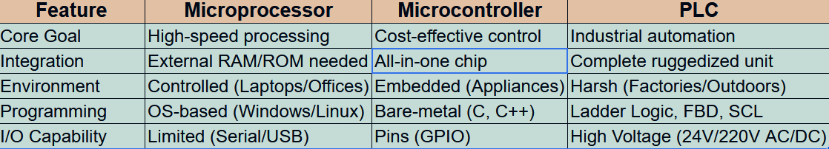
Processor, Micro Controller, PLC

Slide 9

PLC ARCHITECTURE
BLOCK DIAGRAM
(24V DC, 240V AC)
POWER
SUPPY
(Toggle or Push buttons, proximity or pressure sensors)
INPUT DEVICES
PLC
OUTPUT DEVICES
Motors, Solenoids, Valves etc
MEMORY
INTERFACE
(SCADA or HMI)
(External memory module)

Slide 10
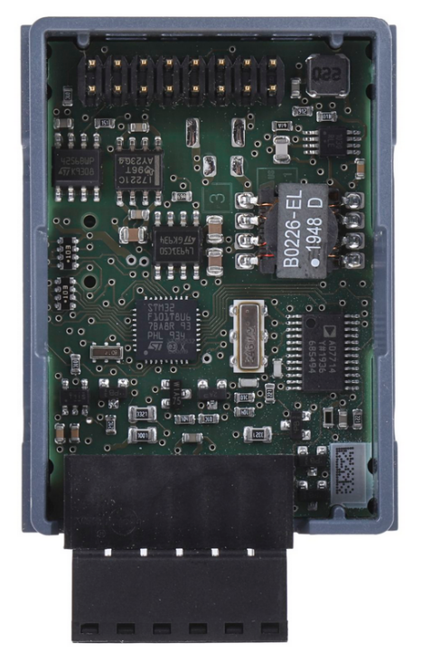
S7 – 1200 Board

Slide 11
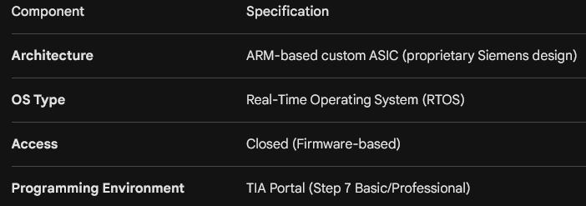
S7 – 1200

Slide 12
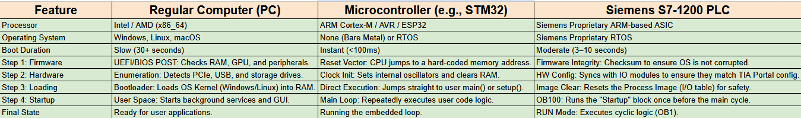
Bootup Process - Comparison

Slide 13
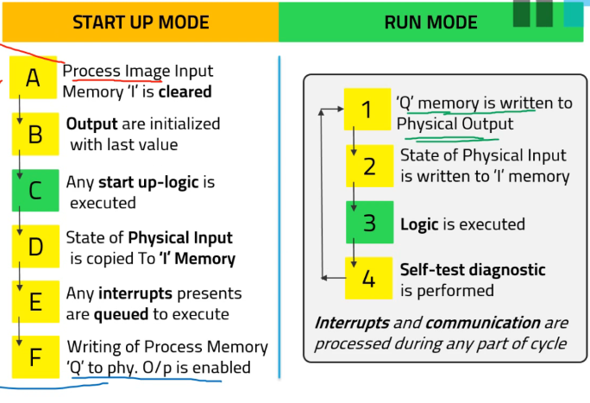
How Processor Starts

Slide 14
PLC Operating Cycle
Four Steps in the PLC Operations
Input Scan
Scan the state of the Inputs
Program Scan
Processes the program logic
Output Scan
Energize/de-energize the outputs
Housekeeping
This step includes communications, Internal Diagnostics, etc.
The steps are continually repeated - processed in a loop.
START
Housekeeping
Input
Scan
Output
Scan
Program
Scan

Slide 15
Human Machine Interface
Face of Industrial Control System
Connects to PLC using PROFINET (Ethernet Based Protocol)
RJ45 Cable
The HMI does not run the machine's logic; it "polls" the PLC
Request: The HMI asks the PLC: "What is the current value of the Temperature sensor?"
Response: The PLC sends back the value (e.g., 75°C).
Visualization: The HMI updates a gauge on the screen to show 75.
Command: If the operator presses a "Start" button on the HMI, it writes a 1 to a specific bit in the PLC memory, which the PLC then uses to trigger a physical motor.

Slide 16
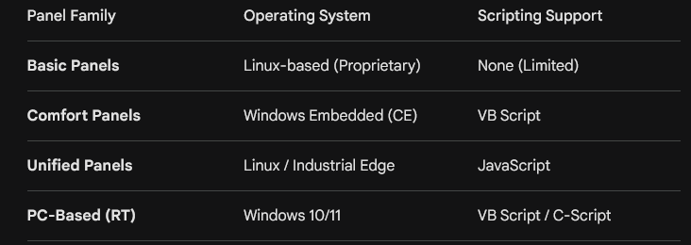
Siemens HMI - OS

Slide 17
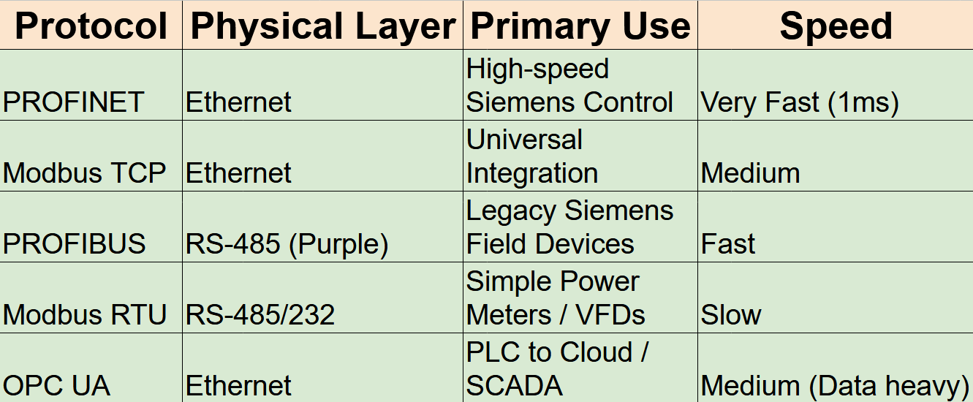
Communication Protocols

Slide 18
PLC BRANDS
Panasonic
Allen Bradley
Delta
Omron
Siemens
Keyence
Schnieder
Mitsubishi

Slide 19
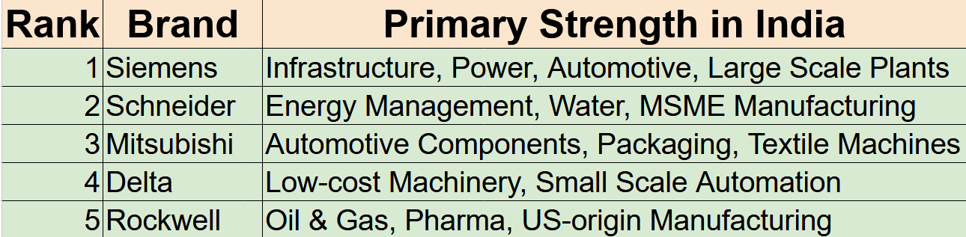
PLC: INDIA

Slide 20
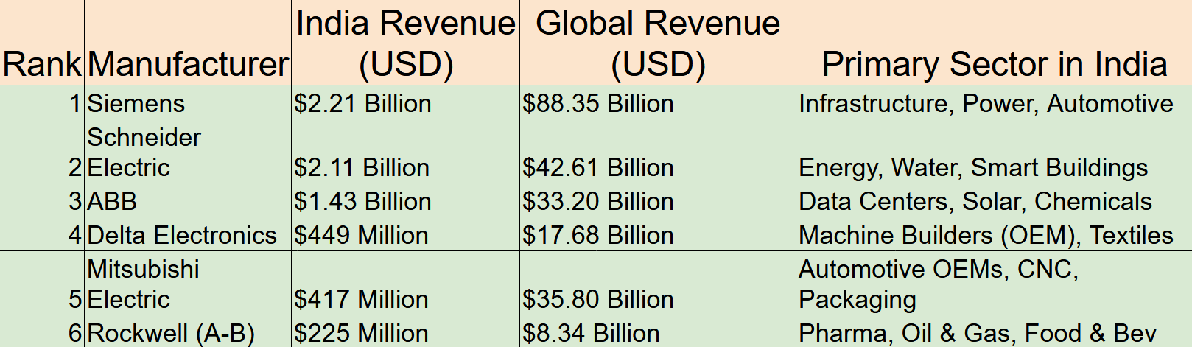
PLC: INDIA PRESENCE

Slide 21
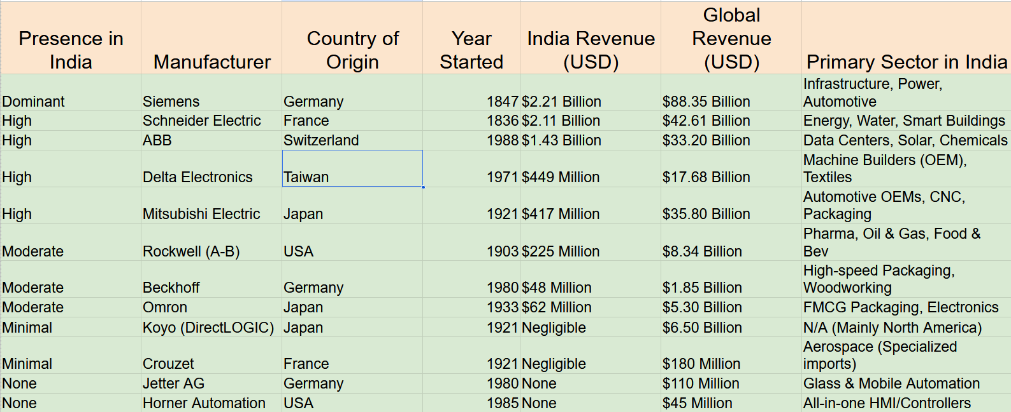
PLC: INDIA PRESENCE

Slide 22
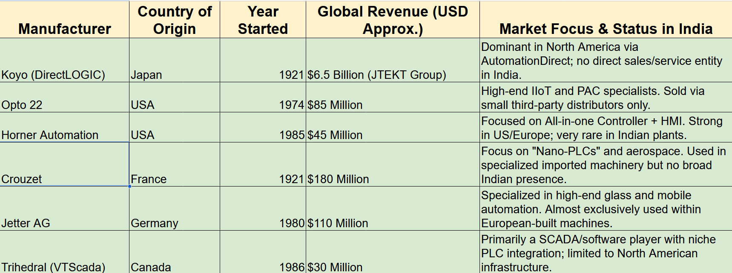
PLC: NOT IN INDIA

Slide 23
THANK YOU

