Slide 1
Welcome to our Presentation

Slide 2
Group Name: MAD (Mobile Application Developers)
Group Members
Name | ID
Babul Miah | 108383
Sirajul Islam | 106940
Kamrul Chowdhury
Shajib

Slide 3
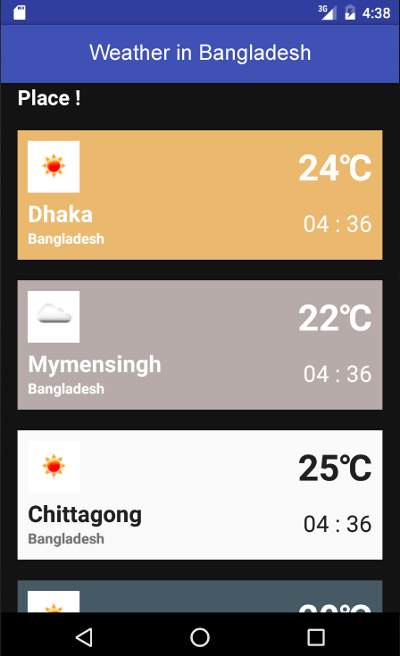

Slide 4
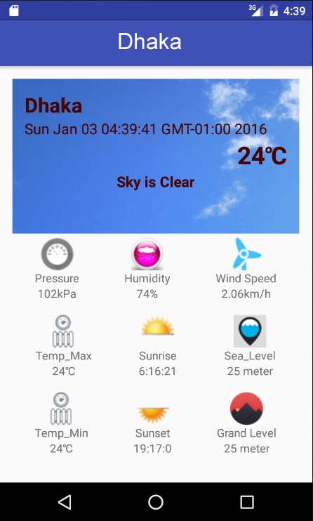

Slide 5
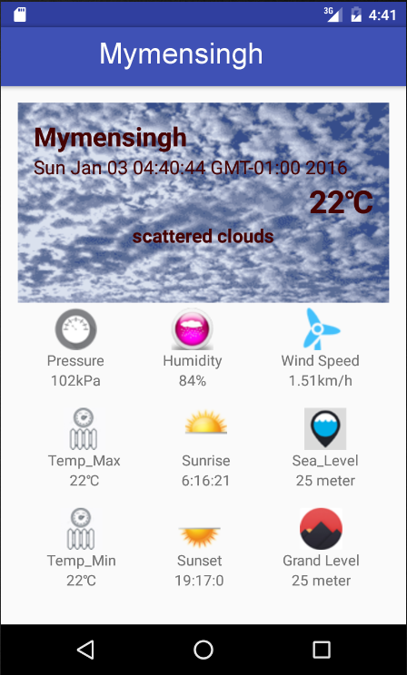

Slide 6
