Slide 1
Normalization

Slide 2
What is Normalization?
Normalization is a process of organizing data in the data base. It is used to reduce data redundancy i.e., it converts inconsistent data into consistent data.
Inconsistent in sense we have anomalies like insertion, deletion, and updation as well as data redundancy in database. So to make the data more consistent we apply normalization.

Slide 3
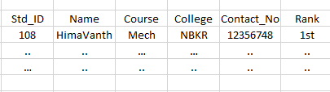
What is Data Redundancy?
Redundancy means having multiple copies of same data in the data base. So to solve this problem we introduce concept called Normalization.
Whenever data in database is normalized i.e., organized then we are free from data redundancy.

Slide 4
Types of Redundancy:
There are three types of redundancy. They are:
Insertion Anomaly
Deletion Anomaly
Updation Anomaly
Whenever we avoid deletion, updation and Insertion Anomalies we automatically reduce data redundancy.

Slide 5
Continuation of Normalization:
So, here we make larger tables into smaller tables and we establish relationship between the tables. So this is how we achieve the Normalization.
The inventor of the relational model Edgar Codd proposed the theory of normalization of data with the introduction of the First Normal Form, and he continued to extend theory with Second and Third Normal Form. Later he joined Raymond F. Boyce to develop the theory of Boyce-Codd Normal Form.

Slide 6
Database Normal Forms
Here is a list of Normal Forms in SQL:
1NF (First Normal Form)
2NF (Second Normal Form)
3NF (Third Normal Form)
BCNF (Boyce-Codd Normal Form)
4NF (Fourth Normal Form)
5NF (Fifth Normal Form)
6NF (Sixth Normal Form)

Slide 7
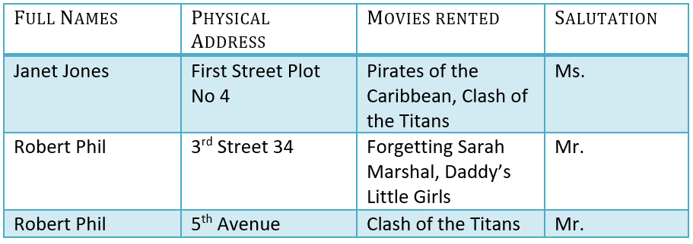
Database Normalization With Examples
Database Normalization Example can be easily understood with the help of a case study. Assume, a video library maintains a database of movies rented out. Without any normalization in database, all information is stored in one table as shown below. Let’s understand Normalization database with normalization example with solution:

Slide 8
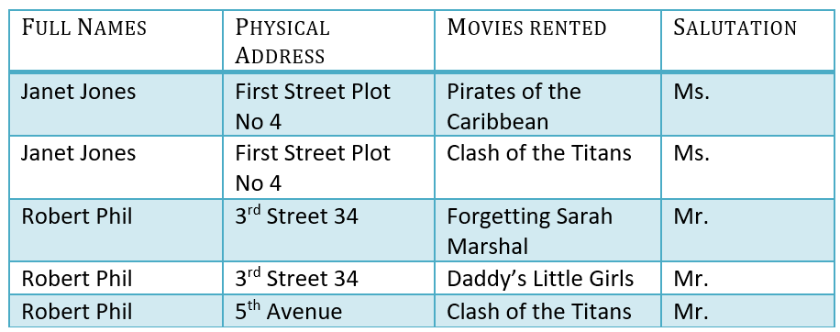
1NF (First Normal Form) Rules
Each table cell should contain a single value.
Each record needs to be unique.

Slide 9
What is a KEY in SQL?
To proceed further with remaining Normal Forms, Key play an important role.
A KEY in SQL is a value used to identify records in a table uniquely. An SQL KEY is a single column or combination of multiple columns used to uniquely identify rows or tuples in the table. SQL Key is used to identify duplicate information, and it also helps establish a relationship between multiple tables in the database.
Columns in a table that are NOT used to identify a record uniquely are called non-key columns.

Slide 10

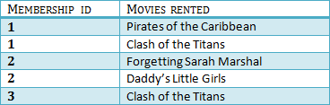
2NF (Second Normal Form) Rules
Rule 1- Be in 1NF
Rule 2- Single Column Primary Key that does not functionally dependent on any subset of candidate key relation
It is clear that we can’t move forward to make our simple database in 2nd Normalization form unless we partition the table above.

Slide 11

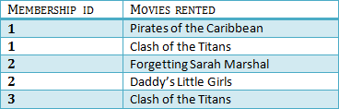

3NF Example:

Slide 12
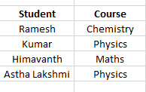
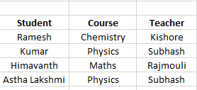

Boyce-Codd Normal Form (BCNF):
BCNF is referred as 3.5 normal form.
For every functional Dependency A -> B, A should be super key of a table.

Slide 13
4NF (Fourth Normal Form) Rules
If no database table instance contains two or more, independent and multivalued data describing the relevant entity, then it is in 4th Normal Form.
5NF (Fifth Normal Form) Rules
A table is in 5th Normal Form only if it is in 4NF and it cannot be decomposed into any number of smaller tables without loss of data.
6NF (Sixth Normal Form) Proposed
6th Normal Form is not standardized, yet however, it is being discussed by database experts for some time. Hopefully, we would have a clear & standardized definition for 6th Normal Form in the near future…

Slide 14
Denormalization:
Denormalization is a strategy used on a previously-normalized database to increase performance. In computing, Denormalization is the process of trying to improve the read performance of a database, at the expense of losing some write performance, by adding redundant copies of data or by grouping data.

Slide 15
Thank You

