Slide 1
Federated Learning

Slide 2

Content
Machine learning on Centralized data
Why Federated Learning (FL)?
FL vs. other distributed optimization
FL Algorithms

Slide 3
Why FL
Federated averaging
“Federated learning” refers to a family of algorithms that attempt to solve machine learning problems. They differ in important details, but share the basic idea: a server coordinates a network of nodes, each of which has training data. The nodes each train a local model, and it is that model which they share with the server.
Federated learning makes it possible to build machine learning systems without direct access to training data.
The data remains in its original location, which helps to ensure privacy and reduces communication costs.

Slide 4
Two things define the federated learning setting.
First, the training data cannot be moved away from its source. The reasons for this constraint can include privacy concerns (I don’t want share my personal photos, chats etc..), regulatory impediments (HIPAA, GDPR, etc.), and practical engineering blockers (the network connection is expensive, slow or unreliable, or the data is too large).
Federated learning helps when the data cannot be moved.

Slide 5
Goal of Federated Learning
The goal of federated learning is
Millions of mobile devices with state of the art machine learning systems without centralizing data and with privacy by default.
Federated Learning is a privacy-preserving technology

Slide 6
Federated Learning setting, the data is distributed across millions of devices in a highly uneven fashion.
The devices have significantly higher-latency, lower-throughput connections and are only intermittently available for training.

Slide 7
Advantages of FL
The benefit of FL is to distribute the quality of knowledge across a large number of devices without necessarily centralizing the data used to optimize and train the model.
That approach also enables to improve the quality of centralized machine learning models while maintaining the privacy of the training datasets.
However, FL does not come without problems. Like any other software architectures, decentralization introduces challenges in areas such as work coordination, management or monitoring.
If nothing else, Fl is an interesting complement, and not necessarily an alternative, to the traditional centralized supervised and semi-supervised learning architectures.

Slide 8
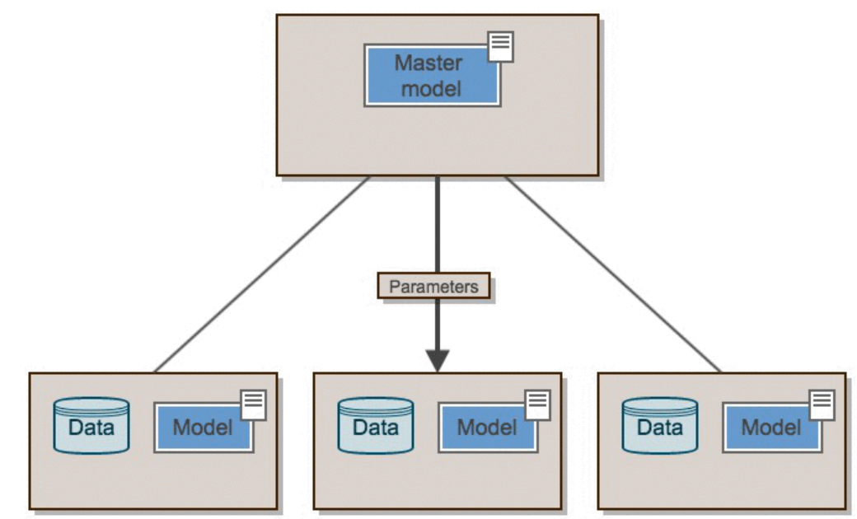
FL: Architecture
ELEPHAS works as follows

Slide 9
Libraries
PySpark,
Keras, and
Elephas

Slide 10
One popular application of Federated Learning is for learning the next word prediction" model on your mobile phone when you write SMS messages: you don't want the data used for training that predictor — i.e. your text messages — to be sent to a central server.
One simple example of Federated Learning in the real world happens with Apple devices.
The application QuickType (Apple's text prediction tool) actually uses models that are sent time to time to iOS devices via WiFi, are trained locally with users' data and are sent back to Apple's central server with their weights updated.

Slide 11
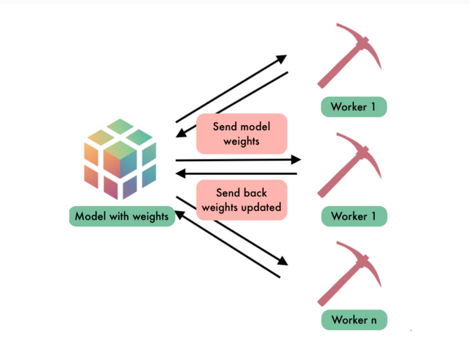
Scehema of FL

Slide 12
Federated Learning
Instead of bringing data all to one place for training, federated learning is done by bringing the model to the data. This allows a data owner to maintain the only copy of their information.
Differential Privacy
Differential Privacy is a set of techniques for preventing a model from accidentally memorizing secrets present in a training dataset during the learning process.

