Slide 1
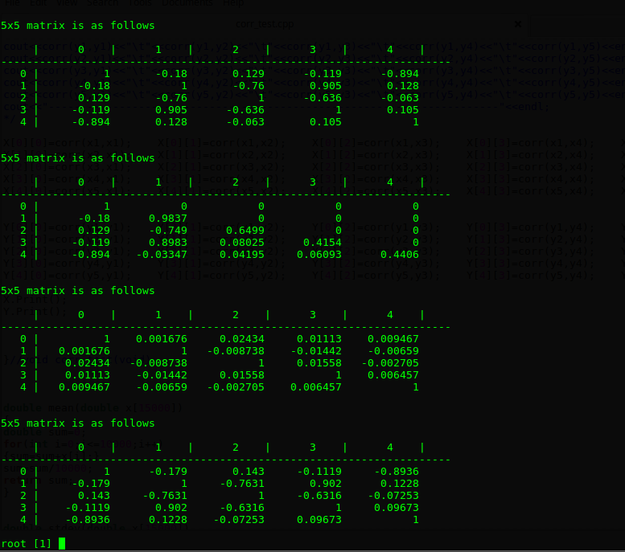
A
starting correlation matrix
B
solution of Cholesky-decomposition
C
correlation matrix of 5 independent random variables
statistics : 10,000
D
correlation matrix after inducing correlation in C
using B
statistics : 10,000

