Slide 1
老板论文阅读笔记

Slide 2
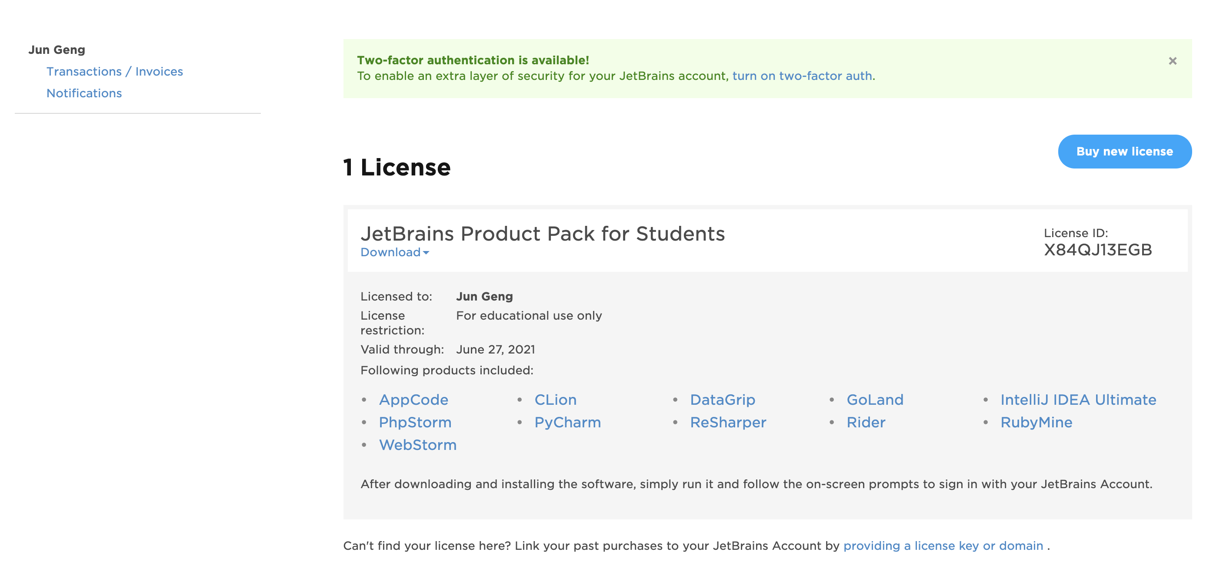
Pycharm安装
申请Jetchain的教育版license，用户名：gjun0317, gejun@chalmers.se,密码: oppo0315@，获得license如下所示:

Slide 3
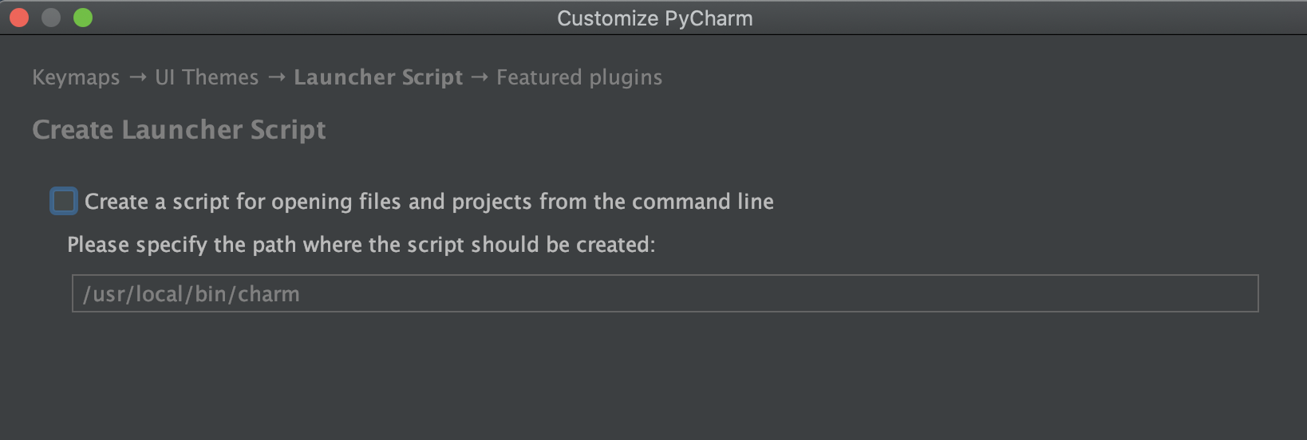
Pycharm安装
安装过程中，默认的创建script的路径如下，没有修改

Slide 4
MAC安装好anaconda后无法在终端使用conda命令解决方案
基本思路就是首先通过command+shift+.打开隐藏文件
然后进入/Users/jungeng，找到/Users/jungeng/.bash_profile
参考” https://www.jianshu.com/p/b9eac8419c8d; https://www.jianshu.com/p/6cdc9713c4ed”的步骤，终端里面用vim操作添加路径，并添加镜像路径等操作修改bash_profile，此时还是不行。
然后把bash_profile里面添加的路径再添加到/Users/jungeng/.zshrc里面，然后就可以了。这一步参考” https://blog.csdn.net/Cece11011/article/details/103820337?utm_medium=distribute.pc_relevant_t0.none-task-blog-BlogCommendFromMachineLearnPai2-1.nonecase&depth_1-utm_source=distribute.pc_relevant_t0.none-task-blog-BlogCommendFromMachineLearnPai2-1.nonecase”
https://blog.csdn.net/qq_16735407/article/details/50561144

Slide 5
连接两个MAC电脑
https://www.jianshu.com/p/77b7b0c2c08a

Slide 6
生物信息学方面书籍
https://mp.weixin.qq.com/s?__biz=MzI5MTcwNjA4NQ==&mid=2247486486&idx=1&sn=32960c5a409236f7c808eb3d7e16ec4c&scene=21#wechat_redirect

Slide 7
Gene set analysis
Enriching the gene set analysis of genome-wide data by incorporating directionality of gene expression and combining statistical hypotheses and methods

