Slide 1
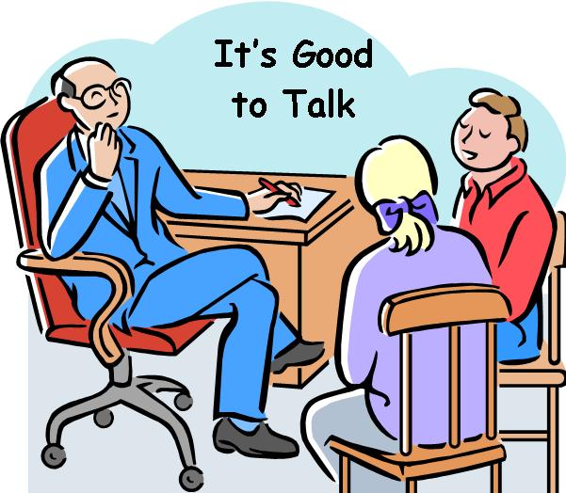
Adrienne C. Davis, PhD ABPP
Licensed Psychologist
Minding Your Mental Health

Slide 2

Did you know?

Slide 3
When women are asked what the most important quality is they look for in a man, the majority say “a sense of humor”.

Slide 4
Did you know?

Slide 5

May is Mental Health Awareness Month

Slide 6
Did you know?

Slide 7
Only 2 out of every 5 patients who are experiencing significant emotional problems actually seek mental health assistance.

Slide 8
Did you know?

Slide 9
Research indicates that most adults get about 5-6 hours of sleep a night; we actually need 8-10 hours.

Slide 10
Did you know?

Slide 11
Regular exercise is associated with a reduced risk of cognitive decline, Alzheimer’s Disease, dementia and other neurodegenerative diseases.

Slide 12
Did you know?

Slide 13
People who have pets tend to have lower blood pressures and better moods.

Slide 14
Did you know?

Slide 15
Stress affects your oral health causing: - cold sores - canker sores - dry mouth - teeth grinding - gum disease - bad breath

Slide 16
Did you know?

Slide 17
Mental and Physical Health are inseparable; what we think and do, our emotions have a strong influence on how our bodies manage disease, and medical conditions affect our mental
and emotional state.

Slide 18
Did you know?

Slide 19
The most important barrier to seeking mental health treatment is the STIGMA associated with mental illness.

Slide 20
Did you know?

Slide 21
Doctors are more likely to diagnose a female patient with depression than a male patient even when they are reporting the same symptoms.

Slide 22
Did you know?

Slide 23
Research has shown that when a man’s favorite football team loses on Sunday, he will be irritable and cranky for the next few days.

Slide 24
Did you know?

Slide 25
About 13% of women who have just given birth experience significant depression

Slide 26
Did you know?

Slide 27
The number 1 cause of insomnia is ANXIETY; Most adults go to bed each night with worries on their mind

Slide 28
Did you know?

Slide 29
Half of all mental illnesses begin by the age of 14 and ¾ by the mid-20s

Slide 30
Did you know?

Slide 31
Women speak 7000 words a day, men speak only 2000 words
a day

Slide 32
Did you know?

Slide 33
The suicide rate among Veterans is 3x higher than that of the general population

Slide 34
Did you know?

Slide 35
When asked about emotional distress, women are more likely to report recent experiences of depression and anxiety while men are more likely to report drug and alcohol abuse

Slide 36
Did you know?

Slide 37
People who stay up later are more likely to experience nightmares than those who
go to bed earlier

Slide 38
Did you know?

Slide 39
“Women are Wonderful” Effect
reflects a phenomenon in which people associate more positive attributes or qualities to the general category of women compared to men.

Slide 40
Did you know?

Slide 41
70% of youth in the juvenile justice system have at least one mental health condition; 20% live with a serious mental illness

Slide 42
Did you know?

Slide 43
People tend to be more truthful face-to-face and in writing (even texting), much less truthful
on the phone

Slide 44
Did you know?

Slide 45
Going to a Comedy Club or watching a funny movie reduces stress because laughing causes the brain to release endorphins leading to feelings of joy and euphoria.

Slide 46
Did you know?

Slide 47
Regular church attendance is associated with a longer life, better mental and physical health, higher educational achievement, less substance abuse and more well-behaved children.

Slide 48
Did you know?

Slide 49
Attention Deficit Hyperactivity Disorder is the most common psychiatric diagnosis given to children and adolescents

Slide 50
Did you know?

Slide 51
Anorexia is the most common cause of death - 12 times higher than any other condition - among young women ages 15 to 24

Slide 52
Did you know?

Slide 53
Research on the social determinants of positive physical and mental heath indicates that “our zip code may be more important than our genetic code”

Slide 54
Did you know?

Slide 55
The United States has the highest incarceration rate in the world

Slide 56
Did you know?

Slide 57
Depression
is the leading cause of disability worldwide

Slide 58
Did you know?

Slide 59
Combining psychotherapy with medication is more effective treatment for depression than medication alone

Slide 60
Did you know?

Slide 61
Women are more likely to report symptoms of emotional distress to their primary care physician; men are more likely to report their emotional distress to a
mental health professional

Slide 62
Did you know?

Slide 63
Most people consider crying an expression of ones’ emotions, but not aggressive and violent behavior.

Slide 64
Did you know?

Slide 65
Going to bed angry raises your blood pressure and interferes with the body’s ability to fight disease.

Slide 66
Did you know?

Slide 67
The voice that speaks the TRUTH is the one that speaks the softest; Pay attention to
your GUT!

Slide 68
Did you know?

Slide 69
Deep breathing and meditation can help fight stress-related disorders like anxiety, depression, heart attacks, irritable bowel syndrome
and insomnia

Slide 70
Did you know?

Slide 71
Go ahead, EAT THAT CHOCOLATE! Research shows that dark chocolate is rich in antioxidants that help to reduce inflammation that leads to many unwanted physical illnesses.

Slide 72
Did you know?

Slide 73
When a man’s favorite football team loses on Sunday, he is likely to exhibit irritable and cranky behavior for several days afterward

Slide 74
Did you know?

Slide 75
Watching a “tearjerker”
movie like ‘Titanic’ or (fill in the blank) make you feel closer to people you love.

Slide 76
Did you know?

Slide 77
Untreated Mental Illness costs society an estimated $273 Billion a year in decreased productivity, accidents, absenteeism, worsening of medical conditions

Slide 78
Did you know?

Slide 79
Adults laugh an estimated 15-20 times a day; for children it’s more like 300 times!

Slide 80
Did you know?

Slide 81
A survey of 4000 women found that 43% had missed out on a trip to the beach or pool party because they didn’t like the way they looked

Slide 82
Did you know?

Slide 83
Even in the age of “I LOVE being single!” research consistently finds that married people are happier than single people

Slide 84
Did you know?

Slide 85
The average person will dream about 1-2 hours a night and have about
4-7 dreams.

Slide 86
Did you know?

Slide 87
Medical conditions such as chronic pain and fibromyalgia are thought to have an underlying psychological component – past trauma, depression, anxiety, chronic stress – factors that trigger the conditions
or exacerbate it

Slide 88
Did you know?

Slide 89
Research has shown that what triggers laughter is not a good joke but interactions with another person

Slide 90
Did you know?

Slide 91
A recent study found that “Girl Talk” helped girls bond with each other but also exacerbates their anxiety and depression

Slide 92
Did you know?

Slide 93
It has been shown that women eat more when there are no men
around to watch

Slide 94
Did you know?

Slide 95
Getting only 5 hours of sleep a night doubles your chances of having
a heart attack

Slide 96
Did you know?

Slide 97
Men really don’t listen. But, it’s not their fault. Women’s voices have more frequencies and the brain has to work harder to analyze and comprehend the meaning of what women say.

