Slide 1
DEFINED RISK TRADING
MODULE 4
Session Liquidity &
Volume Profile
Where liquidity sits, and whether volume agrees
Notes:
Welcome to Module 4. In Module 3 you learned the CRT setup. Now we answer two questions that make that setup better. Where is price headed? And does volume agree with the move? That's session liquidity and volume profile.

Slide 2

RISK DISCLAIMER
Before We Start
This is education, not financial advice.
Futures trading carries a real risk of loss. You can lose more than you planned if you trade without a stop.
Chart examples are for teaching. Past results don't predict future results.
Only trade money you can afford to lose.
Defined Risk Trading
Notes:
Quick note before we start. This is education, not financial advice. Futures can take money out of your account fast, and more than you planned if you trade without a stop. The chart examples are for teaching. Nothing I show you is a promise of what the next trade does. Only trade money you can afford to lose.

Slide 3
MODULE 4
Module 4 Lessons
4.1
What Session Liquidity Means
4.4
Using Volume to Confirm Zones
4.2
Reading the Three Sessions
4.5
Using the POC as an Entry or Exit
4.3
Fixed Range Volume Profile Basics
4.6
Combining Both Tools with CRT
Defined Risk Trading
Notes:
Here's the plan. Six short lessons. 4.1 and 4.2 are session liquidity: where the orders sit. 4.3 and 4.4 are volume profile: where the trading happened. 4.5 is how I use the POC as an entry or an exit. And 4.6 puts all of it together with your CRT setup.

Slide 4
LESSON 4.1
What Session Liquidity Means
Defined Risk Trading
MODULE 4 • LESSON 4.1
Notes:
Lesson 4.1. What session liquidity means.

Slide 5
TELL
Three Sessions, Three Ranges
ASIA
LONDON
NEW YORK
7:00 PM
to 2:59 AM
3:00 AM
to 9:29 AM
9:30 AM
to 3:59 PM
Eastern time
Eastern time
Eastern time
Each session leaves a high and a low on your chart.
Defined Risk Trading
MODULE 4 • LESSON 4.1
Notes:
Every trading session has its own high and its own low. Asia runs 7 PM to 2:59 AM Eastern. London runs 3 AM to 9:29. New York runs 9:30 AM to 3:59 PM. Three sessions, so six levels on your chart every day.

Slide 6
TELL
Sand at the Base of a Slide
Stops and pending orders pile up at session highs and lows.
That pile of orders is fuel. I treat those levels as targets.
Defined Risk Trading
MODULE 4 • LESSON 4.1
Notes:
Here's why those levels matter. Stop-losses and pending orders cluster around them, like sand piling up at the base of a slide. That pile of orders is fuel. So I treat those highs and lows as targets. When price runs toward one, it's going where the orders are.

Slide 7

SCREEN-SHARE: TRADINGVIEW
Session Lines on a Live Chart
ON THE CHART
1
Turn on the Session Liquidity indicator
2
Point to each session's high and low
3
Show what price does with London's high once New York opens
Notes:
Let me show you on a live chart. [Switch to TradingView.] This is the Session Liquidity indicator. This line is the Asia high, and this one is the Asia low. Here's London's high and low. Now New York opens at 9:30. Watch London's high. [Scroll forward.] See how price went after it? That's the liquidity resting there, and that's why I mark these lines every morning. [Switch back to the slides.]

Slide 8
DO
Your Turn: Lesson 4.1
1
Turn on your Session Liquidity indicator
2
Screenshot your chart with all three sessions' lines visible
3
Post it in the community
Defined Risk Trading
MODULE 4 • LESSON 4.1
Notes:
Your turn. Turn on your Session Liquidity indicator if you haven't yet. Screenshot your chart with all three sessions' lines showing. Post it.

Slide 9
LESSON 4.2
Reading the Three Sessions
Defined Risk Trading
MODULE 4 • LESSON 4.2
Notes:
Lesson 4.2. Reading the three sessions.

Slide 10
TELL
Sessions Hand Off to Each Other
ASIA
LONDON
NEW YORK
Builds a range
Often sweeps the Asia range
Often goes after the level nobody touched yet
Same lines as 4.1. Now we read how they interact.
Defined Risk Trading
MODULE 4 • LESSON 4.2
Notes:
Same tool, more depth. In 4.1 you spotted the lines. Now we read how the sessions interact. Asia builds a range. London often sweeps that range. Then New York often goes after whichever session level hasn't been touched yet. Often, not always. That's why we watch it every day.

Slide 11
SCREEN-SHARE: TRADINGVIEW
One Full Day, Session by Session
ON THE CHART
1
Start at the Asia open and mark its range
2
Show London sweeping the Asia high or low
3
Show New York going after the untouched level
Notes:
Let's walk one full day. [Switch to TradingView.] Here's the Asia open. Price builds this range overnight. Here's the high, here's the low. Now London opens at 3 AM. Watch what it does to the Asia range. [Scroll.] There's the sweep. Now which level is still sitting there untouched? This one. New York opens at 9:30, and here's price going after it. [Switch back.]

Slide 12
DO
Your Turn: Lesson 4.2
1
Track today's three session highs and lows on your chart
2
At the end of the day, post which one got swept first
Defined Risk Trading
MODULE 4 • LESSON 4.2
Notes:
Your turn. Track today's three session highs and lows on your chart. At the end of the day, post which one got swept first.

Slide 13
LESSON 4.3
Fixed Range Volume Profile Basics
Defined Risk Trading
MODULE 4 • LESSON 4.3
Notes:
Lesson 4.3. Fixed Range Volume Profile basics.

Slide 14
TELL
A Different Question
Not "where did price go?"
But "where did the most trading happen?"
That's what volume profile answers.
Defined Risk Trading
MODULE 4 • LESSON 4.3
Notes:
This tool answers a different question than price alone. Not where did price go. Where did the most trading happen. Price tells you the path. Volume profile tells you where buyers and sellers spent the most time agreeing.

Slide 15
TELL
Two Words to Know
POC
VALUE AREA
Point of Control. The single price with the most volume.
The zone holding about 70% of the volume. That's TradingView's default.
I draw it on the 30-minute chart.
Defined Risk Trading
MODULE 4 • LESSON 4.3
Notes:
Two words to know. POC, the Point of Control, is the single price with the most volume. The value area is the zone around it holding about 70% of the volume. That's TradingView's default setting, so leave it there. And I draw this on the 30-minute chart. That's the timeframe for everything in this module.

Slide 16
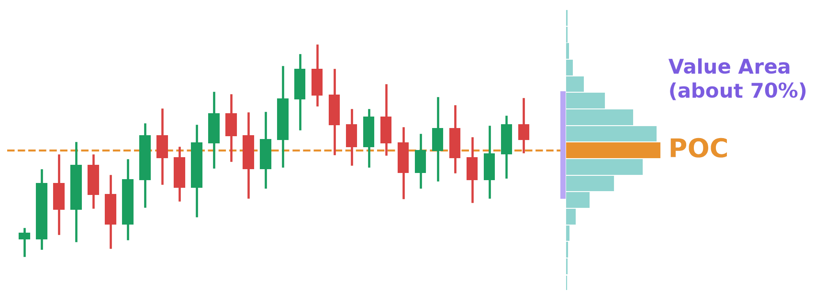
EXAMPLE
What the Profile Looks Like
Example with synthetic candles, not a real trade
Defined Risk Trading
MODULE 4 • LESSON 4.3
Notes:
Here's what it looks like. The bars on the right are volume at each price. The longest bar is the POC, in orange. The purple band marks the value area. On a normal session you get a fat middle and thin edges.

Slide 17
SCREEN-SHARE: TRADINGVIEW
Fixed Range Volume Profile, Live
ON THE CHART
1
30-minute chart
2
Draw Fixed Range Volume Profile over a recent session
3
Point out the POC and the value area
Notes:
Now on a live chart. [Switch to TradingView.] I'm on the 30-minute chart. I pick the Fixed Range Volume Profile tool, click the start of the session, and drag to the end. Here's the POC, the price with the most volume. Here's the value area. Fat middle, thin edges. That's a normal session. [Switch back.]

Slide 18
DO
Your Turn: Lesson 4.3
1
Draw Volume Profile on yesterday's session, 30-minute chart
2
Screenshot it and mark where the POC landed
Defined Risk Trading
MODULE 4 • LESSON 4.3
Notes:
Your turn. Apply Volume Profile to yesterday's session on your own 30-minute chart. Screenshot it and mark where the POC landed.

Slide 19
LESSON 4.4
Using Volume to Confirm Zones
Defined Risk Trading
MODULE 4 • LESSON 4.4
Notes:
Lesson 4.4. Using volume to confirm zones.

Slide 20
TELL
High Volume vs. Low Volume
HIGH-VOLUME NODE
LOW-VOLUME GAP
Price agrees it belongs here. It may pause or reverse. Harder for a sweep to punch through cleanly.
Price moved through fast. Less in the way. This is where I often see manipulation sweeps.
Defined Risk Trading
MODULE 4 • LESSON 4.4
Notes:
High-volume areas mean price agrees it belongs there. It might pause there or reverse, and it's harder for a sweep to punch through cleanly. Low-volume gaps mean price moved through fast, without much disagreement. That's where I often see manipulation sweeps happen, because there's less resistance.

Slide 21
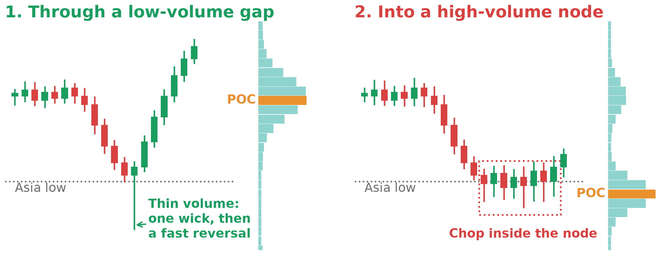
EXAMPLE
Volume Confirms the Sweep
Example with synthetic candles on a 30-minute chart, not a real trade
Defined Risk Trading
MODULE 4 • LESSON 4.4
Notes:
Here's the picture. On the left, the sweep goes through a low-volume gap. One wick through, then price reverses hard. Clean. On the right, the sweep goes into a high-volume node. Price chops around inside it, and the reversal is hard to read. Same sweep, different volume, different trade.

Slide 22
SCREEN-SHARE: TRADINGVIEW
Gap vs. Node on Real Sweeps
ON THE CHART
1
Sweep #1: through a low-volume gap (fast, clean)
2
Sweep #2: into a high-volume node (choppy)
3
Compare how each reversal looked
Notes:
Let's look at two real sweeps. [Switch to TradingView.] Sweep one. Profile's drawn on the 30-minute chart. Look where the wick went: through this thin area, a low-volume gap. One push through and price snapped back. Now sweep two. This one ran into a high-volume node. Look at the chop. Three, four candles going nowhere before anything happened. That's the difference. [Switch back.]

Slide 23
DO
Your Turn: Lesson 4.4
1
Pull up your Module 3 CRT screenshot
2
Overlay Volume Profile on it, 30-minute chart
3
Post: did the sweep pass through high or low volume?
Defined Risk Trading
MODULE 4 • LESSON 4.4
Notes:
Your turn. Pull up your Module 3 CRT screenshot again. Overlay Volume Profile on it, drawn on the 30-minute chart. Post whether the sweep passed through high or low volume, and whether that changes how you'd read the setup.

Slide 24
LESSON 4.5
Using the POC as an Entry or Exit
Defined Risk Trading
MODULE 4 • LESSON 4.5
Notes:
Lesson 4.5. Using the POC as an entry or an exit.

Slide 25
TELL
One Line, Two Jobs
I use the POC as my exit
or as my entry.
This is how I trade it. It's not a law the market has to follow.
Defined Risk Trading
MODULE 4 • LESSON 4.5
Notes:
In 4.4 we used volume to judge the sweep. Now I'm going to show you how I use one line off that profile, the POC, as my exit or my entry. This is how I trade it. It's not a law the market has to follow.

Slide 26
TELL
The POC as My Exit
1
Draw the profile on the 30-minute chart, over the range I'm trading
2
After the sweep and my CRT entry, I manage the trade at the POC, or a few ticks before it
3
Full exit or a partial with a runner: I decide from how the candles move into the POC
Defined Risk Trading
MODULE 4 • LESSON 4.5
Notes:
First, the POC as my exit. I draw the Fixed Range Volume Profile on the 30-minute chart, over the range I'm trading. After the sweep and my CRT entry, I manage the trade at the POC of that range, or a few ticks before it. Sometimes I take the full exit there. Sometimes I take a partial and let the rest run. Which one depends on how the candles move into the POC. That's a read, not a formula. You build the feel for it with screen time.

Slide 27
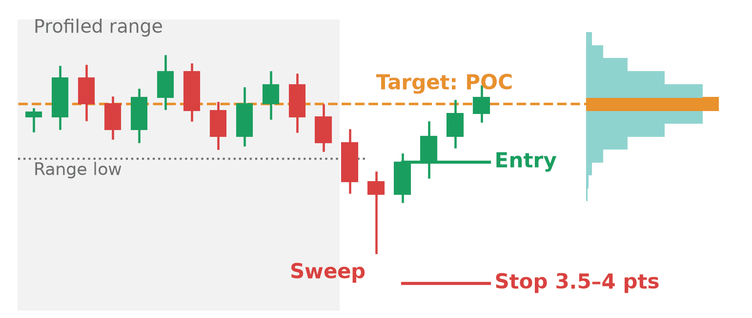
EXAMPLE
The POC as the Exit
Example with synthetic candles on a 30-minute chart, not a real trade
Defined Risk Trading
MODULE 4 • LESSON 4.5
Notes:
Here's the exit on a chart. The gray box is the range I profiled. Price sweeps under the range low, then reverses. Entry on the reversal, hard stop 3.5 to 4 points below it. And the target is the POC of that range, the orange line. That's where I expect price to slow down.

Slide 28
TELL
Where It's Headed vs. Where It Slows Down
SESSION LIQUIDITY
POC
Where price is headed
Where price is likely to slow down on the way
Defined Risk Trading
MODULE 4 • LESSON 4.5
Notes:
Why the POC? It's where the most trading happened in that range, so that's where I expect price to stall. Session liquidity tells me where price is headed. The POC tells me where it's likely to slow down on the way.

Slide 29
TELL
The POC as My Entry
1
Price leaves the range, then comes back to the POC
2
I don't enter on the touch. I wait for a reaction candle at the POC
3
If it lines up with my CRT direction, I enter on that candle's close
Defined Risk Trading
MODULE 4 • LESSON 4.5
Notes:
Second, the POC as my entry. When price leaves the range and comes back to the POC, I watch how it reacts there. I don't enter on the touch. I wait for a reaction candle at the POC. If it lines up with my CRT direction, I enter on that candle's close.

Slide 30
TELL
Your Stop and Target on a POC Entry
3.5–4
Session H/L
±1 pt
point hard stop, measured from the reaction candle's close
target: the untaken liquidity in your direction
exit at that line or within a point of it
No stop, no trade. Full risk rules are in Module 5.
Defined Risk Trading
MODULE 4 • LESSON 4.5
Notes:
Now your stop. I manage my own trades by hand, but that's me, not you. You use a hard stop of 3.5 to 4 points on ES. On a POC entry, that's 3.5 to 4 points from your entry, the close of the reaction candle. If you're a beginner, you don't take a trade without a stop. No exceptions. My target is the session high or the session low, whichever is the untaken liquidity in my trade direction. I exit at that line or within a point of it. We cover size and risk in detail in Module 5.

Slide 31
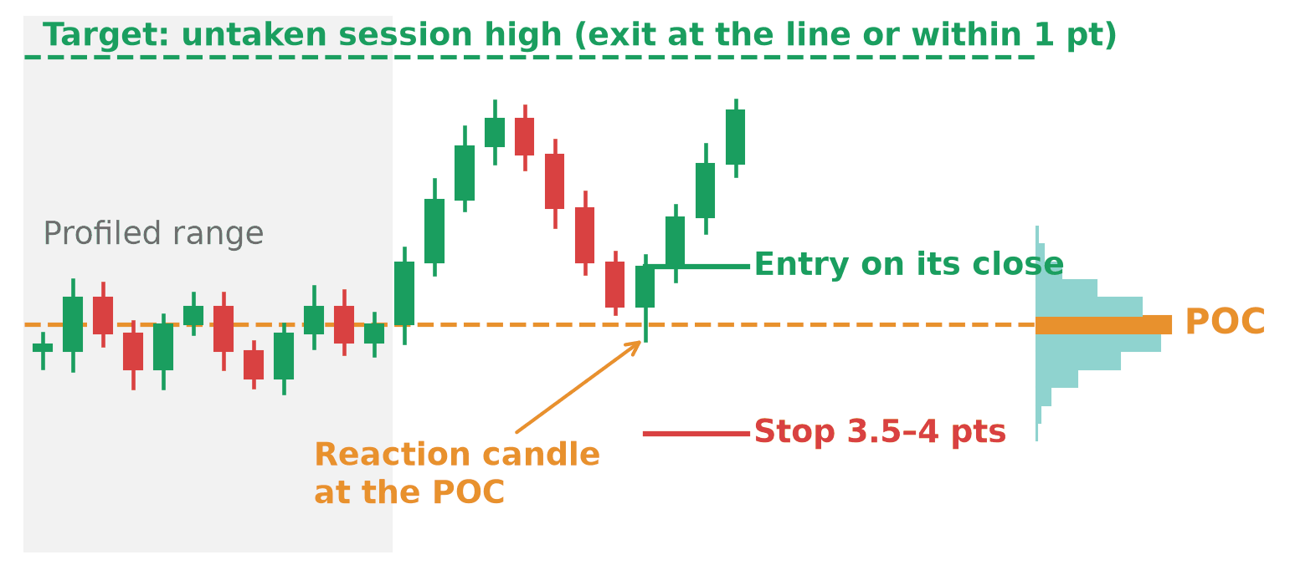
EXAMPLE
The POC as the Entry
Example with synthetic candles on a 30-minute chart, not a real trade
Defined Risk Trading
MODULE 4 • LESSON 4.5
Notes:
And here's the entry. Price leaves the range, then comes back to the POC. I don't enter on the touch. This candle wicks into the POC and closes back up. That's the reaction candle. Entry on its close. Hard stop 3.5 to 4 points below the entry. Target is the session high nobody's taken yet, up here.

Slide 32
SCREEN-SHARE: TRADINGVIEW
The POC on Real Setups
ON THE CHART
1
30-minute chart: draw the profile over the range you trade
2
Setup #1: the POC as the target
3
Setup #2: the POC as the entry, with stop and target marked
Notes:
Now on real charts. [Switch to TradingView.] 30-minute chart. I draw the profile over the range I'm trading, start to end. Here's the POC. Setup one: here's the sweep, here's my CRT entry, and the POC is my target. Look at how the candles slowed down coming into it. Setup two: price left the range, came back down to the POC, and printed this reaction candle. Entry on its close. Hard stop 3.5 to 4 points below. Target up here at the session high nobody's taken yet. [Switch back.]

Slide 33
DO
Your Turn: Lesson 4.5
1
On the 30-minute chart, draw Volume Profile on your range and mark the POC
2
On your Module 3 CRT screenshot, mark the POC: entry or target?
3
Post it with your entry, stop and target marked
Defined Risk Trading
MODULE 4 • LESSON 4.5
Notes:
Your turn. On the 30-minute chart, draw Volume Profile on the range you're trading and mark the POC. Then pull up your Module 3 CRT screenshot and mark the POC on it. Was it your entry or your target? Post it with your entry, stop and target marked. One line doesn't make the trade. The POC has to fit the setup.

Slide 34
LESSON 4.6
Combining Both Tools with CRT
Defined Risk Trading
MODULE 4 • LESSON 4.6
Notes:
Lesson 4.6. Combining both tools with CRT.

Slide 35
TELL
3 Tools, 1 Trade
SESSION LIQUIDITY
CRT
VOLUME PROFILE
Where price is headed
The sweep and the entry
Does volume agree? Where's the POC?
None of these tools work alone. They have to agree.
Defined Risk Trading
MODULE 4 • LESSON 4.6
Notes:
None of these tools work in isolation. Session liquidity tells you where price is headed. CRT gives you the sweep and the entry. Volume profile tells you if volume agrees, and where the POC sits. When all three agree, that's the trade. This lesson proves it out loud, one more time, on a live example.

Slide 36
SCREEN-SHARE: TRADINGVIEW
One Trade, All Three Tools
ON THE CHART
1
Mark the session liquidity target
2
Show the CRT sweep into it
3
Volume profile (30m): sweep through a low-volume gap, entry, POC as the target
Notes:
[Switch to TradingView.] Step one, session liquidity. Which level is untaken? This one. That's where price is headed. Step two, CRT. Here's the sweep, right into that level. Step three, volume. Profile's on the 30-minute chart, and look: the sweep went through a low-volume gap. Clean. Here's the entry, and the POC is my target. Three tools, all saying the same thing. [Switch back.]

Slide 37
DO
Your Turn: Lesson 4.6
1
Find your own three-tool example this week
2
Session liquidity + CRT + Volume Profile all agreeing, POC marked as your target
3
Post it whenever you spot one. No deadline.
Defined Risk Trading
MODULE 4 • LESSON 4.6
Notes:
Your turn. Find your own three-tool confluence example this week. Session liquidity, CRT and Volume Profile all agreeing, with the POC marked as your target. Post it whenever you spot one. No deadline.

Slide 38
MODULE 4 • RECAP
Module 4 in One Slide
Session highs and lows are where the orders sit
London often sweeps Asia. New York often hunts the untouched level
POC = most-traded price. Draw it on the 30-minute chart
Sweeps through low-volume gaps read cleaner
The POC is your exit or your entry. Hard stop 3.5–4 points, every time
Next: Module 5, Full Workflow & Risk Management
Defined Risk Trading
Notes:
That's Module 4. Session highs and lows are where the orders sit. London often sweeps Asia, and New York often goes after the level nobody touched. The POC is the most-traded price, drawn on the 30-minute chart. Sweeps through low-volume gaps read cleaner. And the POC is your exit or your entry, with a 3.5 to 4 point hard stop every time. Next up, Module 5: putting it into one workflow, and the risk rules that keep you in the game.

