Slide 1
DEFINED RISK
TRADING
MODULE 4
Session Liquidity &
Volume Profile
Where liquidity sits, and whether volume agrees

Slide 2
LESSON 4.1
What Session Liquidity Means

Slide 3
TELL
Sand at the Base of a Slide
Every session has its own high and low: Asia (7:00 PM–2:59 AM ET), London (3:00–9:29 AM) and New York (9:30 AM–3:59 PM).
Stop-losses and pending orders cluster around those levels, like sand piling up at the base of a slide. I treat those levels as targets, because that's where the resting orders (the 'fuel') sit.
Defined Risk Trading | The Curriculum
MODULE 4 • LESSON 4.1

Slide 4
SHOW
Session Lines on a Live Chart
Switch to the live chart. Turn on the Session Liquidity indicator and point to each session's high and low. Then show what price does with London's high once New York opens.
Defined Risk Trading | The Curriculum
MODULE 4 • LESSON 4.1

Slide 5
DO
Your Turn: Lesson 4.1
1
Turn on your Session Liquidity indicator if you haven't
2
Screenshot your chart with all three session lines visible
3
Post it

Slide 6
LESSON 4.2
Reading the Three Sessions

Slide 7
TELL
How Sessions Interact
Same tool, more depth. This time we're reading how the sessions interact, not only spotting the lines.
Watch how Asia's range gets swept during London, and how NY often targets whichever session's level hasn't been touched yet.
Defined Risk Trading | The Curriculum
MODULE 4 • LESSON 4.2

Slide 8
SHOW
One Full Day, Session by Session
Switch to the live chart. Walk through one full day: Asia's range, London sweeping it, then New York going after whichever session level hasn't been touched yet.
Defined Risk Trading | The Curriculum
MODULE 4 • LESSON 4.2

Slide 9
DO
Your Turn: Lesson 4.2
1
Track today's three session highs/lows on your chart
2
At the end of the day, post which one got swept first

Slide 10
LESSON 4.3
Fixed Range Volume Profile Basics

Slide 11
TELL
Where Trading Actually Happened
This tool answers a different question than price alone: not 'where did price go' but 'where did the most trading actually happen.'
POC = the single price with the most volume.
Value Area = the zone holding about 70% of the volume around it (TradingView's default).
Defined Risk Trading | The Curriculum
MODULE 4 • LESSON 4.3

Slide 12
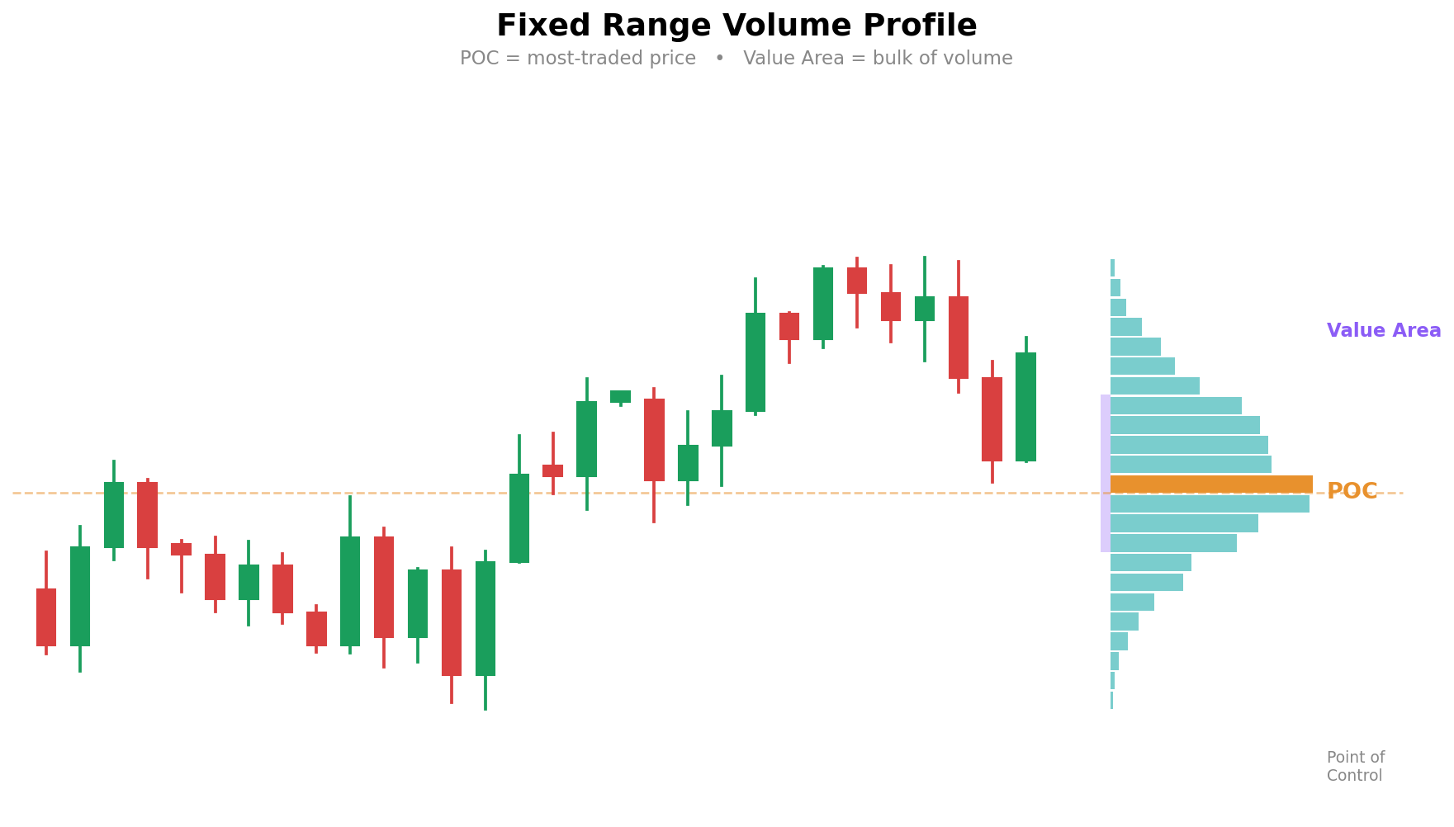
SHOW
Fixed Range Volume Profile

Slide 13
DO
Your Turn: Lesson 4.3
1
Apply Volume Profile to yesterday's session on your own 30-minute chart
2
Screenshot it and mark where the POC landed

Slide 14
LESSON 4.4
Using Volume to Confirm Zones

Slide 15
TELL
High Volume vs. Low Volume
HIGH-VOLUME NODE
LOW-VOLUME GAP
Price 'agrees' it belongs there. Might pause or reverse. Harder for a sweep to punch through cleanly.
Price moved through fast, without much disagreement. This is where I often see manipulation sweeps happen, because there's less resistance.
Defined Risk Trading | The Curriculum
MODULE 4 • LESSON 4.4

Slide 16
SHOW
Gap vs. Node
Start on the example slide next, then switch to the live chart. Compare 2 sweeps: one through a low-volume gap (fast, clean) and one into a high-volume node (choppy, harder to read).
Defined Risk Trading | The Curriculum
MODULE 4 • LESSON 4.4

Slide 17
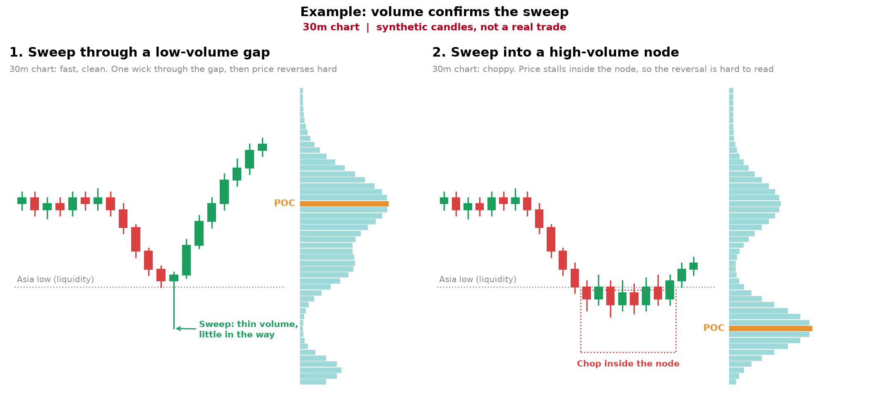
SHOW
Example: volume confirms the sweep

Slide 18
DO
Your Turn: Lesson 4.4
1
Pull up your Module 3 CRT screenshot again
2
Overlay Volume Profile on it now, drawn on the 30-minute chart
3
Post whether the sweep passed through high or low volume

Slide 19
LESSON 4.5
Using the POC as an Entry or Exit

Slide 20
TELL
How I Use the POC
POC AS MY EXIT
POC AS MY ENTRY
I draw the profile on the 30-minute chart. After the sweep and my CRT entry, I exit at or right before the POC of the range I'm trading. Full exit or partial with a runner: I decide from how the candles are moving into the POC.
When price leaves the range and comes back to the POC, I don't enter on the touch. I wait for a reaction candle there. If it lines up with my CRT direction, I enter on its close. I manage my own trades by hand. You use a hard stop of 3.5 to 4 points from that close. Never trade without a stop. Full risk rules: Module 5.
Defined Risk Trading | The Curriculum
MODULE 4 • LESSON 4.5

Slide 21
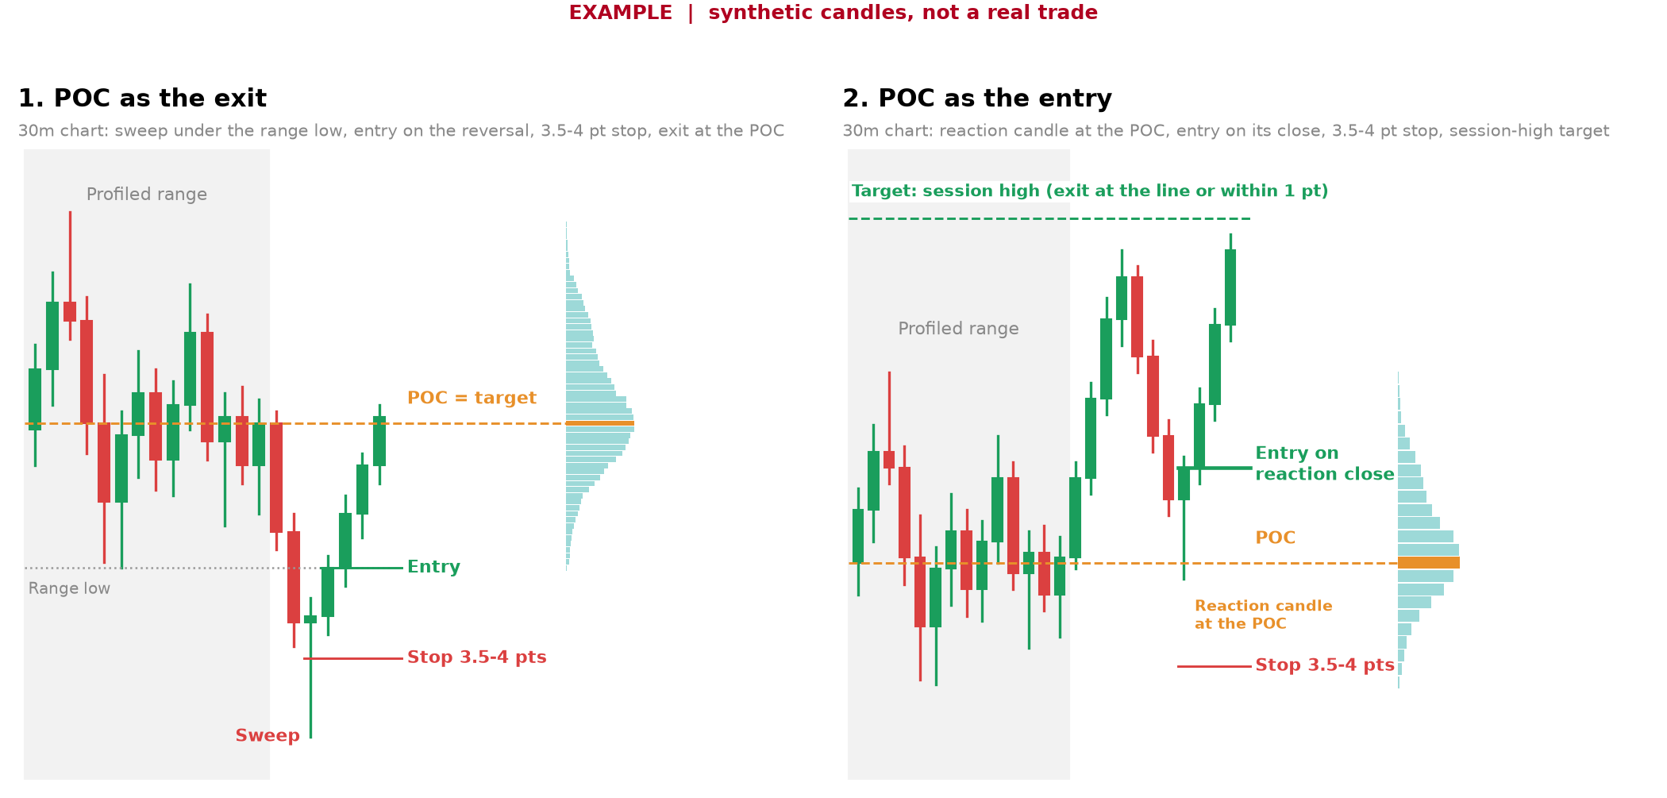
SHOW
Example: POC as the Exit, POC as the Entry

Slide 22
DO
Your Turn: Lesson 4.5
1
On the 30-minute chart, draw Volume Profile on your range and mark the POC
2
On your Module 3 CRT screenshot, mark the POC: entry or target?
3
Post it with your entry, stop and target marked

Slide 23
LESSON 4.6
Combining Both Tools with CRT

Slide 24
SHOW
3 Tools, 1 Trade
Switch to the live chart. One full walkthrough: session liquidity target, CRT sweep hits it, Volume Profile on the 30-minute chart shows the sweep went through a low-volume gap, then the entry, with the POC as the target.
Defined Risk Trading | The Curriculum
MODULE 4 • LESSON 4.6

Slide 25
DO
Your Turn: Lesson 4.6
1
Find your own three-tool confluence example this week
2
Session liquidity + CRT + Volume Profile all agreeing, POC marked as your target
3
Post it whenever you spot one. No deadline.
None of these tools work in isolation. This lesson proves that out loud, one more time, on a live example.

