Slide 1
Agile vs. Waterfall
SNHU travel
Kelly Reinersman
April 2025

Slide 2
The roles in Agile scrum teams
Product Owner (Christy)
Maximizes the product value
Manages the product backlog
Primary point of communication for stakeholders
Scrum Master (Ron)
Oversees all processes
Removes and prevents team impediments
Ensures all Agile Principles are adhered to
Communicates to the Product Owner
Development Team
Cross-Functional talented professionals
Self-organizing
Delivers the product increments (sprints)
Communicates to the Scrum Master
Testers
Tests the works of the developers
Keeps a log of all things that need to be revisited
Communicates to the Development team

Slide 3

SDLC – Software development lifecycle
Sprint Planning
Product Backlog Created
Defining Goals for Sprint
Planning Phase
Design Phase
Development Phase
Testing Phase
Deployment Phase
Small, Frequent Updates
DevOps Integration
Rapid Real-Time Feedback loops
Continuous Development
Iterative Design
Adaptive Approaches
Continuous Testing
AI – assisted Testing
Real-time quality checks
Incremental Development
Rapid Sprint Cycles
Continuous Integration

Slide 4
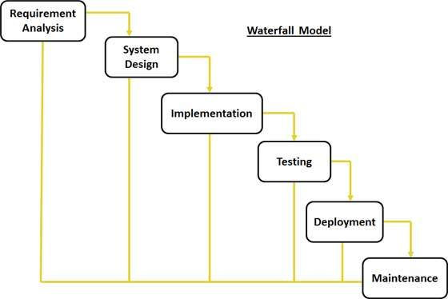
Waterfall model comparison
Key Characteristics
Problem Solving Examples
Linear, sequential approach
Rigid phase transitions
Extensive upfront planning
Limited adaptability
Minimal client interaction
Requirement changes mid-project
Significant rework required
High cost of modifications
Reduced project flexibility
Speedbumps

Slide 5
Waterfall or agile
Agile
Waterfall
Project Complexity
Evolving, dynamic requirements
Client Involvement
Real-Time Collaboration
Risk Management
Incremental risk management
Technology Landscape
Adapts to rapid technological changes
Project Complexity
Stable and Predictable projects
Client Involvement
Limited (if any) Stakeholder Engagement
Risk Management
Detailed upfront risk assessment
Technology Landscape
Struggles to adapt to rapid technology advances

Slide 6
Recommendation
Recommended Approach:
Hybrid Methodology
Combine Agile principles with structured planning principles in Waterfall
Contextual methodology adaptation
Emphasize organizational learning
Key Benefits:
Enhanced flexibility
Improved team collaboration
Faster time-to-market
Conclusion:
Agile provides competitive advantage
Supports continuous innovation
Aligns with modern business needs

Slide 7
Sources
Digital.ai. (2022). 16th State of Agile Report
Forsgren, N., Humble, J., & Kim, G. (2021). Accelerate: State of DevOps Report.
Fitzgerald, B., & Stol, K. J. (2022). Contemporary empirical software engineering methods and research.
Hemon-Hildgen, A., Rowe, F., & Balle, N. (2022). Agile transformation: A systematic literature review.

